Slide 1





LLRF Capabilities of the
European-XFEL
Holger Schlarb
on behalf of LLRF team
Notes:
How to edit the title slide
Upper area: Title of your talk, max. 2 rows of the defined size (55 pt)
Lower area (subtitle): Conference/meeting/workshop, location, date,
your name and affiliation,
max. 4 rows of the defined size (32 pt)
Change the partner logos or add others in the last row.

Slide 2
Requests: operation flexibility
Questions:
Gradient and phase changes over macro-pulse
Beam loading / beam loading variations
Small charge operation
Related issues:
General stability achievements
Multimode operation
Intra-train Feedbacks systems & Diagnostics

Slide 3
Parameter overview LLRF system
 | nominal | Min/max
# of RF channels | ~ 3000 | NA
# of LLRF stations 1.3 GHz SRF | 25 | NA
# of LLRF stations 3.9 GHz SRF | 1 | NA
# of LLRF stations 1.3 GHz NRF (RF Gun) | 1 | NA
Field amplitude stability dA/A | 1e-4 | 3e-5/2e-4
Field phase stability | 0.01deg | 0.003deg/ 0.05deg
# of piezo driver/sensors | 800/800 | NA
# MTCA crates | 52 | NA
# RF channels per station (32 cavities) | 118 | NA
Fully automated system with high flexibility and high precision:
  varying beam load: beam current, bunch spacing, bunch pattern
  macro-pulse to macro-pulse structure variations
  changes in gradient, phase, gradient slopes, phase slopes
  incorporate beam based signals (arrival time, compression, energy)
  local and global energy management
  very robust and reliable system with high availability (downtime < 1%)
  ultra-high precision for 20% of RF stations (<<0.01%, <<0.01deg)
Notes:
Before you start editing the slides of your talk change to the Master Slide view:
Menu button “View”, Master, Slide Master:
Edit the following 2 items in the 1st slide:
1) 1st row in the violet header:
Delete the existent text and write the title of your talk into this text field
2) The 2 rows in the footer area: Delete the text and write the information
regarding your talk (same as on the Title Slide) into this text field.
If you want to use more partner logos position them left
beside the DESY logo in the footer area
Close Master View

Slide 4
LLRF system layout & functionalities
Reliability / Availability / Maintenance:
  Use industrial standard as bases
  Sufficient diagnostics to identify failures & errors
  Redundancy in DAQ system (Probe/Virtual Probe/Cavity model)
  Redundancy in critical hardware components (Power supply)
  Excellent remote access and controllability
  Handle large number of systems simultaneously
  Data acquisition system for off-line analysis / failure identification
Precision / Flexibility / Automation
  Complex controller with FF, LFF, MIMO-FB, BBF-FB
  System identification, calibration of parameters
  Loop-phase / Frequency Control/ Q_{L} control / Cavity phase control
  Quench detection, cavity gradient control and tuning
  Local and global energy management
  Accommodate various beam based FBs
Notes:
Before you start editing the slides of your talk change to the Master Slide view:
Menu button “View”, Master, Slide Master:
Edit the following 2 items in the 1st slide:
1) 1st row in the violet header:
Delete the existent text and write the title of your talk into this text field
2) The 2 rows in the footer area: Delete the text and write the information
regarding your talk (same as on the Title Slide) into this text field.
If you want to use more partner logos position them left
beside the DESY logo in the footer area
Close Master View

Slide 5
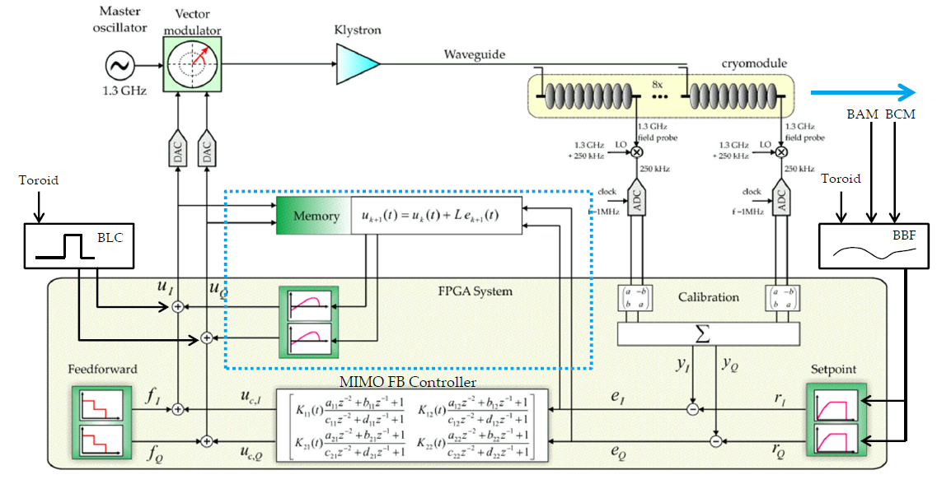
LLRF system overview
Scheme of LLRF RF controller
Notes:
Before you start editing the slides of your talk change to the Master Slide view:
Menu button “View”, Master, Slide Master:
Edit the following 2 items in the 1st slide:
1) 1st row in the violet header:
Delete the existent text and write the title of your talk into this text field
2) The 2 rows in the footer area: Delete the text and write the information
regarding your talk (same as on the Title Slide) into this text field.
If you want to use more partner logos position them left
beside the DESY logo in the footer area
Close Master View

Slide 6
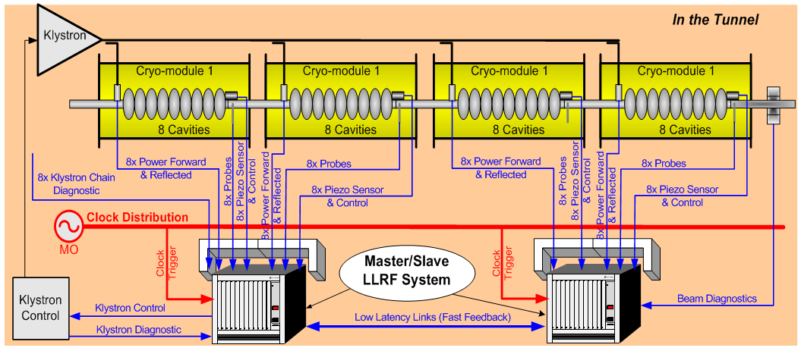
Consequences from FLASH operation
2 semi-distributed uTCA stations (25 RF stations)
Driving Argument Short pickup cables for low drifts (10fs/m/K)
and prevent crosstalk from high power cables
Notes:
Before you start editing the slides of your talk change to the Master Slide view:
Menu button “View”, Master, Slide Master:
Edit the following 2 items in the 1st slide:
1) 1st row in the violet header:
Delete the existent text and write the title of your talk into this text field
2) The 2 rows in the footer area: Delete the text and write the information
regarding your talk (same as on the Title Slide) into this text field.
If you want to use more partner logos position them left
beside the DESY logo in the footer area
Close Master View

Slide 7
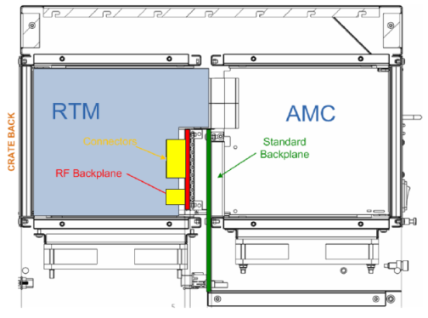
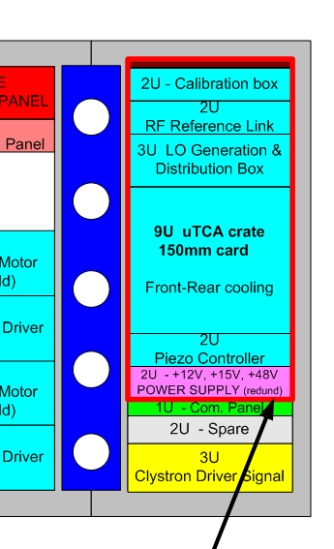
uTCA LLRF hardware platform
How will a LLRF System look like inside . . . 19“ modules . . .
DCModule (no drifts within the rack)
ISE, DMCS, MSK
LOGModule (Local Oscillators)
ISE, MSK
PIEZOModule (Piezo driver)
Power Supply (redundant)
industry
Notes:
Before you start editing the slides of your talk change to the Master Slide view:
Menu button “View”, Master, Slide Master:
Edit the following 2 items in the 1st slide:
1) 1st row in the violet header:
Delete the existent text and write the title of your talk into this text field
2) The 2 rows in the footer area: Delete the text and write the information
regarding your talk (same as on the Title Slide) into this text field.
If you want to use more partner logos position them left
beside the DESY logo in the footer area
Close Master View

Slide 8
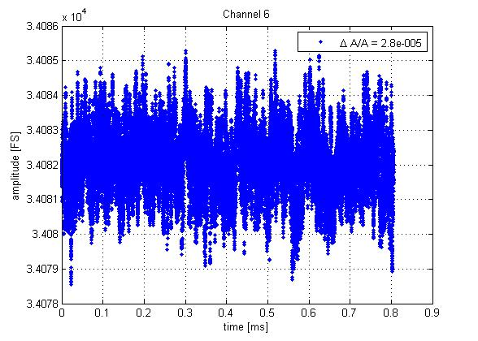
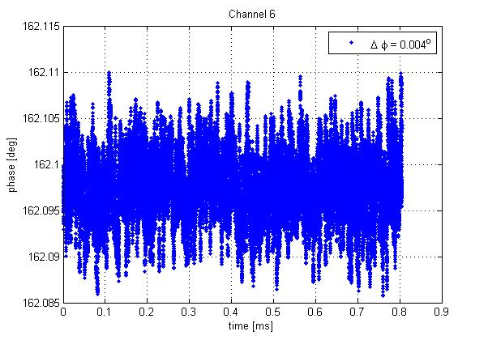
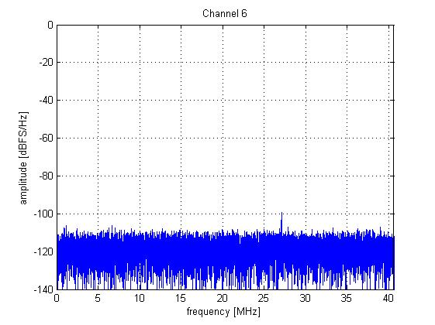
Signal integrity: Single channel performance
Short-term stability in a uTCA crate (laboratory) :
Raw-Data IF Spectrum
(no RF-signal)
Testconfguration:
- DWC8300 R1.0, SIS8300_V2, MCH, CPU, uTCA crate
- DRO 1.3GHz (PSI), 1354 MHz LO, 54MHz IF, 81MHz SR
- LO-Generation Module (19“, FL, PM version)
- Offline Matlab non-iq analysis (N=65K), 1MHz Bandwidth
Power-Entry-Modules: < 110dB spurious free
Poor Power Supplies : < 80dB SFDR
VS-Scaling : < 120dB SFDR
Single cavity resolution improved by a factor of 5 to dA/A=2.8E-5.
Signal integrity in uTCA crate achieved Eval board performance.
(using a Power-Entry-Module, Ericsson BMR911483)
Notes:
Before you start editing the slides of your talk change to the Master Slide view:
Menu button “View”, Master, Slide Master:
Edit the following 2 items in the 1st slide:
1) 1st row in the violet header:
Delete the existent text and write the title of your talk into this text field
2) The 2 rows in the footer area: Delete the text and write the information
regarding your talk (same as on the Title Slide) into this text field.
If you want to use more partner logos position them left
beside the DESY logo in the footer area
Close Master View

Slide 9
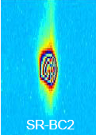
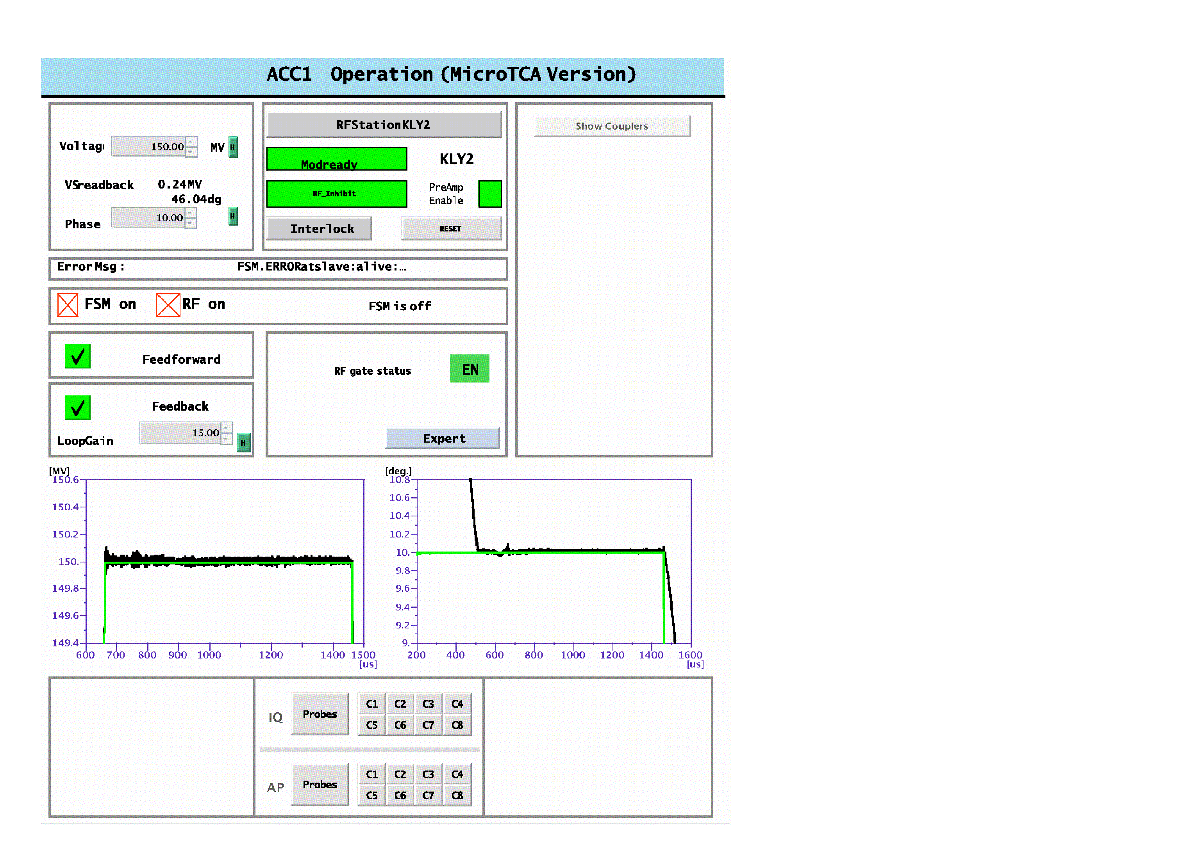
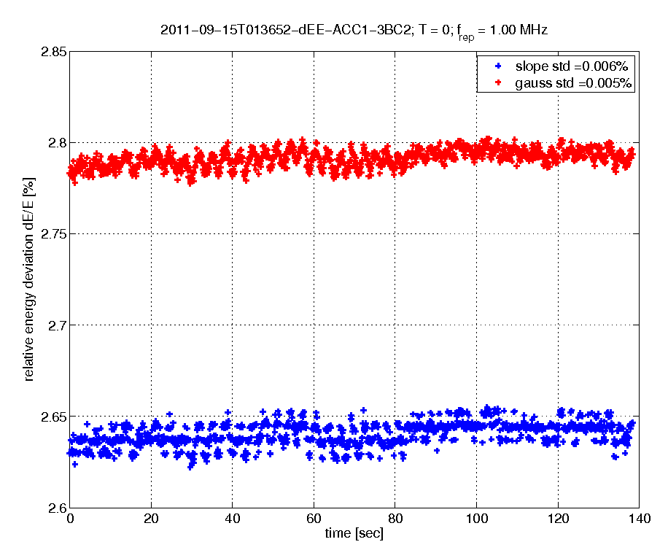
Beam operation using the uTCA-platform
FLASH operation :
On-crest energy stability :
SR-camera resolution limit
Energy stability dE/E=5E-5.
Notes:
Before you start editing the slides of your talk change to the Master Slide view:
Menu button “View”, Master, Slide Master:
Edit the following 2 items in the 1st slide:
1) 1st row in the violet header:
Delete the existent text and write the title of your talk into this text field
2) The 2 rows in the footer area: Delete the text and write the information
regarding your talk (same as on the Title Slide) into this text field.
If you want to use more partner logos position them left
beside the DESY logo in the footer area
Close Master View

Slide 10
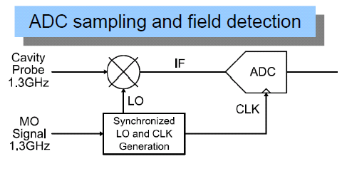
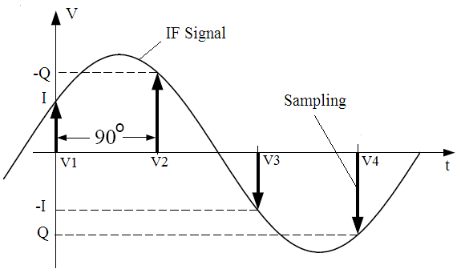
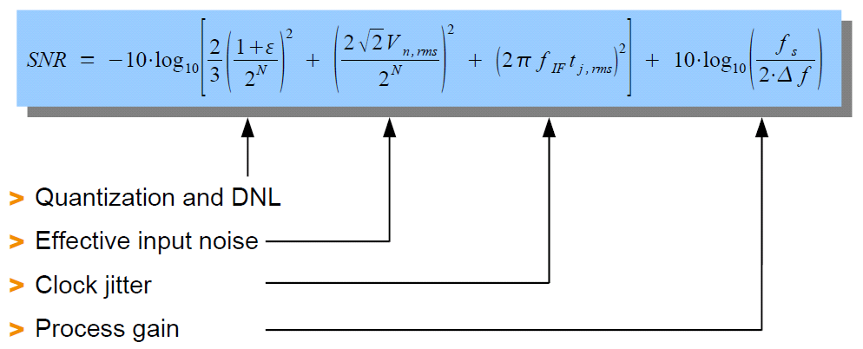
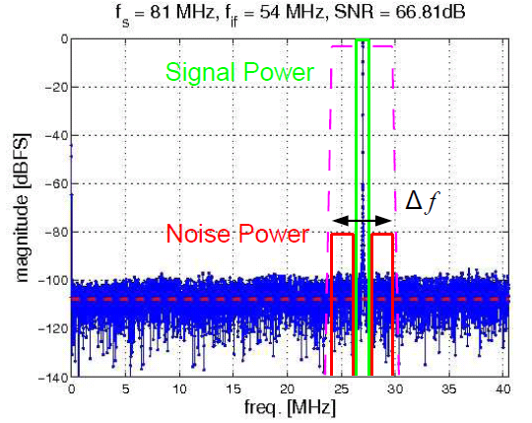
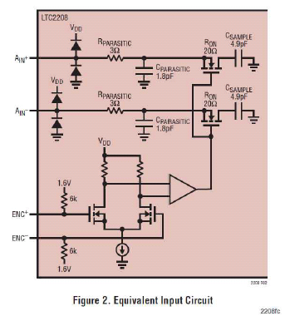
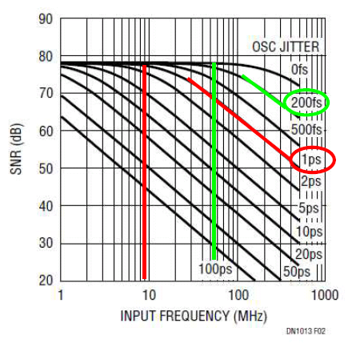
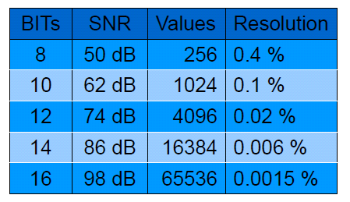
LLRF Stability
Mixer preserves phase noise
Digital down conversion
Notes:
Before you start editing the slides of your talk change to the Master Slide view:
Menu button “View”, Master, Slide Master:
Edit the following 2 items in the 1st slide:
1) 1st row in the violet header:
Delete the existent text and write the title of your talk into this text field
2) The 2 rows in the footer area: Delete the text and write the information
regarding your talk (same as on the Title Slide) into this text field.
If you want to use more partner logos position them left
beside the DESY logo in the footer area
Close Master View

Slide 11
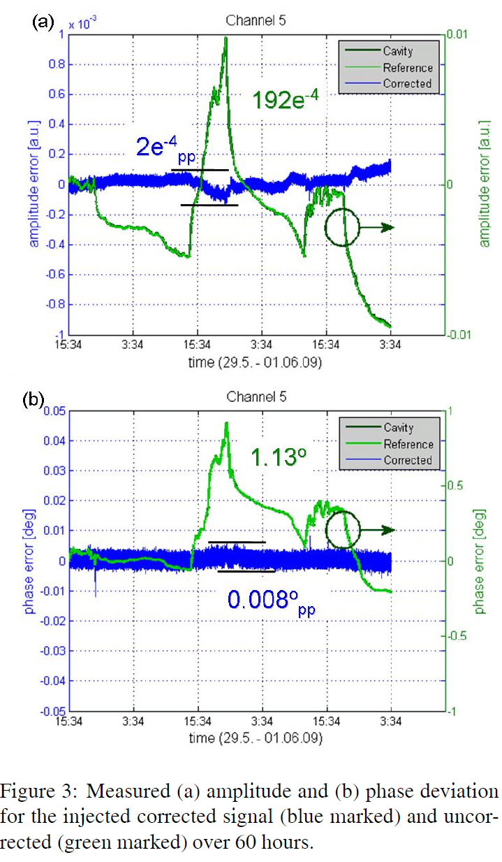
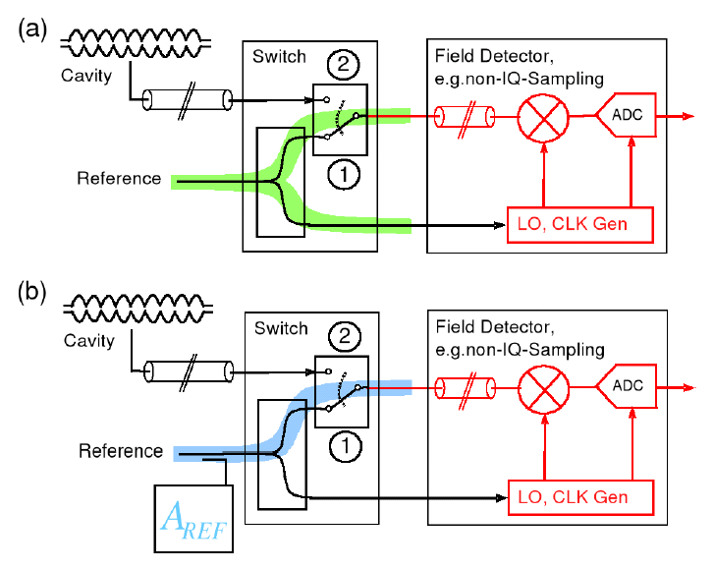
LLRF stability
Reference tracking for mixer drift removal
Mixer phase drifts ~ 0.2°/K
Mixer amplitude drifts ~ 0.2%/K
+ dependence on humidity on PCBs
Remark: mixer drift not equal (one PCB, temp.)
Notes:
Before you start editing the slides of your talk change to the Master Slide view:
Menu button “View”, Master, Slide Master:
Edit the following 2 items in the 1st slide:
1) 1st row in the violet header:
Delete the existent text and write the title of your talk into this text field
2) The 2 rows in the footer area: Delete the text and write the information
regarding your talk (same as on the Title Slide) into this text field.
If you want to use more partner logos position them left
beside the DESY logo in the footer area
Close Master View

Slide 12
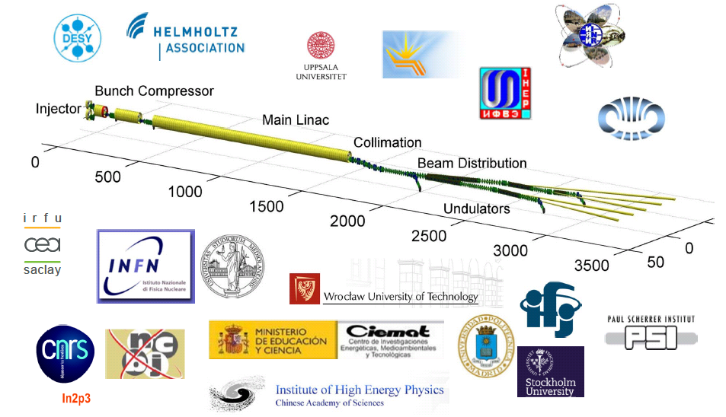
Variation of gradient and phase
Collimator limits energy slope to ~ 3% pkpk

Slide 13
Multiple – gradient/phase operation
Preparation of software for FLASH 1 & 2 & 3 operation!
FLASH 1
FLASH 2
FLASH 3
Used gradient steps -2% and + 3% with 40us transient time
Setting up time < 10 sec

Slide 14
Multiple – gradient/phase operation
Preparation of software for FLASH 1 & 2 & 3 operation!
FLASH 1
FLASH 2
FLASH 3
Used gradient steps -2% and + 3% with 40us transient time
Setting up time < 10 sec

Slide 15
Multiple – gradient/phase operation
Preparation of software for FLASH 1 & 2 & 3 operation!
Klystron forward power for
dA/dt ~ 1.5%/20us
Approx. 70% for cavity filling
1%/10us is approx. limit
transient can be improved
(only LLF used) by addition
calc. FF tables
Slow slopes in phase & ampl.
is none issue
Main point:
Appropriate operator interface
Selective Exception handling
FLASH 1
FLASH 2
FLASH 3
Used gradient steps -2% and + 3% with 40us transient time
Setting up time < 10 sec

Slide 16
Beam loading and varying beam loading
Gradient flatness
  -> orbit variation across macro-pulse
  -> achievable gradient
Stability
  -> Single bunch loading 1nC: dA/A ~ 1.4e-4
  -> variable pattern requires single bunch correction
Coupler kicks due to varying Pfor/Pref at coupler
Beam loading & high gradient (at quench limit) &
High stability is most challenging operation mode
Fundamental for LLRF system is 9 MHz readout

Slide 17
Upgrade of LLRF system (2010-2011)
Upgrade of all RF stations using SimconDSP controller
RF control for 3.9GHz
New cabling in injector racks
Upgrade & unified FPGA controller firmware
  Multiple feed forward table (main/beam loading/correction)
  Multiple set-point table (main/beam based correction)
  Model based Multiple In Multiple Out (MIMO) controller
  Charge correction & intra-train beam based feedback
  Exception & Error handling, limiters
  Error and status displays
Scheme of LLRF RF controller
Feed forward table architecture
Notes:
Before you start editing the slides of your talk change to the Master Slide view:
Menu button “View”, Master, Slide Master:
Edit the following 2 items in the 1st slide:
1) 1st row in the violet header:
Delete the existent text and write the title of your talk into this text field
2) The 2 rows in the footer area: Delete the text and write the information
regarding your talk (same as on the Title Slide) into this text field.
If you want to use more partner logos position them left
beside the DESY logo in the footer area
Close Master View

Slide 18
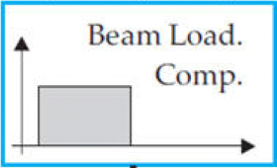
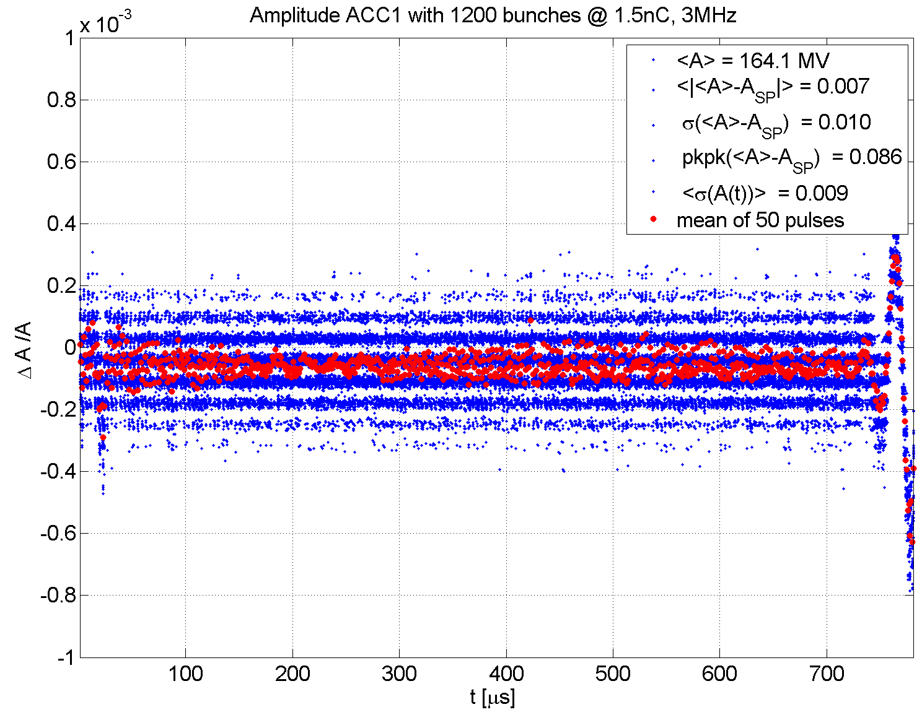
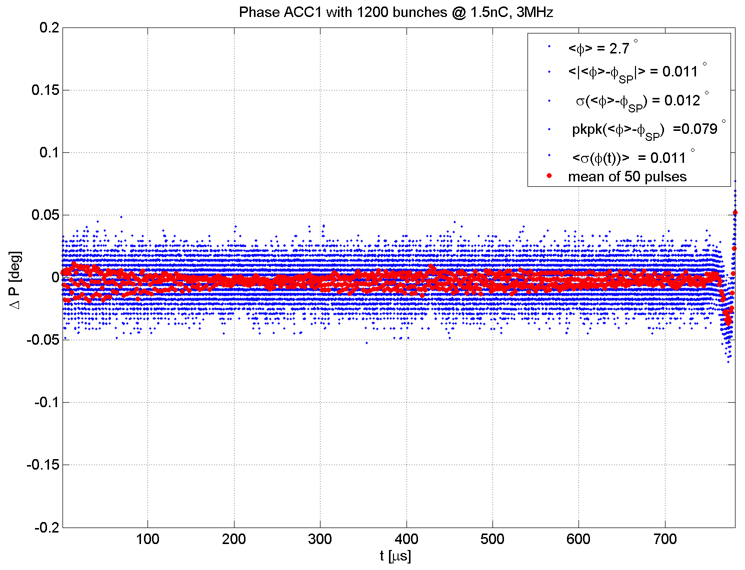
Performance of LLRF system after upgrade
ILC studies: 3 MHz, 1.5 nC = 4.5mA XFEL Parameters
All field control applications are turned on:
LFF, MIMO FB, BLC
Forward
x charge x rep. rate => 4.5mA
Remark: single bunch transient > 1e-4
BLC 1mA
Truncated
Acceleration Voltage ACC1
Acceleration Phase ACC1
dA / A < 10⁻⁴
dP = 0.011 deg
1st bunch start
LFF stop

Slide 19
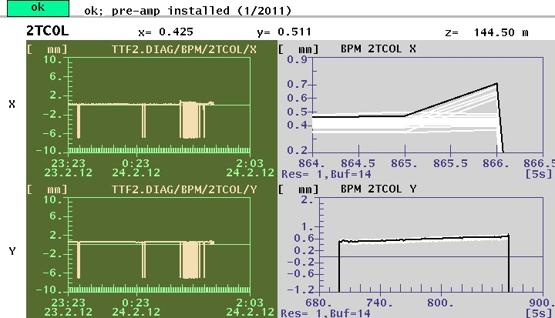
Beam loading and varying beam loading
Beam loading table to short (almost no effect on energy but orbit changes)
9 MHz measurement and 81 MHz DAC output for smoothing of kly input
Signal temporal alignment in LLRF ~ few 10 ns

Slide 20
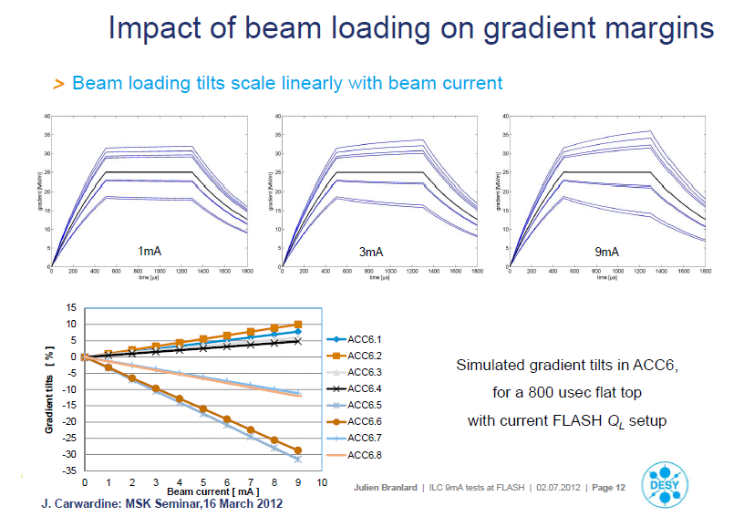
Beam loading and varying beam loading

Slide 21
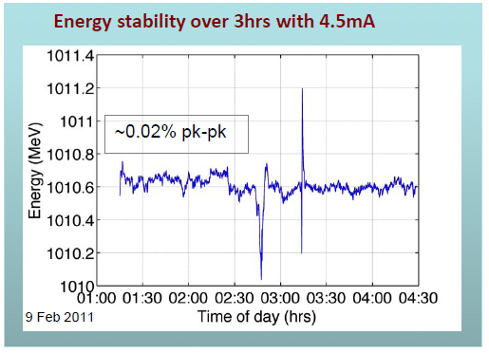
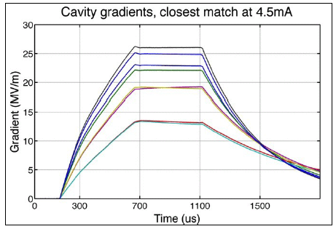
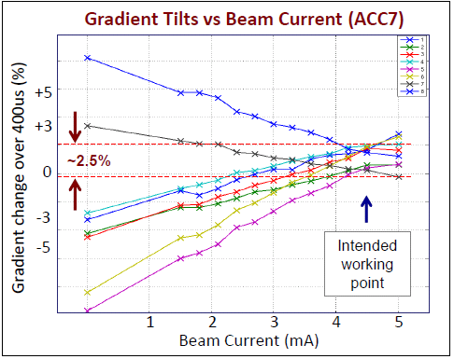
Performance of LLRF system after upgrade
ILC studies: energy stability / gradient flatness / gradient limit
Energy stability exit of accelerator
Minimizing slopes by QL tuning
flatness
Important studies for FLASH & XFEL
Impacts orbit variation and orbit slopes
Achievable energy gain
Notes:
Before you start editing the slides of your talk change to the Master Slide view:
Menu button “View”, Master, Slide Master:
Edit the following 2 items in the 1st slide:
1) 1st row in the violet header:
Delete the existent text and write the title of your talk into this text field
2) The 2 rows in the footer area: Delete the text and write the information
regarding your talk (same as on the Title Slide) into this text field.
If you want to use more partner logos position them left
beside the DESY logo in the footer area
Close Master View

Slide 22
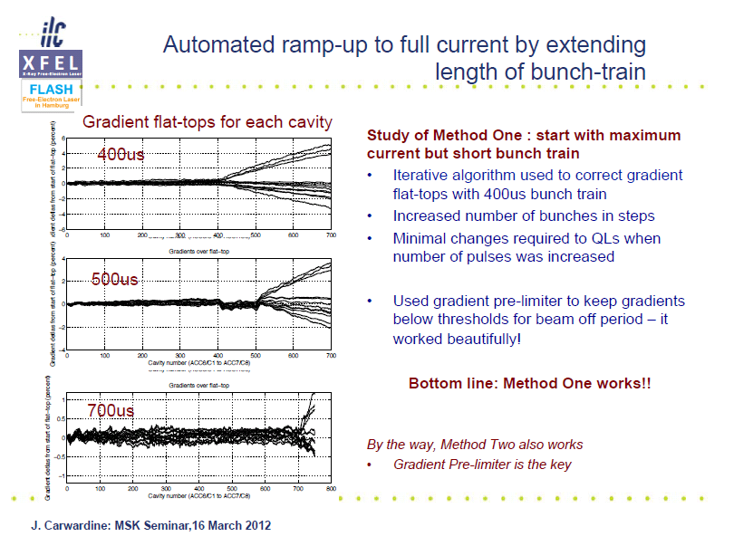
Beam loading and varying beam loading

Slide 23
Beam loading and varying beam loading
open points:
Set stable SASE operation for 4.5 MHz repetition rate (in conjunction with ILC studies)
Develop interface to new timing system providing the corresponding bunch pattern
Develop tools to deal with rapid varying beam load
Developed at FLASH for operation FLASH1/2/3
Preferable if FLASH is operated within the next 3 years with XFEL bunch pattern

Slide 24
Layout longitudinal FBs for European XFEL
BBF Charge
BBF Osc.
3 feedback loops to stabilize photoinjector laser & charge
OXC
BBF BBO
Laser
Toroid
OXC
~
Gun
I1
3rd
BC0
BC1
BC2
~
L1
L2
L2
L2
L3
A/φ
BAM
A/φ
BCM
EO
A/φ
BAM
BAM
BCM
EO
A/φ
A/φ
A/φ
BAM
BAM
BCM
SPEC
LLRF
LLRF
LLRF
LLRF
LLRF
LLRF
LLRF
BBF Gun
BBF I1
BBF L1
BBF L2
4 feedback loops to stabilize arrival times, compression, shape & energy
~
~
L3
L3
COLL
BAM
BAM
A
A
BPMs
BPMs
BPMs
BPMs
LLRF
LLRF
uTCA
BAM
BBF L3
1 feedback loop to stabilize final beam energy
Notes:
Before you start editing the slides of your talk change to the Master Slide view:
Menu button “View”, Master, Slide Master:
Edit the following 2 items in the 1st slide:
1) 1st row in the violet header:
Delete the existent text and write the title of your talk into this text field
2) The 2 rows in the footer area: Delete the text and write the information
regarding your talk (same as on the Title Slide) into this text field.
If you want to use more partner logos position them left
beside the DESY logo in the footer area
Close Master View

Slide 25
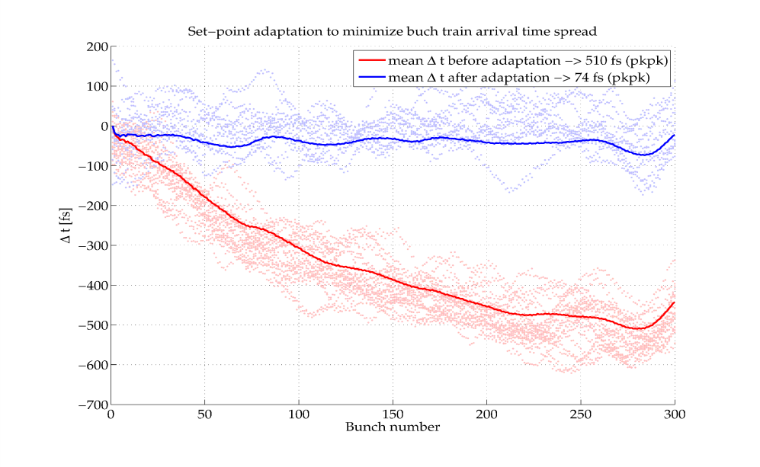
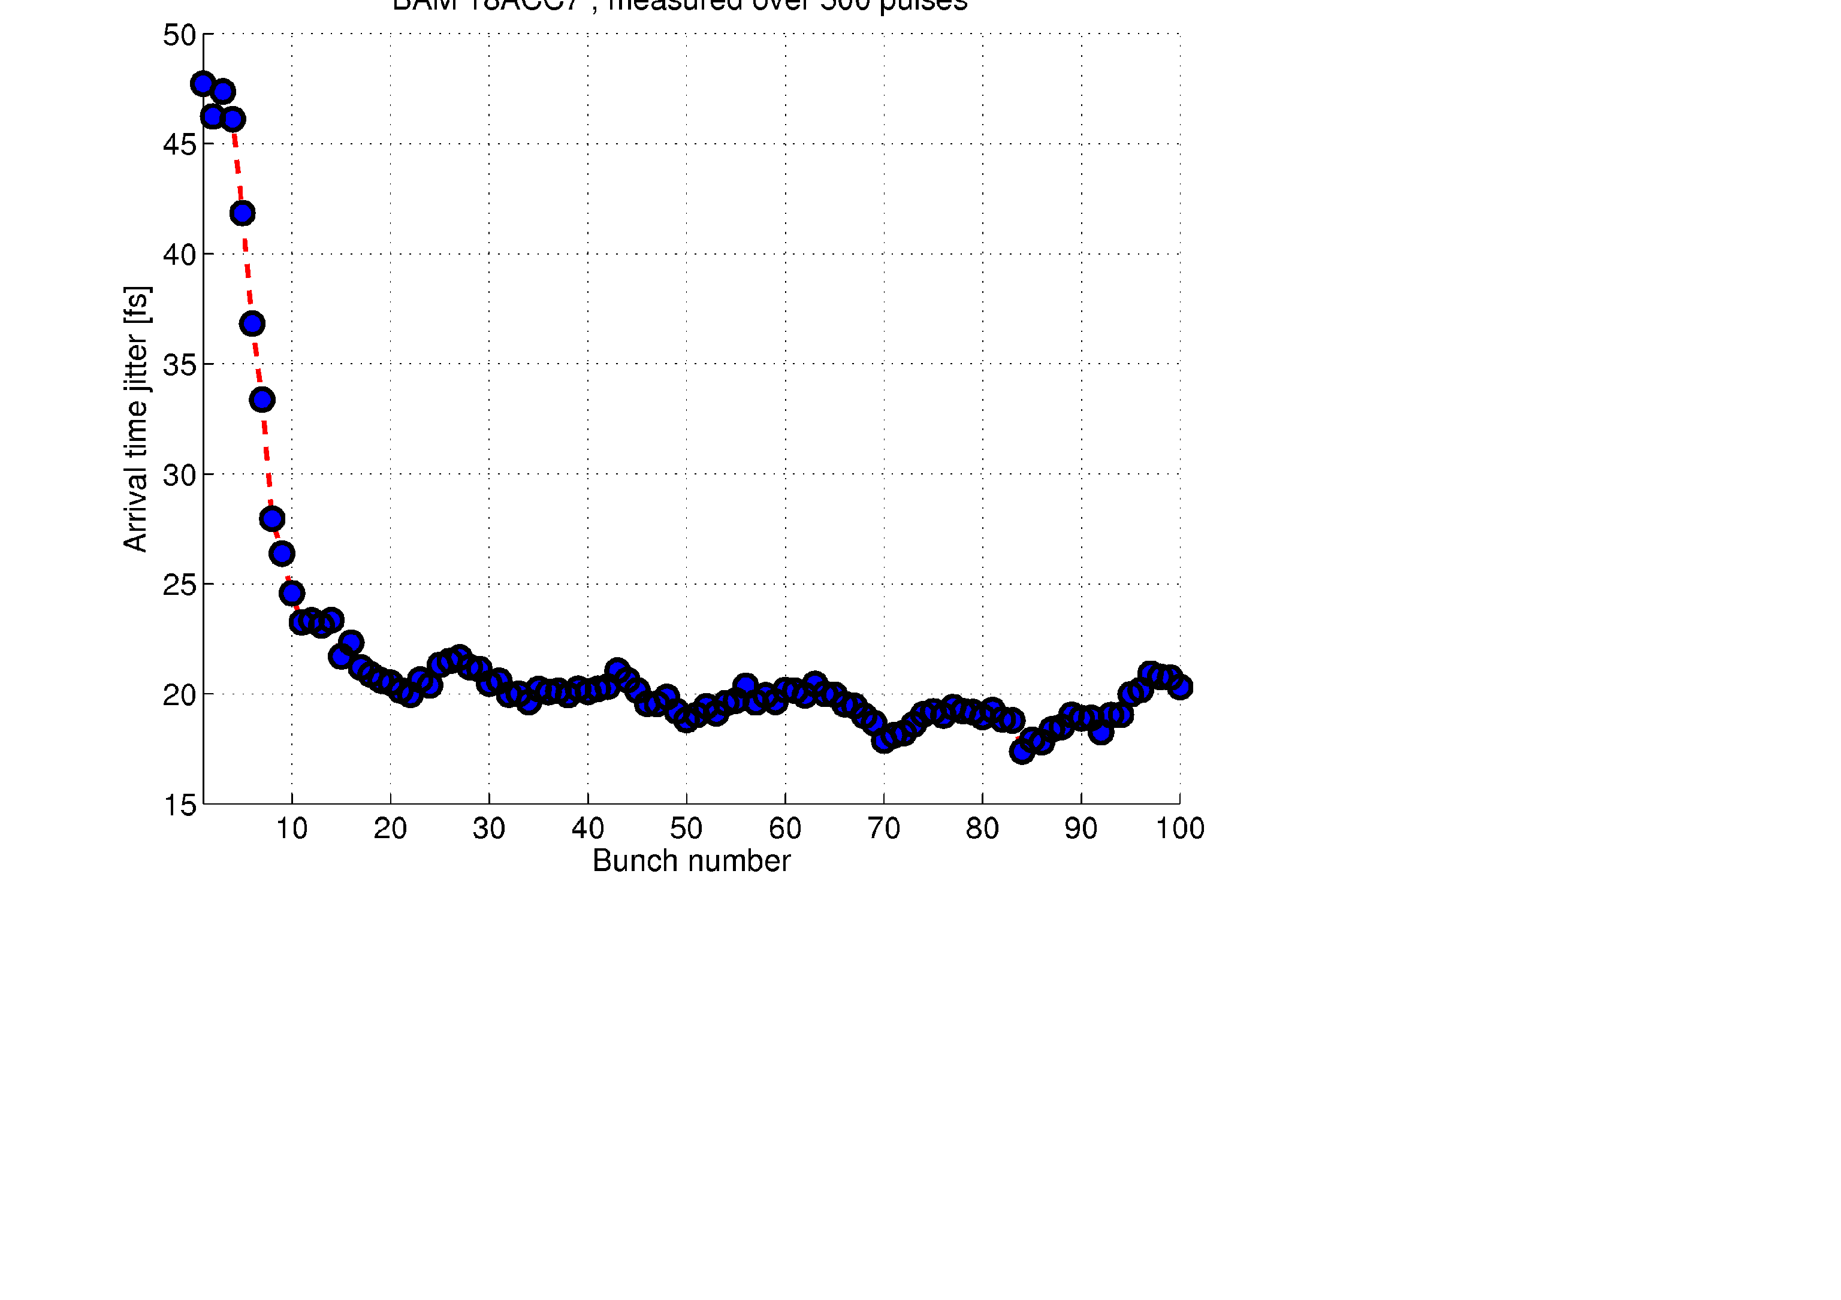
Beam based feedback
Laser
R56=180mm
R56=43mm
~
BC3
~
R56=0.8mm
Gun
ACC1
3rd
BC2
ACC2
ACC3
ACC4
ACC7
FLASH 1
A φ
A φ
BAM
BCM
BAM
BCM
LLRF
LLRF
LLRF
BAM
FLASH 3
FLASH 2
Beam Based Feedbacks:
BAM and BCM after BC2 ⇒ amplitude and phase in ACC1 and ACC39
BAM and BCM after BC3 ⇒ amplitude and phase in ACC23
LLF + BLC + MIMO + BBF at ACC1/ACC23
(act still on setpoint)
< 75fs pkpk
+ beam based SP correction
< 20fs rms arrival jitter
Notes:
Before you start editing the slides of your talk change to the Master Slide view:
Menu button “View”, Master, Slide Master:
Edit the following 2 items in the 1st slide:
1) 1st row in the violet header:
Delete the existent text and write the title of your talk into this text field
2) The 2 rows in the footer area: Delete the text and write the information
regarding your talk (same as on the Title Slide) into this text field.
If you want to use more partner logos position them left
beside the DESY logo in the footer area
Close Master View

Slide 26

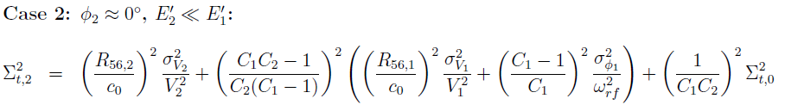
Beam based feedback
Laser
R56=180mm
R56=43mm
~
BC3
~
R56=0.8mm
Gun
ACC1
3rd
BC2
ACC2
ACC3
ACC4
ACC7
FLASH 1
A φ
A φ
BAM
BCM
BAM
BCM
LLRF
LLRF
LLRF
BAM
FLASH 3
FLASH 2
Beam Based Feedbacks:
BAM and BCM after BC2 ⇒ amplitude and phase in ACC1 and ACC39
BAM and BCM after BC3 ⇒ amplitude and phase in ACC23
Voltage
Phase
Incoming
compression
factor
C ~5 … 20
Timing jitter
behind BC2
FLASH: 7.0ps/%
2 ps/deg L-band
0.05 ps/ps C=20
Jitter from BC2 largely remains + additive jitter!
Timing jitter
behind BC3
FLASH: 0.9ps/% for dV₂/V₂ < 2.5e-5 with uTCA => 2fs rms
Notes:
Before you start editing the slides of your talk change to the Master Slide view:
Menu button “View”, Master, Slide Master:
Edit the following 2 items in the 1st slide:
1) 1st row in the violet header:
Delete the existent text and write the title of your talk into this text field
2) The 2 rows in the footer area: Delete the text and write the information
regarding your talk (same as on the Title Slide) into this text field.
If you want to use more partner logos position them left
beside the DESY logo in the footer area
Close Master View

Slide 27
Beam based feedback: new topology
Laser
R56=180mm
R56=43mm
~
BC3
~
R56=0.8mm
Gun
ACC1
3rd
BC2
ACC2
ACC3
ACC4
ACC7
FLASH 1
A φ
A φ
BAM
BCM
BAM
BCM
LLRF
LLRF
LLRF
BAM
FLASH 3
FLASH 2
Beam Based Feedbacks:
BAM and BCM after BC2 ⇒ amplitude and phase in ACC1 and ACC39
but mainly slow variations, systematic & repetitive errors <~20kHz
BAM and BCM after BC3 ⇒ amplitude and phase in ACC23
BAM after BC2 ⇒ feed forward drive for normal conduction cavity
Remark to fast long FB:
Only location possible prior to BC2: large R56 at small energy (150MeV)
Typically ~ 50-100 kV @ 1000 x large cavity bandwidth
Short cables, fast processing time, only semi-conducting amplifier
Latency < 1 us
Shoot for FB bandwidth > 100 kHz
Notes:
Before you start editing the slides of your talk change to the Master Slide view:
Menu button “View”, Master, Slide Master:
Edit the following 2 items in the 1st slide:
1) 1st row in the violet header:
Delete the existent text and write the title of your talk into this text field
2) The 2 rows in the footer area: Delete the text and write the information
regarding your talk (same as on the Title Slide) into this text field.
If you want to use more partner logos position them left
beside the DESY logo in the footer area
Close Master View

Slide 28
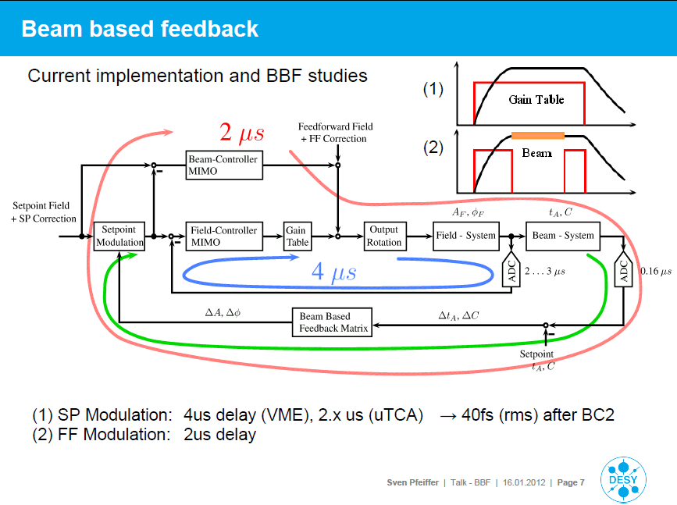
Beam based feedback: new topology
Notes:
Before you start editing the slides of your talk change to the Master Slide view:
Menu button “View”, Master, Slide Master:
Edit the following 2 items in the 1st slide:
1) 1st row in the violet header:
Delete the existent text and write the title of your talk into this text field
2) The 2 rows in the footer area: Delete the text and write the information
regarding your talk (same as on the Title Slide) into this text field.
If you want to use more partner logos position them left
beside the DESY logo in the footer area
Close Master View

Slide 29
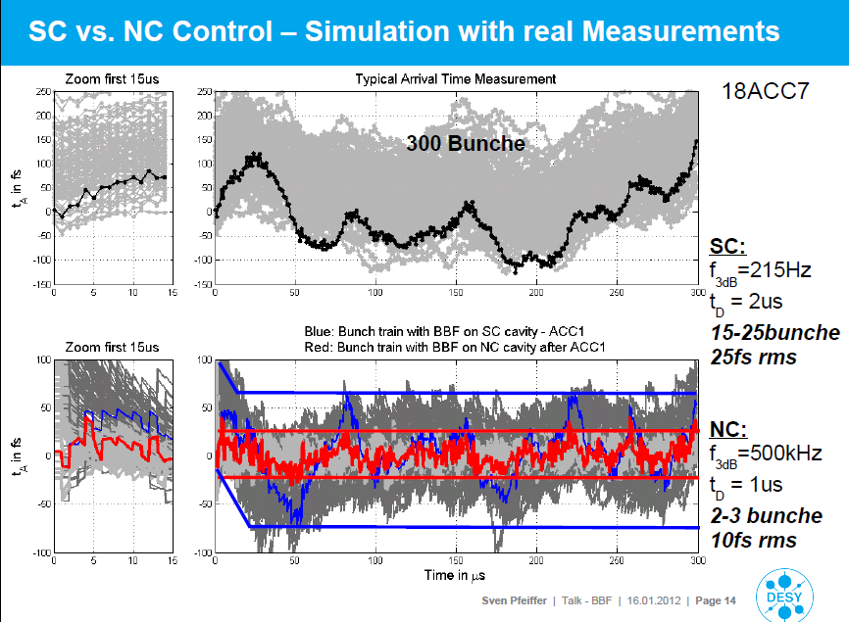
Beam based feedback: new topology
Notes:
Before you start editing the slides of your talk change to the Master Slide view:
Menu button “View”, Master, Slide Master:
Edit the following 2 items in the 1st slide:
1) 1st row in the violet header:
Delete the existent text and write the title of your talk into this text field
2) The 2 rows in the footer area: Delete the text and write the information
regarding your talk (same as on the Title Slide) into this text field.
If you want to use more partner logos position them left
beside the DESY logo in the footer area
Close Master View

Slide 30
Other issues
Detection of soft quench
specs Q₀ > 1e10
likely Q₀ ~ 2e10
load Q_{L} ~ 3e6
soft quenched cavity ~ 2e7 => eats up same power at entire linac!!!
but Q_{L} drops 3.0e6 -> 2.6e6 (~ 10%)
Operation recovery
At level dA/A < 1e-4 other passband modes have to be considered
8/9pi mode (instabilities)
7/9pi mode (contributes to dE of beam)
Diagnostics
Arrival time monitors e.g. dynamic range ~ 3 ps

Slide 31
Thanks for attention
Notes:
Before you start editing the slides of your talk change to the Master Slide view:
Menu button “View”, Master, Slide Master:
Edit the following 2 items in the 1st slide:
1) 1st row in the violet header:
Delete the existent text and write the title of your talk into this text field
2) The 2 rows in the footer area: Delete the text and write the information
regarding your talk (same as on the Title Slide) into this text field.
If you want to use more partner logos position them left
beside the DESY logo in the footer area
Close Master View

