Slide 1
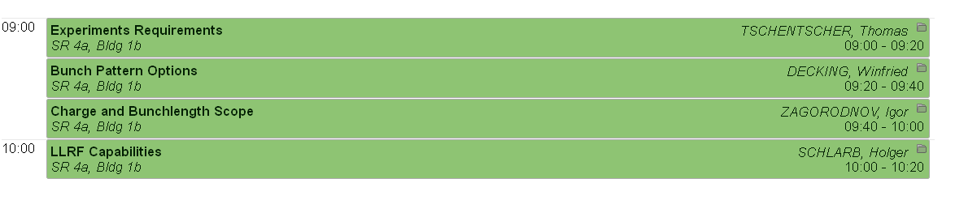


Operation Modes
Working Group Summary
Winni Decking, Torsten Limberg
Notes:
How to edit the title slide
Upper area: Title of your talk, max. 2 rows of the defined size (55 pt)
Lower area (subtitle): Conference/meeting/workshop, location, date,
your name and affiliation,
max. 4 rows of the defined size (32 pt)
Change the partner logos or add others in the last row.

Slide 2
Instrument requests to the delivery of x-ray pulses
Operations working group
European XFEL collaboration meeting Apr 17, 2012
Thomas Tschentscher
thomas.tschentscher@xfel.eu
Notes:
How to edit the title slide
Upper area: Title of your talk, max. 2 rows of the defined size (55 pt)
Lower area (subtitle): Conference/meeting/workshop, location, date,
your name and affiliation,
max. 4 rows of the defined size (32 pt)
Change the partner logos or add others in the last row.

Slide 3
Layout x-ray facility
  2 e⁻-beamlines
  3 (5) undulators
  6 (10-15) instruments
MID
HED
SPB
FXE
SQS
SCS
Boxes only placeholders !

Slide 4
Simultaneous operation of many instruments
Within the bunchtrain
  2 e⁻-beamlines
  5(+) undulators
  15(+) instruments
MID
HED
SPB
FXE
On trajectory → lases
Off trajectory → only SR
SQS
SCS
Sophisticated electron bunch distribution
27.000 bunches/sec to 5 beamlines
in average 10-20 Hz and ~500 pulses/train
using kicking methods to make bunches lase only in dedicated undulator
Boxes only placeholders !

Slide 5
X-ray delivery patterns
99.4
ms
Single pulses (0 – 10 pl/s)
  1 x-ray pulse per train
Few pulses (60 – 6000 pl/s)
  6/60/600 x-ray pulses per train
  Groups of pulses
  Specific time pattern (e.g. log)
Full pulse train (27000 pl/s)
  2700 x-ray pulses per train
0.6 ms
1/10/
100 µs

Slide 6
X-ray delivery patterns / electron bunch distr.
99.4
ms
Single pulses (0 – 10 pl/s)
  1 x-ray pulse per train
Few pulses (60 – 6000 pl/s)
  6/60/600 x-ray pulses per train
  Groups of pulses
  Specific time pattern (e.g. ln)
Full pulse train (27000 pl/s)
  2700 x-ray pulses per train
e-beam distribution to 2 beamlines
  Split train / maintain patterns
  Time for feedback & switching
0.6 ms
1/10/
100 µs
0.01 – 0.3 ms

Slide 7
Electron bunch distribution to 2 BL / 5 undulators
e-beam distribution to 2 beamlines
  Slots for feedback & switching
  Equal splitting on both e⁻-BL
  Equal splitting on 3 undulators
  Equal splitting on 5 und. (future)
  Assymetric splitting
  Specific electron bunch properties
SASE 2
SASE 1 & 3
SASE 2
SASE 1
SASE 3
SASE 2
SASE 4
SASE 5
SASE 1
SASE 3
SASE 2
SASE 1
SASE 3
SASE 2
SASE 1
SASE 3

Slide 8
A prototypical experiment
Preparation
phase
  Detailed proposal → define parameters, check feasibility
  Pre-experiments; preparation of experimental setup
  Setup at European XFEL instrument (without beam)
  Set & verify x-ray parameters according to requirements
  Alignment of sample and additional/secondary diagnostics
  Verify optical laser beam settings and performance
  Verify detection systems settings and performance
  Search for signal
  Time fraction : significant (days) for non-standard exps.
  Time fraction : moderate (hrs) for standard exps.
  Collect data according to experiment protocol
  Modification of variables and switching of samples
  Try new ideas (sample or x-ray technique)
Setup
phase
Data taking
phase
Testing
phase

Slide 9
Conclusions
  Challenges related to high repetition rates have to be overcome in order to make its advantages fully available for users of European XFEL. This will be a real first !
  Operate several undulators / x-ray beam lines / scientific instruments with minimal interference
  Maintain e-beam / x-ray performance while modifying parameters and switching on/off bunches
  Allow specific electron bunch properties. In general only for part of bunch train
  …

Slide 10
XFEL Pulse Pattern Options
Winni Decking
XFEL Machine Layout Coordinator
Accelerator Consortium Meeting, 17.04.2012
Notes:
How to edit the title slide
Upper area: Title of your talk, max. 2 rows of the defined size (55 pt)
Lower area (subtitle): Conference/meeting/workshop, location, date,
your name and affiliation,
max. 4 rows of the defined size (32 pt)
Change the partner logos or add others in the last row.

Slide 11
Pulse Patterns: Laser Operation
  Pulse pattern with laser at n*111 ns with n ≥ 2
    n=2: 2700 bunches, 4.5 MHz
    n=9: 600 bunches, 1.0 MHz
    n=90: 60 bunches, 0.1 MHz
    N=900: 6 bunches, 0.01 MHz
  Less bunches/pulse at above frequencies: shorten laser pulse
Option to pick pulses at laser => Matthias Gross talk this afternoon
Baseline linac operation: constant beamloading

Slide 12
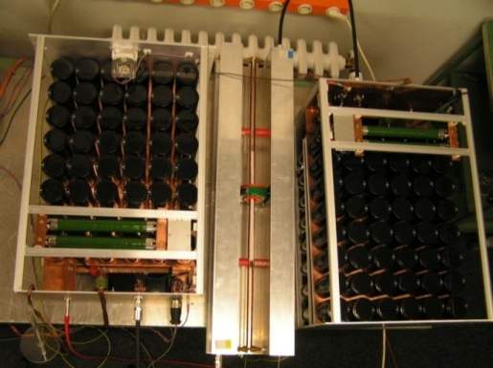
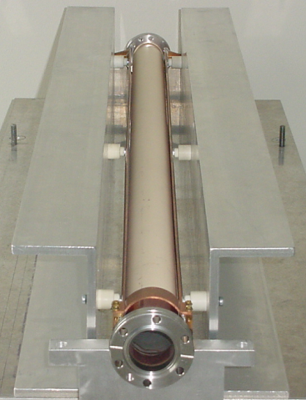
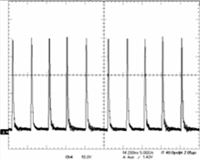
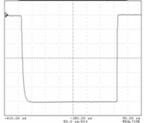
Pulse pattern: Fast kickers
4.5 MHz Dump Kicker
5 MHz Dump Kicker
Gun Linac
5MHz Dump Kicker
(pulse pattern)
(pulse pattern)
(Pulse pattern)
Dump
Flat Top Kicker (pulse width 290 μs)
a)
Dump Gap
< 20 μs
290 μs
μ
600
μ
600
s
650us
s
200 ns
low accuracy
(>1 %)
4.5 MHz burst operation
high accuracy
(< 0.01 %)
10 Hz operation
300 μs
example:
pulser prototype
example:
pulser prototype

Slide 13
Pulse Pattern: Subsequent undulators
SASE 1 / 2 undulator
Fast Kicker
Corrector
Corrector
Reasonable in one undulator only if L_{und}>L_{sat}
Bunch to bunch switching possible
Separate beam lines (θ ≈ 10 μrad) possible ?
‘De-coupled’ operation of SASE1 and SASE3 obviously possible
Hardware for intra-bunch switching not in baseline

Slide 14
Summary: Pulse Pattern Baseline
Laser pulse frequency defines bunch distance (benefits if similar requests from experiments to relax burden on fast kicker)
Distribution into two beam lines within bunch train
Individualization of pulse with fast kickers
Fate of each bunch coded into the timing system, hardware extracts info and acts accordingly (session this afternoon)
Baseline layout assumes constant linac and bunch compression parameters
Variation of bunch parameters within bunch train
  Energy variation appears to be easiest
  Variation of charge and pulse length much more challenging

Slide 15
Charge and Bunch Length Scope
Compression Scenarios for the European XFEL
Igor Zagorodnov
1st Meeting of the European XFEL Accelerator Consortium
DESY, MPY
14. April 2012

Slide 16
Compression for Different Charges
Q=1 nC
Phase space
Current, emittance, energy spread
bunch head

Slide 17
Compression for Different Charges
Q=20 pC
Phase space
Current, emittance, energy spread

Slide 18
Compression for Different Charges
Radiation energy statistics (1-25-120 runs)
Mean energy
Radiation pulse width (RMS)
250 pC
1 nC
1 nC
250 pC
20 pC
20 pC
Charge, nC | 1 | 0.25 | 0.02
Mean radiation energy, mJ | 1-4 | 1-2 | 0.1-0.4
Pulse radiation width (FWHM), fs | 25-50 | 10-20 | 1-2

Slide 19
Strong Compression for 250 pC
Radiation power vs. compression rate

Slide 20
Summary
Bunches with charge 20-1000 pC can be compressed to 5 kA and higher
Radiation energy drops down at “full” compression
Overcompression scenario can be used
Acknowledgements
to M.Dohlus and T.Limberg for many useful discussions

Slide 21





LLRF Capabilities of the
European-XFEL
Holger Schlarb
on behalf of LLRF team
Notes:
How to edit the title slide
Upper area: Title of your talk, max. 2 rows of the defined size (55 pt)
Lower area (subtitle): Conference/meeting/workshop, location, date,
your name and affiliation,
max. 4 rows of the defined size (32 pt)
Change the partner logos or add others in the last row.

Slide 22
Requests: operation flexibility
Questions:
Gradient and phase changes over macro-pulse
Beam loading / beam loading variations
Small charge operation
Related issues:
General stability achievements
Multimode operation
Intra-train Feedbacks systems & Diagnostics

Slide 23
Multiple – gradient/phase operation
Preparation of software for FLASH 1 & 2 & 3 operation!
FLASH 1
FLASH 2
FLASH 3
Used gradient steps -2% and + 3% with 40us transient time
Setting up time < 10 sec

Slide 24
Beam loading and varying beam loading
Gradient flatness
  -> orbit variation across macro-pulse
  -> achievable gradient
Stability
  -> Single bunch loading 1nC: dA/A ~ 1.4e-4
  -> variable pattern requires single bunch correction
Coupler kicks due to varying Pfor/Pref at coupler
Beam loading & high gradient (at quench limit) &
High stability is most challenging operation mode
Fundamental for LLRF system is 9 MHz readout

Slide 25
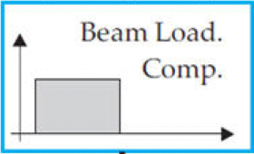
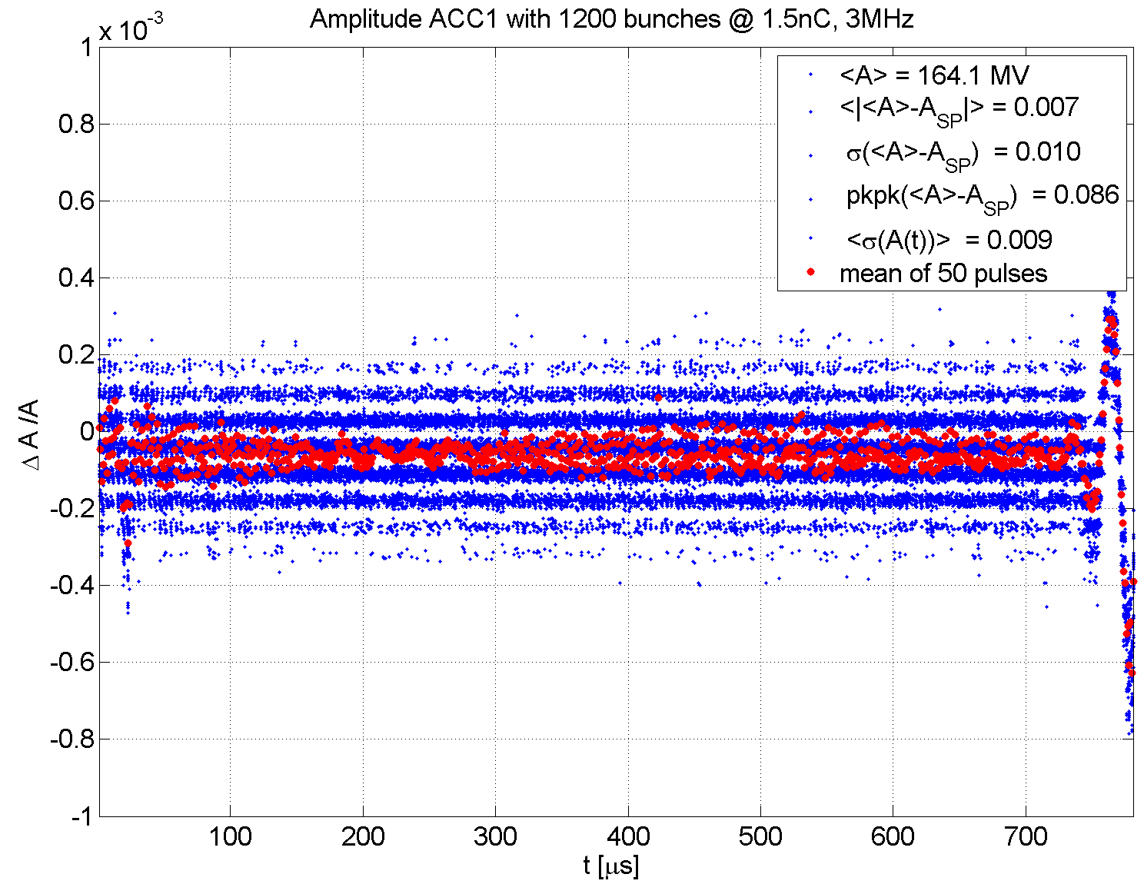
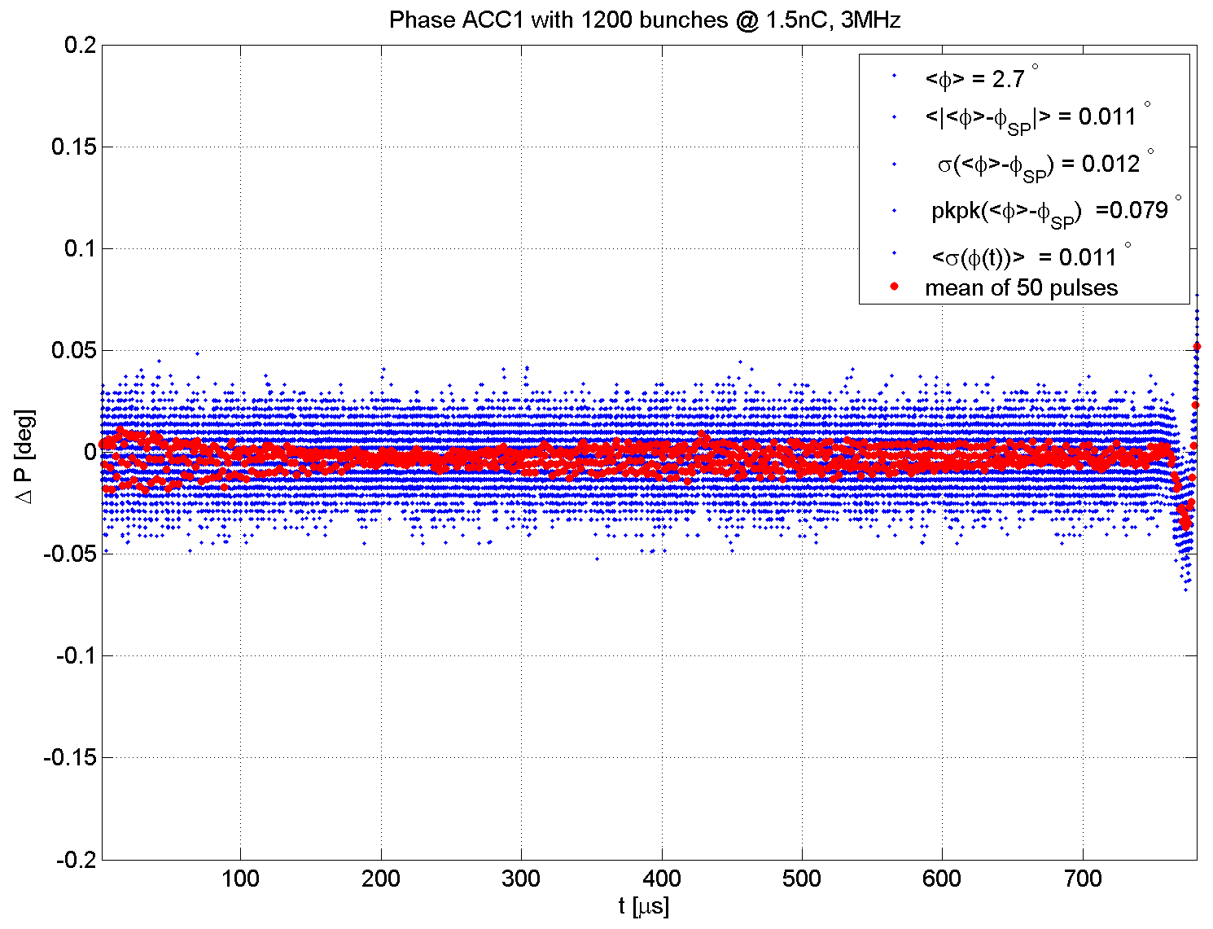
Performance of LLRF system after upgrade
ILC studies: 3 MHz, 1.5 nC = 4.5mA XFEL Parameters
All field control applications are turned on:
LFF, MIMO FB, BLC
Forward
x charge x rep. rate => 4.5mA
Remark: single bunch transient > 1e-4
BLC 1mA
Truncated
Acceleration Voltage ACC1
Acceleration Phase ACC1
dA / A < 10⁻⁴
dP = 0.011 deg
1st bunch start
LFF stop

Slide 26
Beam loading and varying beam loading
open points:
Set stable SASE operation for 4.5 MHz repetition rate (in conjunction with ILC studies)
Develop interface to new timing system providing the corresponding bunch pattern
Develop tools to deal with rapid varying beam load
Developed at FLASH for operation FLASH1/2/3
Preferable if FLASH is operated within the next 3 years with XFEL bunch pattern

Slide 27
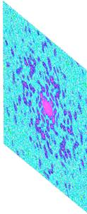
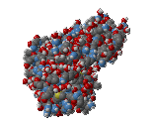
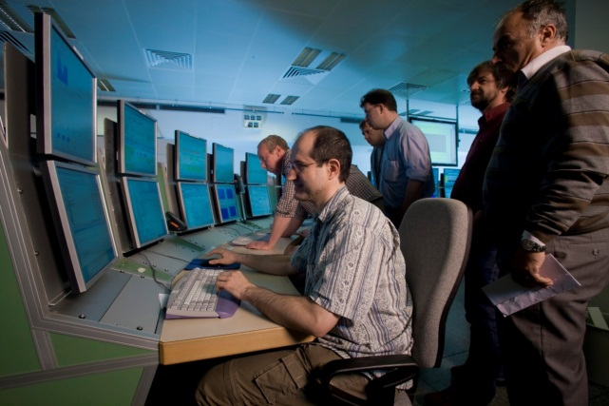
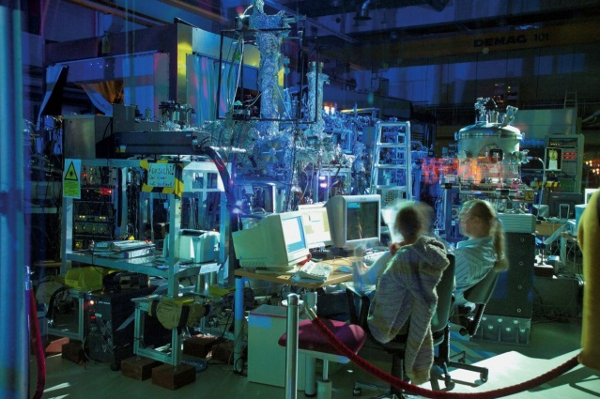
Interaction of acc. operators & experimenters
X-ray pulse
Electron bunch
Diffraction
pattern
Reconstruction
Accelerator operation
Instrument operation
As close as possible interaction

