Slide 1
Equipment Protection for the Photon Beam Transport
Harald Sinn
WP73: X-ray Optics and Beam Transport
April 17 2012, 1st XFEL Accelerator Consortium Meeting

Slide 2
Photon beam transport: Active protection
Beam loss monitor
Orange color: Beam Transport and X-ray optics
Notes:
----- Meeting Notes (4/4/11 16:59) -----

Slide 3
Active system: X-ray Beam Loss Monitor
BLM photo-multi-plier
CVD diamond or YAG
optical light
X-rays
DN 40
DN100
to shutter experiment hall
BLM photo-multi-plier
Can stop beam within pulse train
Under discussion with WP 17 & 74

Slide 4
Photon beam transport: Passive Protection
slit ≈ 250 m behind source
Orange color: Beam Transport and X-ray optics
Notes:
----- Meeting Notes (4/4/11 16:59) -----

Slide 5
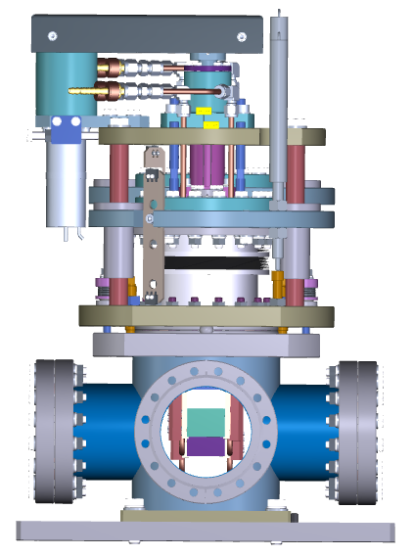
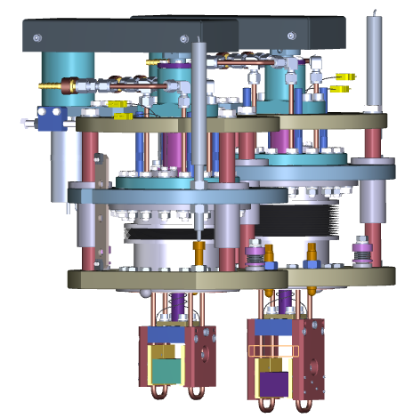
Passive Protection: Slit (only slow T-monitors)
beam
B4C, water-cooled,
4° incidence angle
SRA- slit by Germano Galasso (XFEL) and ALCA

Slide 6
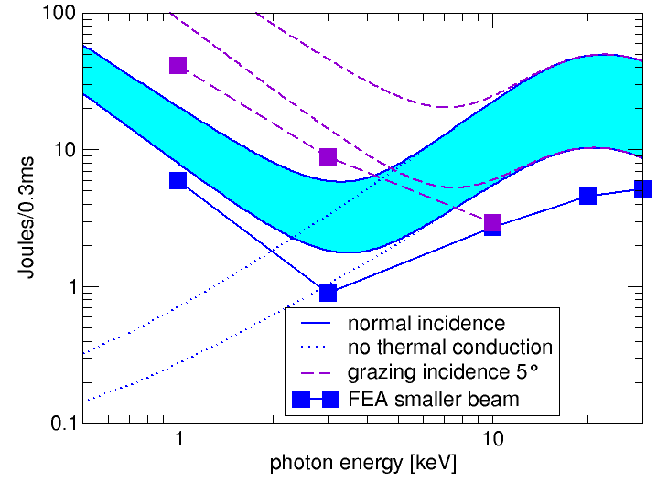
Reaching T_{melt} during pulse trains
Example: Graphite beam stop at SASE1,2,3 295 m from source point (B4C very similar)
1 Joule
= e.g. 1000 x 1 mJ pulses per train
= single shot
FEA simulations done by Fan Yang 2012

Slide 7
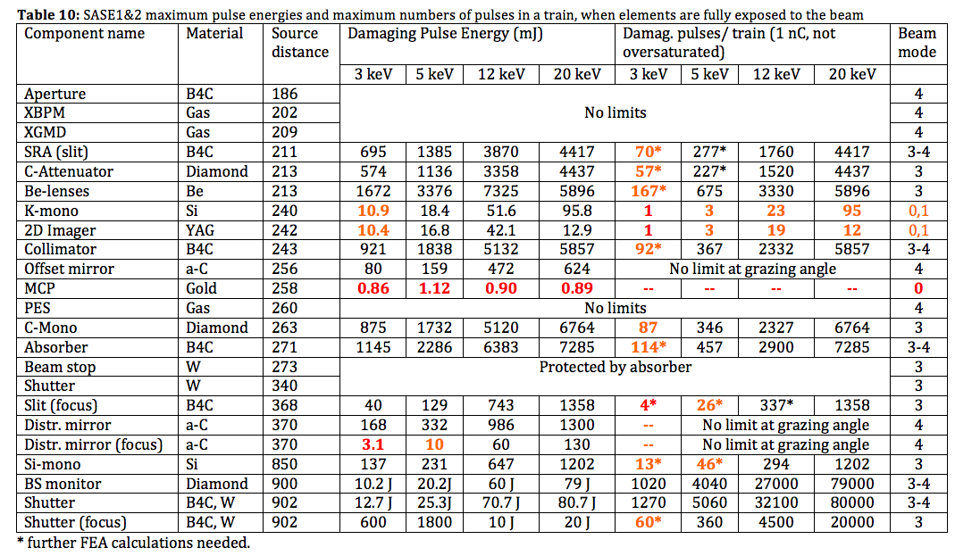
Damage Levels SASE1&2

Slide 8
Proposed Beam Modes
Number of allowed pulses per train at different bunch charges:
 | < 0.1 nC | < 0.25 nC | < 1 nC | > 1 nC
Mode 1 (Alignment …) | 1 | 1 | 1 | 1
Mode 2 (C-Window …) | 600 | 200 | 30 | 1
Mode 3 (Mono, Slits …) | 2700 | 1350 | 200 | 10
Mode 4 (Full beam) | 2700 | 2700 | < 2700* | < 900*
*Limited by electron dumps
+ Diagnostics non-FEL mode (Mode0): shift Mode 1 to Mode 2 when undulators open

Slide 9
Injector
Machine Vacuum
Trip,
Mode 1-4
Vacuum trip
Fast valve closes on trip
Machine Protection System (RS422 inputs only)
Vacuum trip
All valves out?
Beamline Vacuum PLC
Personal Interlock SASE 1,2,3
Beckhoff online?
Equipment Protection System
Thermal, sound, water, intensity, and loss monitors
Beam stops in, Shutters in
(limit switches)
RS 422 monitor devices
Trip beam
active protection
Limit switches
Attenuators in
Beam stops in
Si mono in
Screens in
K-mono in
Distr. mirrors
High Level Control System
adjust
Mode
Mode 3
Mode 1
Mode 1-4 OK
Beam Transport PLC
Experiment 1
Set beam mode
decrease
Mode
Beckhoff online?
passive protection
change Mode 1➔2
Experiment 2
≤ 3 undulators closed
Undulator PLC
Experiment 3

Slide 10
De-coupling of experiments
1 HED
2 MID
3
4
5
6
SASE5
SASE4
7
SASE2
8
9
10 FXE
SASE1
11 SPB
SASE3
12
13 SQS2
MPS needs to know which branch is active
MPS needs to know where pulse lases (requires R&D)
Beam Transport PLC needs to know which experiment
active (max 10 Hz switching)
14 SQS
15 SCS

Slide 11
Preferred Beam Modes
HED MID FXE SPB SQS SCS
Number of allowed pulses per train at different bunch charges:
 | < 0.1 nC | < 0.25 nC | < 1 nC | > 1 nC
Mode 1 (Alignment …) | 1 | 1 | 1 | 1
Mode 2 (C-Window …) | 600 | 200 | 30 | 1
Mode 3 (Mono, Slits …) | 2700 | 1350 | 200 | 10
Mode 4 (Full beam) | 2700 | 2700 | < 2700* | < 900*
*Limited by electron dumps

Slide 12
Summary Equipment Protection
Active and passive protection systems
Definition of beam modes necessary
Beam Modes Beamlines ≠ Beam Modes Accelerator
Different Experiments will run different modes
Experiments will change modes during run time
Damage test needed when operation starts and improves
Thank you for your attention!

