Slide 1
Summary of the
Vacuum Session
presented by
Sven Lederer
Notes:
How to edit the title slide
Upper area: Title of your talk, max. 2 rows of the defined size (55 pt)
Lower area (subtitle): Conference/meeting/workshop, location, date,
your name and affiliation,
max. 4 rows of the defined size (32 pt)
Change the partner logos or add others in the last row.

Slide 2
In sum 7 contributions, chaired by S. Lederer
  Electron machine vacuum
    S. Lederer, DESY, “Warm vacuum system”
    A. Krasnov, BINP, “Status report on RU19 (warm vacuum system)”
    M. Hamberg, Upsalla University, “Laser heater vacuum system”
    A. Zavadtzev, INR, “XFEL TDS Vacuum components”
    D. Nölle, DESY, “Vacuum components for Standard Beam Diagnostics”
  Photon vacuum systems
    M. Dommach, XFEL GmbH, “Photon vacuum system”
    R. Villanueva, XFEL GmbH, “The gas attenuator @ SASE 3”
    Thanks to all the speakers!

Slide 3
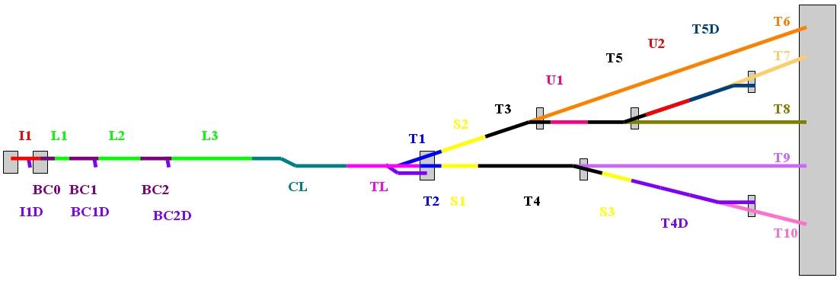
Warm vacuum overview
The complete vacuum system for the electron machine except the superconducting modules!
Overall length about 3 km
    High Level Specifications for Alignment and Surface Properties of Vacuum Components (EDMS D00000001914751)
    Specifications for the Vacuum Sections of the European XFEL (EDMS D00000001975641)
    Roughness / oxide layer requirements
    RF-shielding requirements
    Magnetic permeability requirements
    Particle cleanliness requirements
    Pressure to be achieved
    Pump type approximate distance in-between
    Specifications of flanges, stainless steel quality, gaskets
MVS-ZM stamp
  Each vacuum component to be installed into an DESY accelerator must fulfill special requirements in terms of cleanness and general vacuum suitability. This holds for the European XFEL too.
    To be checked by MVS. Without this installation prohibited.
    http://spez.desy.de

Slide 4
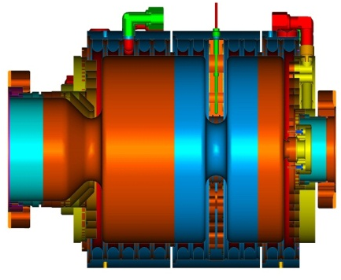
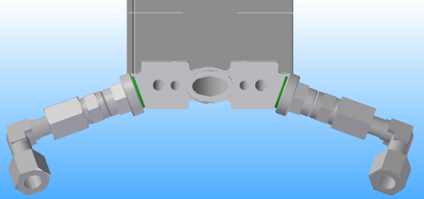
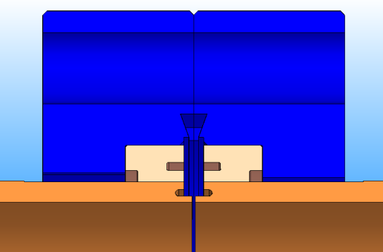
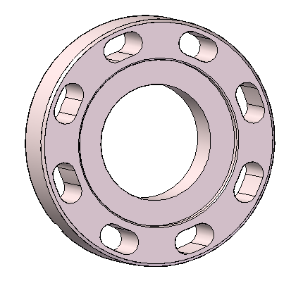
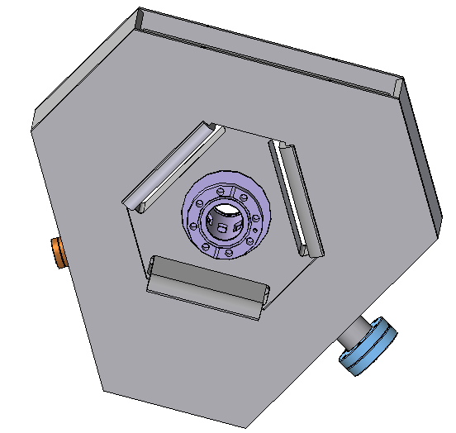
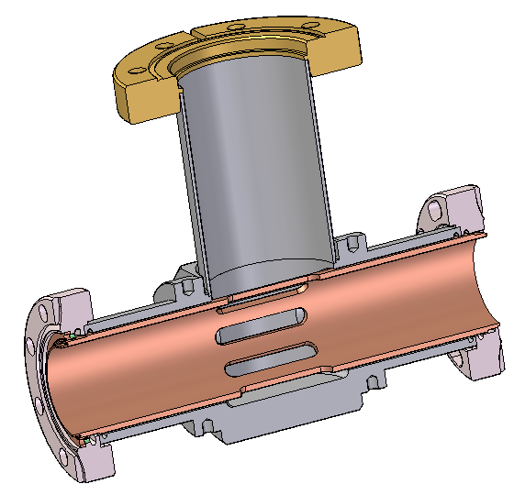
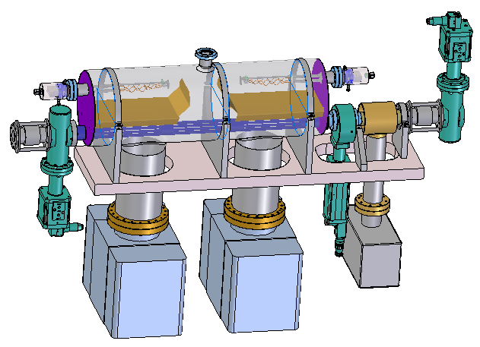
Warm vacuum overview
Standard beam pipe: Cu, ID 40.5 mm
Standard flange: CFX50 with RF-nose to ensure longitudinal gap and tight tolerances to ensure vertical step
No rotational flanges
INJ, BC1, BC2: SIPs connected to standard pump crosses with Cu-insert to fulfill MLC specification
TB, COL, SY, BD, Dumps: special In-line SIP
About 50 all metal gate valves for segmentation and separation of critical components
8 fast shutters to protect superconducting modules from particle contamination in case of accidental venting

Slide 5
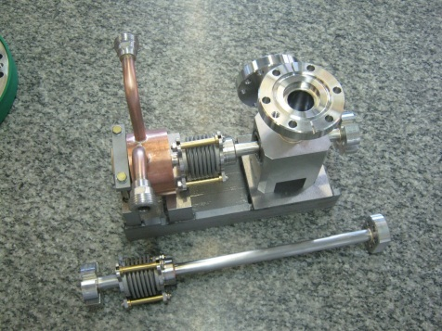
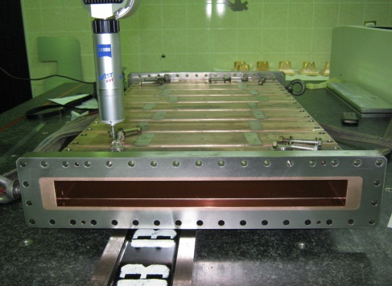
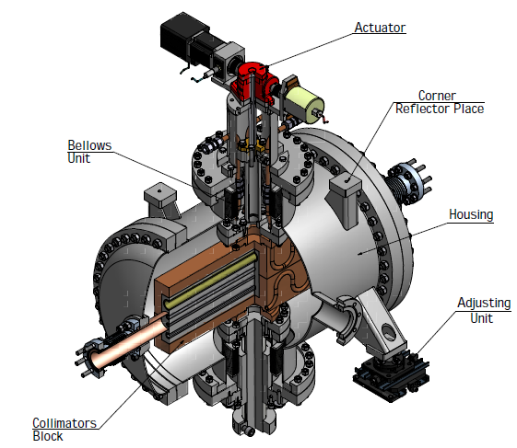
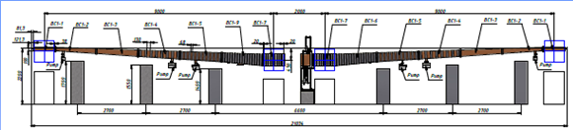
BINP contribution to the warm vacuum
Intersection of Undulator Bean Line – 100 sets
Collimators – 5 pieces for power up to 12 kW
Chicane Sections BC0 (~6 m), BC1(~20 m), BC2(~20 m)
Vacuum System for Beam Distribution and temporary beam lines
Mechanical Support System for Undulator Chambers
Courtesy A. Krasnow

Slide 6
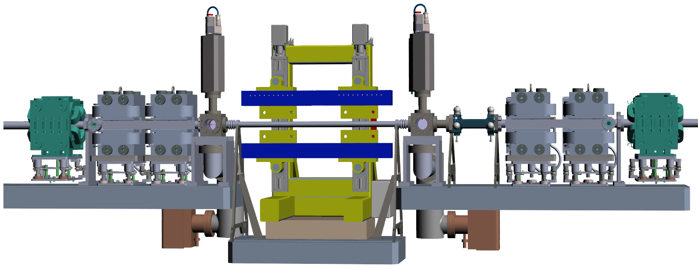
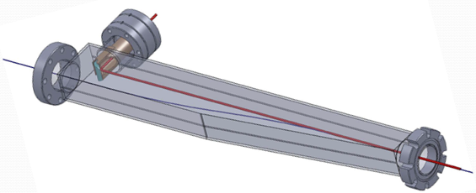
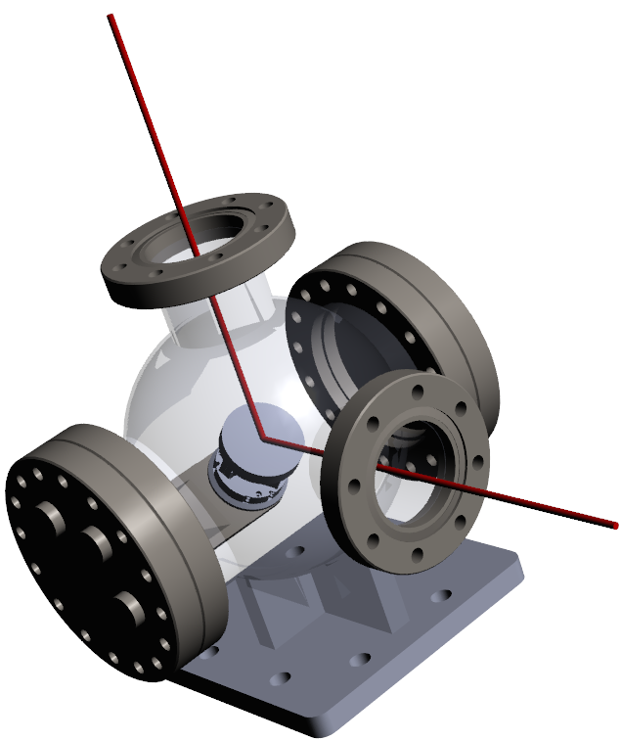
Laser heater vacuum system
Inlet
BPM (DESY)
Short interfacing pipes
OTR-cross
Undulator beam pipe with elliptical shape
OTR-cross
Outlet (as Inlet)
CFX50 flanges
In addition to machine vacuum
  Vacuum for laser transport
  Total length close to 40 m
Courtesy M. Hamberg

Slide 7
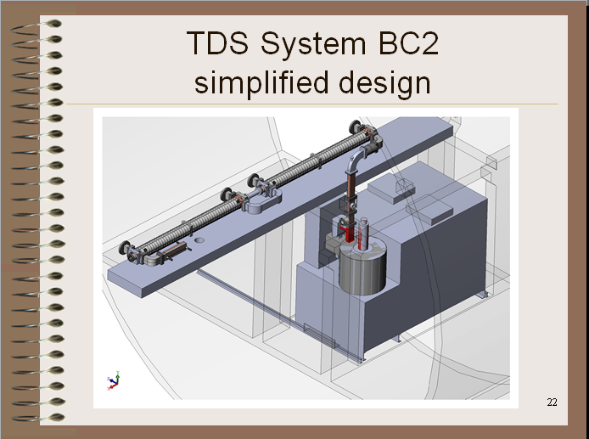
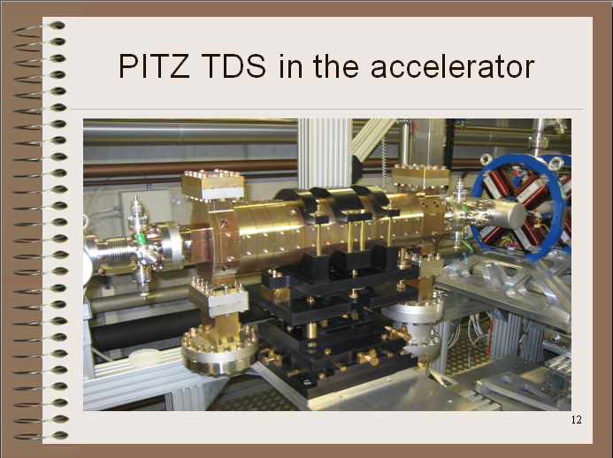
XFEL TDS vacuum components
Transvers Deflective Structures for
  Injector
  BC1
  BC2
Prototype mounted at PITZ
Courtesy A. Zavadtzev

Slide 8
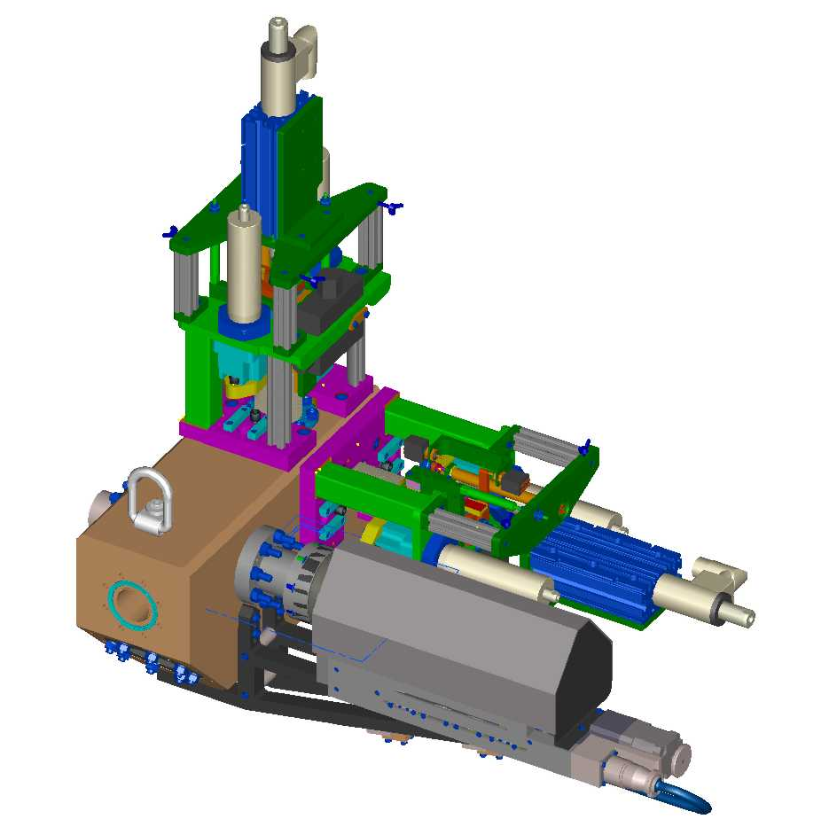
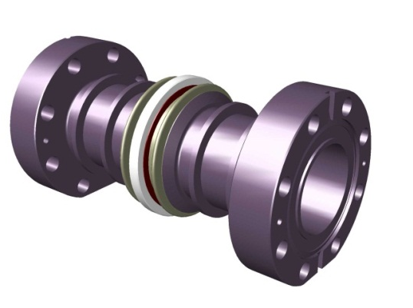
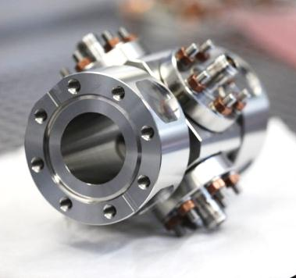
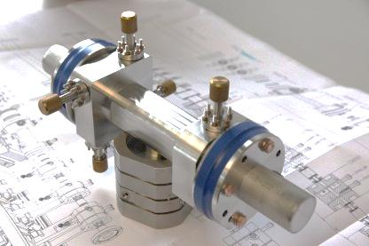
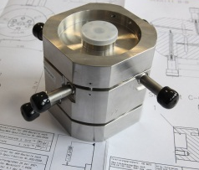
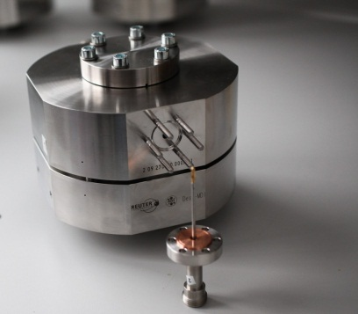
Vacuum components for Standard Beam Diagnostics
BPMs
  250 Standard Button BPMs (BPMA, BPMB, BPMD, BPMW)
  101 Cold BPMs for Cryo-modules (BPMC, BPMR)
  30 Cavity BPMs Beamline Type (BPMF/I)
  118 Cavity BPMs for Undulator Intersections (BPME)
36 Toroids (TORA, TORB, TORC)
Dark Current Monitors (DCM)
Screens/Wire Scanners
  20 Standard Screen Station (OTRA/C)
  20 Long Screen Stations with Wirescanner Option (OTRB)
  Screen Stations for Dump and Septum Areas (OTRD)
Stuff for WP-18
  BAM
  E-BPM
Courtesy D. Nölle

Slide 9
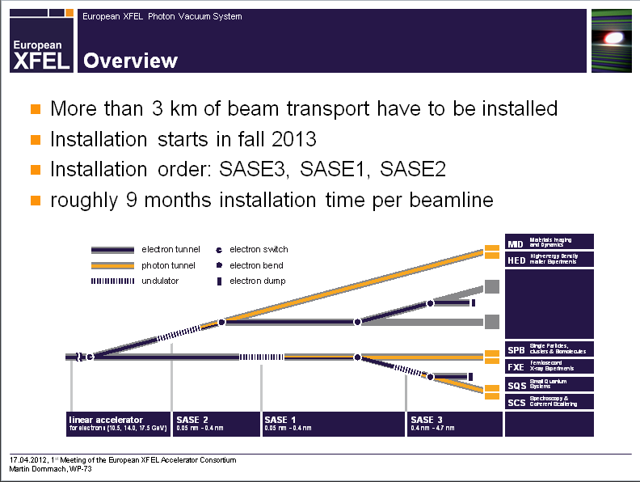
Photon vacuum system
Courtesy M. Dommach

Slide 10
Photon vacuum system
All main vacuum parts made of stainless steel
Standard length for vacuum pipes will be 6m
Only use of CF-flanges with copper gaskets
Hydrocarbon free, particle free areas ±30 m around mirrors
All-metal valves between air and vacuum (roughing and venting valves)
Viton sealed valves to separate different vacuum sections
75l/s Ion pumps (star cell type)
For details: UHV Guidelines for X-Ray Beam Transport Systems (TN-2011-004, http://xfel.eu/documents/technical_documents/)
For long distances, at SASE2 several 100m
18m sections made of three 6m prefabricated parts
Purchase pipes cleaned and sealed in foils, ready for orbital welding in the tunnel
Good experience at LCLS
  Used for beam transport
  between near and far hall
  Less potential leaks
  Less installation work
  Less expensive

Slide 11
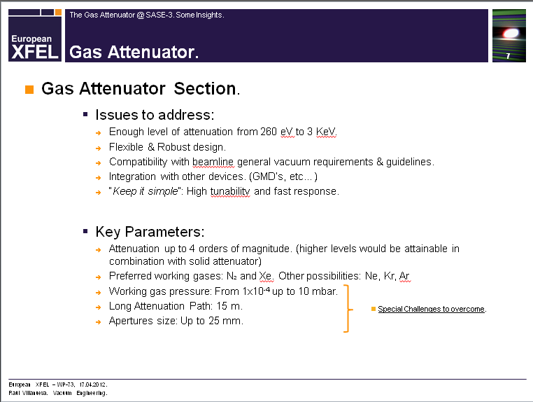
The gas attenuator @ SASE 3
Courtesy R. Villanueva

