Slide 1
PIT and Reviews
Markus Hüning
European XFEL Accelerator Consortium Meeting
Notes:
How to edit the title slide
Upper area: Title of your talk, max. 2 rows of the defined size (55 pt)
Lower area (subtitle): Conference/meeting/workshop, location, date, your name and affiliation, max. 4 rows of the defined size (32 pt)
Change the partner logos or add others in the last row.

Slide 2
Project Integration Timeschedule (PIT)
Covers Installation and Technical Commissioning of the Accelerator Complex and Experimental Area
Represents major tasks by time slots
Detailed planning and resource planning still covered by WPs
Satellite plans to schedule pre-integration activities
Milestones from WPs
Global Project Schedule
Intermediate Milestones
First Beam
Project Integration Time Schedule (PIT)
Pre-Integration Plans
„Ready For Installation“ Milestones
WPx
WPy
WPz

Slide 3
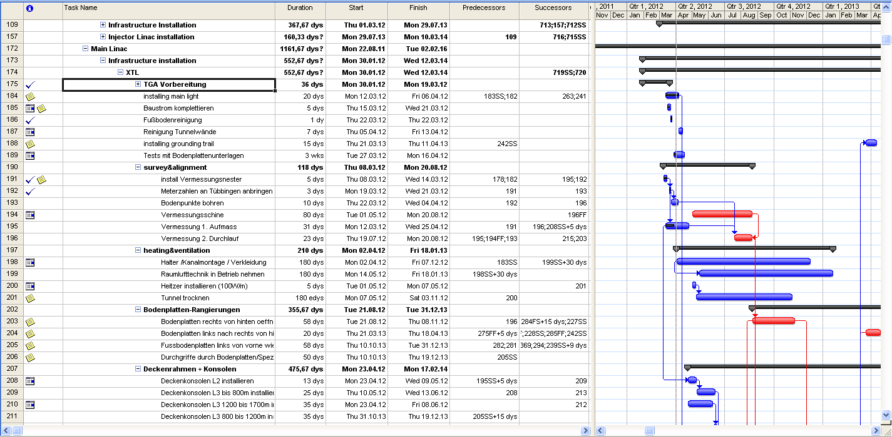
Schedule, PIT

Slide 4
The PIT and Milestones
Global Schedule and PIT define the schedule – once planned – Top-Down
Dates agreed with external contributors and contractors cannot be shifted easily
Shifts within one WP must not alter the overall planning
The delayed task must be accomodated without affecting others
Frequency of updates must be weeks rather than quarters
This is a minor clash with the usual Milestone follow-up
www.industriedenkmal.de

Slide 5
PIT and Milestones
Generally a Receiver „books“ Incoming Milestones:
Date of Milestone shifts according to schedule of deliverer → might destroy delicately orchestrated plan
Update only when deliverer updates his schedule → often too slow for timely reaction
Inserting better knowledge destroys the link
Proposal: Insert a „Sollbruchstelle“ inside Milestone Linking Plan
Milestone will stay on Top-Down scheduled date
Milestone linking merely for follow-up

Slide 6
Installation Readiness Review (IRR)
Two months prior to scheduled begin of installation campaign
Answer a small number of questions concerning
Availability of Material & Personnell
Known Delays
Safety Assessments
Safety Training
Registration of workers
No documents need to be provided, assuring their existence is sufficient
Review will be performed during installation meeting (every 2nd Tuesday), estimated duration 5 min. (an attempt to do this by mail and questionaire may be called failure)

Slide 7
Scheduling of IRR
Installation campaigns are defined in the PIT
Sequence of installation to be agreed upon in meetings beforehand
2 months prior to installation IRR will be arranged
This will be asked for by TC, there is no need to schedule it yourselves
The milestones asked for are „ready for installation“ (RFI)#
The IRR is merely a „friendly reminder“

Slide 8
Production Readiness Review (PRR)
To be performed before actually starting production or procurement
A number of mandatory documents to be reviewed by project stakeholders
Documentation of documents and reviewing process in EDMS

Slide 9
Mandatory Documents
PRR Stakeholders & Reviewing Instructions
[To be reviewed by: All listed Stakeholders and all WP‑Representatives]
Procurement Dossier – Technical & Commercial Parts
[To be reviewed by: Designated reviewers/specialists/stakeholders incl. purchase department]
Supervision and Further-Processing Readiness Description
[To be reviewed by: Designated reviewers/specialists/stakeholders and the concerned Coordinations (CLC, MLC, PSC, TC)]
Safety Analysis
[To be reviewed by: WP16, 35, 36, 38, 39]
WP Organisation
[To be reviewed by: PB]
Schedule & Milestones
[To be reviewed by: PB]

Slide 10
PRR Stakeholders & Reviewing Instructions
A list, which explains/maps, which stakeholder shall review which particular section(s) of the provided documents.
Important: Restrict assignments to the minimum required, people have to other things than checking your work
New request: Make WP40 mandatory stakeholder to ensure proper documentation

Slide 11
Procurement Dossier – Technical & Commercial Parts
This dossier shall contain inter alia and as far as applicable:
List of all deliverables including hardware, software, documentation;
Detailed or functional specifications
Explanatory drawings, assembly drawings, detail drawings
Machining instructions, processing instructions, test instructions, assembly instructions, survey instructions, marking instructions, transport instructions
Collision Check Report (performed/provided by WP40 in Master Model)
Envelope Compliance Check Report (performed/provided by TC – placeholder model DG2 vs. DG3))
Production & delivery schedule
Production follow-up and auditing clauses
Requirements on Quality Management / Control, material or test certificates, …
Assessment & awarding procedures
Financial terms
Etc.

Slide 12
Supervision and Further-Processing Description
Explains how the production will be followed-up
Explains how delivered items will be further-processed (received, checked and passed to subsequent steps – cut-off point: acceptance tests also with respect to legal/warranty aspects).
Explains all prerequisites – including for the direct subsequent steps (like: personnel, equipment, facilities, logistics, instructions, checklists, information systems…)
Provides evidence that all prerequisites are available and timely ready for efficient follow-up and reception
Organisation Chart with roles, names and responsibilities regarding the procurement, production supervision and further processing

Slide 13
Safety Analysis
A written assessment of all risk and safety issues, based on the applying regulations, which includes:
A list of the essential health and safety requirements, which apply to the deliverable
The description of the protective measures implemented to eliminate identified hazards or to reduce risks
The indication of the residual risks associated with the deliverable
The assessment on how the component(s) could contribute to the overall and/or system-internal “Undesired Top Events” (see CDR System-Concept-Description – EDMS: D00000002104341) and a description how this shall be avoided
Details to be agreed with:
WP16 – Lattice & Beam Dynamics -> Machine Protection System
WP35 – Radiation Safety
WP36 – General Safety
WP38 – Personnel Interlock
WP39 – EMC

Slide 14
WP Organisation
Organigram: i.e. a graphical description showing the organisational structure, i.e. all organisational functions/roles and interrelationships.
Statement of Responsibility: i.e. a list in which each function/role, that is shown in the organigram, is explained in terms of allocated responsibilities and activities to be performed.

Slide 15
Schedule & Milestones
PDF extract of XFEL-MSPE plan
Main Activity Strands
Related Milestones (Incoming-MS, Internal-MS, Outgoing-MS, Production & Delivery MS)

Slide 16
Remarks
The PRR is a means to institutionalize good project management practice
If done correctly, it is merely a write-up of steps that have to be performed in any case
For inexperienced WP leaders it can be of assistance for more experienced ones it can help to focus
A good deal of the quality plan that is required from in-kind contributors is covered by the PRR

Slide 17
Documentation
Reviews are to be documented in the EDMS
A lot of important information can be drawn from the documents (technical and organisational)
Therefore we want to make an attempt to make documents from earlier reviews (PRRs) available
Publish unpublished documents
Assign common classifiers to published documents
Turn the graveyard for information into a well
(The same goes for Change Requests)

