Slide 1


Laser Heater Vacuum Components
XFEL Consortium Meeting 2012-04-17
Mathias Hamberg, Volker Ziemann, Niklas Johansson
Uppsala University
Sweden

Slide 2
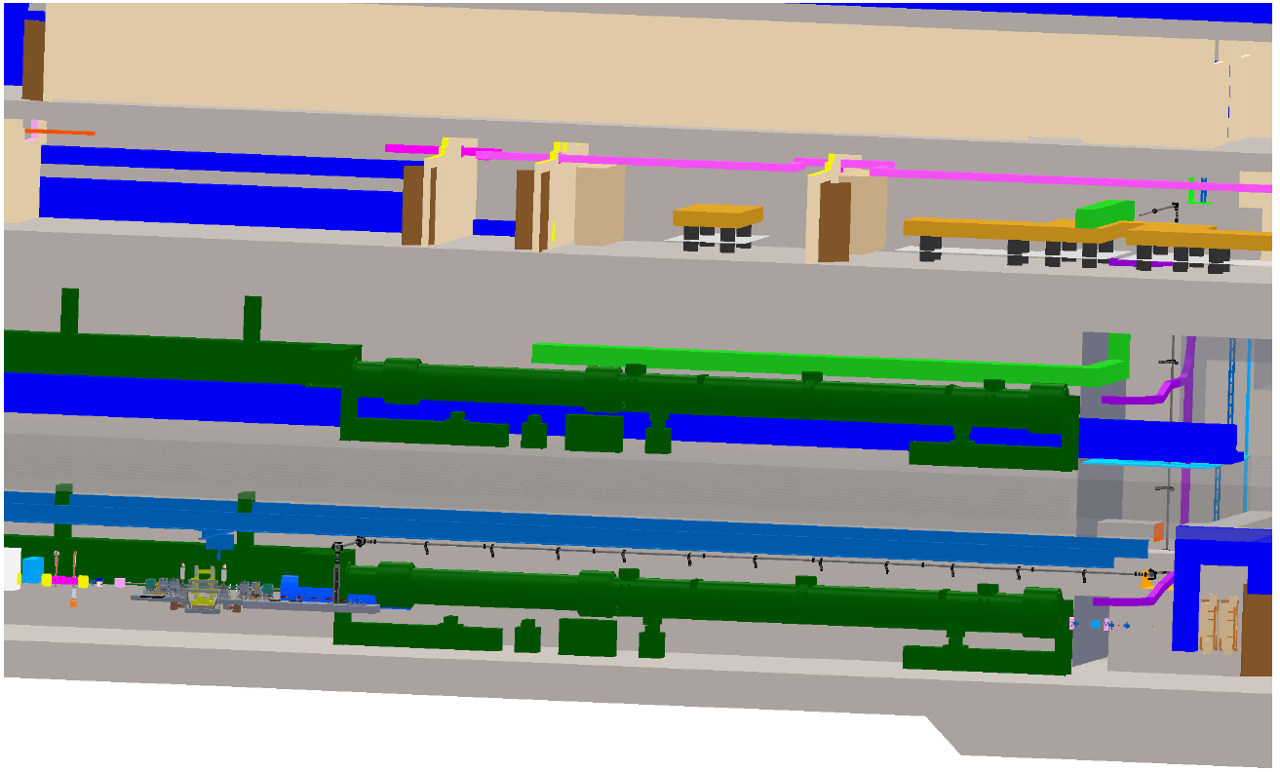
Laser Heater Overview
Counteract beam instabilities by heating the electron bunches
Use IR photons from gun laser (time locking)
Delay line timing control & telescope
Photon Routing (in vacuo)
Telescope and XY control
Electron Beam Overlap (in vacuo)
Diagnostics
Major part in vacuo

Slide 3
Laser Heater Overview
LVL 5
LVL 7

Slide 4
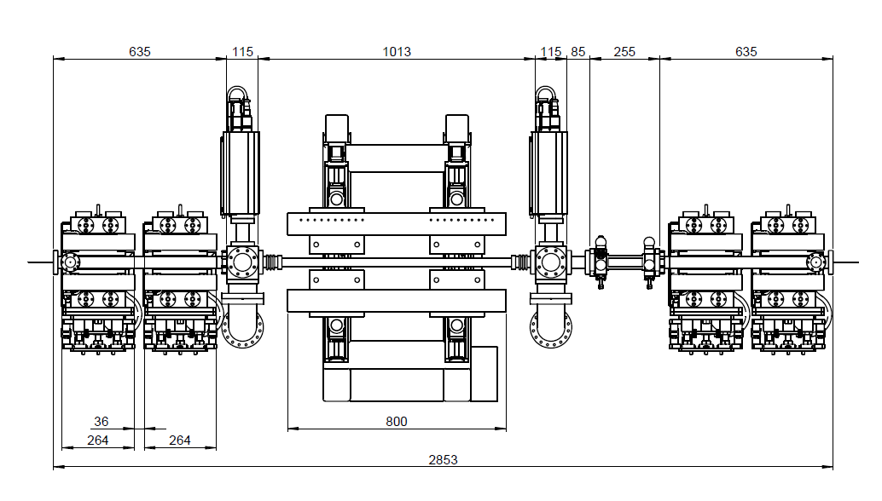
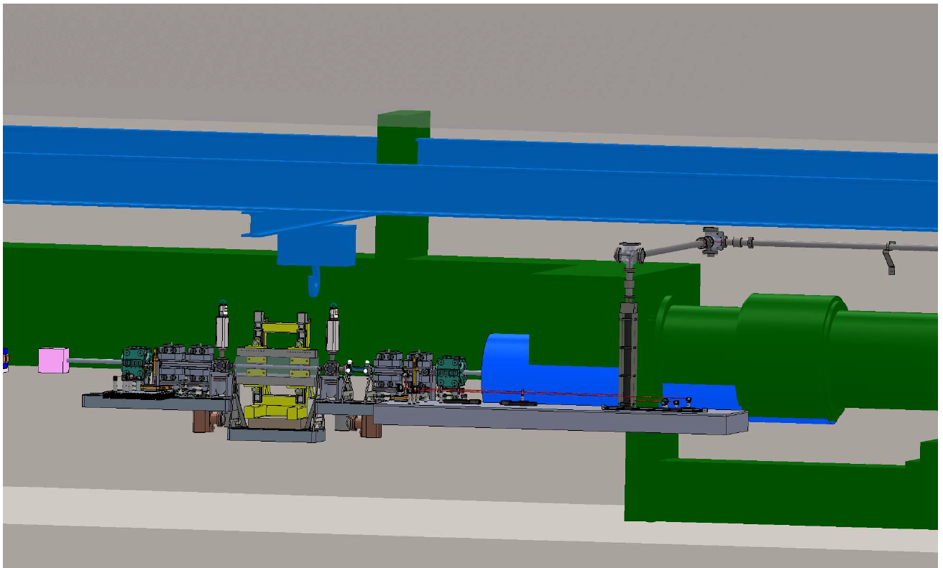
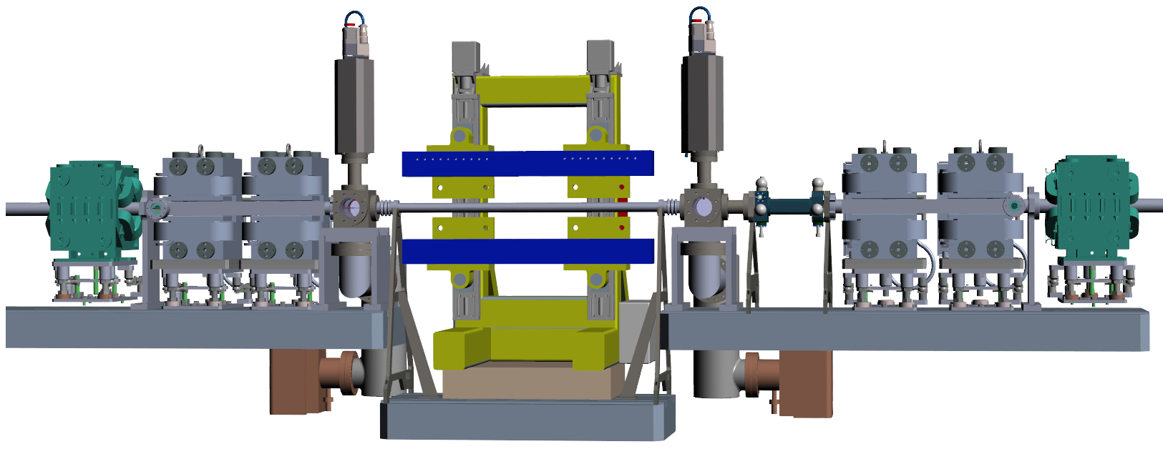
Electron Beam Vacuum System
Inlet*
BPM (DESY)
Short interfacing pipes
OTR-cross**
Undulator beam pipe
OTR-cross**
Outlet*
CFX50
flanges
*Identical
**Identical

Slide 5
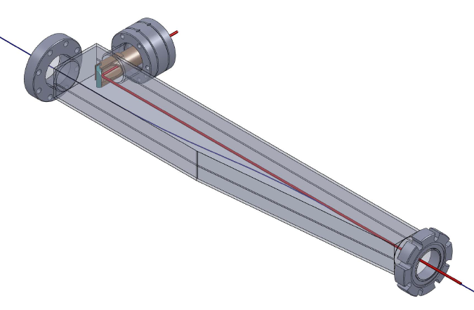
Electron Beam Vacuum System
Inlet/Outlet
Mirror mount
Double flange
30 mm transversal move

Slide 6
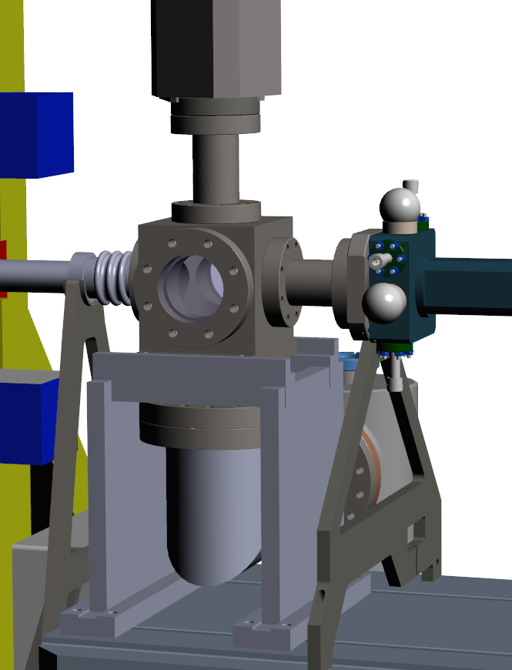
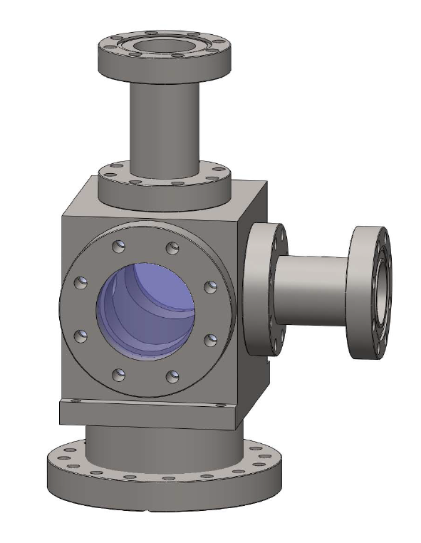
Electron Beam Vacuum System
OTR-cross

Slide 7
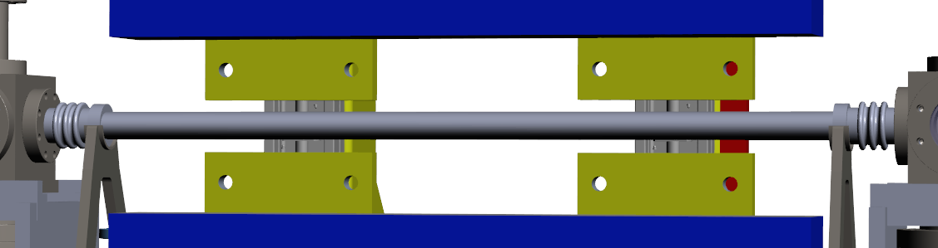
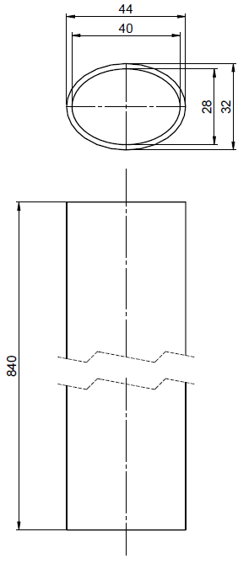
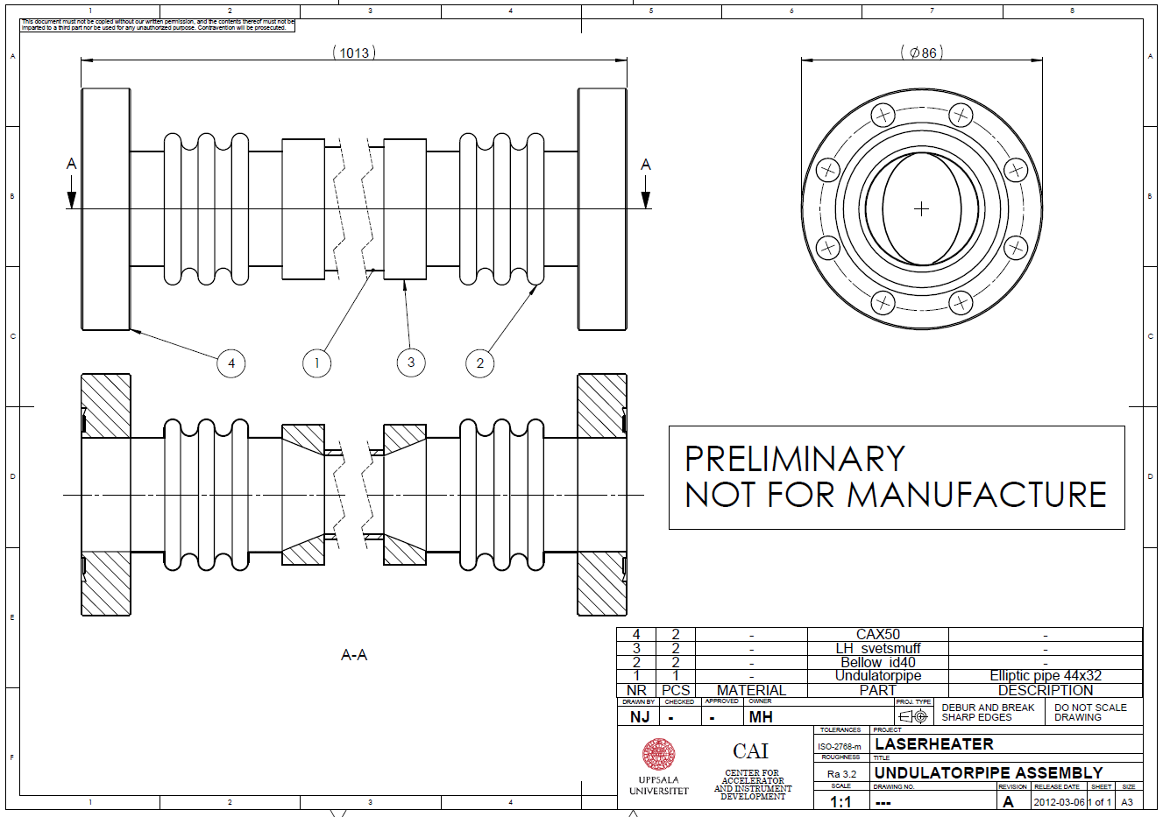
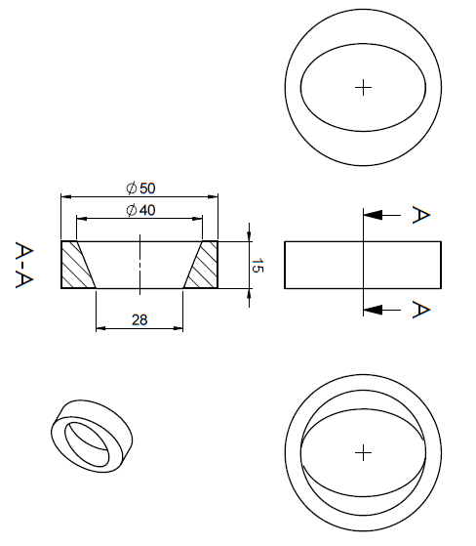
Electron Beam Vacuum System
Undulator beam pipe

Slide 8
Manufacturing
UHV
µ≤1.05
Copper coating ≥ 2 µm
Sum of rms surface roughness R_{RMS} (nm) and oxide layer O (nm) times 50 should be below 1250: R_{RMS} + O*50 ≤ 1250 (How do you verify? RBS*?)
Brazing preferred ➔ heating over Curie temperature ➔ Use 1.4429 (316LN) steel for flanges
Tight tolerances ➔ Long quotation time
Several companies choose not to quote
One quotation where we should make the flanges and Copper coating ourselves.
Await quotation from several companies for the complete system.
*RBS = Rutherford Backscattering

Slide 9



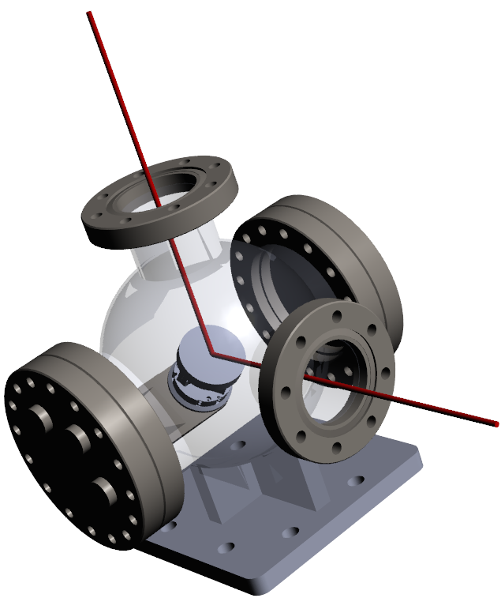
Photon Routing Vacuum System
Transporting the laserLVL5 to LVL 7
Concept Universal mirror mount corner
Mirror dirt sensitive
Vibration sensitive
Bellows before and after
Ion pumps
Feedthroughs
Mirror Mount
Outgassing from detectors and actuators
Much more relaxed compared to e-beam vacuum

Slide 10
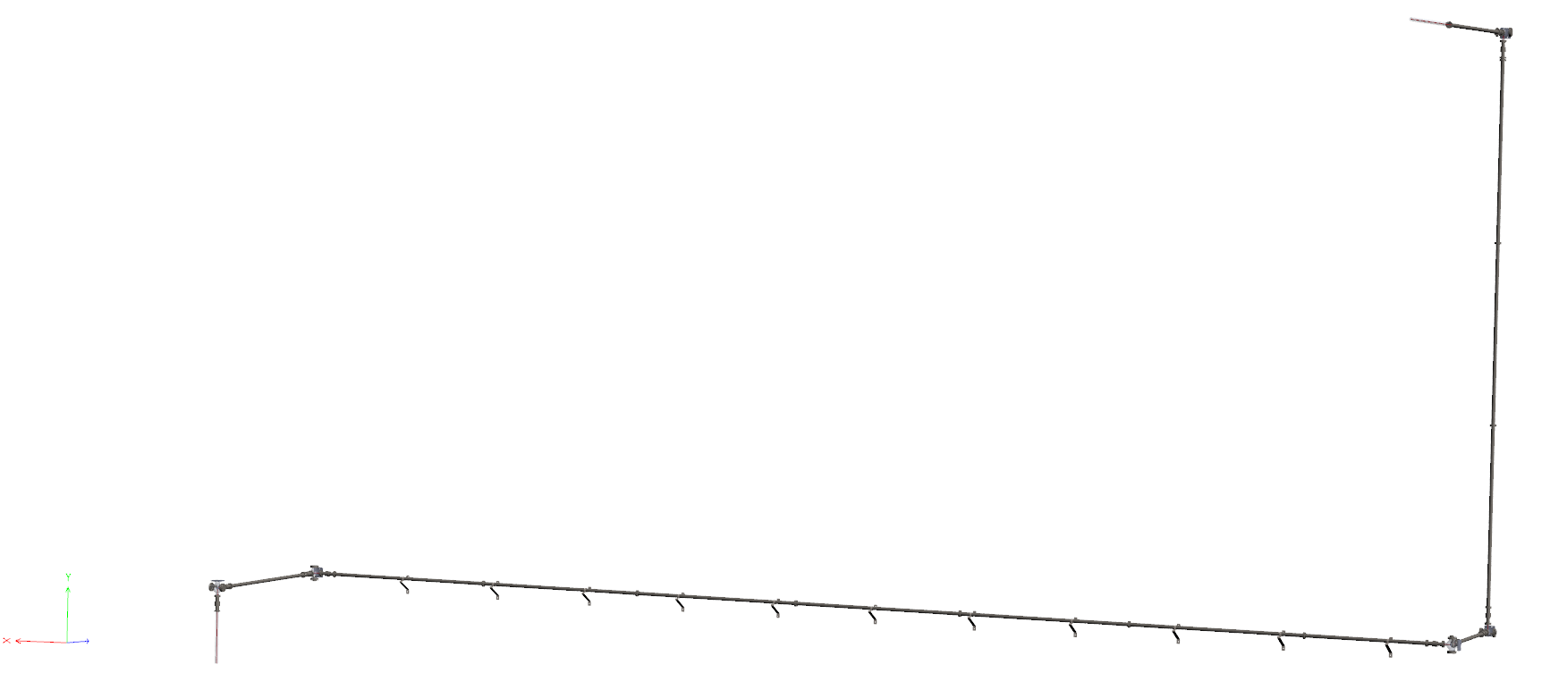

Photon Routing Vacuum System
Transporting the laserLVL5 to LVL 7
Total length close to 40 m
3 m pipe sections (DN63) where possible
Bellows before and after mirror corners
Small Ion pumps at each corner mount

Slide 11
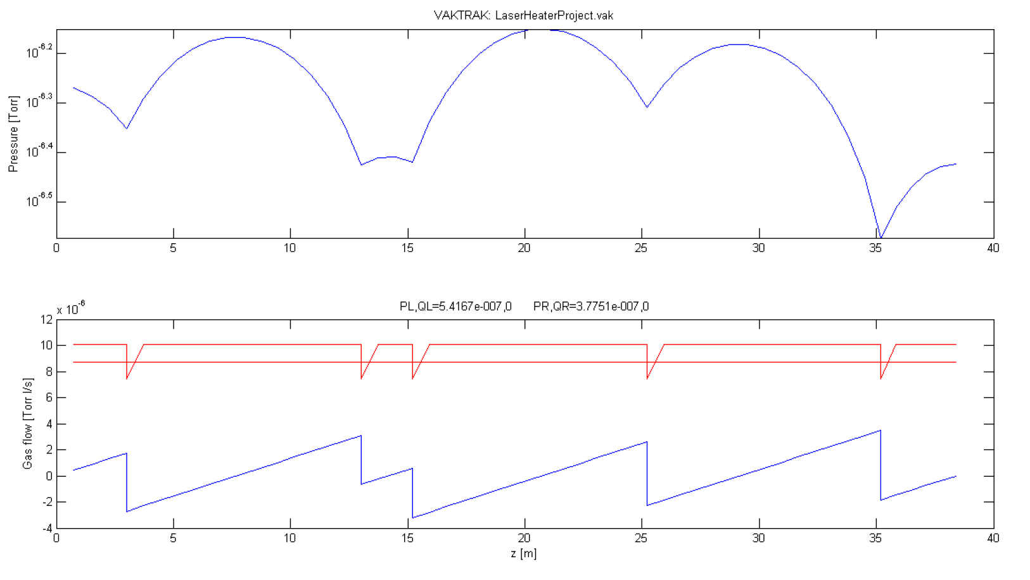
Photon Routing Vacuum System
Ion Pumps
First Simulation (pipes & bellows)
Conductance limited
10 l/s pumps theoretically enough
(used in VAKTRAK simulation)

Slide 12
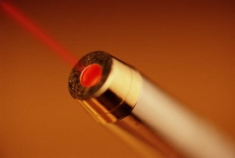
Thank You For Your Attention
Thanks to all collaborators at DESY

Slide 13
Backup Slides below

Slide 14
Electron Beam Vacuum System
Total Length 2853 mm

Slide 15
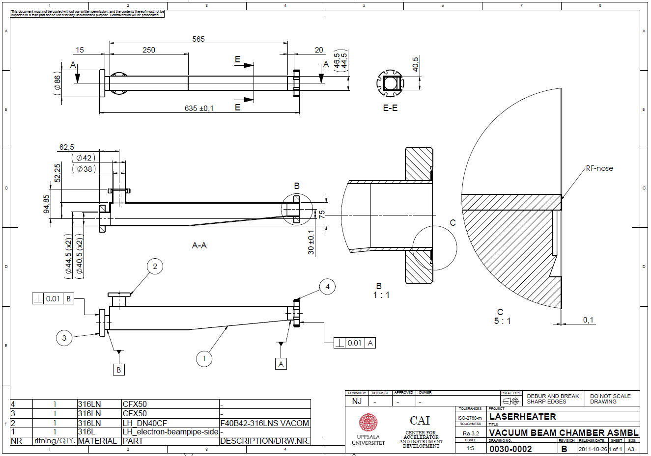
Electron Beam Vacuum System
Inlet/Outlet

Slide 16
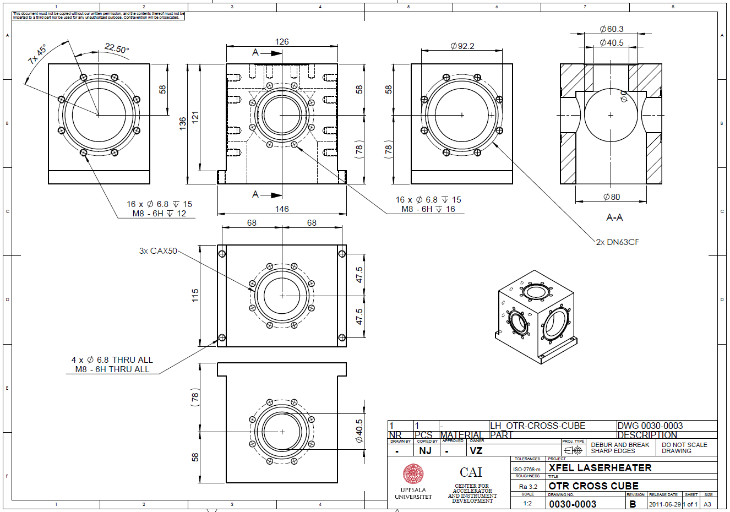
Electron Beam Vacuum System
OTR-cross

Slide 17
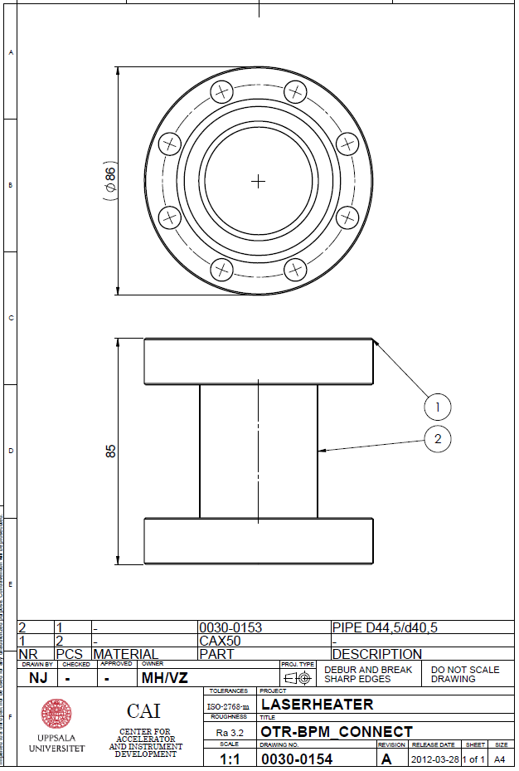
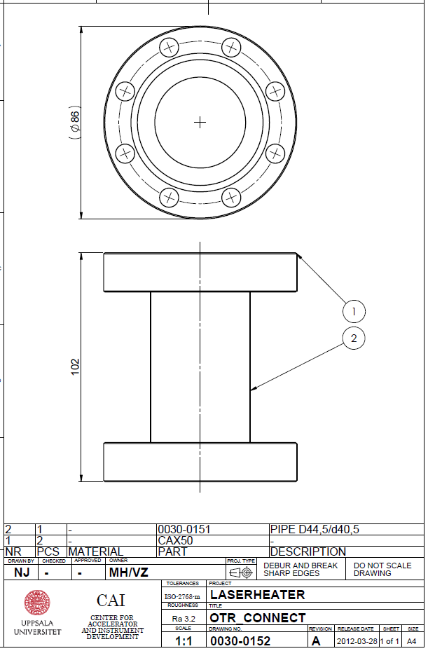
Electron Beam Vacuum System
Short interfacing pipes

Slide 18
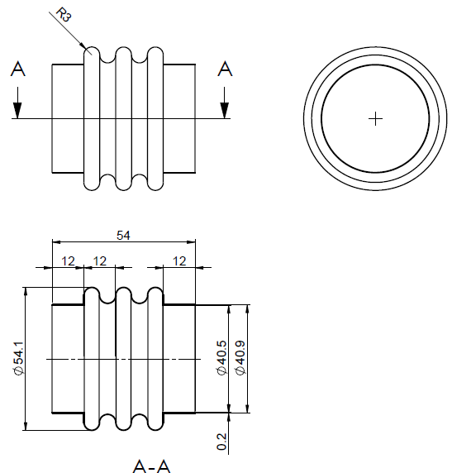
Electron Beam Vacuum System
Undulator beam pipe

Slide 19
Numbers in
Particle free ISO 5
Hydrocarbon free
ERDA (Elastic Recoil Detection Analysis)
needs samples that go through the same processes as chambers
Best surface smoothness measured by Lars Westerberg (priv. communication) was 20 nm RMS.

Slide 20
