Slide 1


XFEL Scheduling Concept
Schedule and Schedule Follow-up
Notes:
How to edit the title slide
Upper area: Title of your talk, max. 2 rows of the defined size (55 pt)
Lower area (subtitle): Conference/meeting/workshop, location, date,
your name and affiliation,
max. 4 rows of the defined size (32 pt)
Change the partner logos or add others in the last row.

Slide 2
We will NOT discuss dates today!
see presentations by Hans and Markus yesterday

Slide 3
XFEL Scheduling Approach
XFEL follows a distributed planning approach
  bottom-up project planning by work package leaders
Notes:
Before you start editing the slides of your talk change to the Master Slide view:
Menu button “View”, Master, Slide Master:
Edit the following 2 items in the 1st slide:
1) 1st row in the violet header:
Delete the existent text and write the title of your talk into this text field
2) The 2 rows in the footer area: Delete the text and write the information
regarding your talk (same as on the Title Slide) into this text field.
If you want to use more partner logos position them left
beside the DESY logo in the footer area
Close Master View

Slide 4
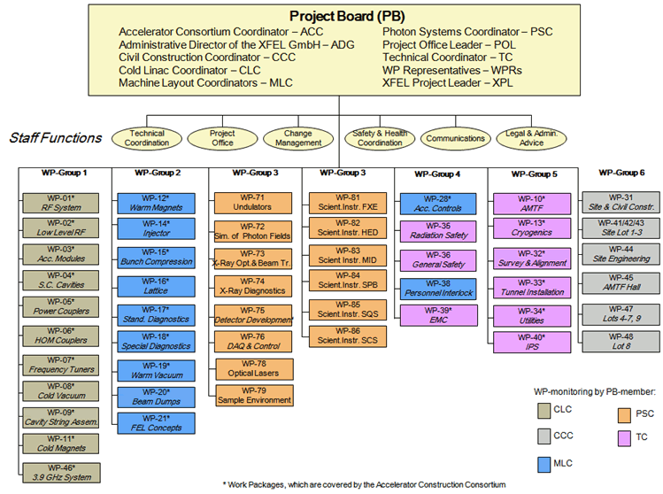
XFEL Project Structure
TC
XPO
plans on WP level only!

Slide 5
XFEL Scheduling Approach
XFEL follows a distributed planning approach
  bottom-up project planning by work package leaders
  XFEL Project Office (XPO) to maintain overall schedule
maintain overall consistent project plan over ~6 years
maintain dependencies between WPs (transparent & traceable)‏
provide trend analysis as early warning system
Challenges:
Notes:
Before you start editing the slides of your talk change to the Master Slide view:
Menu button “View”, Master, Slide Master:
Edit the following 2 items in the 1st slide:
1) 1st row in the violet header:
Delete the existent text and write the title of your talk into this text field
2) The 2 rows in the footer area: Delete the text and write the information
regarding your talk (same as on the Title Slide) into this text field.
If you want to use more partner logos position them left
beside the DESY logo in the footer area
Close Master View

Slide 6
XFEL Project Plan = Hierarchical System of Plans
WP plans: maintained by the WPLs
  schedule tasks and milestone
  progress reporting by “% complete” and remaining work
WP Dependency Schedule (WPD): maintained by XPO
  dependencies between different WPs via milestones
Project Integration Time-Schedule (PIT):
maintained by TC / SC
  infrastructure and machine / instrument installation slots
XFEL Global Schedule Plan (GSP): maintained by XPO
  project relevant milestones linked to WP milestones
  few composite milestones

Slide 7
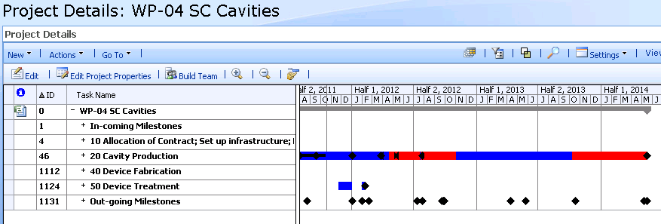
MS Project Plan Structure
all project plans have the same structure
WPD → schedule information for the WP
schedule information provided by the WP → WPD
→ GSP
→ PIT
XFEL Project Management System:
MS Project 2007 Enterprise

Slide 8
Content of the WP Plans
activities and milestones that lead to bringing the XFEL into operation
for all major systems / components / top MBOM elements:
  development, design, fabrication, installation tasks
  milestones: technical reviews like CDR, DR, PRR, start and end fabrication, IRR, start and end of installation
  (← see previous presentation)

Slide 9
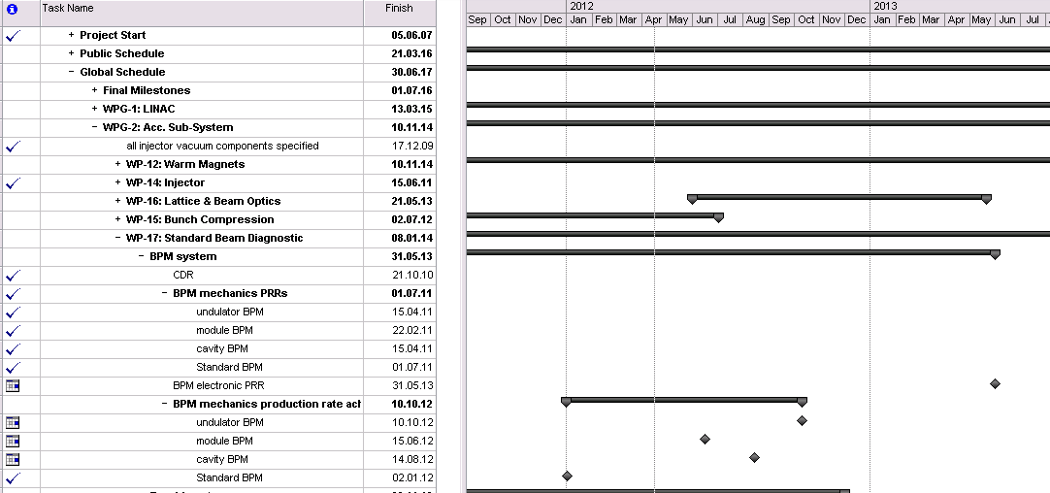
Content of the WP Plans
Example of scheduling technical reviews

Slide 10
Content of the WP Plans
activities and milestones that lead to the bringing the XFEL into operation
for all major systems / components / top MBOM elements:
  development, design, fabrication, installation tasks
  milestones: technical reviews like CDR, DR, PRR, start and end fabrication, IRR, start and end of installation
  (← see previous presentation)
installation tasks and milestones are matched with the time slots in the → Project Integration Time-Schedule (PIT)

Slide 11
Update Schedules and Report Progress
status date
progress reporting: three times a year
  mark tasks as finished
  update tasks: no unfinished tasks/work in the past
if still necessary: refine planning for up-coming quarters
update also needed for IKC tasks in the WP plans

Slide 12
IKCs in the WP Plans
Tasks of the IKCs are maintained by the contributor
  contributor has to go through the XFEL MS Project training
  work remotely on the DESY server
  close coordination with WPL @ DESY
Tasks of IKC are added / updated by WPL
  regular communication of progress from contributor to WPL
  utilize set of predefined milestone
    typical candidates: technical reviews (CDR, DR, PRR, IRR) → see next presentation
Preferred

Slide 13
XFEL Project Plan = Hierarchical System of Plans
WP plans: maintained by the WPLs
  schedule tasks and milestone
  progress reporting by “% complete” and remaining work
WP Dependency Schedule (WPD): maintained by XPO
  dependencies between different WPs via milestones

Slide 14
WP Dependency Schedule
there are no direct links between WPs
  avoid automatic schedule shift propagation
  should be a controlled & moderated process
  WPL as responsible has to update his plan
Work Package Dependency Plan
WP-x
Mx1 current: 15.04.12
approved: 15.04.12
WP-x
WP-y
Incoming milestones
Out-going milestones
Myx1 approved: 15.04.12
Mx1 current: 15.04.12

Slide 15
Schedule Shift Propagation
WP-x shifts milestone Mx1
on the next update of WPD, the Mx1 delay becomes visible
Wednesday discussion in the project meeting
Upon approval, the new date is set (by hand) also in the WPD
On the next update of WP-y, the delay is propagated to the WP-y plan
Work Package Dependency Plan
WP-x
Mx1 current: 15.04.12
Mx1 new: 20.06.12
Δ used to detect delays or advances
approved: 15.04.12
approved: 20.06.12
WP-x
WP-y
Incoming milestones
Myx1 approved: 20.06.12
Out-going milestones
Myx1 approved: 15.04.12
Mx1 new: 20.06.12
Mx1 current: 15.04.12
Another iteration may be necessary, if WP-y reports a delay as consequence

Slide 16
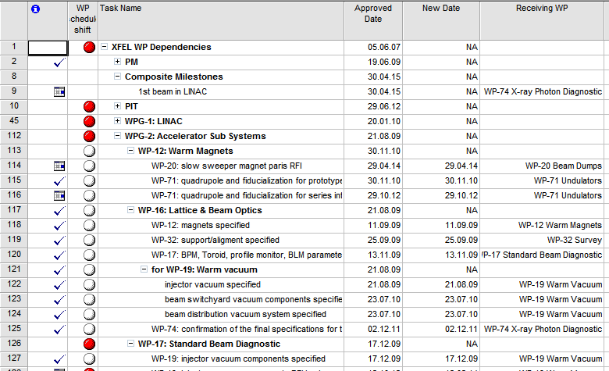
Work Package Dependency Schedule (WPD)
also these milestones are marked as completed after they are!

Slide 17
XFEL Project Plan = Hierarchical System of Plans
WP plans: maintained by the WPLs
  schedule tasks and milestone
  progress reporting by “% complete” and remaining work
WP Dependency Schedule (WPD): maintained by XPO
  dependencies between different WPs via milestones
Project Integration Time-Schedule (PIT):
maintained by TC / SC
  infrastructure and machine / instrument installation slots

Slide 18
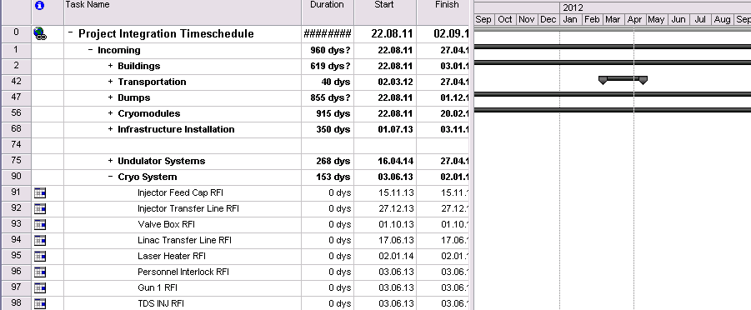
Project Integration Time-Schedule (PIT)
Incoming are typically Ready-for-Installation (RFI) milestones
  result of the Installation Readiness Review (IRR)
  see next talk for more details on PIT and IRR

Slide 19
XFEL Project Plan = Hierarchical System of Plans
WP plans: maintained by the WPLs
  schedule tasks and milestone
  progress reporting by “% complete” and remaining work
WP Dependency Schedule (WPD): maintained by XPO
  dependencies between different WPs via milestones
Project Integration Time-Schedule (PIT):
maintained by TC / SC
  infrastructure and machine / instrument installation slots
XFEL Global Schedule Plan (GSP): maintained by XPO
  project relevant milestones linked to WP milestones
  few composite milestones

Slide 20
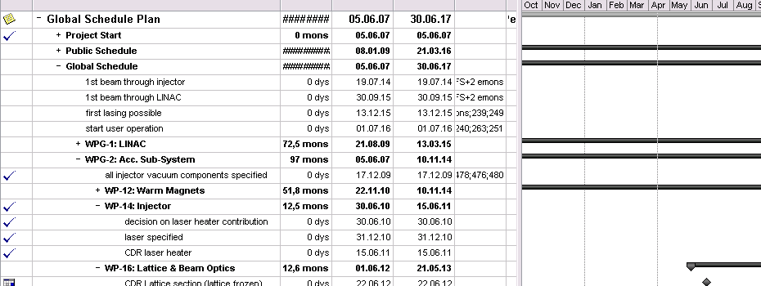
Global Schedule Plan (GSP)
used to provide an overview schedule
  typical milestones are again the technical reviews
used to track and follow-up the overall progress
  e.g. use MTA

Slide 21
Schedule Follow-up
based on GSP, WPD (and PIT)
in the weekly Technical Coordination Meeting
  use a 3-month forward looking window
  discuss status of milestones in this window
  request update if necessary
after tri-annual WP plan updates / status reports (PPR)
  consolidate overall schedule
  look for delays in GSP, WPD and PIT
  discuss reason, analyze effects and
  check for recovery strategies

Slide 22
22
Introduction: Milestone Trend Analysis
recognize trends in the schedule development
Status / Report Date
01.01. 01.02. 01.03. 01.04. 01.05. 01.06. 01.07.
Green:
01.06.
milestone stays as planned
01.05.
Blue:
Milestone Date
milestone is delayed but eventually
reached, action may be necessary
01.04.
01.03.
Red:
01.02.
milestone is further and further delayed;
recovery strategy critically needed
01.01.
Riko Wichmann, XFEL Project Office, Desy

Slide 23
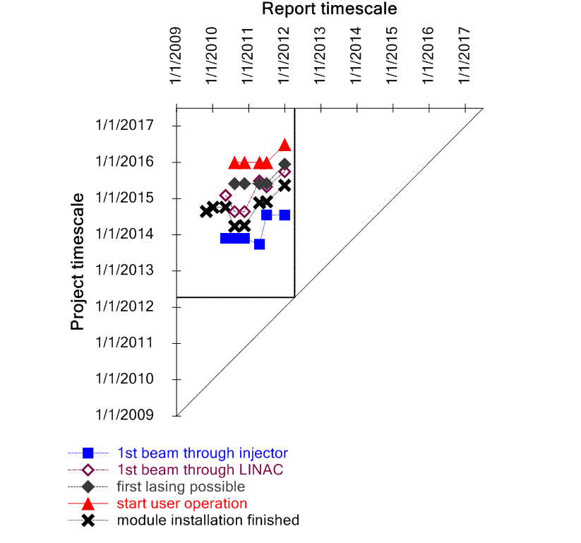
MTA on Global Schedule
note, this includes going from
17.5 GeV → 14 GeV → 17.5 GeV

Slide 24
Public Schedule on XFEL Web Servers (planned)
overview schedule picture
pdf version of the consolidated Global Schedule Plan
to be provide on http://xfel.eu and/or http://xfel.desy.de

Slide 25
Summary
scheduling performed bottom-up with very few final top-down milestone
Global Schedule Plan: heavily utilizes the mandatory technical reviews, e.g. CDR, PRR …for all major systems / top MBOM elements
PIT: Project Integration Time-Schedule for the infrastructure and machine installation
  heavily relies on scheduled IRR → RFI milestones
minimum requirement for all IKC
  mandatory technical reviews have to be included in the corresponding WP plan

