Slide 1
FE Gruppe.
Electronics development at DESY (Hamburg)
Mathias Reinecke
Workshop on Fast Beam Conditions Monitoring DESY Zeuthen, 3.2.2012

Slide 2
Contents
People in the FE electronics groups
Current Projects / Focus of Activities
Optical data transfer (old project)

Slide 3
People at FE
FE
M. Zimmer
A. Schröder
FEA
M. Zimmer
H. Arpe
K. Diekmann
C. Kosinski
F. Krivan
I. Shevyakov
P. Vetrov
Q. Xia
FEB
P. Göttlicher
W. Baatz
K.-H. Gooßen
T. Pwalam
M. Reinecke
P. Smirnov
L. Steffen
H.J. Wentzlaff
M. Zeribi
FEC
K. Hansen
I. Diehl
J. Hampe
P. Kavalakuru
H. Klär
D. Müntefering
M. Randall
C. Reckleben
J. Szymanski
A. Titze
A. Venzmer
E. Wüstenhagen

Slide 4
Kernkompetenzen von FE
Main Activities | FEA | FEB | FEC
PCB circuit design and layout | x | x | x
fast FPGA - based data acquistions xTCA, PXI, 10G-Ethernet, fast serial links, VHDL | x
processing of sensitive analogue- and detector signals |  | x | x
ASIC-Development (Analog, Mixed-Signal, Digital) |  |  | x
hybrid module assembly, chip bonding |  |  | x
low- and high-level software (µC, LabView) | x | x | x
complex measurements techniques | x | x | x
System design (EMC, Grounding etc.) | x | x | x
ECAD Service for Mentor Graphics and CADENCE | x |  | x

Slide 5
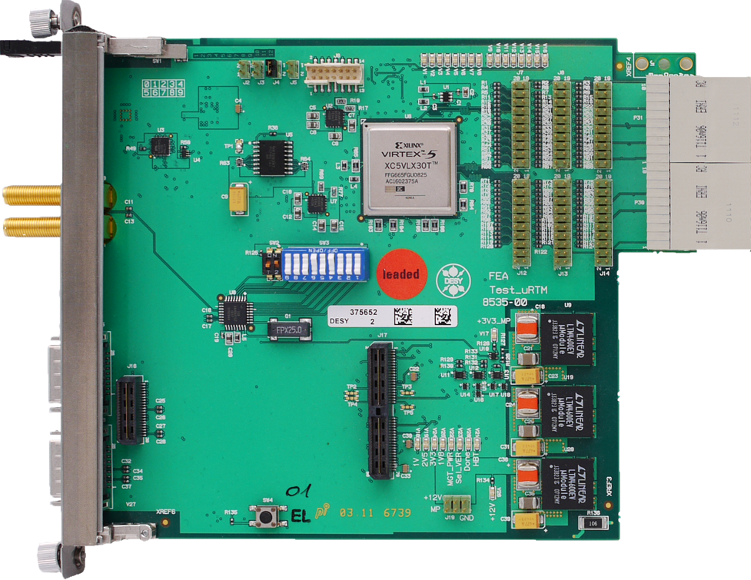
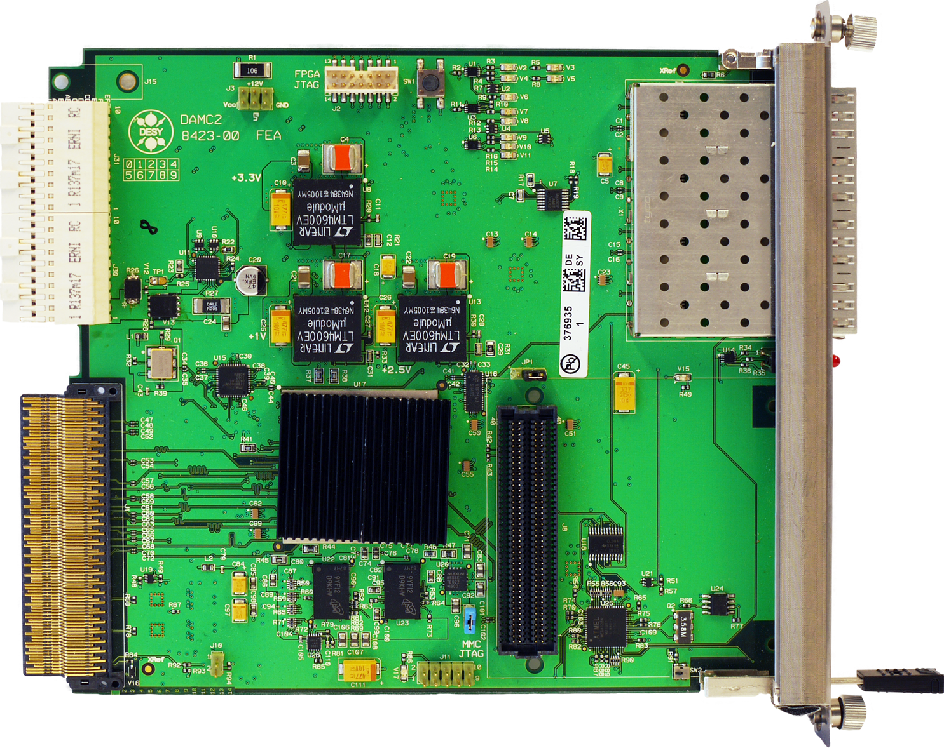
Data acquisition module DAMC2
xTCA for Physics as extension of the standard
Extension of specifications from running experience and customers advice.
Double height, extendable by Rear-Transition-Modul (µRTM)
Separation of data acquisition and I/O, firmware can be adapted to task
Board is foreseen for many different appliccations!

Slide 6
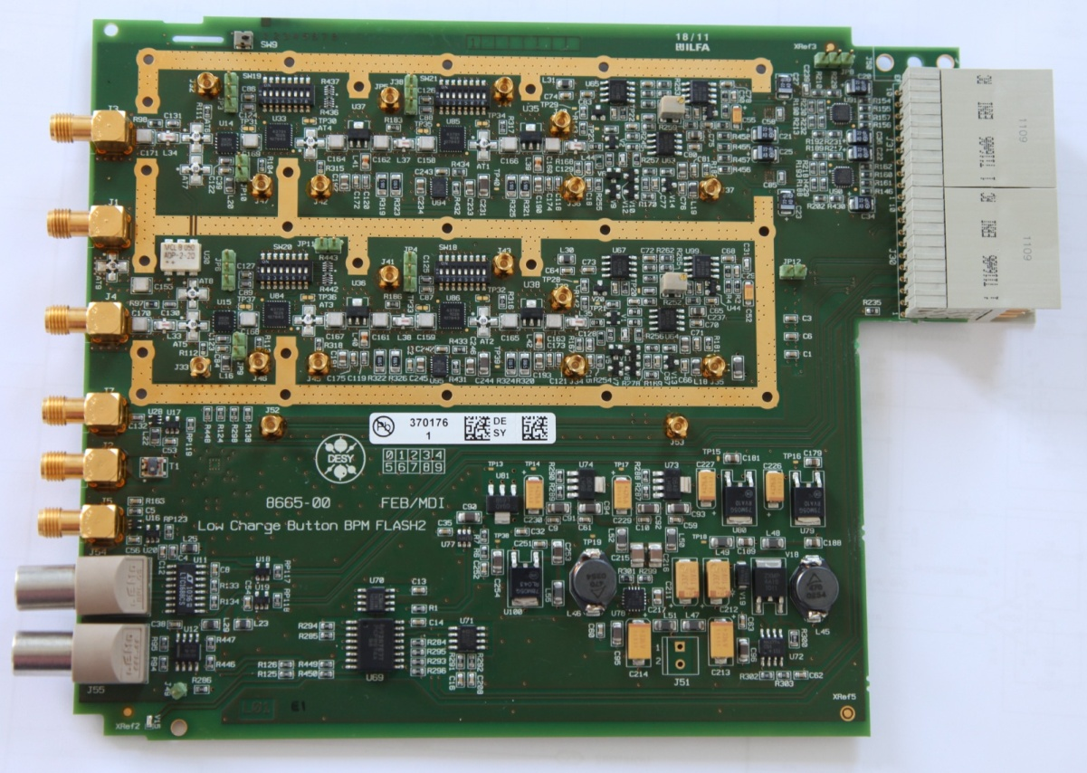
µRTM Modules for FLASH II and XFEL
µRTM Modules for:
Beam Position Monitor in test at FLASH II
Machine Protection System in production.
Beam Halo Monitor to be finished in 2012.
Beam Loss Monitor scheduled for 2012.
Typical tasks: multichannel A/D conversion and additional functions.
Hardware: FEB, Firmware: FEA

Slide 7
Readout-Module for XFEL - detetcors
Versatile Readout Module as Mezzanine - Card
Input digital data rate up to 100 GBit/s / Up to 4x 10GBit Ethernet outputs
Applications: AGIPD, MEDIPIX and CMOS - Imager for XFEL
Spezielles Carrierboard für jeden Detektor
Sensor
Digitalisierte Signale
Steckverbindung
Digitales Readout Modul
Bis 4 x
10 GBit
Ethernet
Slow
Control
146 Pairs/ 700 Mbit/s
Offline Computing
Daten
Signal-anpassung
8 GB RAM
2 SODIMM
PHY / SFP+
PHY / SFP+
FPGA
Virtex5
PHY / SFP+
PHY / SFP+
Power

Slide 8
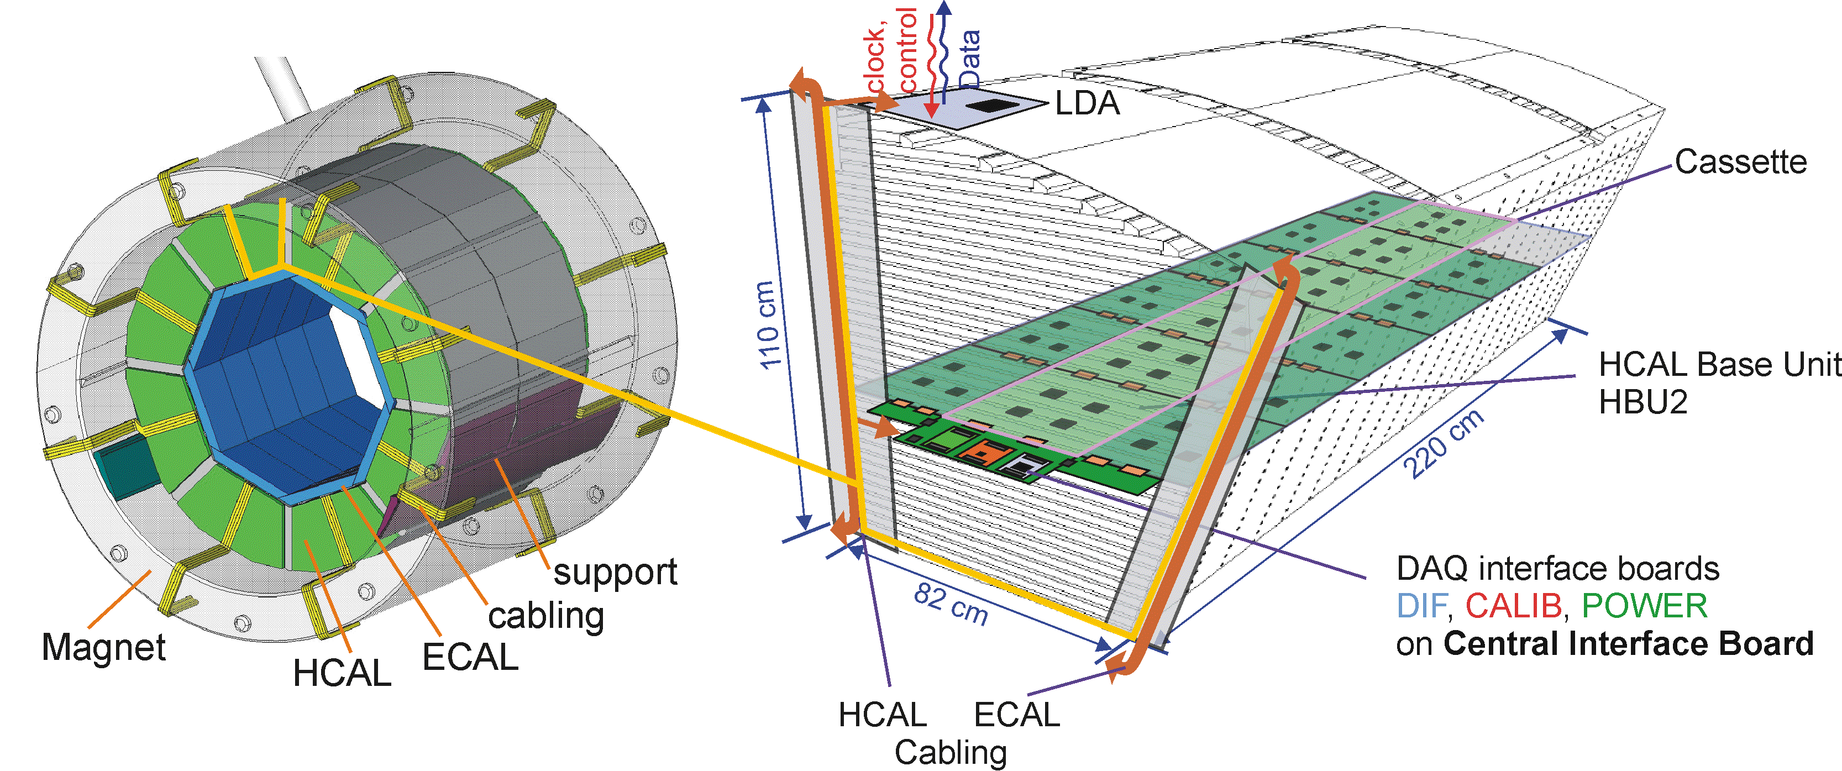
Analogue, hadronic Calorimeter (AHCAL)
4m
Research for the ILC:
48 layers steel/tungsten - detector. 2600 channels per layer.
Almost 4 million channels in the barrel. 1/16 HCAL module: > 24t.
FEB: concept- and prototype development within the CALICE collaboration.

Slide 9
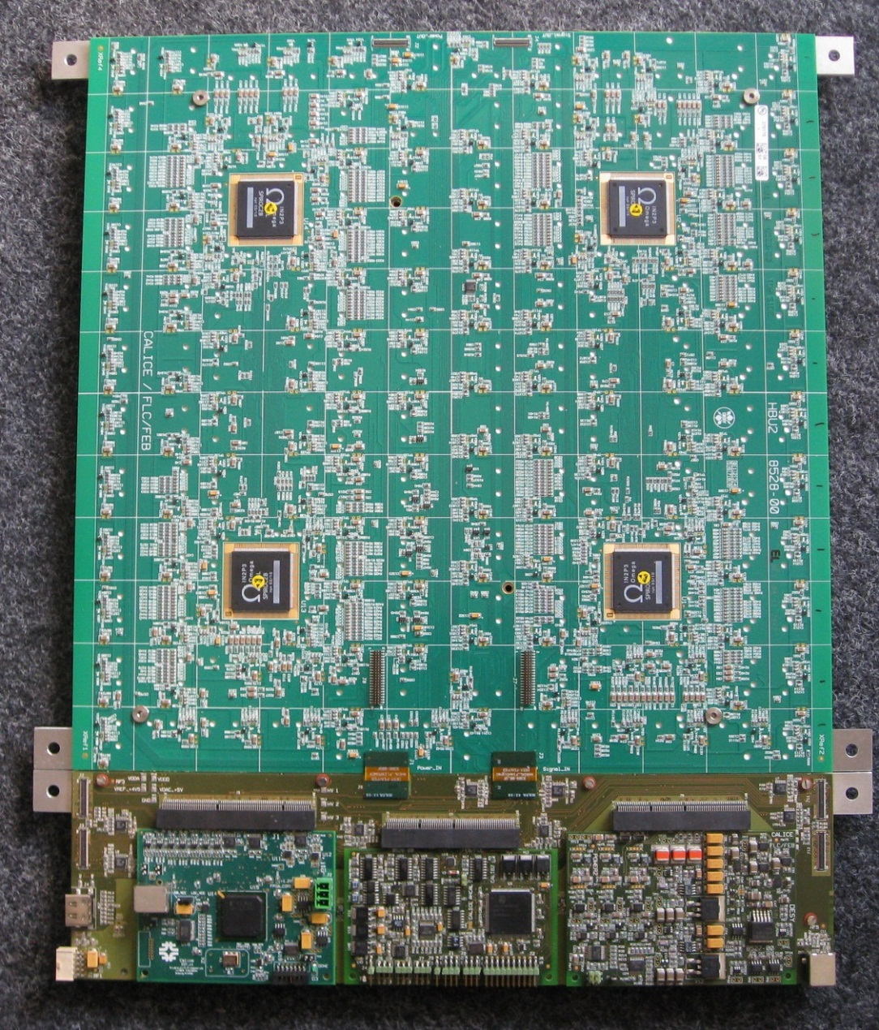
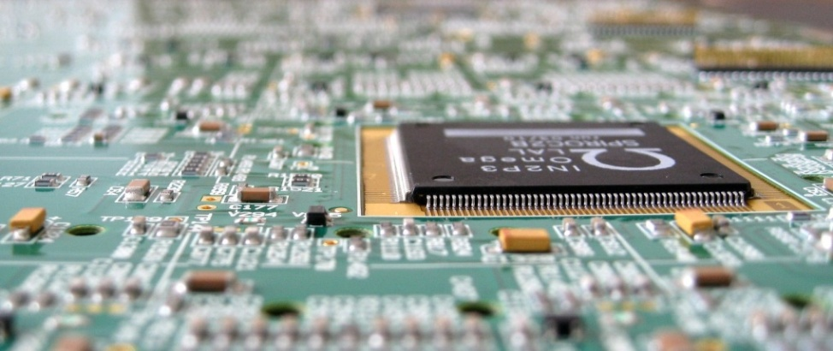
AHCAL – Prototype Electronics
SiPM
Szintillator
HBU2
144 Stück auf Rückseite
36 cm
High integration level:
„As thin as possible“

Slide 10
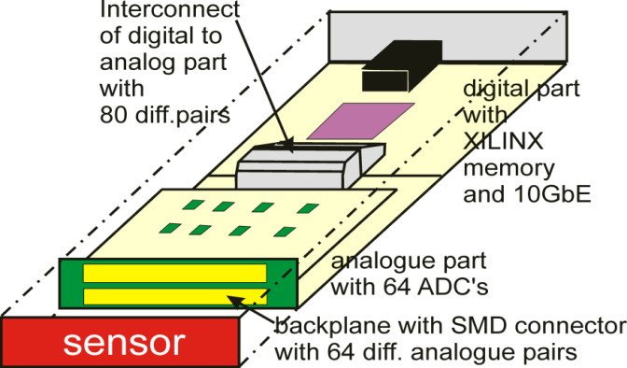
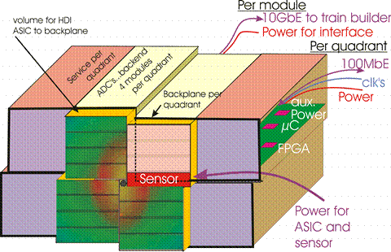
Adaptive Gain Integrating Pixel Detector (AGIPD)
High-speed camera for XFEL:
64 ADCs (14bit, 50MS/s)
1 MegaPixel for 12keV-photons
Dynamic range: 0, 1, 2, … up to 20000 photons
Full frames all 222ns.
No data compression. => DAQ data rate: 80GBit/s.
FEB
FEA
Further FEB contribution:
Slow Control and Configuration:
ARM9 microcontroller

Slide 11
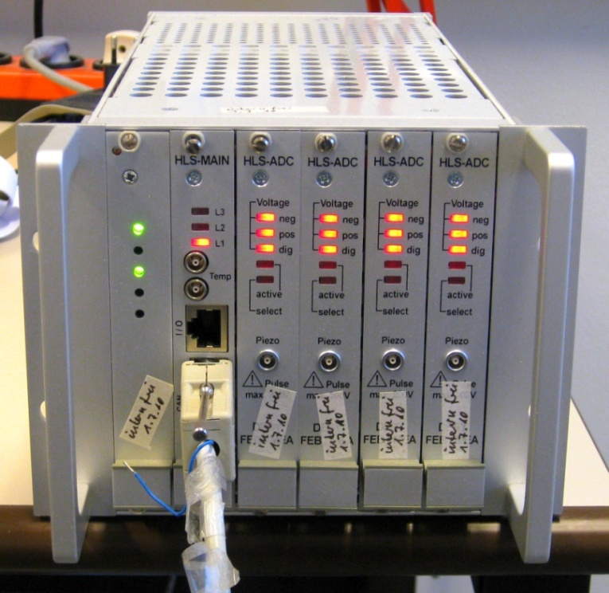
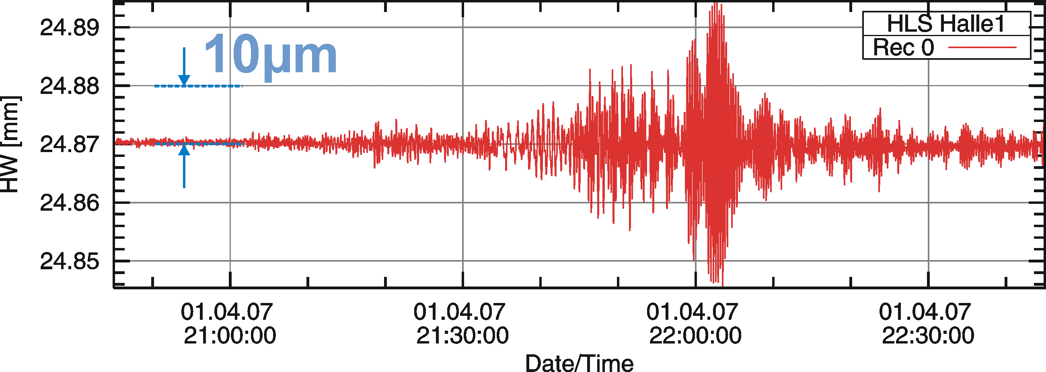
Hydrostatic Leveling System (HLS)
HLS for vertical position determination of accelerator components using ultrasound.
PETRA III: 130 metering points in operation for 1.5 years. Achieved accuracy: ~1µm.
Full system delivered.
Earthquake at the Salomon Islands
CE certified
HLS Prototype

Slide 12
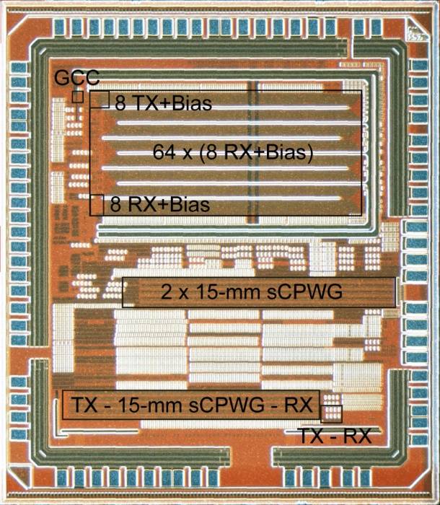
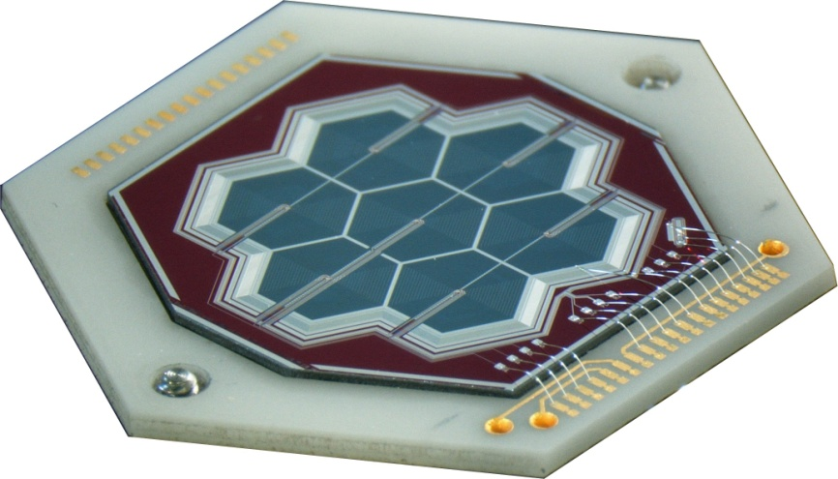
ASIC Development and Microelectronics
Analogue, digital and mixed-signal Circuits
CADENCE
130 nm CMOS process by IBM
350 nm BiCMOS process by AMS
Assembly, Interconnection and Packaging
Various bonding techniques
Quality assurance (pull, electrical, optical test)
3D-packaging
Characterization
Probe station based ATE system
Measurement equipment up to 20 GHz

Slide 13
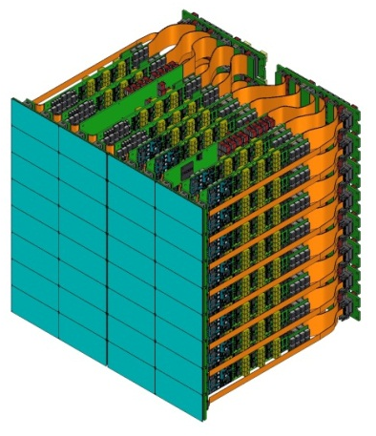
Hybrid Module and System Design
XFEL Pixeldetektor DSSC:
24,1 x 25,1 x 22,4 cm3
32 Sensoren (128 x 256 pixel)
256 ASICs.
FEC: 64 x 64 channel ADC
8 x 8 channel ADC
prototype ASIC

Slide 14
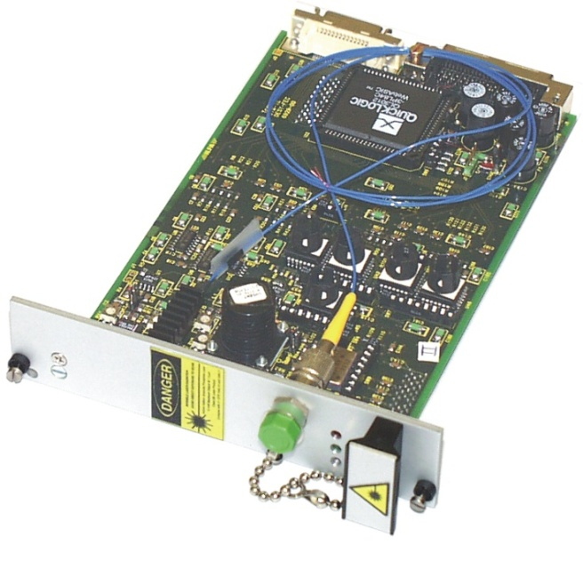
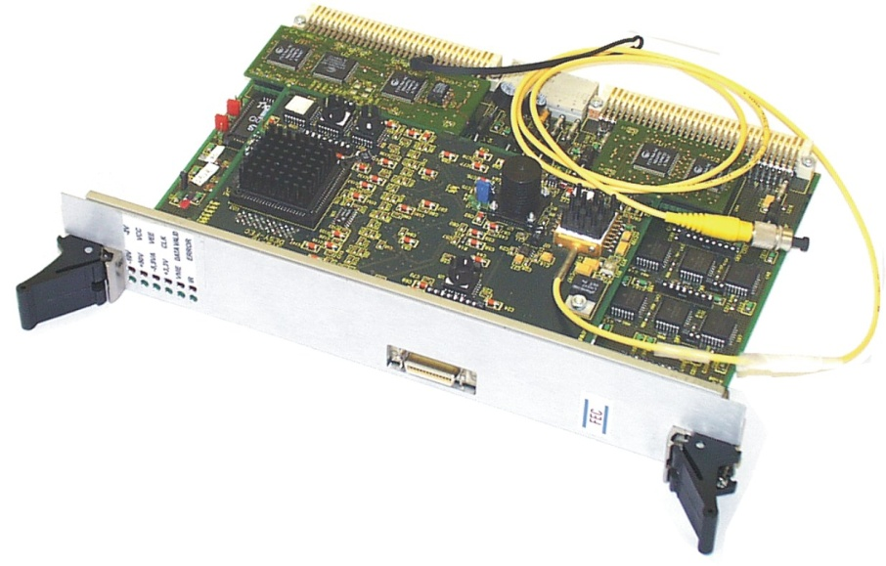
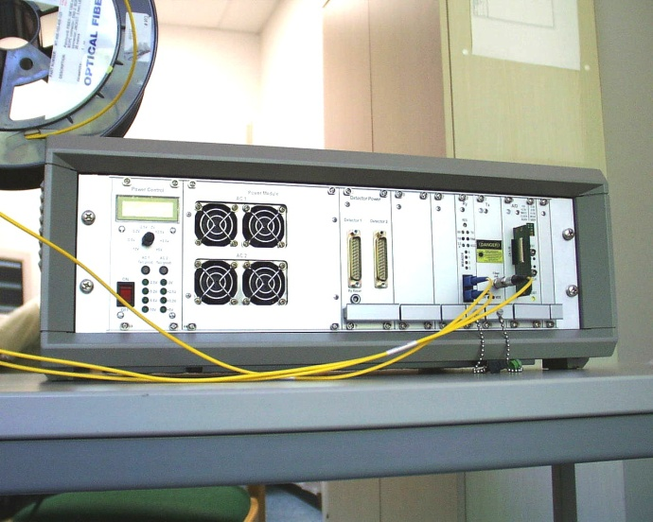
Optical data transmission system
Data transfer in a Silicon-Drift-Detector setup (for HASYLAB in 1998).
Data Rate: 2.5GBit/s
Channel-Coding, multiplexing of data, laser-biasing, clock -and data recovery in dedicated functional blocks.
Tested up to 20km with BER < 10^(-13)
Tx
Rx

Slide 15
Optical data transmission system
Analogue, optical data transmission
Temperature sensitivity (temperature control necessary?).
Settling time of optical signal fast enough?
Radiation induced degregation of optical power. Lifetime limited by radiation. Channel-to-channel variation of optical power.
No ADC in front-end
Digital, optical data transmission
Needs more space in front-end (ADC, channel coding)
High data-rate, “no” temperature problems. Lifetime limited by radiation.
Many channels can go through single fiber (WDM) to back-end.
Electrical transmission
Galvanic separation has to be set up, EMC (sens. detector) has to be considered.
Moderate data rate possible.

