Slide 1
BCM1F: what would be needed
Beam-gas monitoring
Lumi measurement
After-glow measurement

Slide 2
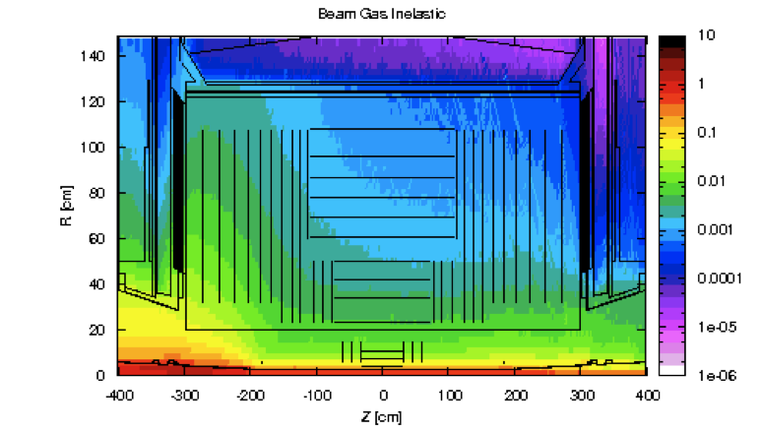
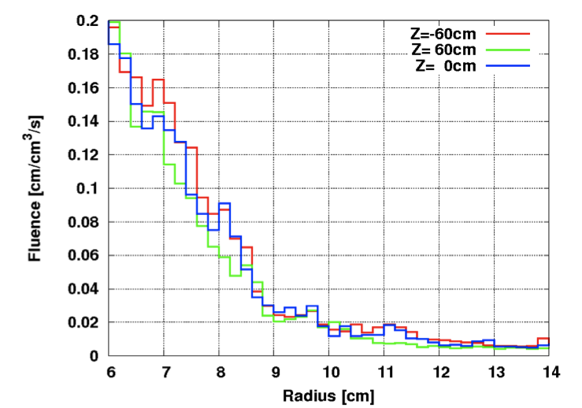
Beam-gas monitoring
Cut-off
Primary beam-gas interactions occur all along LSS5, those reaching UXC55 mostly from the triplet area.
Subsequent interactions of primary products may shower in the inner part of the CMS detector.
The result is a clearly collimated event on the incoming side, opening up in the CMS magnetic field as it moves forward to the opposite side
Data and simulations agree very well in conveying this picture
The order of magnitude of beam-gas rate is a few Hz per 1E11 protons in the machine

Slide 3
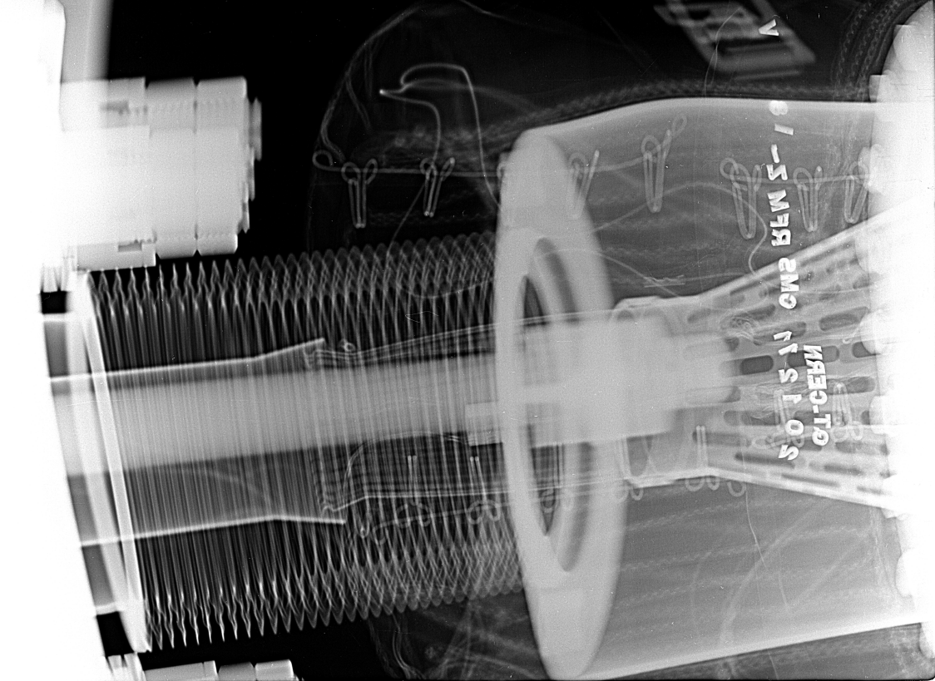
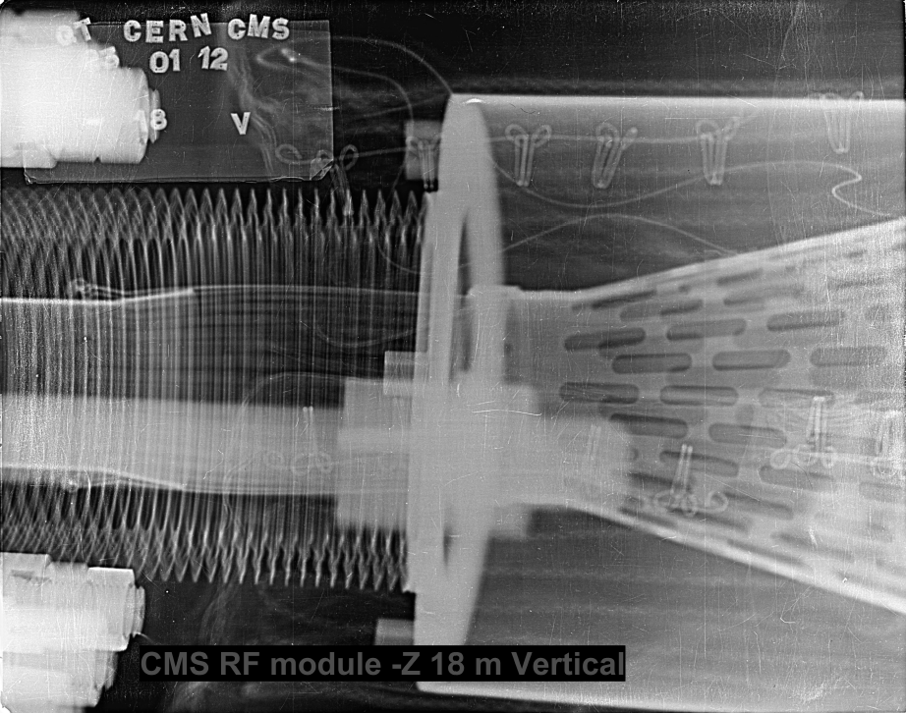
Beam-gas monitoring
It is very important to be able to properly monitor beam-gas rate (and in general beam induced background) as it allows us to monitor the quality of the beam and diagnose possible pathological beam conditions.
No better example can be given than the RF fingers issue at -18.3m from IP5. The capability of monitoring beam-gas with BCM1F and correlate it with vacuum gauges measurements has been instrumental in correctly diagnose the nature and location of the problem. We were suspecting our vacuum spikes may be induced by sparking in that region well before any x-ray was taken (in other places of the machine), showing this was indeed the probable mechanism.
DEC 20 2011
JAN 20 2011

Slide 4
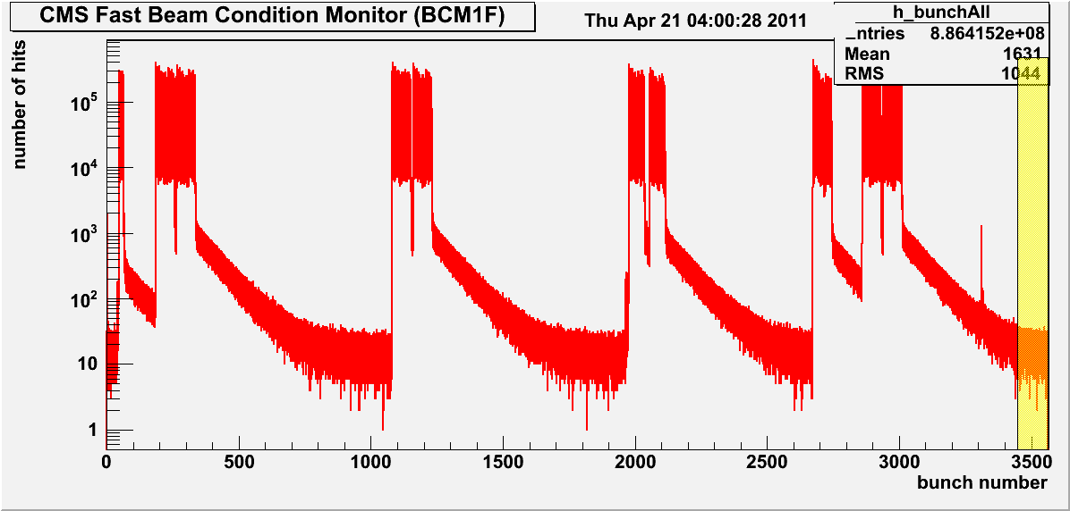
Beam-gas monitoring
For properly monitor beam-gas events, two main issues have to be taken into account:
Collision products
Afterglow
In 2012, in order to avoid the spoiling effect on the measurement due this, a special trigger was setup masking out all hits on BCM1F except those falling in a small time window in coincidence with:
Non-colliding bunches (no contribution from collision products)
Far away from last collision (minimize the contribution from afterglow)
R.Walsh,
TDC data
colliding
Non-colliding

Slide 5
Beam-gas monitoring
Need to mitigate as much as possible both spoiling factors:
Not necessarily will continue to have non-colliding bunches for all future filling scheme.
The requirement of being “far away” from previous collision may become more difficult to fulfill.
Being able to measure the beam-gas content for colliding bunches would allow for much higher statistics (factor of 1000!)
This can be done by exploiting the fact that beam-gas products will reach the incoming BCM1F about 12.5ns before collision products do.
Above scheme works if diamonds have a FAST signal output (~1ns) and a FAST back-end electronics for precise gating and timing.

Slide 6
Beam-gas monitoring
Fast output signals allows for distinguishing signals from beam-gas (arriving precisely at -12.5ns from collision) avoiding pile-up effects from the “continuum” falling afterglow background.
The challenge is to be able to well separate a few Hz/1E11 of beam-gas rate from a background of a few KHz.
Having a separate signal from each diamond (instead of the presently implemented OR of 4 from same side) is an advantage
Separate diamonds might give us a hint on the r/phi distribution of the beam-gas products (hints from the Pixel detector and MARS simulations show a possible elongated shape)
Time coincidence of more than 1 diamond could be used to enhance the signal (we might be learn something more this year).

Slide 7
Luminosity Measurement
Presently, online luminosity measurements are done using a special readout chain (which accumulates histograms at 40Mhz from individual towers) from the HF calorimeter.
Offline absolute calibrations are carried out during VdM scan by precisely measuring the beam size (and current):

Slide 8
Luminosity Measurement
A number of offline crosscheck algorithms are currently used to verify the consistency and stability of the HF luminosity measurement:
Vertex counting and zero vertex counting
Tracking counting and zero track counting
Pixel cluster counting
2011 run period exposed quite a few issues with HF as luminometer:
Non linearity as a function of pile-up (instantaneous luminosity)
Need for afterglow correction
Gain drift vs time
These problems were detected, quantified, and corrected by using the rate for pixel clusters in zero-bias events.
Owing to this heavy dependence on pixel cluster counting, and the delicate nature of the corrections, the lumi group decided that in order to achieve a lower systematic error, we should base our offline normalization directly on the pixel cluster counting.

Slide 9
Luminosity Measurement
The plan is to use the newly built PLT as our main online luminometer after LS1. 4+1 telescopes have been installed around the CT2 pipe during this YETS and the hope is to verify and exercise these capability already in 2012 running.
Nonetheless, online relative luminosity measurements would also be a desirable feature of BCM1F.
In this case, precise recording of all collision product hits (or absence of, if zero counting) bunch by bunch (40 MHz) need to be established.
In order to achieve a good luminosity measurement a certain number of detector properties need particular attention:
Good to excellent detector efficiency
Good uniformity of response amongst the different diamonds
Good stability of detector parameters vs time and radiation damage.
Multiple hit recognition capability (for hit counting algorithm) might also be desirable. Perhaps not a significant issue for BCM1F given the low acceptance.
In situ calibration procedures to establish/correct relevant detector parameters.

Slide 10
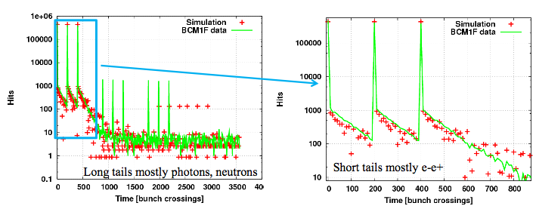
Afterglow Measurement
For a correct determination of both the beam-gas rate and luminosity, BCM1F needs to be able to cope with the afterglow rate.
Afterglow depends on: instantaneous luminosity, time after collision, collision rate (number of injections, filling scheme).
Simulated by S.Muller with Fluka.

Slide 11
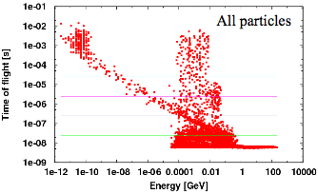
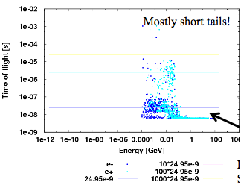
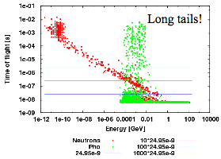
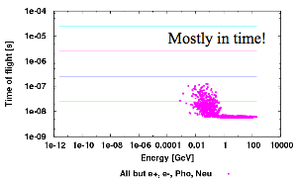
Afterglow Measurement
Two major components identified:
Very long component (mostly neutrons)
Very short component (mostly electrons)
More on S.Muller thesis
electrons
neutrons
others

Slide 12
Afterglow Measurement
For each measured point (whether for lumi or for beam-gas) a proper “before” and/or “after” count of the albedo component need to be implemented so that a proper “pedestal” value can be subtracted.
For beam-gas measurement, it would still be beneficial to have non-colliding bunches away from collision, as it may be used as reference for an almost afterglow free value.

Slide 13
example
Colliding train
Width needs sharpening
Looking for beam-gas signal exceeding the afterglow background here
DA
EB
Non-colliding B1
C
B
A
…..
A
B
C
D
<-Beam2
…..
Beam1->
D
C
B
A
Beam-gas interaction products are visible also for the first colliding bunch as it arrives at BCM1F ~12ns before collision products
C
D
D-gas
t0
t0+11ns
Beam2 A-bunch
Beam1 D-bunch
Z=0
~12ns
Z=1.8m
4/21/11

