Slide 1
Integration of BCM1F in CMS
Maria Elena Castro Carballo
Workshop on Fast Beam Conditions Monitoring
DESY-Zeuthen 1st February 2012

Slide 2
Contents
BCM1F within the CMS BRM and brief description of the sub-detector
Description of the DAQ chain
Delivered information to the CMS and LHC control rooms
Status of BCM1F and operation conditions for the 2012 LHC restart
Conclusions

Slide 3
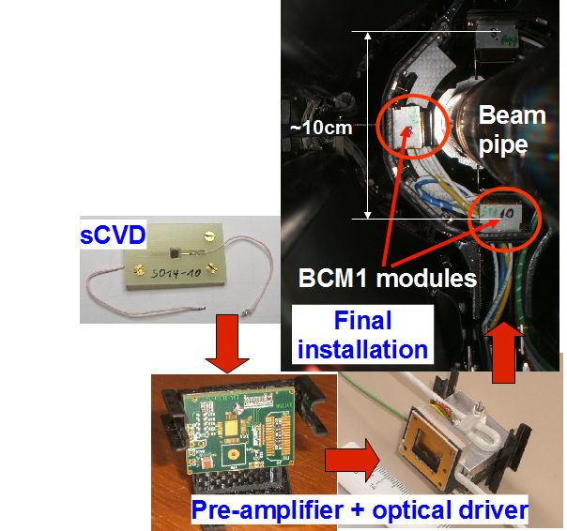
Description of the CMS Fast Beam Conditions Monitor (BCM1F)
  Particle detector with nanosecond time resolution measuring
  the beam halo particles, beam-gas interaction, and collision products
  Tasks:
Monitoring and protection
BKGD1 (total flux in the inner detector region) to LHC
BKGD2 (beam halo flux) to LHC
Instant luminosity to CMS
  Requirements:
Detection of MIPs
Low power and radiation hardness
  Design:
  4 Single Crystal Chemical Vapor Deposition
  (sCVD) diamond sensors (5 x 5 x 0.5 mm³)
  in 4 modules at Z=  1.8m (~6.25ns)
  on both sides of the CMS IP, r < 5 cm

Slide 4
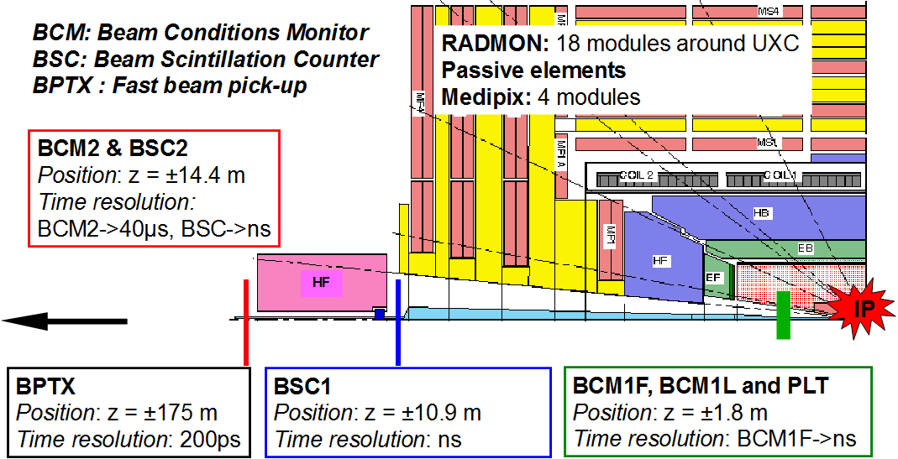
BCM1F and BRM subdetectors in CMS
CMS half cross section

Slide 5
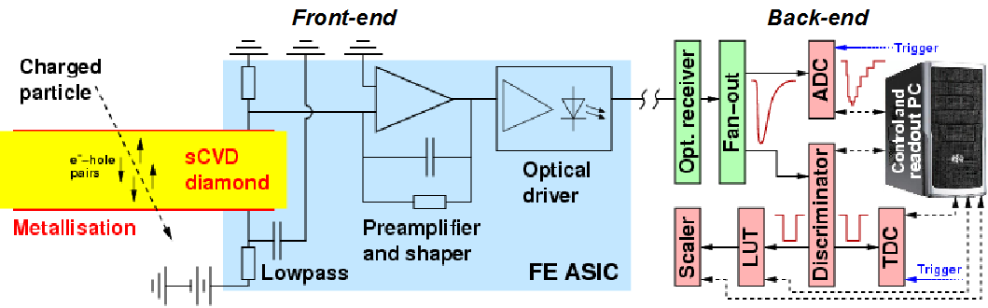
BCM1F components
Front-end: metallized sensors operate as solid state ionization chambers.
A charge sensitive pre-amplifier collects the induced charges and shapes a proportional signal that is transmitted to the counting room as analog optical signal.
Back-end: the optical signal is converted into electrical signal and is processed
and stored independently of the CMS DAQ framework. The main data-acquisition devices are: scalers, ADCs, TDCs and LUT (FPGA)

Slide 6
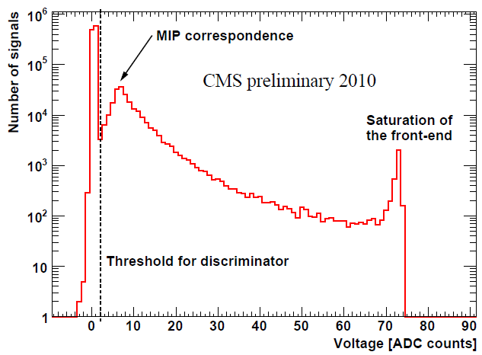
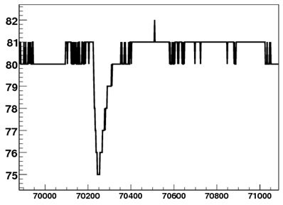
Signal sampling with the ADC
The sensor signals are digitized in a VME CAEN v1721 flash ADC.
DAQ is regularly done with test pulses, non colliding beam and colliding beam for characterization and maintenance of the 8 channels: baseline monitoring (running permanently), SNR estimation , FEE radiation damage…
Baseline
ADC counts
Pulse height
For a detailed information, follow the
talk of Olga Novgorodova „ADC analysis and aging“

Slide 7
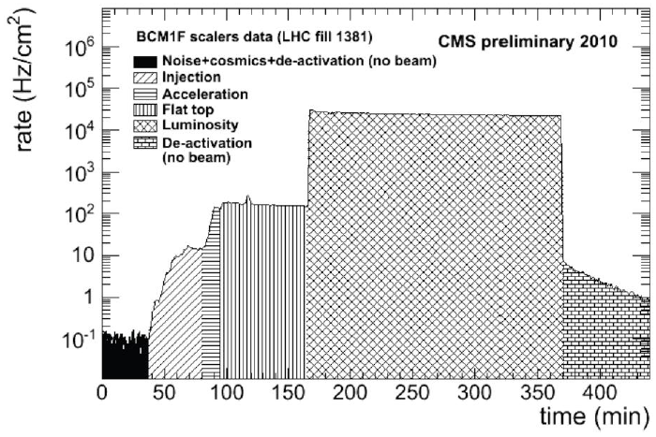
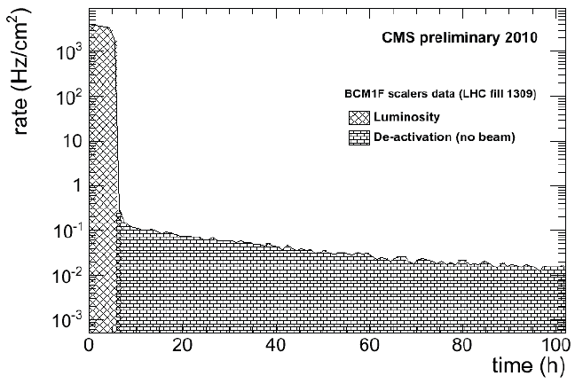
Particle rates
Discriminated sensor signals are counted in a CAEN v560B scaler and forwarded to LHC as BCKD1 (flux in inner detector region).
A longer deactivation tail of ~40 h
is also observed
After dump of high intensity beam, the rates drop
exponentially for ~34 min due to de-activation of
material around BCM1F

Slide 8
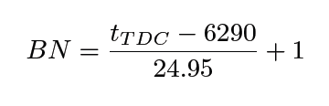
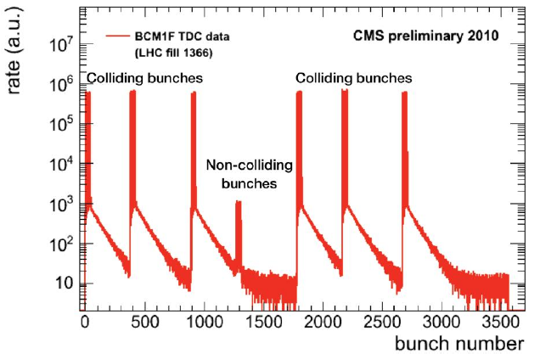
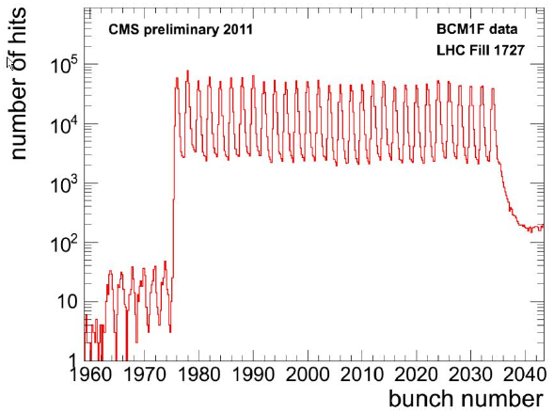
Time information
Discriminated sensor signals are time digitiyed by a multi-hit VME TDC CAEN v767 board with 0.8ns resolution using the LHC orbit as reference.
Using the arrival time distribution of the hits, the bunch number identification is done and forwarded to the CMS control room:
Bunch ID plot
Zoom in 50ns bunches
„Albedo“
effect
tails
2.12 ~μs
Colliding bunches
Non-colliding bunches
For a detailed information, follow the
talk of R. Walsh, A. Bethani „TDC results“
For a new concept on bunch ID, see talk
by M. Penno „Arrival time histogramming unit “

Slide 9
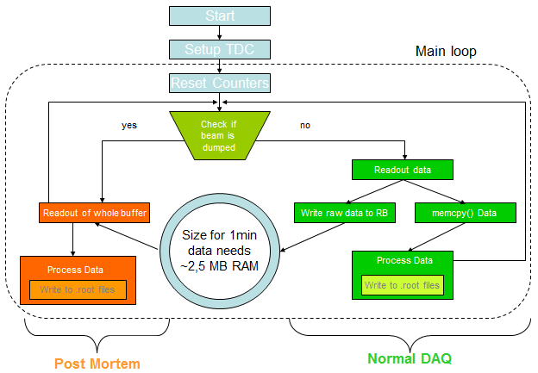
Additional features of the DAQ chain
Software Ring Buffer in TDC:
The readout of the TDC data and the analysis are 2 independent processes.
The readout stores data in a RB. In case of beam abort, the past record of beam conditions will go for the post mortem analysis.
Look Up Table (CAEN v1495):
The v1495 module is a user-programmable I/O and logics block. The functionality depends on configuration data stored in a non-volatile memory, which is contained in the module.
Current task in the chain: back to back coincidences, semi hardware TDC VETO, Beam Abort detection, 1sec scalers gate, veto of Start signal and software switchable options.
By Hans Henschel
By Konstantin Boyanov, DESY

Slide 10
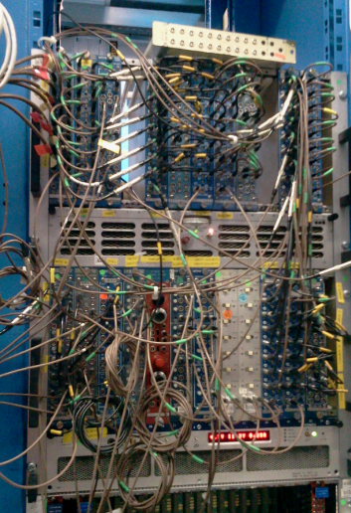
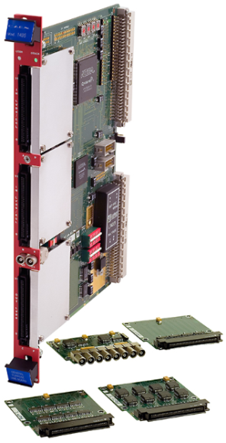
CMS beam halo & beam-gas flux measurement (BKGD 2)
Since August 2011, BCM1F provides normalized beam halo and beam
gas flux to CMS and LHC using rates of non-colliding bunches corrected for the „Albedo“ effect.
The algorithm gates non-colliding bunches of Beam 1&2 using BPTX and subtracts
Albedo rates counted before non-colliding bunches.
Current logic is based on NIM modules but the replacement by FPGA based single
board is ongoing.
More details in talk by H. Henschel
„FPGA module for gated counting “
Hans Henschel
D. Stickland, N. Bacchetta, A. Dabrowski

Slide 11
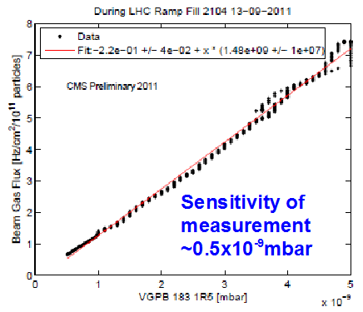
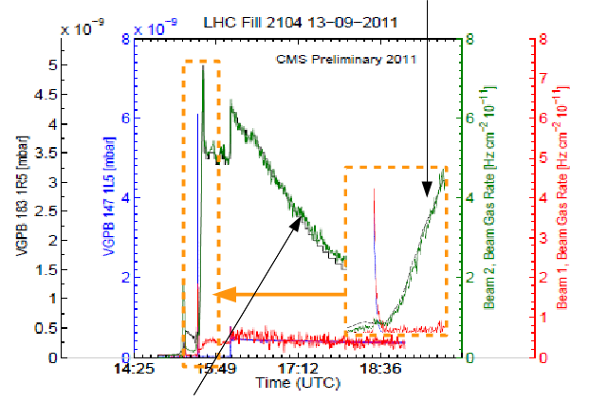
Correlation of beam-gas rates and vacuum pressure
During the LHC ramp, an increase in vacuum
pressure on the left side of CMS measured
by the vacuum gauge VGBP 147 1L5 is followed
by an increase of beam1-gas flux. Later, the same
happens for beam 2 on the right side of CMS
The correlation of the normalized beam-gas measurement for beam 2 with the vacuum pressure measured by the vacuum gauge VGPB 183 1R5 during the ramp, confirms that the particle flux is dominated by beam-gas interactions.
Better vacuum conditions, especially
on the right side of CMS during the fill,
and the reduction beam 2 beam-gas flux

Slide 12
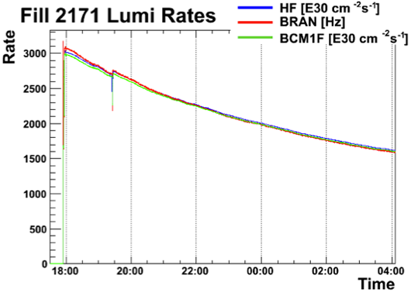
Instantaneous luminosity monitor
The BCM1F count rates are proportional to the HF instant luminosity. Since BCM1F is decoupled from the central CMS DAQ it provides instant online luminosity even when HF lumi is not available.
The BCM1F +Z and -Z signals for
colliding bunches are given by a
12 ns gate provided by BPTX.
Assuming HF is perfect, a BCM1F
lumi calibration factor is calculated.
Studies are still on going to
correct the non-linearities and
to extract bunch by bunch
luminosity.
For additional information follow
N. Odell talk: “Bunch-by-bunch luminosity measurement”

Slide 13
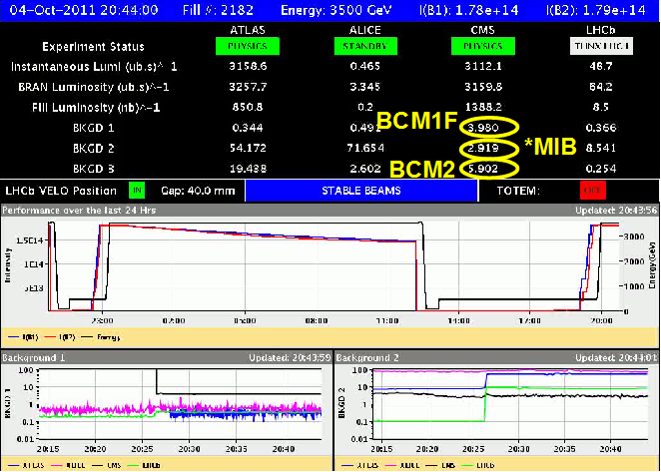
Feedback to CMS and LHC
All our measurements are available in CMS control room.
Published background numbers indicate normal/safe operation.
Based on these numbers pixel and tracker decide in the beginning of a fill if they will switch on their detectors.
They are an indication for the LHC control room about beam quality.
Background 1
Background 2
CMS in black
*MIB: Machine Induced Background

Slide 14
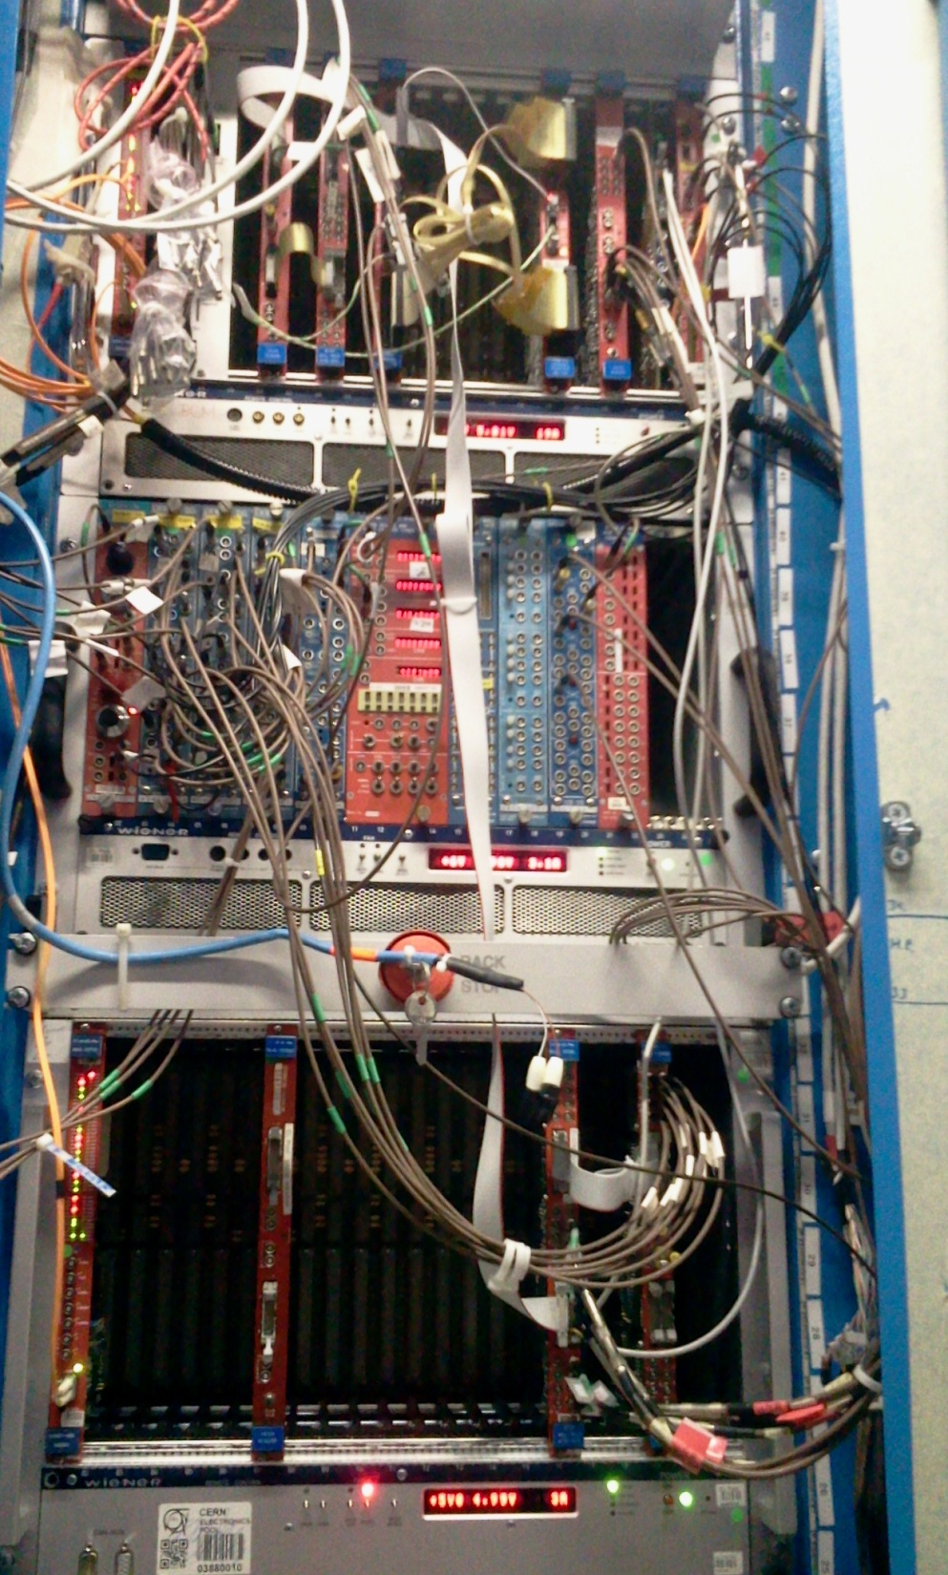
DAQ setup for 2012 LHC restart:
Daisy chained VME crates
With the increase of Luminosity, since summer 2011 we observe some coupling in the operation of TDC and scalers.
The result is an increase of the scalers rates when TDC readout errors appear.
In order to discard an alteration in the discriminator thresholds due to the high data transfer of the TDCs, a daisy chain scheme was implemented and the discrimininator board was inserted into a 2nd VME controlled by same PC.

Slide 15
Summary
The BCM1F, has been used as a fast beam conditions monitor since the LHC restart in autumn 2009.
It became a key tool in the CMS BRM system by giving valuable beam information: background 1, background 2, instantaneous luminosity, bunch identification (with observation of Albedo effect).
New measurement algorithms and devices are being developed in order to improve and simplify the back end scheme currently used for the calculation of the mentioned numbers.
Due to the good results obtained with the 8 BCM1F sensors so far, the LHC ring is being equipped with additional scCVD diamonds that will operate as BLMs. First results are promising (See talk of M. Hempel on “Data analysis for BCM1F4LHC”).
Thanks to the BRM crew for helping with BMC1F preparation for 2012 LHC run!

