Slide 1
BCM1F 4 LHC Status and Challenges
Bernd Dehning
CERN BE/BI
Histograming of loss events synchronous with revolution period
Event triggered beam loss measurements
BCM1F 4 LHC upgrade considerations
Loss electronic developments at CERN

Slide 2
HERA Scraping Beam with Wires
Inner wire
wire ~ 4 sig
begin fill
HERA
  Bunch spacing 96 ns
  Samples taken every 21 ns
No coasting beam halo
  3 samples with zero intensity (left, top)
Partially coasting halo
  Inter bunch samples measure intensity (left, middle)
Only coasting halo
  No observation of bunch structure
  (left bottom)
Strong coasting component at begin of fill (centre top)
Bunched halo only minutes later (centre, middle)
With retracted wire diffusion of coasting component into cleaned area (centre bottom), SPS?
Effect caused by RF system noise, faulty amplifier
Outer wire
wire ~ 4 sig
4 min later
Halo Intensity
Outer wire
wire ~ 6 sig
wire retracted

Slide 3
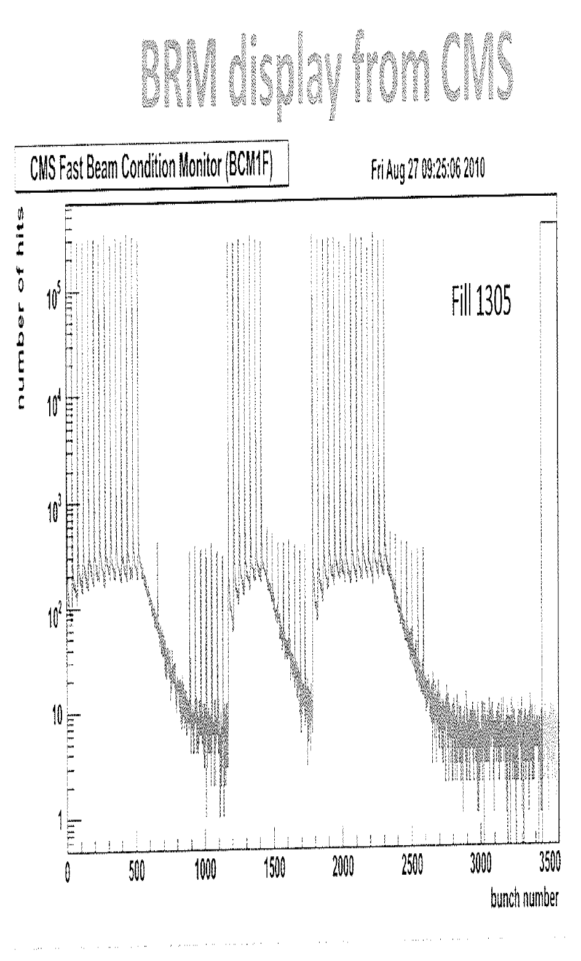
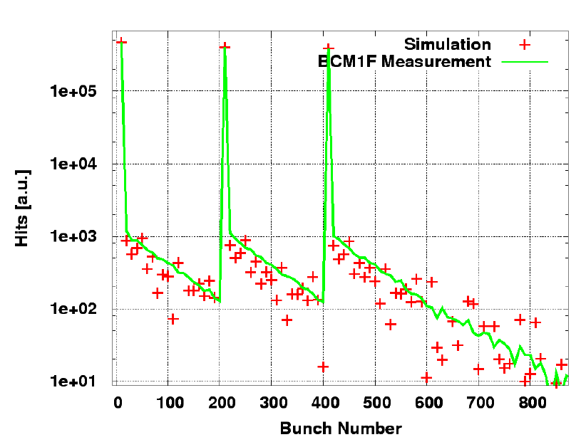
Diamonds Signal over Threshold and Arrival Time Histogram
Non
colliding
bunche
Empty
bunch
region
Courtesy S. Mueller
bunch number
Measurement of bunch filling scheme
with high dynamic range
Model reproduces measurements

Slide 4
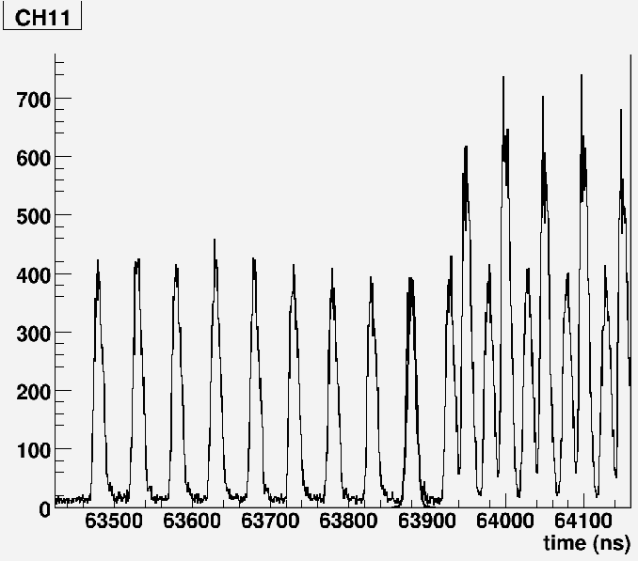
Arrival Time Histogram from Losses downstream of Collimator
Measurement set up allows details study of loss origin
Counts
Losses from beam and interaction debris from the LHCb experiment
Losses from beam approaching the LHCb experiment
25 ns bunch spacing

Slide 5
BCM1F2LHC
Halo from ARC and debris + halo from experiment, both beams
LHC P5
Different combination of losses at different location will allow halo formation studies
ARC halo is measured by detection of shower particles originating from collimator proton impact
Debris detected by shower particles originating form vacuum chamber aperture limitation
LHC P4
Only halo losses (no debris from collisions)
CERN Prevessin (865)
Halo (B1) from ARC and debris from experiment + halo (B2)
LHC P8
LHC P2
Halo (B2) from ARC and debris from experiment + halo (B1)

Slide 6
BCM1F4LHC Topology
LHC P5
Conceptional considerations
Amplifier near to the detector (sCVD)
=>
fast signal amd low noise
Optical signal transmission
=>
almost no cable lenght limitation
=>
concentration of signal acquistion at one location (Prevessin 865)
Radiation tollerant design
=>
placement of the detectors near to the loss location
LHC P4
Slow control: HV, low voltage, test pulse locally with Ethernet multi purpose ADC – DAC unit
CERN Prevessin (865)
LHC P8
LHC P2
Centralised acquisition: VME crate, CAEN module, LINUX PC

Slide 7
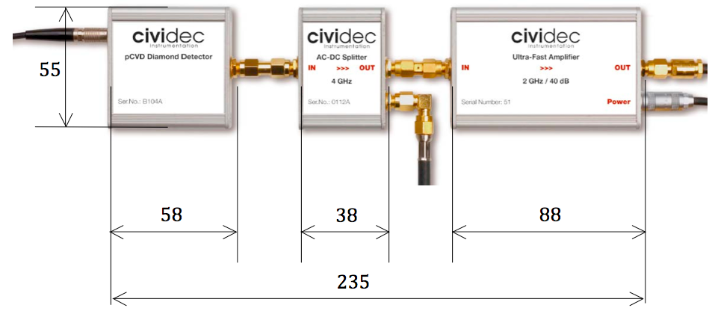
4 Diamond BLMs for Observation at LHC (event triggered)
ATS/Note/2011/048 (TECH), B. Dehning et al.
Chemical Vapor Deposition (CVD) diamond
IP7 collimators (TCP) – one per beam
    All sizable local losses are also seen at collimators
Injection regions – one per beam
40 dB amplification
2 GHz upper limit
Dose up to 1 MGy
Risetime 180 ps
Pulse width 300 ps
Fall time 400 ps
SNR of 5 with 1.6 fC
Courtesy E. Griesmayer

Slide 8
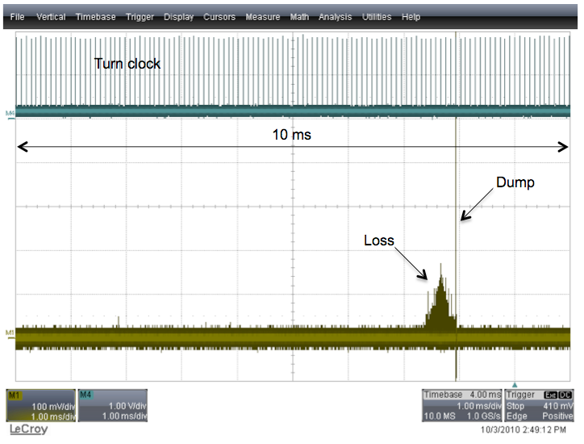
LHC: 152 bunches, 150ns bunch spacing (3/10/2010 12h48)
Loss signal
loss due extraction
kicker imperfection
due to macro particle collision
Time
Notes:
Figure
25:
The
10
ms
buffer
(1
ms/div)
shows
the
characteristics
of
the
event
and
the
turn-­clock
signal
of
LHC
(89.2
us).
The
dump
causes
a
high
pulse
at
the
end
of
the
loss
pattern.

Slide 9
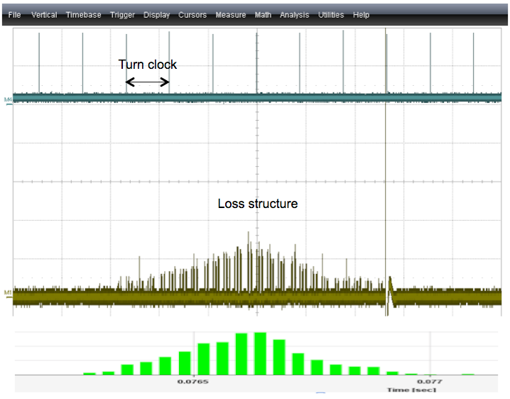
LHC: 152 bunches, 150ns bunch spacing (3/10/2010 12h48)
Loss signal
Diamond signal
Ionisation chamber
(40 us integration time)
Time
Notes:
Figure
26:
Zoom
factor
101
(100
us/div):
the
time
structure
of
the
bunch
trains
can
be
estimated.
The
corresponding
measurement
from
the
ionization
chambers
is
shown
at
the
bottom
and
shows
an
excellent
agreement
between
the
DBLM
and
the
ionization
chambers.

Slide 10
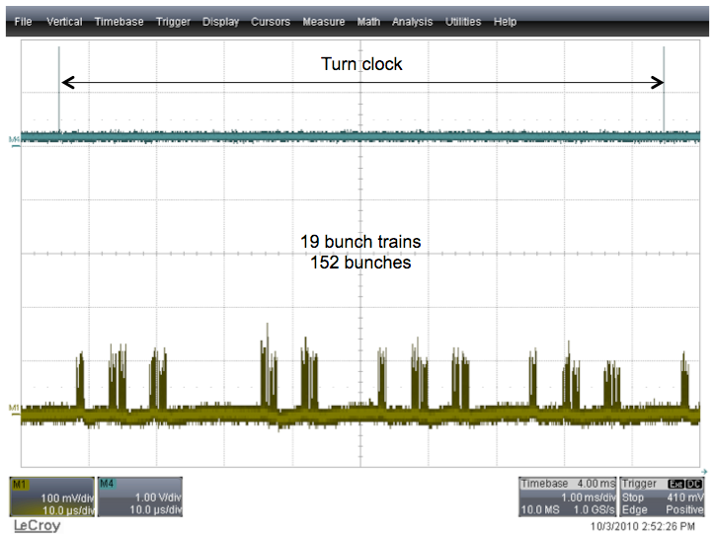
LHC: 152 bunches, 150ns bunch spacing (3/10/2010 12h48)
Loss signal
Time

Slide 11
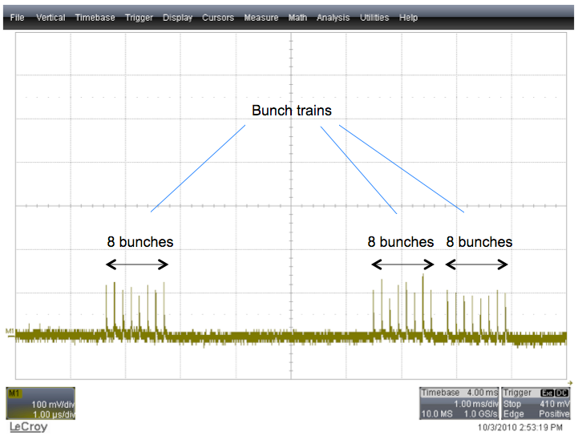
LHC: 152 bunches, 150ns bunch spacing (3/10/2010 12h48)
Loss signal
Time

Slide 12
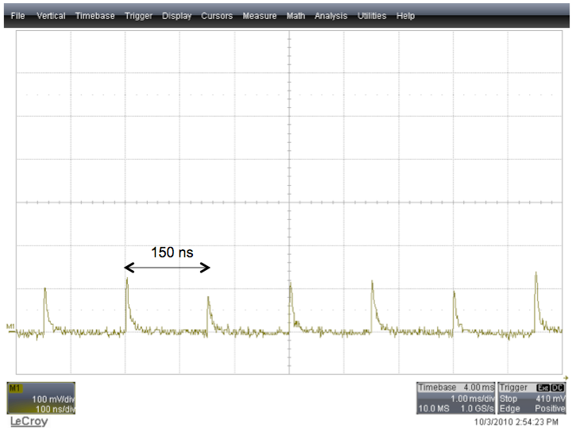
LHC: 152 bunches, 150ns bunch spacing (3/10/2010 12h48)
Loss signal
About 20 particle per pulse
Time

Slide 13
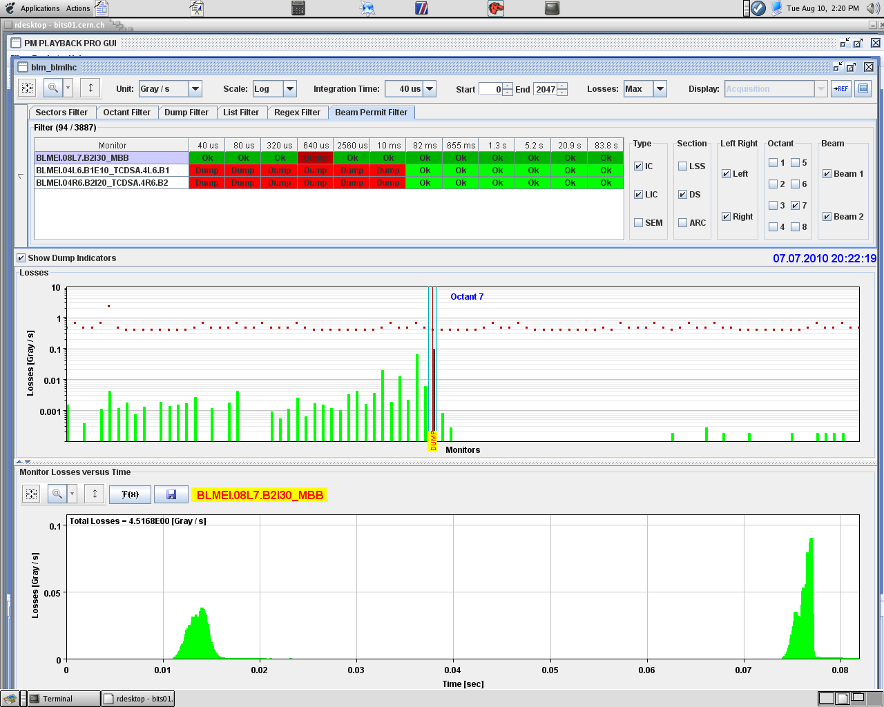
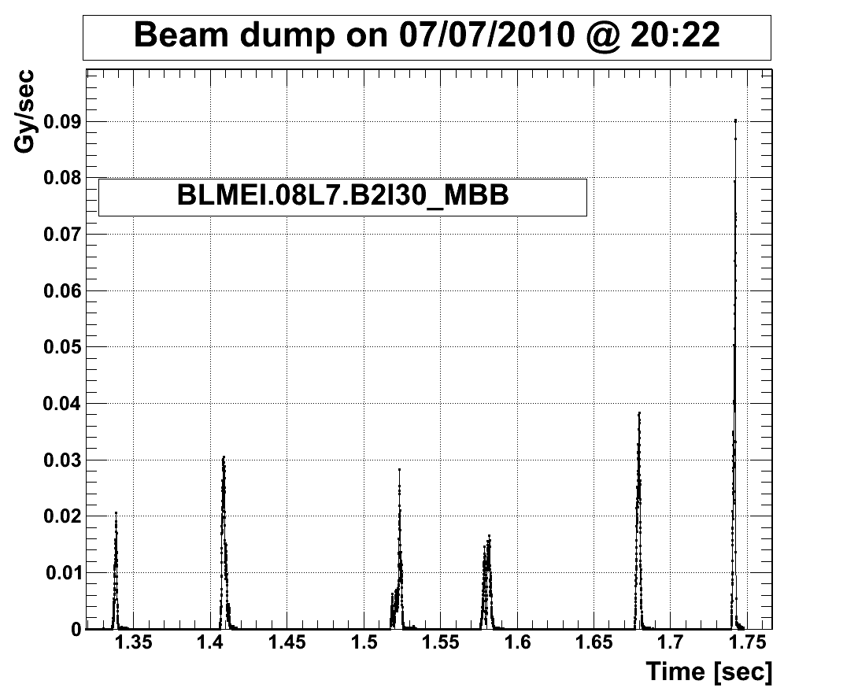
Post Mortem Data (some examples)
Loss in a bending magnet
PM application: BLM data of 0.082 sec
online available
Longer PM buffer: BLM data of 1.72 sec
offine available
BEAM
43000 values (40 us)
Monitors
2000 values (40 us)
Time

Slide 14
BCM1F4LHC Upgrade Considerations
Keep topology like implemented
Time over threshold detection in front end will allow:
  histograming synchronous to revolution period of MIP events
  Pulse high spectrum analysis (dynamic between 2 to 3 orders of magnitude)
  Detection of rare multi MIP signals (dynamic between 2 to 3 orders of magnitude)
  Digital signal transmission
Reduction of peaking time (higher double pulse resolution, lower MIP detection jitter)
Use GBT for transmission
Data acquisition in single FPGA directly connected to optical fibres
Thresholds setting done by slow control unit locally using Cu cable

Slide 15
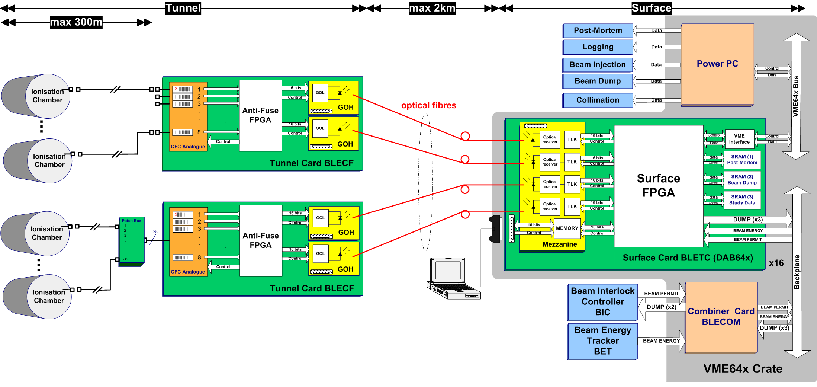
The BLM Acquisition System (Experiments and LHC)
Range 1 pA to 1 mA
Radiation tolerant to 500 Gy
SEE tested
Analog front-end FEE
Current to Frequency Converters (CFCs)
Analogue to Digital Converters (ADCs)
Tunnel FPGAs:
Actel’s 54SX/A radiation tolerant.
Communication links:
Gigabit Optical Links.
Real-Time Processing BEE
FPGA Altera’s Stratix EP1S40 (medium size, SRAM based)
Mezzanine card for the optical links
3 x 2 MB SRAMs for temporary data storage
NV-RAM for system settings and threshold table storage
New: direct Ethernet read out at front and back-end foreseen

Slide 16
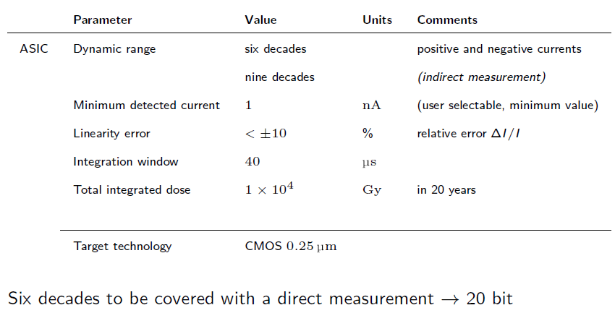
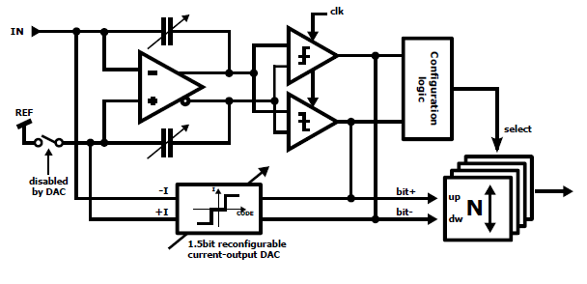
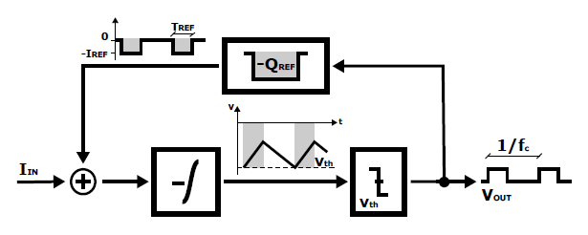
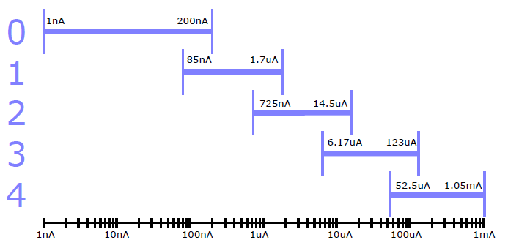
Advanced Current to Frequency Converter Principle
LHC current to frequency converter:
only positive signals (limitation in case of signal under shoots)
500 Gy radiation tolerance
Reference current source
Integrator
Comparator
f = I_{input} / (I_{ref} * T_{ref})

Slide 17
Advanced Current to Frequency Converter Principle
LHC current to frequency converter:
only positive signals (limitation in case of signal under shoots)
500 Gy radiation tolerance
Reference current source
Integrator
Comparator
f = I_{input} / (I_{ref} * T_{ref})

Slide 18
Advanced Current to Frequency Converter Principle
LHC current to frequency converter:
only positive signals (limitation in case of signal under shoots)
500 Gy radiation tolerance
Reference current source
Integrator
Comparator
f = I_{input} / (I_{ref} * T_{ref})

Slide 19
Advanced Current to Frequency Converter Principle
LHC current to frequency converter:
only positive signals (limitation in case of signal under shoots)
500 Gy radiation tolerance
Reference current source
Integrator
Comparator
f = I_{input} / (I_{ref} * T_{ref})
Development for LHC BLM system upgrade, optical link GBT

Slide 20
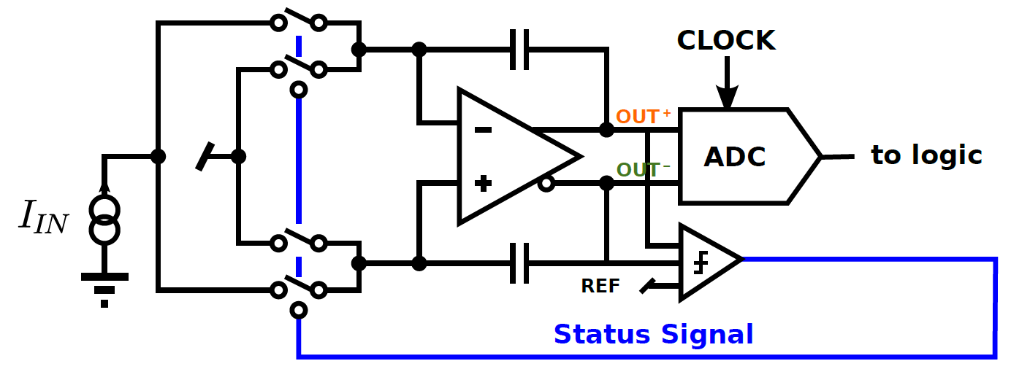
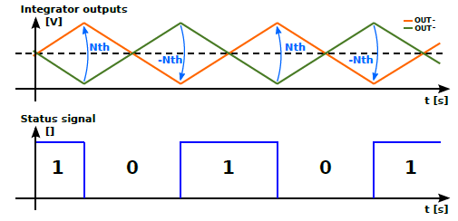
Fully Differential Current to Frequency Converter Principle
Discrete components: not radiation tolerant
Specifications:
  Dynamic range 7 orders integration window 2 us 1nA to 200mA
  Dynamic range 9 orders integration window 1 s
  10pA to 200mA
A status signal selects in which branch of a fully deferential stage the input current is integrated.
Two comparators check the differential output voltage against a threshold, whenever is exceeded, the status signal changes to the complementary value (0 ! 1 or 1 ! 0) and the input current is integrated in the other branch.
Input switch
Fully differential Integrator
Development for injector BLM system upgrade, optical and Ethernet link

Slide 21
Fully Differential Current to Frequency Converter Diagram
Input 50 ohm resistor split in two: 47 + 3 ohm
Re-routing on the ADC buffer amplifier
ADC
input
shunt
resistor
switches
ADC shunt or
CFC operation
CFC
switches
for CFC

Slide 22
Fully Differential Current to Frequency Converter Diagram
Input 50 ohm resistor split in two: 47 + 3 ohm
Re-routing on the ADC buffer amplifier
ADC
input
shunt
resistor
switches
ADC shunt or
CFC operation
CFC
switches
for CFC

Slide 23
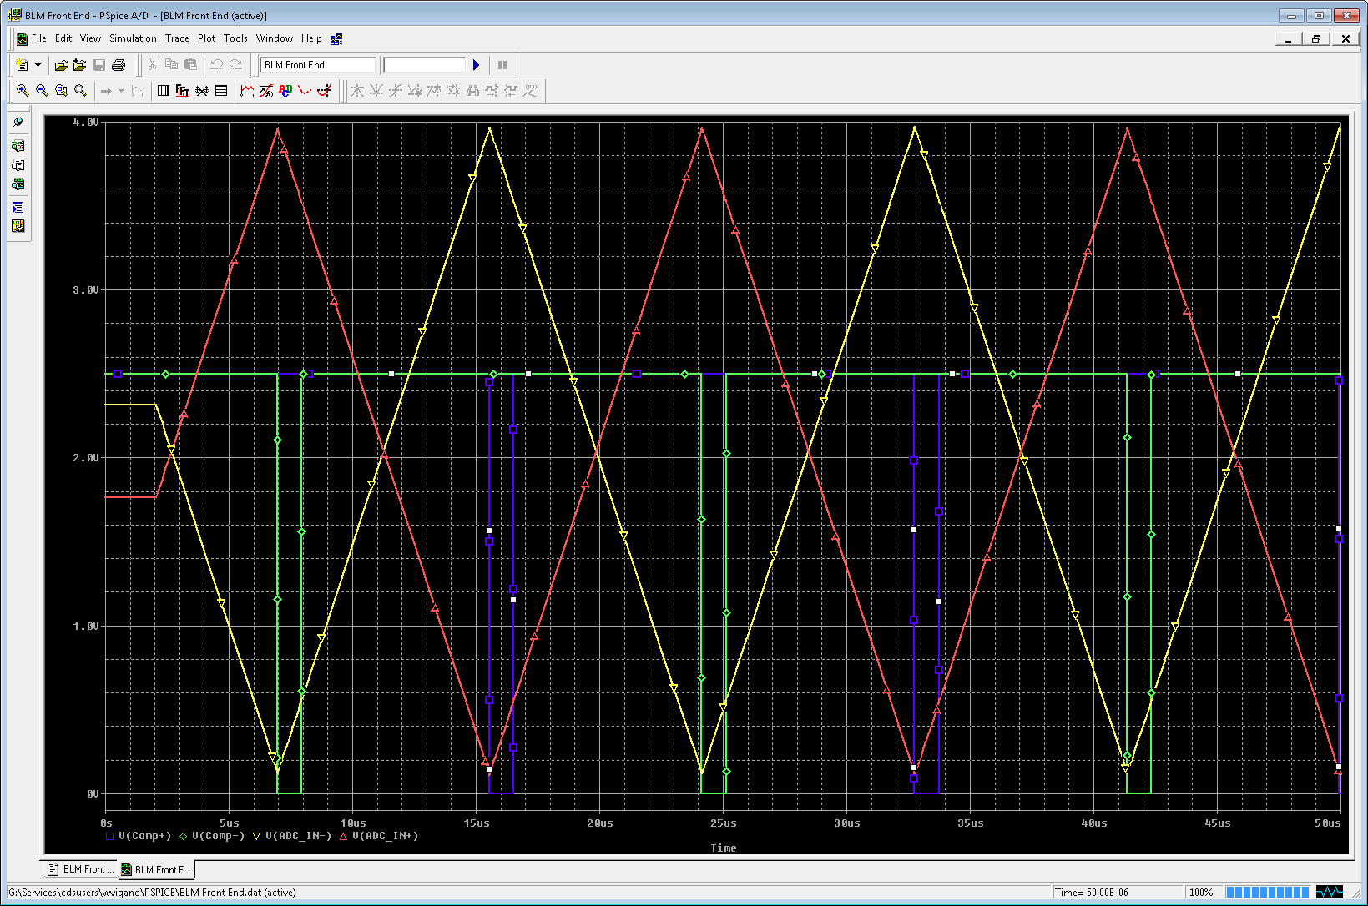
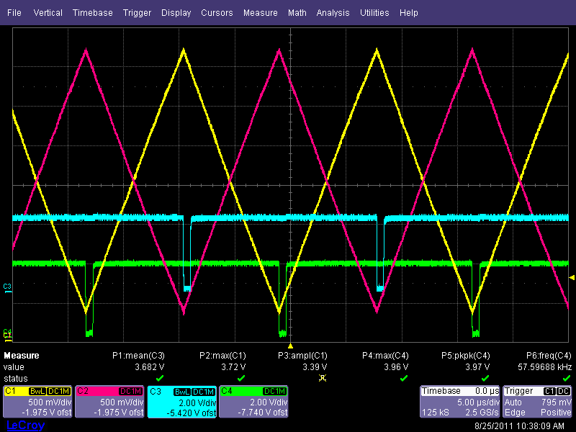
Fully Differential Current to Frequency Converter
Top: PSpice simulation of CFC part of circuit
Bottom: first PCB circuit results
To be used for the beam loss system in the CERN pre-accelerators

Slide 24
Acquisition System Specification for Diamond Signal
Two data sets should be available:
Signal versus time
Number of signals over threshold versus arrival time
Next project: compact diamond signal
acquisition system; industries - CERN
Detector
Pulse | Amplitude | Max. | 2 | V
 |  | Min. | 1 | mV
 | width |  | 5 | ns
 | time jitter |  | 1 | ns
 | noise level | below | 1 | mV
Double pulse resolution |  |  | 20 | ns
Digitalisation of the signal
ADC (min) |  |  | 10 | bit
 | range | Max. | 1 | V
 | sampling |  | 500 | MHz
 | bandwidth |  | 250 | MHz
Buffer |  |  | 1.00E+007 | words
Trigger | input |  | TTL
Histogramming of arrival times
Threshold DAC |  | min | 0.5 | mV
 |  |  | 10 | bit
Reference frequency |  | min | 10 | kHz
 |  | max | 2 | MHz
 |  |  | TTL
Histogram |  |  | 5.00E+004 | bins
Signal frequency |  | max | 10 | MHz
Signal to be measured
Oscilloscope features
Market survey has
been started
Histogram of time of arrival

Slide 25
Summary
The revolution period synchronised loss histrograming is regarded as essential for LHC halo studies (collimation – luminosity optimisation)
Non periodic signals need to be measurable (UFO)
MIP and multi-MIP events occurring in LHC
For injector and LHC BLM upgrades electronics is under development, experience is and will be available for:
  optical link design and data treatment (CRC, …)
  Direct Ethernet read out of front and back-end electronics
  FPGA firmware design – digital and analog signal treatment

Slide 26
Reserve Slides

Slide 27
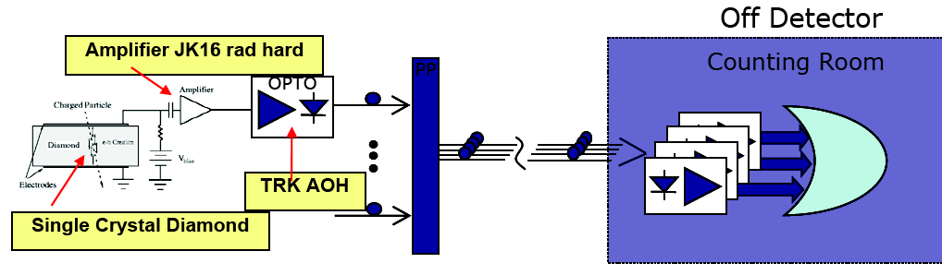
CMS BCM1F Monitor System (histogram of loss arrival time)
See Elena Castro talk
Radiation tolerant ASIC amplifier and
laser diodes
Detector and electronics mounted in a
few centimeter case
VME based CAEN module acquisition
system
  ADC 500 MHz
  Scalar
  TDC
Next project: increase of dynamic range and transmission link optimisation
DESY Zeuten – CERN BE/BI

Slide 28
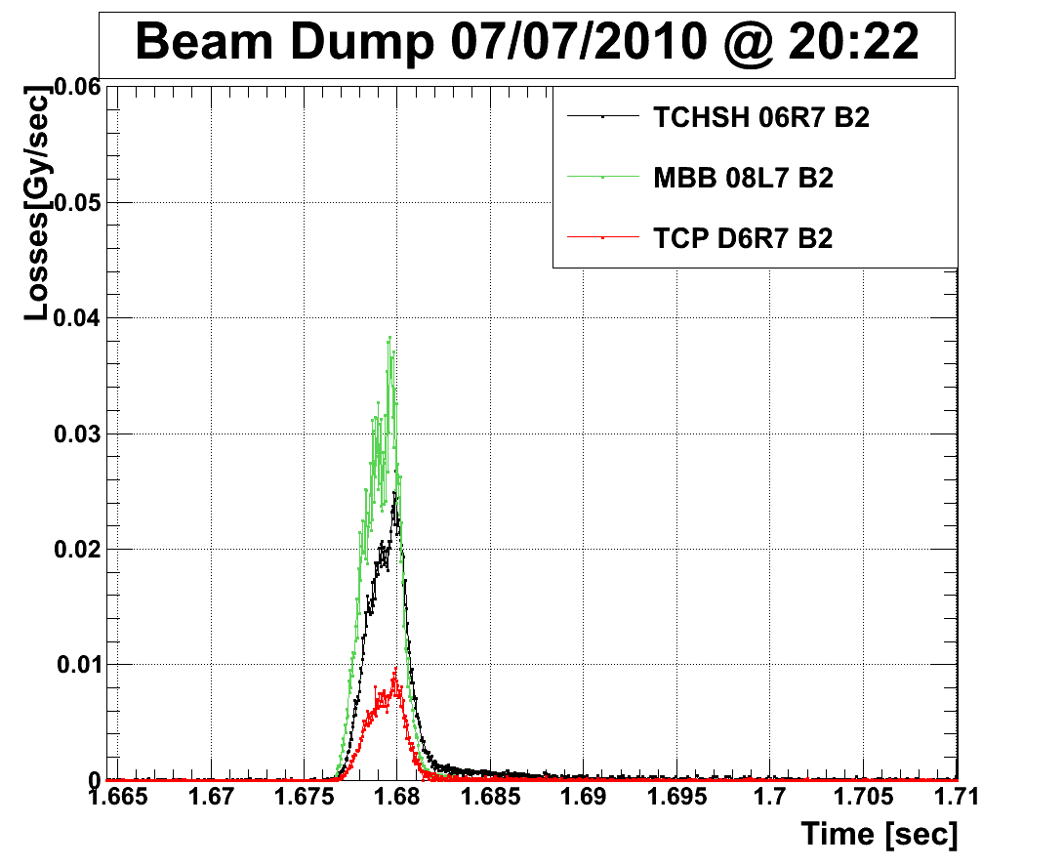
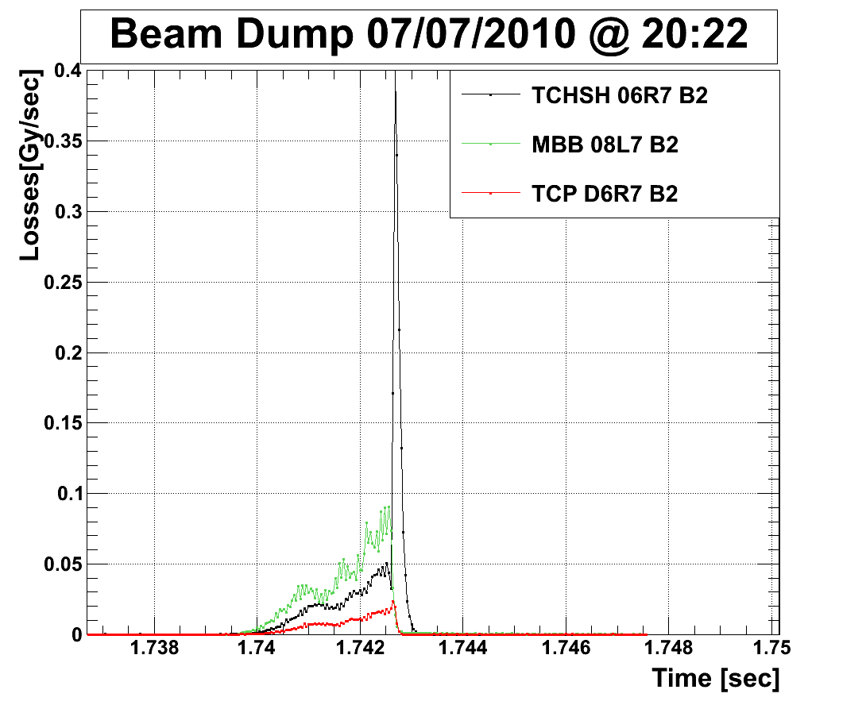
Post Mortem Data (some examples), Zoom
Loss from primary event
+
dump system loss

Slide 29
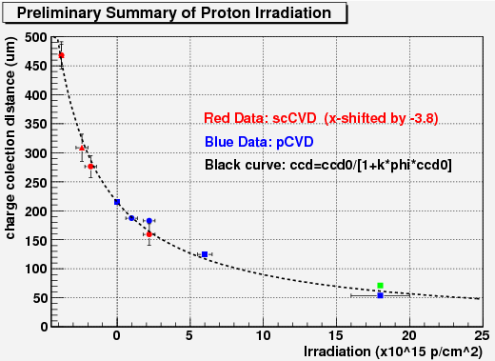
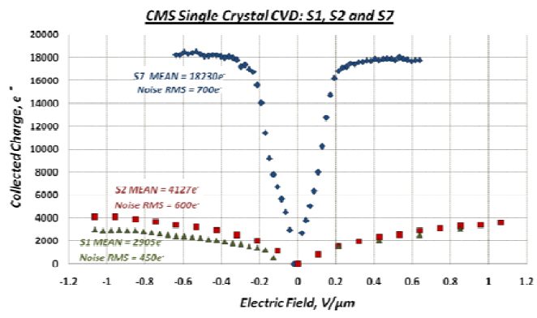
Diamond and Radiation Hardness
Top: sCVD shifted to the left to show that it follows the same degradation parameterization as pCVD
Bottom: sCVD irradiation loss: 20 % of initial signal
drop of signal to noise from 26 to 7
From:
W.Trischuk & RD42, “Resent advances in
diamond detectors”
From
“Fast beam conditions monitoring
(BCM1F) for CMS” by N/Bernardino Rodriguess, …
1.5 E17 1/cm2 (MIP)
No data are available at
temperatures below 100 Kelvin

Slide 30
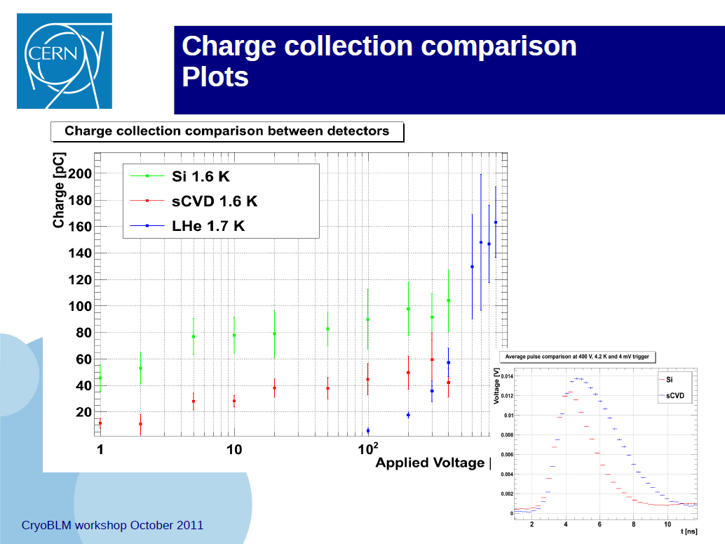
Integration over length of spill (400 ms)
Leakage current below
1 pA
Test of radiation tolerance foreseen
for June & Nov. 2011 (dose: 1MGy,
few E15 prot/cm2)
Signal integration over 0.6 seconds
Average response of
single particle
Christoph Kurfuerst, CERN BE-BI

Slide 31
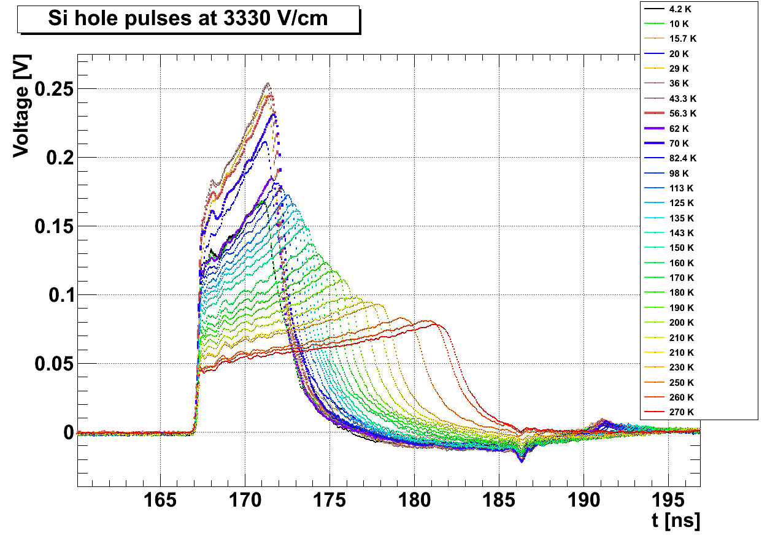
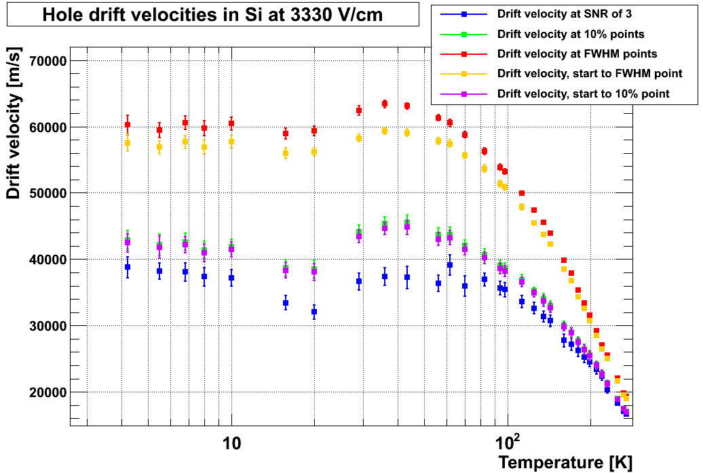
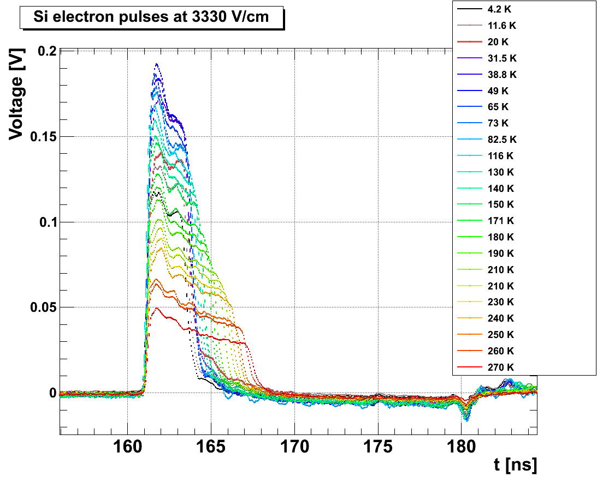
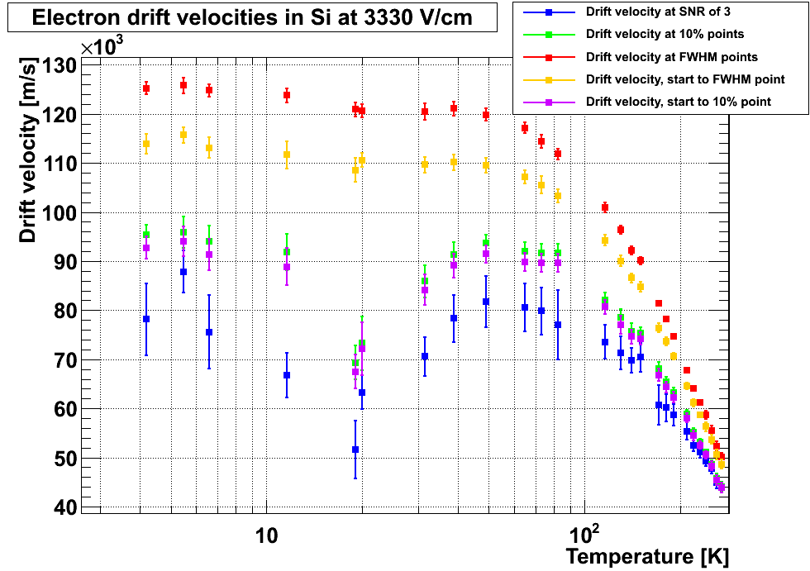
Si Studies with Pulsed LASER (100 ps duration) I
CVD 500 um thickness

Slide 32
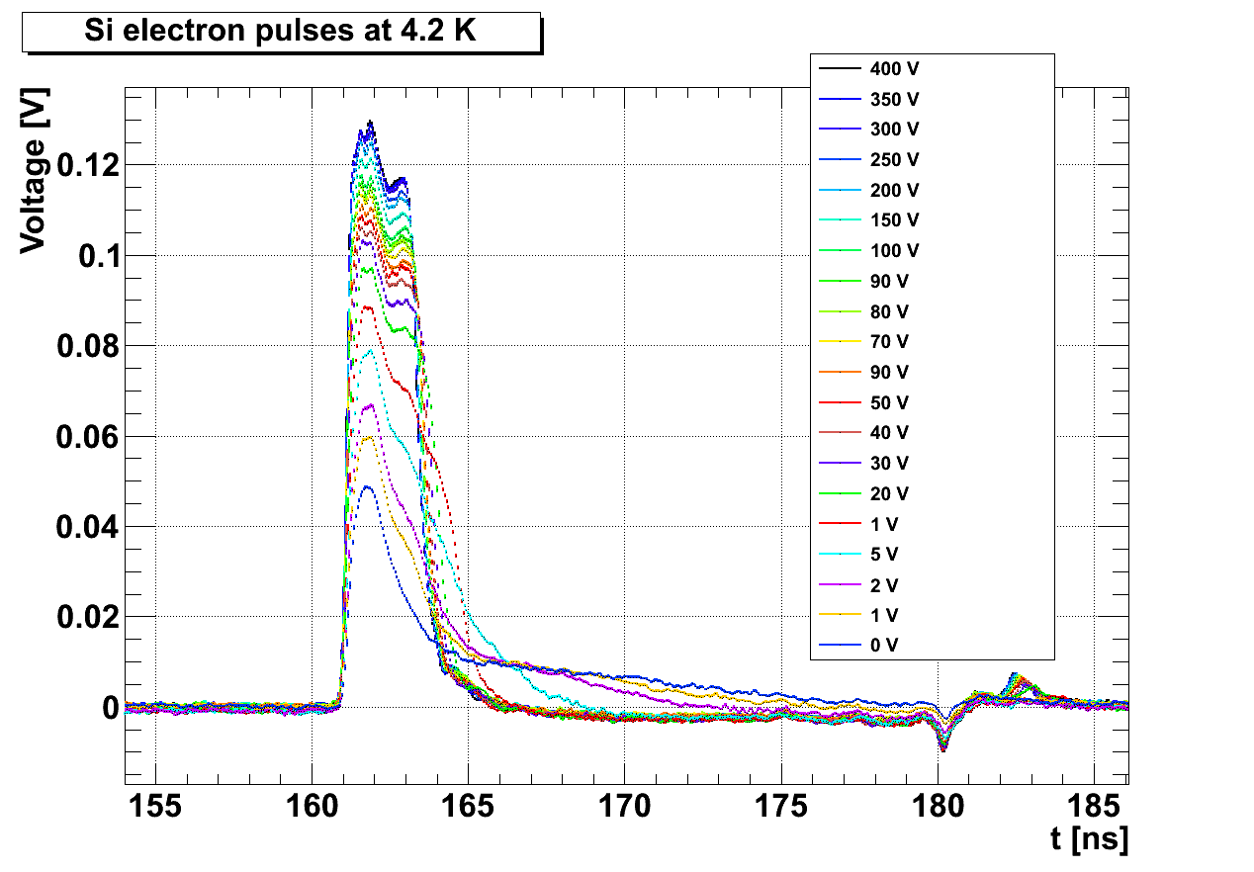
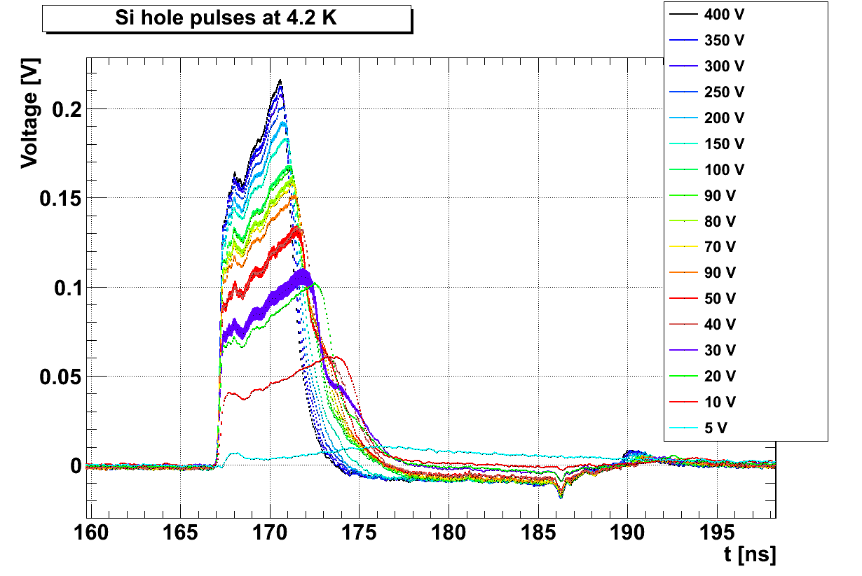
Si Studies with Pulsed LASER (100 ps duration) II
Drift velocity is constant up to 40 Kelvin
Drift velocity variation (saturation to 300 K) for holes by a factor 3 and for electrons by a factor 2.4
Saturation plateau shows some variation (hypothesis shallow energy level capture charges)
General: for steady state irradiation and radiation damaged material polarisation effects expected.

Slide 33
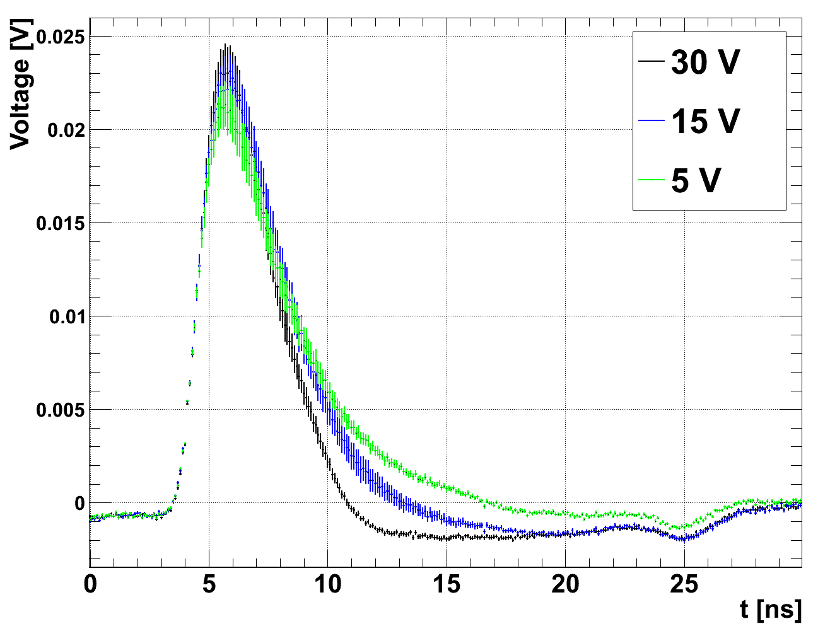
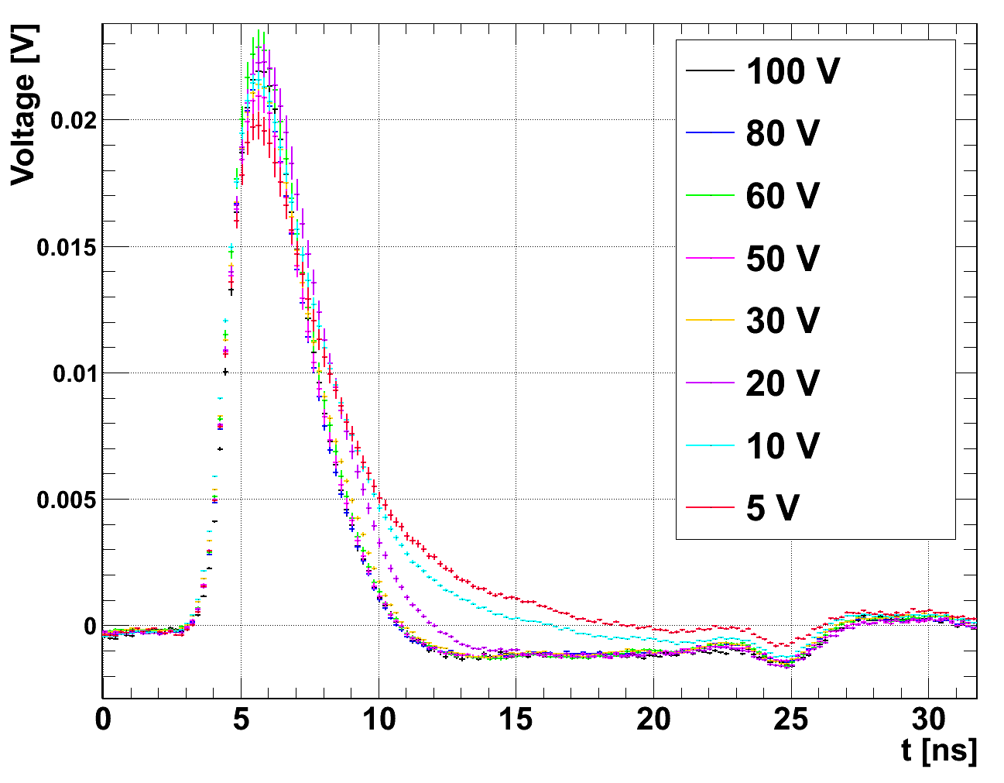
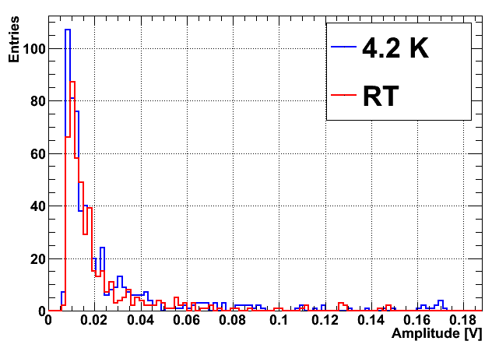
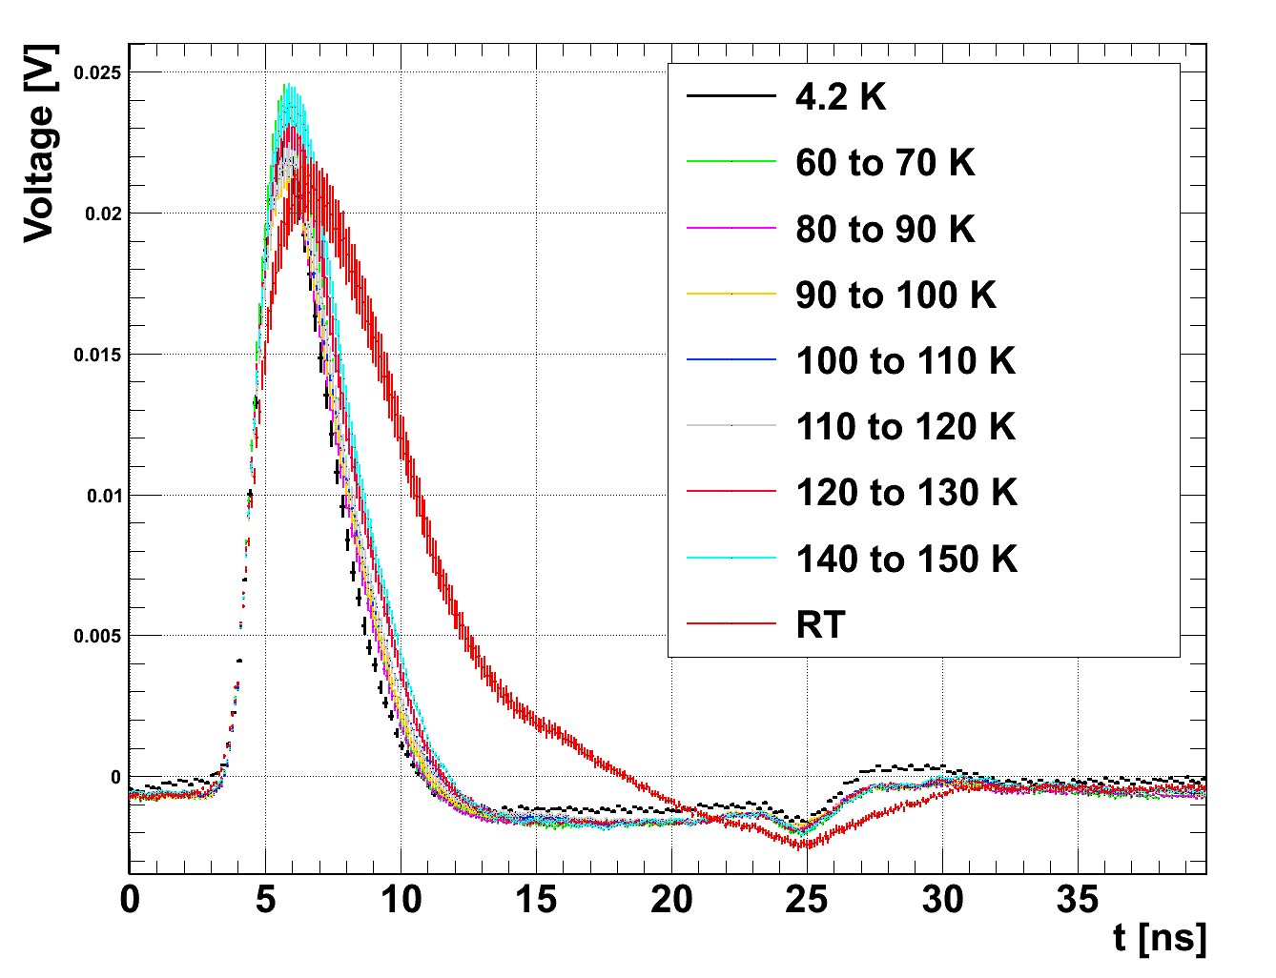
1.8 Kelvin Loss Detection – MIP response (20 GeV Protons)
Si at 1.8 K
Si at 4.2 K
Diamond (sCVD)
Open questions: radiation hardness, DC current value, non linearity effects
for high losses

Slide 34
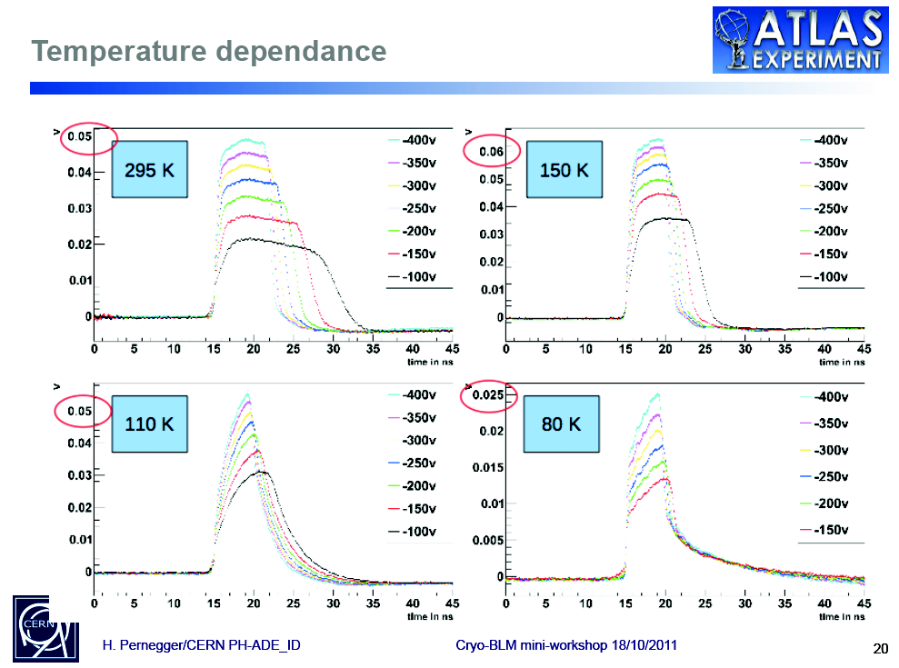
ALPHA source
sCVD

Slide 35
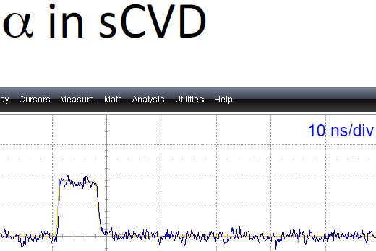
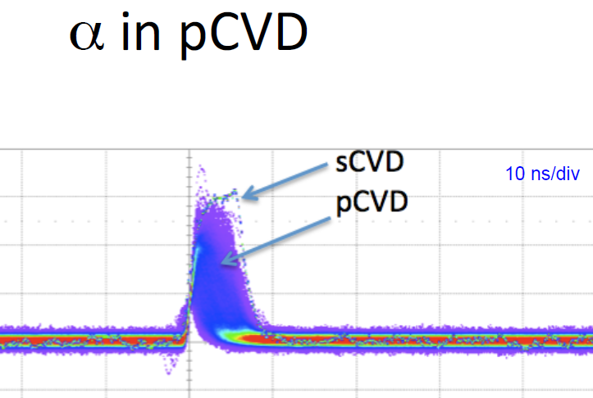
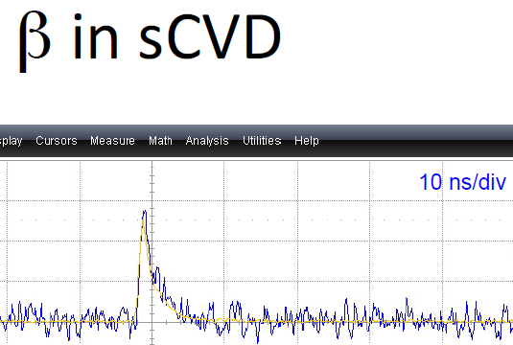
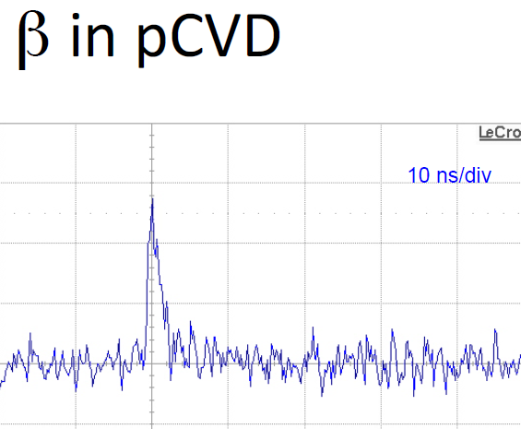
Poly and single crystalline CVD (Diamond) Detectors
Courtesy to E. Griesmayer, CIVIDEC
stopped after few um
20 mV/div
pCVD faster but less signal compared to sCVD
traverse the detector
10 mV/div
10 mV/div

