Slide 1
Future Challenges at CMS
A view to LS1 and a bit beyond
Anne Dabrowski
CERN
BCM1F Workshop
02-02-2012

Slide 2
Outline
BCM1F functions for CMS
  Beam Background measurement
  Online Luminosity measurement
  Albedo “after glow” measurement (decay products of activated material)
Schedule
  LHC beam schedule
  CMS planning
Relevant LHC Beam Parameters, that determine rate in BCM1F
  Luminosity and energy determining the overall rate
  Bunch spacing effecting occupancy
  Longitudinal beam dynamics, effecting time stability and luminous region
Upgrade needs and resources
  First step to defining detector requirements
  Identifying needed resources

Slide 3
BCM1F functions for CMS
Single particle counting device ➔ providing rich functionality for CMS,
➔ because the detector is at a “golden” location (1.8m / 6ns from IP) and the time resolution is good
 | Bunch shape | 95% of longitudinal bunch distribution
Start collisions | Cosine-squared | 600 ps
After 10 hrs coasting | Gaussian, tails chopped off by 2.5 ns RF bucket | 1080 ps
Typical LHC bunch length

Slide 4
BCM1F single particle time dependent counting
Single particle counting
Exploiting golden location of BCM1F
(12.5 ns time of flight)
& precise timing information
Count products from incoming beam background ;
T = -12.5 ns
Albedo ;
Out of time background with exponential decay life time
Count collision (& outgoing beam) products ;
T=0
Notes:
Must put the reliability down

Slide 5
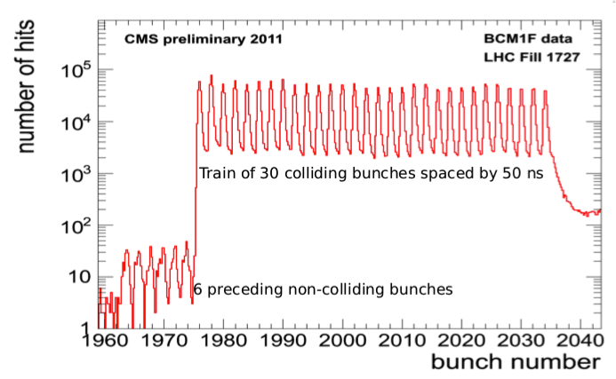
BCM1F single particle time dependent counting
Count products from incoming beam background ;
T = -12.5 ns
Albedo ;
Out of time background with exponential decay life time
Count collision (& outgoing beam) products ;
T=0
Single particle counting
Exploiting golden location of BCM1F
(12.5 ns time of flight)
& precise timing information
TDC data with 0.8 ns bins
R. Walsh
Notes:
Must put the reliability down

Slide 6
BCM1F single particle time dependent counting & CMS needs
Single particle counting
Exploiting golden location of BCM1F
(12.5 ns time of flight)
& precise timing information
Count products from incoming beam background ;
T = -12.5 ns
Albedo ;
Out of time background with exponential decay life time
Count collision (& outgoing beam) products ;
T=0
CMS Needs:
Luminosity
Normalized Beam Induced background measurement
Measure of activation
Notes:
Must put the reliability down

Slide 7
CMS measurements using single particle time dependent counting
&
Luminosity Collision Products
  Particle count rate consistent with collision products only
    “Removing” the Albedo (require co-incidence)
    “Removing” the Beam-induced background
    With correct rate / dead time normalization
  Do this for every 25 ns bunch crossing
Normalized Beam Induced background measurement
  Particle count rate consistent with incoming beam products only
    “Removing” remnants from collision products (Albedo) which dominated the rate
    With correct rate / dead time normalization
  Do this for every 25 ns bunch crossing
Measure of activation
  Particle count rate continuously over the full LHC orbit
    “Removing” hard collision products
    “Removing” beam induced backgrounds
    With correct rate / dead time normalization
Notes:
Must put the reliability down

Slide 8
BCM1F single particle time dependent counting
Count products from incoming beam background ;
T = -12.5 ns
Albedo ;
Out of time background with exponential decay life time
Count collision (& outgoing beam) products ;
T=0
Single particle counting
Exploiting golden location of BCM1F
(12.5 ns time of flight)
& precise timing information
Using co-incidences or some majority logic in the 8 diamonds will help beat down albedo
➔ But the efficiency must be studied and understood with data and MC
Improving the BCM1F time resolution:
➔disentangle / flag better these 3 components
TDC data with 0.8 ns bins
R. Walsh
Notes:
Must put the reliability down

Slide 9
Important BCM1F upgrade ingredients
Front-end specific:
Time resolution ~ bunch length ( 1000 ps 3 sigma)
Preamplifier return to baseline within < 12 ns, even if saturated to reduce and control dead time
Time jitter ~< 200 ps (to be discussed)
Other important ingredients:
Reliability and stability ➔ this is essential if we commit to CMS luminosity
Measureable dead time
Ability to count 1,2 … 8 mips (simulation needed to set dynamic range)
Radiation Hard design (140 fb-1) with ability to monitor degradation
Perhaps? Local co-incidence of back to back sensors to improve ability to veto out-of-time low energy albedo products
Notes:
Must put the reliability down

Slide 10
Impact of LHC / CMS schedule on BCM1F
Notes:
Must put the reliability down

Slide 11
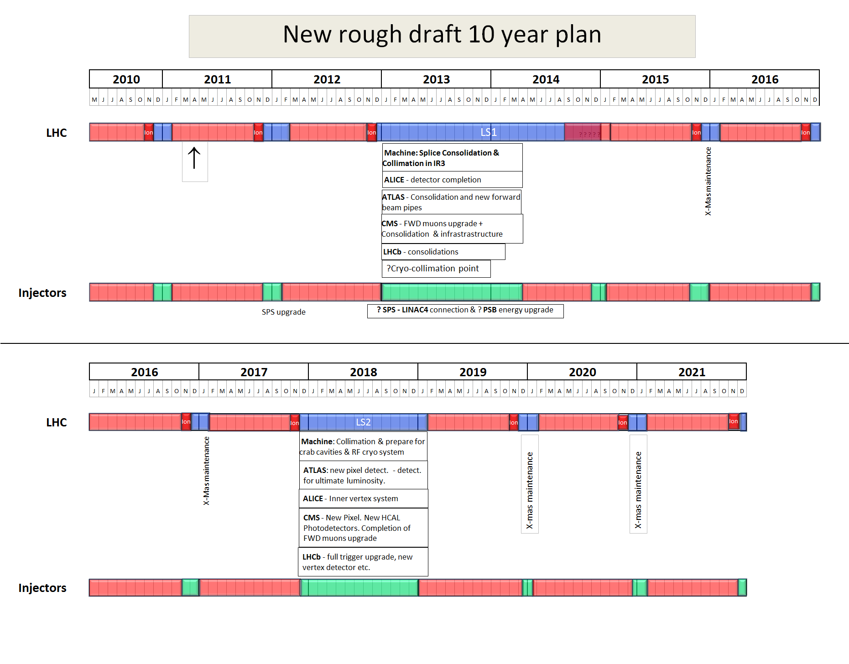
10 year plan 2011-2021
from early 2011
4 TeV?
6.5 TeV?
p-Pb
run
2022
LS3
Installation of the HL-LHC hardware
Courtesy F. Zimmerman,
CMS upgrade workshop, Nov. 2011
* Updated planning expected after Chamonix 2012, mid-Feb

Slide 12
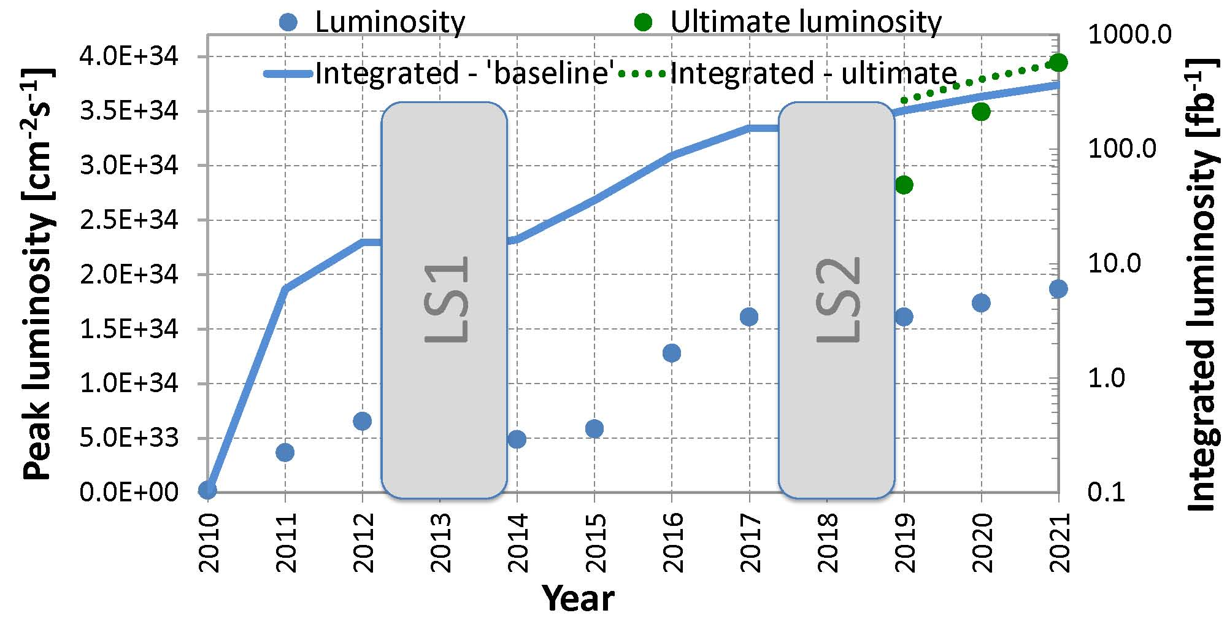
10-year luminosity forecast
total
~400 fb⁻¹
total
17 fb⁻¹
total
156 fb⁻¹
6.5 TeV &
transition
to 25 ns
modified from O. Brüning, M. Lamont, L. Rossi

Slide 13
10-year luminosity forecast
total
~400 fb⁻¹
total
17 fb⁻¹
total
156 fb⁻¹
6.5 TeV &
transition
to 25 ns
Today
4 years + Exposure to 140 fb⁻¹
Rad. hard design & ability to monitor degradation
End of LS1 shutdown

Slide 14
LHC beam parameters
Based on 2011 Experience, we can estimate quite accurately how BCM1F will perform in 2012 and 50 ns bunch spacing
 | design | October 2011 | end 2012 ? | 2016 ??
Beam energy | 7 TeV | 3.5 TeV | 4 TeV | 6.5 TeV
transv. norm. emittance | 3.75 μm | 2.5 μm | 2.5 μm | 3.5 μm
beta* | 0.55 m | 1.0 m | 0.7 m | 0.5 m
IP beam size | 16.7 μm | 24 μm | 19 μm | 17 μm
bunch intensity | 1.15x10¹¹ | 1.5x10¹¹ | 1.6x10¹¹ | 1.2x10¹¹
# colliding bunches | 2808 | 1331 | 1350 | 2800
bunch spacing | 25 ns | 50 ns | 50 ns | 25 ns
beam current | 0.582 A | 0.335 A | 0.388 A | 0.604 A
rms bunch length | 7.55 cm | 9 cm | 9 cm | 7.6 cm
full crossing angle | 285 μrad | 240 μrad | 240 μrad | 260 μrad
“Piwinski angle” | 0.64 | 0.37 | 0.51 | 0.61
peak luminosity | 10³⁴ cm⁻²s⁻¹ | 3.6x10³³ cm⁻²s⁻¹ | 7.4x10³³ cm⁻²s⁻¹ | 1.3x10³⁴ cm⁻²s⁻¹
average peak pile up* | 25 | 18 | 36 | 30
* with σ~80 mbarn
Courtesy F. Zimmerman,
CMS upgrade workshop, Nov. 2011
Updated planning expected after Chamonix 2012, mid-Feb

Slide 15
LHC beam parameters most relevant for BCM1F
 | design | October 2011 | end 2012 ? | 2016 ??
Beam energy | 7 TeV | 3.5 TeV | 4 TeV | 6.5 TeV
# colliding bunches | 2808 | 1331 | 1350 | 2800
bunch spacing | 25 ns | 50 ns | 50 ns | 25 ns
peak luminosity | 10³⁴ cm⁻²s⁻¹ | 3.6x10³³ cm⁻²s⁻¹ | 7.4x10³³ cm⁻²s⁻¹ | 1.3x10³⁴ cm⁻²s⁻¹
r.m.s. bunch length | 7.55 cm | 9 cm (300 ps) | 9 cm | 7.6 cm (253 ps)
~ Hit rate BCM1F per diamond | 2.2 MHz | 0.8 MHz | 1.6 MHz | 2.8 MHz
~ Hits per diamond / orbit | 190 | 70 | 140 | 250
~ Hits per diamond / bunch crossing | 0.07 | 0.05 | 0.10 | 0.09
Rate in 2012, go up by factor ~ X2 compared to 2011 ➔ backend electronics must be able to work @ higher rate!
Even in 2016, occupancy in BCM1F is less than 1 hit / diamond / bunch crossing ➔ a good property for a luminosity measurement based on zero counting.
Bunch spacing of 25 ns implies need for faster front end electronics
Higher energy ➔ tighter collimator settings, 25 ns ➔risk electron cloud ➔ beam induced background monitoring will be essential for CMS

Slide 16
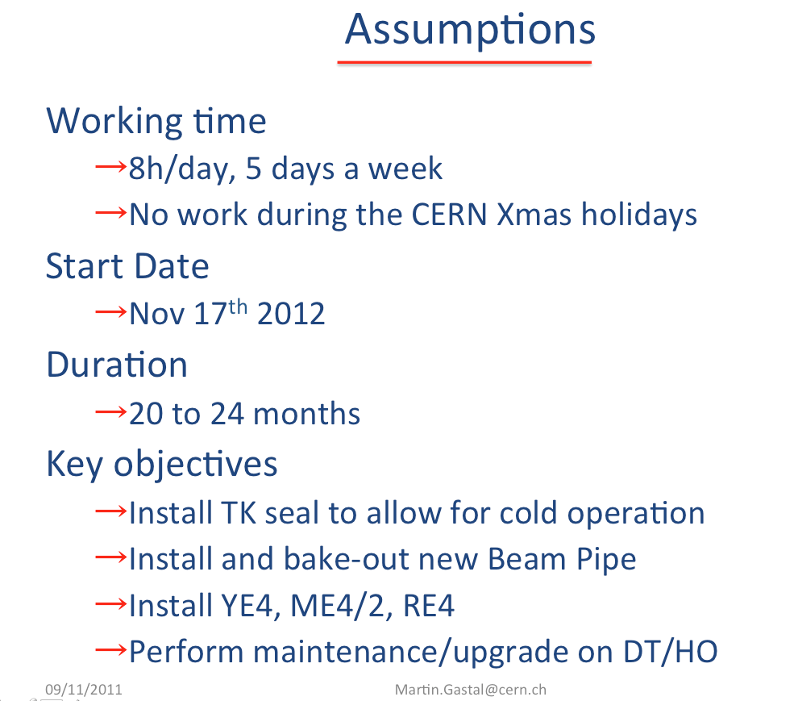
CMS schedule Long Shutdown 1 (LS1)
Note: Schedule as presented at the CMS upgrade workshop in Chicago;
Revised schedule to be presented in Chamonix Feb 2012

Slide 17
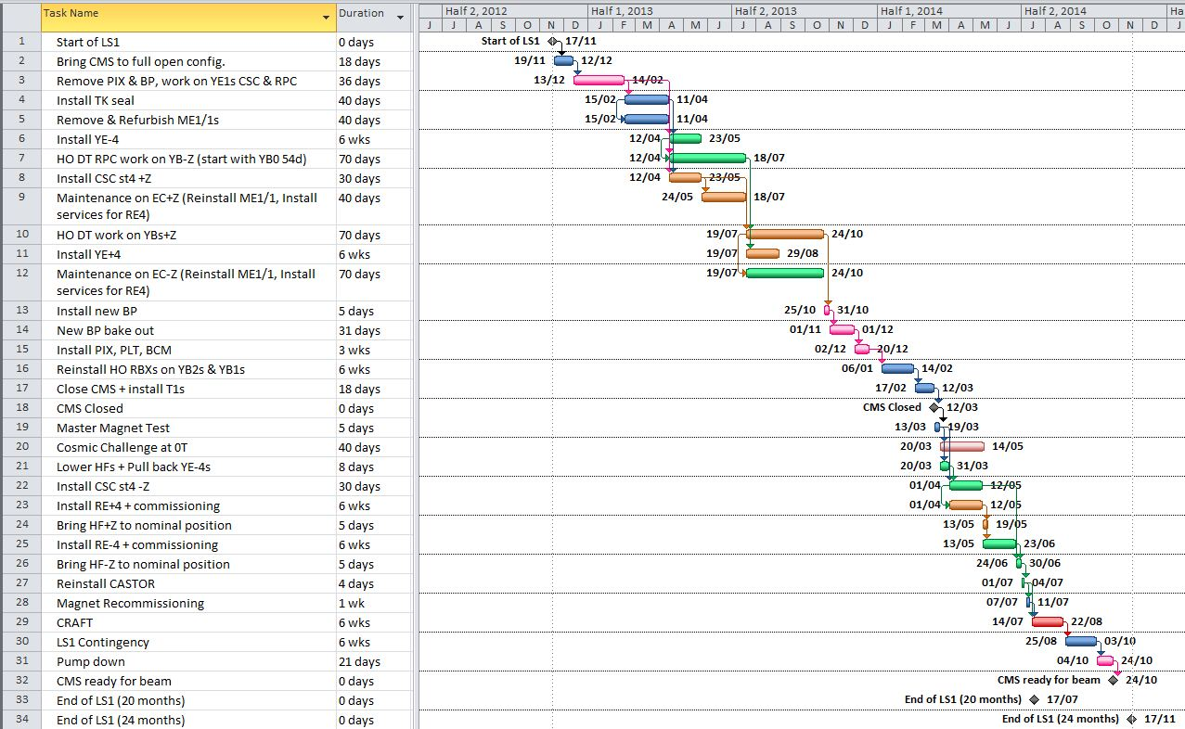
Top Level Draft Schedule

Slide 19
March 2014

Slide 20
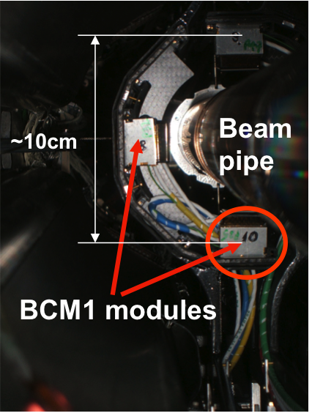
Implications of CMS Schedule on BCM1F front end upgrade
Feb. 2012
TODAY, BCM1F Front-end upgrade specifications needed
Mid-2012, Front-end prototype design finished
2013,Testing & Assembly of Front-End + sensors 2013
Installation complete March 2014
End-2012, Compete Production of Front-end
5 months
5 months
12 months
2 months
Mar. 2014

Slide 21
Implications of CMS Schedule on BCM1F front end upgrade
Feb. 2012
TODAY, BCM1F Front-end upgrade specifications needed
Mid-2012, Front-end prototype design finished
2013,Testing & Assembly of Front-End + sensors 2013
Installation complete March 2014
End-2012, Compete Production of Front-end
5 months
5 months
12 months
2 months
Mar. 2014
Very short schedule:
Need pragmatic path, making the most use of our manpower, our experience and existing R&D of colleagues
Physics needs must be well described with corresponding detector specifications

Slide 22
CMS needs after LS1, assuming fast front end
Online Luminosity Measurement:
  Extreme stability of full detector chain – LHC and CMS will look @ these numbers daily / On-call phone will ring day & night.
  25 ns bunch spacing
  Method to understand and correct for albedo contribution
  Dead time correction known
  Number published every lumi section, 2.3 sec.
  Bunch-by-bunch rate histograms
  Stable DAQ, running whenever beam in machine
  Ability to monitor efficiency due to radiation damage or temperature
  Programmable threshold to count 1, 2, 3 etc mips (dynamic range checked with simulation)
  Aim for < 10% error on online measurement
Normalized Beam Induced background measurement
  Fewer non-colliding bunches in future ➔ need to use info from the incoming beam for every 25 ns bunch crossing
  Faster front-end electronics essential
  Rate of ~8-9 kHz expected for beam background hit contribution
  Method to understand and correct for albedo contribution online
  Publish background for each of Beam 1 and Beam 2 to the LHC every 1 sec
  Bunch-by-bunch background measurement needed, as an input into beam background contribution in the lumi sample
Notes:
Must put the reliability down

Slide 23
First step at BCM1F detector specifications for LS1 - (2016)
Parameter | Unit | Specification
Front End
Peaking time | ns | 1
Time to reach baseline (alive to receive next event, 12.5 ns later) | ns | < 12
Return to baseline after saturated event | ns | < 12
Jitter (not necessary to be faster than beam arrival / orbit jitter which is of order 100-200 ps) | ns | 0.2
Dynamic range (to be defined by simulation) | mips | 1-10 …?
Fluence to sensor after 140 fb-1 | [1 MeV neutron eq cm⁻²] | ~ 3.5e+14
Expected integrated maximum dose at nom. Lumi * | Mrad/year (kG/year) | 7 (70)
Either Backend or on-chip digitization
Maximum total rate / sensor | MHz | 5
Time sampling of TDC-type measurement | ns | < 1
Narrow, programmable gate width (hardware/software) | ns | 2
Frequency of gate generation | MHz | 100
To be discussed depending on where logic is done
* Must double check
Notes:
Must put the reliability down

Slide 24
First step at BCM1F detector specifications for LS1
Parameter | Unit | Specification
Either Backend or on-chip digitization
Dead-time | ns | Small deadtime is OK (sampling detector), but must be measureable & understood
Accumulate data (histograms) then publishing rate | s | 1
Calibration / efficiency monitoring due to radiation & temperature | yes | Needed, channel by channel
Detector reliability | 100% | On whenever beam in machine
Power consumption quota allowed in front end to be checked
Notes:
Must put the reliability down

Slide 25
Decision steps needed
Functionality agreement
Beam induced background
Technical Specifications
Time resolution
1 Year time limitations for R&D
Pragmatic choices to be made fast
Small adaptations of present preamplifier chip use existing services
Online luminosity
Dynamic range
Identify “Adopt” R&D from other project
Incorporate needs from LHC BE/BI
Analog output pulse OR
Digital time, and time over threshold (power consumption, additional services)
Make very accurate specifications, sub-contract ASIC design work to an external company or new collaborator
This we know now, must write it down. Beam parameters not changing much
This we need to define today during this workshop, all the main players are here
Implications of each choice Way forward defined during this workshop
Notes:
Must put the reliability down

Slide 26
Backend / or “front-end” electronics
TDC, Time arrival monitoring synchronous to the bunch orbit
Mip counting capability important for beam background measurement
Timing jitter stability important
Maintenance should not be too labour intensive. Simple and reliable is the way to go.
Should conform to CMS DAQ upgrade specifications as much as possible.

Slide 27
Outlook
We must write down today what we want from physics
  Propose an editor today for this document?
Define and refine the detector specifications
  Propose an editor for this chapter?
Identify resources needed to do the job
  Engineering design support
  Additional services and infrastructure
  Define cost
  Manpower needs
  Interested parties with expertise

