Slide 1
Fast Beam Monitoring in ATLAS (BCM)
The original BCM
Mechanical Design
Readout capabilities
Results from 2010-2011 running
Upgrade to add spatial information (DBM)
William Trischuk
University of Toronto
on behalf of the ATLAS-BCM group
February 2, 2012

Slide 2
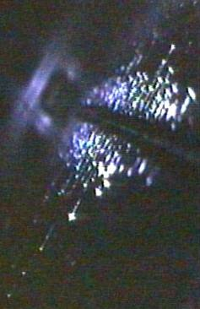
The Beam Conditions Monitor Mission
Primary goal: Protect ATLAS and the LHC machine
Tevatron beam ~10 MJ (bus at 120 km/h)
LHC beam ~1.4 GJ (an A380 at takeoff)
Protect against beam accidents
Monitor backgrounds during injection
Montior losses during abort
Detect instabilities early
Warn of deteriorating conditions
Abort the beam if necessary
Secondary goals
Monitor collision rate
IP location and shape
Protons
A 1m long melted stretch of Tevatron collimator

Slide 3
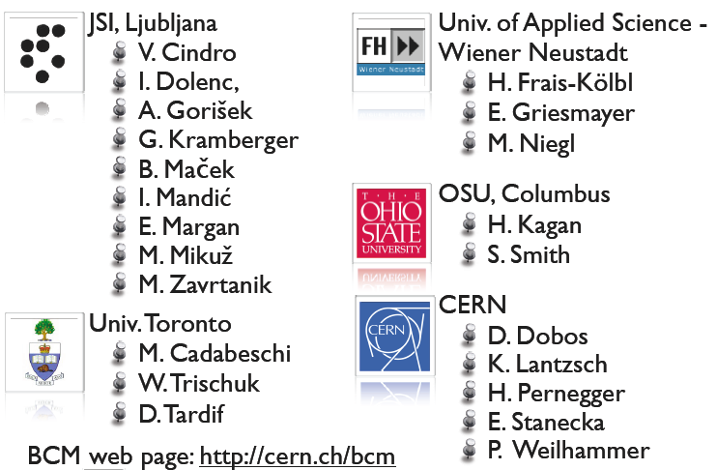
The ATLAS BCM Collaboration
A. Svetek
M. Deliyergiyev
M. Fischer
H. Merritt
J. Moss
H. Jansen
E. Jiankowski
N. Venturi

Slide 4
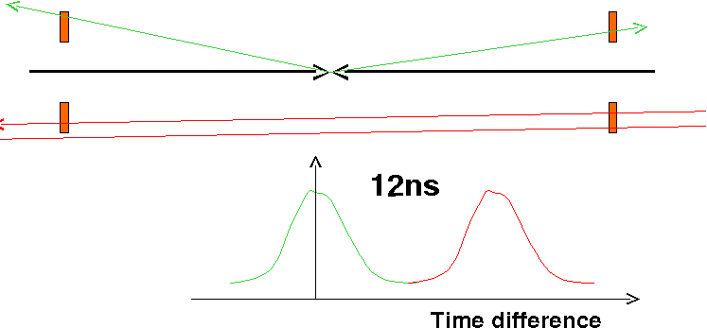
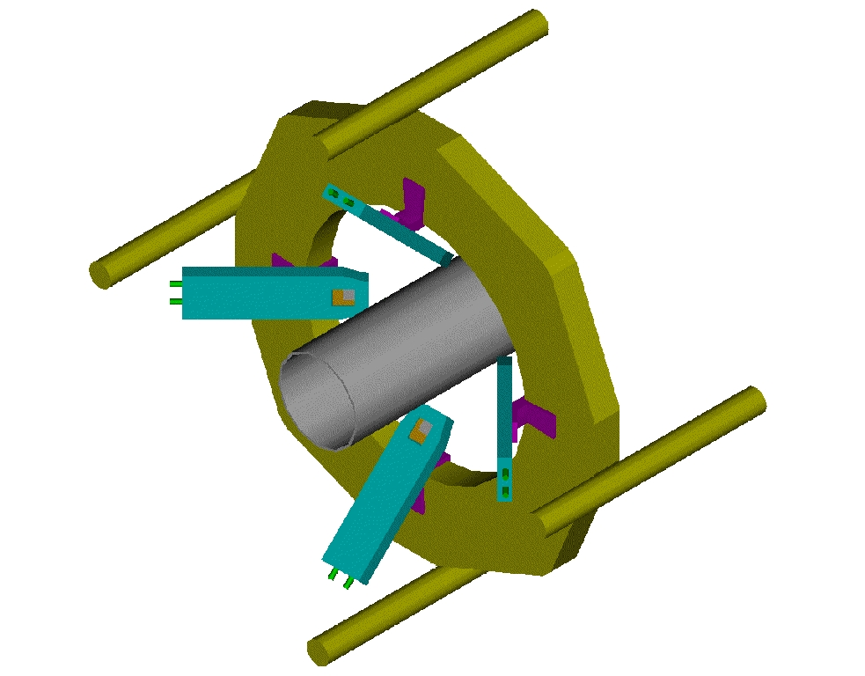
The ATLAS Beam Conditions Monitor
ATLAS will use time-of-flight to distinguish collisions from lost beam particles
4m separation gives 12ns time-of-flight: optimal
Pixel space-frame support at ± 1.9m
Use CVD diamond sensors
10x faster signals and 10x more radiation tolerant than silicon
Use GaAs amplifiers with 1ns rise-time, 5ns baseline restoration

Slide 5
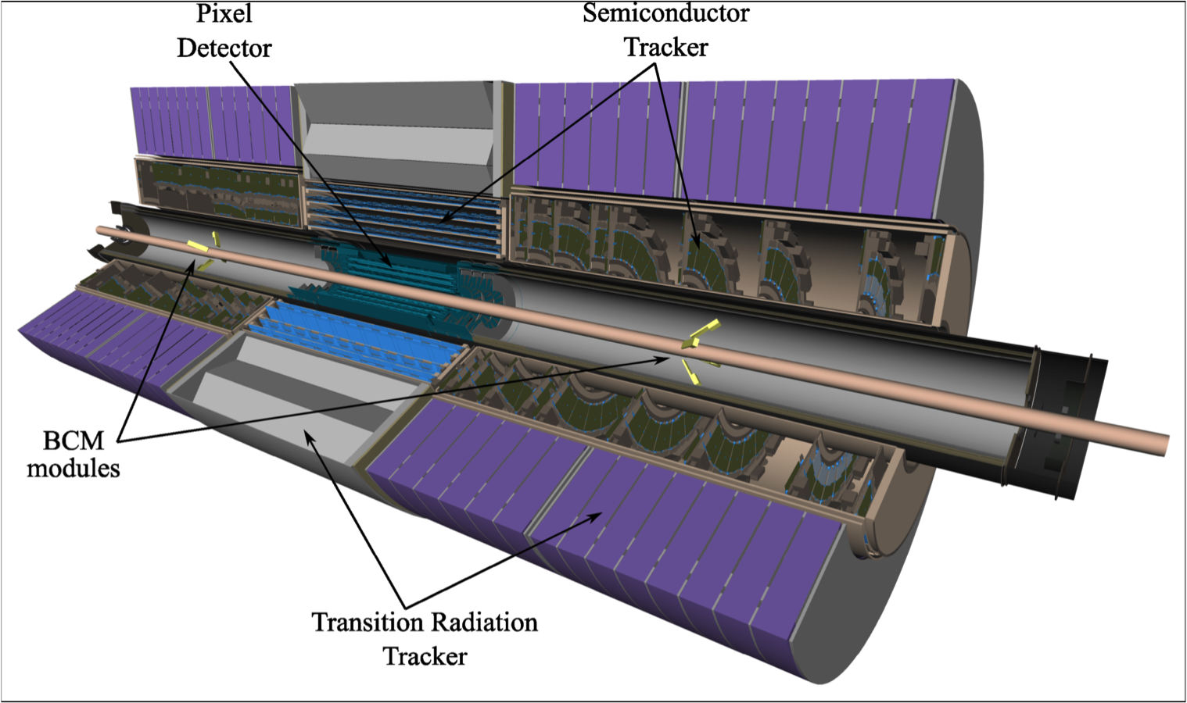
The BCM in ATLAS

Slide 6
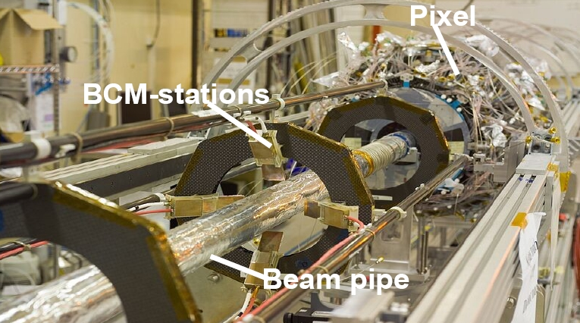
The BCM Installation
Half of BCM modules on ATLAS Pixel support frame
BCM module support mechanics designed in Toronto

Slide 7
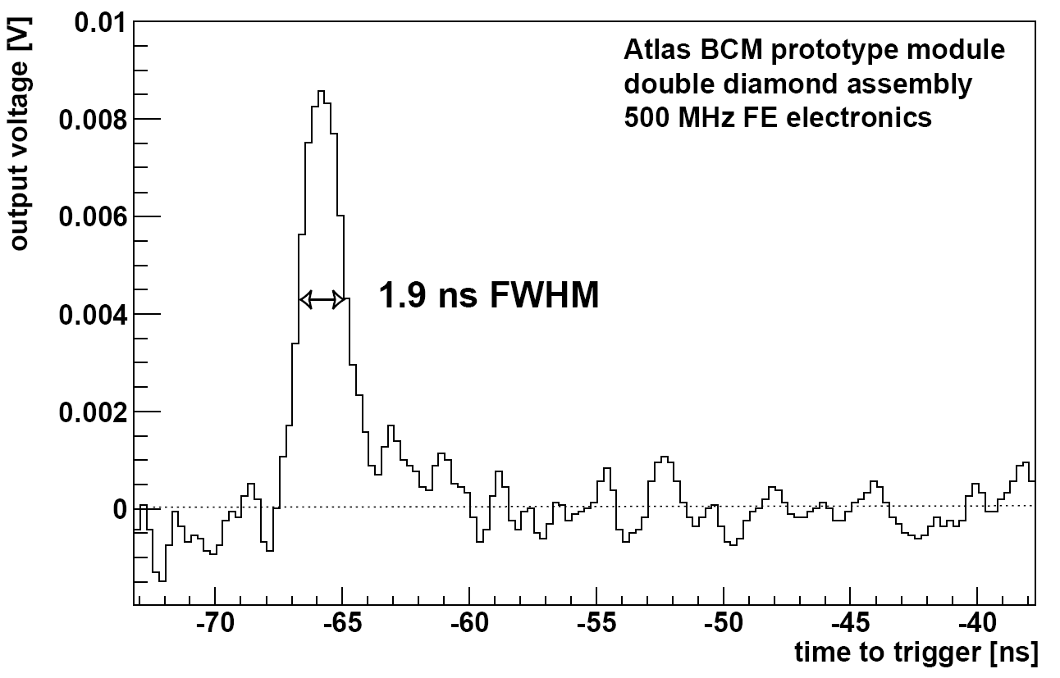
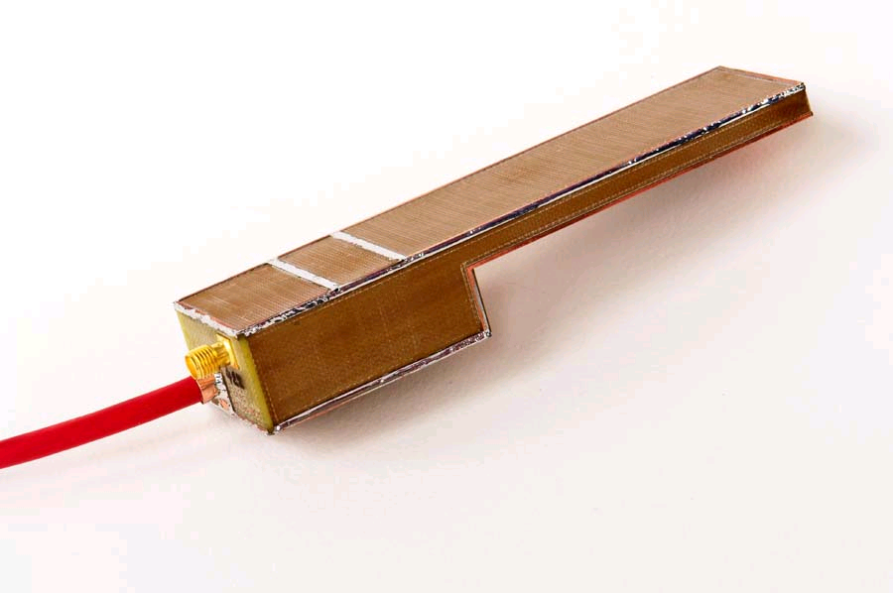
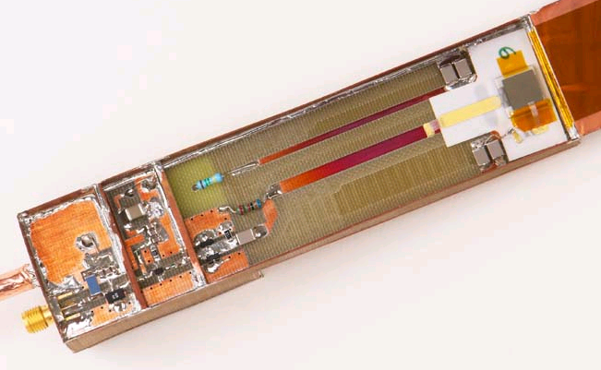
The BCM Detector Modules
pCVD diamond sensors (10x10 mm², 2x500μm thick)‏
Withstand doses > 10¹⁵ p/cm²
Fast & short signal (FWHM~2ns, rise time<1ns)‏
Count hits above two thresholds:
½ MIP (for luminosity measurements
100 MIPs (for beam protection)
Agilent MGA-62653 500Mhz (22 dB)‏
Mini Circuits GALI-52 1 GHz (20 dB)‏
BOTTOM
pCVD diamond

Slide 8
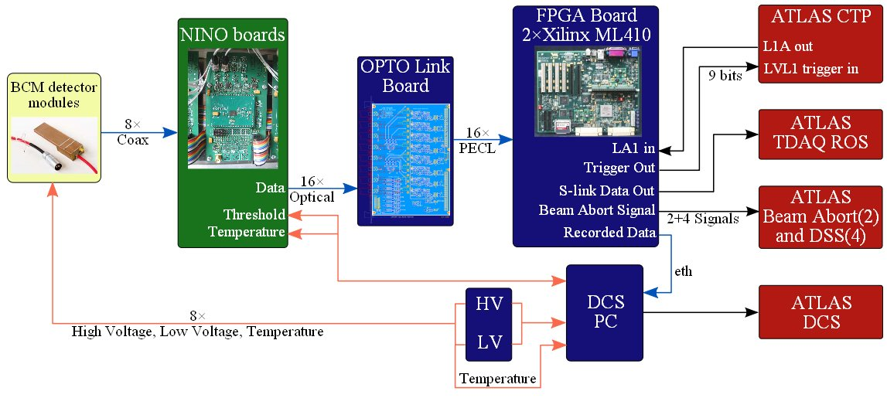
The BCM Readout
Must provide independent beam background assessment
Also provides luminosity and trigger information for ATLAS
ATLAS
Cavern
USA-15 (Counting room)
Control room

Slide 9
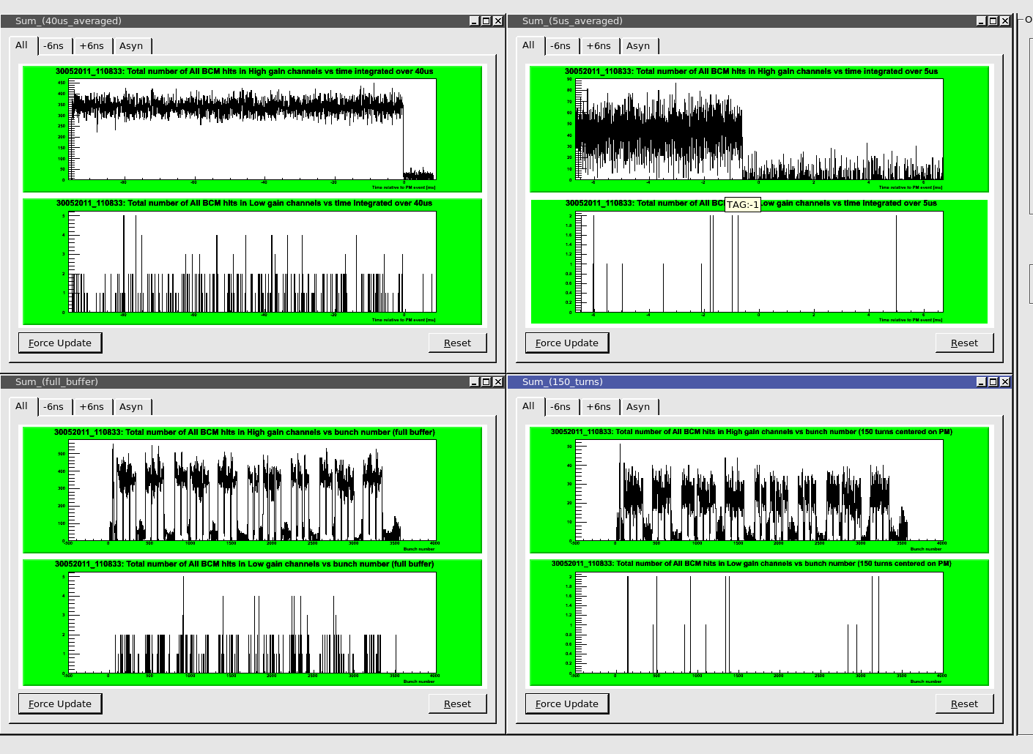
BCM Abort Post-mortem
Provide fast feedback (within 5 minutes of abort) to CERN CC
After every abort (about 3000 per year)
Normally look like:
1000 turns
100 turns
Single MIP
vs. Time
Hundred MIP
vs. BCID

Slide 10
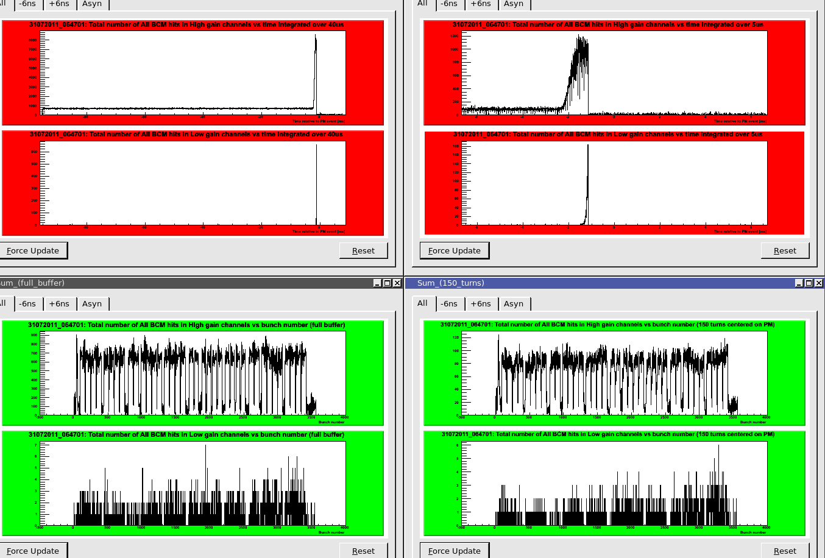
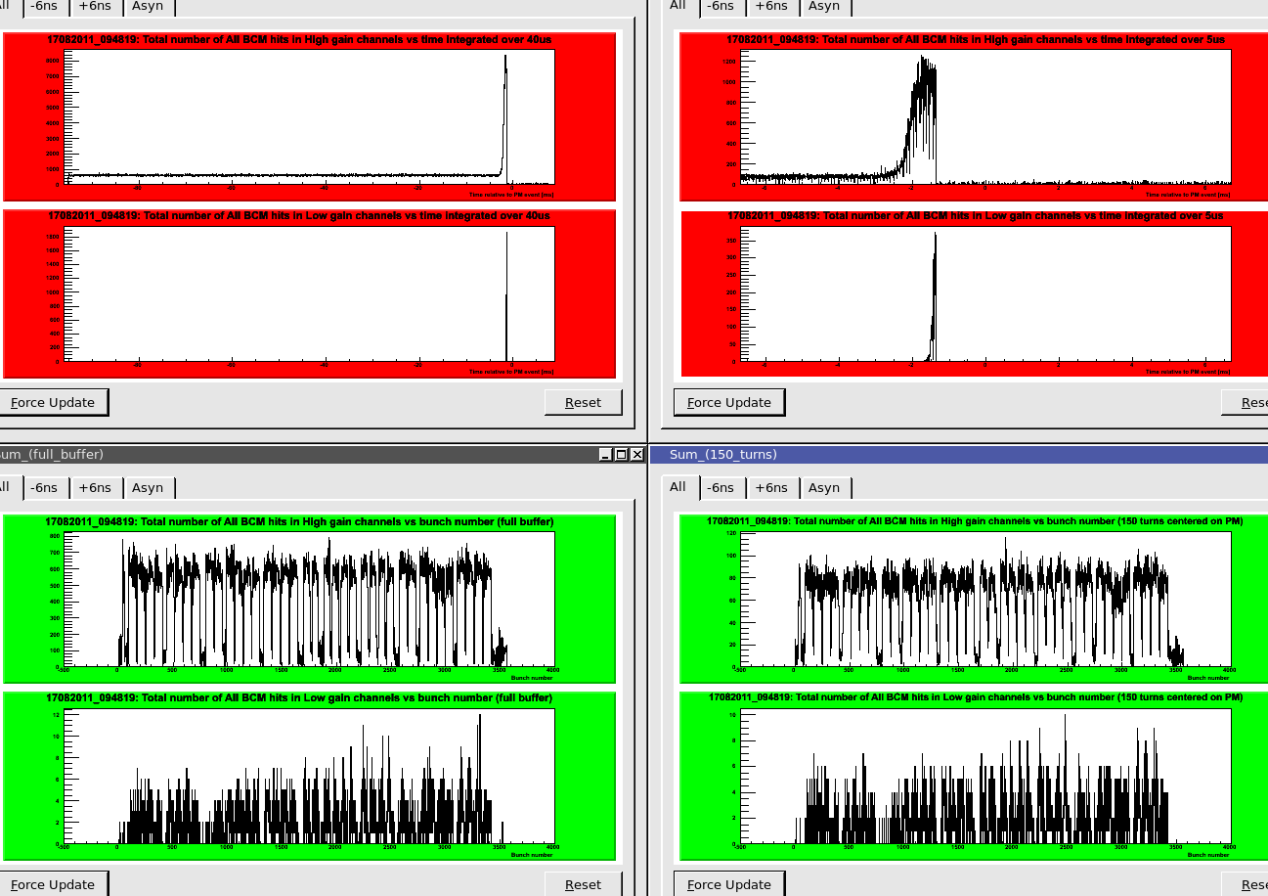
Two Aborts Seen – 2+ Years of Operation
Two aborts seen (July 31, 2011, August 18, 2011)
Both corroborated by LHC machine beam loss monitors
Typical of unidentified falling objects seen elsewhere in machine
Approaching danger levels for SCT and Pixel detectors

Slide 11
Two Aborts Seen – 2+ Years of Operation
Two aborts seen (July 31, 2011, August 18, 2011)
Both corroborated by LHC machine beam loss monitors
Typical of unidentified falling objects seen elsewhere in machine
Approaching danger levels for SCT and Pixel detectors

Slide 12
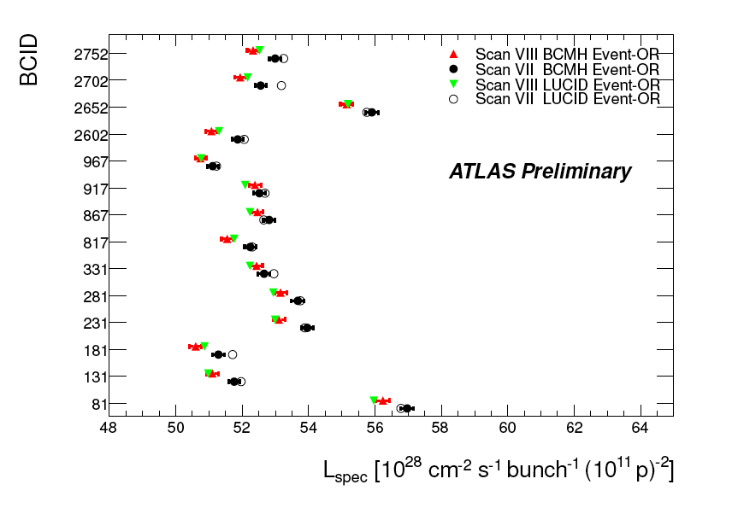
BCM: ATLAS Default Luminosity Monitor
Since early 2011 the BCM is ATLAS’ default luminosity monitor
Provides robust rate measurements
Negligible backgrounds
Operates when other systems are not active
Used during all Van de Meer scans
Measure few % variations in bunch currents
Reproducibily and reliably

Slide 13
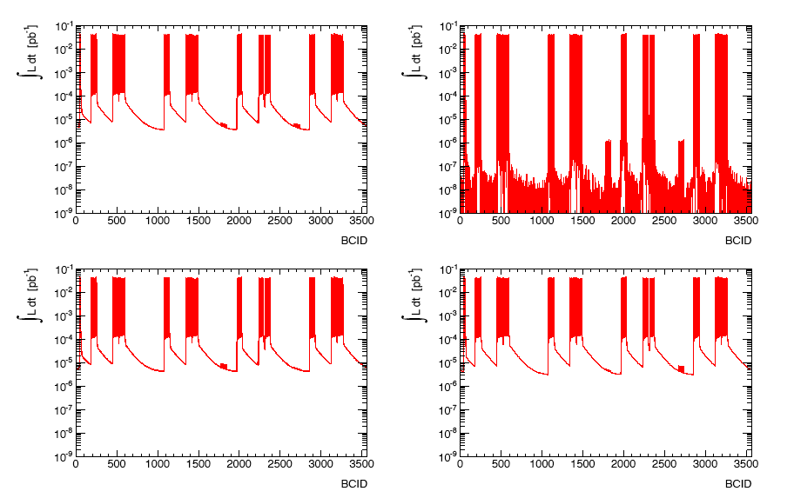
BCM Luminosity Maps
A and C
A or C
Only A
Only C

Slide 14
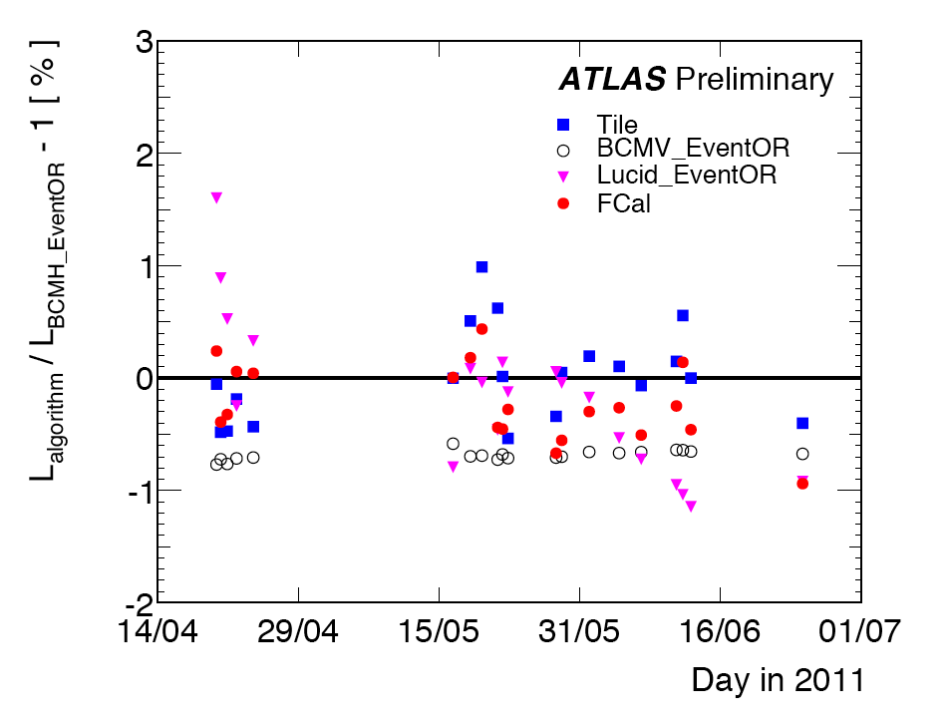
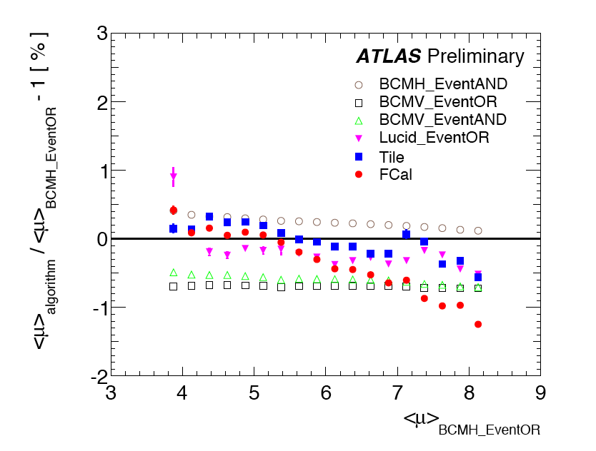
BCM: Luminosity Stability
Two independent lumi measurements (BCMH (ref), BCMV (o))
Stable over months (left) Stable against pile up (right)
One of the keys to ATLAS stated 3.4% absolute luminosity uncertainty

Slide 15
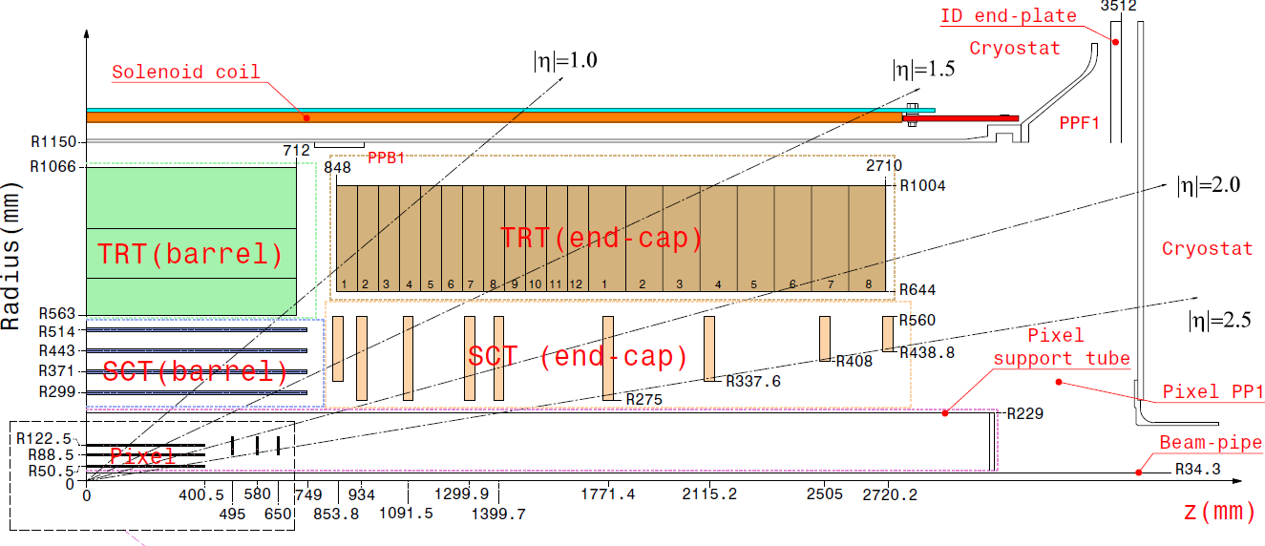
The Diamond Beam Monitor (DBM)
Build on success of BCM – include pixel readout pattern
Install with service quarter panel (nSQP) replacement
Four 3-plane stations on each side of ATLAS-IP
nSQP replacement sets installation date – Februrary 2013
DBM: 3.2<η<3.5

Slide 16
DBM Location
Pixel
DBM
BCM
BPSS

Slide 17
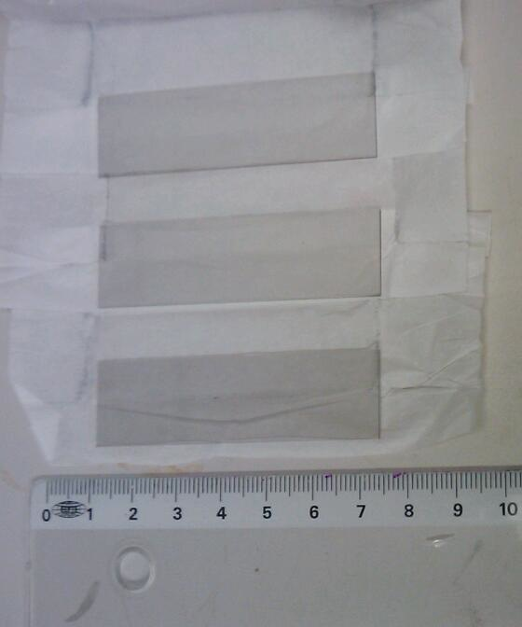
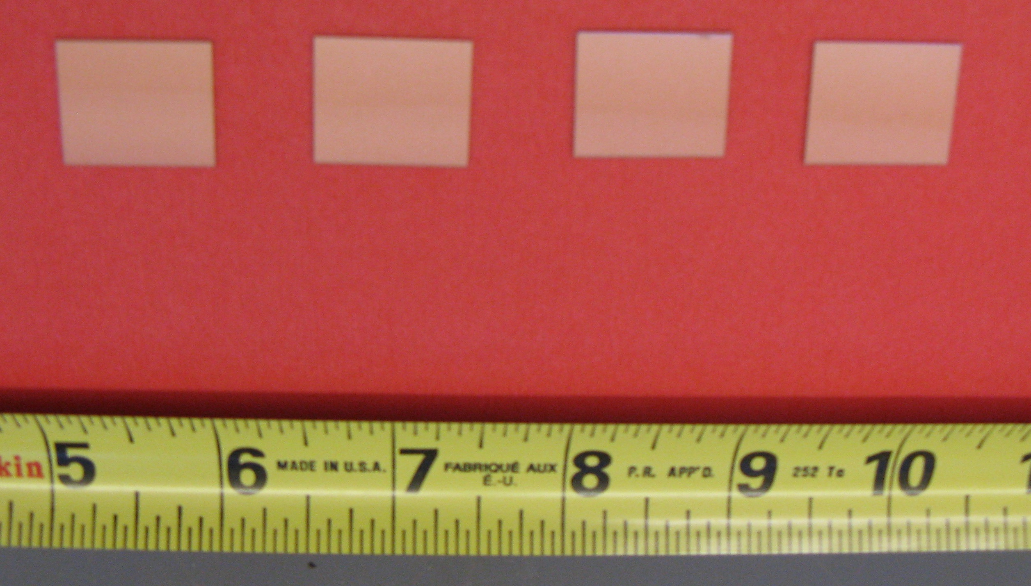
DBM Sensor Inventory
27 sensors ``in hand’’ from IBL demonstrator work
Most need thinning
5 FE-I3 sensors will be cut to give 15 DBM sensors
4 DBM sensors ready for bump-bonding
4 (thick) built into I4 modules
All currently meet DBM specifications

Slide 18
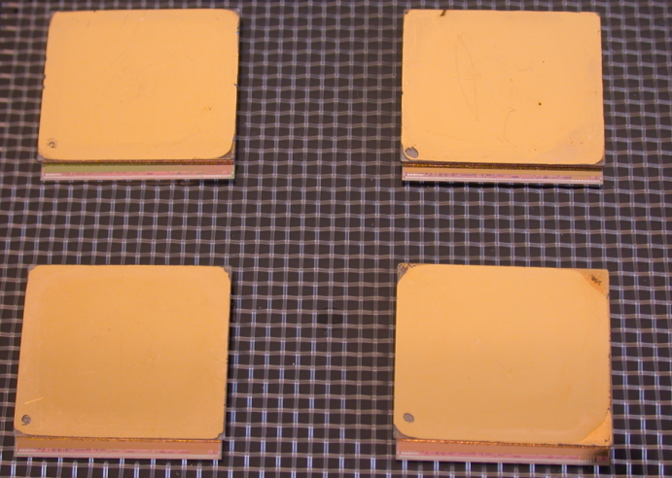
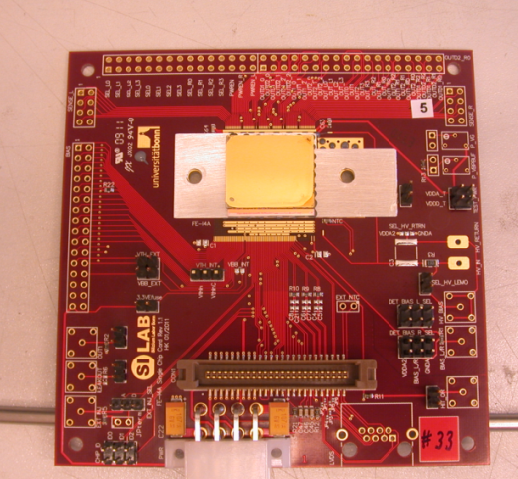
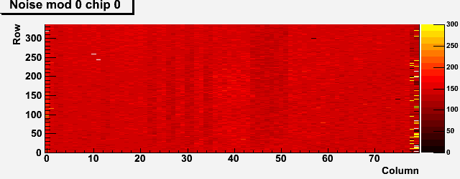
First four DBM modules
Four DBM modules built at IZM
21x18 mm² pCVD from DDL
FE-I4 ATLAS IBL pixel chip
336x80 = 26880 channels, 50x250 μm²
Largest ASIC/diamond flip chip assembly
4 modules after flip-chipping
X-ray perfect
Noise map uniform
Indication of success
HV issues due to IZM metallization up to edge
Module on
test board
Diamond + I4
X-ray after
bump bonding
I4 only
First noise map of a DBM module

Slide 19
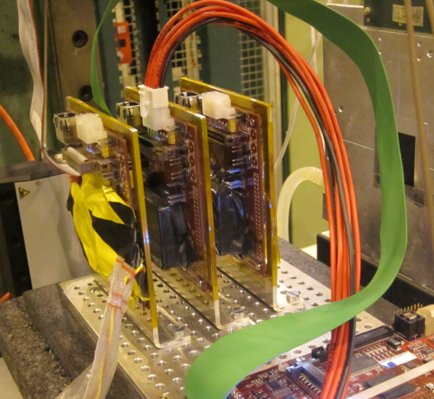
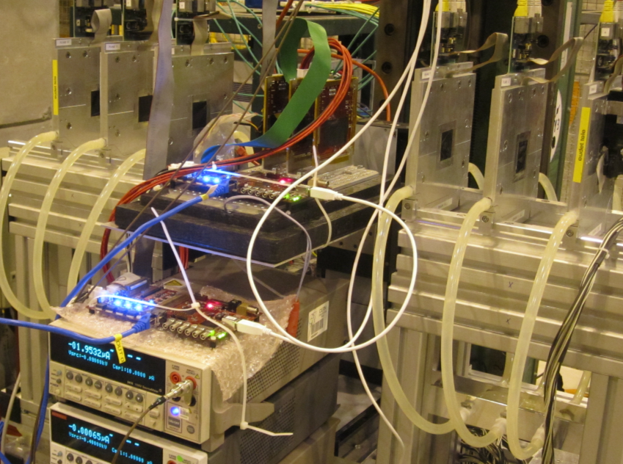
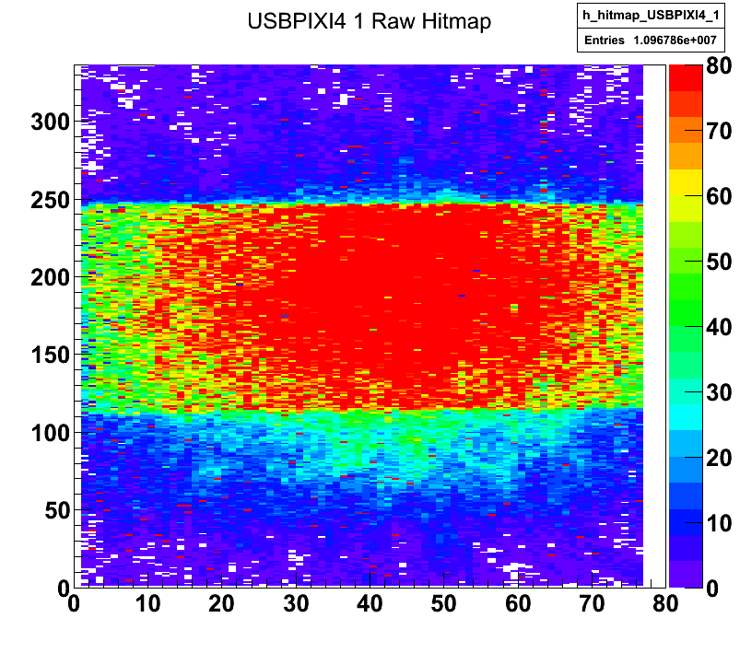
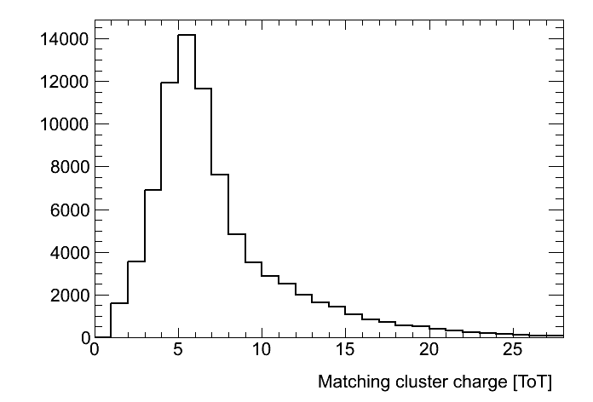
DBM: Module Testbeam Studies
Run1394 1000e Threshold
October 2011
Three Testbeam campaigns
July, late August, October
Learning about FE-I4 performance
Calibration/tuning for low thresholds unique to diamond
Achieved 1000 e threshold (needed for irradiated silicon)
Use testbeam data to tune charge model

Slide 20
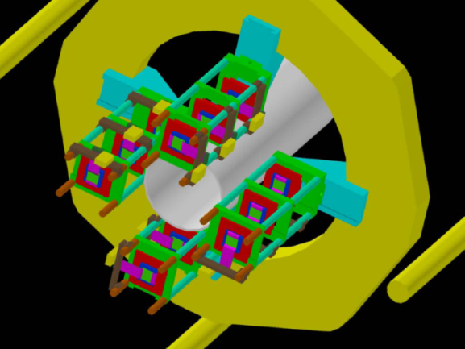
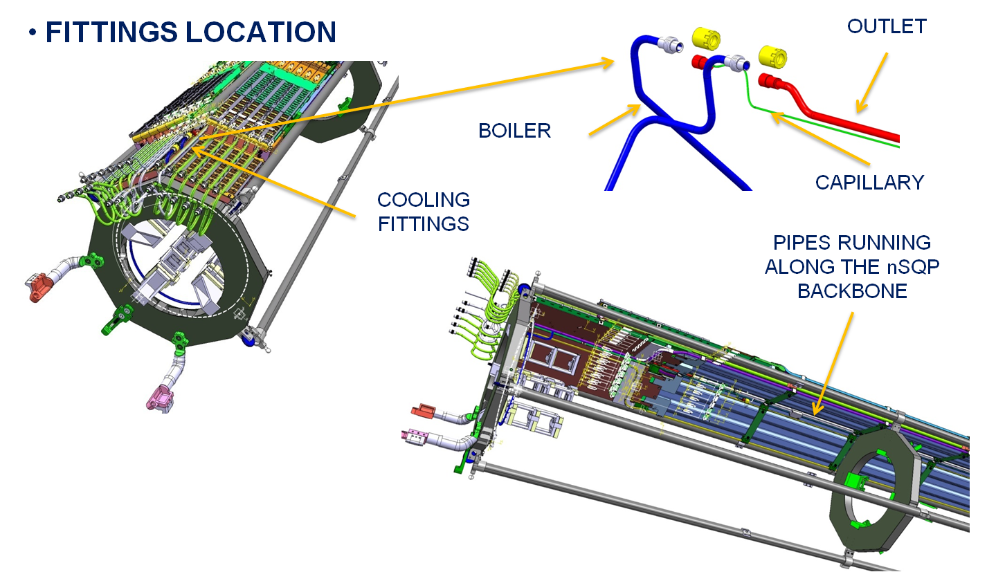
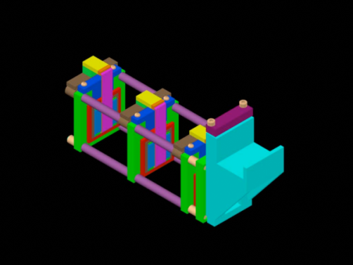
DBM: Support Mechanics
Projective telescope design now being prototyped
Integrate cooling circuit in a simple way
Ensure DBM is thermally neutral, but modules can run at 40C

Slide 21
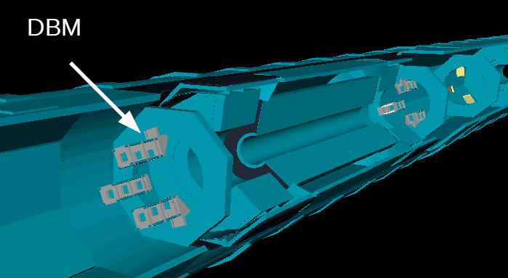
DBM: Simulation/Reconstruction
Full GEANT model available
Geometry forces us to focus on z,θ reconstruction
Momentum resolution weak anyway => precise pixel in r
50 µm in Φ
σ_{z} ~4 cm
50 µm in r
σ_{z} ~0.6 cm

Slide 22
Summary
Fast beam monitoring is very successful in ATLAS
BCM is default luminosity monitor
Abort algorithm in place since 2010
No false positives
Responded as expected in two UFO events near Pt. 1
Expect to arm the BCM abort during 2012 running
Planning an upgrade with spatial resolution
DBM design is finalised
Modules under construction
Will install in long shutdown
Ready to augment BCM information in 2014 running

