Slide 1
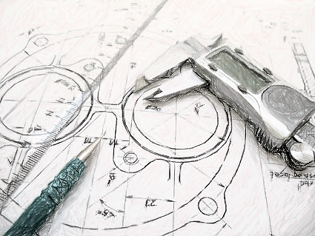
Arrival Time Histogramming Unit.
Requirements and concept
Marek Penno
Dr. Holger Leich
Workshop on Fast Beam Conditions Monitoring at DESY Zeuthen
2012/02/01

Slide 2
Outline.
Objective
  Detector Subsystem BMCF1
  Provide Histogram and Postmortem Data
Requirements
Hardware Concept
Summary

Slide 3
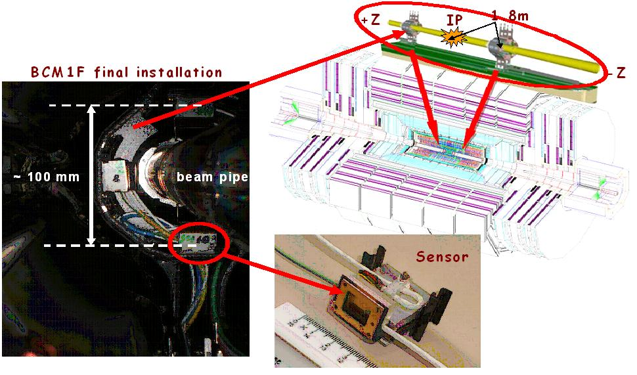
Objective.
BCMF1, a subsystem of the CMS Beam Condition Monitor System
  designed for fast flux monitoring measuring bunch-by-bunch both beam halo and collision products
  located inside the CMS pixel detector close to the beam-pipe
Source: https://znwiki3.ifh.de/CMS/Bcm1F

Slide 4
Objective Goals.
Extend existing DAQ system
Provide continuous beam particle distribution in real time
Provide post-mortem data after beam abort

Slide 5
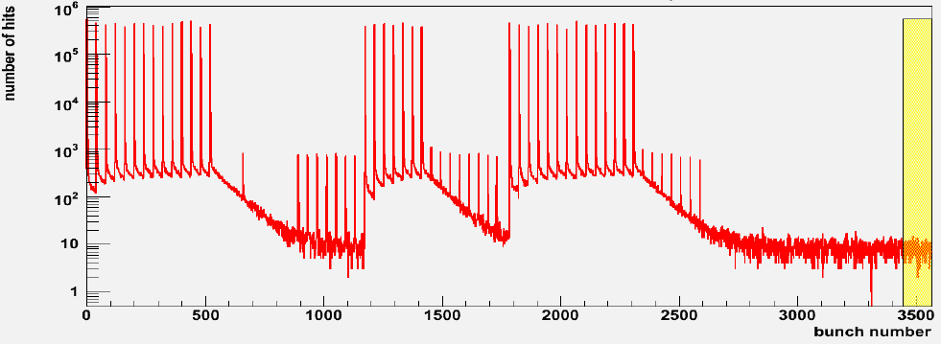
Objective – Reconstruct Particle Distribution.
Reconstruct particle distribution in the accelerator ring
  Monitor the discriminated signals (events) from the detectors of BCM1F
  Monitor detector events in respect to LHC bunch clock and orbit clock
  Acquire time of the orbit trigger and the time of the detector events
  → Reconstruct the distribution of particles in the accelerator ring
  Example Data from the existing DAQ System, TDC Modules:
Source: Elena Castro, FSP CMS Workshop, Beam Condition Data Analysis with BCM1F

Slide 6
Outline.
Objective
Requirements
  Interfaces
  Acquisition
Hardware Concept
Summary

Slide 7
Requirements – Interface for data acquisition.
8 detector input channels
  ECL Type, optional 120 Ohm Termination, common ground
  Sample Rate: 6.25ns
supplementary input channel “Bunch filled”
  Sample Rate: <= 25ns
supplementary reserve input channel
  Sample Rate: <= 25ns
Orbit Trigger input
  NIM, 50Ohm termination
Bunch Clock input
  NIM, 50Ohm termination
Beam abort input signal
  NIM, 50 Ohm termination

Slide 8
Requirements – Further Interfaces.
VME Slave
  Communication with VME Controller, access the control registers
Network
  Communication with DAQ System, transfer of acquired data
USB Slave
  Optional communication with DAQ System
RS322
  Administrative Interface
JTAG
  Programming Interface

Slide 9
Requirements – Data Acquisition.
Post Mortem Data
  Filled continuously with event data from the detector inputs
  Organized as ring buffer → outdated data being overwritten
  Acquisition is stopped at beam abort event
  Postmortem Data contains detector event data of the last 50 orbits
  Software reads out post mortem data on beam abort

Slide 10
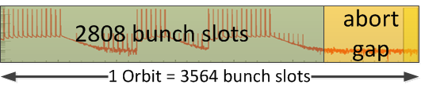
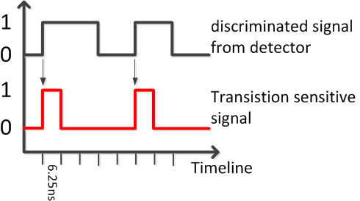
Requirements – Data Acquisition.
Histogram Data
  For each channel (8 detector + 2 supplementary)
  Statistical overview of count of events in respect to N orbits
  Sample Rate: 6.25ns = 160 MHz = 4 times bunch clock (40 MHz)
  Each orbit: 3564 bunch timeslots → 14256 bins in histogram per channel
  → Monitor all possible
  bunches and the
  “abortion gap“
  Bin’s width: 16 Bit → 65535 orbits = 5839.1ms timespan
  Double Buffered System: continuous data acquisition → no information loss
  Transition sensitive sampling
  or synchronous sampling:

Slide 11
Outline
Objective
Requirements
Hardware Concept
Summary

Slide 12
Hardware Concept – ATHU Bird eye view

Slide 13
Hardware Concept – Block Schematic.
Single FPGA solution
Ext. RAM for post mortem data
  Reduced FPGA memory requirements
Int. FPGA ram for histogram data
  Fast read and write requests with in 6.25ns
Single Board Computer
  Data readout
  Acquisition control
  Network communication

Slide 14
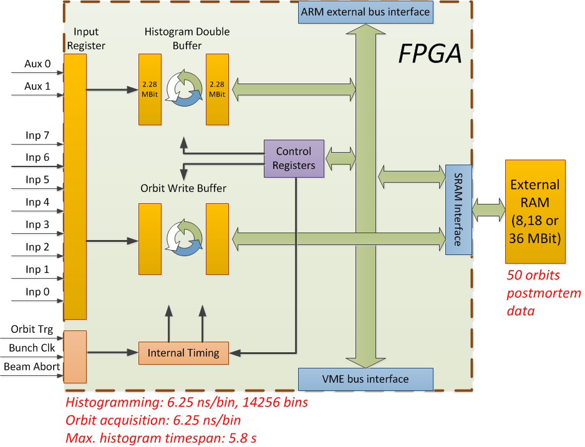
Hardware Concept – Detailed Implementation Schema.

Slide 15
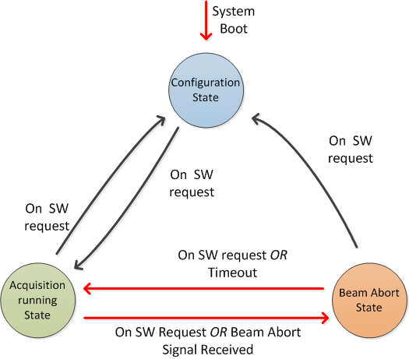
Hardware Concept – Operation States.
Configuration
Acquisition
Postmortem Analysis

Slide 16
Summary.
Concept of a VME Module
Extending the existing DAQ system
10 Channel, Sample Resolution 6.25ns
Continuous beam particle distribution in real time
  Histogram function: 14256 Bins a 16 Bit per channel
  Continuous data acquisition, no information loss
Post-mortem data after beam abort
  50 orbits detector event data
Communication via VME Bus, Network and USB

Slide 17
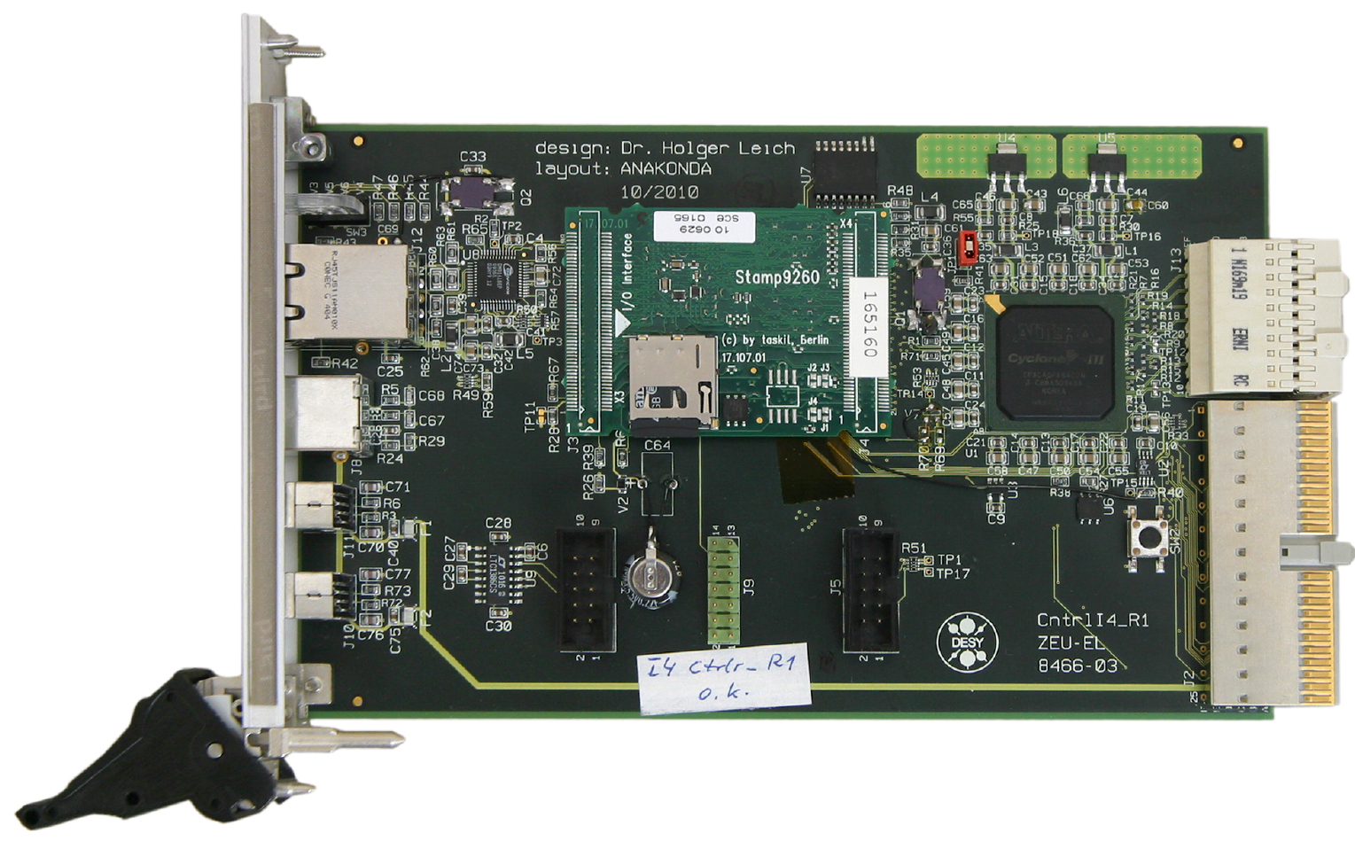
Example of SBC with FPGA

Slide 18
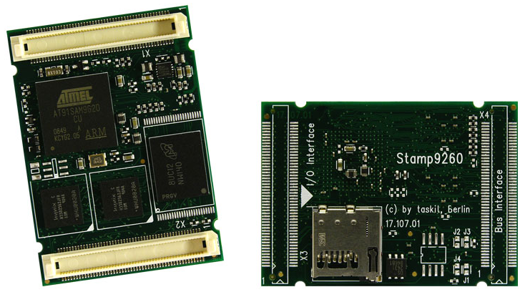
Single Board Computer
CPU: AT91SAM9G20
RAM: 128MB, FLASH: 512 MB,
Static Memory Interface to FPGA (~ 20MB/sec)
USB 2.0, Ethernet 10/100MBit, SD Card Drive as persistent Memory

