Slide 1
AIDA Infrastructure for very forward calorimeters
9/05/2012
Designers: In collaboration with:
Eric David François-Xavier Nuiry
Christophe Bault Andrea Catinaccio

Slide 2
Overview
Requirements
AIDA very forward calorimeter design
→Mechanical frame
→Tungsten support
→Silicon detector support
Tungsten mounting concept
Design validation
→Tests on springs, glued joints, bearings, manufacturing
Manufacturing status
→Mechanical frame
→Combs
→Tungsten frame
→Silicon Sensor frame
→Hood
→Tungsten
→Silicon sensors
Summary

Slide 3
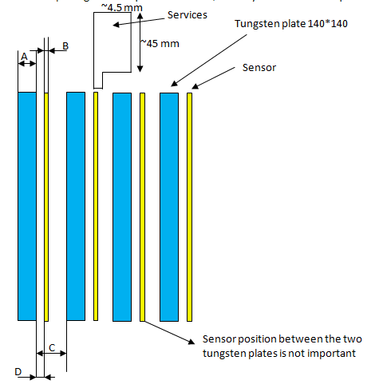
Requirements
Design and manufacturing of a mechanical structure for tungsten plates and silicon sensors.
A=3.5±0.5mm B=0.32±0.015mm C=2, 1, or 0.5 ±0.05mm D=not really important
60

Slide 4
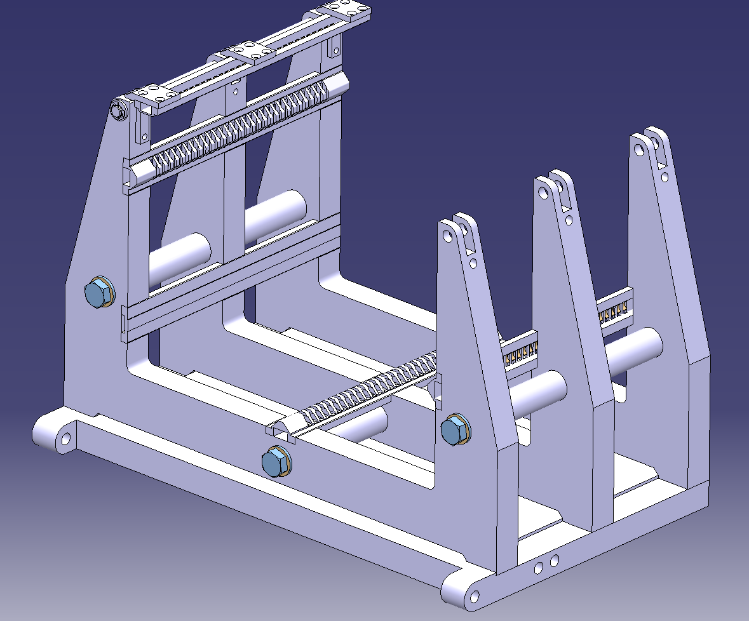
AIDA very forward calorimeter design Mechanical frame
Multi-parts structure ST0372459
Able to work with 2mm and 1mm gap between tungsten plates
212mm
255mm
3 spacers
3 Comb slots
368mm
200mm
Plan support slot
3 holders

Slide 5
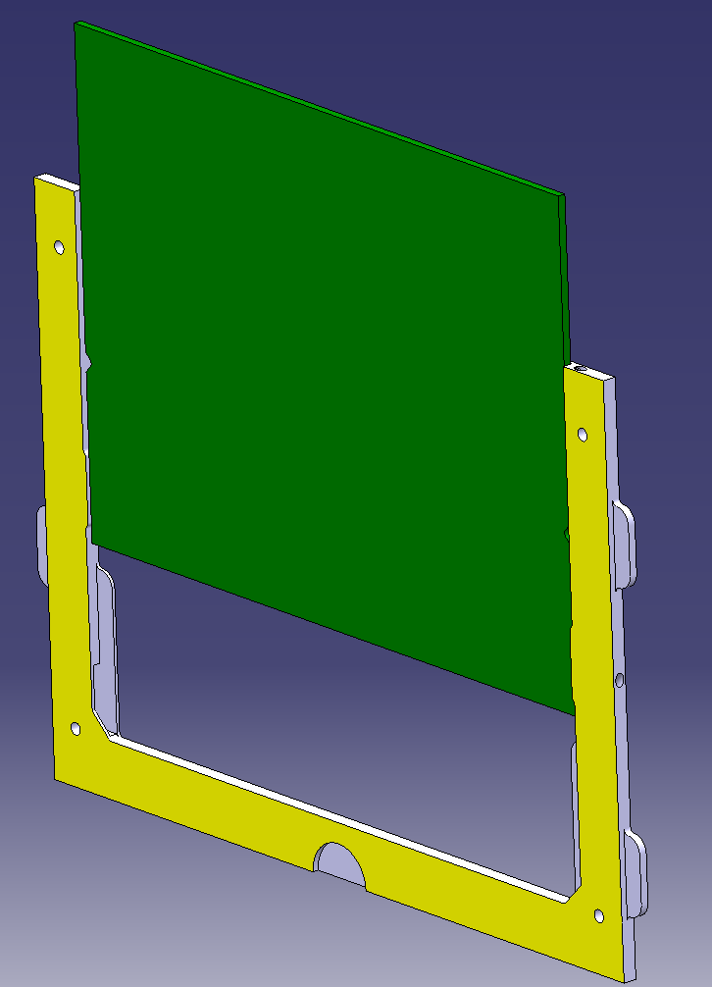
AIDA very forward calorimeter design Silicon sensor support
210mm
160mm
Silicon detector
Permaglas U shape

Slide 6
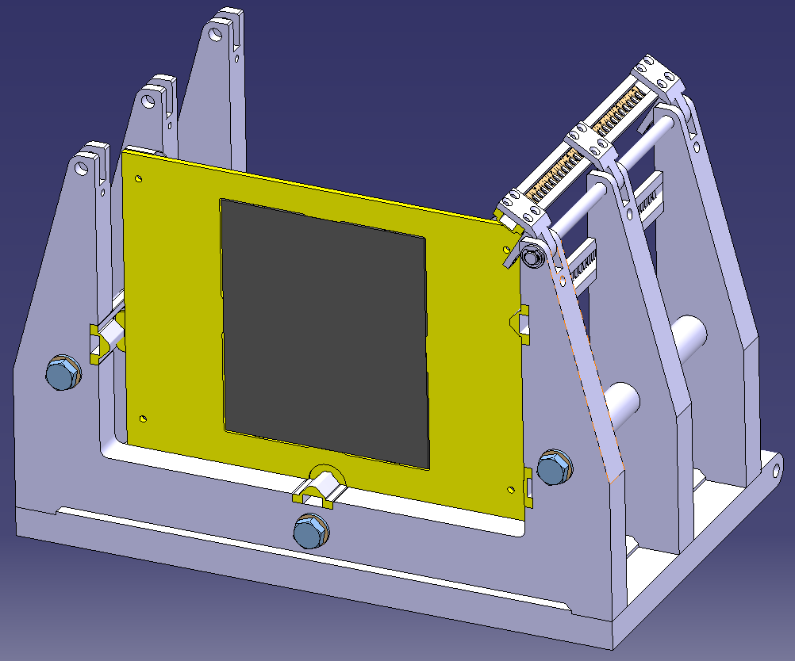
AIDA very forward calorimeter design Tungsten support
3 bearings
Front view
Back view
Spring
Ground
Material: Epoxy + glass fibres = PERMAGLAS
Tungsten plate is glued inside this frame

Slide 7
Tungsten plate mounting concept
On the marble
W
W
J=C+D-(A+B)
A=3.5 +/-25μm
B=2 +/-2μm
C=5.5 +/-20μm
D=2 +/-2μm
Jmax = 5.520+2.002-3.475-1.998=2.049mm
1. W plate put on the marble
2. Three red spacer are installed on top of bearings
3. Perm. frame installed around the W plate, supported only on 3 red spacers
4. Glue (Araldite 2011) between W and Permaglas
J
A
3.5
B
D
C
J=B-A
A min=3.475mm
A max=3.525mm
B min=5.480mm
B max= 5.520mm
J max= 5.520-3.470= 2.05mm
J min= 5.480-3.530= 1.95mm
In the calorimeter
W
W
1. W + Permaglas insertion in combs
2. Accuracy given only by the W machining and the comb machining.
J
A
3.5
B

Slide 8
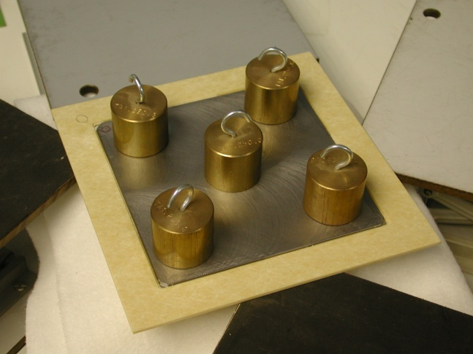
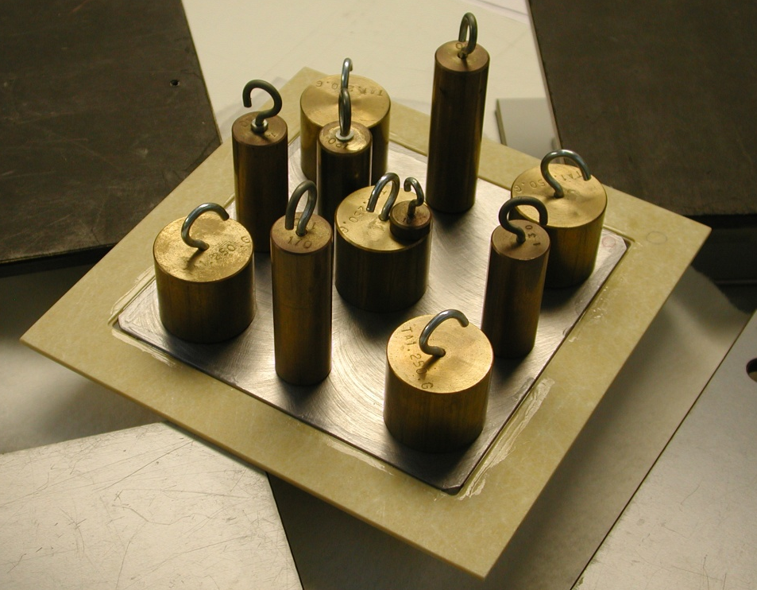
Calorimeter design validation Tests on glued joints
Glued joint
1Kg
W plate + Permaglas assembly held on 3 points
2Kg
During 24 hours
The tungsten plate can be easely removed from the frame while putting it in a methyl chloride bath (the test has been done).

Slide 9
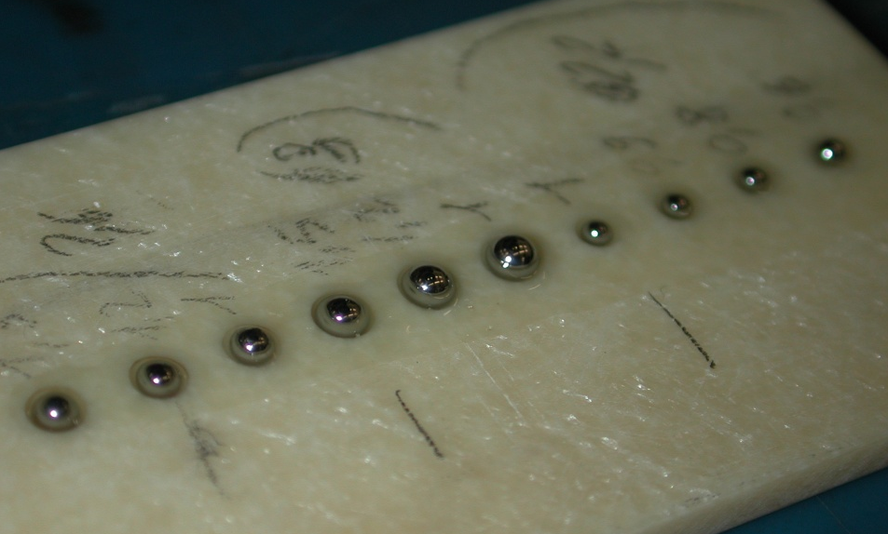
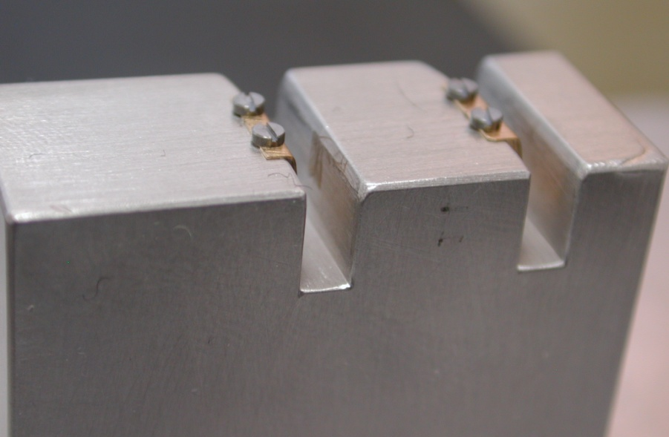
Calorimeter design validation Tests on springs and bearings
1
1
2
1
2

Slide 10
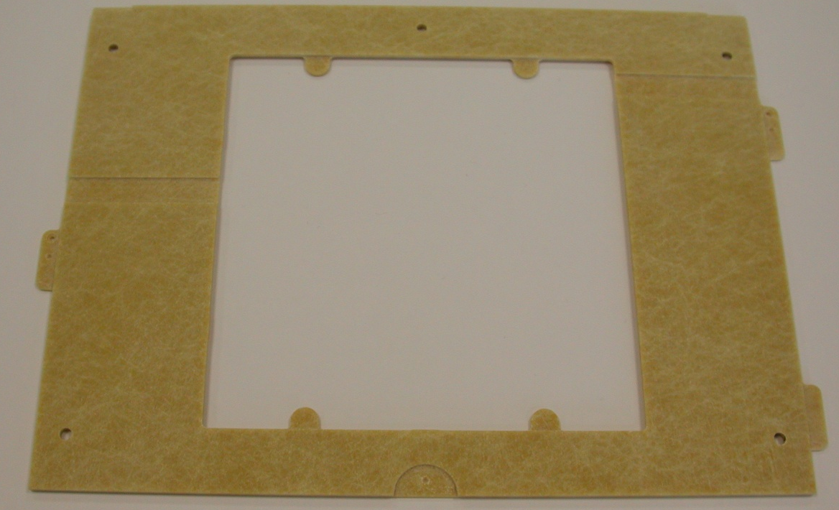
Calorimeter design validation Manufacturing tests
W frame machining tests
W machining tests
Detail of an ear
Groove for the glue
Groove for the grounding

Slide 11
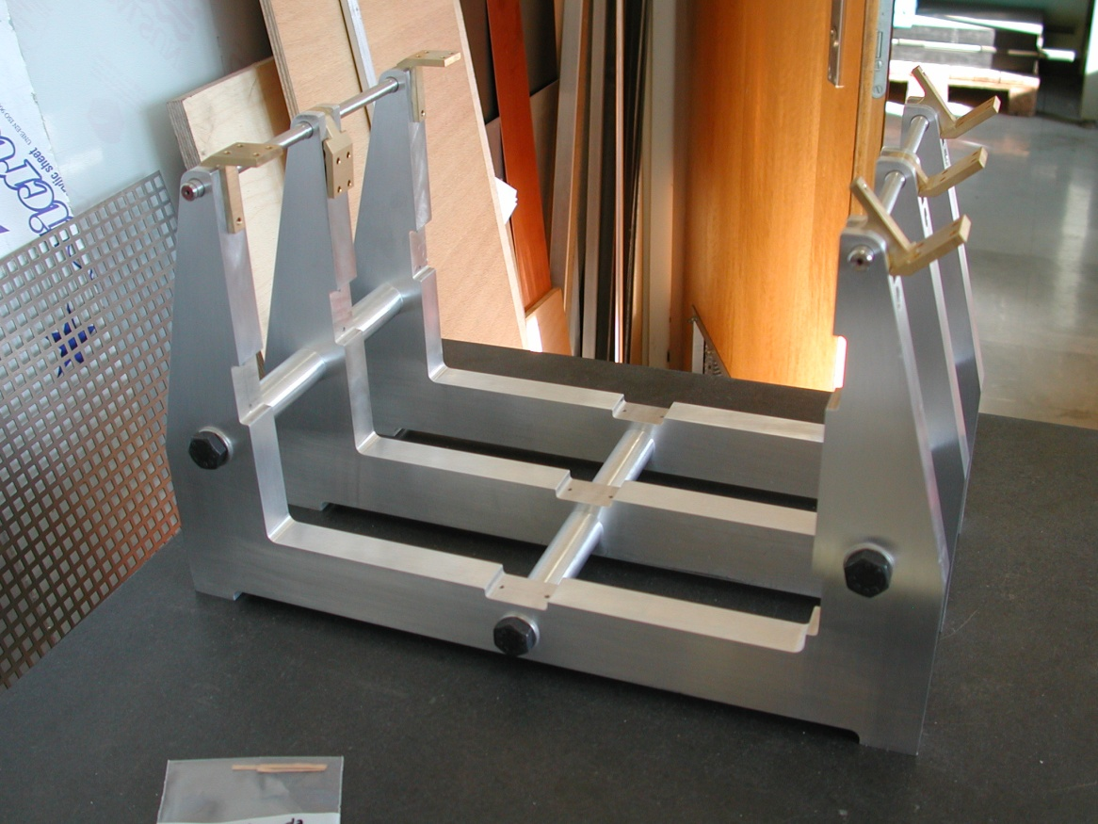
Manufacturing status Mechanical frame
The frame is done
The support plate is under manufacturing @ CERN
End: ~30/04/2012

Slide 12
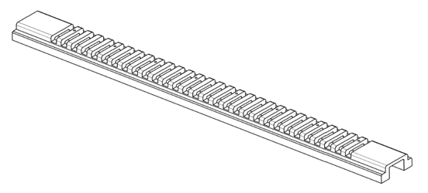
Manufacturing status Combs
→3 combs types, and 2 sets
Subcontracted to a Belgium firm BRITTE
Delivery date: 15 Mai 2012

Slide 13
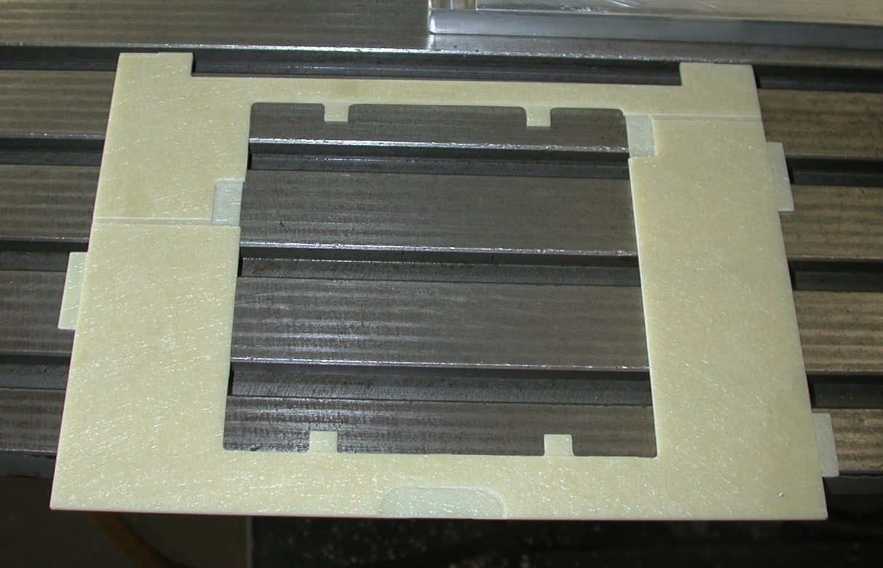
Manufacturing status Tungsten frame
2 frames have been manufactured at CERN
We may be able to launch 3 additional frames @ CERN
TOTAL: 5 frames done at CERN
An order of 20 frames is ongoing

Slide 14
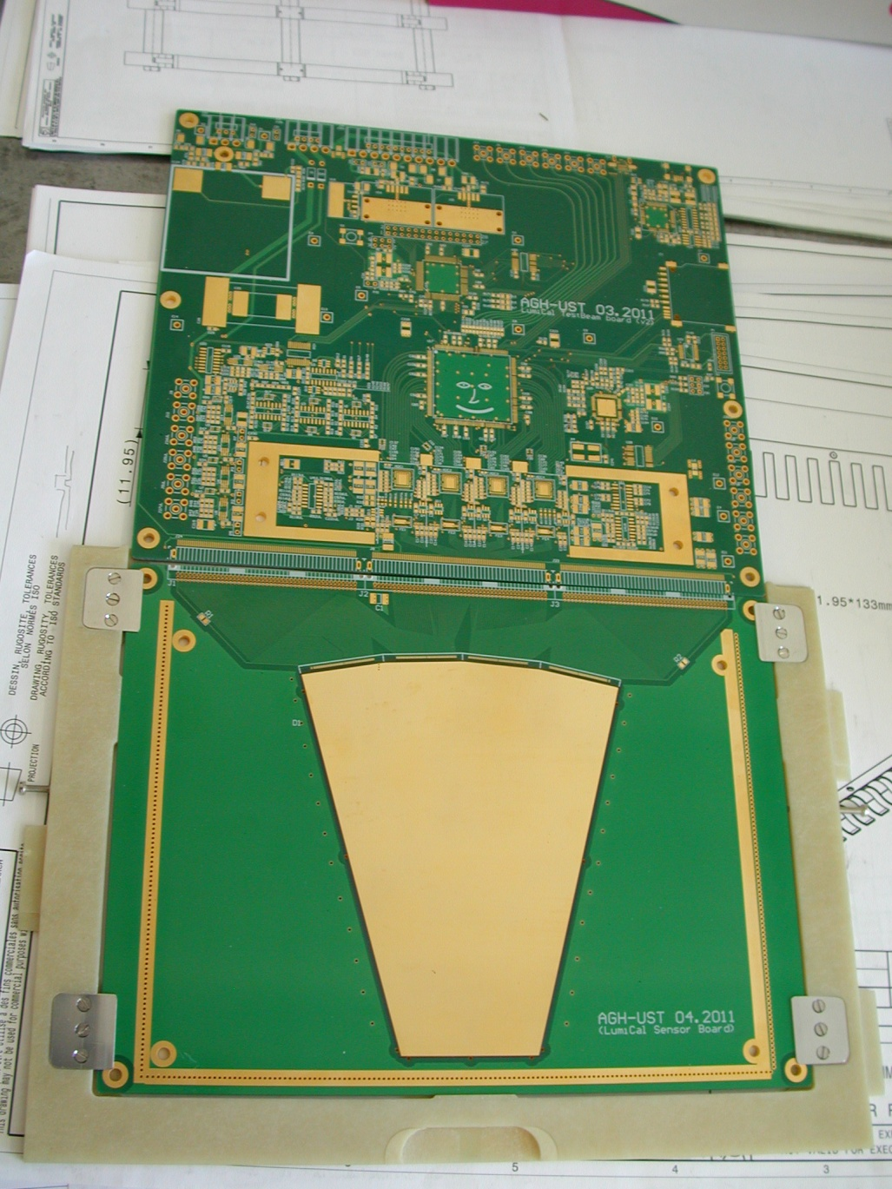
Manufacturing status Silicon sensor frame & Silicon sensors
1 frame has been manufactured at CERN
We may be able to launch 4 additional frames @ CERN
TOTAL: 5 frames done @ CERN
The calorimeter might be ready for 5 silicon sensors (picture design).

Slide 15
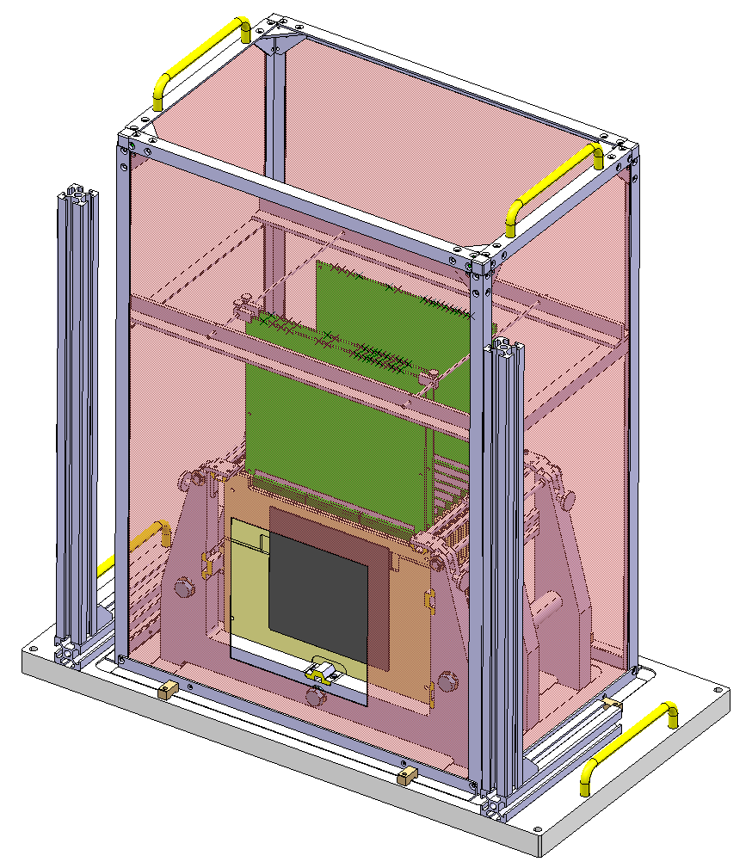
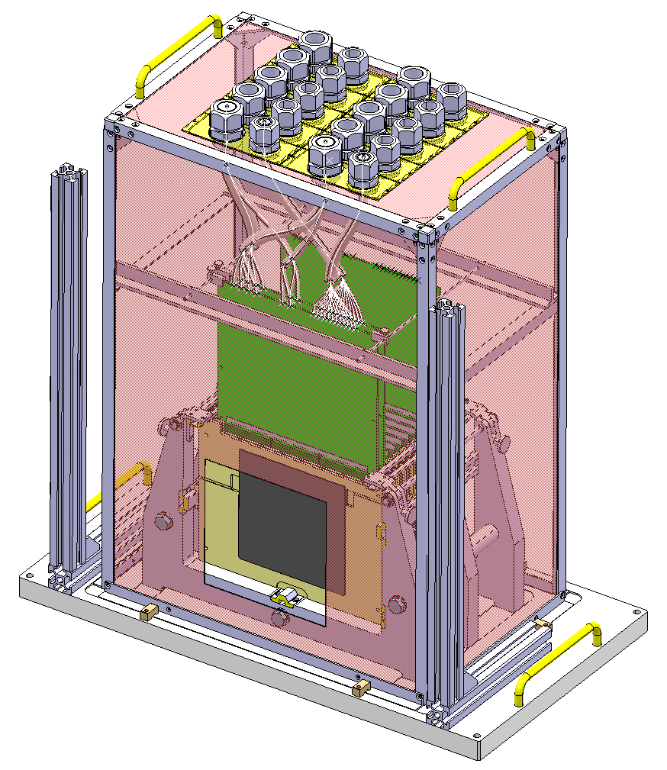
Manufacturing status Hood & Services supports
Electronic card blocking system
Will be soon manufactured (May/June)

Slide 16
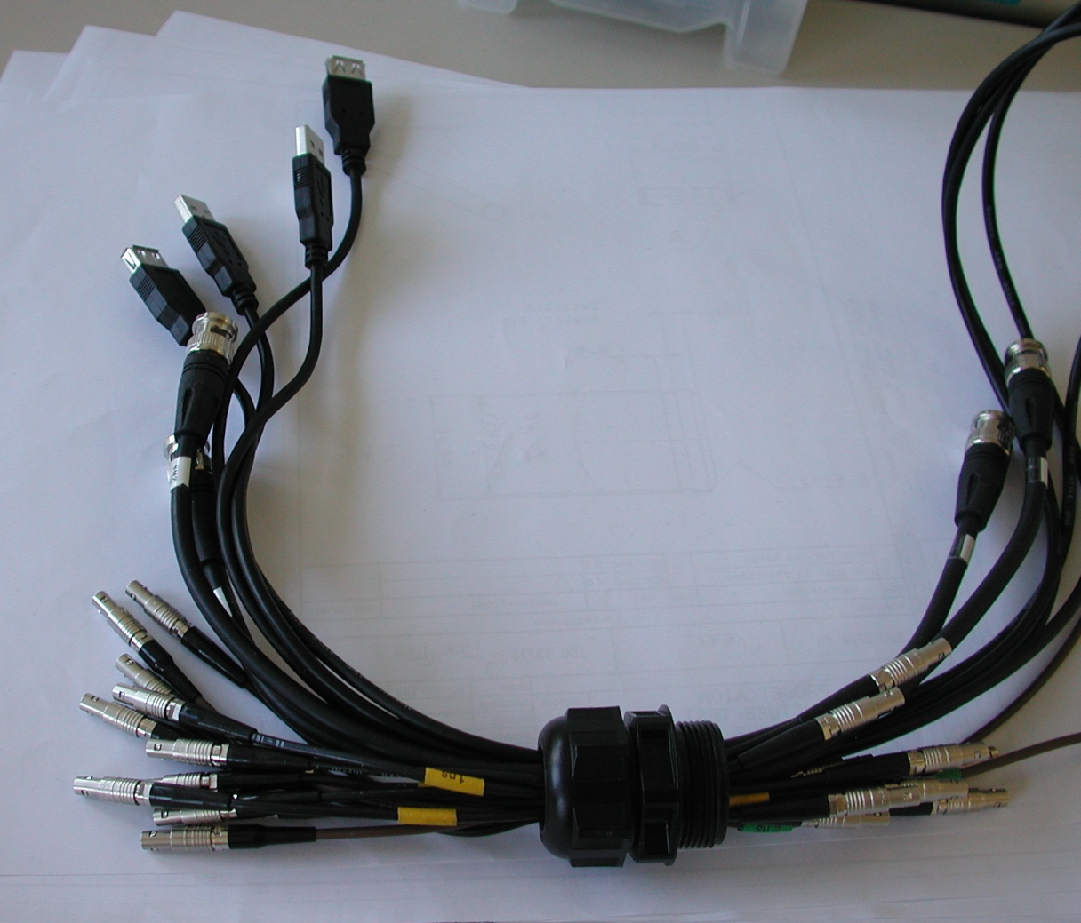
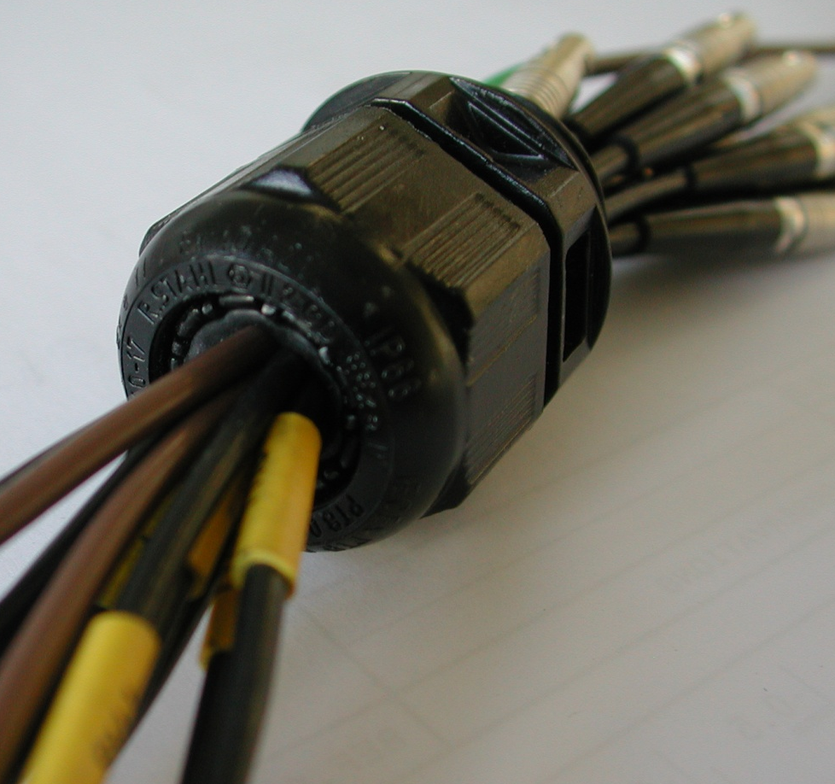
Manufacturing status Hood & Services supports
Standard Compression Gland

Slide 17
Manufacturing status Tungsten plates
5 tungsten alloy plates ordered to each companies:

Slide 18
Summary
Group | Tasks / Parts | Manufacturer | Status | Delivery Dates
Manufacturing | Mechanical frame | Subcontractor + CERN | 100% by beginning of May | -
 | Combs | Subcontractor BRITTE | 100% Manufactured by 15/05 | 15th May
 | Springs | CERN | Top and bottom springs have to be done | 5/05/2012
 | Tungsten frame | Subcontractor Resarm + CERN | 2 are ready, 3 more could be done at CERN Rest: subcontracted | ~ 1/07/2012
 | Silicon sensor frame | CERN | 1 is ready, 4 have to be manufactured | ~End of June
 | Hood and services support | CERN | Drawings are done Parts have to be manufactured | ~ 1/07/2012
Assembly & tests | Integration tests with dummy W plates | CERN | Could be done end of May | ~ 1/06/2012
 | W plates delivery | Plansee + MG sanders | Under manufacturing | ~ 15/06/2012
 | Hood assembly | CERN |  | 30/07/2012
 | W & Si frames assemblies | CERN |  | 30/07/2012
The calorimeter should be ready, with 10 W plates by end of August.

Slide 19
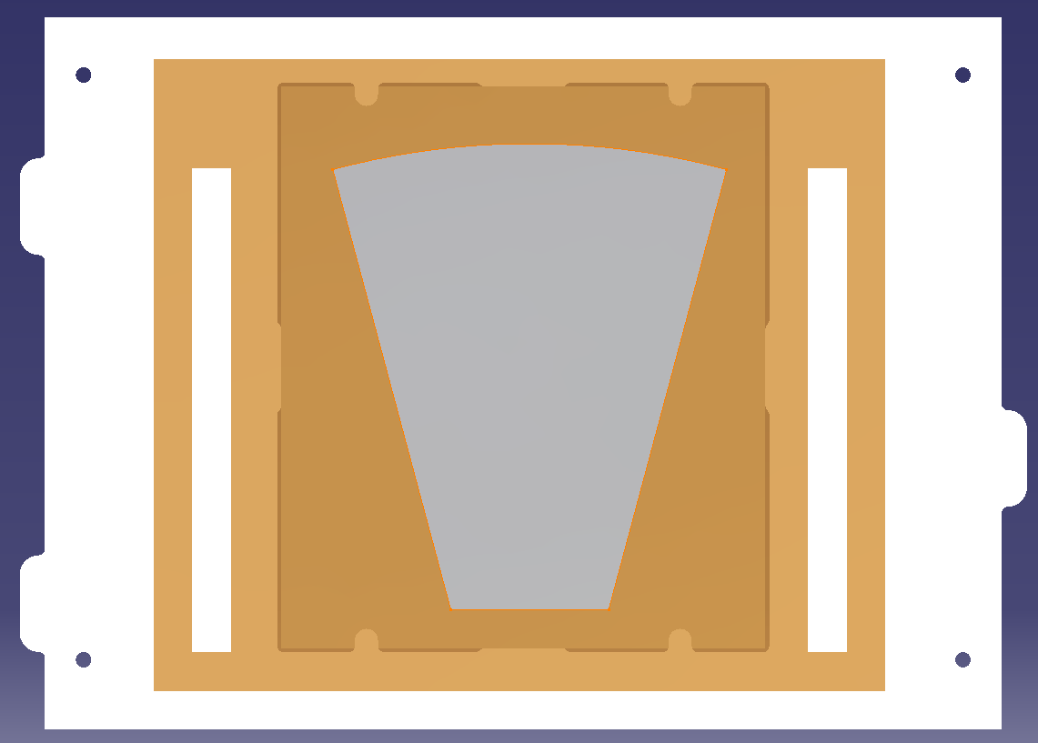
Next Step...C=0.5mm
The idea:
We use the same tungsten plates
We could use the same Permaglas frame (in white in this picture)
We glue the Si detector + the read-out on the Permaglas frame
We could realise a sliding kinematic between each tungsten plate, in order to reach the 0.5mm gap between each W plate.
A new mechanical frame is mandatory

Slide 20
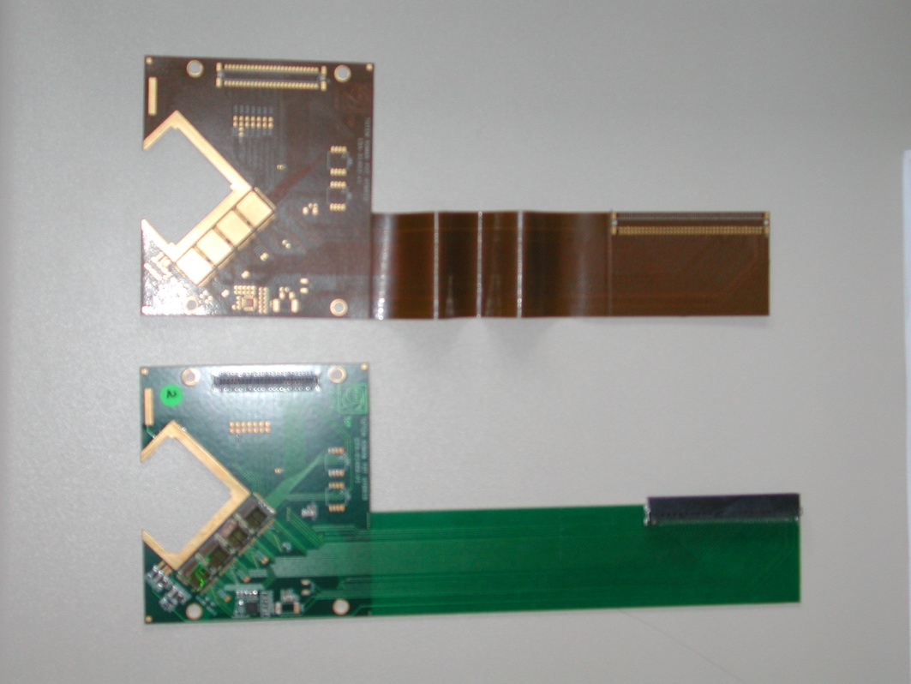
Next Step...C=0.5 mm
The most important for us:
Realising a flexible link between the sensor and the read out.
Something similar to this example:
Silicon sensor
Connector for the read out
Flexible part
Rigid part (PCB)

Slide 21
Appendix 1: Additional information about the frame
C=2mm
→ We work with an offset of 5.5mm
C=1mm
→ We work with an offset of 4.5mm
A=3.5
A=3.5
Distance before next
tungsten
Distance before next
tungsten
BEAM
C=2
Tungsten plate 125*145
C=1
Tungsten plate 125*145
Gap=5.5
Gap=4.5

Slide 22
C=2mm between each tungsten
→ We work with an offset of 5.5mm
Electronic board
Electronic board
Electronic board
~10.5
~10.5
~10.5
A=3.5
~2.5
~2.5
~2.5
BEAM
Sensor
Sensor
Sensor
Tungsten plate 125*145
C=2
C=2
Gap=5.5
Gap=5.5
Gap=5.5
Gap=5.5
Gap=5.5
Gap=5.5
Gap=5.5
No sensor In this gap
No sensor In this gap
No sensor In this gap
No sensor In this gap

Slide 23
C=1mm between each tungsten
→ We work with an offset of 4.5mm
Electronic board
Electronic board
Electronic board
New set of combs!
~10.5
~10.5
~10.5
A=3.5
~2.5
~2.5
~2.5
BEAM
Sensor
Sensor
Sensor
Tungsten plate 125*145
C=1
Gap=4.5
Gap=4.5
Gap=4.5
Gap=4.5
Gap=4.5
Gap=4.5
Gap=4.5
Gap=4.5
Gap=4.5
No sensor In this gap
No sensor In this gap
No sensor In this gap
No sensor In this gap
No sensor In this gap

Slide 24
Appendix 2: Additional information about the frame
What we can do with C=2mm:
→ We work with an offset of 5.5mm
Electronic board
Electronic board
Electronic board
Electronic board
~10.5
~10.5
~10.5
A=3.5
~2.5
~2.5
~2.5
BEAM
Sensor
Sensor
Sensor
Tungsten plate 125*145
C=2
Gap=5.5
Gap=5.5
Gap=5.5
Gap=5.5
Gap=5.5
Gap=5.5
Gap=5.5
Gap=5.5
No sensor In this gap
No sensor In this gap
No sensor In this gap
No sensor In this gap

