Slide 1
Porting: Lessons learned and plans for Monte Bianco and beyond
Cristina Aiftimiei (INFN)
EMI Release Manager
Andrea Ceccanti (INFN)
SA1 WP Leader
4th EMI All-Hands Meeting
Hamburg, 8th – 10th May. 2012

Slide 2
Outline
Essential ingredients
The Matterhorn porting challenges
Lesson learned
Y3 plans

Slide 3
Essential ingredients
Knowledge of specific platform packaging policies
Clear procedures
Stable tools
Progress monitoring

Slide 4
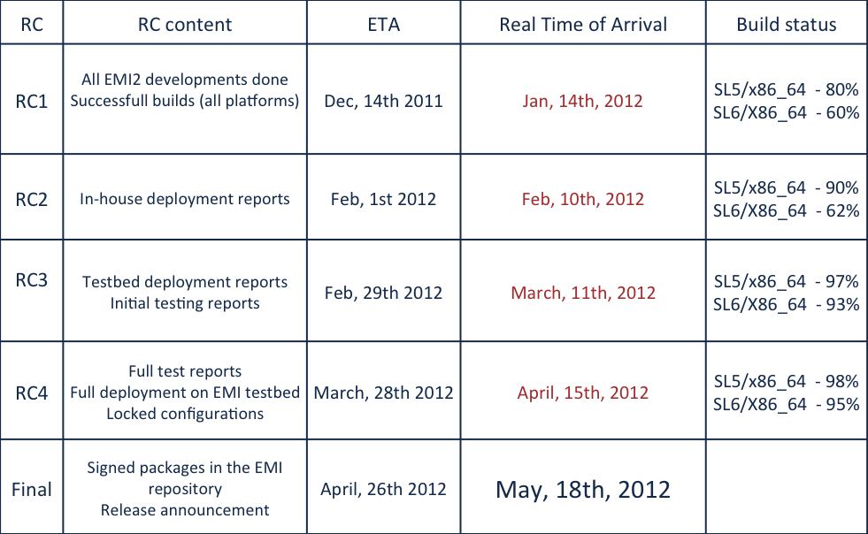
Matterhorn porting challenges

Slide 5
Lessons learned – SL6 porting
SL6 is NOT SL5 !
Several subtle changes that made our life harder
tomcat5 to tomcat6
Libcurl/nss (instead openssl)
Bouncycastle 1.46: Revision release, HUGE changes From BC release notes: "It's not a simple drop in like previous releases, if you wish migrate to it you will need to recompile your application.”
YUM repository handling changes
impact on tools and configuration

Slide 6
Lessons learned – Deb6 porting
Debian6 is not SLx!
No experience:
steep learning curve for PTs and ETICS developers
Not perceived as an high priority objective
No clear requirement from our customers
SL6 porting, maintenance and development were enough to fill PTs agendas

Slide 7
Y3 plans - Debian6
Tools (modulo small bugs) are now stable
No major new functionality will be added in the third year
All clients ported before October
Porting closely monitored on a weekly basis

Slide 8
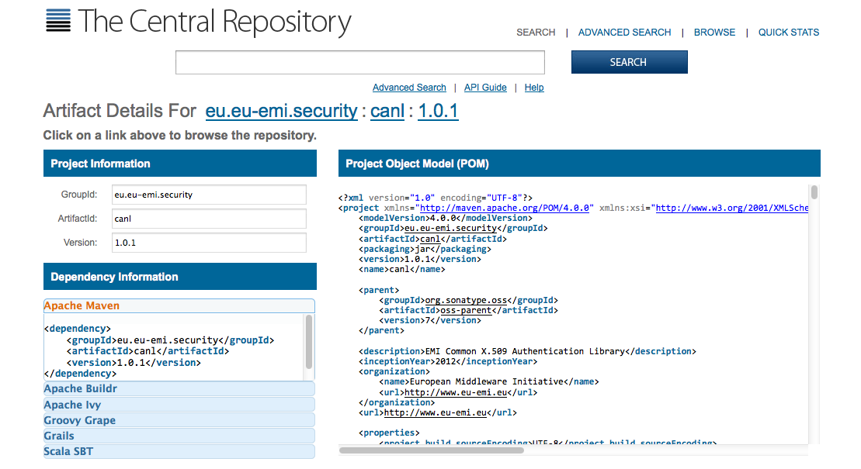
Y3 plans
EMI presence on main upstream repositories
EPEL/Debian repositories:
Managing EMI packages in EPEL
Assess current status:
a survey will be setup in the next weeks
Work towards EPEL compliance leveraging SA2 RPMLint and Lintian monitoring
this gets more priority in year 3 for SA1
Maven central:
Maven Central submit process
push EMI Java APIs on Maven central
follow CANL example

Slide 9
Y3 plans
Goal – “binary packages of a high enough level of maturity and maintained by expert open source packagers are distributed via officially endorsed repositories like EPEL, Debian, Fedora, Maven Central”
Achieve by:
“high level of maturity” ~ 100% EPEL compliance (Rpmlint) & srpms maintained by PTs (packager) → target EMI 2
“expert open source packagers” ~ PTs own “packager” or “trusted” packager maintain/push to endorsed repositories → target EMI 3
Y3 - Building & Packaging strategies:
Assess who's still using the ETICS packager (June)
All builds are done from source packages (October)
ETICS role is to fetch src package from external repo (EPEL/ PT internal)
and run mock/pbuilder on it

Slide 10
Thank you
EMI is partially funded by the European Commission under Grant Agreement INFSO-RI-261611

