Slide 1
NA2 – Dissemination and Training
Emidio Giorgio, INFN Catania
Desy, 4th EMI All hands meeting 08-05-2012

Slide 2
Overview
Highlights since Padua
Dissemination
Training
Next activities

Slide 3
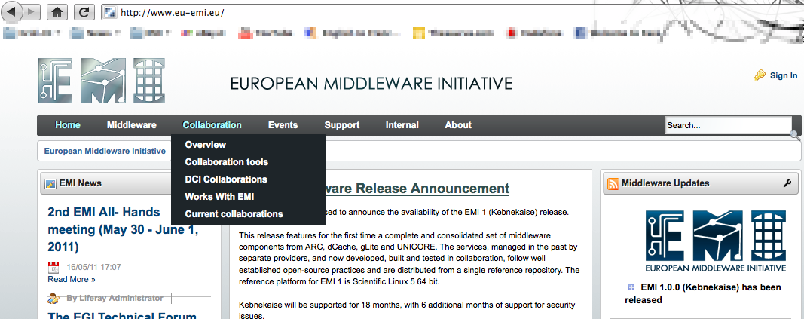
Web site improvements
Notes:
General lines : lightweight approach, less text and more pictures, less info about the project and more about the software
Navigation path

Slide 4
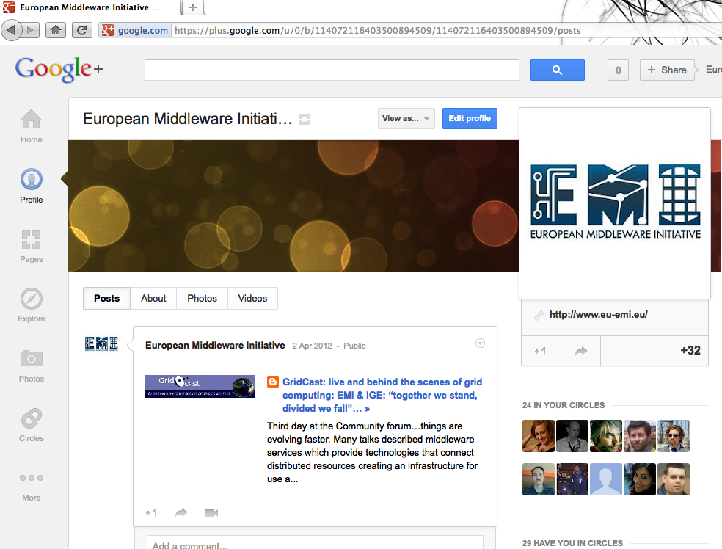
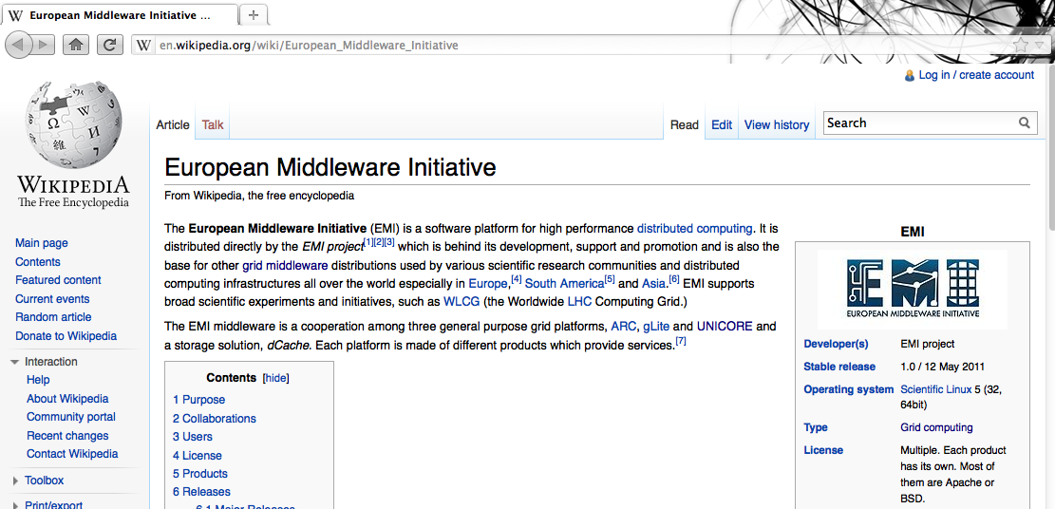
Web presence

Slide 5
Web Articles
Middleware and Standardization
Data evolutions in EMI 2
Security Token Services
EMI and UMD
Science Soft
Upcoming EMI 2 release
EMI quality of software
EMI Execution Service
Information system advances : EMIR, Glue2

Slide 6
Dissemination events
ISCG2012, Taipei
EMI TC2, Münich
EMI Online Game
Publication of proceedings
CHEP 2012 – New York, May
ISC2012 – Hamburg, June
OGF 35, Delft, The Netherlands
EGI Technical Forum, Prague
OGF 36, Chicago
SuperComputing 2012, Salt Lake City
We need to know your contributions to these or other events
Any
suggestions ?

Slide 7
Dissemination material
https://www.eu-emi.eu/dissemination
Dissemination Material
A0 Posters (10)
High level videos (2)
Banner
Brochure 2012
Bookmark
EMI Online games (2)
New poster templates with acknowledgement of EU funding

Slide 8
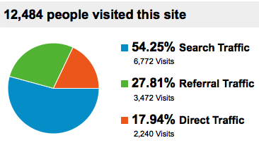
An overview of web accesses
 | 2011 | 2012 | Trend
Visits | 5160 | 12484 | +141,94%
Unique Visitors | 2179 | 4868 | +123,41%
Pageviews | 17,406 | 40238 | +131,17 %
Trends comparison Nov 2010 - Apr 2011 Nov 2011 - Apr 2012
Top 5 visited pages
Products
Emi-1-kebnekaise
Documentation
Releases
Emi-1-kebnekaise-updates
Top 5 search keyword
Emi middleware
Emi
Emi grid
European middleware initiative
Configure LB WMS same host

Slide 9
Training
In reach
Debian packaging tutorial
EMI 2 updated policy changes
EGI/EMI 2nd TC
L&B, ARC CE data staging, EMI-ES, WNoDeS, DPM
ARGUS, ARC [Developers]
Training for NGI’s, June-July
GridKa2012 :
CREAM, site BDII, UNICORE, ARC
EGI TF 2012, September
Thanks for input (emi-training ‘at’ eu-emi.eu)

Slide 10
Summary
More interaction needed
Good examples : Release web pages (SA1), Documentation review (SA2), Factsheet area (NA3)
Disseminate/contribute to the web site
it’s our main source/gateway of information
Conferences
let us know your contributions
Pro-active support
Indication of worth disseminating subjects
Contributions/inputs for articles
Notes:
Too much focus on technical aspects

Slide 11
Thanks

