Slide 1
EMI SA2 Report
Alberto AIMAR, CERN SA2, WP Leader
EMI AHM, Hamburg Germany

Slide 2
SA2
Quality Assurance
SA1
SA1
QA Policies
QA Metrics
Development Trackers
Reports &
Dashboards
Quality Control
Integration Infrastructure
Build and Test Tools
JRA1
NA2
JRA1

Slide 3
Outline
Policies
Tools
Testbeds
Metrics
Quality Control
https://bit.ly/emisa2

Slide 4
Outline
Policies
Tools
Testbeds
Metrics
Quality Control
https://bit.ly/emisa2

Slide 5
QA Policies
QA Policies

Slide 6
QA Policies Updates
QA Policies
Mayor update to the Policies for EMI 2
Adaptations for SL6 and Debian 6 (config, packaging, etc)
Changes to adapt to conventions for each platform
Training on the policies changes
https://twiki.cern.ch/twiki/bin/view/EMI/SA2
Consolidation of the Verification Dashboard
Improved with real use feedback from EMI 1 updates
Integration with other tools as source for reports
Many small features to improve usability
http://emi-verification.cern.ch/

Slide 7
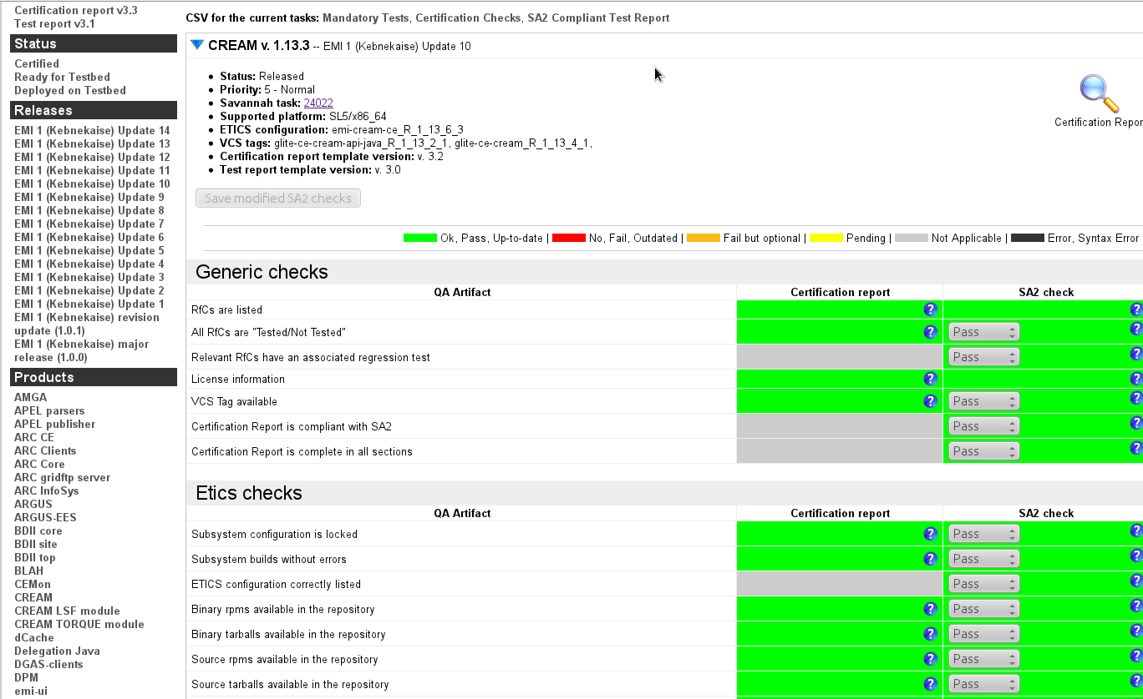
EMI Verification Dashboard
QA Policies
http://emi-verification.cern.ch

Slide 8
QA Policies – Year 3
QA Policies
Update of the SA2 QA policies
No mayor changes planned for EMI 3, but policies can still be discussed and changed as needed
Will depend on the post-EMI plan
Maintenance of the Verification Dashboard
In order to provide more data for the reports
Adapt to possible changes in the policies
General bug fixing and maintenance

Slide 9
Outline
Policies
Tools
Testbeds
Metrics
Quality Control
https://bit.ly/emisa2

Slide 10
EMI Tools and ETICS
Fedora (SL5, SL6) and Debian 6
Standard build tools (Mock and PBuilder)
Standard packaging/repositories (EPEL and APT)
Two ways of building
Using ETICS for build and packaging
PT sources run with Mock/Pbuilder
Extend ETICS infrastructure
Better workload management, improvements of the VMs
Maven mirror
VM images for developers
Elastic build infrastructure
Build and Test Tools
Montlhy ETICS Builds

Slide 11
ETICS - Other Improvements
Repository
APT repository generation and portal changes to be able to handle Debian packages and APT repositories
Improvements to avoid AFS slow downs and fix some registration issues
Debian NB summary page
Collects information about the NBs
All builds done in parallel, split by subsystems
Chart generator framework
Developed to produce plots (or CSV files) out of metrics
Easily adapt to new requirements and report
Build and Test Tools

Slide 12
Changes for Performance
Increase performance of VMs
New file systems in the worker nodes: EXT2 -> EXT3
Disk type modified in the worker nodes: IDE -> SCSI
RAID level in the hypervisors: RAID-1 -> RAID-0
Separate virtual disks to allow easy disk resizing for specific needs (services)
Average job time reduced between 15% and 20%
Improved work load distribution
Handle 3x no of jobs with the same hardware (more platforms)
Decided changes in resource management → from a static to a elastic pool
Native drivers for SL6, not Debian 6 (parallel NB by subsystem)
Build and Test Tools

Slide 13
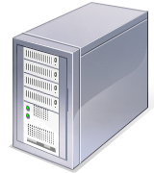
Elastic VM Build Pool
SL5 32
SL5 64
SL6 64
Deb 6 64
ETICS Pool
When a job arrives, it will go to the free VM for that platform
HV1
There are lot of identical VMs on many Hypervisors
Job queue is checked and the exact type and number of VMs are started
When the job ends, the VM is cleaned and paused
HV2
HV3

Slide 14
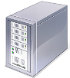
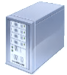
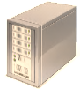
WN Snapshots
Same VM is used by many jobs
VM is reverted to its “clean status”
Before “reverting to clean“, a snapshot is taken
Developers can ask ETICS support for their snapshot (e.g. to check a test crash) and in order to analyze the results

Slide 15
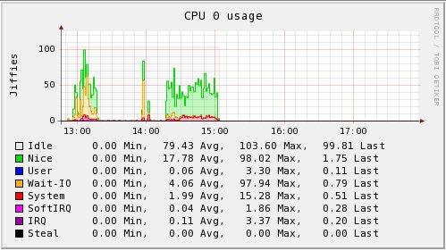
Infrastructure Monitoring
Monitoring system
Improved prompt alerts via email and SMS if urgent
Recurrent cases solved by the monitoring itself, when possible
Benefits: better issue reporting even before it occurs
Resource monitoring system
“Collectd” installed on every VM
Monitor current usage and detect bottlenecks
Build and Test Tools

Slide 16
Improvements for Developers
Maven repository
New Maven repository is available for EMI developers
Mirror from the official Maven Central repository
More reliable builds
Much faster access during the builds
VM images for developers
SL5, SL6 and Debian6 images can be available for downloading
List of free VM conversion tools available
We run on the CERN virtualization infrastructure, HyperV images
Instruction to install starting from standard OS up
Build and Test Tools

Slide 17
ETICS – Year 3
No major changes
Client updates
SL6 32 bits
Lintian plugin to check Debian packages compliance
Better filters/search in the submissions tab
Performance updates in the portal
Improve reliability, fix bugs
+ Output of discussions at this AHM
Build and Test Tools

Slide 18
Outline
Policies
Tools
Testbeds
Metrics
Quality Control
https://bit.ly/emisa2

Slide 19
Testbeds since EMI-1
Integration Infrastructure
Increased Testbed size
>200 installations of pre-EMI, EMI-1, EMI-2 products
Sites : CERN, CESNET, CNAF INFN, DESY, JUELICH, KOSICE, NIIF
https://twiki.cern.ch/twiki/bin/view/EMI/TestBed
Increased scope of activities
Deployment Tests (15 Updates + EMI2 RCs + Nagios probes)
Provide feedback on documentation, deployment logbooks
Migrated to some generic EMI Tests, dissemination and support
Testing some new SAM-NAGIOS probes (from EGI-EMI)
https://twiki.cern.ch/twiki/bin/view/EMI/EMITestbedInventory
Releases | pre-EMI | EMI-1 | EMI-2
Platforms | SL4/SL5, (Debian) | SL5/64 | SL5/64, SL6/64, Debian6

Slide 20
Testbeds - Ongoing activities
Integration Infrastructure
EMI and EMI 2 Updates
Testbed involved in SAM Nagios Probes testing
→ Presentation on SAM Nagios Probes on Wednesday
Integration Test Campaigns
Integration Test Campaigns defined but few products ready at due dates
Demo and Training Support
Training Infrastructure with stable versions of EMI products with GILDA CA (supported best demo winning at EGI TF 2011)
FutureGrid (-> NA3): Unicore deployed (thanks to Juelich staff). For other host certificate based services (on demand/dynamic instantiation model)
EMI Preview / Large Scale
15 services installed, outside the EMI testbed

Slide 21
Testbeds - Open Issues
Integration Infrastructure
Integration Testing
With 60 products x 3 platforms, coordination is a key aspect
We need realistic and respected deadlines
RC 2-3-4 versions needed?
Multiplatform deployment is VERY time/effort consuming -> better to have less RC versions but really certified by PT
For new products (e.g. EMIR) documentation and verification step MANDATORY before asking for deployment
EMI Preview / Large Scale
Better to do deployment on demand to catch interest in User communities
No interest from PTs in performing large scale tests

Slide 22
Outline
Policies
Tools
Testbeds
Metrics
Quality Control
https://bit.ly/emisa2

Slide 23
Metrics
QA Metrics
Several improvements to EMT Bug-tracking report
Defined comprehensive set of QA metrics (Quality Model)
All QA reports available here http://cern.ch/emiqa
Added metrics for EPEL compliance (ongoing for Debian)
Done by ETICS team: Integrated RPMlint (and soon Lintian)
Compliance to EPEL policies is an EMI target → EMI Metrics
Build from sources is also goal of the project
Developed bug-tracking dashboard
Verify EMT bug-tracking report
Allow SA1 and QC to filter data and produce customized reports
Bring PT trackers into line with required XML fields

Slide 24
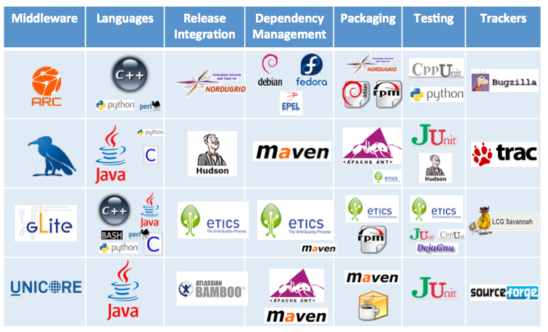
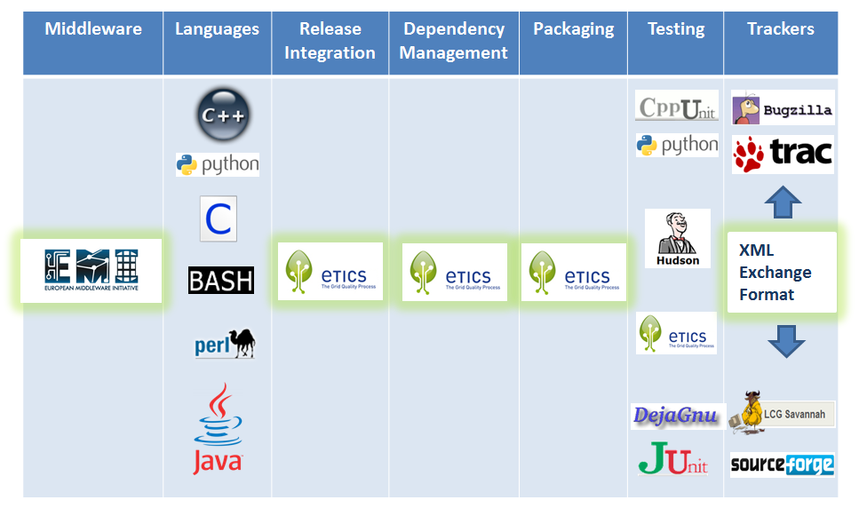
Tools Year 0, Year 1, Year 2

Slide 25
Why Produce a Common Format?
Many data sources → many formats
Data obtained from multiple organisations
Must have the same meaning everywhere otherwise metrics are meaningless.
Helps the EMI project gather only the important information
Leaves organisations the freedom to produce other internally useful information.
QA Metrics

Slide 26
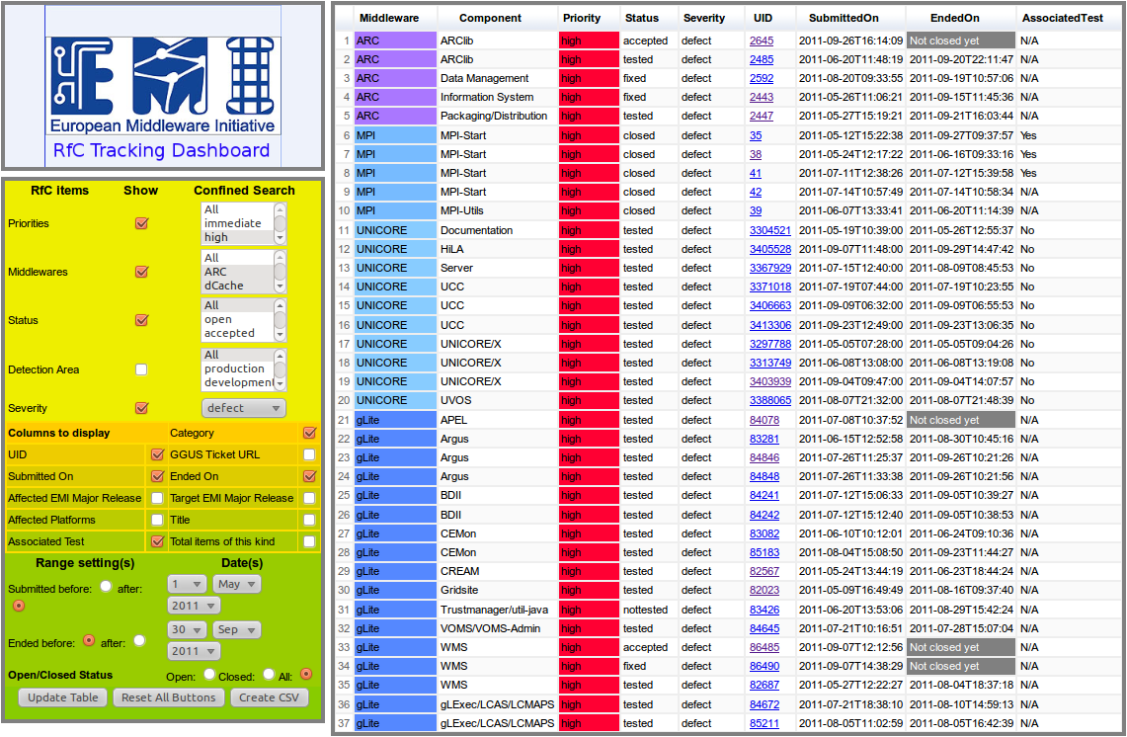
RfC EMI Dashboard
http://emi-rfc.cern.ch
Reports &
Dashboards

Slide 27
Outline
Policies
Tools
Testbeds
Metrics
Quality Control
https://bit.ly/emisa2

Slide 28
Follow QC Plenary Presentation
(Wednesday)
28

Slide 29
EMI Verification Dashboard
Reports &
Dashboards
http://emi-verification.cern.ch

Slide 30
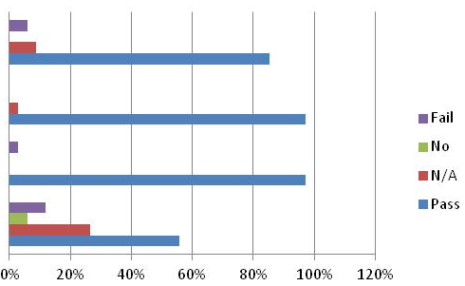
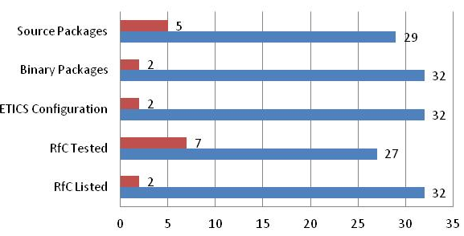
QC of EMI 1 Updates 8 - 14
Quality Control
34 products released, 5 postponed
20 fully verified, 14 released although not fully compliant
Automated Regression
Basic Functionality
Clean Deployment
Unit Testing
Source Packages
Binary Tarballs
ETICS Configuration
RfC tested
RFC Listed

Slide 31
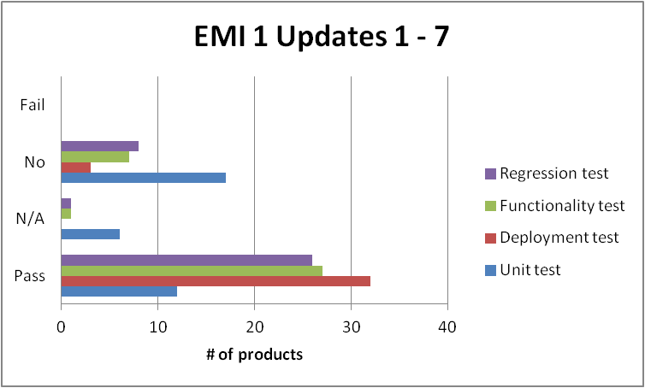
QC - Software Testing
Quality Control
EMI 1
Updates 1-7
Updates 8-14

Slide 32
More SA2 at AHM Hamburg
SA2 Plenary talks
Quality Control lessons/stats/issues
EMI Nagios Probes
___________________
SA1+SA2 Common Session
SA2 Parallel Session
Send me topics for Parallel Sessions

Slide 33
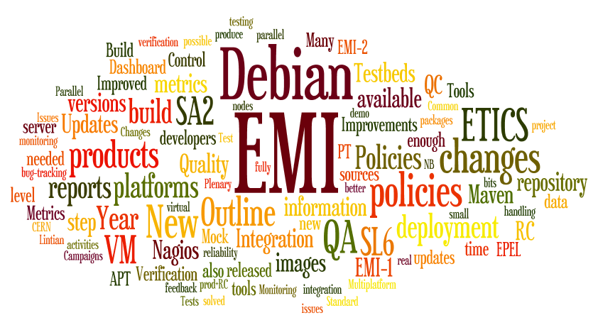
Questions?
Thank you

