Slide 1
StoRM EMI 2 Update
Hamburg 8/5/2012
Michele Dibenedetto

Slide 2
Outline
StoRM EMI 1 release
Year 2: EMI 1 Maintenance
Year 2: EMI 1 Updates
Major developments
Main issues faced

Slide 3
StoRM EMI 1 release
Year 2: EMI 1 Maintenance
Year 2: EMI 1 Updates
Major developments
Main issues faced

Slide 4
StoRM EMI 1 release
Released on EMI 1 Update 3
  07.07.2011
Major delay factors:
  underestimated effort
  inadequate project risk management
    first official release on SL5
      new version of gSoap and Boost
    first official release for x86_64 architecture
    GPFS licensing issues
      see https://savannah.cern.ch/task/?18387

Slide 5
StoRM EMI 1 release
Not the best start possible but...
we learned from this and
  Adopted "Release early Release Often" strategy
    http://en.wikipedia.org/wiki/Release_early,_release_often
    Periodical releases (approximately every 3 months)
    Fast community feedback
    Faster reaction upon issues notification
  Persistent testbed with all maintained StoRM versions

Slide 6
StoRM EMI 1 release
Year 2: EMI 1 Maintenance
Year 2: EMI 1 Updates
Major developments
Main issues faced

Slide 7
Year 2: EMI 1 Maintenance
Focus on product reliability and stability
  Increase software quality
    Continuous Test Plan updating
    Enhanced documentation
    Adhering to packaging standards (FHS)
  Enhance certification process
    Deployment of an internal virtual machines testbed
    Introduction of StoRM Pre-Assembled Configuration (PAC)
    Automatic Test Plan execution: introduction of
    T-StoRM

Slide 8
Year 2: EMI 1 Maintenance
Some numbers
  64 RFC managed
  20 GGUS ticket managed

Slide 9
StoRM EMI 1 release
Year 2: EMI 1 Maintenance
Year 2: EMI 1 Updates
Major developments
Main issues faced

Slide 10
Year 2: EMI 1 Updates
4 EMI 1 Update StoRM releases
  Update 6: StoRM 1.7.1
    Bug fix release
    Increased FHS compliance
  Update 9: StoRM 1.8.0
    Management of Storage Space information enhanced
    Repackaged and redistributed xmlrpc-c (from RedHat)
      Bug opened to RedHat

Slide 11
Year 2: EMI 1 Updates
  Update 11: StoRM 1.8.1
    Bug fix release
    Increased FHS compliance
  Update 13: StoRM 1.8.2
    Bug fix release
No new High/Immediate RFC received since StoRM 1.8.2 is out

Slide 12
StoRM EMI 1 release
Year 2: EMI 1 Maintenance
Year 2: EMI 1 Updates
Major developments
Main issues faced

Slide 13
Major developments
GLUE 2.0 Information Service
  Released within EMI 1 Update 3
Support for HTTP(s) file transfer protocol over SRM
  Released within EMI 1 Update 3
Argus integration
  User banning during SRM requests validation
  Released with EMI 2

Slide 14
Major developments
Porting on SL6 x86_64
  Released with EMI 2

Slide 15
Major developments
Enhanced Service Monitoring
  Provided StoRM FrontEnd monitoring facilities
    Request results and execution time information available in a proper log file
    Can be used to evaluate FrontEnd instance performance and upper limits
    Provides information useful to spot bottlenecks and performance degradation factors
    Released with EMI 2

Slide 16
Major developments
Enhanced Service Monitoring
  StoRM Ganglia Module
    StoRM Community project by M. David (LIP)
    Monitors StoRM BackEnd component managed requests
    To be released within EMI 2 Updates
    Already deployed at the LIP-Lisbon site integrated in the site’s ganglia monitoring framework

Slide 17
Major developments
New StoRM components released with EMI 2
  T-StoRM
    Mainly aimed to validate StoRM installations by site administrators
    Used by StoRM PT to certify new releases
  StoRM PAC
    Mainly aimed to allow a quick-install of StoRM
    A 16 step bullet list available in StoRM Sysadmin guide
    Used by StoRM PT to certify new releases

Slide 18
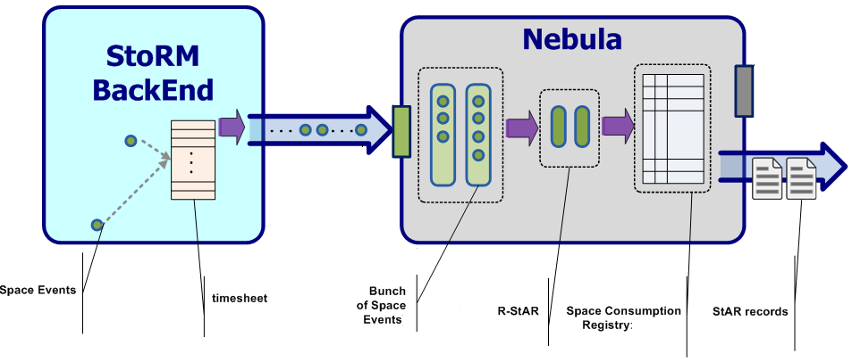
Major developments
Storage Accounting support
  New StoRM component for StAR records production designed: Nebula
  Development will start after EMI 2 release
  Design document at http://bit.ly/IFslFv
Notes:
ho tolto la descizione degli elementi di star dall'immagine che il testo era troppo piccolo e non si leggeva niente

Slide 19
StoRM EMI 1 release
Year 2: EMI 1 Maintenance
Year 2: EMI 1 Updates
Major developments
Main issues faced

Slide 20
Main issue faced
ETICS stability
  4 GGUS tickets opened by StoRM PT (over 169 total)
  Many other support requests via mailing list
New release certification procedure requires a big effort
And…

Slide 21
Main issue faced
External dependency upgrade issues
  gSoap
  xmlrpc-c
  SWIG
  Globus GridFTP
    solved by the provider

Slide 22
Thanks for your attention!
Questions?

