Slide 1
Can we move the SCS instrument to 2.4 m distance?
20.1.2012
Harald Sinn WP73

Slide 2
Current Plan (CDR update)
Side view
horizontal focus
experiment hall
M1
M2
G1, G2, (M4)
M5
M6
M3
vertical exit slits
Top view
1.4 m
1.4 m
SCS
281
283.9
300
301
339
341
374
400
417

Slide 3
Version A: increase angle
Side view
horizontal focus
experiment hall
M1
M2
G1, G2, (M4)
M5
M6
M3
vertical exit slits
Top view
1.4 m
2.4 m
SCS
281
283.9
300
301
339
341
374
400
417

Slide 4
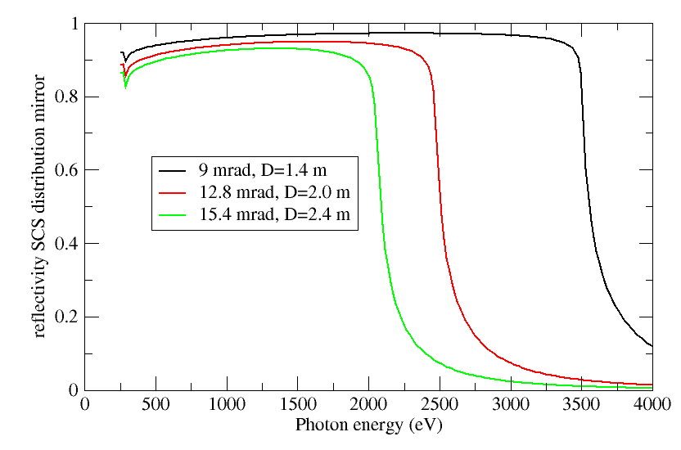
Change of reflectivity
Energy -10%
due to lower density

Slide 5
Version B: move mirror
Side view
G1, G2, (M4)
horizontal focus
experiment hall
M1
M2
M5
M6
M3
vertical exit slits
Top view
horizontal focus
1.4 m
2.0 m
SCS
281
283.9
300
301
305
341
374
400
417

Slide 6
Impact of horizontal focus change
Beam already focused significantly at grating
40% less damage tolerance at grating
(91 mJ ➔54 mJ, B4C coating, 290 eV)
Beam size larger in experimental hall
(for flat M5 e.g. 800 eV: 3 mm ➔15 mm, vertical size 1.7 mm
Or M5 focusing: hor. 43 um ➔ 67 um)

Slide 7
Conclusions
Shift from 1.4m to 2.0 m possible by shift of distribution mirror. The damage tolerance on the grating reduces by 40% and the horizontal focusing deteriorates by 50%.
Increasing the take-off angle lowers the transmitted upper energy to 1.8 keV (2.4 m) or 2.2 keV (2.0 m)
Whispering gallery also possible (add 0.5 M€)
Safety and transport implications would have to be considered.

