Slide 1
Commonly used lab space
Maintained by WP79
Wet labs and bio-sample preparation 200m²
Dry sample preparation 200m²
X-ray lab 50m² (better more)
Photoelectron and Auger spectroscopy (not yet on the plan)
Microscopy (included in dry labs)
Nano-fabrication (not yet on the plan)
EMBL and WP79
Bio labs 300m²
Crystal storage 40m²
Mechanical workshop 40m²
Electronic workshop 40m²
Not in WP79
General electronics lab 300m²
Mechanical preparation lab 100m²
Cleanroom area
Laser labs
Vacuum preparation labs 200m²

Slide 2
Bio- and Chemistry-Labs
200m² wet lab in “Anforderungsliste XHQ”
100m² bio lab WP84
300m² bio lab in the EMBL “UseXBI” user consortium
We need
common safety and access policy
clarify the legal status of the EMBL labs (XFEL or EMBL property)
common waste management
common use of lab kitchen and supplies is desirable

Slide 3
XFEL common use bio and chemical labs
Suggestion:
Use window-labs for bio-preparation
Possible office for lab-technician
No-window room for chemical preparation and storage
Bio labs
Office
Chem 1
Chem 2
Storage
however:
Window-labs might be needed for EMBL as well

Slide 4
WP 84 Bio lab (bio-imaging)
Bio lab
With direct access to the SPB instument beneath
  Needs clarification!
Same safety standards as commonly use lab
Open for SPB users
Bio-safety class 1 or 2?
Direct access to UseXBI consortium desired?

Slide 5
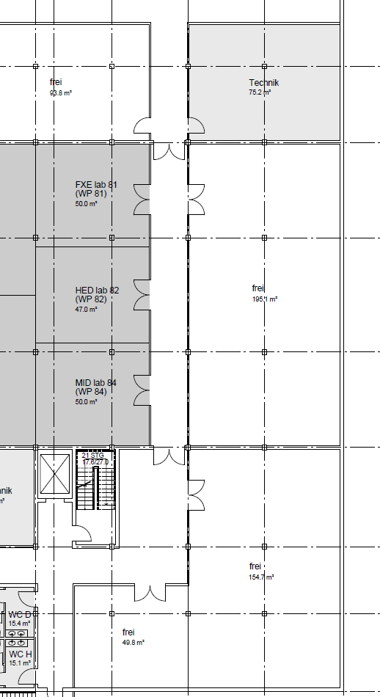
EMBL bio labs
Suggestion
Redistribute FXE,MID,HED to free spaces
Dedicate a complete corridor to UseXBI consortium
Planning in coordination with EMBL
342 m²
Need management decision on
Legal status of the labs
Saftety responsibilities
Office space

Slide 6
Dry sample preparation
Smaller lab with
Desiccators for storing
Glove box
Clean work bench
Larger lab with
Clean work bench
More storage space
Ultrasonic bath
Optical microscope
Hot plate
balance

Slide 7
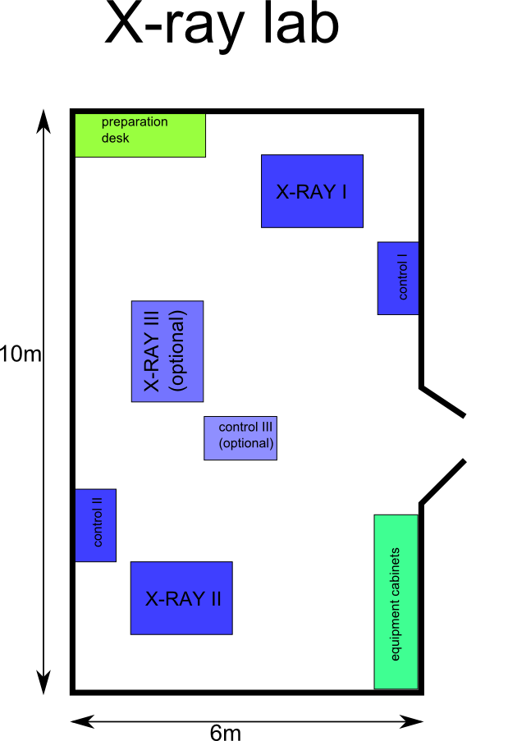
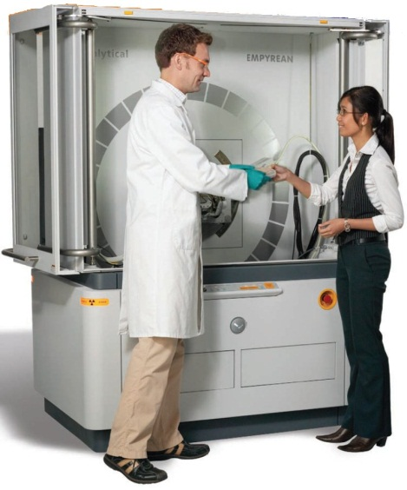
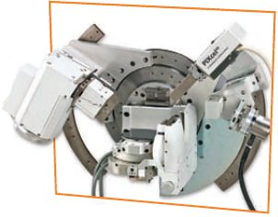
General use X-ray laboratory
60m²
Example: Empyrean from PANalytical
Powder crystallography
Rocking curves
SAXS
Easy to configure
50m² foreseen in the requirements

Slide 8
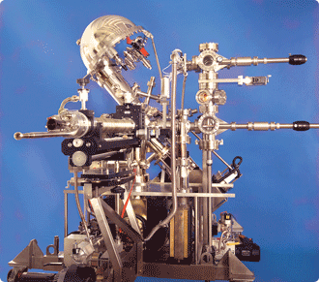
Photoelectron spectroscopy (PES/AES)
Will allow
sample characterization
test of equipment and methods
in-house research
Needs
~50² lab space
Cooling water
pump exhaust
service room with rough pump
Compressed air
40m²
PES
50m²
FXE

Slide 9
Microscopy and Nano-Fabrication
Suggestion to reserve these labs for
Atomic force microscope (AFM)
Scanning tunnel microscope (STM)
Scanning electron microscope (SEM)
Focussed ion beam (FIB)
This would demand
Low mechanical noise
Low electronic noise

Slide 10
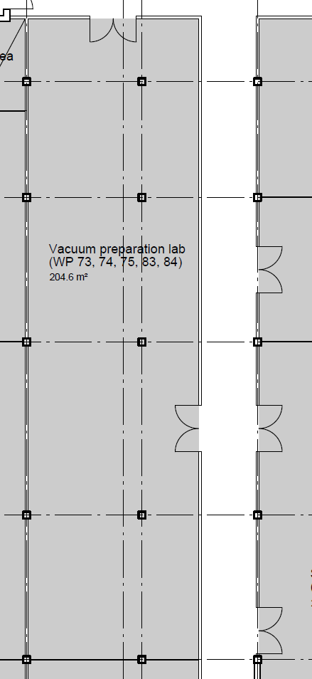
Vacuum preparation lab
Vacuum equipment tends to be noisy. Therefore:
Suggestion
Split into separate rooms
Introduce service rooms for rough pumps

Slide 11
Clip board – copy and paste
Headline
first level
  second level
    third level
Headline
Texttext texttext texttext texttext texttext texttext
Keyword
Keyword
keyword
keyword
Keyword
Result Headline
result text
result text
Result headline
Result text, result text, result text
Result headline
result text
result text
result text
Notes:
Copy & paste an element from the Clip Board to the particular slide:
1) Click on a box to mark it.
2) Position the mouse pointer on the box frame: Copy!
3) Click on the particular slide: Paste!
How you intend to use the elements is your choice.
You can combine the text block style with the background colour
in different manner.
How to change the height or the width (or both) of a box
(including its background):
Mark the box, and grip and draw the specific edge of the box frame.
You can position a text block inside a frame: 1) Mark the text block.
2) Click on the menu point “Format”: “Text box”, “Text Box”,
“Text Anchor Point”.
Insert a new slide: Menu button “New Slide”
For more bullet levels (max. 5) use the tab stop button →| on your keyboard,
back with |←
The default colour scheme for font, line and fill is (1st row, from left to right):
White  Violet  Grey  Black  Violet  Orange  Violet  Orange

