Slide 1
How much space is in the tunnel for the wall-sided branch beamlines?
Harald Sinn
30.3.2012, Friday TC meeting

Slide 3
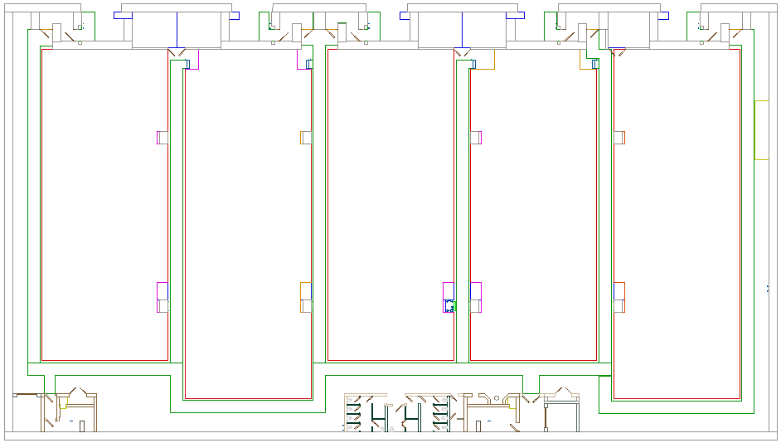
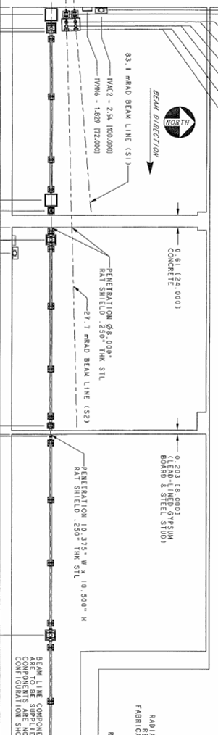
SASE3
SASE1
SASE2
SQS
FXE
HED
SCS
SPB
MID
15 m
15 m = 4 cm, 1.40 m = 0.373cm, 2.8m=0.75cm.
tilt angle S1/S2: 2.4 mrad = 120 mm/40m, S3: 20 mrad = 800 mm/40m= 0.213cm/10.66cm
LCLS scale: 801.7-757.4=44.3 m =11.81cm
From TC meeting, February 4, 2011

Slide 4
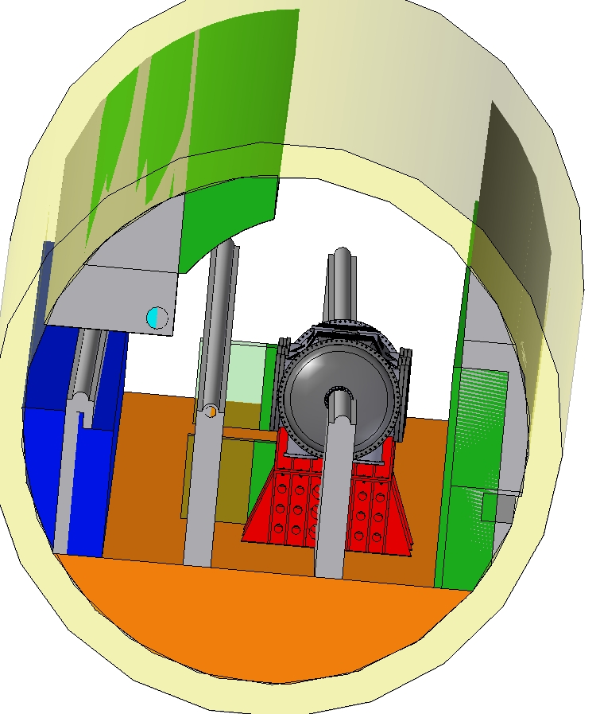
SASE2, XTD 6, 100m before XHEQ

Slide 5
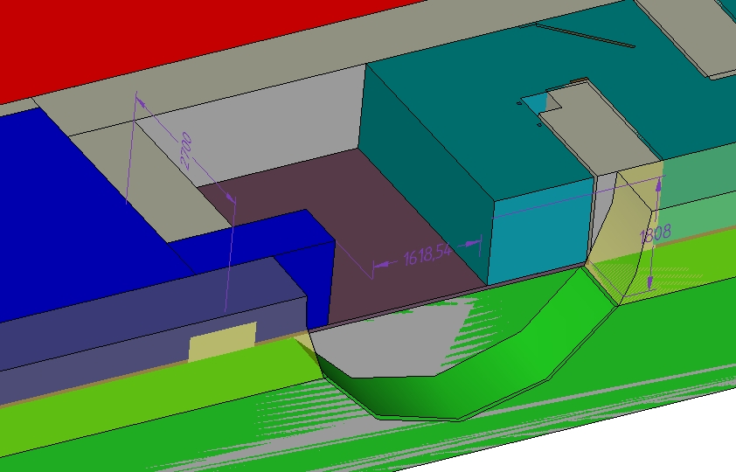

Slide 6
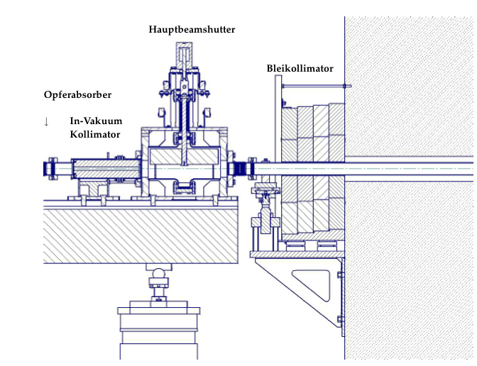
Space for beam shutter

Slide 7
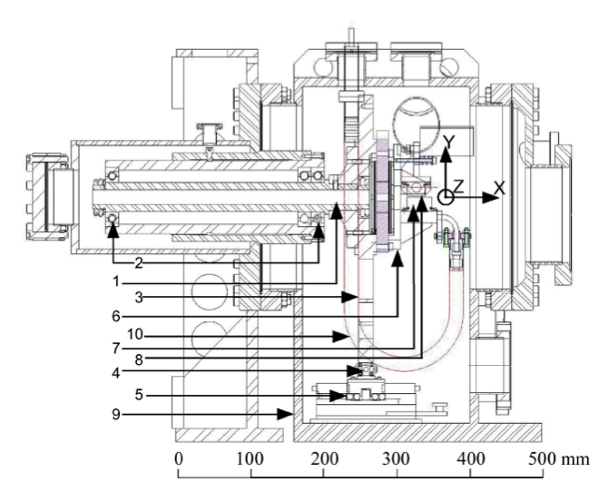
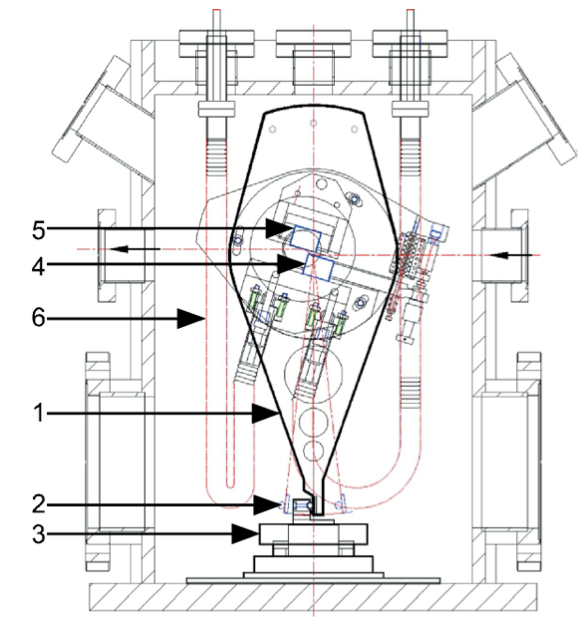
Hard X-ray mono (ANL)

Slide 8
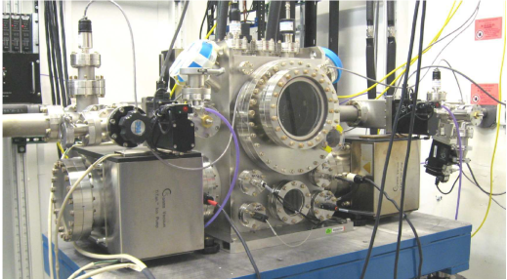
Hard X-ray Mono (ANL)

