Slide 1
Synchronizing the clock to the beam
Luigi Calligaris
DESY CMS Phase I Pixel meeting, 09/03/2012

Slide 2
Synchronizing the clock
At the moment Pixel ROC is clocked internally
  Particles could be assigned to different “BX” tags
We want to synchronize the CMS pixel to the DESY II beam
  CMS Pixel → approx. 40 MHz clock
  DESY II beam → RF is approx 1,024 MHz
Testbeam area has a wire carrying RF signal
  Try to use it to synchronize our chip
  We have to synthetize 40 MHz from 1,024 MHz

Slide 3
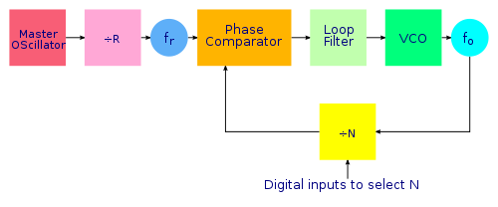
PLL: a negative feedback loop
Take input signal with frequency f_{r}
Generate with a Voltage Controlled Oscillator an output signal with frequency f_{o}
Divide f_{o} by the multiplication factor N
Phase compare f_{r} and f_{o}/N and output as a voltage
Feed this voltage to the VCO

Slide 4
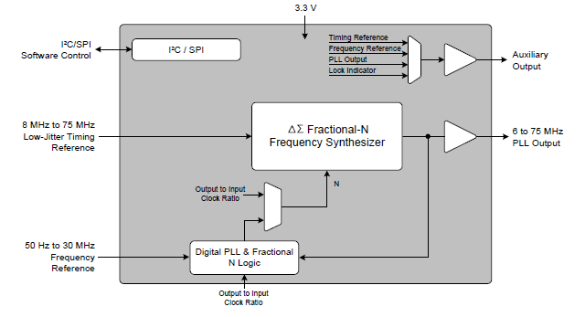
Our setup – Cirrus Logic CS2000CP

Slide 5
Status
Thu 8/3/2012
  First tries at the test beam
  PLL doesn’t lock to DESY II signal
    Probably due to jitter in the input clock signal
  PLL does locks on a very stable function generator signal at the same frequency and amplitude
Hypothetical mechanism for lock failure
  Amplifier in DESY II crate is not powerful enough to drive the long cable with a fast rise time
  Time walk in this signal leads to jitter
  The PLL cannot lock due to jitter

Slide 6
