Slide 1
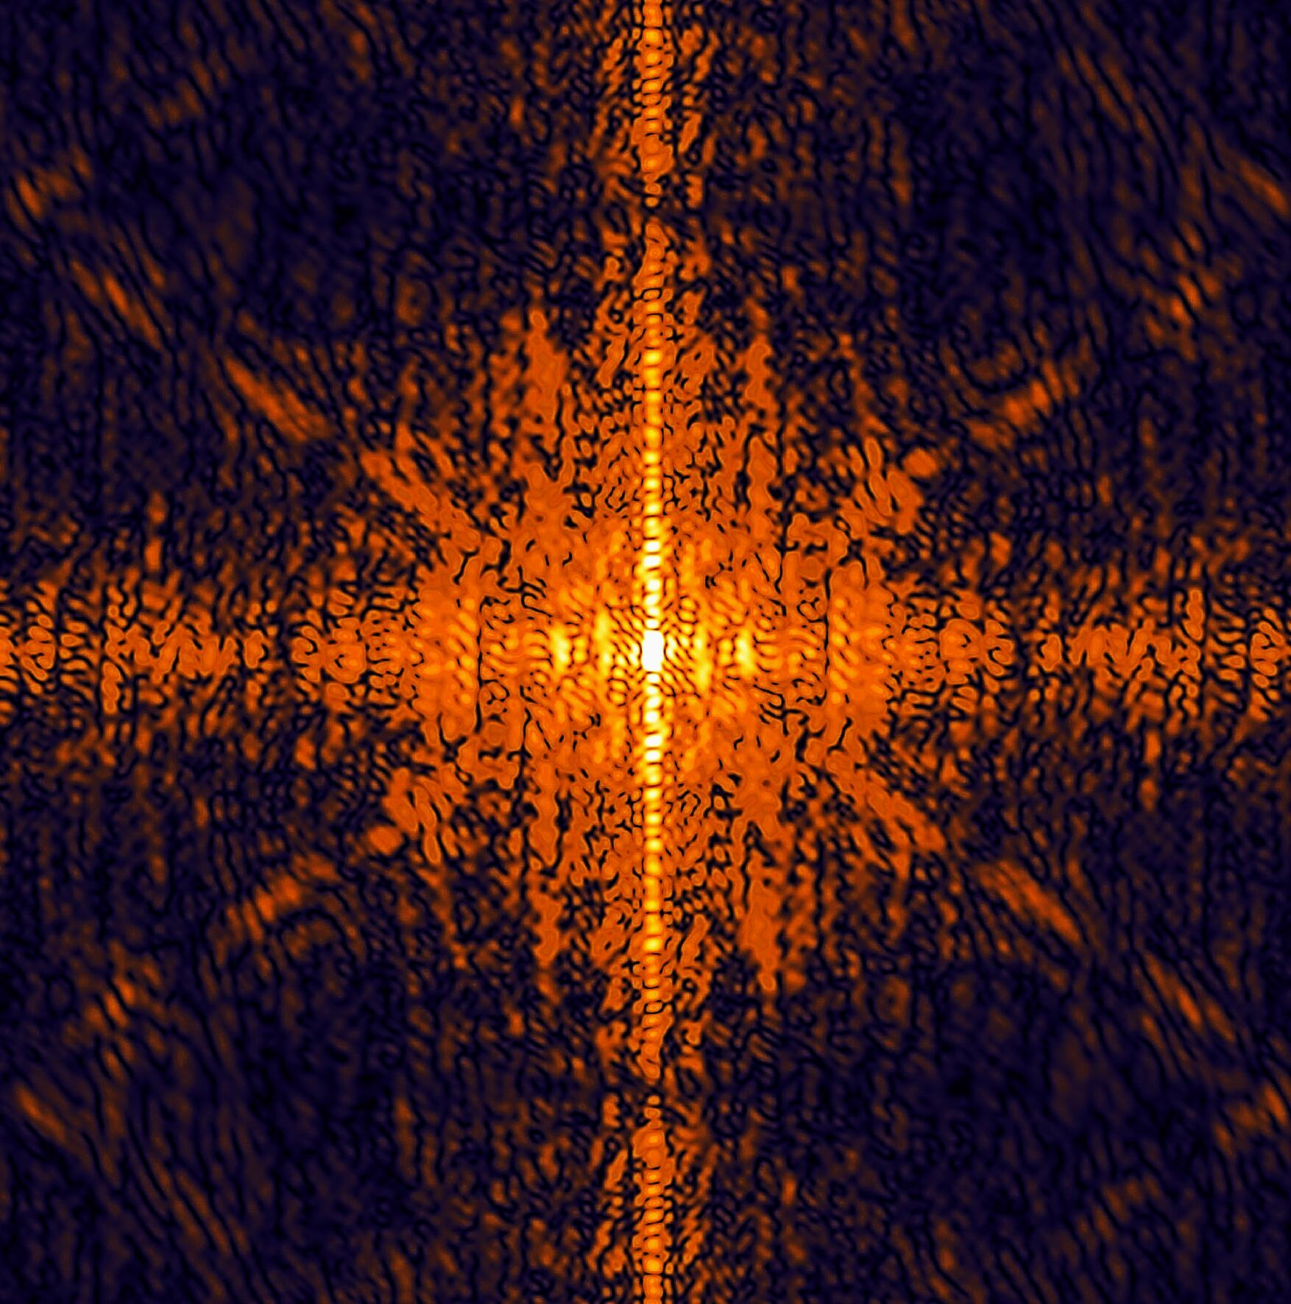
Detector Calibration Concepts and Status of the Calibration Working Group
Jola Sztuk-Dambietz (XFEL)
on behalf of
the Calibration Group
May 14th, 2012
11th Meeting of the XFEL Detector Advisory Committee
European XFEL GmbH, Hamburg
Notes:
How to edit the title slide
Upper area: Title of your talk, max. 2 rows of the defined size (55 pt)
Lower area (subtitle): Conference/meeting/workshop, location, date,
your name and affiliation,
max. 4 rows of the defined size (32 pt)
Change the partner logos or add others in the last row.

Slide 2
Outline
Introduction
Goals of the group
Detector calibration – challenges & status
Infrastructure for detector calibration and tests
DAQ and data format
Calibration software
Conclusion & plans

Slide 3
The goals of the group
  Why calibrate detectors?
  Well calibrated detector → precise measurement → high quality scientific results
  The goal(s):
Calibrated detectors and well defined, user-friendly procedures and tools to re-do calibration during operation period
  To achieve the goal:
Define detector parameters to be calibrated and the required accuracy
Develop strategies to calibrate the different types of detectors
Define and build the infrastructure needed for calibration
Define calibration and test (re-calibration) procedure
Define & implement calibration data format and structure
Develop & implement calibration software in the XFEL software framework

Slide 4
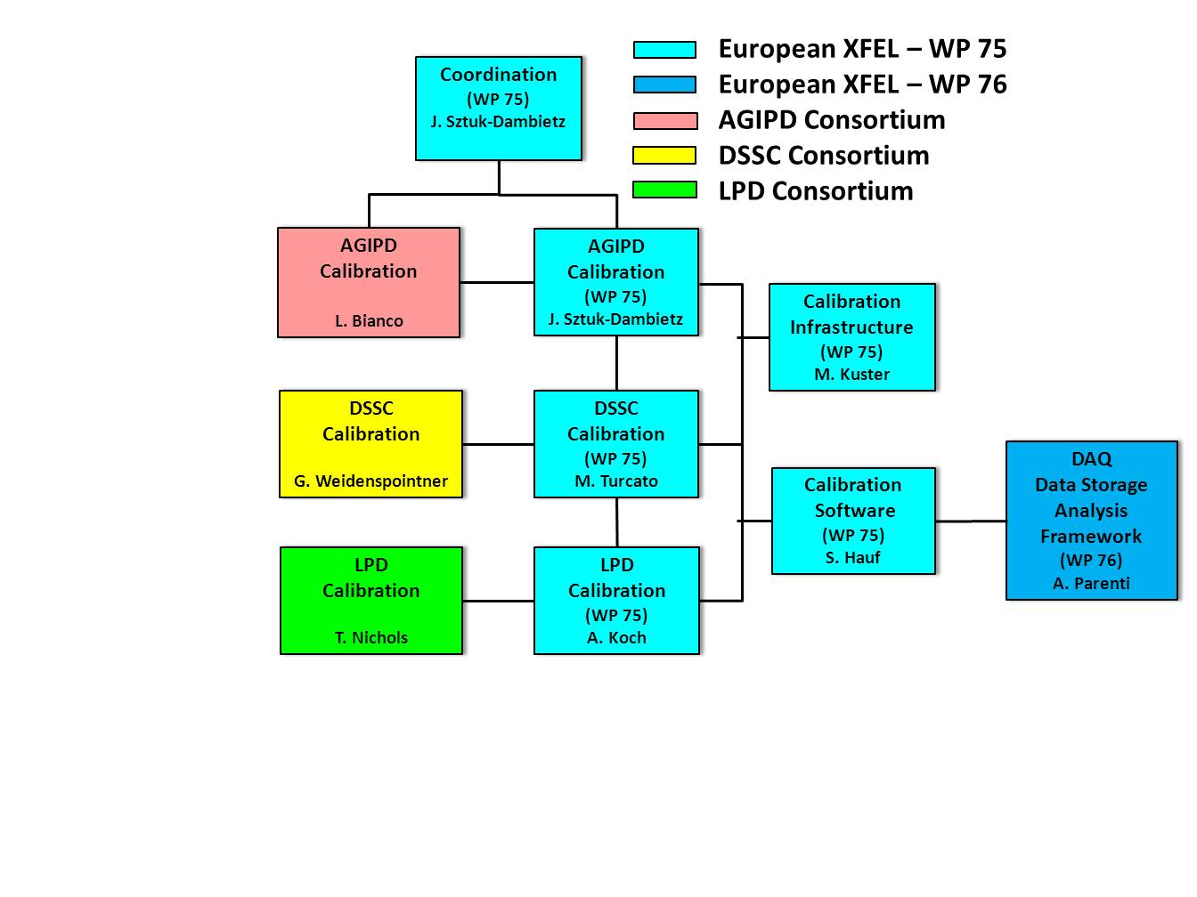
Calibration Working Group - Organization
Structure of the group:
Meetings: every 6 months
→ next meeting in September
Mailing list:
xfel-detector-calibrationgroup@desy.de
Indico page with presentations and documents (password-protected):
https://indico.desy.de/categoryDisplay.py?categId=278
Physicist for Software Development
starts in September

Slide 5
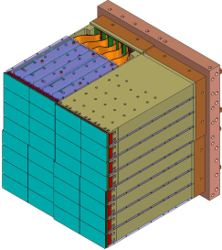
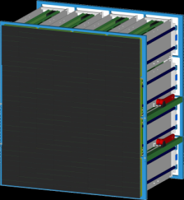
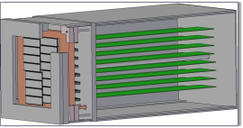


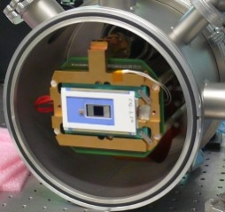
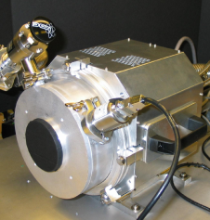
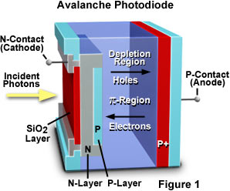
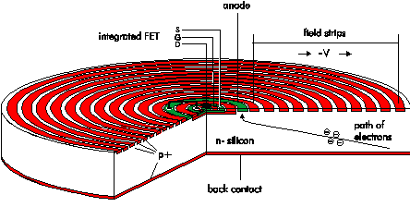
Detectors to be calibrated & characterized
2-D Mpixel X-ray imaging detectors
High repetition rate detectors: AGIPD, DSSC, LPD
LPD
Low repetition rate detectors:
pn CCD, other CCDs
pn CCD
..and more to come
  Avalanche PhotoDiode (APD)
  Silicon Drift Detector (SDD)
  …

Slide 6
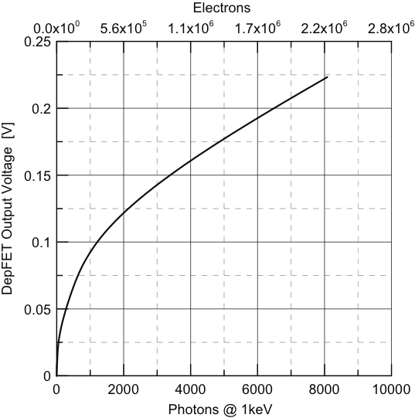
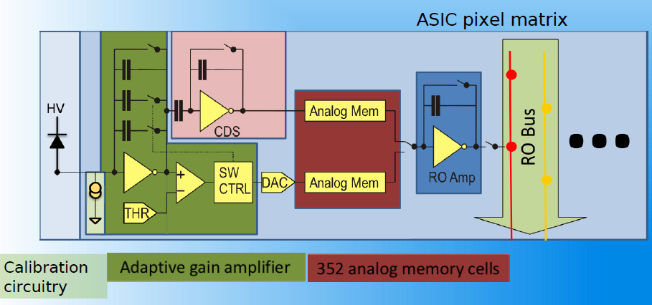

Calibration Challenges - Some Examples
Characterize in most efficient way huge (~10⁹) number of parameters
Calibrate non-linear gain response
100s cells/pixel (droop check) x 1M pixel x 3 gains
Courtesy L. Bianco, DESY
adapted from
Porro et al., 2010
Time Structure of the XFEL
Average 27000 pulses per second

Slide 7
Detector Calibration & Characterization Parameters
Parameter | AGIPD | DSSC | LPD | CCDs
Parameters common for all detector technologies
Conversion gain G(x,y) | + | + | + | +
Dark signal O(x,y) | + | + | + | +
Noise N(x,y) | + | + | + | +
Bad “pixels” B(cell nr, x,y) | + | + | + | +
Detective quantum efficiency DQE | + | + | + | +
Dynamic range DR(x,y) | + | + | + | +
Detector technology specific parameters
Memory cell droop (signal losses) MD(cell nr, x,y) | + |  | +
Charge transfer inefficiency CTI(x,y) |  |  |  | +
Point spread function PSF(x,y) | + | + | + | +
Line spread function LSF(x,y)
Preliminary
More to come: APD, SDD,…

Slide 8
Calibration Status
Performance characteristic
Activity | AGIPD | DSSC | LPD
Noise performance study | ongoing | ongoing | ongoing
Characterization of memory cell droop after irradiation & at different temperatures | ongoing | not applicable | not applicable
Develop strategy for non-linear gain response | not applicable | ongoing | not applicable
PSF measurement | to be done | to be done | to be done
QE measurement | to be done | to be done | to be done
Optimization of calibration strategies with test structures | ongoing AGIPD0.1-0.4 | ongoing pxd-7 | to be done
Optimization of calibration strategies with simulation | to be done | ongoing | to be done

Slide 9
Calibration Concept
Activity | AGIPD | DSSC | LPD | XFEL CCDs, APD, SDD & delivered prototypes of AGIPD, DSSC & LPD)
Internal (on chip) calibration sources | Yes Pulsed capacitor Current source | Yes Internally generated signal charges | Yes Injection circuit | Not applicable
Requirements def. for calibration sources | ongoing | ongoing | to be defined | ongoing
Calibration and characterization planning | ongoing | ongoing | to be done | ongoing
Calibration stability checks concept | to be done | ongoing | to be done | to be done
Concept for implementation of calibration setup(s) | ongoing | ongoing | ongoing | ongoing
REQUIREMENT DOCUMENT: Calibration Infrastructure, Calibration Software and Calibration Concepts in preparation → including input from the consortia and WP76

Slide 10
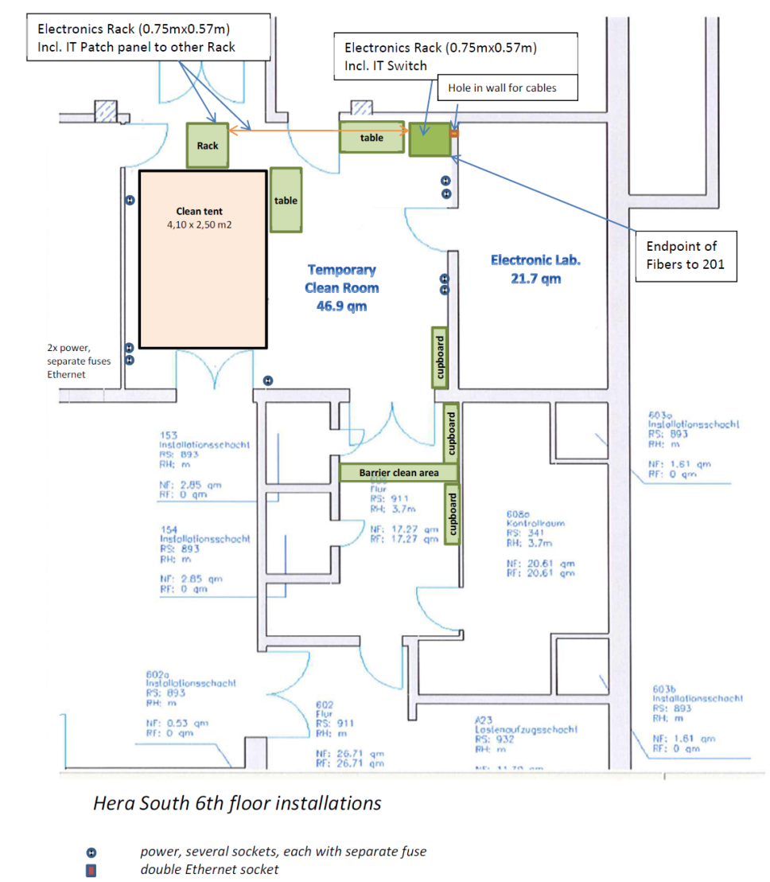
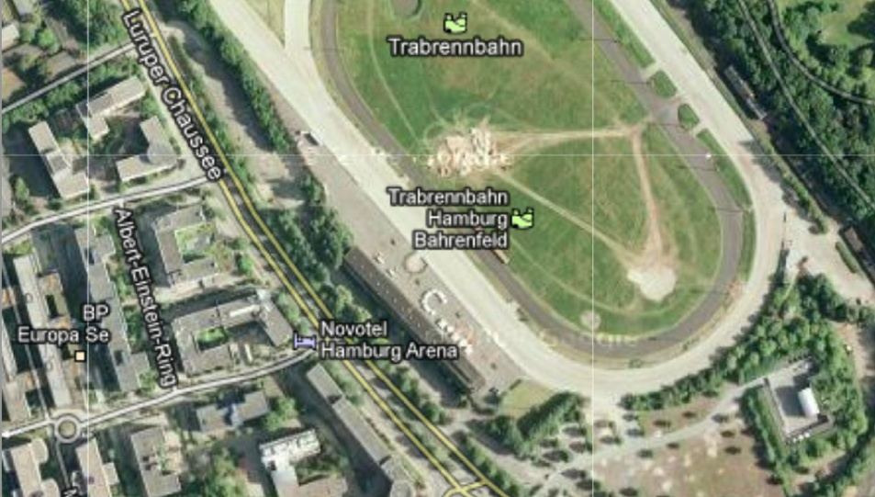
WP-75 Laboratory in HERA-South - Start-up Configuration
Provisional infrastructure
HERA South Hall
XFEL- AER19
HERA South
Hera South – 6th floor installation →
Temporary clean room – 46m²
Electronic lab – 22m²
Move to the ground floor as soon as possible

Slide 11
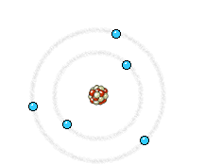

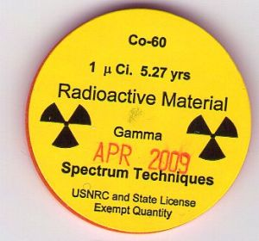
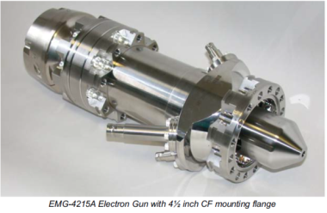
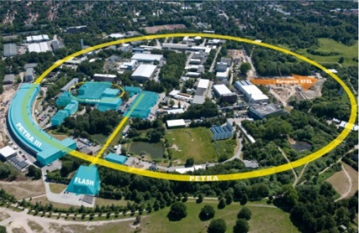
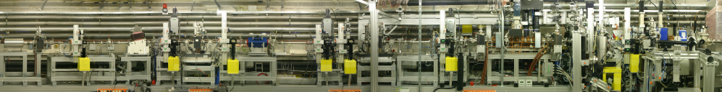
Calibration Sources
X-ray sources:
Calibrated Radioisotope (X-ray/Gamma/Alpha) Sources (⁵⁵Fe + chopper, ¹³³Ba, ²⁴¹Am, etc..)
X-ray tubes
- “DC mode” X-ray tube
- pulsed X-ray tubes
Access to X-ray facilities:
- PETRAIII → try to get beamtime
- XFEL → start to plan for commissioning and installation
- PITZ (Photo Injector Test Facility) → not strong needs from the detector consortia
Stable laser system
Review is ongoing based on input from the consortia and the XFEL needs

Slide 12
X-ray Generators - Requirements
X-ray source(s) for detector calibration & characterization purpose
Photon energy: Energy range 0.2-25 keV, monochromatic
Time structure:
- pulsed source with repetition rate if possible up to 4.5MHz or at least
two pulses delivered with Δt=220 ns
- short pulses <1ps
Adjustable and stable intensity (1ph/pixel/pulse – 10⁴ph/pixel/pulse)
Two types of illumination:
- point-like illumination (ideal case: possibility for one pixel illumination)
- flat field illumination with homogeneity of the order of 10% (ideal
case: size of the flat field compatible with the size of the full
detector module: 20x20cm, or as large as possible)
Well calibrated reference detector
Vacuum/ambient compatibility

Slide 13
DAQ and Data Format
Calibration data loaded
(files, DB)
Run started
Online processing (DQM, etc..)
Correction of the raw data
Experiment data taking procedure:
Calibration run
Processing of calibration data
Files with calibration constants
Metadata Catalog
Validity period, version, …
Production of calibration constants:
Image data format hdf5 broadly defined
  Content of calibration data sets will be defined by the detector consortia/WP75
  Calibration data format will be defined by WP75/WP76
Centralized DAQ system → special calibration runs and/or special calibration events within the run
Centralized metadata catalog → validity period and version, …

Slide 14
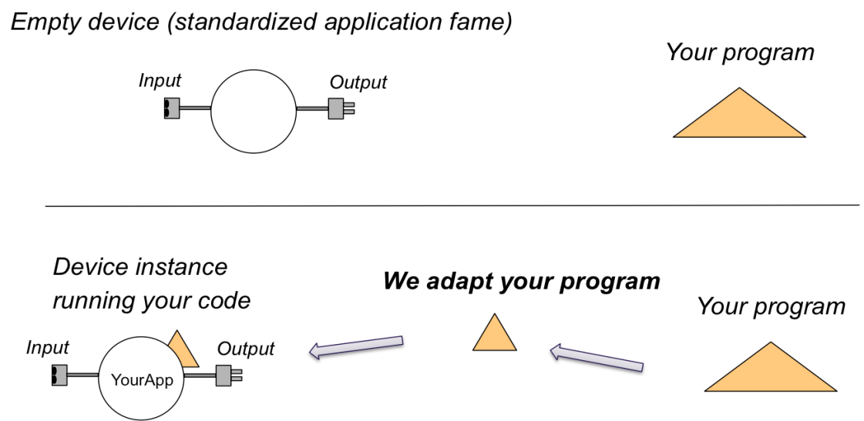
Calibration Software in the XFEL Analysis Framework
14
XFEL will provide services for data storage and data analysis
The provided services focus on solving general problems like data taking procedure, calibration procedure, data-flow, configuration, project-tracking, logging, parallelization, visualization
XFEL.EU software will be designed to allow simple integration of existing algorithm/packages
→ BUT the input has to be provided by the framework users
Requirements for the implementation of the external software packages into the XFEL analysis framework are defined (programing rules & languages, software repository, documentation, etc...)

Slide 15
Calibration Software - Status
XFEL
  Work on the analysis framework is ongoing
  Requirements for the analysis framework are defined
  Calibration software development & implementation starts in Q3 2012
Status of Calibration Software
Activity | AGIPD | DSSC | LPD | XFEL
Define software requirements | to be defined | ongoing | to be defined | to be defined
Status of calib. software development | to be developed | ongoing | To be developed | to be developed
Status of calib. software implementation in the XFEL AF | to be implemented | to be implemented | to be implemented | to be implemented

Slide 16
Summary & Outlook
Done:
  The structure of the group and responsibilities
  Communication strategy
Ongoing:
  Work on definition of the calibration requirements (XFEL/Consortia)
  Work on building the infrastructure for the detector calibration (XFEL/Consortia)
  Work on definition of data format and structure
  Calibration software
    Work on calibration software (Consortia)
    Work on the XFEL software framework → access to the framework for the detector consortia is foreseen in Q4 2012 (XFEL)

Slide 17
Calibration – next steps (Q2-Q4 2012)
Review & provide input to the requirement document (AGIPD, DSSC, LPD & XFEL) → Finalize the requirement document
Provide CDR for the X-ray sources needed for the detector calibration at the XFEL
Continue to work on characterization of detector performance
  Storage cell memory droop (AGIPD), NLGS, PSF, QE (DSSC), noise (AGIPD, DSSC, LPD)
Continue to work on the calibration strategy/concept using existing test structures, prototypes and simulations (AGIPD, DSSC, LPD & XFEL)
Continue to work on DAQ and definition of data content in context of calibration
Provide access to the XFEL analysis framework for the detector consortia → organize a short training for new users/ consortia members
Continue or start to work on the calibration software and detector simulation
Increase involvement of the beamline scientists (required precision, etc...)
Install and start tests with detectors at XFEL: CCDs & prototypes in collaboration with consortia (AGIPD, DSSC, LPD)
Define the test setup to be delivered to the XFEL (AGIPD, DSSC)

Slide 18
Thank you very much for your attention
Notes:
How to edit the title slide
Upper area: Title of your talk, max. 2 rows of the defined size (55 pt)
Lower area (subtitle): Conference/meeting/workshop, location, date,
your name and affiliation,
max. 4 rows of the defined size (32 pt)
Change the partner logos or add others in the last row.

Slide 19
Backup slides

Slide 20
Calibration status & next steps - AGIPD
The goal
Characterize in the most efficient way:
352 cells/pixel (droop check), 1M pixel, 3 gains (to convert ADC → Nγ)
➔ ~10⁹ parameters

Slide 21
Calibration status & next steps - AGIPD
Status
Performance of the existing test structures is studied:
Memory cell droop is investigated and characterized (vs. radiation dose, temp.)
Noise performance is investigated
Several calibration structures used in parallel to cover the whole dynamic range are planned: electrical sources and radiation sources
electrical sources: in-pixel pulsed capacitor and in-pixel current source are considered
Preliminary estimation on how frequent the different types of checks and calibration shall be
Calibration concept to provide fully corrected data has to be developed
→ first initial ideas were presented at the 2nd Calibration Meeting
Next steps:
Review & provide input to the requirement document - Q2 2012.
Continue work on memory cell droop characterization, noise performance
Study different calibration strategies using test structures

Slide 22

Calibration status & next steps - DSSC
Status
The calibration of the properties of the DSSC system has been studied
Preliminary strategies for the calibration were developed and requirements for the calibration sources were defined:
Non-linear system gain (NLSG)
Quantum efficiency and spectral response
Point spread function (charge sharing between neighboring pixels)
Tests with a pxd-7 DEPFET (with non-linear gain) prototype were done
A Geant4-based DSSC system simulation package, covering the full simulation chain from incident photon distribution to digital output signal was developed
and validated with real data.
Work on calibration software is ongoing

Slide 23
Calibration status & next steps - DSSC
Next steps:
Review & provide input to the requirement document - Q2 2012.
Continue to improve and refine the integrated system simulation, calibration, data analysis, and response generation software packages
Develop and build the experimental set-ups for the calibration of:
NLPC (non-linear pixel characteristic) of each DEPFET pixel
PSF
quantum efficiency
spectral response
Continue to develop experimental methods and software for quick verification and monitoring of the DSSC calibration, specifically of the NLPC
Prototype pxd-7 will be the used test device
Use for calibration also internally generated signal charges (just started)

Slide 24
DSSC – Calibration Strategy for NLGS
Two-step procedure for full calibration for given photon energy
and operating parameters:
Step 1: Tune offset and gain to achieve single photon counting in linear region:
linear response → two calibration points
no signal → dark frames
- all pixels simultaneously
single X-ray photons → flat fields
– all pixels simultaneously
– X rays from radioactive sources (e.g. ⁵⁵Fe) or various types of X-ray tubes
Step 2: Calibrate non-linear characteristic with pulsed charge injection;
DSSC signal integration time ≤ 600 μs
pulsed and stable charge generation →linear variation
vary charge by varying number of pulses: Q_{N} = N⋅Q₁
→ linearly spaced charge amounts, spanning dynamic range,
Q_{N} not known absolutely due to pixel-to-pixel variation
→ absolute calibration of Q_{N} by comparison to X-ray result(s)
simultaneous calibration of many pixels

Slide 25

Calibration status & next steps - LPD
Status:
Performance testing has started:
Using on-chip injection circuits of electrical test signals in ASIC.
With X-rays, i.e. X-ray generator and Doris bending magnet radiation.
Calibration concept to provide fully corrected data has to be developed.
→ first initial ideas were presented at the Calibration Meetings.
Next steps:
Review & provide input to the requirement document - Q2 2012.
High level test plan and estimation of tasks, infrastructure and efforts
- Q2/Q3 2012.
Feasibility study to test different calibration strategies using prototype detectors will start in Q3 2012, probably first with a 2-tile system of 64 x 128 pixels.

Slide 26
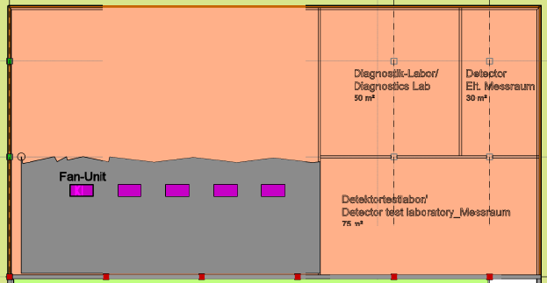
WP-75 Laboratory Space in Schenefeld
Clean room: 225 m² usable space
Detector test laboratory 75m²
Detector electronics test laboratory – 30m²
Experimental hall in Schenefeld will not be available before 2015.
Detailed laboratory planning started

Slide 27
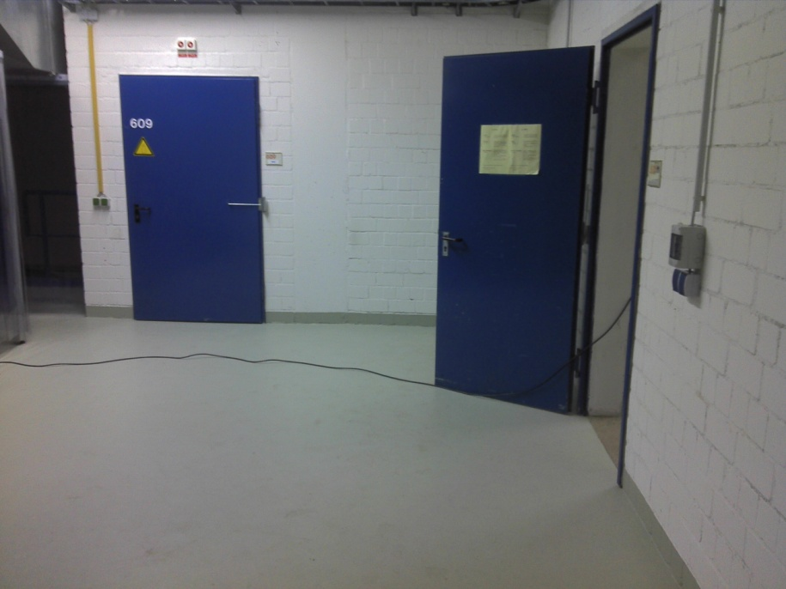
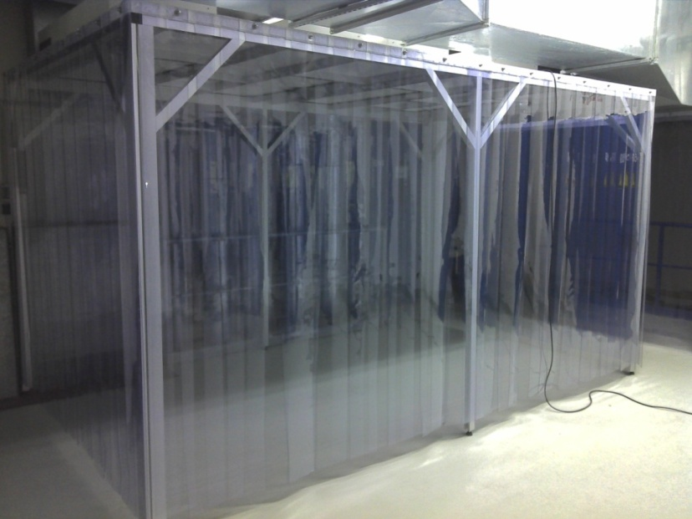
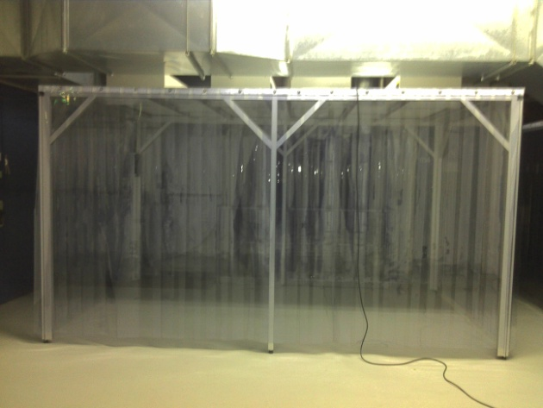
WP-75 Laboratory in HERA-South
- Start up Configuration (6th floor)
SPETEC Soft-Wall Clean Tent (ISO 6) has been installed
Movement of the electronic equipment from AER19 to HERA South in March

Slide 28
Requirements for the calibration software
C++, C or Python as programming language (in this order of preference)
Code has to be build on state-of-the art linux-based operating systems
Simple, stand-alone command-line tools
Clear part in the code where configuration is parsed (e.g. command-line parameters)
IO operations has to be separated from compute logic
Reduce external dependencies
The latest versions of external libraries has to be used
Documentation: how to build the program
SVN server has to be used as a repository
recommended tool for image processing CImg (http://cimg.sourceforge.net/)

