Slide 1



X-Ray Radiation Damage: Sensors
Introduction
Basics on X-ray (Si-SiO₂) Damage
Measurement of the relevant Parameters
Impact on Sensors and Sensor Design
Summary
Work supported by:

Slide 2
Introduction
Bulk vs. surface damage in silicon sensors:
  Si-bulk damage (energetic particles/hadrons):
  → Lots of user experience + basic R&D:
  Radiation produces point and cluster defects
    Increase of dark current
    Change of doping (incl. sign inversion) + of shape of electric field in sensor
    Charge losses due to charge trapping by defects
  Many groups work on this topic – vital for particle physics
  Si-SiO₂ surface damage (X-rays and low energy electrons):
  Little experience from sensor users + little basic R&D
    Reports (mainly) on increase in leakage current → problems ASICs
  Lots of experience + basic R&D for electronics:
    Change of transistor characteristics
    Leaking capacitors, isolation break-down, and more
Do we have to worry at the XFEL ???

Slide 3
Introduction
What are the worries ?
  XFEL: a new regime for X-ray science:
    Dose up to 1 GGy non-uniformly over sensor [ = 1 GJ/kg ! → ~ 5 MJ in sensor of AGIPD type]
    0, 1 ... 10⁵ photons/( < 100 fs pulse)
    Time between bunches: 220 ns
The worries:
    Breakdown
    Dark current
    Increase of inter-pixel capacitances
    Charge losses
    Slow pulses due to plasma effects (high eh-densities)
    Pile-up
    Change of performance (with time, over sensor area)
I will attempt to address some of these worries

Slide 4
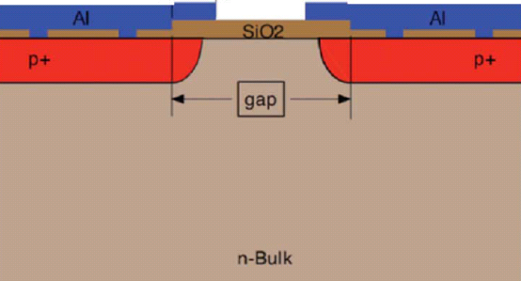
Basics of Surface (X-ray) Damage
radiation
Properties of thermally grown SiO₂
density | 2.27 g/cm³
diel. constant | ~ 3.8
diel. strength | (5 – 10)∙10⁶ V/cm
energy gap | 8.8 eV
spec. heat | 10⁻³ J/(kg∙K)
Effects of radiation as function of γ energy:
>1.12 eV: eh-pairs in Si → signal [on average ~ 3.6 eV/(eh-pair)]
> 8.8 eV: eh-pair in SiO₂ [on average ~ 18 eV/eh-pair] → positive charges due to low mobility of holes → “surface” radiation effects
>300 keV: crystal damage: point defects (vacancies + interstitials → kinetics)
> 3 MeV: crystal damage: cluster defects
→ for 12 keV X-rays only “surface – SiO₂” damage

Slide 5
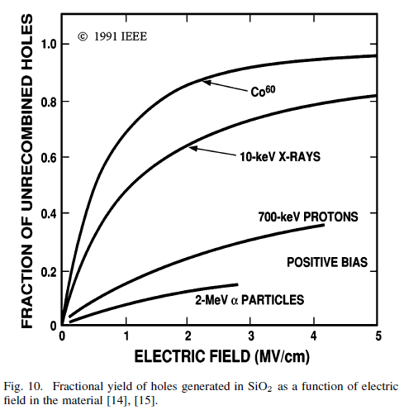
Damage of SiO₂ and at Si-SiO₂ Interface
Generation of
eh-pairs in SiO₂
for 500 nm SiO₂: 4∙10¹⁶ cm⁻² for dose of 1 MGy
depends on ionization density and E-field
Prompt recombi-nation of eh-pairs
Transport of
free carriers
M.R. Shanefield et al.,
IEEE TNS 38(1991)1187

Slide 6
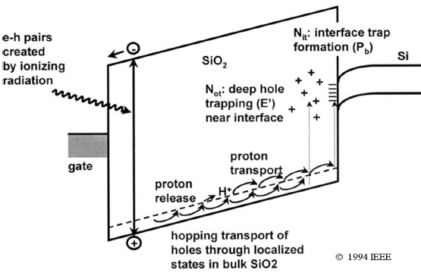
Damage of SiO₂ and at Si-SiO₂ Interface
μ_{electrons} ~ 20 cm²/V∙s → electrons escape
„μ_{holes}“ < 10⁻⁵ cm²/V∙s → holes trapped in SiO₂
or (mainly) at Si-SiO₂ interface
[there are O(10¹⁵ cm⁻²) surface states]
Transport of
free carriers
Trapping
at Si-SiO₂
interface
Trapping
in SiO₂
F.B. McLean,
T.R.Oldham
(1987)
Effects
on sensor

Slide 7
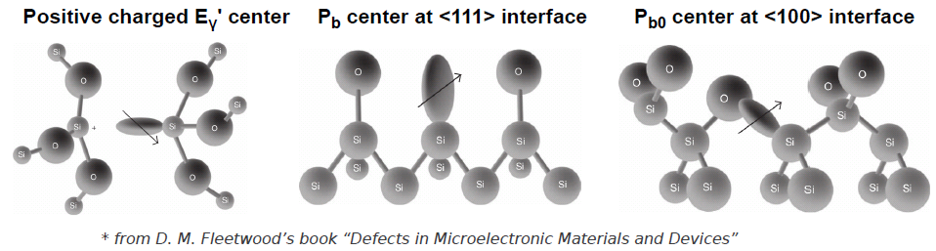
Damage of SiO₂ and at Si-SiO₂ Interface
+ Oxide trapped charges (N_{ox}):
- mainly positive oxygen-vacancy defects
(one shallow trap → hole transport,
+ one deep trap E’_{γ} @~3 eV) saturation: h-trapping = e- recombination
Mobile ions: not an issue anymore
-
+
+
+
-
+
+
SiO₂
+ Border oxide traps (“add” to N_{ox}):
positive E’_{γ} defect can exchange
charge with Si depending on Fermi-
level on time scales 0.01 s - seconds
+
+
-
-
+
+
+
+
-
+
+ + + + + + + + + + + + + + + + +
+ + + + + + + + + + + + + + + +
~3 nm
SiO_{X}
X Interface traps (D_{it}^{*)}):
traps at interface (no barrier !)
dangling bond defects (P_{b}) – H⁺ released when h captured:
SiH + H⁺ → (Interface Trap)⁺ + H₂
no. limited by no. of dangling bonds
x x x x x x x x x x x x x x x x x x
Si
^{*)} Distribution of traps in the Si bandgap
D_{it} [1/(eV∙cm²)]

Slide 8
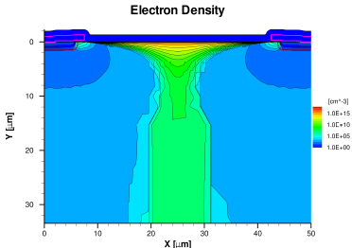
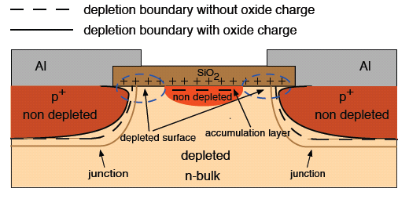
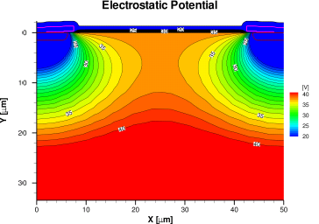
Impact of Oxide + Surface Damage on Sensors
Effects on p⁺n sensors:
  Accumulation layer
  Lower breakdown voltage
  Increase of inter-pixel capacitance
  Increase of leakage current
  Charge losses close to Si-SiO₂
Tasks:
  Measure N_{ox} and D_{it} vs. dose for different technologies
  → Implement results in TCAD sensor simulations
  → Optimize sensor design
  → Verify by experiment
J.Schwandt

Slide 9
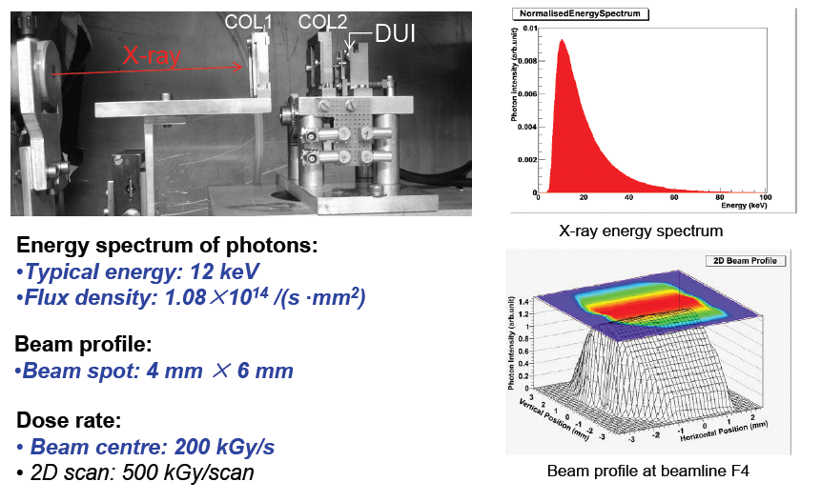
Irradiation Set-up at F4 (DORIS)
H.Perrey
J.Zhang
DORIS will have stopped operation by end 2012 !!!

Slide 10
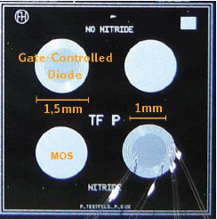
Measurement Techniques + Structures
Irradiations: 10 kGy → 1 GGy
(immediately after irradiation not all results reproducible due to short term annealing effects → most of measurements made after 10’@80°C)
- MOS capacitor: C/G-V vs. frequency …..→ N_{ox} + N_{it}
vs. V_{max} ………..→ border traps
TDRC ……………………………→ D_{it} and N_{it}
- Gate Controlled Diode: C/G-V ……………. → N_{ox} + N_{it}
I/V ………………… → I_{surface} (D_{it})
- Strip sensors: I/V → compare to TCAD simulations
C/V → compare to TCAD simulations
TCT → charge losses + surface effects
6 mm x 6 mm test field
- MOS Capacitor (MOS-C)
- Gate Controlled Diode (GCD)
(from different vendors and crystal orientations)

Slide 11
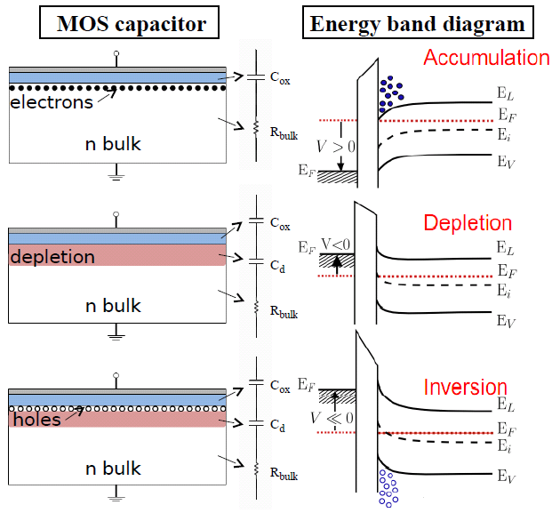
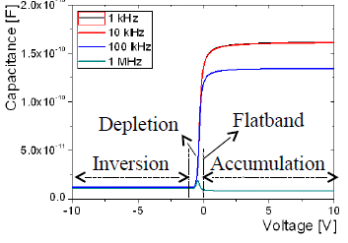
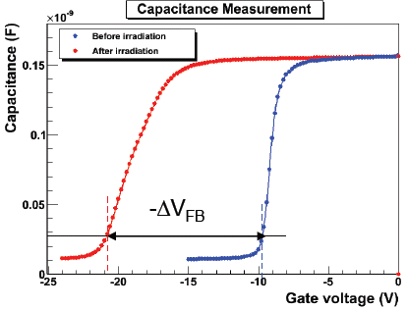

MOS Capacitor: Principle of Measurement
Ideal
V
non depleted bulk
V
non depleted bulk
after
before
irradiation
V
J.Zhang
non depleted bulk

Slide 12
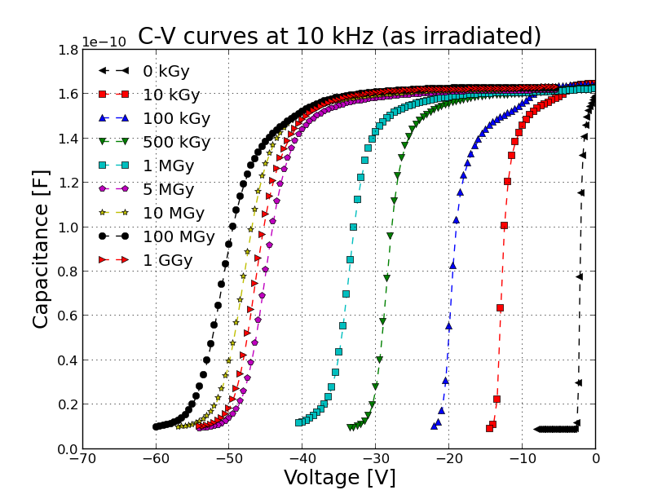
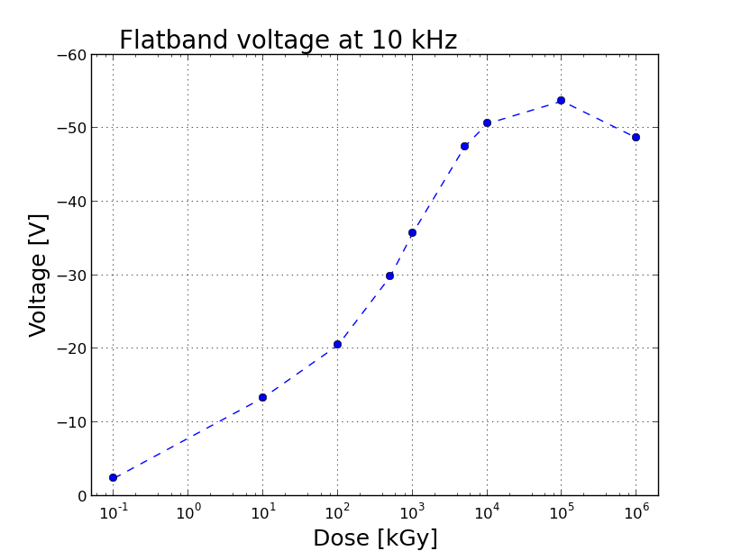

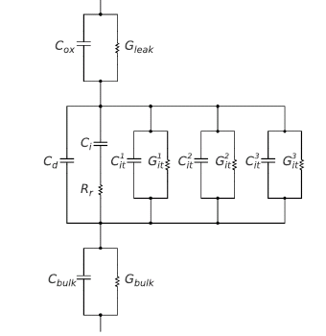
MOS Capacitor: V_{FB}-shift vs. X-ray Dose
H.Perrey
J.Zhang
V_{FB}-shift measures N_{ox} and N_{it}
  Increase up to 10-100 MGy
  Decrease above 100 MGy ?
  Need additional measurements to separate contribution from N_{ox} and N_{it}
Al
SiO₂
Si depleted
Si non-depleted

Slide 13
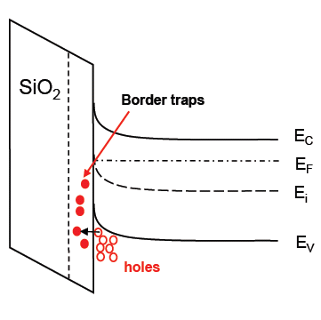
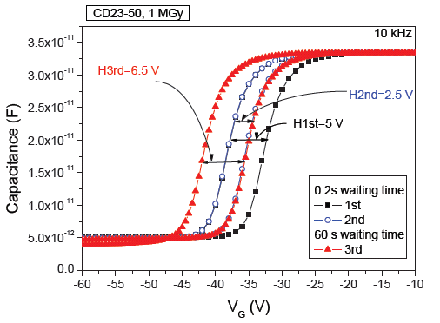
MOS Capacitor: V_{FB}-shift and Border Traps
V_{FB}-shift shows strong hysteresis effect
I.Pintilie
Biasing in deep inversion:
  High hole concentration at Si-SiO₂ interface
  → Injection of holes into border traps (~5 nm) dependent on injection time
  → Increase of N_{ox}
  → V_{FB} shift (depends on time in deep inversion – “waiting time”)

Slide 14
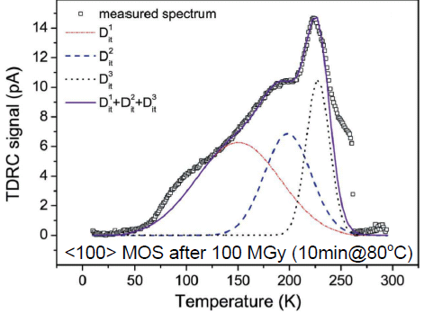



Measurement of D_{it}
TDRC on MOS capacitor (Thermal Dielectric Relaxation Current)
Bias MOS capacitor in strong accumulation → fill interface traps with electrons
Cool to 10 K → freeze traps
Bias to depletion and heat up to 290 K → measure current due to charges released from Si-SiO₂ interface
T[K] → E_{c}-E_{it} [eV]
I[pA,t] → D_{it} [(eV∙cm²⁾⁻¹]
$$N_{it}=\int{D_{it}(E)dE}$$
I.Pintilie
J.Zhang
3 dominant traps:
→ D_{it}^{i} vs dose
 | IT⁽¹⁾ | IT⁽²⁾ | IT⁽³⁾
E_{c}-E_{it} [eV] | 0.39 | 0.48 | 0.60
FWHM [eV] | 0.26 | 0.13 | 0.07
σ_{eff} [cm²] | ~10⁻¹⁵ | ~5∙10⁻¹⁷ | ~10⁻¹⁵
Interpretation not unambiguous !

Slide 15
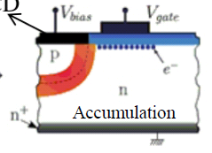
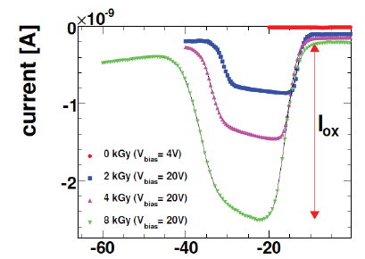
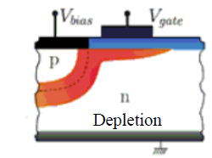
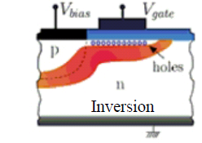
GCD^{*)}: Principle of Measurement
Measurement of surface current I_{surf} ← D_{it} (at mid gap)
I_{surf}
^{*)} GCD = Gate Controlled Diode

Slide 16
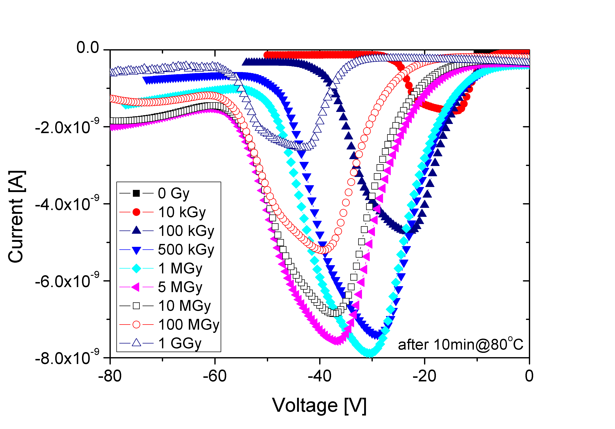
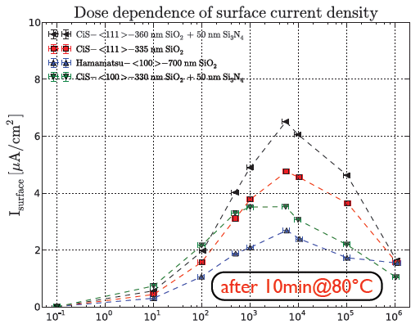
GDC: Surface Current vs. X-ray Dose
I-V curves for irradiated diodes: → I_{surface}
Results not easy to interpret - Increase up to ~5 MGy
- Decrease beyond 10 MGy
→ Saturation expected – Decrease ???
(no I_{surf} plateau @ high doses, diff. values V↑ and V↓)

Slide 17
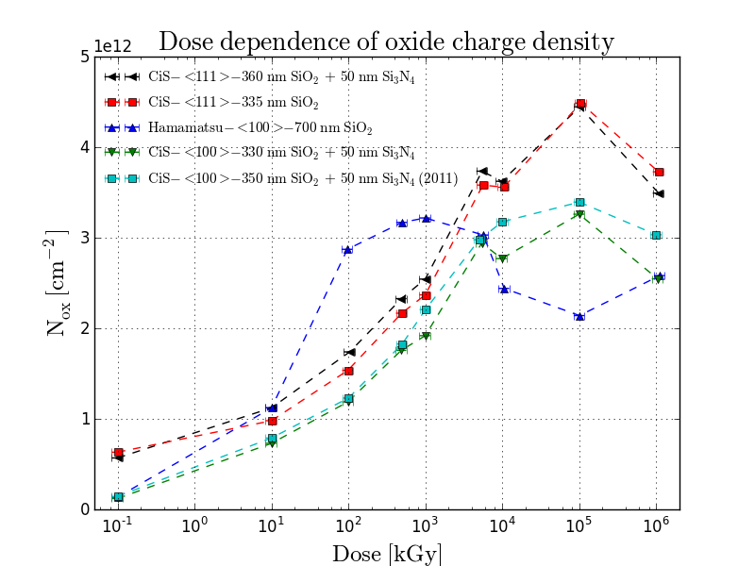
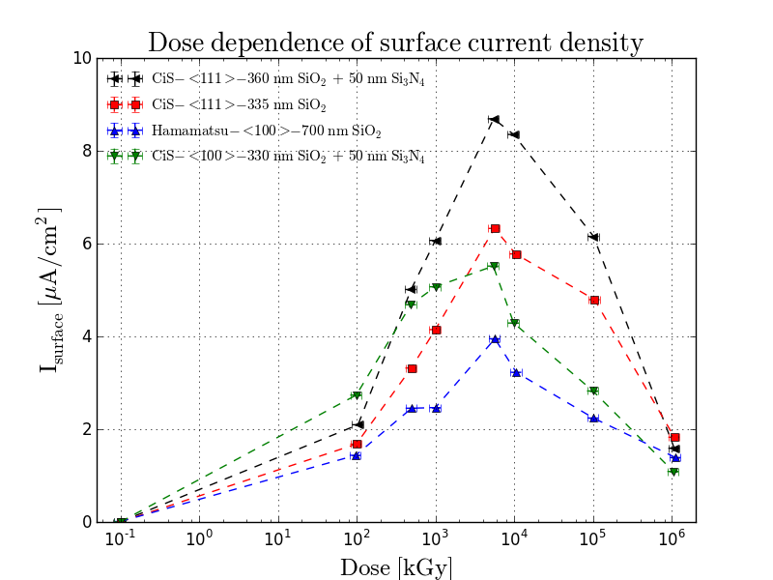
Summary: Results on X-ray Rad. Damage
Parameters used for TCAD Simulations (~ for CIS and Hamamatsu)
  Compare to measurements on segmented sensors
  Optimize AGIPD sensor design for X-ray radiation hardness
as irradiated
as irradiated
H.Perrey, J.Zhang
Typical values :
Talk by J. Schwandt
TCAD simulations:
 | 0 Gy | 10 kGy | 1 MGy | 10 MGy
N_{ox} [cm⁻²] | (1-5)∙10¹¹ | 1∙10¹² | 3∙10¹² | 3∙10¹²
I_{surf} [μA/cm²] | 0.005 | 1 | 4 | 6

Slide 18
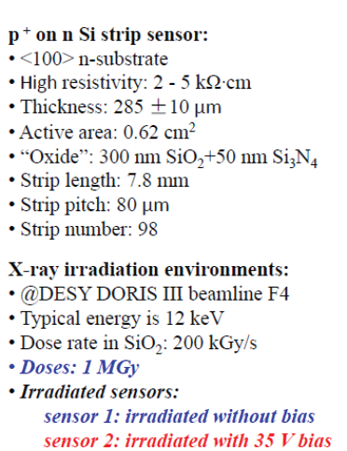
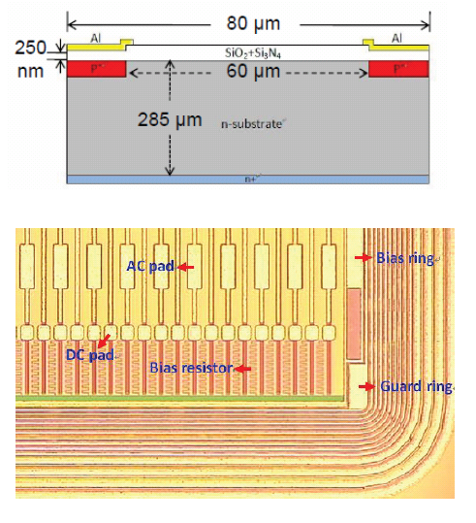
Impact on p⁺n Sensors
Sensors irradiated:
  AC coupled from CIS(80 μm pitch)
  DC coupled from Hamamatsu(50 μm pitch)

Slide 19
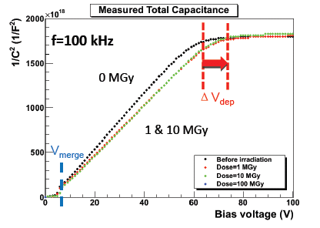
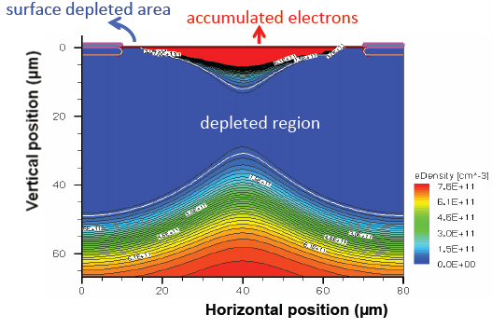

Impact on p⁺n Sensors: V_{depletion}
AC coupled CIS sensor :
for pad sensor $C= \frac{ε∙ε_{0}∙A}{w_{depletion}}→\frac{1}{C^{2}}\sim V$up to depletion, then C constant
J.Zhang
J.Schwandt
Effects of N_{ox} → increase of electrons in accumulation layer
- step in 1/C² when undepleted regions below SiO₂ separate
- voltage required to deplete entire sensor depends on N_{ox}
→ Effect not of relevance for user

Slide 20
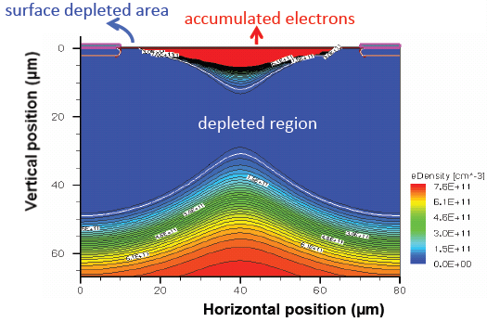
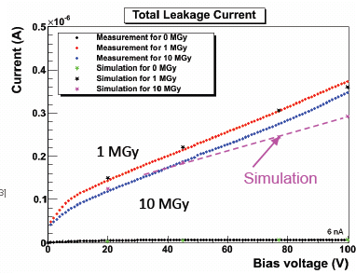
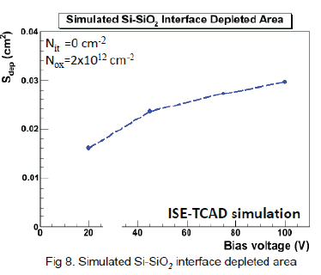
Impact on p⁺n Sensors: Dark Current
AC coupled CIS sensor:
I_{interface}
J.Zhang
Interface current (D_{it}) dominates
- Current from depleted interface (E-field)
- Interface area changes with V_{bias}
→ seen by X-ray users
→ minimize depleted interface area
→ Important for sensor optimization
A.Srivastava

Slide 21
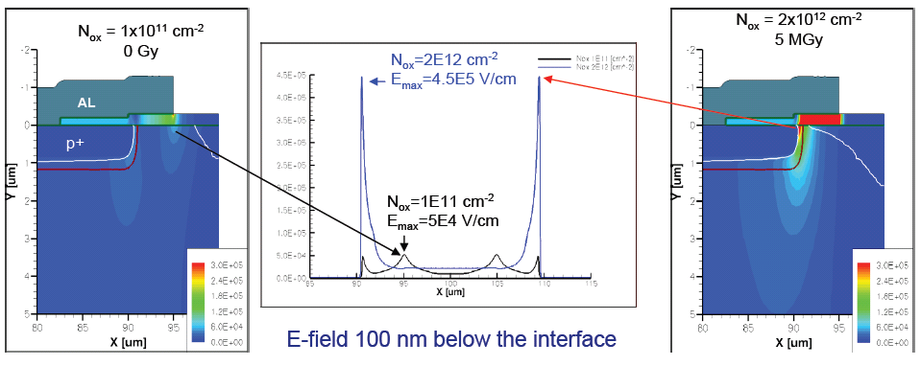
Impact on p⁺n Pixel Sensors: Breakdown
Simulation 2-dim [x,z and r,z] and 3-dim:
N_{ox} → accumulation layer → changes curvature p⁺-depletion → changes E-field
J.Schwandt
z [μ]
z [μ]
Breakdown depends on N_{ox},t_{ox},p⁺-implant, Al-overhang, potential on top of sensor (passivation layer), technology, etc.
→ Major challenge for sensor design for dose range 0–1 GGy @ > 500 V)

Slide 22
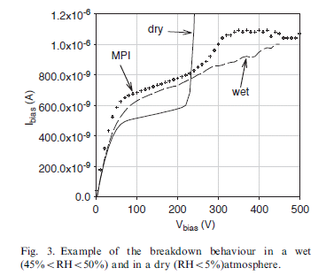
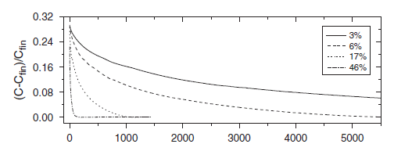
p⁺n Sensors: Potential on Sensor Surface
V_{breakdown} also depends on potential/charge distribution on surface:
- Change of bias voltage → surface fields (non-equilibrium) → movement of surface charges – conductance is a strong function of humidity
- V_{breakdown} depends on surface charges
ATLAS SCT Sensors
(non-irradiated/no Al overhang
Measured inter-strip capacitance vs. time:
humid: ~ 10 min.; dry: days; vacuum: ???
humidty:
(T = 22°C)
A.Chilingarov et al., NIMA 560(2006)118
→ Effects for sensors with X-ray damage ???
F.G. Hartjes, NIMA 552(2005)168

Slide 23



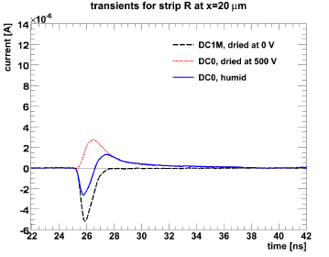
p⁺n Sensors: E-field close to Si-SiO₂ interface
L
600nm laser (λ _{att} ~ 3μm)
R
For low N_{ox}
500V (equilibrium) → 200 V:
→ „surplus” of neg. charges on surface
→ E-field will point Si → SiO₂
→ holes will be „lost“ at surface
0V (equilibrium) → 200 V:
→ „lack” of neg. charges on surface
→ E-field will point SiO₂→Si
→ electron „loss“ at surface
For high N_{ox} (X-ray rad. damage)
0V (equilibrium) → 200 V:
90% e-loss → 30% e-loss
500V (equilibrium) → 200 V:
5% e-loss → 30% e-loss
Way to measure time con-stants to reach equilibrium
Al
Al
- - - - - - - - -
- - - - - - - - -
h
e-h pairs
e
+ + +++++++++++++++++++++++++++++++++++
----- no losses
- - - - electron losses
------- hole losses
Signal of R
hole losses
no losses
electron losses
T.Pöhlsen

Slide 24
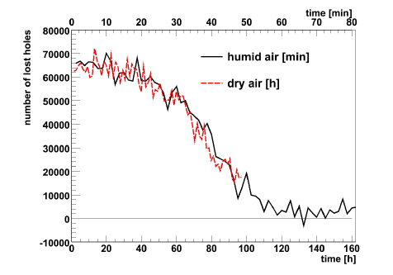
Time Constants to reach “Surface Equilibrium”
Results for time constants
- humid: 10’s of minutes
- dry (RH < 5 % @ RT): days
- vacuum: ???
Effect of charge losses:
- only for few μm → ~irrelevant
- charge storage → no pile-up effects as accumulation layers of entire sensor connected
~ 40 min
~ 80 h
T.Pöhlsen
Break-down at high N_{ox} for non-equilibrium: More studies needed !
(in particular for guard ring breakdown in vacuo)
→ Efforts needed to optimize properties of “SiO₂” and/or passivation layer!

Slide 25
Summary – Personal Conclusions
X-ray damage is complex:
  N_{ox} and N_{it} saturate (decrease) for > 10- 100 MGy
  → Main parameters measured (understanding? technology !) → Dark current and capacitance not a problem for pixels → Charge losses and pile-up no problem (plasma effect!)
  Main challenge: High breakdown voltage and stable operation
  → Proper implementation of parameters into TCAD simulation → Verification simulations with results from segmented sensors → Strategy of sensor optimization → Effects of sensor surface (passivation) → Effects of technology
  What surprises ???
Should XFEL afford building-up expertise in X-ray radiation damage for sensors and electronics ???
Can XFEL afford not

Slide 26
Thanks
Thanks to:
  Group @ UHH:
    E.Fretwurst
    I.Pintilie (Bukarest + UHH)
    M.Matysek
    T.Pöhlsen
    J.Schwandt
    J.Zhang
  AGIPD @ DESY + PSI + Uni-BN
    + Inspiration from Rainer Richter HLL-München

Slide 27
Master

