Slide 1
LSDMA kickoff
Kompetenzen und Pläne für das erste Jahr von DESY
Volker Guelzow, Martin Gasthuber,
Birgit Lewendel
DESY IT
Karlsruhe, 22. März, 2012

Slide 2
Storage System design
DESY is running large experiments in HEP & Photon Science
The DESY experiments do require very high I/O rates in the DAQ
The offline system requires high capacities and high bandwidth for analysis
The whole chain by design must be well balanced
Appropriate datamanagament software is required from filesystems to dCache-type
dCache is the major working horse for LHC datamanagement and DESY has the lead
started before 1999 from DESY and FNAL in collaboration
very strong local storage development and project management expertise
accompanied by many local storage/data management projects (i.e. NFSv4.1 Tests)

Slide 3
dCache, Status
dCache : a world wide recognized storage technology
DESY provides the project infrastructure (headquarters)
Development :
Web Pages, Wikis and Documentation.
Central Code Repositories
Organization of developers meetings and workshops
Services activities:
Test infrastructure & performance (Grid-Lab)
Quality Management
Release Management
Customer support : Tier I conferences, support@dcache.org
Network Activities :
DESY : dCache operations (DOT) and Grid-Lab
Germany : HGF, DGI, German Support
Europe : EMI, NDGF, Swedish National Infrastructure
Worldwide : WLCG, Open Science Grid, Open Grid Forum
Main communities
WLCG
HERA
Photon Science (@ DESY)
LOFAR (LOw Frequency ARray) : Amsterdam & Jülich
Swedish academic storage e-infrastructure (SNIC)
dCache.org dCache.org
Contact : Patrick Fuhrmann @ DESY

Slide 4
dCache, The Deployment
94 PB in total WLCG
8 Tier I’s
60 Tier II’s
WLCG Storage per SE type
dCache
Other
Storage
Systems
Dresden
Freiburg
Mainz
Göttingen
Wuppertal
Aachen
Munich
FERMIlab
Florida
DESY
KIT
Germany
16 PB
BNL
Purdue
USA
28 PB
Madison
Wisconsin
Barcelona
Cambridge, MA
Europe
44 PB
East : 1 PB
Lyon
Athens
Sweden
Pisa
Roma
Madrid
NDGF
Amsterdam
London
Contact : Patrick Fuhrmann @ DESY

Slide 5
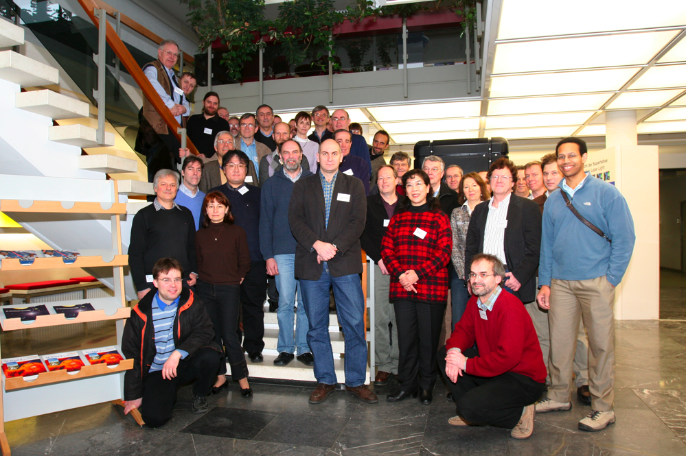
DPHEP: International Study Group on Data Preservation
Chair: Cristinel Diaconu (DESY/CPPM)
Working Groups
Physics Cases: François Le Diberder (SLAC/LAL)
Preservation Models: D. South (DESY), Homer Neal (SLAC)
Technologies: Stephen Wolbers (FNAL), Yves Kemp (DESY)
Governance: Salvatore Mele (CERN)
International Steering Committee
Participants from ee, ep and pp collider experiments
Associated computing centres at the labs
Some funding agencies
International Advisory Committee
Chairs: Jonathan Dorfan (SLAC), Siegfried Bethke (MPIM)
Advisers: Gigi Rolandi (CERN), Michael Peskin (SLAC), Dominique Boutigny (IN2P3), Young-Kee Kim (FNAL), Hiroaki Aihara (IPMU/Tokyo), Alex Szalay (JHU)
IHEP
Group has grown since 2008 to over 100 contact persons
Endorsed by ICFA summer 2009
LHC experiments joined in 2011
Notes:
5

Slide 6
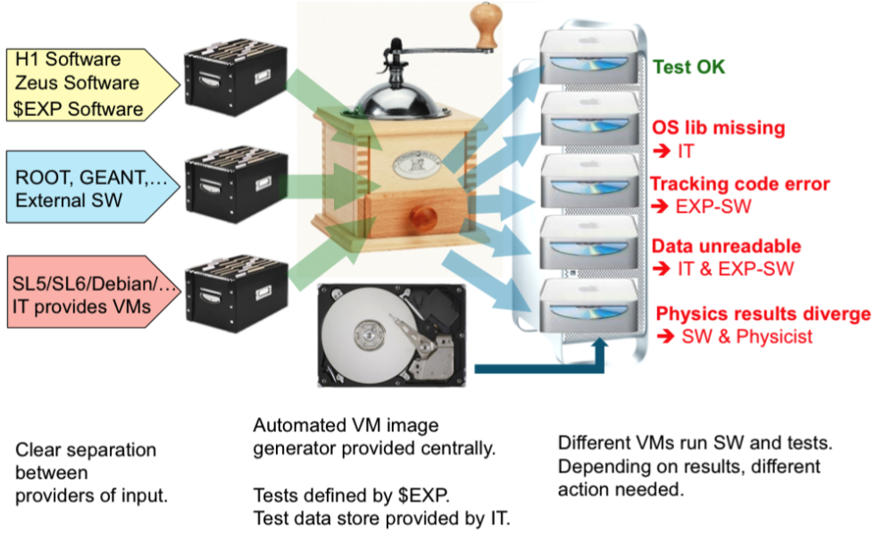
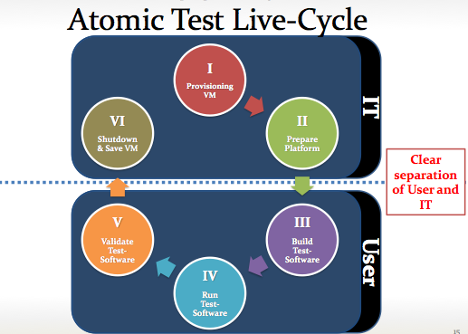
Towards a Generic Solution at DESY-IT
Validation of experimental software using a virtual environment
Generic solution, for all HERA experiments: validate the whole analysis chain
Useful collaboration for future OS, external software transitions
Successful pilot project implemented, full project (people and $) now secured
Should be useful for other experiments
Notes:
6

Slide 7
Pläne DSIT
Data intensive computing…
Zusammenarbeit mit HDRI, europ. Projekten, lokale HEP Exp. und LHC Gruppen, CFEL/XFEL/Petra3/Flash
Migration, Preservation & Curation
DPHEP Ausbau und Verbreiterung – auch für ´nicht HEP´
Universal Data Access
dCache-Solution, Ultra-Fast Storage für HEP und PS Analyse, Physicist @ the beach work model
System Storage Design
Design-Strategies for the Data Chain, Cloud awareness, automated tiering, Group support

Slide 8
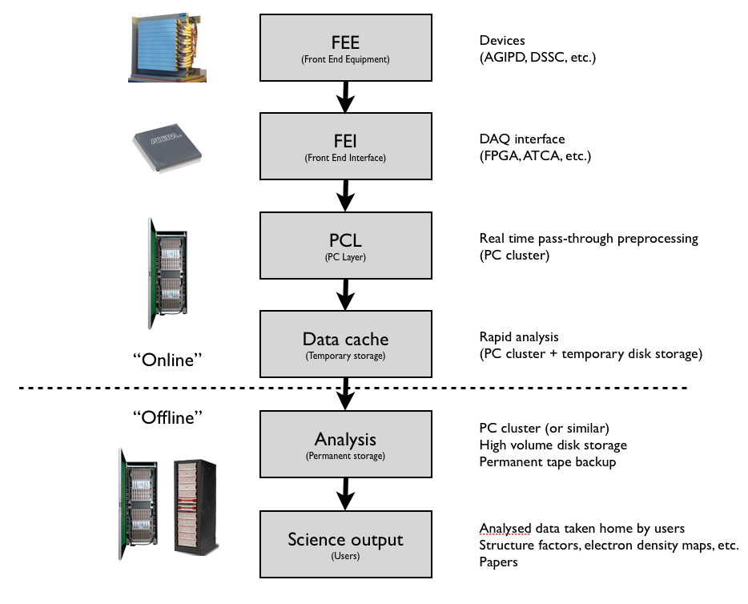
Pläne DLCL
Erfassen der Bedarfe (gemeinsam mit GSI) von zunächst „Matter“ Communities
Aufbau von einer Support-Struktur für die „Matter“-Communities
Mitwirkung am Aufbau einer allgemeinen „DLCL“-Struktur
Zusammenarbeit mit der HDRI-Initiative, Pandata, Crisp
Mitarbeit in CFEL/XFEL Data Analysis Development Project

