Slide 1
Directions in High-Resolution Particle Measurement
Ashfaq Ahmad
Stony Brook University
Ashfaq Ahmad

Slide 2
Outline
Calorimetry
  Ongoing R&D and the future Calorimeters
  Current Electromagnetic Calorimeters in ATLAS and CMS
Calibration of the Atlas Electromagnetic Calorimeter
  Impact on Higgs searches
    Brief status of the H→γγ search in ATLAS
Searches for SUSY in multilepton events (in backup slides)
Summary

Slide 3
Calorimetry
Measure energies of charged and neutral particles, jets as well as measure total missing transverse energy
Consists of:
  Dense absorber material to fully absorb incident particles
  Active material to produce an output signal proportional to the input energy
Fast processing time, could recognize and select interesting events in real time, used for triggering
The intrinsic resolution of calorimeters improves with energy(as 1/√E ) in contrast to magnetic spectrometer
Calorimetry is widely used, very much matured and effective technique
  But still need to improve resolution, achieve even faster response and more radiation hardness for future experiments

Slide 4
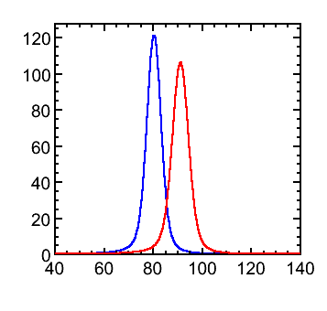
Particle-Flow Calorimetry (1/2)
A novel idea for high resolution calorimetry
  Partly motivated by the need to distinguish dijet invariant masses of W and Z bosons on event-by-event basis(e.g in future e⁺e⁻ linear collider)
The idea is to measure the energy of all particles in a jet using
  Tracker for charged particles
  EM calorimeter for prompt photons
  Hadronic calorimeter for neural hadrons
  A typical jet has:
    60 % of jet energy in charged hadrons
    30 % in photons (mainly from π⁰→γγ )
    10 % in neutral hadrons (mainly from n and K_{L})
  Normally jet energy is measured in calorimeters(HCAL and ECAL)
    70% of the jet energy is measured in HCAL with poor resolution, for ATLAS σ/E ~ 50%/√E ⊕ 0.03
    Could improve resolution using PFC by a factor 3 , σ/E < 20%/√E, enough to distinguish W/Z decays
    Only 10% of the energy is measured in HCAL
Need to isolate the energy deposited by charged particles from that by photons and neutral hadrons
3% jet resolution give 2.6σ separation in W/Z

Slide 5
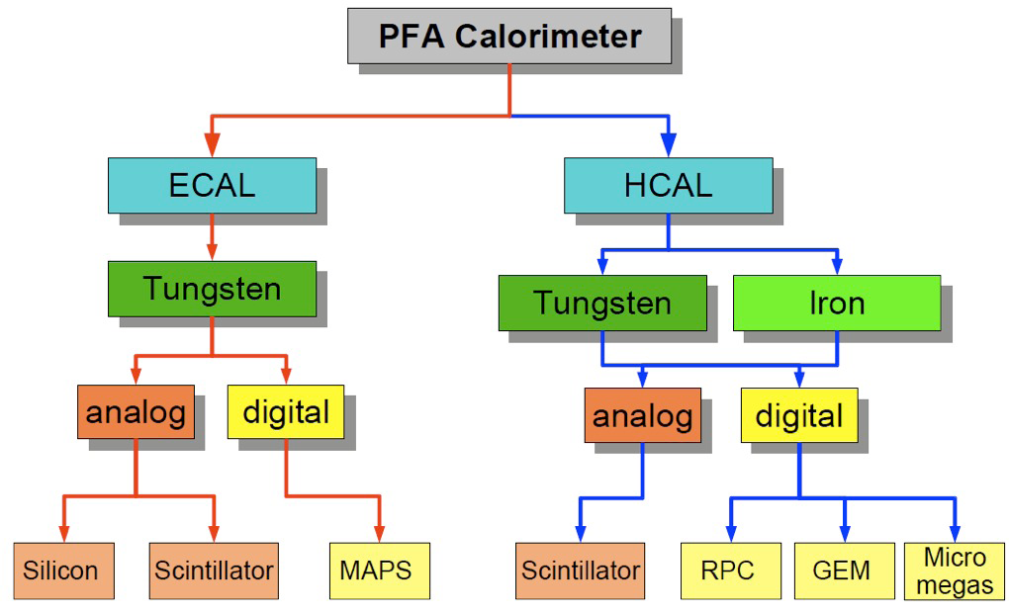
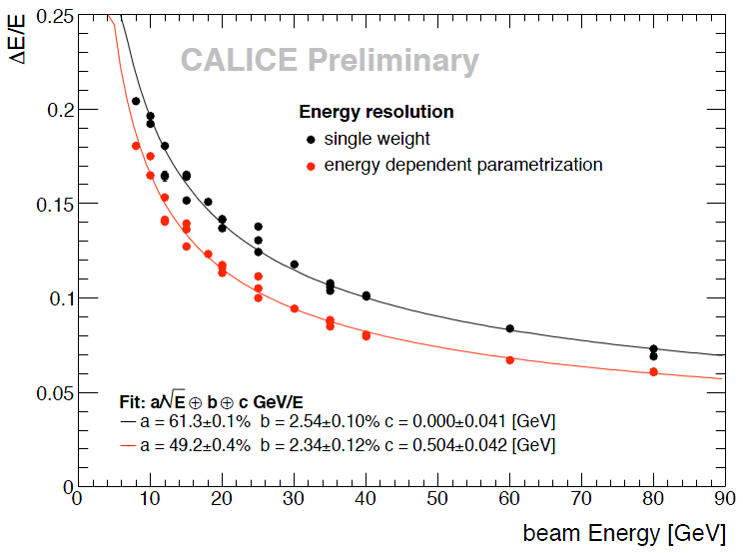
Particle-Flow Calorimetry (2/2)
The concept is a combination of both advance Hardware and Software
  Need highly segmented detectors(ECAL and HCAL), for example SiW sampling ECAL from CALICE
    Using tungsten as absorber and silicon as active layer
  Need very good pattern recognition algorithms optimized with highly segmented high resolution detector
  Like PandoraPFA, such NIM 611 (2009) 24-40
Hadronic resolution with CALICE Analog HCAL as function of pion energy before(black) and after (red) software compensation
CALOR 2010
J. Repond DPF 2011
Absorber
σ/E = 49.2%/√E ⊕ 2.34%
Readout
Active
Notes:
e/h<1, hence to compensate for lower hadronic response weights proportional to energy density are introduced. Silicon photomultiplier detectors (SiPM)

Slide 6
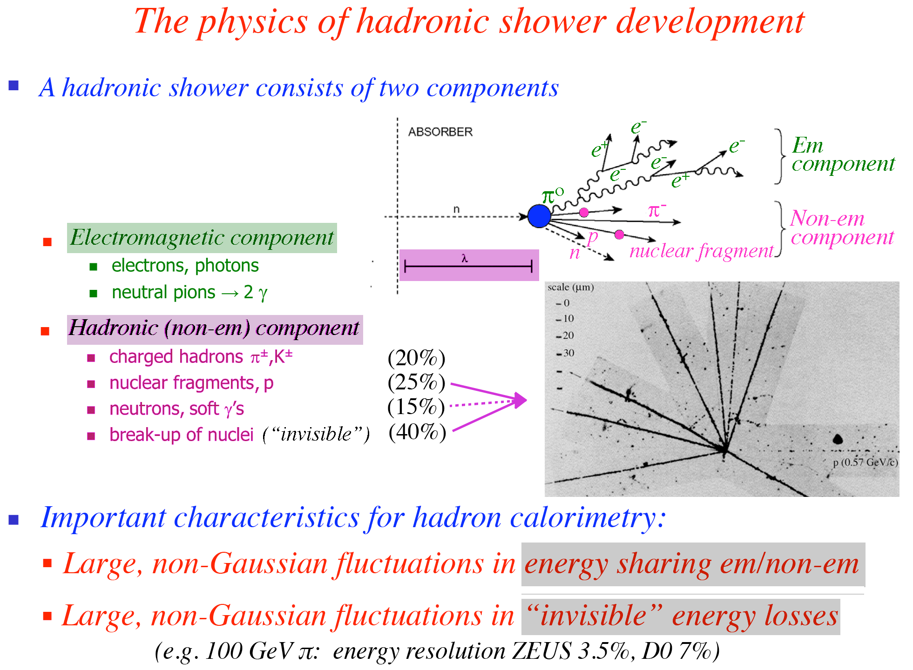
Dual-Readout Calorimetry(1/2)
A hadronic shower consists of two
components: EM and hadronic
Calorimeters(e/h≠1) give a larger signal per unit deposited energy for the EM shower component (mostly initiated by π⁰→γγ) than for non-EM components
  fluctuations in the intrinsic energy-sharing between the EM and non-EM component of the deposited energy
  Hence large fluctuation in hadronic response
  Poor resolution, non linearity and non Gaussian response
One way out as adopted by DREAM collaboration is Dual-Readout Calorimetry
Measurement of both the ionization/scintillation(hadronic fraction) and the Cherenkov signals(EM fraction) generated by a hadronic shower in order to determine on event by event basis the electromagnetic fraction of the shower
  The total shower energy can be reconstructed by using the measured values of EM fraction
  Resolution, linearity can be improved

Slide 7
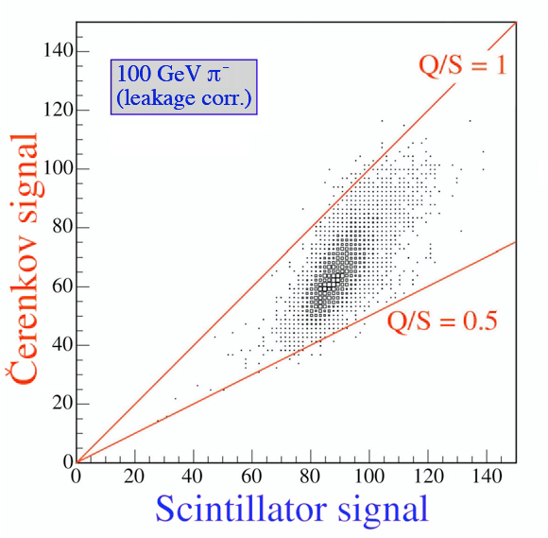
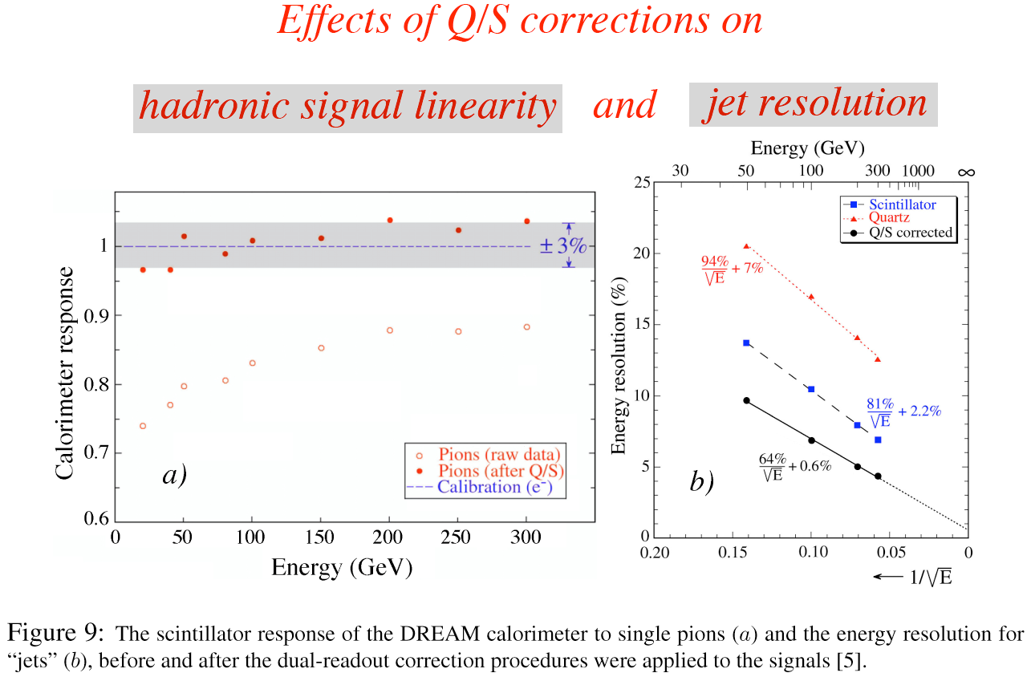
The effect of Dual-Readout corrections
Improved resolution to σ/E = 64%/√E ⊕ 0.6% after corrections
Small constant term means resolution improve with energy
The DREAM Calo. suffers from limited lateral coverage, therefore particle leakage occurs. Space for improvement, goal is to have hadronic resolution as good as EM
R. Wigmans, Fermilab Seminar 2011
Jet Energy Resolution

Slide 8
State of the Art:
ATLAS and CMS Electromagnetic Calorimeters

Slide 9

The ATLAS(A ToroidaL LHC ApparatuS) Detector
Muon Spectrometer (|η|<2.7) : air-core toroids with gas-based muon chambers
Muon trigger and measurement with momentum resolution < 10% up to E_{μ} ~ 1 TeV
Size of the detecor
Length : ~ 46 m
Radius : ~ 12 m
Weight : ~ 7000 tons
~10⁸ electronic channels
3000 km of cables
3-level trigger
reducing the rate
from 40 MHz to
~200 Hz
Inner Detector (|η|<2.5, B=2T):
Si Pixels, Si strips, Transition Radiation detector (straws)
Precise tracking and vertexing,
e/π separation
Momentum resolution:
σ/p_{T} ~ 3.8x10⁻⁴ p_{T} (GeV) ⊕ 0.015
Standard size
people!
EM calorimeter: Pb-LAr Accordion
e/γ trigger, identification and measurement
E-resolution: σ/E ~10%/√E ⊕ 0.7%
HAD calorimetry (|η|<5): segmentation, hermeticity
Fe/scintillator Tiles (central), Cu/W-LAr (fwd)
Trigger and measurement of jets and missing E_{T}
E-resolution: σ/E ~ 50%/√E ⊕ 0.03
Notes:
9

Slide 10
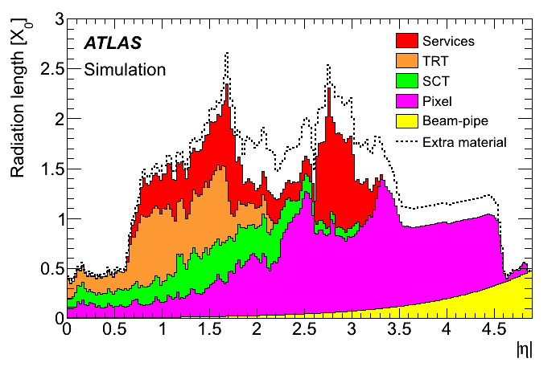
ATLAS: A Huge Detector
Building such a huge apparatus which involves millions of channels and sophisticated technology is not a trivial task
Need decades of R&D, thousands of people and a lot of money
Once components are built, the next step is the assembly
  Need to weigh all components and assemble them precisely
  A small distortion or misplacement could affect position and momentum resolution
    After careful assembly particle tracks have to be used in-situ to correct for distortions/misalignments
    The so called CSC book(~2000 page book about ATLAS and it’s performance is based on my alignment related work that I did a few years back)
Also involve a lot of passive material
  Power cables, cooling pipe, solenoid etc
  As a result:
    Electrons initiate showers , hence Identification,
    efficiency Problems, charge misID, jet fakes etc
    Photons converts to e+ e- pairs before reaching EM
    Calorimeter
  All material has to be properly mapped and it’s effects
  has to be understood
Material budget within ID

Slide 11
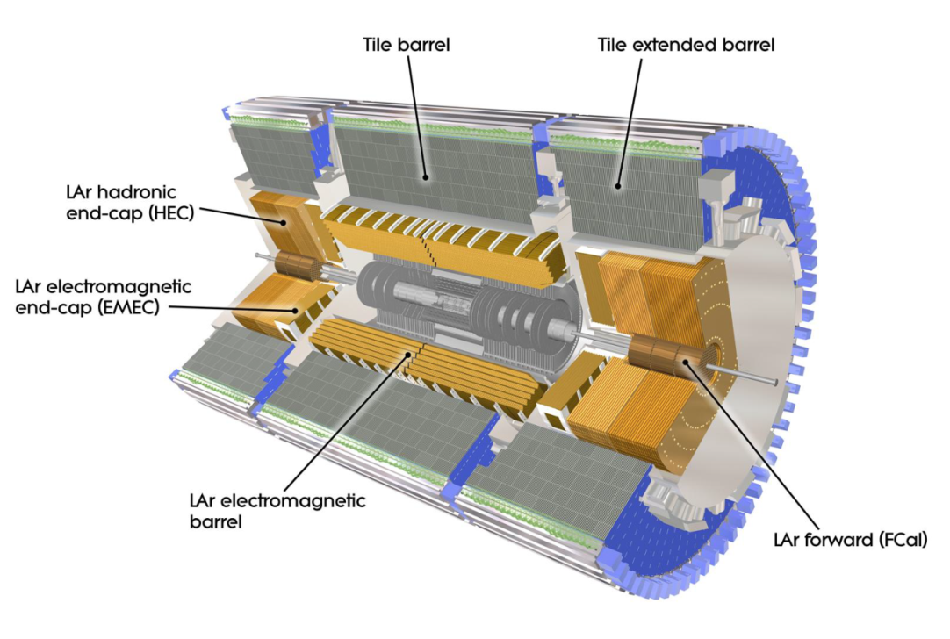
ATLAS Calorimeters
  Identify and measure energies of electrons, photons, taus, hadronic jets
  Measure missing energy signatures to spy for weakly interacting particles
  Need high granularity and hermitic detector
The ATLAS LAr Calorimeter consists of
  Electromagnetic calorimeter Barrel (EMB)
  Electromagnetic calorimeter End-Cap (EMEC)
  Hadronic end-cap calorimeter (HEC)
  Forward calorimeter (FCAL)
Optimization of parameters like
sampling, thickness, transverse and
longitudinal granularity done with detail simulation and beam tests

Slide 12
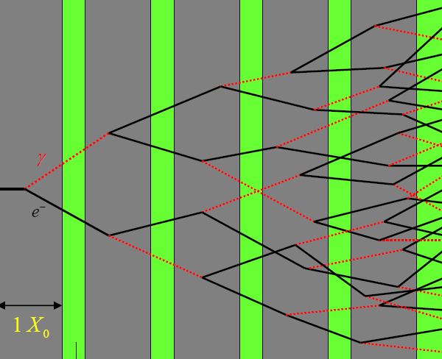
Sampling Calorimeters
A SAMPLING calorimeter is a calorimeter in which the medium in which the particle energy is deposited is interleaved with additional layers to periodically sample the energy
We infer the total energy deposited from the ionization deposited in the sampling layers - by converting it to an electrical signal and digitizing it
ATLAS uses Sampling
calorimeters
e⁻
Absorber
Active medium : Ionization or scintillation

Slide 13
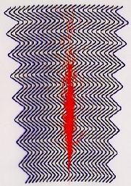
ATLAS LAr Electromagnetic Calorimeter
LAr calorimeters play a central role in ATLAS detector
  Pb-LAr sampling calorimeter with Pb as a passive (absorber) and LAr as active medium
    Energy is measured through ionization
  Measure energies of electrons and photons with high resolution and detect hadronic jets and missing energy signatures
Excellent γ/π⁰ , γ/jet and e/jet separation power
  Rejection factor of ∼10⁵ for e and ∼10⁴ for photon
To cope with pile-up, detector is designed to have
fast response (40MHz, against pile-up) and fine granularity to
separate overlapping photon from single photon (see later)

Slide 14
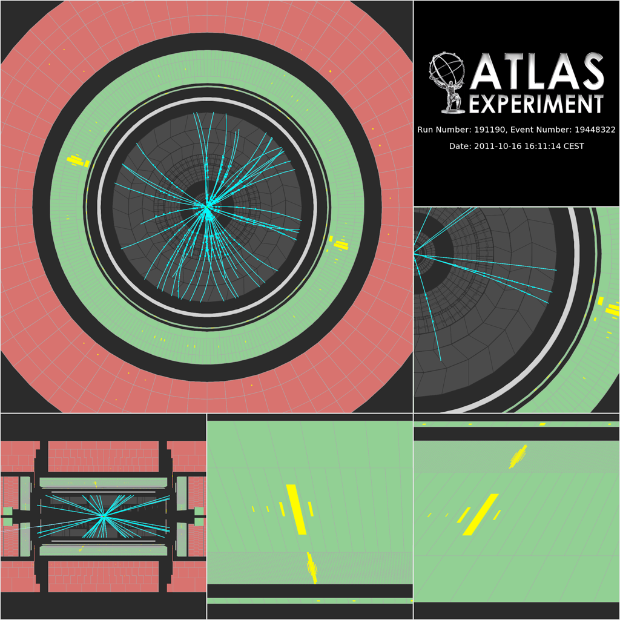
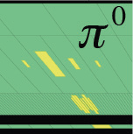
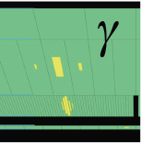
How does photon look?
Event display for X→γγ
Back layer
middle layer
Strip layer
Pre-Sampler
Conversion
Photon shower
η

Slide 15
Liquid Argon (LAr) Electromagnetic Calorimeter
Layer | Δη x Δφ
preSampler | 0.025 x 0.1
Strip | 0.003 x 0.1
middle | 0.025 x 0.025
back | 0.05 x 0.025
2 X₀
16 X₀
4.3 X₀
Good angular resolution : σ(Φ) ~ 10⁻³ rad
σ(η) ~ 5.10⁻⁴ rad
Coverage |η|<3.2

Slide 16
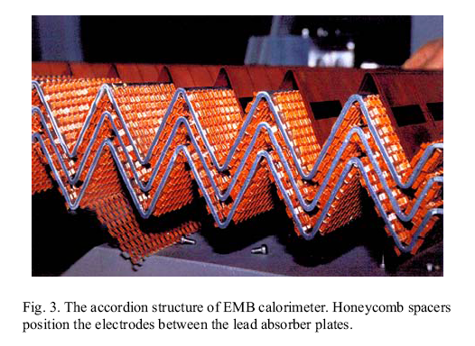
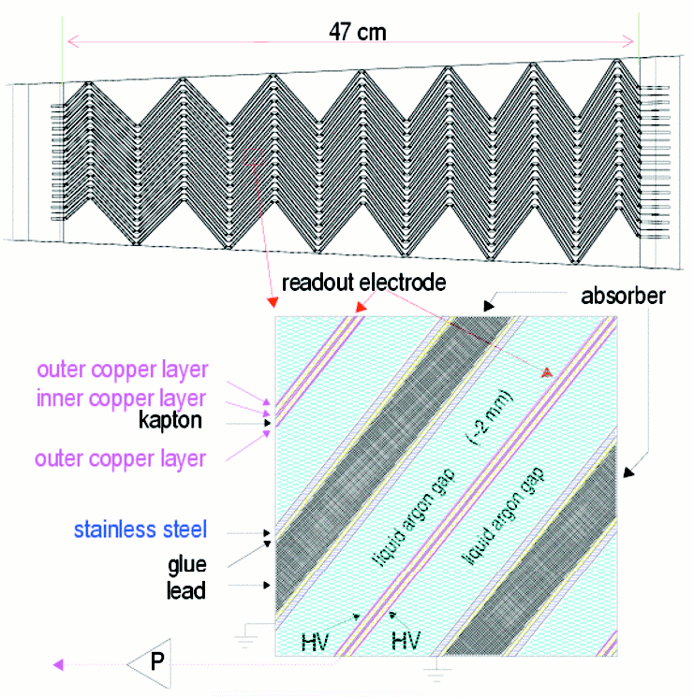
Detector Design
Accordion geometry to design a hermetic detector and to minimize signal deterioration due to calo. cell capacitance and connections to preamplifier
Longitudinal depth should be enough to contain the full shower, typically ∼25X₀
  Divided into three compartments/sampling plus a pre-sampler for measurement of energy loss upstream
Lateral segmentation to fully contain the shower, 95% of the shower energy contained in a cylinder of radius = 2xMoliere radius ∼9.5cm (layout with 2mm Lead and 4mm LAr)
  Lateral segmentation 1/3 of the above to separate electron/photon from hadrons(∼0.025 in the middle layer)
Lead ∼ 2mm
LAr ∼4mm

Slide 17
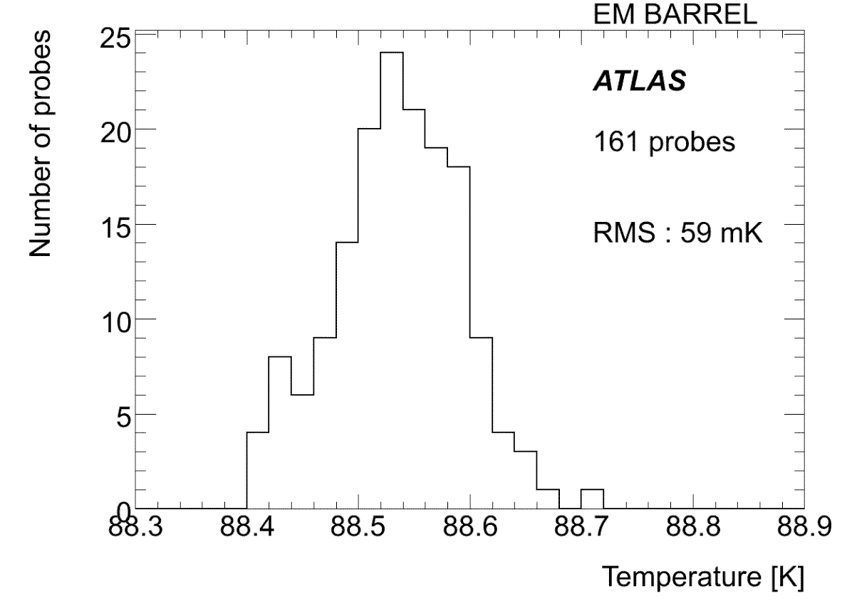
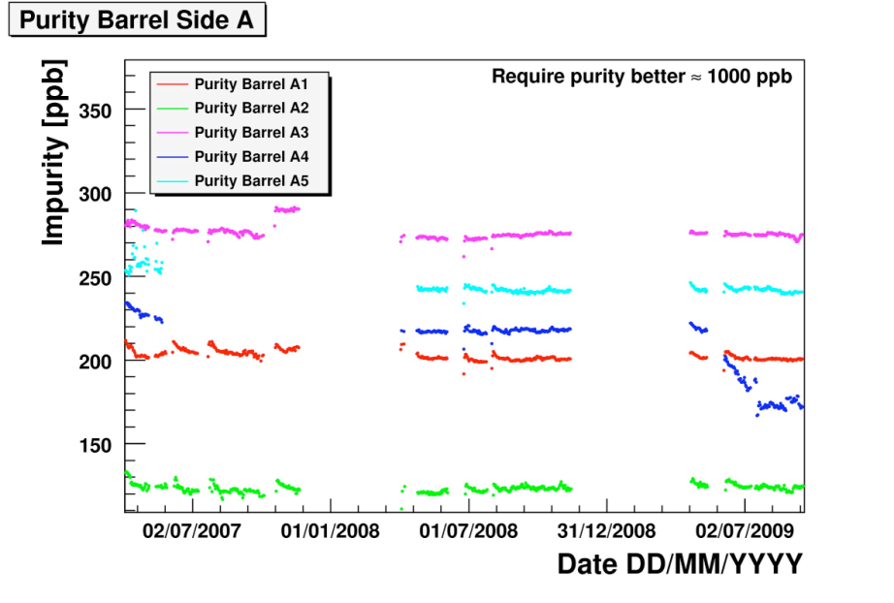
LAr Temperature and Purity
LAr temperature stability
  59 mK RMS
Excellent homogeneity and stability for LAr
temperature
  Each cryostat: ~ 88 K
  Designed value of < 100 mK for stability
  Signal sensitivity to temperature change: 2% / K
LAr purity in each cryostat is well within
required limits
Measured signal reduced by electronegative
impurities
Requirement: < 1000 ppb O2 equivalent
Measured with purity monitors:
  Barrel ~ 200 ppb, EndCap ~ 140 ppb
  Impurity level in LAr is in the range of
  200±100 ppb
Temperature stability and purity within limits
  Negligible impact on constant term of energy resolution

Slide 18
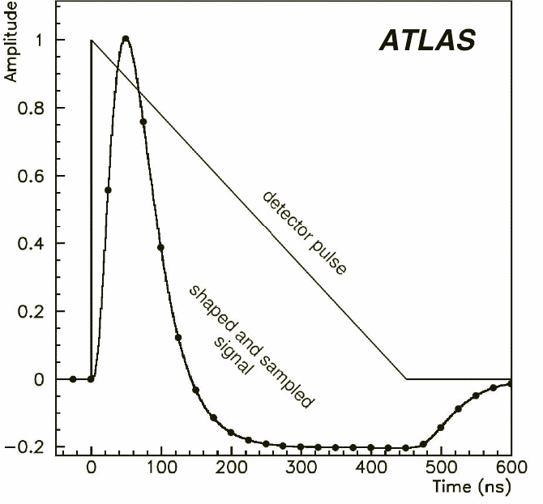
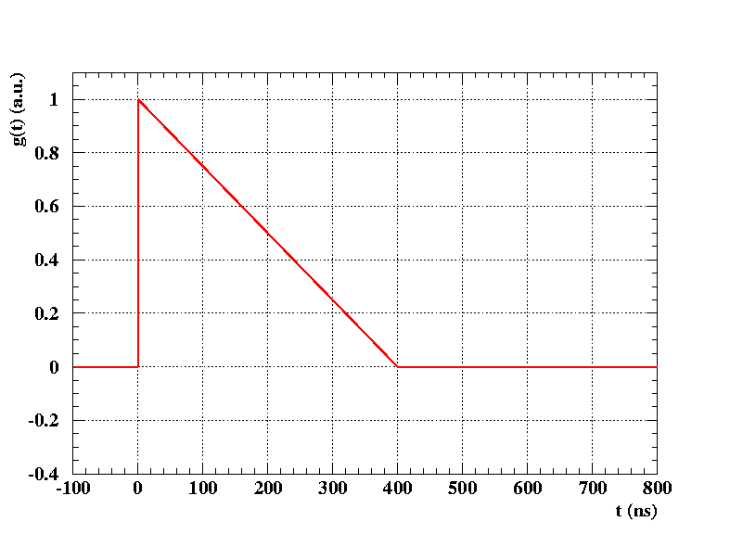
LAr Pulse Shaping
Slow signal collection in LAr via ionization as compared to LHC bunch crossing of 25ns
  Drift time of electrons in ∼2mm gap is 400ns
Solve the problem by shaping the triangular current signal with preamplifier-shaper system which has a bipolar shape
  Shaped signal sampled at 40MHz
Energy deposited can be measured from the amplitude(current) of the measured pulse
CR-(RC)²
E

Slide 19
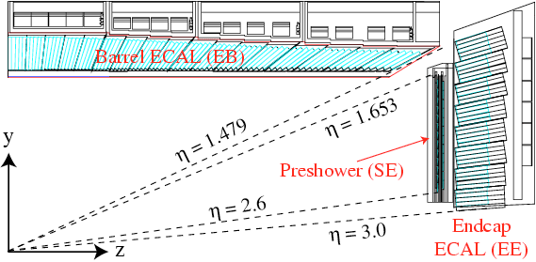
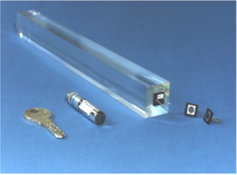
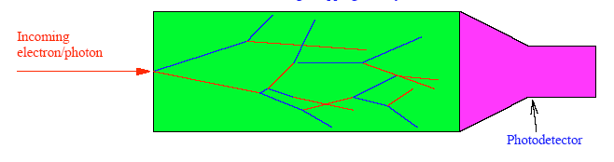
CMS Electromagnetic Calorimeter
Homogeneous calorimeter
One of the CMS EM barrel calorimeter PbWO4 crystals (230x22x22 mm³)
Read by APD (Avalanche PhotoDiodes)

Slide 20
ATLAS and CMS Electromagnetic Calo. Comparison
 | Atlas |  |  | CMS
Technology | Lead/LAr accordion |  |  | PbWO4 scintillating crystals
 | Sampling Calorimeter |  |  | Homogenous Calorimeter
Radiation hardness | Radiation resistant |  |  | Radiation damage, stability∼0.2%
 | Barrel |  | Endcaps | Barrel | Endcaps
η coverage | 0-1.475 |  | 1.4-3.2 | 0-1.48 | 1.48-3
channels | 110208 |  | 63744 | 61200 | 14648
Granularity | longitudinal segmentation |  |  | no longitudinal segmentation
 | ΔηxΔΦ |  |  | ΔηxΔΦ
pre-sampler | 0.025x0.1 |  | 0.025x0.1
Strips | 0.003x0.1 |  | 0.003-0.006x0.1 |  | Pb/Si preshower
Main sampling | 0.025x0.025 |  | 0.025x0.025 | 0.017x0.017 | 0.018x0.003 to 0.088x0.015
Back | 0.05x0.025 |  | 0.05x0.025
Depth
pre-sampler | 10 mm |  | 2x2mm | - | -
Strips/Si-preshower | ~4.3 Xo |  | ~4.0 Xo | - | ~3 Xo
Main sampling | ~16 Xo |  | ~20 Xo | 26 Xo | 25 Xo
Back | ~2 Xo |  | ~2 Xo | - | -
Design resolution
Stochastic Term | 10% |  | 10-12% | 3% | 5.50%
Local constant term | 0.20% |  | 0.35% | 0.50% | 0.50%
Noise per cluster(MeV) | 250 |  | 250 | 200 | 550
Design resolution(Barrel)
CMS gain in energy resolution is compensated by ATLAS gain in pointing resolution, comparable sensitivity for H→γγ

Slide 21
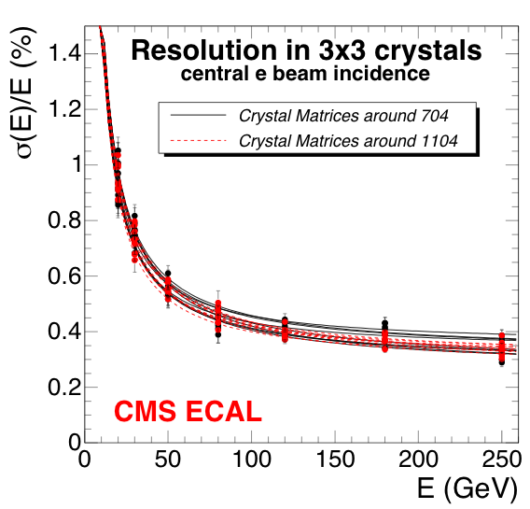
ATLAS and CMS Test beam performance
2004 TB
CMS ECAL
0.5%
ATLAS
ATLAS and CMS: different technology and design, complementary performance

Slide 22
ATLAS Electromagnetic Calorimeter Calibration

Slide 23
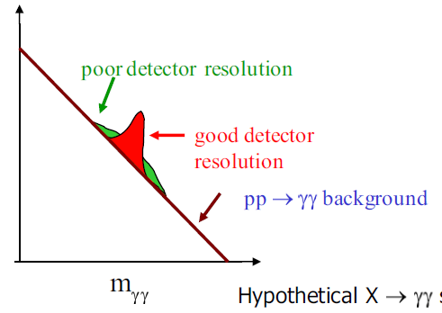
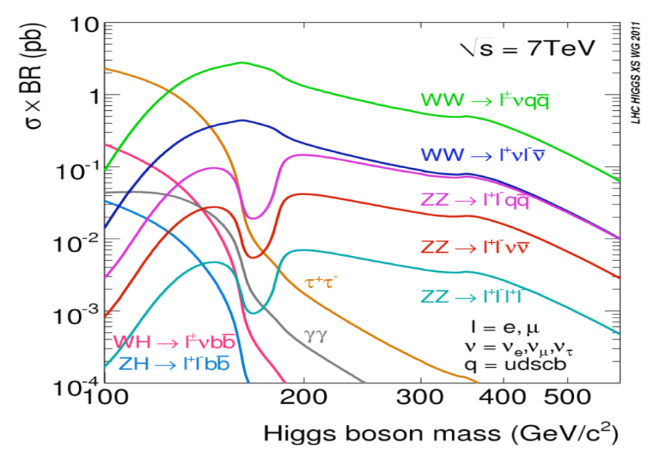
Motivation for calibration
H→γγ and H→4e are the most promising channels for low mass Higgs
  Need good mass resolution
  Powerful γ/jet separation
  Robustness against pileup
  Good understanding of the detector
Stringent requirement on the performance of EM Calorimeter are imposed by H→γγ search above the huge γγ continuum
  need γγ mass resolution of ∼1% , hence better energy and angle resolution
  response uniformity ≤ 0.7% over |η| < 2.4
    Could be achieved by in-situ measurement from Z, W and J/ψ(see later)
hypothetical signal and background

Slide 24
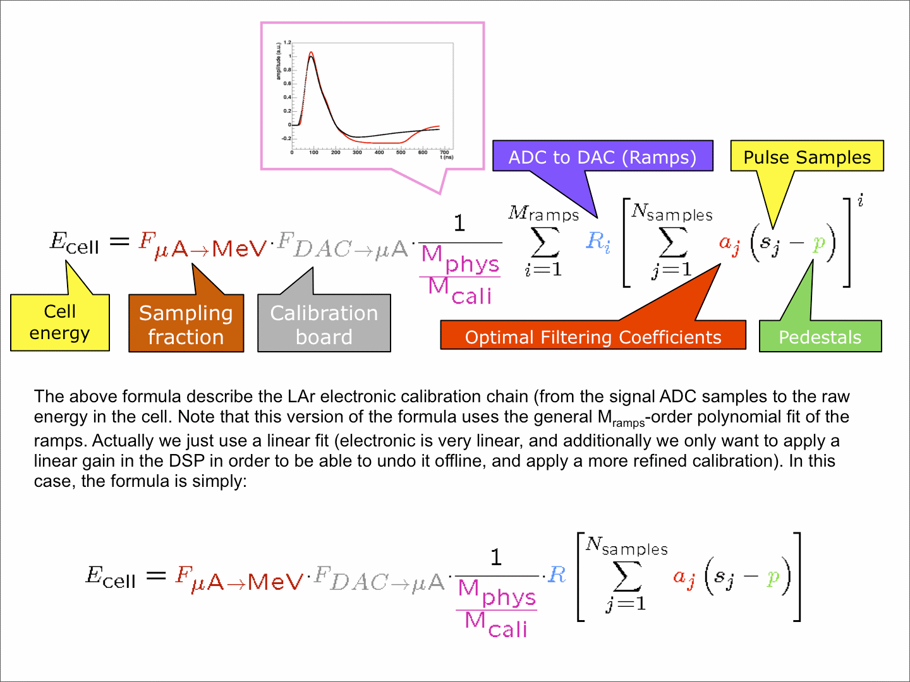
Energy Reconstruction

Slide 25
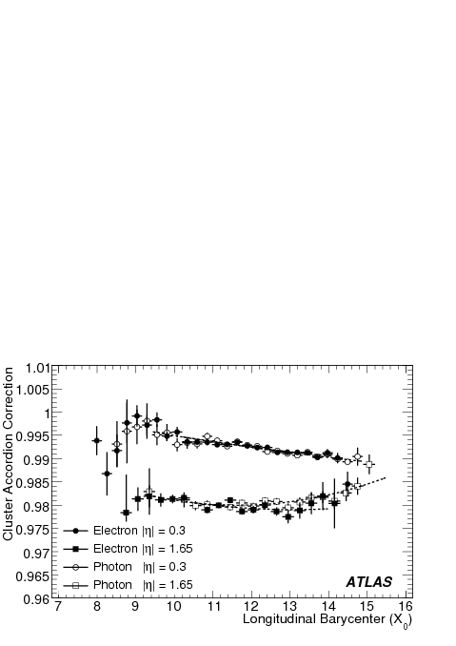
Cluster Calibration
Combine energy deposits in each layer and the presampler
Compute corrections by using special simulations (Calibration Hits) where energy deposited in all material (active + inactive) is recorded
Energy depositions in the inactive material can be
correlated with the measurable quantities
Corrections are derived for electrons and photons
separately
Cell-Level
Calibration
Electron
reconstruction
Cluster level
Calibration
In situ
Calibration
Raw signal→energy deposit
Absolute scale
Intercalibration
MC based calibration
Calib. factor vs X
Electron=solid
Photon =open
X = Shower depth
X_{i} = long. depth of layer “i”
E_{i} = energy deposit in layer “i”
S_{acc}(X,η) = calib. factor

Slide 26
Cluster Calibration

Slide 27
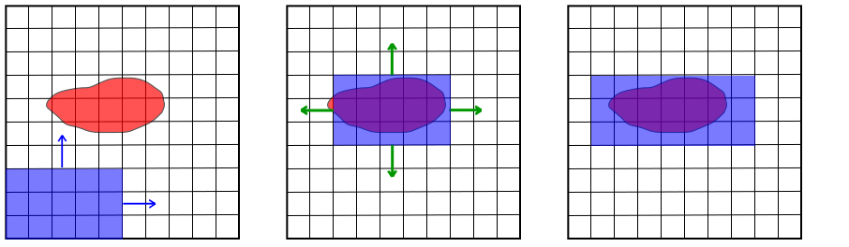
Electromagnetic objects in ATLAS
In ATLAS an electron or a photon candidate is defined as a cluster of cells in the calorimeters representing the energy deposit to which we can associate tracks reconstructed in the inner detector
Clustering algorithms group cells together and sum the total deposited energy within each cluster
Sliding-Window algorithm is used to reconstruct the energy deposits
Apply cluster calibrations
The identification of such objects is then based on :
  The shower shape in the calorimeter
  Track quality (number of hits, direction wrt the cluster,...)
  Transition radiation (TRT “high threshold hits”)
  E/p
η
Photon 3x5
Electron 3x7
ϕ

Slide 28
In-situ Calibration
Determination of energy scales and resolution is crucial for precision measurements and searches
The methods and algorithms that I developed for the calibration of EM calorimeter are officially used by ATLAS as a baseline
  Provide scales and resolutions and the required infrastructure to the whole collaboration as well as lead a group working on these issues
The purpose of In-situ calibration is to establish
  Absolute EM scale to an accuracy of ∼0.1%
  Inter-calibrate different regions of Calorimeter to
  establish long-range constant term to be ≤ 0.5%
Energy scale was initially measured in 2004 test beam, then tested with π⁰→γγ and η→γγ in the beginning of data taking
To measure Energy scale with a better accuracy, the precise knowledge of the well known Z lineshape has to be used

Slide 29
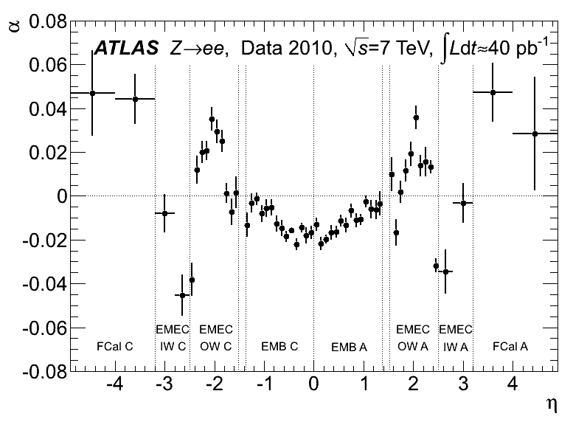
The Method
The energy of electron in zone “i” is parameterized as
  where zone is a slice in Δη×Δφ=0.2×0.4
Where α’s are obtained from unbinned likelihood fit by constraining the measured di-electron invariant mass to the Z boson line shape
Linearity of response at low energy is cross checked by using electrons from J/ψ→ee
  Also use E/p for electron from W→eν as a cross check, need better knowledge of momentum scale from Inner Tracker
Three different algorithms optimized for performance, computing time etc
Performance based on 2010 data described
in the egamma paper, Eur. Phys. J. C(In Press),
arXiv:1110.3174
CONF Note based on full 2011 data is under
review

Slide 30
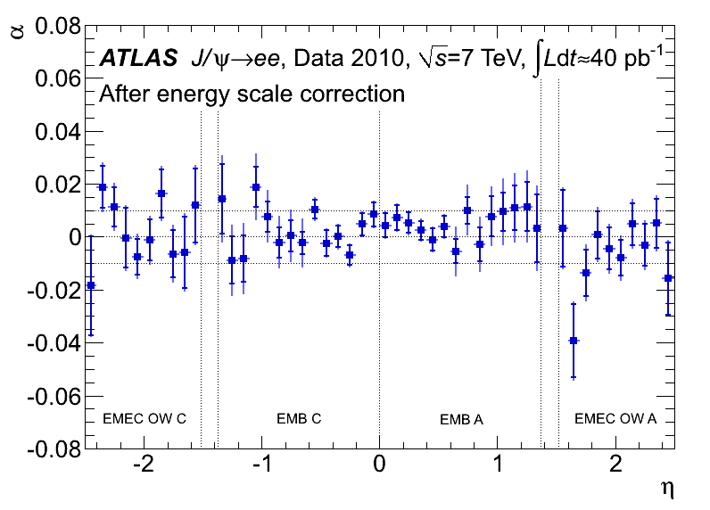
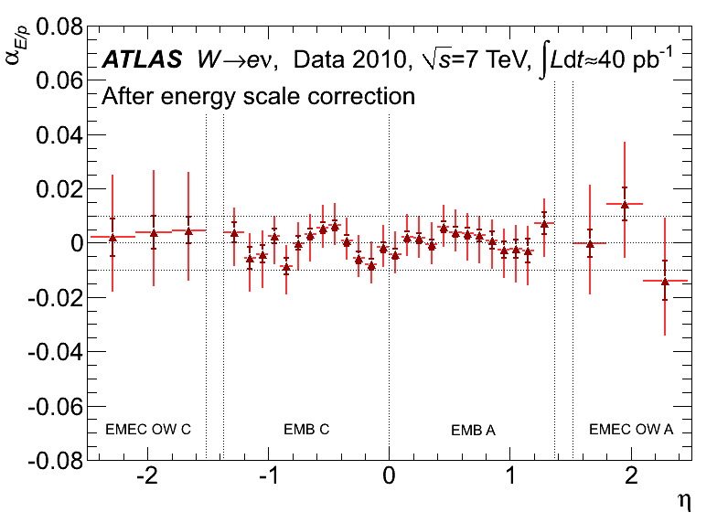
Energy Scales from Z→ee, J/ψ→ee and W→eν
The J/ψ and W plot were made after the Z corrections were applied
Inner error bars are statistical only, while outer are total uncertainty
J/ψ plot shows good linearity of EM Calo. and modeling of material in front of Calorimeter
Please note the same plot for ∼5fb⁻¹ are under review
Statistics is no more an issue, more than a million good Z’s after selection
Calibration at low energy with J/ψ is very important for H→4l and SUSY searches

Slide 31
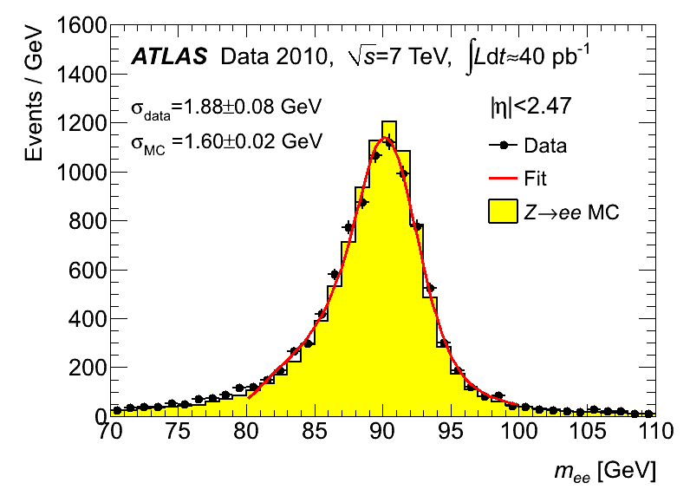
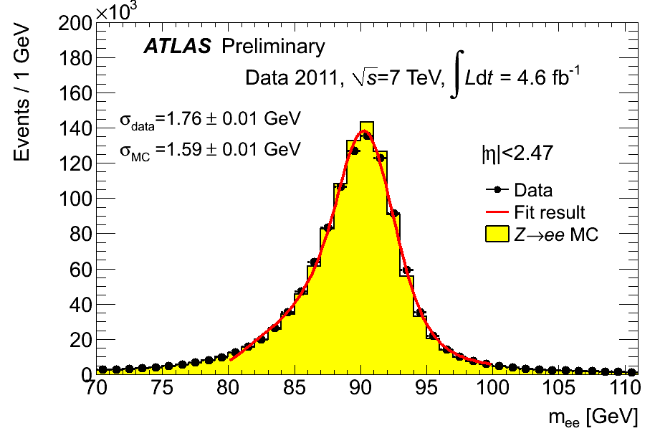
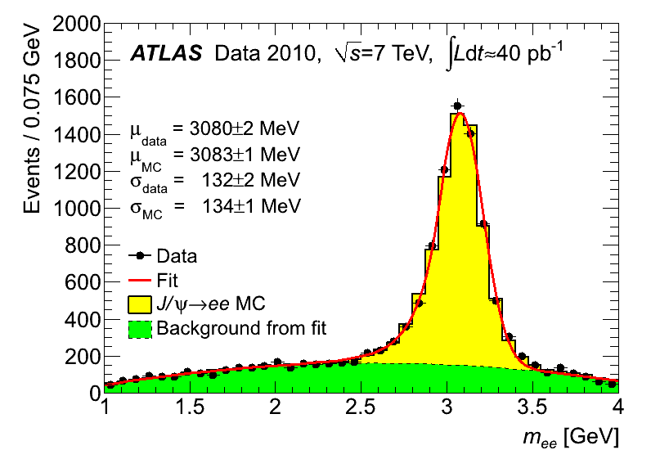
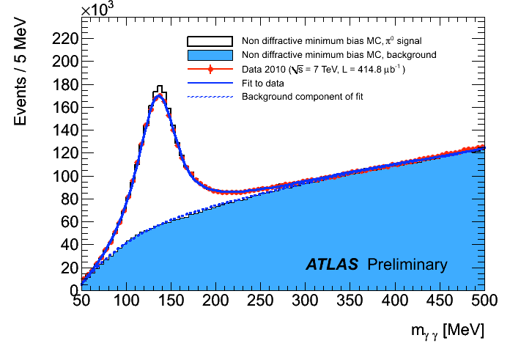
Performance of the Detector
Z→ee
Z→ee
J/ψ→ee
π⁰→γγ

Slide 32
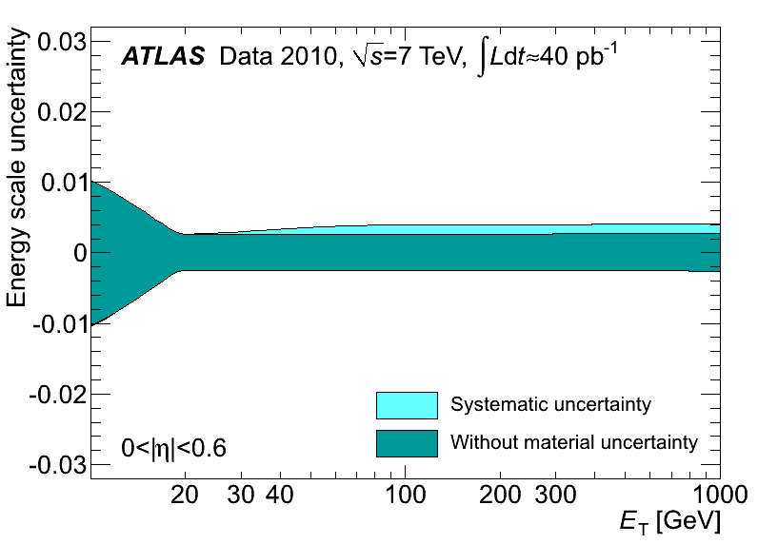
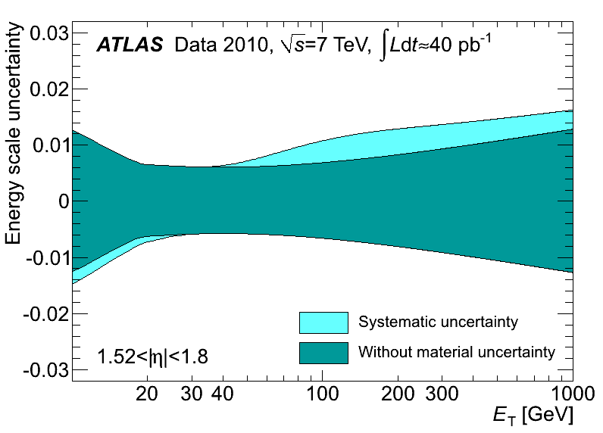
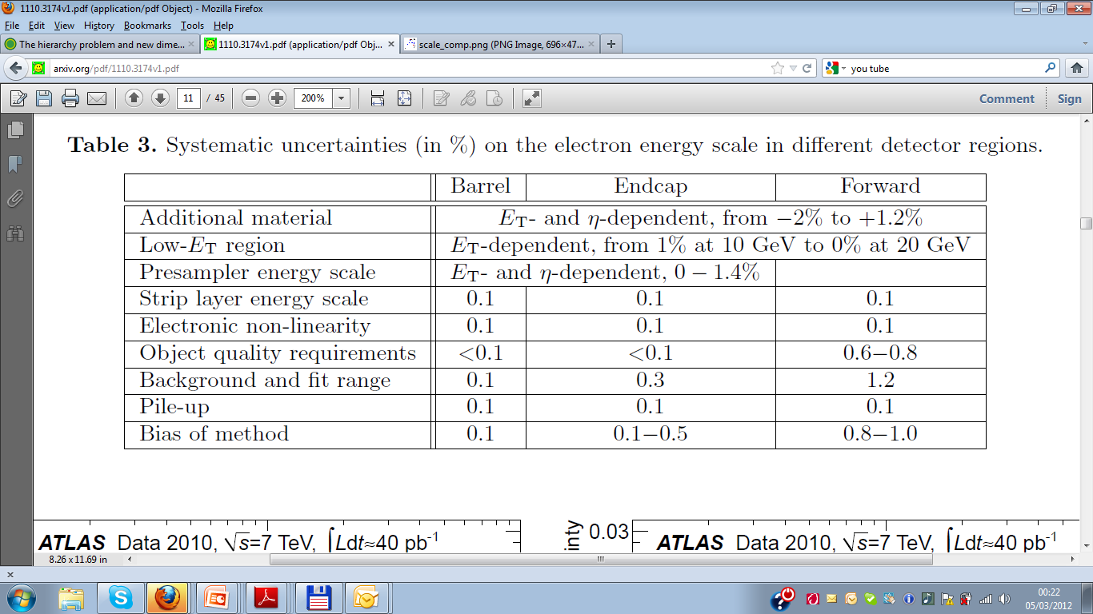
Energy Scale Systematics
Important to understand systematics, have strong impact on physics searches

Slide 33
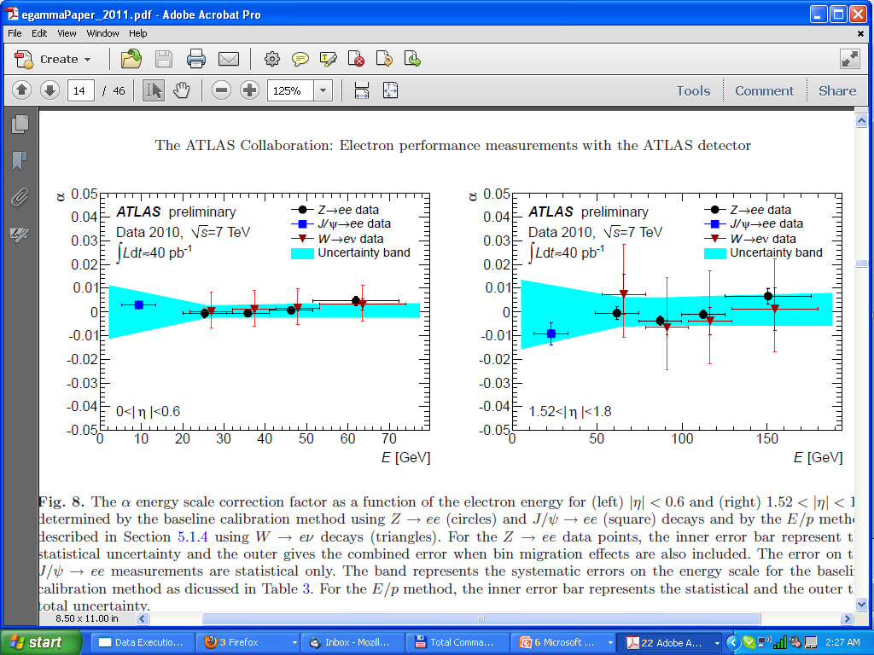
Linearity
Linearity ~1% and within uncertainty bands

Slide 34
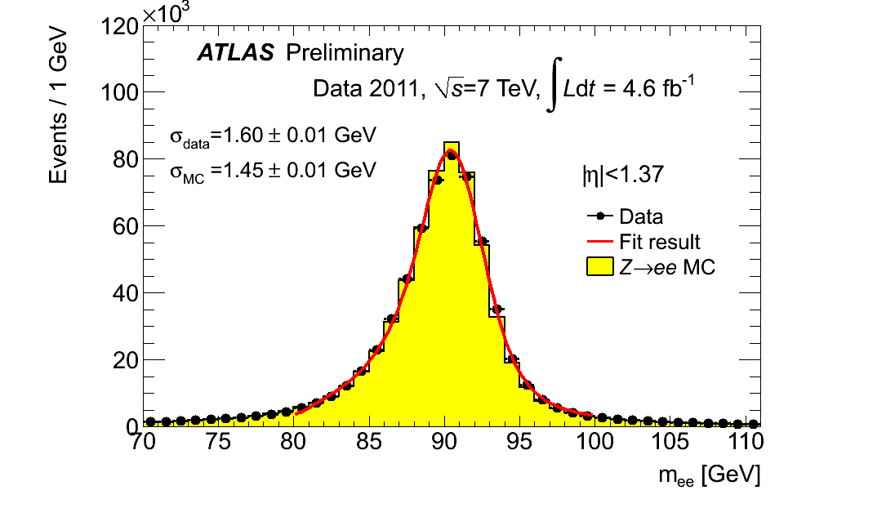
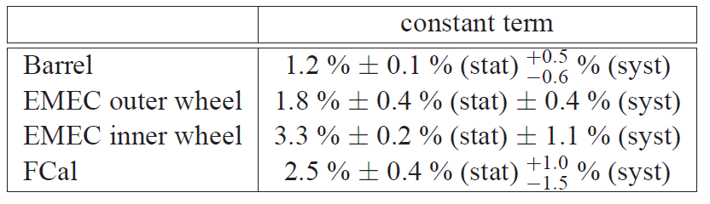
Resolution
Any data/MC differences can be attributed to the constant term (C) because the MC reproduces reasonably the invariant mass distribution for J/ψ→ee events for central electrons
  For such a low energy the electron energy resolution is dominated by the sampling term
An effective constant term is extracted by comparing Z mass resolution in data and MC by using the formula
Resolution was obtained by fitting a convolution of Breit Wigner and Crystal ball
  BW mean is fixed to the Z width and resolution is
  described by Crystal ball function
2010

Slide 35
Search for Higgs Boson

Slide 36
Search for H→γγ in ATLAS
The search for a Higgs boson in the γγ final state is looking for a small and narrow peak on a falling background continuum
Higgs boson decay to γγ either through W/top loop
Need very good m_{γγ} resolution, applied the corrections ( ±1%) and smearing that I derived using Z→ee
Selection:
  E_{T}(γ₁)> 40GeV, E_{T}(γ₂) > 25GeV
  |η|< 1.37 or 1.52 < |η| < 2.37,
  Isolation energy < 5 GeV , photon identification
Main background:
  irreducible γγ(30 pb)
  reducible γj (200 nb)
  reducible jj (500 μb)
Total background from fit to m_{γγ} spectrum
  Simultaneous fit to all 9 categories
  Exponential function, free slope and normalization
  Background composition validated with control data
4/5/2012
Ashfaq Ahmad
36

Slide 37
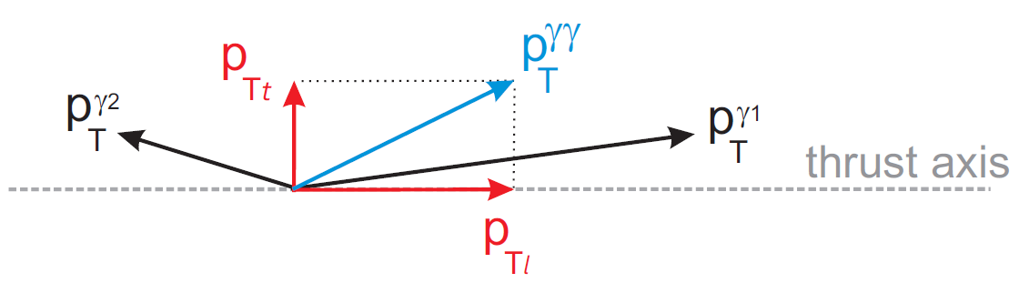
H→γγ Search Strategy
To increase sensitivity events have been divided in 9 different categories with different m_{γγ} resolution and S/B
Categorize events based on
  Conversion status, Photon η and
Both unconverted:
  Central
  Rest
At least one converted:
  Central
  Transition
  Rest
Central and Rest further divided into two categories based on
Signal events have larger pTt than the backgrounds, in particular the VBF and associated production modes
arXiv:1202.1414 (to PRL)
Resolution: Good, Medium, Poor
4/5/2012
Ashfaq Ahmad
37

Slide 38
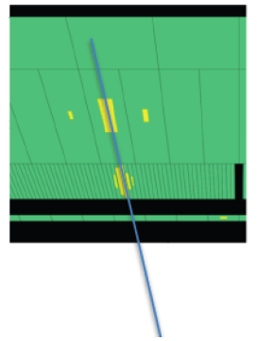
Mass Reconstruction
Calorimeter pointing to deduce PV
  Determine photon direction from 1st and 2nd calorimeter layer
  Combine 1st layer with inner detector information if photon is converted
  σ(z) = 1.5 cm for unconverted photon
  σ(z) = 0.6 cm for converted photon
Contribution of resulting angular resolution to mass resolution is negligible
Uncertainty on mass resolution(±14%) dominated by uncertainty on energy resolution
Z
4/5/2012
Ashfaq Ahmad
38

Slide 39
Diphoton mass after event selection
22489 events in total (100<m_{γγ}<160GeV)
  ~70% of them are true photon
  A sidebands technique is used to estimate the number of γγ, γj and jj
  Exponential fit to the background is shown in red
Summed over all categories
4/5/2012
Ashfaq Ahmad
39

Slide 40
H→γγ Significance/Limit
The largest excess is found at 126 GeV, with a local significance of 2.9σ (2.8σ with ESS)
Considering the probability of such excess appearing anywhere in the mass range investigated (Look Elsewhere Effect), the significance would be 1.5σ
Expected limit is around 1.6-2.7 times the SM cross section
Observed limit lies between 0.84 and 3.6 times the SM cross section
A SM Higgs boson is excluded at 95% CL in the mass ranges of 113 - 115 GeV and 134.5 - 136 GeV
4/5/2012
Ashfaq Ahmad
40

Slide 41
Summary
ATLAS EM Calorimeter is performing well
Well advance in-situ calibration with electrons from Z→ee, J/ψ→ee and W→eν
  Design resolution within reach
  Energy scale within ~1% for central calorimeter
  Linearity ~1% for central calorimeter
  Calibration is very important for Higgs, BSM and all searches where scales and resolutions are important
Novel idea’s to improve resolution(especially for hadronic showers) in future colliders
  Especially in less busy environments like ILC and CLIC
  R&D for future calorimeter well advance
Search for H→γγ channel which heavily rely on the results of insitu-calibration reveals a small excess of 1.5σ around 126 GeV
  Statistical significance not large enough (yet) to draw definite conclusions
For more higgs results and my my work on SUSY searches, please take a look at backup slides
4/5/2012
Ashfaq Ahmad
41

Slide 42
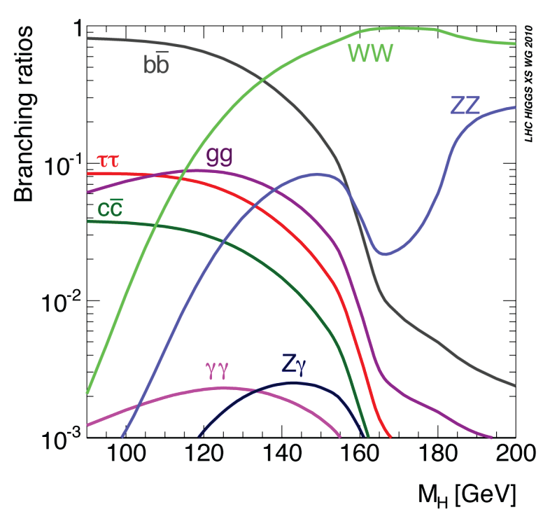
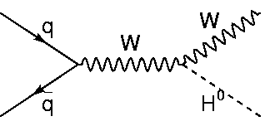
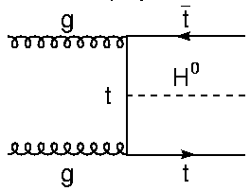
Higgs Production and Decays at the LHC
The dominant Higgs production at the LHC is via gluon fusion
  The fraction of gluon fusion, VBF, WH, ZH and ttH production are 87%, 7%, 3%, 2% and 1% at the LHC (7 TeV) for M_{H} = 120GeV
arXiv:1101.0593v3
Branching ratios
4/5/2012
Ashfaq Ahmad
42

Slide 43
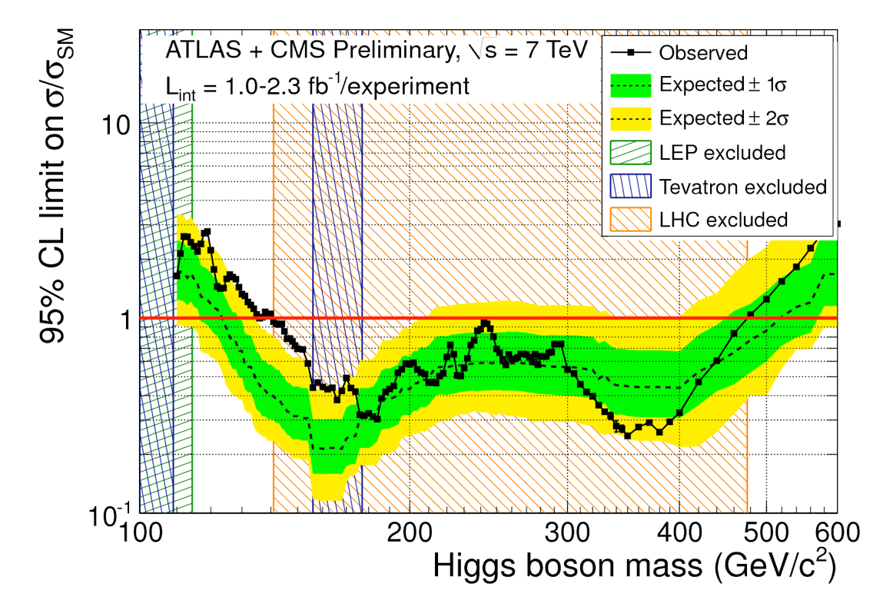
Search for Higgs Boson
Search for Higgs boson is one of the most important goal of the LHC
A wide range of masses(141-476 GeV) has been excluded by previous searches (as of Nov. 2011)
The two most sensitive channels in the low mass Higgs region, namely
  H→γγ (will cover only this one)
  And H→4l (where l = e or μ)
  Can reconstruct invariant mass
Profile likelihood ratio is used to
calculate p0-value/significance of
excess (Eur.Phys.J.C71:1554,2011)
Exclusion limits on signal
strength μ = (σ/σ_{SM}) are
set at a 95% confidence level using
the CLs method (J. Phys. G 28 (2002) 2693-2704)
From Nov. 2011
4/5/2012
Ashfaq Ahmad
43

Slide 44
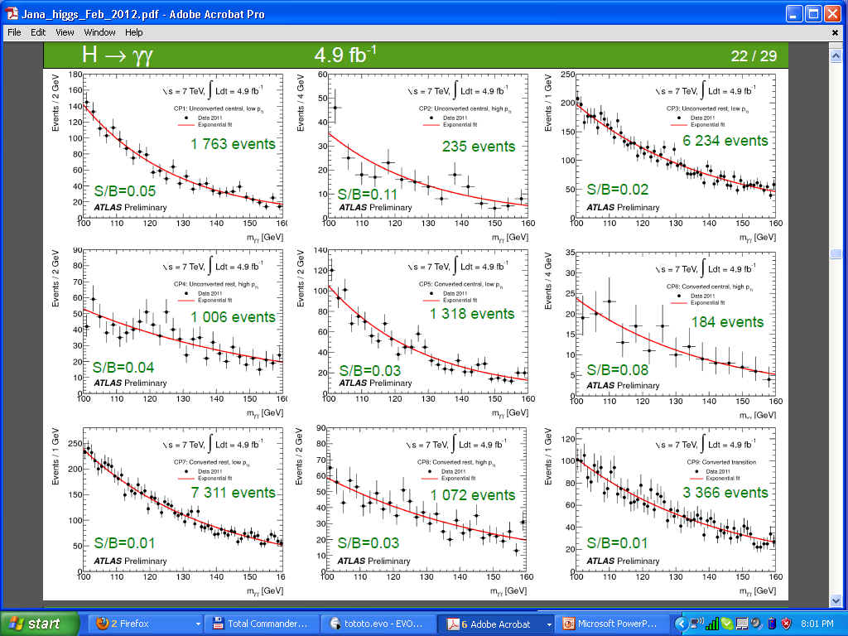
Higgs H→γγ Categories
4/5/2012
Ashfaq Ahmad
44

Slide 45
Combination
Higgs Boson search in 12 distinct channels
Excess is mainly observed in two high-resolution channels (Improved calibration has been used)
  H→γγ and H →ZZ*→4l combined local significance : 3.4σ
No such excess in other channels
All channels combined: 2.5σ local significance
Higgs mass has been squeezed to a tiny region 117.5-118.5 GeV or 122.5-129 GeV, excess is most compatible with 126 GeV but statistical significance not large enough yet to draw any conclusion
4/5/2012
Ashfaq Ahmad
45

Slide 46
Combined exclusion limit
Observed exclusion at 95% CL: 110-117.5, 118.5-122.5, 129-539 GeV
4/5/2012
Ashfaq Ahmad
46

Slide 47
SUSY Multilepton searches

Slide 48
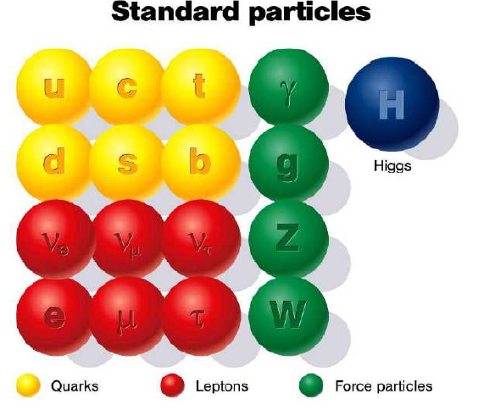
The Search for New Physics
Limitation of the Standard Model indicates that there should be new particles at the ∼TeV scale. At minimum, this includes the Higgs and a Dark Matter candidate. One possibility is Super Symmetry
1950’s
1995
2012 – 2020?
Some Possibilities:
Super Symmetry
Extra dimensions
New quark generation
Lepto-quarks
Something unexpected!
Gauge Bosons | Υ
Leptons and neutrinos | e+, ν_{e} μ+, ν_{μ}
Mesons | K, π
Baryons | P, N
?
4/5/2012
Ashfaq Ahmad
48

Slide 49
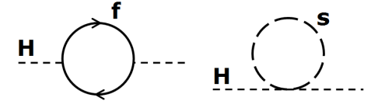
Supersymmetry (SUSY)
Symmetry between fermions and bosons
For each Standard Model particle there is a superpartner which differ by a half unit of spin
Physics Motivation:
  Natural solution to hierarchy problem
    Stabilize Higgs mass,
      Cancellation of quadratic divergences from fermionic loops by contributions from superpartners
  Provide a dark matter candidate (stable Lightest SUSY Particle(LSP) in R-parity conserving models i,e conserved quantum number: R = (-1)^{3B+2S+L} , for SM R = +1, SUSY R = -1)
  Provide Unification of coupling at high energy ~GUT scale
4/4/2012
Ashfaq Ahmad
49

Slide 50
Is SUSY an exact symmetry?
Must be a broken symmetry
  otherwise we should have seen sparticle with same masses as SM particles
  This allows super partners to take large mass
Several mechanisms to break SUSY
  Gravity mediated SUSY breaking, SUSY breaking transmitted by hidden sector through gravitational interactions to MSSM
    minimal supergravity is mSUGRA
  Anomaly mediated
  Gauge mediated (GMSB), messenger sector communicates with MSSM via gauge interaction
    Messenger sector could be particle from large group like SU(5)
  General Gauge Mediation (GGM) Symmetry Breaking of SUSY
    The lightest MSSM sparticle is NLSP and LSP is always gravitino
4/4/2012
Ashfaq Ahmad
50

Slide 51

SUSY searches in Multilepton(>=4 leptons) events
If sparticle masses are within LHC reach, then squarks and gluinos can be abundantly produced
  Multileptons can arise from cascade decays of squarks and gluinos via charginos, neutralinos and sleptons
  Sensitive to weak production
  Can also be produced via RPV where LSP are Stau’s
Significant Missing Transverse Energy(MET) Which can be used to suppress SM background
Each extra lepton makes the analysis
clean, reduce background and the need to cut
tight on MET
SM events with 4 leptons are rare
MET: momentum imbalance in the detector
caused by neutral, weakly interacting particles
(e.g. neutrinos … or SUSY neutralinos, “dark matter”
candidates)
4/4/2012
Ashfaq Ahmad
51

Slide 52
Event Selection
Electron
  pT > 10 GeV, |η_{cl}| < 2.47
  overlap removal
  Isolation, ptcone20/pT < 0.1
  …
Jet
  pT > 20 GeV, |η|< 2.8
  AntiKt4Topo
Muon
  Baseline pT > 10 GeV, |η|< 2.40
  Using information from both ID and Muon system
  overlap removal
  Isolation ptcone20 < 1.8 GeV and etcone30 < 4 GeV
  …
Signal Region 1(SR1)
  At least 4 signal electrons+muons,
  pT > 25/20(e,mu),10,10,10 GeV
  Must satisfy trigger plateau requirements
  MET > 50 GeV
  Choice of MET cut effective for wide range of SUSY scenarios
Signal Region 2(SR2) = SR1+Z-veto
  Veto events with MSFOS within 10 GeV of Z mass
Background estimation from MC, validated in background rich control region (i,e MET<50GeV)
4/4/2012
Ashfaq Ahmad
52

Slide 53


Results
No significant excess seen in data
Visible cross section
= σ x BR x A x ε
SR1
p-value 0.10
95% CL on visible cross section
expected < 2.1 fb
observed < 3.5 fb
SR2
p-value >0.5
95% CL on visible cross section
expected < 1.5 fb
observed < 1.5 fb
4/4/2012
Ashfaq Ahmad
53

Slide 54

Leptons E_{T} distributions
Good agreement between data and MC
4/4/2012
Ashfaq Ahmad
54

Slide 55

Data/MC distributions
4/4/2012
Ashfaq Ahmad
55

Slide 56

ATLAS SUSY searches limits
Already excluding sparticles masses at TeV scale
4/4/2012
Ashfaq Ahmad
56

Slide 57

ATLAS Calorimeter parameters

Slide 58

ATLAS Sub-Detectors Resolution

Slide 59



Slide 60

Dual-Readout Calorimetry

Slide 61
A word about Look Elsewhere Effect (LEE)
SM doesn’t predict the value of Higgs boson mass
  Therefore mass resonance (excess of events) has to be searched in a wide mass range in experiments
  An excess of events at a given mass point could also be the result of background fluctuation
    Non zero probability, like 3σ excess due to background would be 0.13% X LEW
      Where LEW = mass range/mass resolution
Therefore in a search for new mass resonance the significance of observing local excess of events anywhere in a possible mass range must take into account the probability of observing such an excess anywhere in the range, the so called Look Elsewhere Effect (LEE)
  Different ways to quantify LEE, e.g, in terms of the ratio between the probability of observing the excess at some fixed mass point to the probability of observing it anywhere in the range
P-value:
  Is the probability that the background fluctuates to the observed number of events or higher
  Or measure of how much evidence we have against the null or background only hypothesis
  Small (<0.05) p-value means evidence against null hypothesis while large p-value means little or no evidence against null hypothesis

Slide 62
Search for long-lived Neutralino NLSP
While we continue searching for SUSY and any new Physics BSM, it's possible that any new physics may not look the way we use to search for it
  one possibility is that we may have non-prompt decays instead of the usual prompt physics that we are focused on
Exploring GMSB with long lived neutralino
  In gauge mediated SUSY models, we may have long lived NLSP depending on SUSY breaking scale
    For example NLSP decay lengths of 0.1mm to 10's m for SUSY breaking scale from few hundred to few thousand TeV
  Many other scenarios allowing for such a signature like split-SUSY, stealth-SUSY, hidden-valley or meta-stable SUSY breaking etc
The general neutralino NLSP is a mixture of bino/higgsino/wino eigenstates
  For NLSP with significant higgsino or wino component can decay ~100% time to Z+G and h+G
  So the final states could be ZZ/WZ/gg/hh/Wg +MET
  Note In the final states we can have both or one non-prompt neutralino's
Paper in progress, aim for summer
4/4/2012
Ashfaq Ahmad
62

Slide 63

Combination plot (old)
The major channels, γγ(4.9 fb⁻¹) and 4l(4.9 fb⁻¹) have comparable sensitivities around 126GeV
The γγ excess is in coincidence with a smaller 4l excess, leading to a 3.5σ excess in the Higgs combination
4/4/2012
Ashfaq Ahmad
63

Slide 64


Multilepton production
RPV scenario, Prompt decay of LSP (Stau) – 4-body decay,
Typical σ ~ 0.33 pb
Typical production
4/4/2012
Ashfaq Ahmad
64

Slide 65

Example of Energy scale systematics
4/4/2012
Ashfaq Ahmad
65

Slide 66
Systematics for H→γγ mass resolution/scale
4/4/2012
Ashfaq Ahmad
66

Slide 67
Fit Function
Relativistic Breit-Wigner
Resolution function: Crystal Ball
Convolution of BW and CB
with

Slide 68


Unification
SUSY
Standard Model

Slide 69


Background Composition
4/4/2012
Ashfaq Ahmad
69

Slide 70

H→γγ Categories
4/4/2012
Ashfaq Ahmad
70

