Slide 1
DESY and the
Helmholtz Detector Portfolio
Detector Technology und Systems Platform
Heinz Graafsma (FS-DS)
KEK-DESY meeting
20-03-2012

Slide 2
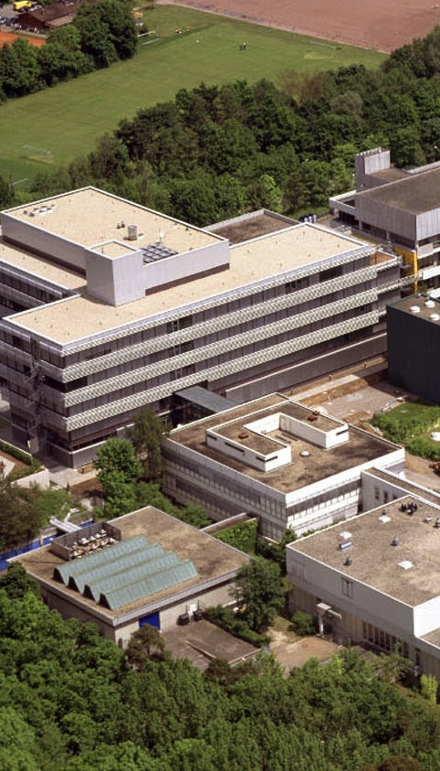
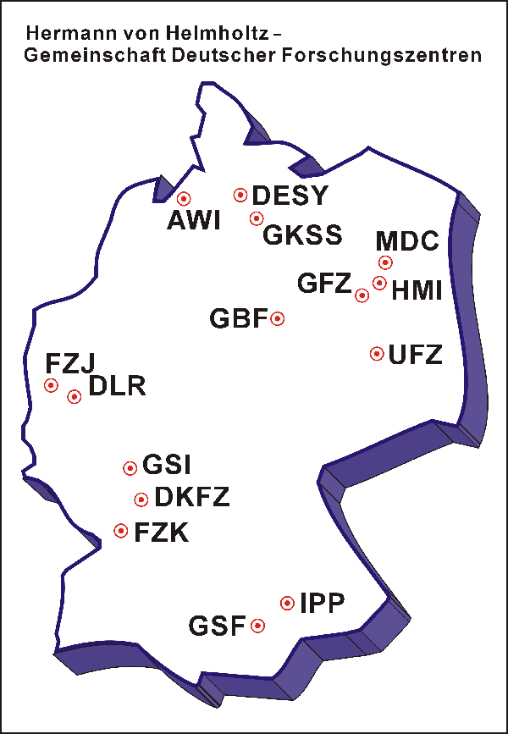
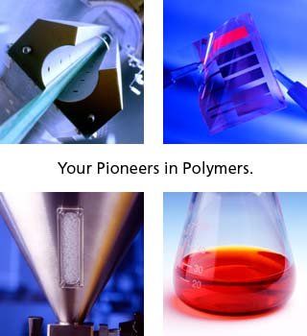



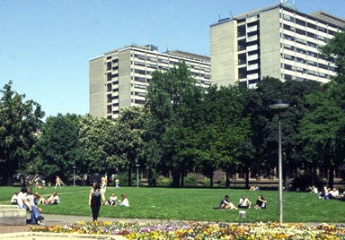

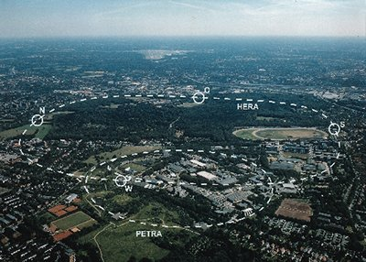
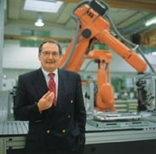

Research Landscape Germany
Universities
Land 100
Federal St. : Excellence Initiative
Research-Education
Max-Planck-Gesellschaft
Federal St. -Land 50:50
Fundamental Research
no research policy requirements
Helmholtz Association
Federal St. -Land 90:10
Research Infrastructure
Strategic Research: RPR
Fraunhofer Society
Federal St.-Industry ≈ 65:35
Applied Research
Knowledge Transfer

Slide 3
Helmholtz-Gemeinschaft Deutscher Forschungszentren
17 National Research Centres
3 billion € budget
30 000 employees
Research fields
Energy
Earth and Environment
Health
Key Technologies
Structure of Matter
Transport and Space
Notes:
11.5.2009: Budget und employee numbers updated

Slide 4
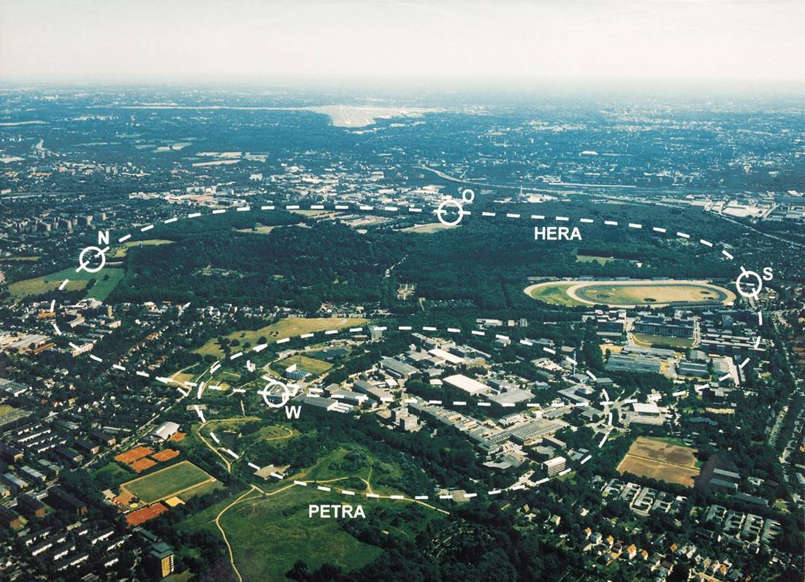
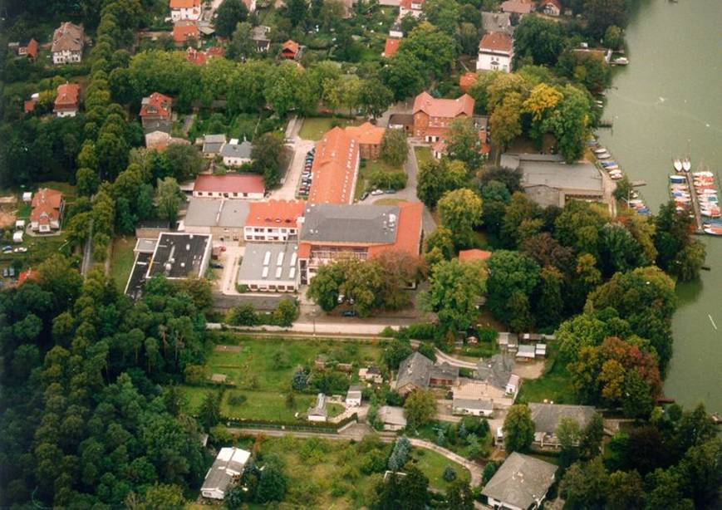
DESY: member of the Helmholtz Association
Nationally funded but
internationally used
research center
Staff: ~1900 (1600 FTE)
Budget: ~183 M€
Users: ~3000 (> 2400 for
synchrotron radiation
experiments)
Hamburg
two sides of DESY
Zeuthen
Notes:
16 national research centers, 2.8 billion € budget, 28000 employes

Slide 5

DESY Core Competence.
Detectors
Particle
Physics
Photon
Research
Computing
Lasers
Accelerator
Technologies

Slide 6
Goals of Helmholtz Detector Portfolio:
Development of fundamental and innovative Detector Technologies within the Helmholtz Association.
Networking between the various centers active in the filed “Structure of Matter”.
Create centralized links with centers outside the field “Structure of Matter”, as well as institutes outside the Helmholtz Association.

Slide 7
Structure: 3 pillars
Application areas
Ultra fast data
transfer and
processing
Demonstrator
detector systems
Elementary particle physics
Technologies for
highly integrated
Detectors
Fast light
and X-ray detectors
Astro-particle physics
Intelligent
programmable
hardware
3D ASICs
Hadrons and nuclei
Diamond based
detectors
Mixed-signal ASICs
Front-end optical
signal transmission
Photons, Neutrons
and Ions
3D / high-Z Sensors
Detectors for
thermal neutrons
High-density interconnect
technologies
Medical Technology
Fastest data
processing, using
parallel computing
Innovative construction
materials
Compact gas
detectors
Materials Science
…

Slide 8
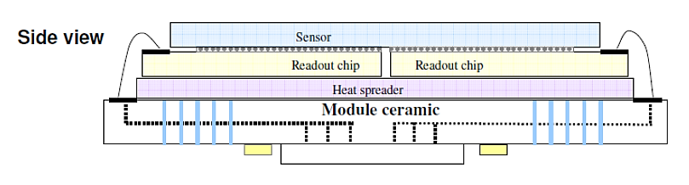
1st pillar : The “Helmholtz-Cube”
Current State-of-the-art

Slide 9
1st pillar : The “Helmholtz-Cube”
Vertically Integrated Detector Technology
Replace standard sensor with: 3D and edgeless sensors, as well as High-Z
Replace standard bump-bonds with new interconnect techniques
Replace standard ASIC and wire bonds with thinned ASICs and TSV as well as ball-grid arrays
Replace standard ASIC with 3D-ASICs
Develop new high speed IO’s

Slide 10
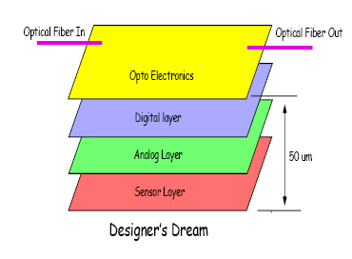
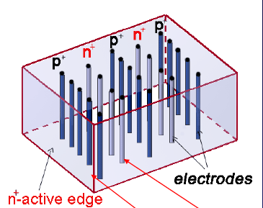
1st Pillar: 3D ASICS and 3D Detectors
3D structures
multi-tier ASIC approach allows mixtures of technologies
Advantages for DESY:
  Increased electronic functionality per area
  Compact, and thin sensors, with no dead areas (tiling)
  Challenges:
  3D-design tools
  High density interconnect
  First prototypes at DESY

Slide 11
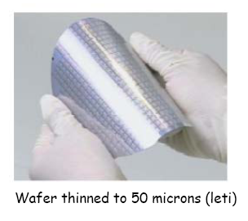
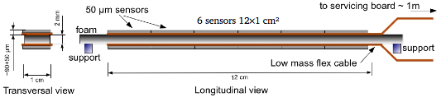
1st Pillar: Innovative materials
  Light
  Radiation hard
  Mechanical and thermal properties
  Electrical properties
  Big challenge is the power dissipation
Geometry for an ILD vertex
detector, 2009­2012
11

Slide 12
Structure: 3 pillars
Application areas
Ultra fast data
transfer and
processing
Demonstrator
detector systems
Elementary particle physics
Technologies for
highly integrated
Detectors
Fast light
and X-ray detectors
Astro-particle physics
Intelligent
programmable
hardware
3D ASICs
Hadrons and nuclei
Diamond based
detectors
Mixed-signal ASICs
Front-end optical
signal transmission
Photons, Neutrons
and Ions
3D / high-Z Sensors
Detectors for
thermal neutrons
High-density interconnect
technologies
Medical Technology
Fastest data
processing, using
parallel computing
Innovative construction
materials
Compact gas
detectors
Materials Science
…

Slide 13
3rd Pillar: Fast Photon Detectors
Hybrid SiPM:
SiPM without Poly Silicon layer integrated with readout chip:
  Readout of individual pixels (digital Info)
  No analogue electronics needed, purely digital
  Fast
  Applications:
      Single photon imager (photon science)
      High precision tracker
      Calorimeter Readout
      Fast X-ray imager
ASIC development
Bump bonding
3D interconnect
3D Chip
Sensor development

Slide 14
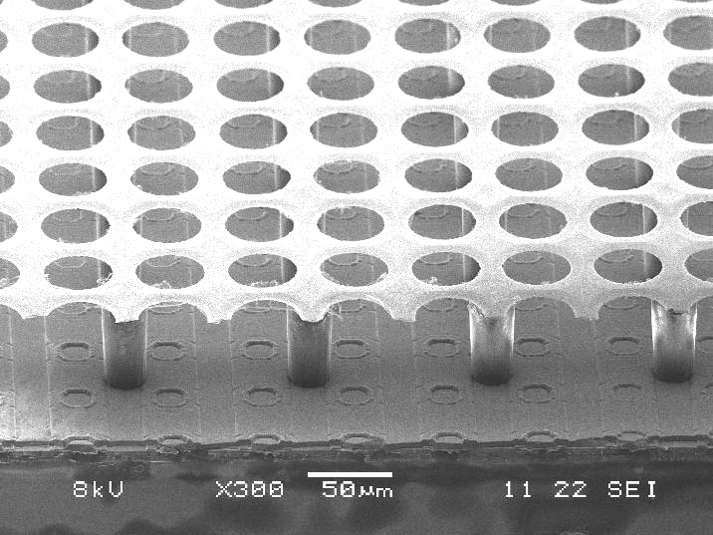
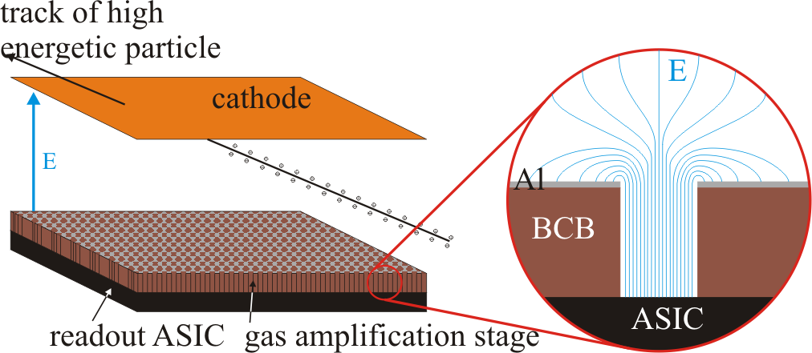
3rd Pillar: Gas detectors
Amplification technologies (GEM, μ-Megas, …):
Transition to integrated technologies (wafer post processing)
Readout chip Development (Timepix-3? Others?)
DESY, GSI, HZDR

Slide 15
Organization
Mitgliederversammlung
(collaboration board)
Zentrumsverantwortliche,
Koordinationausschuss
Beirat
(advisory board)
Beteiligte Forschungszentren, Repräsentation der Universitäten
Koordinationsausschuss
(executive board)
Sprecher: M. Weber (KIT),
Säulenverantwortliche
S1 Technologien
H. Graafsma
(DESY)
S2 Ultraschnelle Kommunikation
J. Ritman
(FZJ)
S3 Detektortypen
C. J. Schmidt
(GSI)
.
.
.
.
.
.
.
.
.
Arbeitspaket
Arbeitspaket
Arbeitspaket
Querschnitt
F. Fiedler
(HZDR)

