Slide 1
Data Acquisition System of the Belle II Pixel Detector
Takeo Higuchi (KEK)

Slide 2

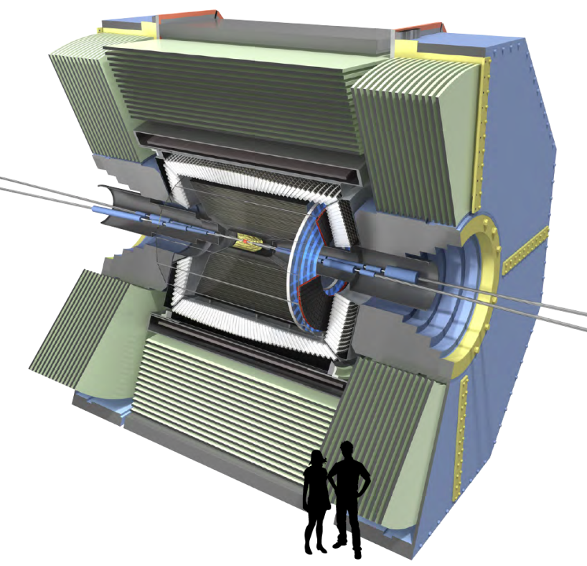
Belle II Detector in a Nutshell
Time of propagation counters
Central drift chamber with smaller cell size and longer lever arm
Ring image Čerenkov counters
More elaborated hardware trigger
Fast and broad-band data acquisition system
2-layer DEPFET pixel
Large scale mass storage system
4-layer DSSD
Electromagnetic calorimeters
barrel: CsI(Tl)
endcap: pure CsI
K_{L}μ detector
barrel: RPC
endcap: scintillator + SiPM

Slide 3
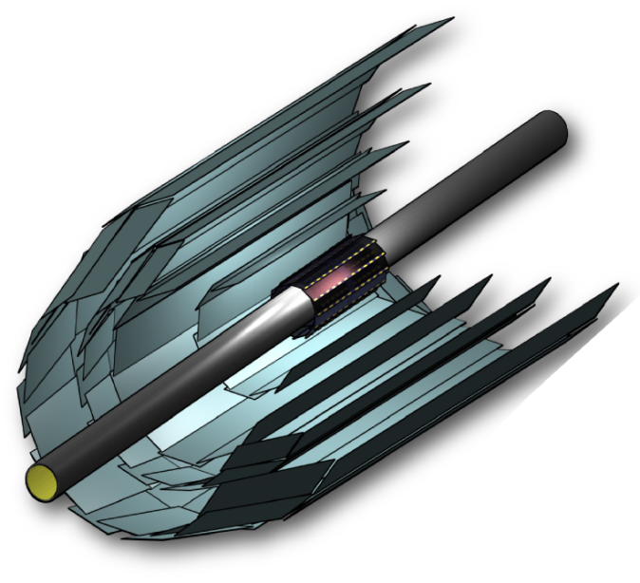
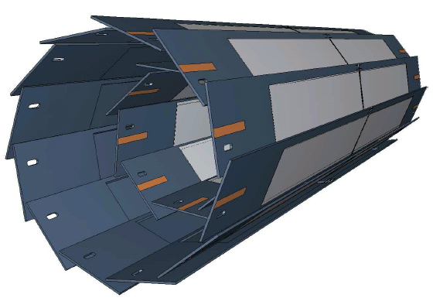
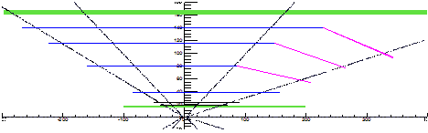
Belle II Vertex Detectors
4-layer DSSD
(SVD)
Detector | Layer # | R | # ladder
DEPFET (PXD) | 1 | 1.4 cm | 8
 | 2 | 2.2 cm | 12
DSSD (SVD) | 3 | 3.8 cm | 7
 | 4 | 8.0 cm | 10
 | 5 | 12.0 cm | 12
 | 6 | 13.5 cm | 16
Beam
pipe
Significant resolution improvement
2-layer DEPFET pixel (PXD)
[µm]
PXD+SVD
200
100
Side view
Vertex resolution
in beam direction
Belle
50
30mm
DEPFET:
thin sensor (75 µm)
unique worldwide
20
Belle II
SVD
15mm
PXD
0
0.4
0.8
1.2
1.6
2.0
pβsin(θ) [GeV/c]

Slide 4
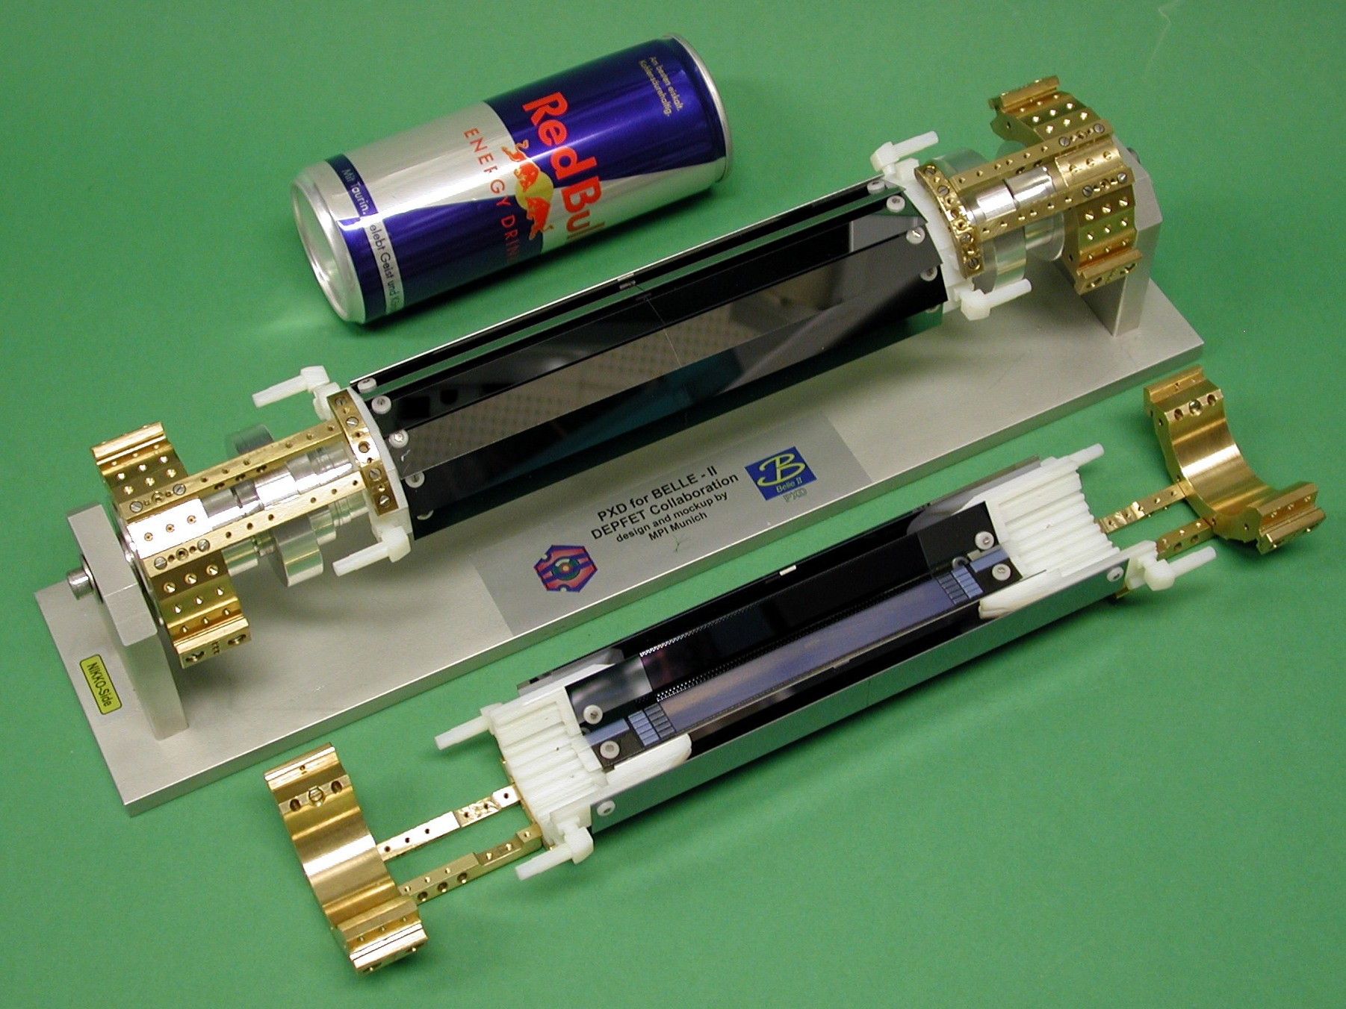
Full-Size Mockup of the PXD

Slide 5
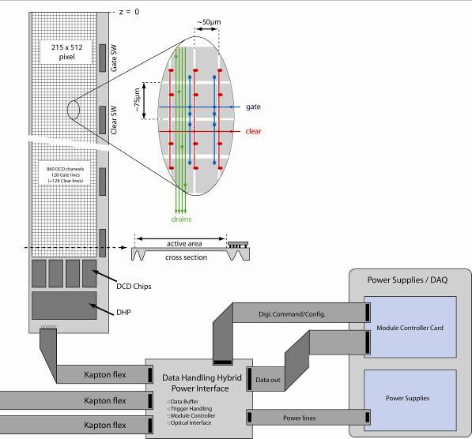
PXD Readout System (Front-End)
Half ladder
768 rows x
250 cols
x(half+half)
x(fwd+bwd)
x10-ladders
= 7680000 px
Total of 8M pixel
readout in 20µs
Switcher
CDAQ I/F
Trigger timing
DHH
DCD
Opt.
10-20 m
DHP
Data
~20 cm
Power Supply
Slow control
Patch-panel
Power
control
Cu
Opt.

Slide 6
Pixel Charge Readout
Row-by-row readout (rolling shutter mode)
  Row is select with external gate
  (controlled by SWITCHER).
  Current corresponding to
  the row is readout.
Readout time
  The entire PXD is readout in
  20µs (100ns per row).

Slide 7
Pixel Charge Readout
Four-fold parallel readout
Pixel
(75x50μm²)
250 cols
…
Gate ON
2 x 768 rows
…
Gate OFF
4
Digitizer
(DCD)

Slide 8
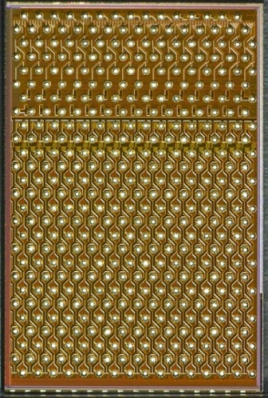
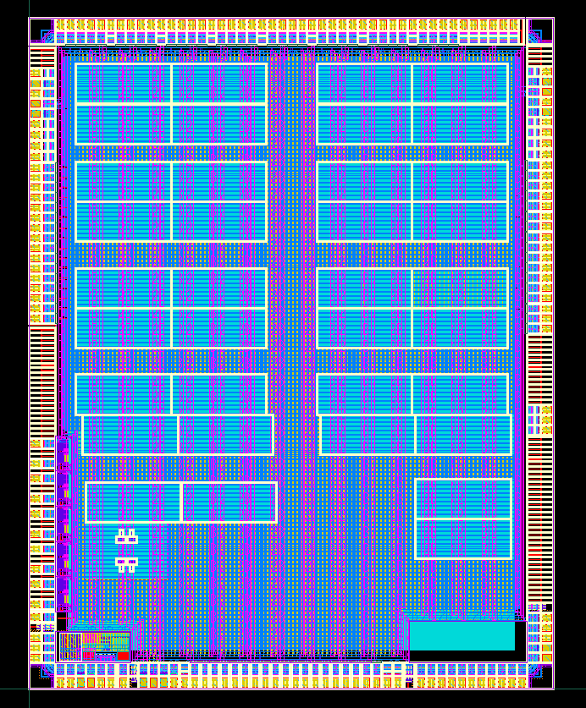
On-Ladder ASICs
Layout of the DCD chip
3.2x5.0mm²
Drain Current Digitizer (DCD)
  256 analog inputs per DCD chip.
  Signal digitization in 8-bit resolution.
  Serialized data output to DHP.
  Measured signal dispersion = 1.7 ADC-units (RMS).
Data Handling Processor (DHP)
  On-ladder data size reduction by zero
  suppression with corrections for common
  mode noise and pedestal fluctuations.
  Measured link speed to downstream
  receiver over 15m cable = 1.6Gbps.
256-input-
pad area
2bytes/px
Logic area
Layout of the DHP chip
  Signal control for the row-wise
  pixel readout.
  JTAG configuration.

Slide 9
Interface to the Level-1 Trigger
Data Handling Hybrid (DHH)
  The DHH merges 4 incoming data streams from DHPs to a single stream, then stores the data to its memory.
  When a level-1 trigger arrives, the DHH moves the stored data to downstream modules with data reformatting.
PXD ladder
DHH
DCD
DHP
2GB DDR2
Level-1 trigger &
System clock
DCD
DHP
DCD
DHP
Virtex6
FPGA
DCD
DHP
Triggered data
output
4x1.6Gbps
VME-6U sized module

Slide 10
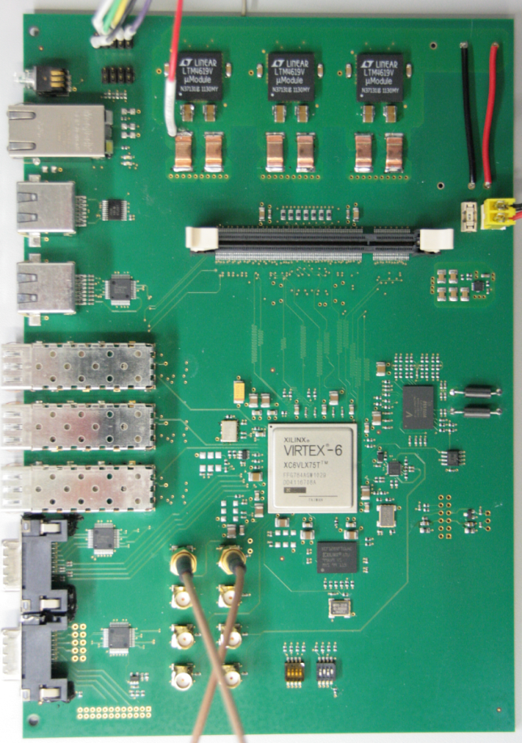
Data Handling Hybrid (DHH)
Snapshot of the DHH
Measured output bit-error-rate
@ 6.25 Gb/s links: < 10⁻¹⁵
2x RJ45 to receive
level-1 triggers and JTAG signals
Up to 2GB
DDR2 memory slot
2x SFP+ to output data to
downstream receivers
SFP+ to interface DHH controller
Virtex6 FPGA
(XC6VLX75T-FF784)
2x Infiniband
to receive data from DHP chips

Slide 11
PXD Readout System (Back-End)
RocketIO
over opt.
DHH
PXD
DHH
Readout
modules
GbE
DHH
RoI finding
logic
HLT decision
DHH
SW
DATCON
2nd Layer EVB
SVD
COPPER
Readout
PC
1st Layer EVB
HLT
CDC
COPPER
Readout
PC
…

Slide 12
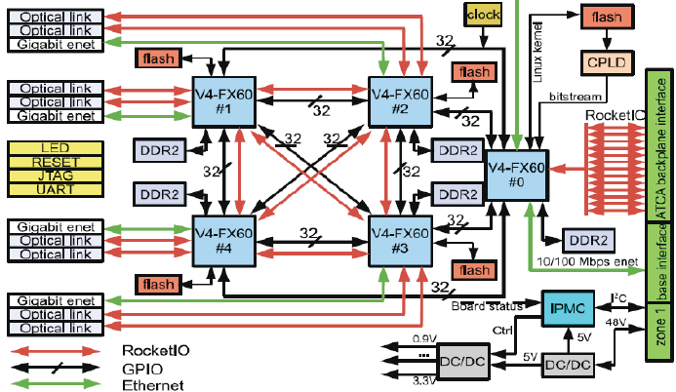
DHH Readout
DHH readout module (ATCA system)
  x4(x2) optical inputs from
  x4 DHHs and x4 GbE
  outputs to the 2nd
  layer event builder.
  More elaborated data
  size reduction using
  externally determined
  region-of-interest (RoI).
  The ATCA system
  comprises of a buffer for RoI-determination latency (5secs at maximum).
Block diagram of the ATCA module

Slide 13
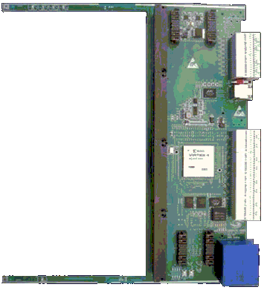
ATCA System – Carrier Board
Carrier board houses 4 computing nodes
  4 AMC connectors to I/F
  computing nodes.
    “Computing” node performs
    data size reduction based
    on RoI information.
  Virtex-4 FPGA for arbitration
  of 4 computing nodes.
  Peripherals
    2GB DDR2 memory.
    512Mb flash memory.
    x2 GbE ports.
    x16 RocketIO I/F to backplane.
Carrier board in ATCA form factor
4x AMC slots

Slide 14
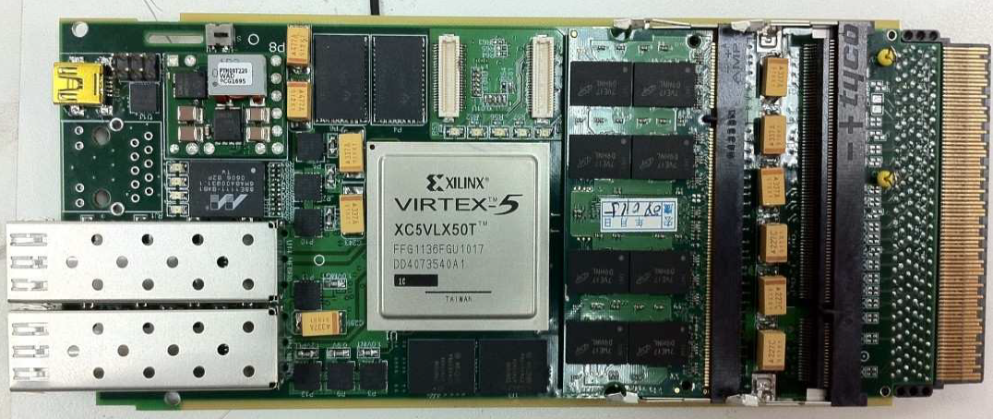
ATCA System – Computing Node (CN)
Computing node is in the AMC form factor
  4Gbps link speed is achieved with 200MHz clock.
  Measured bit-error-rate is < 4x10⁻¹⁴ at 4Gbps link.
  Measured memory-access speed is 400MHz for read/write at 200MHz clock.
4GB memory
for up to 5-second
RoI-finding latency
Virtex-5 FPGA
2x2GB DDR2
GbE port to I/F EVB
AMC connector
to I/F the carrier
board
2x SFP+
(6.25Gbps)
to I/F DHH

Slide 15
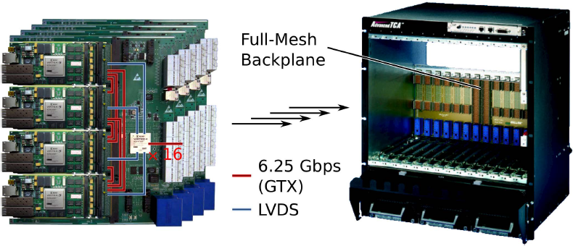
ATCA System – System Assembly
Drawn by Illustrator
Full-mesh
backplane
6.25Gbps
(GTX)
LVDS
40 x [ 4x computing-node + carrier-board ]

Slide 16
RoI-Based Data Size Reduction
RoI-based data size reduction
  PXD RoIs externally determined by track finding algorithm are informed to the ATCA module; the computing nodes (FPGA) within the ATCA module abandon PXD-hit signals out of the RoIs before sending the hit signals to the 2nd level event builder.
  Data size reduction by a factor of 10 is expected.
Reconstructed
track
… Survived pixel hits after
zero suppression by the DHP.
x
x
x
… RoI associated to the
reconstructed track.
x
x
x
x
PXD ladder
… Pixel hits within the RoI, which
should be recorded.
x

Slide 17
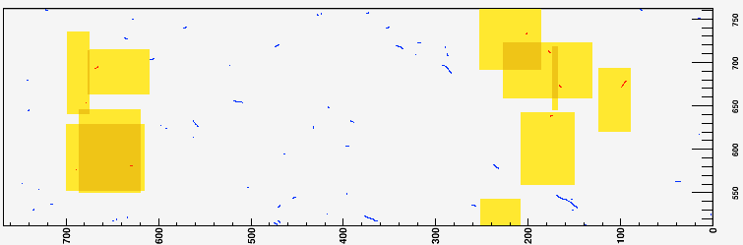
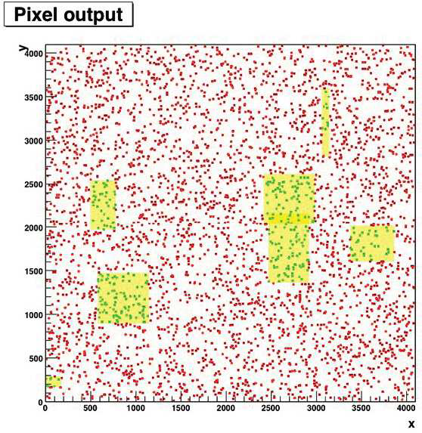
RoI↔PXD-Hit Matching on the CN
FPGA on the computing node examines
pixel hits and output only associated hits to the RoIs.
MC-gend. random pixel hit; MC-gend. signal pixel ht
  Implemented firmware works up to 31 RoIs per event.
  No error after processing of
  1.9x10⁶ random hit events;
  1.2x10⁵ signal hit events
MC-gend. realistic pixel hit with Touschek BG added
  DHP and DHH output-format decoder is implemented to the firmware.
  No problem observed as well.

Slide 18
RoI Finding in PC Farm
High Level Trigger (HLT)
  HLT reconstructs tracks→RoIs from SVD and CDC hit signals.
DHH
PXD
DHH
Readout
modules
DHH
HLT
decision
HLT
decision
RoI finding
logic
DHH
SW
SW
DATCON
2nd Layer EVB
SVD
COPPER
Readout
PC
1st Layer EVB
HLT
HLT
CDC
COPPER
Readout
PC

Slide 19
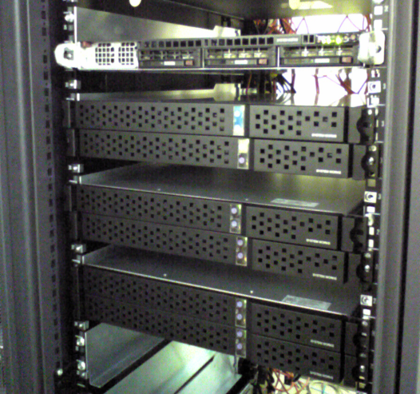
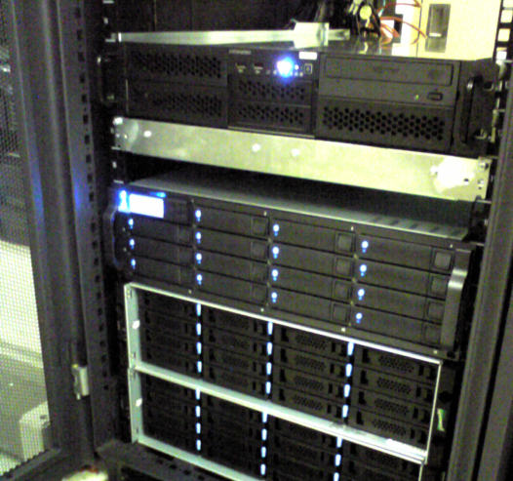
High Level Trigger
HLT functionalities
  RoI finding by track reconstruction.
  Event rate reduction by a factor of 3.
HLT = PC farms
  10 PC-farm units, each of which comprises
  of 150 CPU cores.
  Uniformed software framework for online
  and offline data analysis will be provided.
  The system is under development; it will
  be ready by the end of this year.
HLT R&D setup
96 cores
Storages

Slide 20
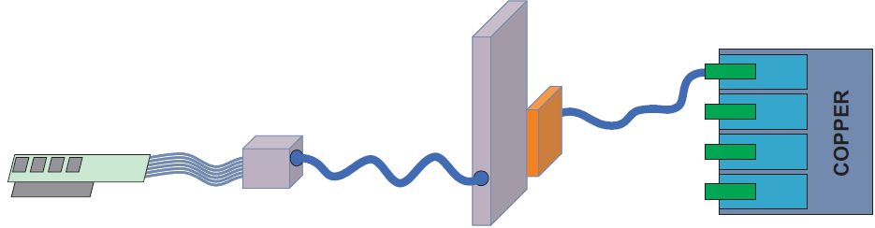
RoI Finding in DATCON
Data concentrator (DATCON)
  We are studying possibility of SVD-only track and RoI finding in a FPGA on the “DATCON” module.
ATCA modules
Opt. link
Opt. link
Opt. link
Opt. link
FPGA
DAT
CON
Opt. link
FINESSE
transmission
board
SVD
x40 (FINESSE + COPPER)
x1902
readout chips
(APV25)
‘FADC+PROC’
Analog-to-digital conversion, data size
reduction, and hit time finding module

Slide 21
New Idea on Hit Recovery
Hit recovery
  A track with p_{t}<75MeV/c cannot be reconstructed by the SVD sololey because of its small curvature.
  → No associated RoI is generated.
  → Corresponding PXD hit will be totally lost.
  PXD+SVD track finding may salvage these PXD hits.
PXD
DHH
ATCA modules
PXD+SVD
track
finding
CPU
Central
DAQ
SVD
DATCON

Slide 22

Backup Solution for DHH Readout
PCI-express cards receive data from DHH.
Link-speed study with a prototype card
DHH
RX card on PCIe
PCs
RX-card readout with RoI-based data size reduction
PXD
DHH
RX card on PCIe
2nd Layer EVB
GbE
DHH
RX card on PCIe
…
DHH
RX card on PCIe
.
.
.
.
  ML605 (Virtex-6 (LX240T) evaluation kit)
  Capability of PCIe Gen2 (x4).
  x2 FMC connectors to optional daughter card
.
.
.
.
.
.
.
.
.
.
.
.
OPT4 Board
.
.
.
.
.
.
.
.
Loopback
optical link
.
.
.
.
.
.
.
.
FMC
PC
x4 Aurora 5Gbps
x8 PCIe 2.5Gbps
11.84Gbps
achieved
FMC
ML605
Virtex-6
PCIe

Slide 23
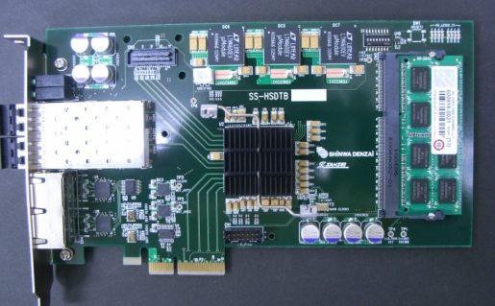
Backup Solution for DHH Readout
A newly developed PCI-express card
  The card has just delivered to KEK a month ago; we start a test of this card soon.
x2 SFP+ modules to
receive DHH outputs
DDR3 4GB buffer
for accidental block
of PCI-express
x2 RJ45 connectors to alert buffer full
PCI-express
x4 Gen2
Virtex-6
(XC6VLX75T)
The card can be a next
Belle-II DAQ platform.

Slide 24
Communication with the 2nd EVB
Processed Data →
Event Builder
AMC
computing
nodes
Requirement: 33MB/s
2nd Layer EVB
TCP/IP on
PowerPC core
~26MB/s ☹
UDC/TCP
converter
Processed Data →
Event Builder
AMC
computing
nodes
2nd Layer EVB
UDP/IP
over HDL stack
TCP/IP
over GbE
Preliminarily >118MB/s
is achieved ☺

Slide 25
PXD R&D Milestones
Evaluation of PXD6 (test production) | Oct. | 2011
Start final (PXD9) production | May | 2012
DAQ / power / cooling ready for test | Jan. | 2013
“Telescope test” at DESY (full DAQ + slow control) | Fall | 2013
All ASICs produced | Feb. | 2014
Finish final DEPFET production | Apr. | 2014
Finish assembly of PXD | Apr. | 2015
DAQ / power / cooling ready for installation | Jul. | 2015
PXD installed on beam pipe at KEK | Sep. | 2015
1/10 SVD
+
partial PXD

Slide 26
Summary
Data stream of the Belle II PXD from pixels to an event building system has been presented.
The full size of PXD output is 16MB/event. We design the PXD DAQ that can reduce the data size to a manageable level.
A telescope test of 1/10 SVD + partial PXD is planned in fall 2013 at DESY. It is a quite important milestone toward the successful operation of PXD DAQ.

Slide 27
Backup Slides

Slide 28
Belle II Collaborating Institutes
As of Feb, 2012
AUSTRALIA | Univ. of Melbourne
 | Univ. of Sydney
 | HEPHY, Austrian Academy of Sciences
CHINA | Institute of High Energy Physics
 | Peking Univ.
 | Univ. of Science and Technology of China
CZECH | Charles University in Prague
GERMANY | Deutsches Elektronen-Synchrotron
 | Karlsruhe Institute of Technology
 | Ludwig Maximilians University Muenchen
 | Max-Planck-Institut fur Physik Muenchen
 | Technical Univ. of Munich
 | Univ. of Bonn
 | Univ. of Giessen
 | Univ. of Goettingen
 | Univ. of Heidelberg
INDIA | Indian Institute of Technology Guwahati
 | Indian Institute of Technology Madras
 | Institute of Mathematical and Sciences
 | Panjab Univ. Union Territory
 | Tata Institute of Fundamental Research
KOREA | Gyeongsang National Univ.
 | Hanyang Univ.
 | Korea Institute of Science and Technology Information
 | Korea Univ.
 | Kyungpook National Univ.
 | Seoul National Univ.
 | Yonsei Univ.
MALAYSIA | Univ. of Malaya
POLAND | Institute of Nuclear Physics PAN
RUSSIA | Budker Institute of Nuclear Physics
 | Institute for High Energy Physics
 | Institute for Theoretical and Experimental Physics
SAUDI ARABIA | Univ. of Tabuk
SLOVENIA | Univ. of Ljubljana
 | Univ. of Nova Gorica
SPAIN | Istituto de Fisica Corpuscular
TAIWAN | Fu Jen Catholic Univ.
 | National Central Univ.
 | National Taiwan Univ.
 | National United Univ.
U.S.A. | Indiana Univ.
 | Luther College
 | Pacific Northwest National Laboratory
 | Univ. of Cincinnati
 | Univ. of Hawaii
 | Univ. of South Alabama
 | Virginia Polytechnic Institute and State Univ.
 | Wayne State Univ.
VIET NAM | Institute of Physics
 | Vietnamese Academy of Science and Technology
JAPAN | High Energy Accelerator Research Organization
 | Nagoya Univ.
 | Nara Women's Univ.
 | Niigata Univ.
 | Nuclear Physics Consortium
 | Osaka City Univ.
 | Toho Univ.
 | Tohoku Univ.
 | Tokyo Metropolitan Univ.
 | U-Tokyo
 | Yamagata Univ.
PXD R&D is contributed by colored institutes.

Slide 29
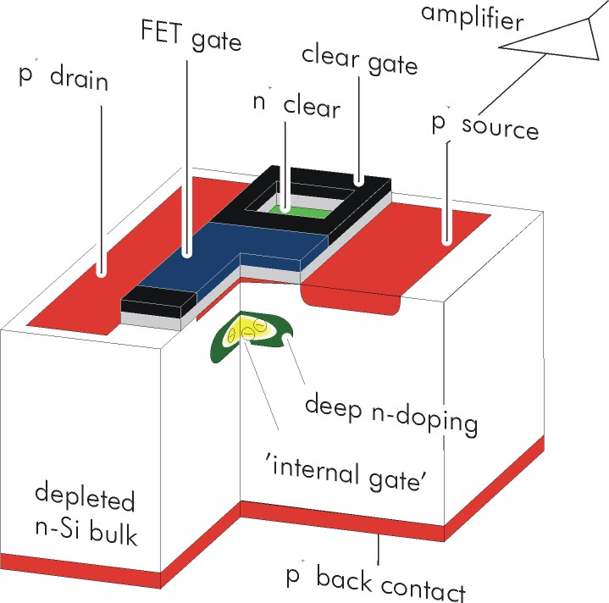


DEPFET
Depleted p-channel FET
Theory of operation
  A p-channel FET resides on a
  completely depleted silicon bulk.
  A deep n-implant creates a potential
  minimum for electrons under the gate.
  Signal electrons accumulate in the
  internal gate and modulate the
  transistor current (g_{q} ~ 400pA/e⁻).
  Accumulated charge can be removed by a clear contact.
Fully depleted → Large signal, fast signal collection
Low capacitance, internal amplification → Low noise
Transistor on only during readout → Low power

Slide 30
Thinning Technology
Sensor wafer bonded on “handle” wafer.
Rigid frame for handling and mechanical stiffness
50μm thickness produced.
Full-sized Belle II matrices have been produced.
Electrical properties tested successfully.

Slide 31
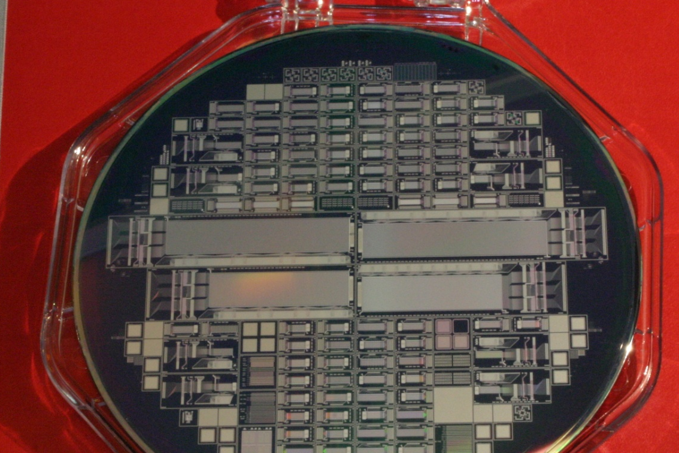
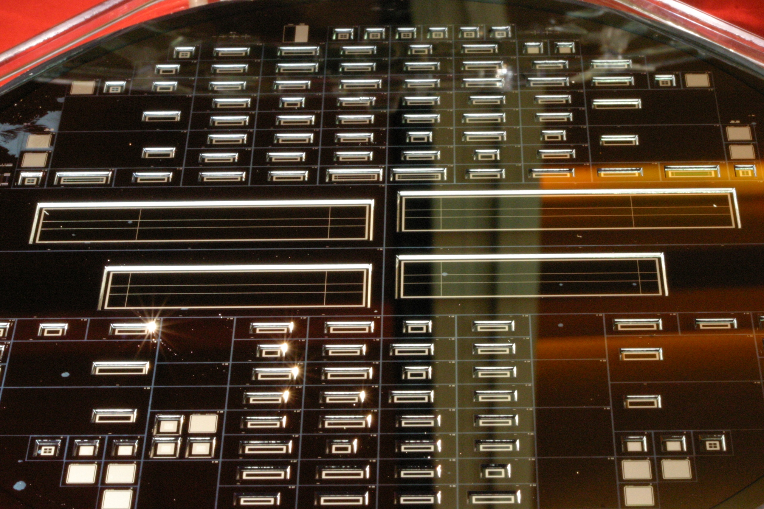
Test Production of Sensors
Front side
Thinned back side
First thinned (50µm) DEPFETs ever.

Slide 32
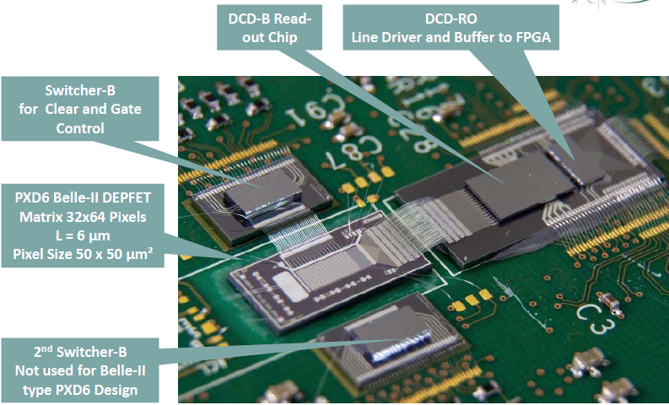
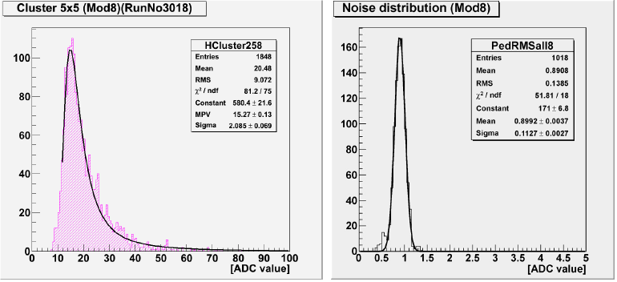
Tests of Thin DEPFET Sensors
DUT: 32x64 pixel, Belle II type
pixel size 50x50 µm²
100ns row read out time
S/N = 17:1 (will improve, not yet optimal bias setting due
to current DCD design)
Landau curve from ⁹⁰Sr source

Slide 33
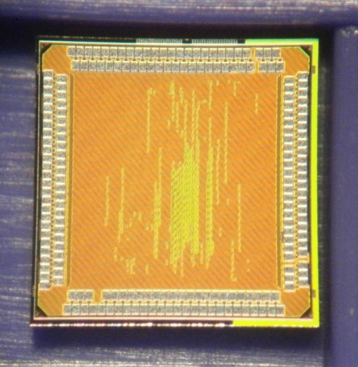
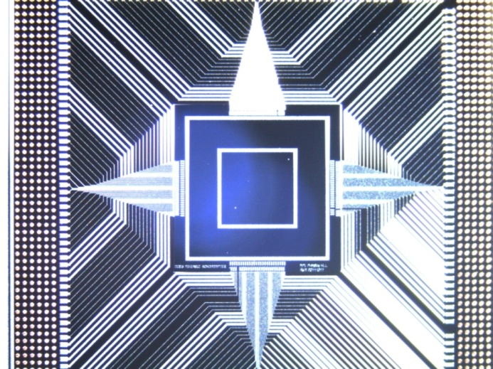
Clustering ASIC (DCE3)
DCE3 mini-chip with 256 clustering nodes
  Power: 165mW @ 400MHz.
  Bonding adapter ready.
  Clustering carrier board will be ready soon.

Slide 34
DHP Output Format
Frame header (32bits)
  The frame header is always sent at every start of a new frame independently of a level-1 trigger.
  Data type (3bits)
  Chip ID (8bits)
  Frame ID (16bits)
  Reserved (5bits)
Row header (16bits)
  The row header is only sent when hit data are available in the active row.
  Flag (1bit)
  Row address (9bits)
  Common mode (6bits)
Data word (16bits)
  Flag (1bit)
  Column address (7bit)
  ADC data (8bit)

Slide 35
DHH Output Format
Packet 1 (128bits)
  Header ID0(16bits), error-code(8bits), DHH-ID(6bits)
  Trigger information (32bits)
  Time tag (64bits)
Packet 2 (32bits)
  Header ID1(16bits), error-code(6bits), data-type(2bits),
  DHH-ID(6bits), DHP-ID(2bits)
Data body
  Same as the DHP output format.

Slide 36
Expected Data Rate
Occupancy assumption = 3%
Design maximum level-1 trigger rate = 30kHz (ave.)
8Mpixel x 3% x 16bits x 30kHz = 103Gbps
  We have 40 DHH-links
  → 2.6Gbps per DHH-to-downstream-link

Slide 37
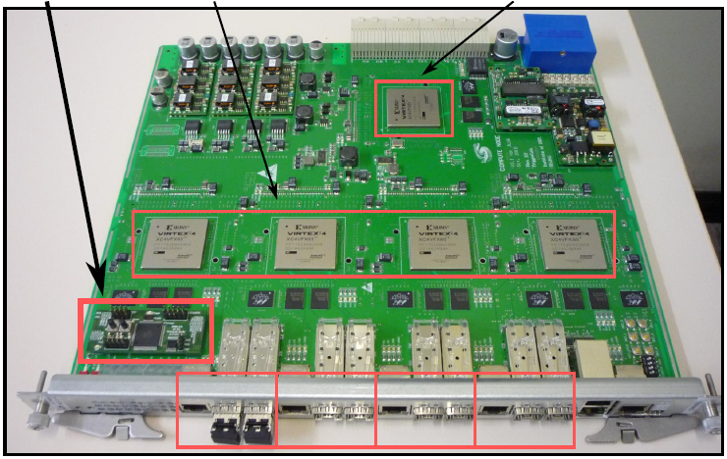
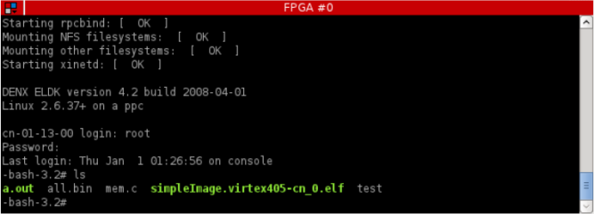
Prototype ATCA System
FPGA
programming
I/F (IPMC)
Computing
FPGAs
Switching
FPGA
Linux runs on embedded
PowerPC in the FPGA
Virtex4
FPGAs
GbE output to
2nd level EVB
2xSFP+ I/F
with DHH
For the optical links
6.25Gbps links
Aurora 8B10B encoding
are confirmed to work well.
4x

Slide 38
ATCA/CN Buffer Management
PXD/DHH → Pixel Data
Get free block,
write data to memory,
store ptr in lookup
HLT Trigger → ROI data
get free block, write ROIs to
memory, get pixel ptr from
lookup, feed both ptr to IP core
Lookup:
PXD Data Blocks
List of
Free Blocks
Event Builder ←
Processed Data
Read both ptr to IP core
write processed data
to Ethernet free blocks,
DDR2 memory
UDP/IP
over GbE
HW Registers
Write FIFO
Links between cores inside
the FPGA are being established.
HW Registers
Read FIFO
IP Core
RoI selection

Slide 39
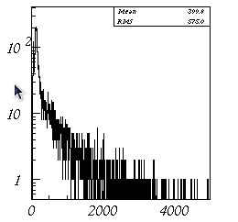
RoI-Finding Latency
RoI-finding latency = 5secs in the worst case
  To allow up to 5-second RoI-finding latency, 4GB online buffer per DHH is required assuming 2.6Gbps/link with a
  margin factor.
3.2GHz
Intel Xeon,
e-time/core.
[ms]
Elapsed time distribution for Belle track finding

Slide 40
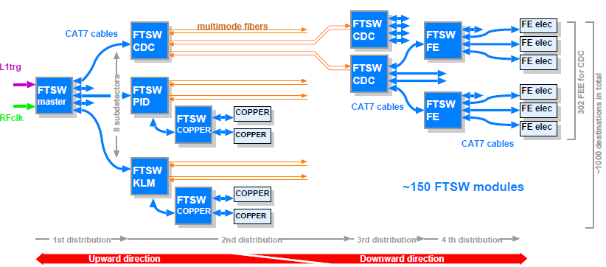
Trigger Timing Distribution
Tree-structured trigger timing distribution
  The system is getting well matured.
  Clock jitter requirement: <20ns; achieved: <15ns.
~1100 destinations

