Slide 1
Belle II Overview
Yutaka Ushiroda (IPNS, KEK)
DESY-KEK Meeting
Mar. 20, 2012

Slide 2
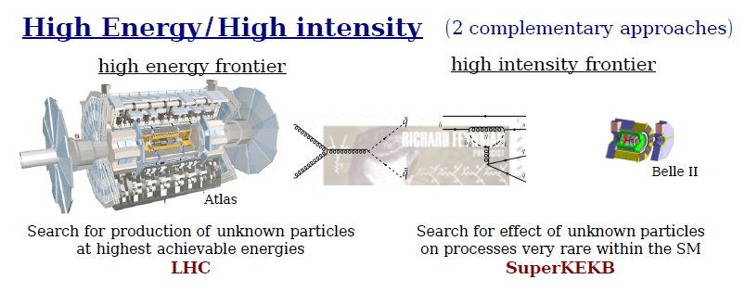
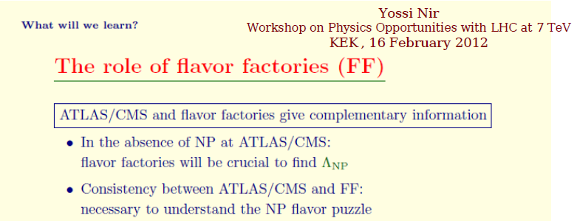
Role of Flavour Factories in coming 10 years

Slide 3
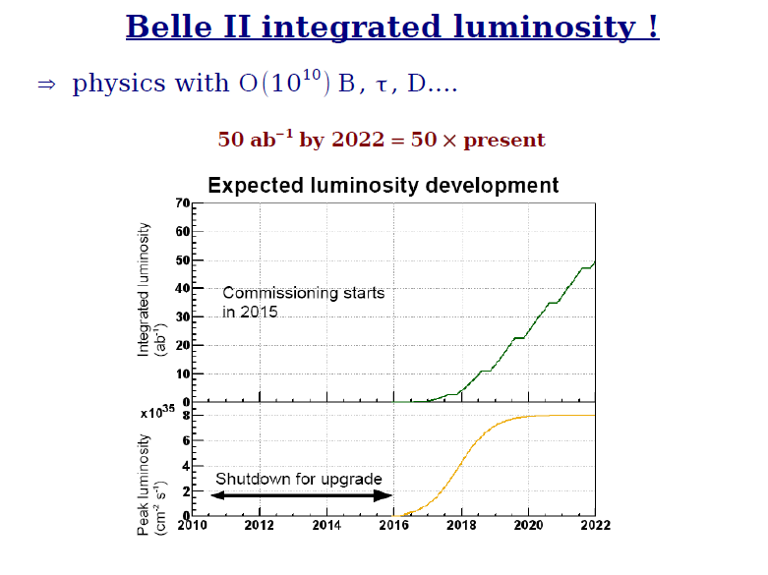
Keystones of Flavour Factory
High luminosity lepton collider with well controlled background
Good detector of low material

Slide 4
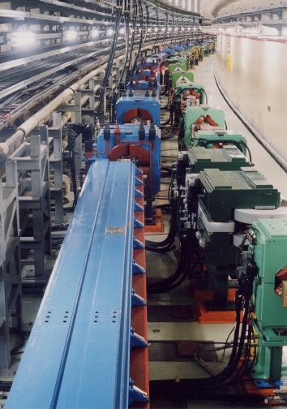
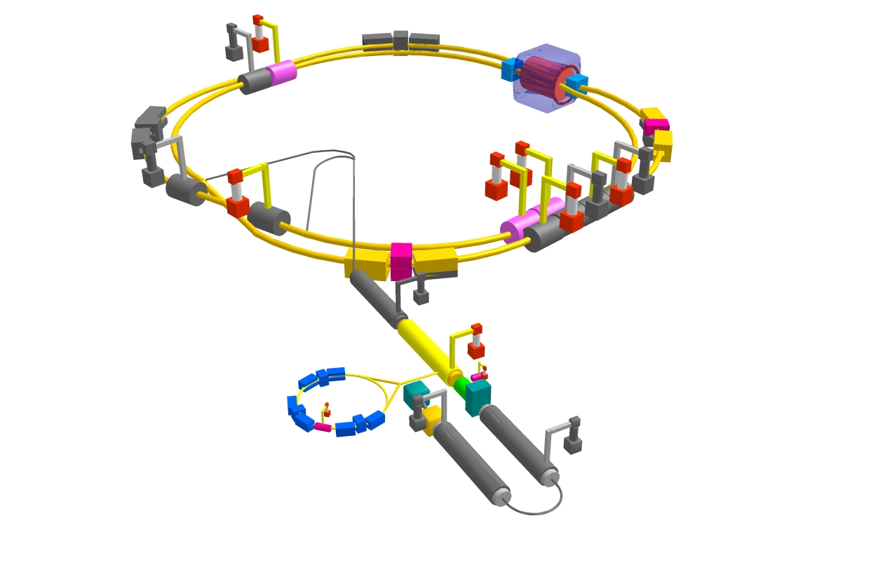
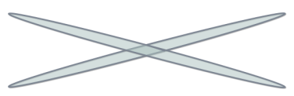
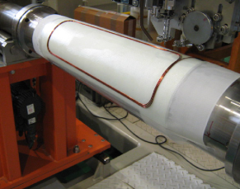
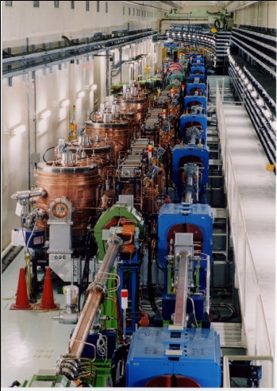


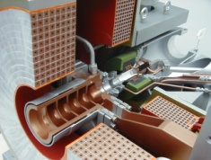
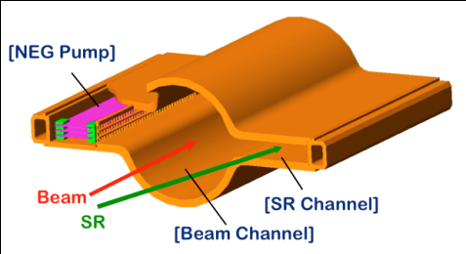
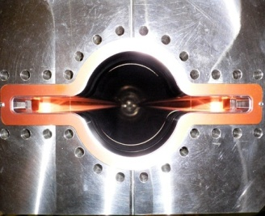

SuperKEKB and Belle II
Belle II
e⁺ 4GeV 3.6 A
Colliding bunches
New IR
e⁻ 7GeV 2.6 A
New superconducting /permanent final focusing quads near the IP
New beam pipe
& bellows
SuperKEKB
Replace short dipoles with longer ones (LER)
Add / modify RF systems for higher beam current
Low emittance positrons to inject
Positron source
Redesign the lattices of HER & LER to squeeze the emittance
Damping ring
New positron target / capture section
TiN-coated beam pipe with antechambers
Low emittance gun
Low emittance electrons to inject
Target: L = 8x10³⁵/cm²/s

Slide 5
Belle II Detector
K_{L} and muon detector:
Resistive Plate Counter (barrel outer layers)
Scintillator + WLSF + MPPC (end-caps, inner 2 barrel layers)
EM Calorimeter:
CsI(Tl), waveform sampling (barrel)
Pure CsI + waveform sampling (end-caps)
Particle Identification
Time-of-Propagation counter (barrel)
Prox. focusing Aerogel RICH (fwd)
electron (7GeV)
Beryllium beam pipe
2cm diameter
Vertex Detector
2 layers DEPFET + 4 layers DSSD
positron (4GeV)
Central Drift Chamber
He(50%):C2H6(50%), Small cells, long lever arm, fast electronics

Slide 6
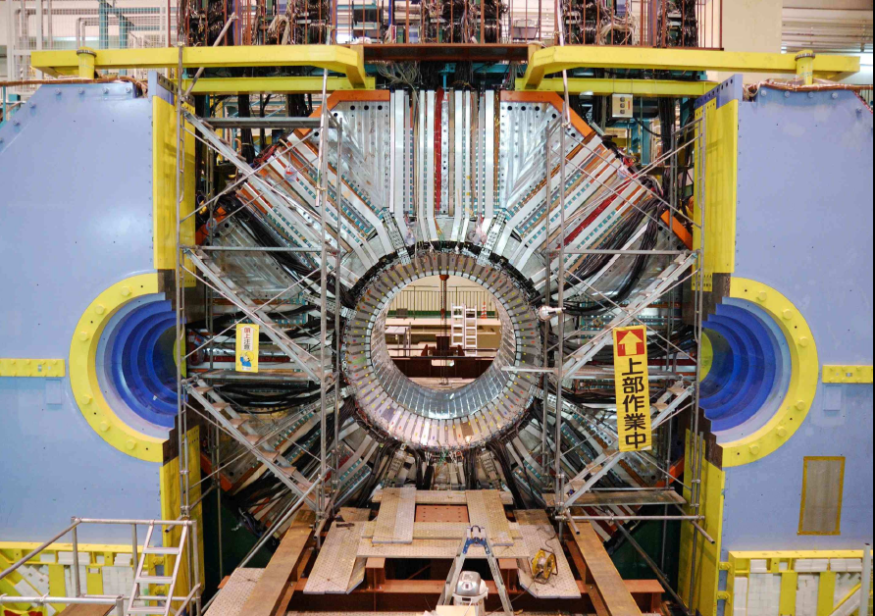
Status of Belle 1
Beam Pipe and Vertex Detector extraction: on Nov. 10, 2010
Belle Detector Roll-out: Dec. 9, 2010
End-caps, CDC, B-ACC, TOF extraction: in Jan. 2011

Slide 7
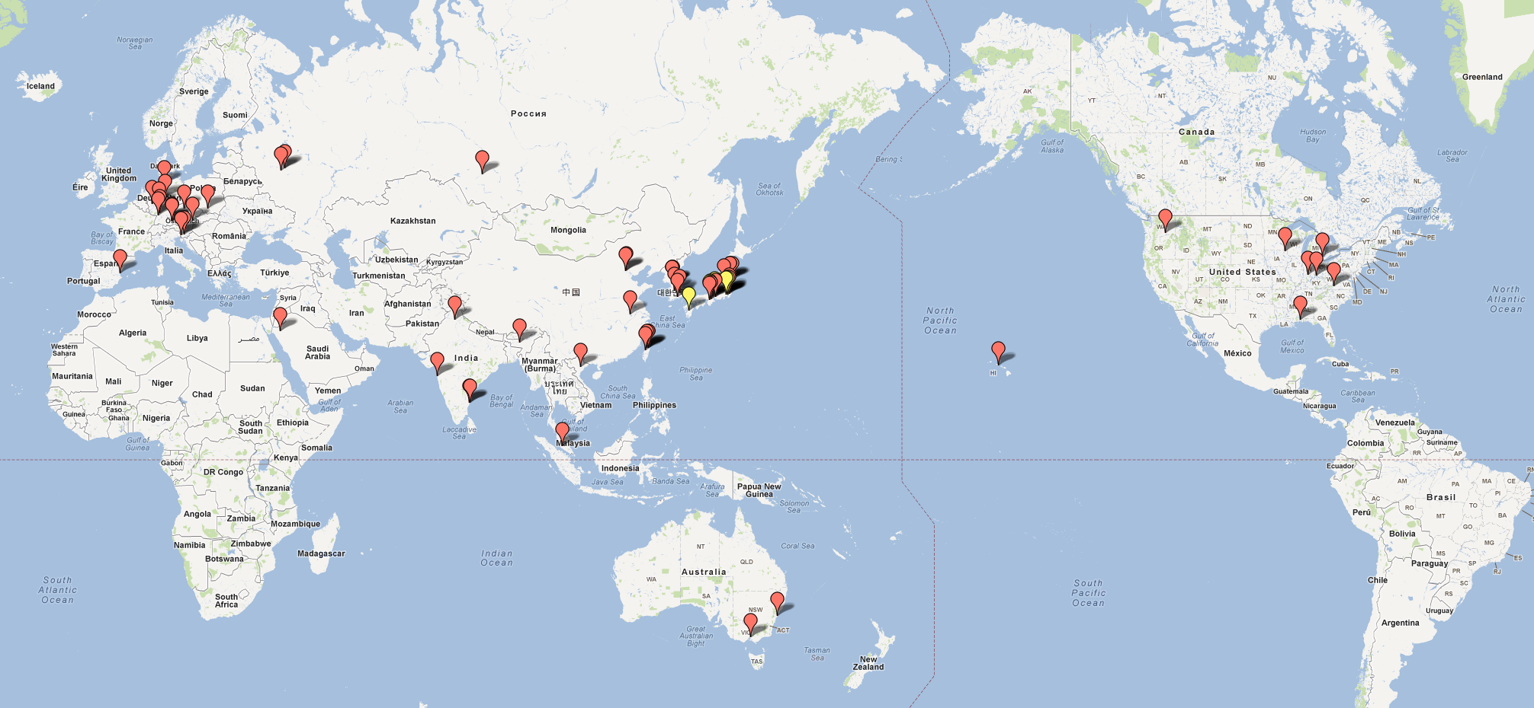
Belle II Collaboration
17 countries/regions, 62 institutes, ~400 collaborators (Jan. 2012)
+2 countries, 4 institutes (Mar. 14, 2012)

Slide 8
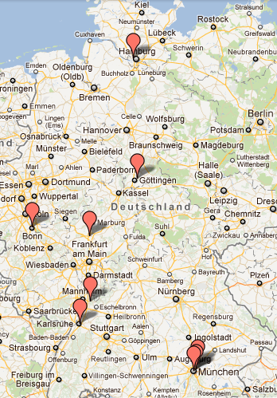
German Institutes
DESY
Univ. of Goettingen
Univ. of Bonn
Univ. of Giessen
Univ. of Heidelberg
Karlsruhe Institute of Technology(KIT)
Ludwig Maximilians University (LMU)
Max-Planck-Institut fur Physik
Technical Univ. of Munich (TUM)
9 institutes, ~50 people
2nd largest (JP, 12 inst. ~130 people)

Slide 9
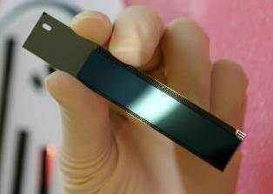
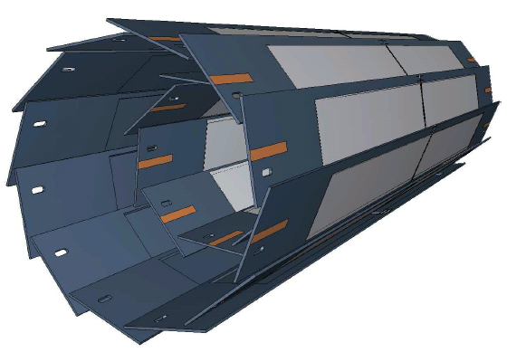
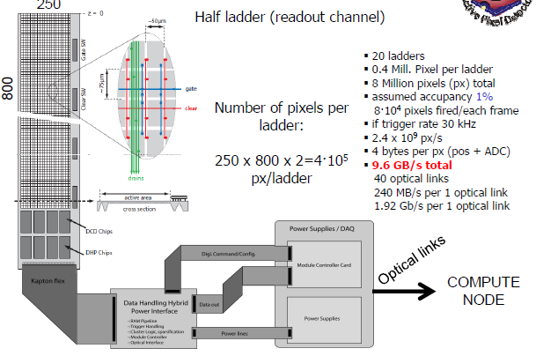
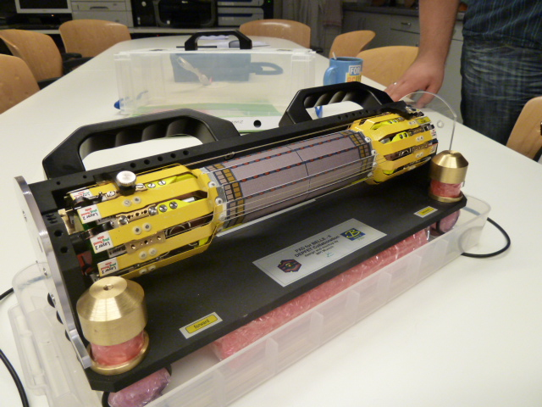
DEPFET for Belle II
Layer | radius (mm) | px size (μm²) | thickness (μm) | half ladder rows×cols | half ladder size (mm×mm) | #ladders
1 | 14 | 50x55 | 75 | 768×250 | 70×15 | 8
2 | 22 | 50x75 | 75 | 768×250 | 85×15 | 12
total of 8 Mpx
Mechanical mockup

Slide 10
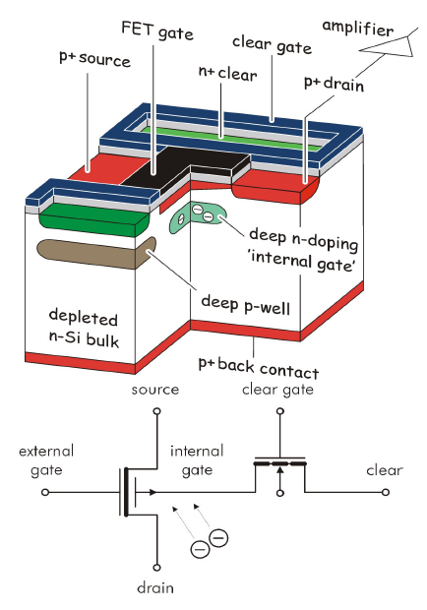
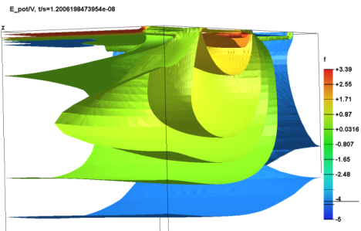
Principle of DEPFET
Each pixel is a p-channel FET on a completely depleted bulk
A deep n-implant creates a potential minimum for electrons under the gate (“internal gate”)
Signal electrons accumulate in the internal gate and modulate the transistor current (g_{q} ~ 400 pA/e⁻)
Accumulated charge can be removed by a clear contact (“reset”)
Rolling shutter mode (column parallel) for matrix operation
20 µs frame readout time
Low power (only few lines powered); 0.1W/cm²
Air-cooling sufficient

Slide 11
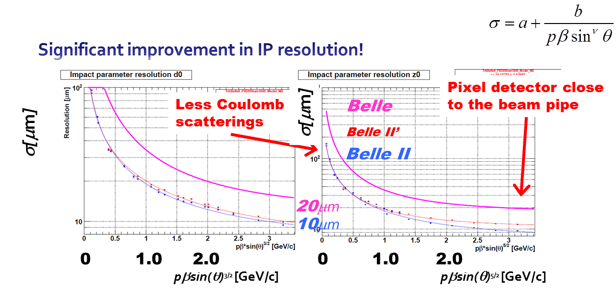
Real merit for B physics (esp. t-dep. CPV)

Slide 12
The DEPFET Collaboration
Country | Funding Agency | Member (Abbreviation) | Representative
Czech Republic |  | Charles University Prague (PRA) | Zdenek Dolezal
China | CAS | Inst. for High Energy Physics (IHEP) | Zhen’An Liu
Germany | BMBF | University of Bonn (BON) | Norbert Wermes
 |  | University of Göttingen (GOE) | Ariane Frey
 |  | University of Heidelberg (HEI) | Peter Fischer
 |  | University of Karlsruhe (KAR) | Thomas Müller
 |  | University of Gießen (GIE) | Sören Lange
 |  | University of Munich (LMU) | Jochen Schieck
 |  | Technical University Munich (TUM) | Stephan Paul
 | DESY | DESY Hamburg (DES) | Carsten Niebuhr
 | MPI | MPI for Physics, München (MPI) | Hans-Günther Moser
Japan | JSPS | Struct. Biol. Research Center (KEK) | Soichi Wakatsuki
Poland |  | Inst. of Nucl. Phys,, Krakow (KRA) | Maria Rozanska
Spain | Ministerio de Ciencia e Innovación | CSIC-CNM Barcelona (CNM) | Enric Cabruja
 |  | University of Barcelona (UBA) | Angel Dieguez
 |  | CSIC-IFCA Santander (IFC) | Ivan Vila Alvarez
 |  | CSIC-IFIC Valencia (IFV) | Carlos Lacasta

Slide 13
Weak Point of DEPFET Collaboration
have never built and installed a full DEPFET detector into a real HEP detector complex as a system
  Practical constraint in space, …
  Integration with others
  …

Slide 14
Role of DESY-KEK (1):
Mechanical Integration of PXD
Dry volume, cooling pipe, cables
Coupled with Mechanics of Interaction Region and Vertex Detector as a whole
  SVD Group needs help on Mechanical Design
  Lack of Mechanical Engineer at KEK
    Official request sent out to IPNS/Mechanical Engineering Group several months ago, but …
[Software effort] Alignment of tracking detectors (CDC/SVD/PXD)
  Coupled with mechanical design
    Overlap of sensors
    Support and positioning of ladders

Slide 15
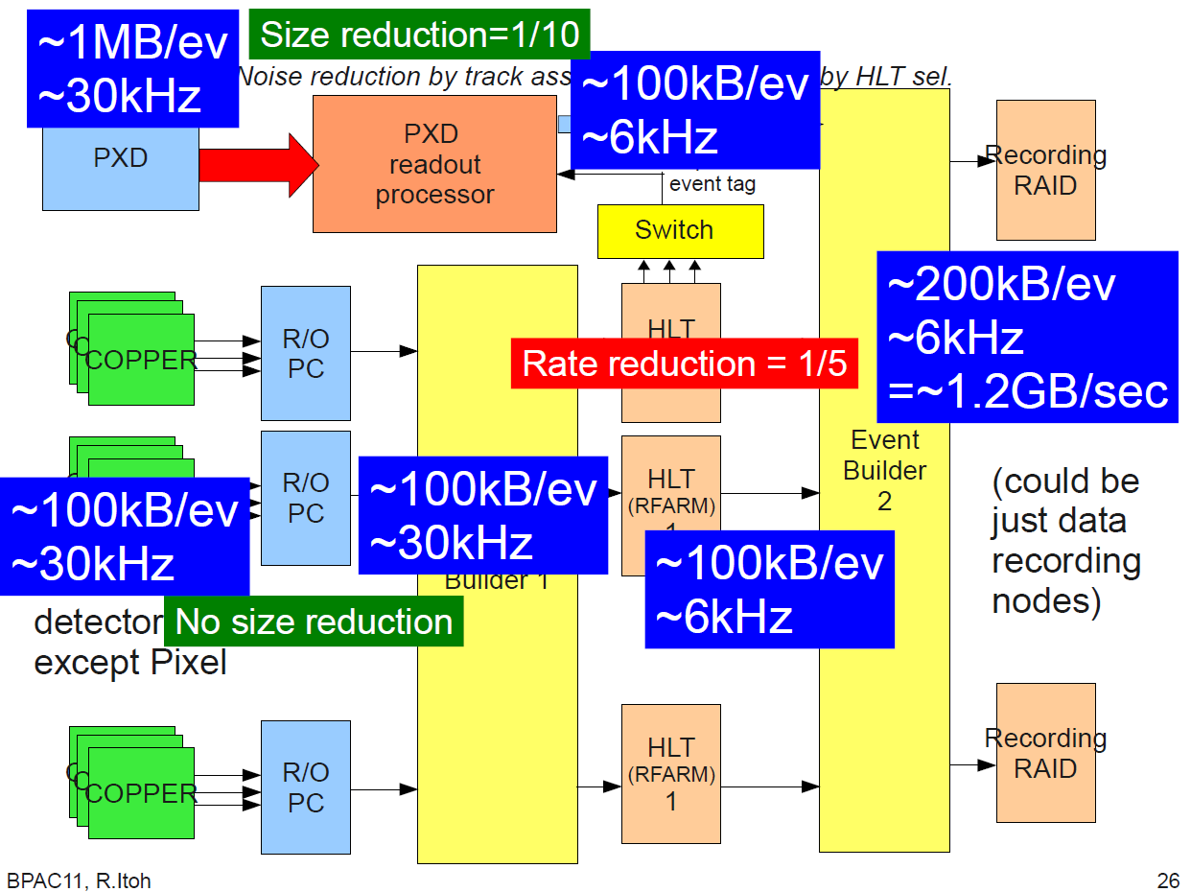
Role of DESY-KEK (2):
Integration of data flow from PXD
Huge data from PXD must be reduced

Slide 16
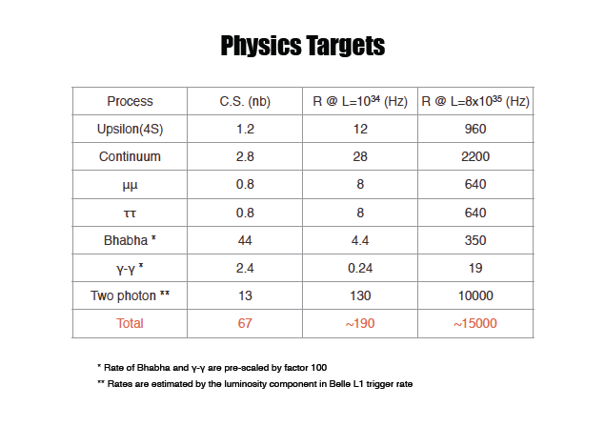
Data rate comparison
Experiment | Event Size [kB] | Record rate
 |  | [Hz] | [MB/s]
Belle II | 300 | 6,000 | 1,800
ALICE(HI) | 12,500 | 100 | 1,250
ALICE(pp) | 1,000 | 100 | 100
ATLAS | 1,600 | 200 | 320
CMS | 1,500 | 150 | 225
LHCb | 25 | 2,000 | 50
Event size is small
Record rate is so high and cannot be low!

Slide 17
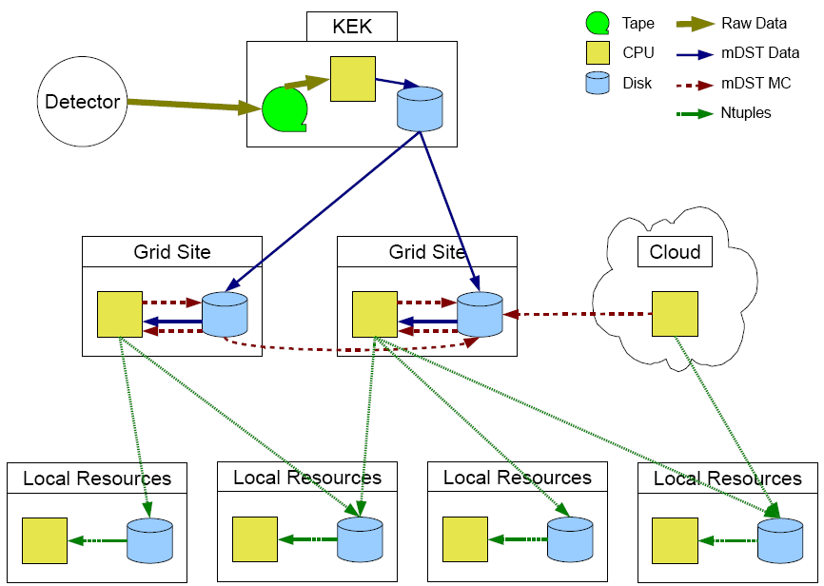
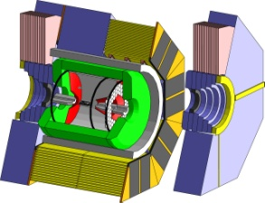
Role of DESY-KEK (3):
GRID-based distributed computing
KEK alone cannot handle our huge data
Help needed for the sake of analyzers in remote sites
Raw Data Storage
and Processing
Belle II
detector
MC Production
(optional)
MC Production
and Ntuple
Production
Ntuple
Analysis

Slide 18
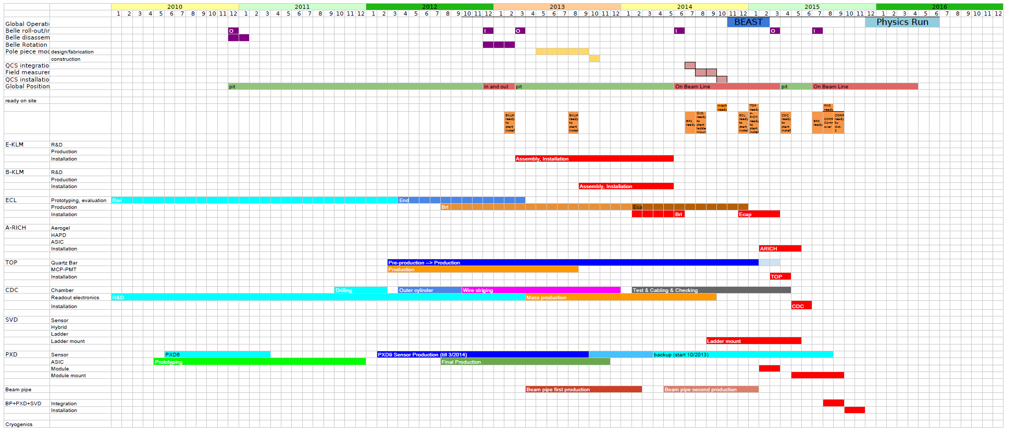
Belle II Construction Schedule
JFY 2014
Machine operation starts
JFY2012 (April-March)
Belle rotation
JFY2013
Installation of KLM
Physics run starts in end of CY 2015

