Slide 1
Belle-II beam background
Background sources at Belle-II
Countermeasures to mitigate BG
Impact on detector (GEANT4 simulation)
Hiroyuki NAKAYAMA (KEK)
KEK-DESY (Mar. 20, 2012)

Slide 2
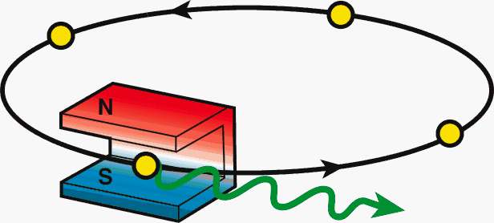
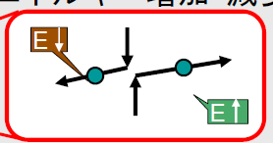
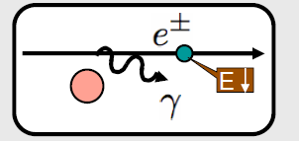
Beam background at SuperKEKB/Belle-II
At SuperKEKB with x40 larger Luminosity, beam background will also increase drastically.
Touschek scattering
Beam-gas scattering
Synchrotron radiation
Radiative Bhabha event: emitted γ
Radiative Bhabha event: spent e+/e-
2-photon process event: e+e-→e+e-e+e-
Beam-beam effect
etc…
e⁺
e⁻
e⁻
Notes:
In this slide, I have listed up variety of possible beam background sources at SuperKEKB.
Among these background sources, so-called “Touschek scattering” will be the most difficult one to cope with, which I will explain in more detail in the following slides.

Slide 3
Expected change on BG from KEKB to SuperKEKB
x20 smaller beam size
Touschek scattering rate increases drastically. Need special care.
x2 more beam current
→ Touschek/Beam-gas scattering rate increases.
x40 higher luminosity
→ Radiative Bhabha/2-photon scattering rate increases drastically.
Smaller IR beam pipe aperture
→ scattered particles are more likely to be lost in IR, not in the tunnel.
Final focusing scheme
→less back-scattering SR and over-bent radiative Bhabha

Slide 4
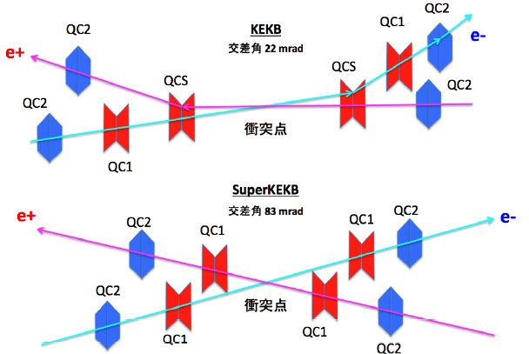
Final focusing scheme
θ =22mrad
IP
θ =83mrad
IP
In Belle-II, thanks to the independent final Q magnets for each ring, downstream orbits pass through the center of Q magnets, which results in less dispersion and therefore less back-scattering SR BG and less over-bent radiative Bhabha background.
Notes:
Although there are a number of features of the accelerator upgrade, here, let me pick up the design of final focusing magnet.
The crossing angle is changed to be much larger than that of KEKB, so that each rings can have their own final q magnet.
This will lead to flexible adjustment of orbit design.
The another benefit from independent final q magnet is that the bend by downstream Q magnet which existed at KEKB will disappear.
This will realize less emittance without dispersion coming the bend close to IP,
and also lead to less background such as SR at downstream magnet or over-bent spent electron from Radiative Bhabha event, which is expected to be the dominant BG of Italian SuperB.

Slide 5
History
Coulomb LER
Lossrate
110GHz
Touschek LER
Coulomb HER
40GHz
15 GHz
More horizontal collimators near IP
Vertical collimators at small beta_y
Extrapolation from machine study
Coulomb BG found to be dangerous
(+RBB HER 1turn 0.7GHz)
RBB LER
0.9GHz eff
1 GHz
RBB HER
0.7GHz eff
Touschek HER
0.2 GHz
0.2 GHz
0.1 GHz
0.1 GHz
Sep. ‘10
Dec. ‘10
Mar ‘11
Jun. ‘11
Sep. ‘11
Dec. ‘11
Now
IPAC’11

Slide 6
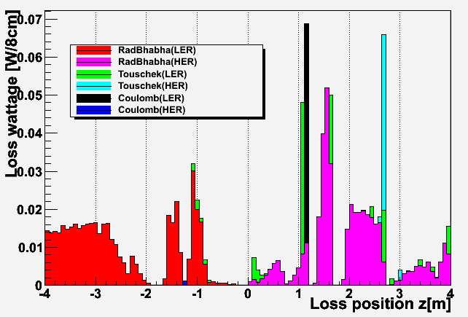
Ver. 2012.2.2
Total BG (for 2nd MC campaign)
Cf . 1st campaign
LER Touschek
0.9GHz (0.58W) @ z = +1m
L-side
R-side
 | LER (4GeV e+) | HER (7GeV e-)
Rad. Bhabha | 0.45 W (eff. 0.7GHz) | 0.44W (eff. 0.40GHz)
Touschek | 0.10 W (0.16GHz) | 0.05 W (0.04GHz)
Coulomb | 0.06 W (0.09GHz) | 0.001W (0.001GHz)
1GeV ,1GHz
= 0.16W
Notes:
RBB: LER 4.77GHz HER 3.47GHz
Touschek: LER 0.16GHz HER 0.05GHz

Slide 7
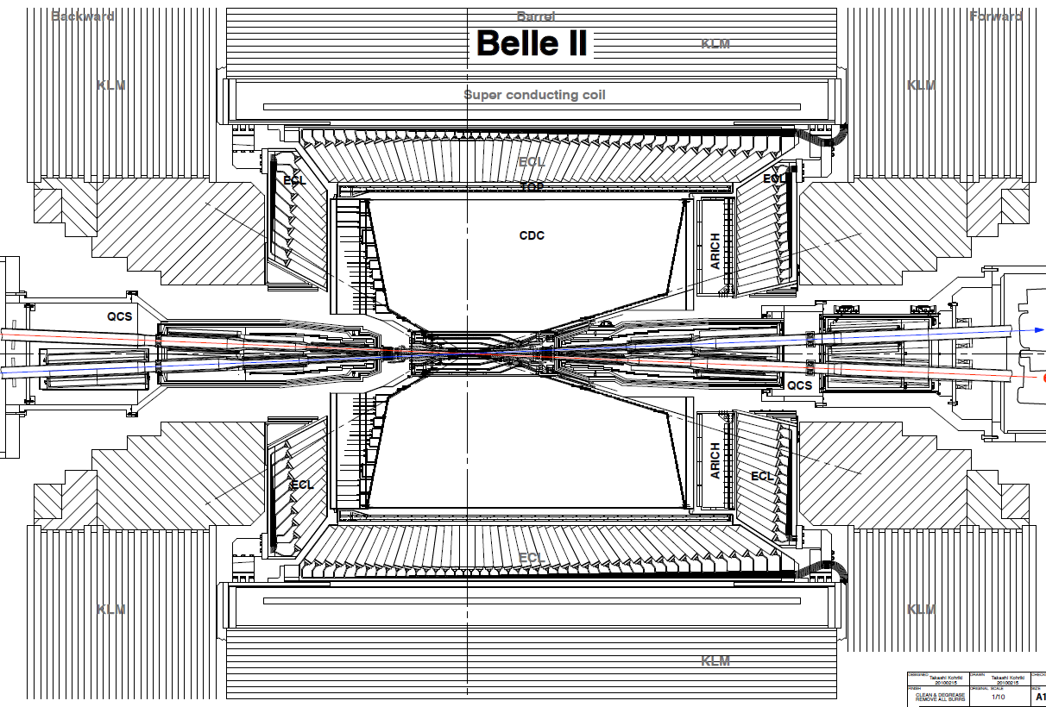
Background picture at Belle-II
←RBB LER
RBB HER→
Touschek HER→
←Coulomb LER
SR
Neutrons (rad. Bhabha)
HER e-
LER e+
Coulomb HER→
←Touschek LER
-3m
-2m
-1m
0m
1m
2m
3m

Slide 8
Touschek background
Y. Ohnishi
H. Nakayama
Intra-bunch scattering, Rate∝(beam size)⁻¹,(E_{beam})⁻³
More dangerous in LER

Slide 9
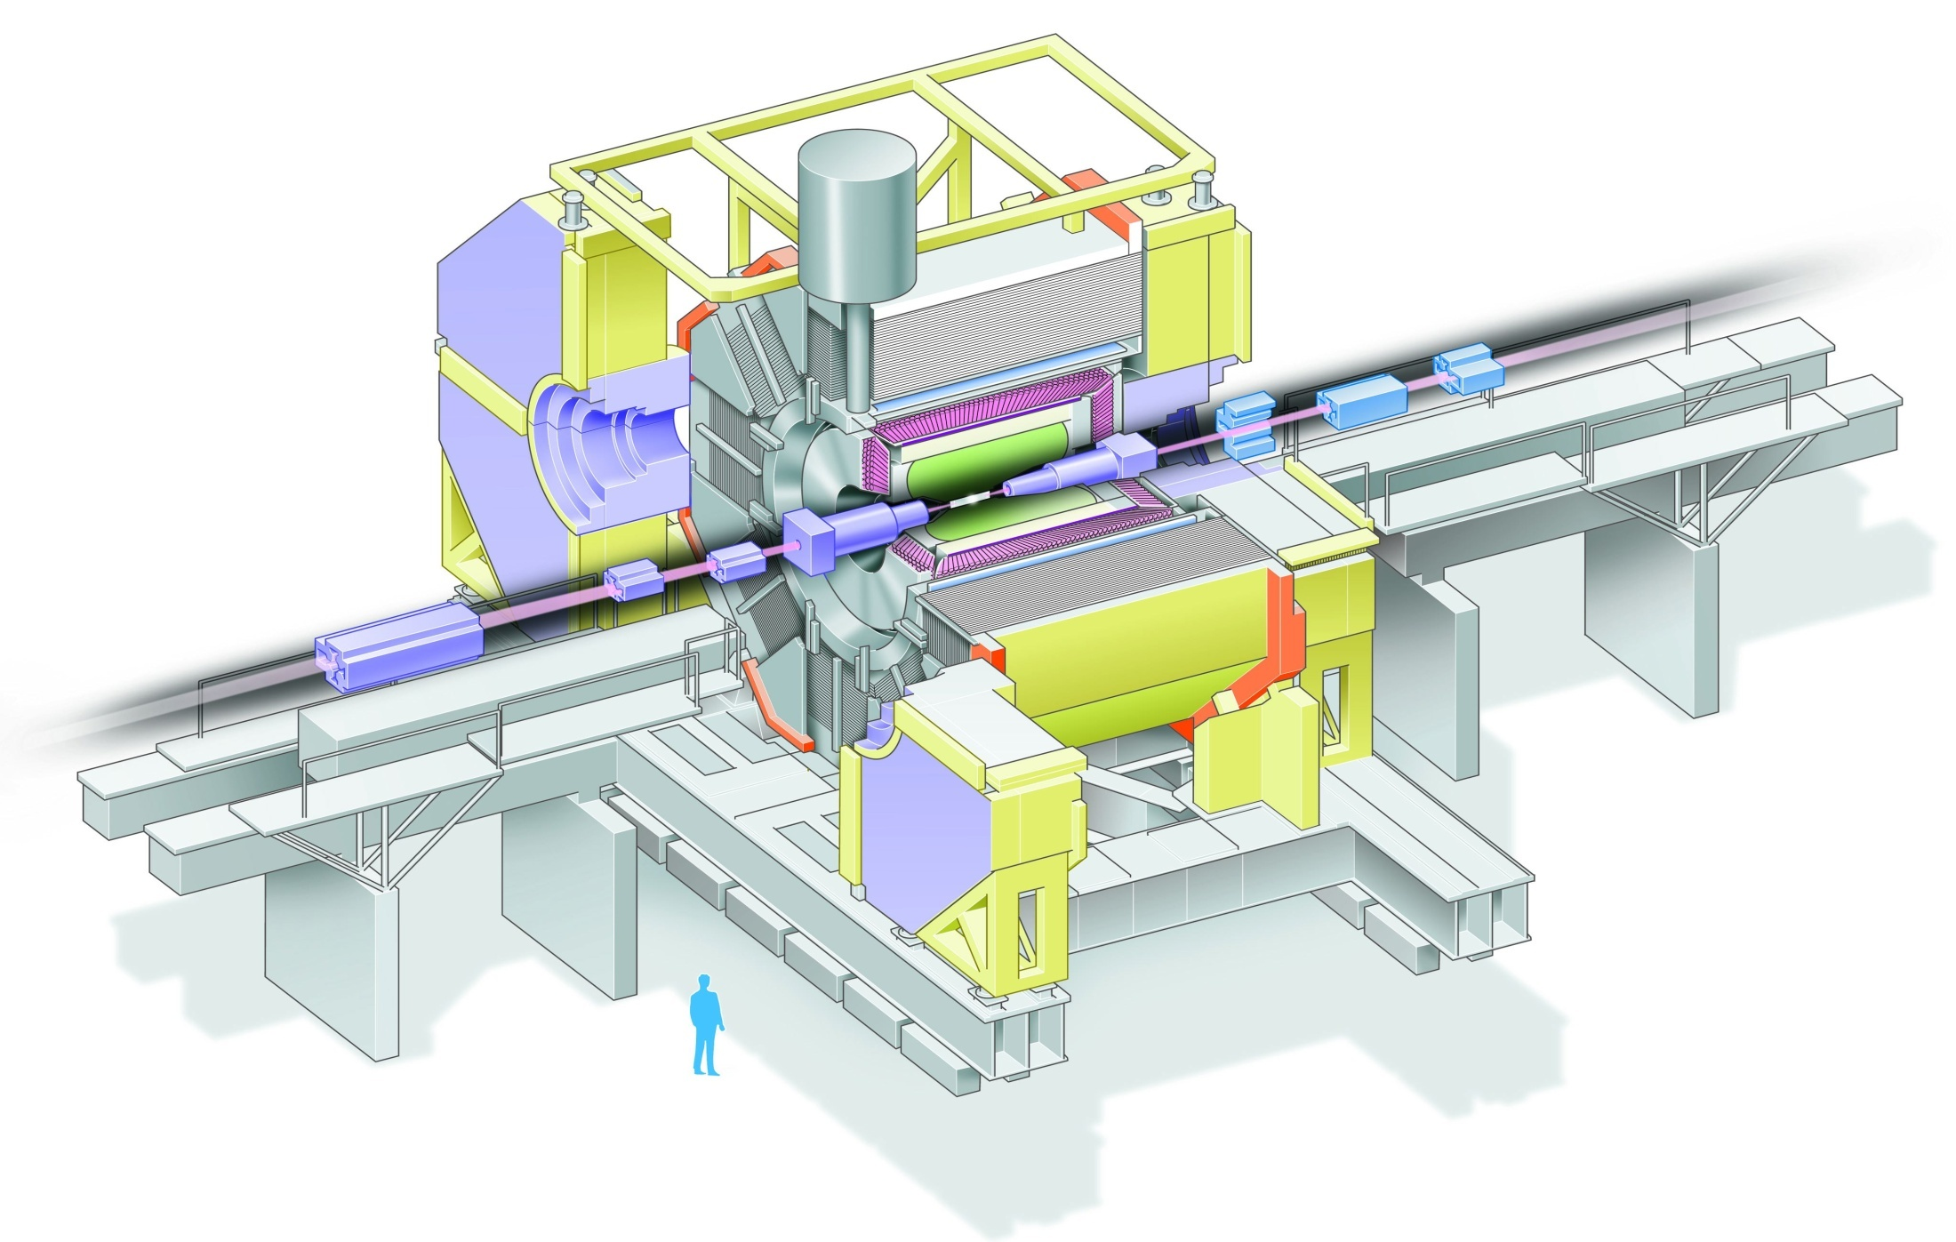
Touschek/beam-gas background
Scattered e+
Shower
Shower
Scattered e-
Scattered e+/e- becomes off-trajectory and hit IR beam pipe.
They create not only EM shower but also neutrons.
Notes:
How those background loos like? You can see this drawing.
Scattered particles get off-trajectory and eventually lost by hitting beam pipe.
If they are lost near detector and generated shower reach to detector, they become background.
Here I would like to mention that not only EM particles, but also neutrons are created by gamma via giant dipole resonance.

Slide 10
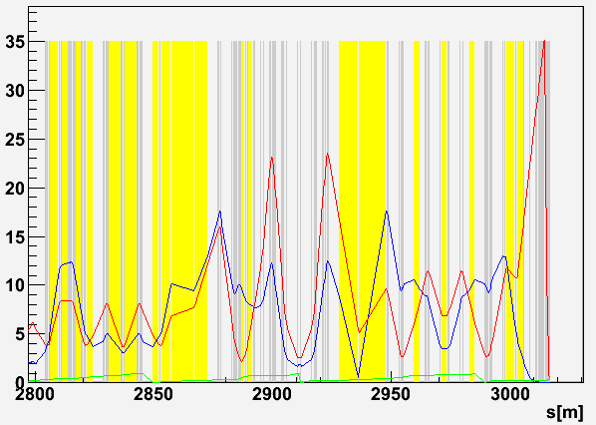
LER horizontal collimators
e⁺
H4
H1
H2
H3
IP
Collimator width: 10~15mm
β_{x} or η_{x} converted to collimator width (mm)
e⁺
H6
H7
H8
H5
IP
Compared to KEKB, we add more collimators (H5-H8) just before IP (-200m~-18m).
Collimators are located where beta function or dispersion is large.

Slide 11
Touschek loss rate in the detector
With horizontal /vertical collimators
LER
HER
e-
e+
IP
IP
Within |z|<4m,
- loss rate: 0.22 GHz
- loss wattage: 0.14 W
Within |z|<4m,
- loss rate: 0.10 GHz
- loss wattage: 0.10 W

Slide 12
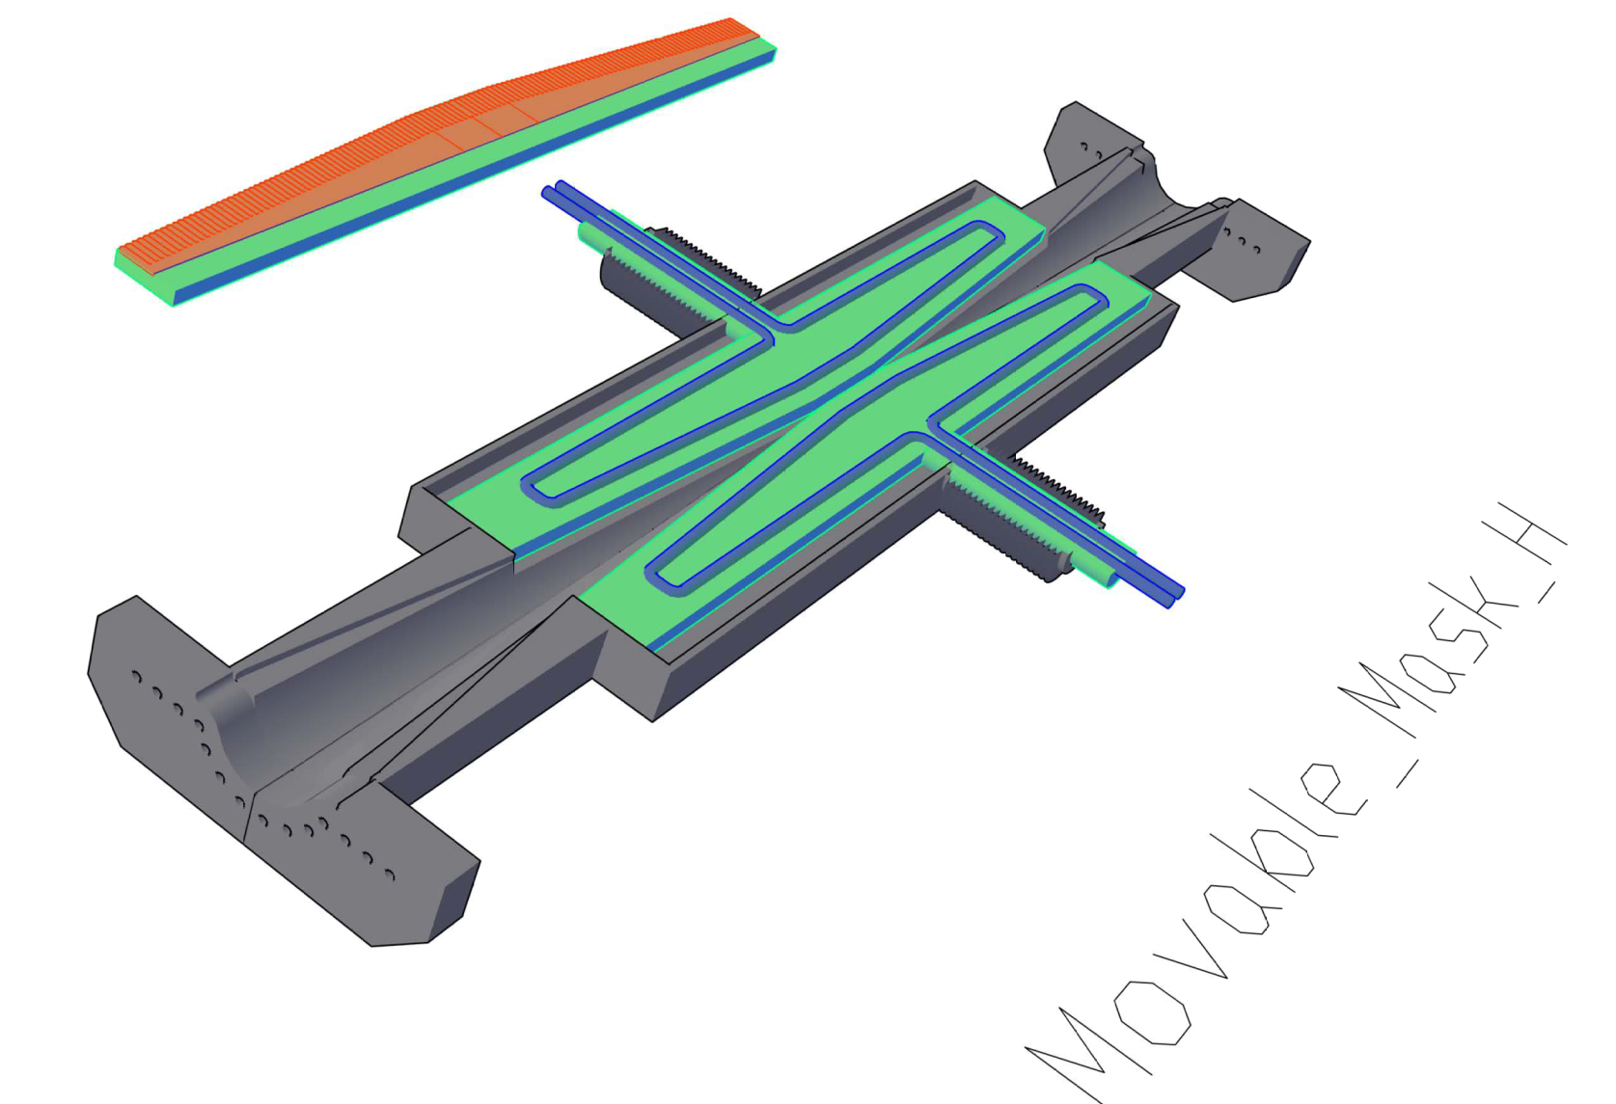
Concept of movable collimators
RF shield fingers around body (GridCop?)
Pair-type
d = 10~15 mm
1500
Mask head: Tungsten
Mask body: Copper
Cooling water
Reduced aperture at the mask head eliminates trapped modes.
Beam
Mask head
Final collimator is located only 18m upstream from IP.
We decided to use heavy material (Tungsten) for collimator head, according to the secondary simulation. Beam particles should deposit enough energy to be lost before reaching IR.
Tapered pipe
Cooling water
φ90

Slide 13
Collimator R&D
Horizontal/vertical collimators are important to reduce Touschek/Beam-gas background
Can collimators live with ~100GHz loss?
Choice of collimator head material
Cooling scheme
Secondary particle simulation
So far we assume perfect collimation
In reality, some beam particles which slightly hit (tip-scattered) on collimator head could reach to the detector.

Slide 14
Beam-gas background
H. Nakayama
K. Kanazawa
Y. Funakoshi
P = 10⁻⁷Pa is assumed
<Coulomb BG>
Elastic scattering with ΔE=0, Δθ!=0
Small-β collimation to avoid TMC instability was proposed at the last B2GM. Further detailed study has been performed.
<Bremsstrahlung BG>
ΔE<0, similar to Touschek
~1MHz loss in IR << Touschek

Slide 15
Beam-gas Coulomb lifetime
H. Nakano
K. Kanazawa
$(β_{y,2}$, $φ_{y,2})$
$θ:$Scattering angle
$(β_{y,1}$, $φ_{y,1})$
$$y_{2}= θ\sqrt{β_{y,1}⋅β_{y,2}} \sin{(φ_{y,2}−φ_{y,1})}$$
y₂
s
s=s₁
s=s₂
The minimum scattering angle $θ_{c}$
to hit QC1 beam pipe
$$θ_{c}={r_{QC1}}/{\sqrt{{\left\langle β_{y}\right\rangle ∙β}_{y,QC1}}}$$
Beam lifetime $τ_{R}$is
proportional to ${θ_{c}^{}}^{2}$
 | KEKB LER | SuperKEKB LER
QC1 beam pipe radius: r_{QC1} | 35mm | 13.5mm
Max. vertical beta (in QC1): β_{y,QC1} | 600m | 2900m
Averaged vertical beta: <β_{y}> | 23m | 48m
Min. scattering angle: θ_{c} | 0.3mrad | 0.036mrad
Beam-gas Coulomb lifetime | >10 hours | 2200sec
Rate ∝P x I x <β>
x β_{QC1} / r_{QC1}²
Beam-gas lifetime is only x1/100 of KEKB, due to larger vertical beta in QC1 and narrower QC1 physical aperture
15

Slide 16
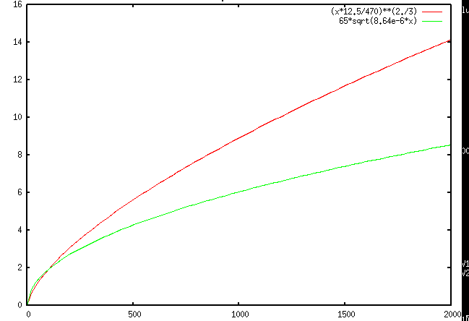
Where we should put vertical collimator?
Collimator position
Collimator aperture should be narrower than QC1 aperture.
d[mm]
TMC:
Aperture
TMC instability should be avoided.
Assuming following two formulae:
beta[m]
> 1.44 mA/bunch (LER)
taken from “Handbook of accelerator
physics and engineering, p.121”
Kick factor
(in case of rectangular collimator window)
We should put collimator where beta_y is SMALL!
Notes:
d[mm], beta[m]
beta* 12.5/sqrt(d^3) < 470 → sqrt(d^3) < beta * 12.5 / 470 → d < (beta*12.5/470)^(2/3)
d/1000/sqrt(8.64e-12*beta)) > 65 → d > 65 * sqrt(8.64e-6*beta)
betax8, dx4,Nsigmaxsqrt(2)

Slide 17
Vertical collimator width vs. Coulomb loss rate, Coulomb life time
ler1604, V1=LLB3R downstream
V1 width[mm] | IR loss [GHz] | Total loss[GHz] | Coulomb life[sec]
2.40 | 0.04 | 149.5 | 1513.3
2.50 | 0.05 | 137.8 | 1642.0
2.60 | 0.09 | 127.4 | 1776.0
2.70 | 0.24 | 118.1 | 1915.2
2.80 | 0.81 | 110.0 | 2057.2
2.90 | 8.48 | 109.3 | 2069.6
3.00 | 18.98 | 109.3 | 2069.6
Based on element-by-element simulation considering causality the phase difference (by Nakayama)
her5365,V1=LTLB2 downstream
V1 width[mm] | IR loss [GHz] | Total loss[GHz] | Coulomb life[sec]
2.10 | 0.001 | 48.4 | 3379.4
2.20 | 0.001 | 44.1 | 3709.0
2.30 | 0.357 | 40.0 | 4053.8
2.40 | 6.862 | 33.0 | 4099.1
2.50 | 12.004 | 27.9 | 4099.1
IR loss rate is VERY sensitive to the vertical collimator width.
(Once V1 aperture>QC1 aperture, all beam loss goes from V1 to IR
Typical orbit deviation at V1 : +-0.12mm (by iBump V-angle: +-0.5mrad@IP )

Slide 18
Radiative Bhabha background
Y. Funakoshi
- Spent e+/e- loss in downstream
Dominant loss position is very far (~10m) from IP, but little fraction
with large ΔE (still dangerous with Lx40) can be lost inside detector.
Gamma emitted from IP
They hit downstream (~10m) beam pipe/magnet and generate neutrons
by giant dipole resonance. Neutron shielding inside tunnel will be increased

Slide 19
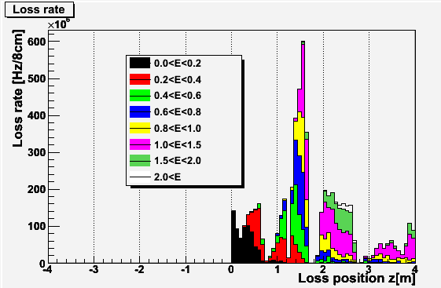
Radiative Bhabha BG
LER (positron from RBB event)
HER (electron from RBB event)
e+
e-
IP
IP
Within |z|<4m,
loss rate: 6.8 GHz(0~1.4GeV)
loss wattage: 0.55 W
Within |z|<4m,
loss rate: 5.8 GHz(0~2GeV)
loss wattage: 0.75 W
(Equivalent to 0.86GHz of 4GeV e-)
(Equivalent to 0.68GHz of 7GeV e-)

Slide 20
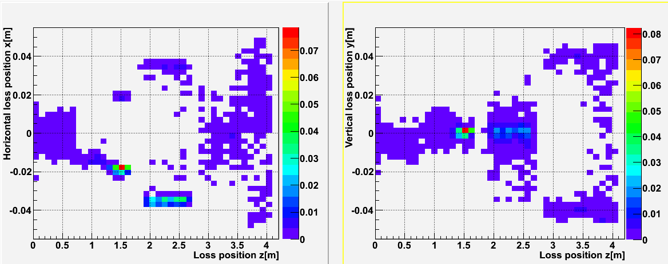
Radiative Bhabha HER (contd.)
x-z plane
W
y-z plane
W
e-
e-
e-
HER QC1
HER QC2
Horizontally lost at z=1.5m
LER QC1 leak field
Notes:
QC1RPE: 0.46-1.18(0.74-1.2)
QC1RE: 1.2-1.63 (1.27-1.57)
QC2RPE: 1.68-2.6
QC2RE: 2.66-3.20(2.75-3.1)

Slide 21
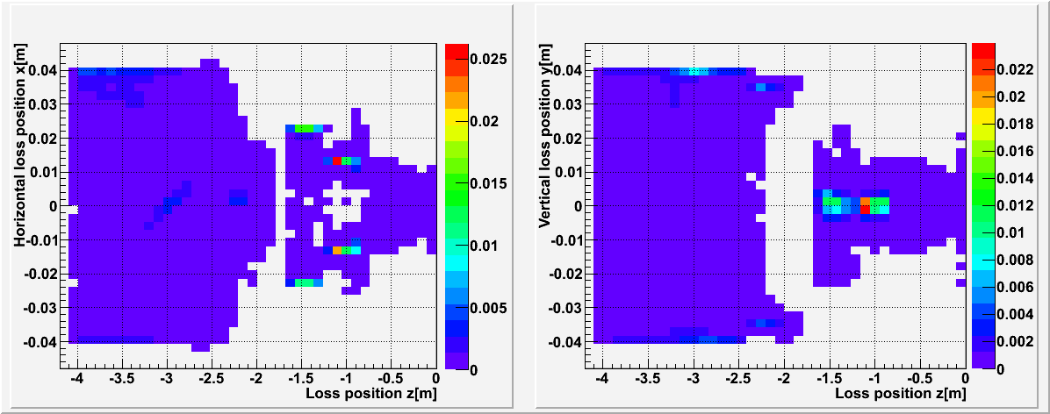
Radiative Bhabha LER (contd.)
x-z plane
W
y-z plane
W
e+
e+
LER QC2
LER QC1
Horizontally lost at z=-1m
Notes:
QC1LP: 0.75-1.19
QC2LP: 1.71-2.15

Slide 22
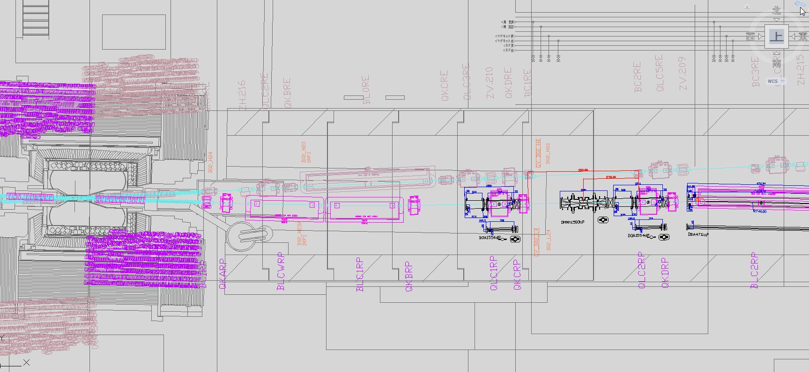
Increase shields in the tunnel
Neutron rate on Endcap detectors
Radiation level of Tsukuba-hall
HER first bend (BL0RE)
IP+7~11m
Photon dump
IP ~14m
n
e-
γ
n
n
e-
e-
e-
e-
n
n
Polyethylene shield (10cm) at KEKB
Additional concrete shield at tunnel exit
Additional neutron shield
around gamma dump
Notes:
The neutron generation rate will be 40 times higher than KEKB.
We should increase the neutron shield around gamma dump, to protect our detectors.

Slide 23
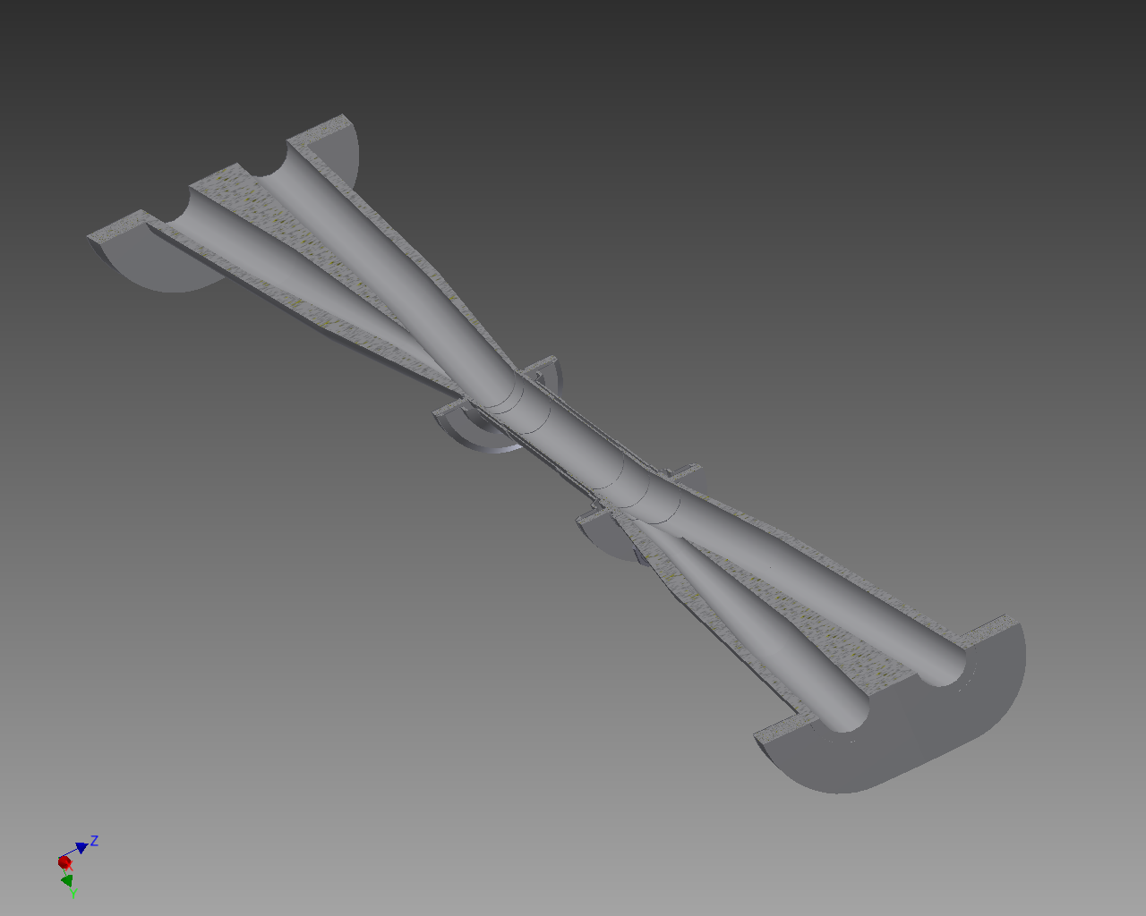
Synchrotron BG
e-
Dia. 20mm
Dia. 9mm
e+
mainly from HER
Ti
Be
Ti
HER e- beam
SR must not hit Be part.
SR is desired not to hit Ti part.
LER e+ beam

Slide 24
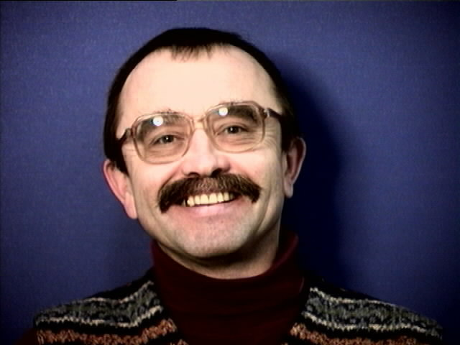
Yuri Soloviev: 1-month stay at KEK
From February 17th to March 16th
Supported by KEK Short-term
Visiting Scientist Program
He worked on synchrotron
radiation background study

Slide 25
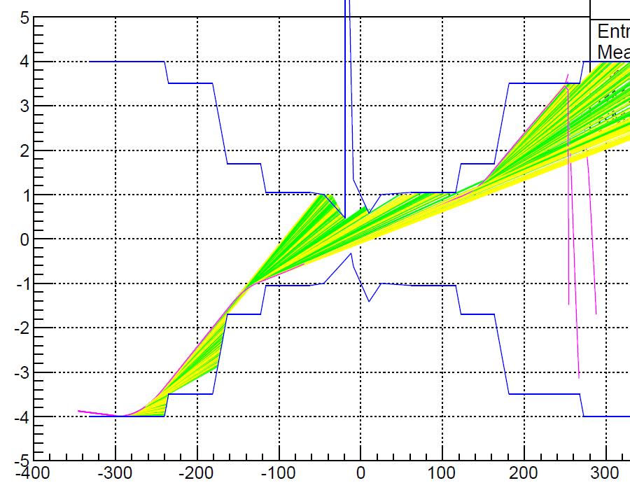
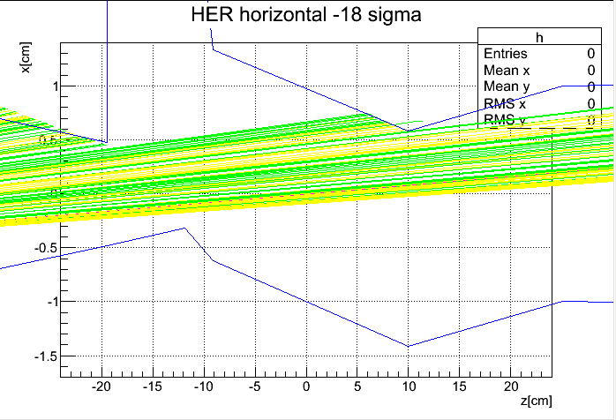
Detailed SR simulation in 2012
Y. Soloviev, K. Itagaki
H. Nakayama
Detailed beam pipe geometry implemented.
Reflection/scattering on Au coating of beam pipe is considered
Only QC1/2 included so far, missing bending magnets upstream
Currently using 2D “cylindrical” solenoid field, need to be updated with 3D
Beam pipe hit rate is ready, impact on PXD/SVD/CDC will be studied soon
Test-beam study to implement home-made “tip-scattering” model
x[cm]
IP
Be: -3.7<z<5.9cm
SR (>5keV)
SR (>0.1keV)
z[cm]
For more details, see Soloviev-san’s talk

Slide 26
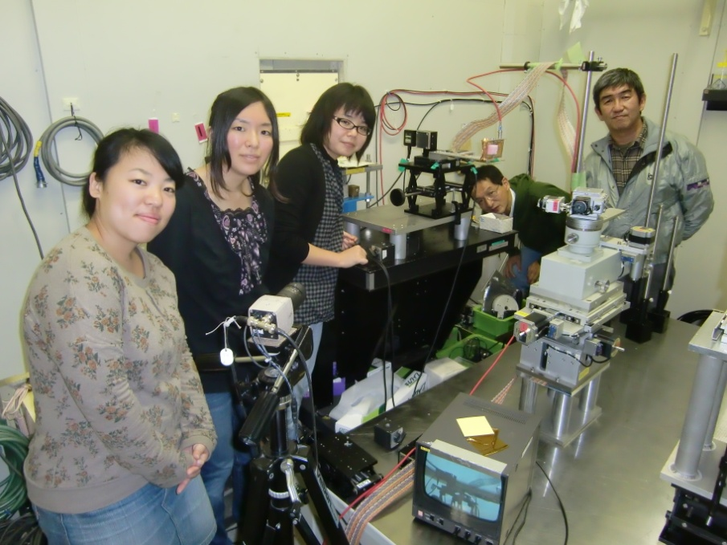
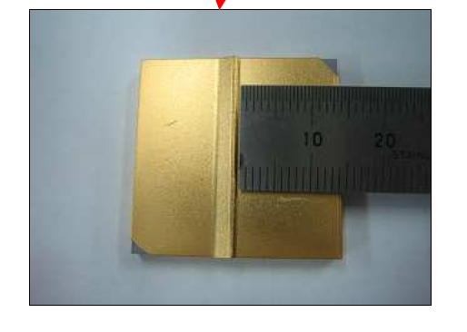
X-ray beam test
J. Murakami
S. Tanaka
Test target
Measure scattering angle distribution
Irradiate X-rays onto Ta tip plated with gold and measure angle distribution of scattered flux.

Slide 27
Full-detector simulation

Slide 28
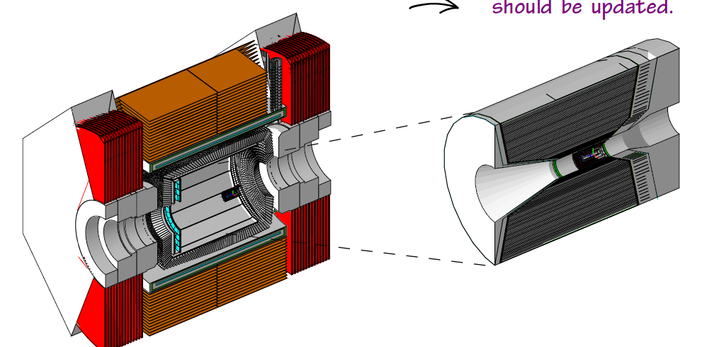
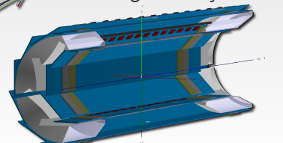
Whole geometry ready in GEANT4
PXD

Slide 29
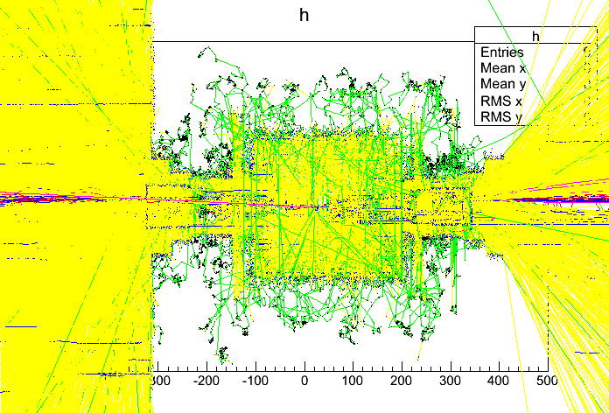
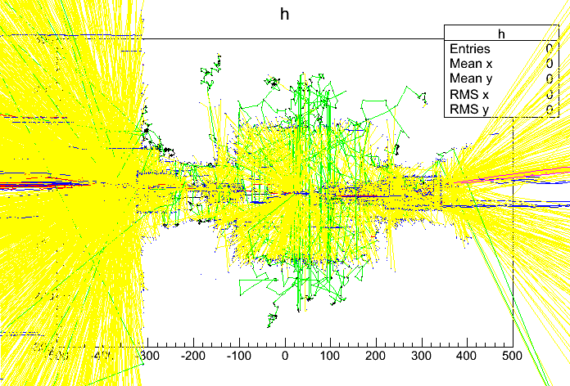
RBB+Touschek+Coulomb
Magenta: primary particle
Red: e+
Blue: e-
Yellow: gamma
Green: neutron
Show particles with E>1MeV
r*sign(x)[cm]
z[cm]
170 events in 20ns

Slide 30
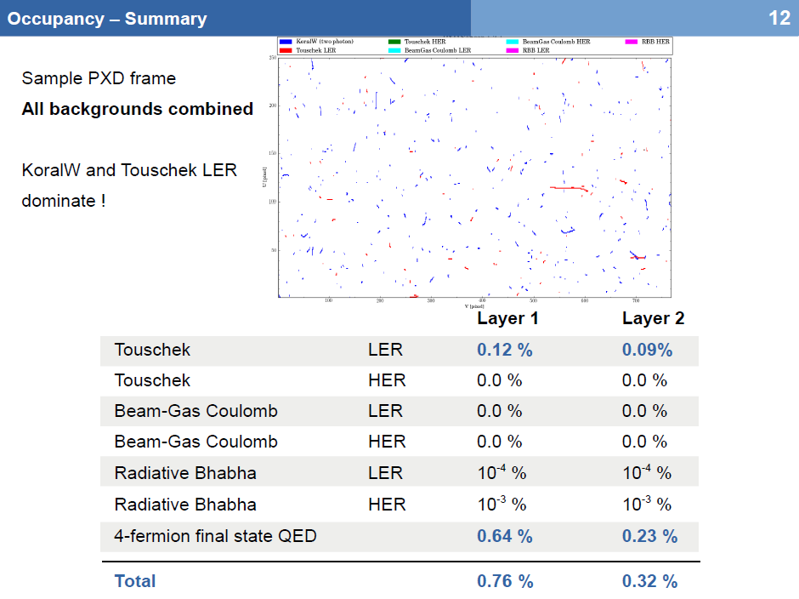
Simulated hits on sub-detector (PXD for example)
A.Moll (MPI),
at 11th B2GM
Simulated PXD occupancy is
smaller than requirement (<3%)

Slide 31
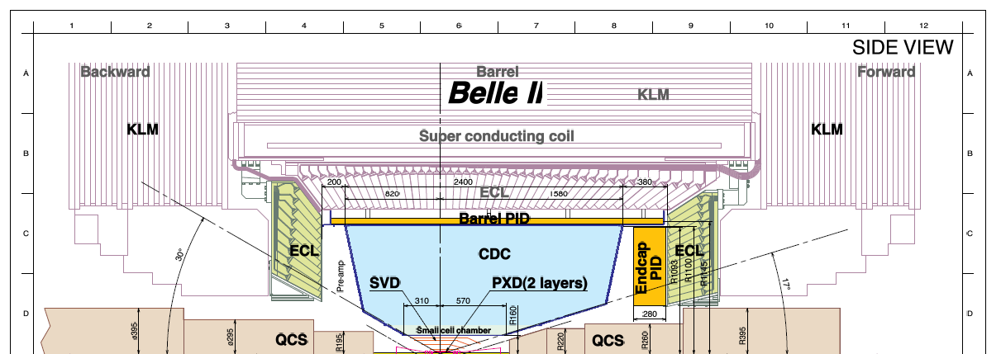
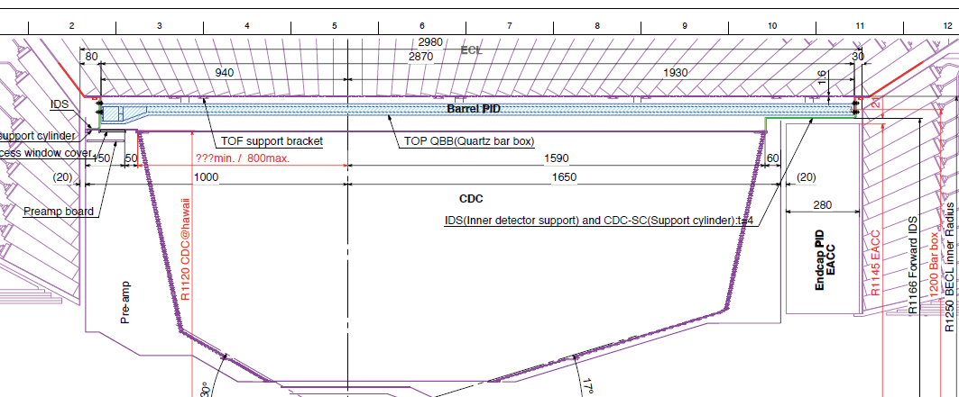
neutron damage /radiation dose
BKLM inner layers
Whole EKLM
ECL
Photo diodes
TOP readout electronics
Typical numbers:
neutron: 10¹¹ eqn/cm2/year
dose: 100Gy/year
CDC readout electronics boards
ARICH HAPD

Slide 32
Full detector simulation status
Simulation framework ready to use
Estimated background level is tolerable for most of sub-detector performance. Radiation dose/neutron damage on readout electronics are also studied
Some detector sees trouble (such as TOP photocathode aging). We start discussion on mitigation ideas.

Slide 33
Background group organization
IR/PXD/SVD mechanical design
Tanaka, Tsuboyama, Koriki, Koike(KEK)
Emmanuel(HEPHY), Charie (MPI)
QCS/IR beam pipe design
Ohuchi, Kanazawa(KEK acc.)
mechanical
simulation
Background generators
Nakayama (KEK)
A.Moll, S.Koblitz (MPI)
Yuri Soloviev (DESY)
Accelerator optics design
Ohnishi, Funakoshi
(KEK acc.)
Sub-detector groups
A.Moll(MPI) for PXD
P.Kvaniscica(Prague) for SVD
Uchida(TIT) for CDC
M.Petric/L.Santelj(Slovenia) for PID
P. Chen(NTU) for ECL
L.Piilonen(VT)/T.Uglov(ITEP) for KLM
GEANT4 simulation
Nakayama, T.Hara (KEK)
and software group

Slide 34
Summary of this talk
Touschek, beam-gas BG have been reduced successfully, now radiative Bhabha dominates.
Recent progress in SR simulation by Yuri Soloviev (see details in next talk)
Full detector simulation campaign ongoing

Slide 35
backup

Slide 36
Vertically oscillating Touschek BG
Belle detector
Touschek scattered particles scattered at Fuji-area (where vertical dispersion exists) start vertical oscillation and are eventually lost in IR QC1 where βy is large.
Vertical collimator narrower than QC1 can reduce such Touschek loss. Beam instability caused by such collimator is an issue.
HER
LER
In Fuji area, LER ring bends vertically , to pass under HER ring
Vertical collimator width: few mm
LER
Few GHz e+ loss w/o vertical collimator

Slide 37
Movable Collimators
Updated on 20111219
lerfqlc_1604
Touschek
herfqlc5605
Touschek
 |  | s[m] | Depth [mm] | Loss [GHｚ]
H1 | L8EE.34 | 2057.52 | 8.94 | 0.0006
H2 | L8EE.22 | 1302.95 | 8.94 | 0.0058
H3 | L8EE.10 | 549.85 | 8.94 | 0.0006
H4 | L8EE.3 | 202.3 | 8.94 | 0.0000
H5 | L8EE.2 | 156.6 | 8.94 | 0.0000
H6 | L8EE.1 | 128.16 | 16.1 | 0.0000
H7 | LTLA1 | 99.84 | 17.46 | 0.0000
H8 | LTLB4 | 75.75 | 16.66 | 0.0000
H9 | LTLY1.2 | 48.38 | 5.83 | 0.0000
H10 | LTLY1.1 | 34.11 | 5.83 | 0.0000
H11 | LTLC6 | 17.7 | 10.58 | 0.0023
 |  | s[m] | Depth [mm] | Loss [GHｚ]
H1 | L8P.13 | 956.17 | 12.34 | 73.9
H2 | L8PM H1.1 | 1710.94 | 12.31 | 52.3
H3 | L8P.32 | 2463.71 | 12.34 | 38.7
H4 | -L8PM HD3.3 | 2783.89 | 12.28 | 76.2
H5 | LLA8R | 2872.03 | 10.54 | 22.0
H6 | LLA4R | 2895.88 | 19.65 | 11.8
H7 | LLB3R | 2926.89 | 17.36 | 0.7
H8 | LLB2R | 2947.36 | 17.39 | 8.0
H9 | LLC2R | 2998.22 | 11.52 | 18.2
LER collimators
HER collimators
Tsukuba
Belle
new
V1 | LLB3R | 2934.18 | 2.6 | 1.9
Fuji
V1 | LTLB2 | 60.95 | 2.2 | 0.0000
Touschek IR loss | 0.16
Touschek IR loss | 0.045
Beam-gas
Beam-gas
V1 | LLB3R | 2934.18 | 2.6 | 127.4
Element name means collimator should be placed downstream of that element
V1 | LTLB2 | 60.95 | 2.2 | 44.1
Beam-gas IR loss | 0.09
Beam-gas IR loss | 0.001
Notes:
TURTLEは中山の手元に引き取る
20111204の版では、
LER H4は –L8PMHD3.4, d(LER V1)=2.48mm, d(HER V1)=2.31mm

Slide 38
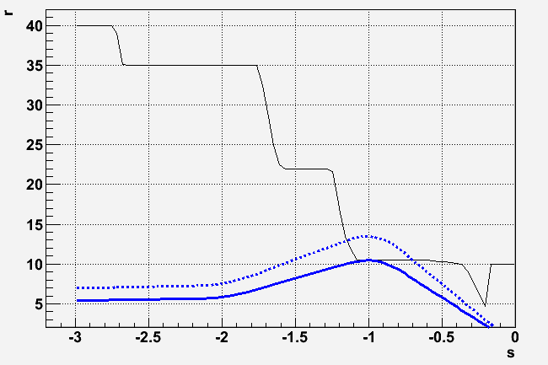
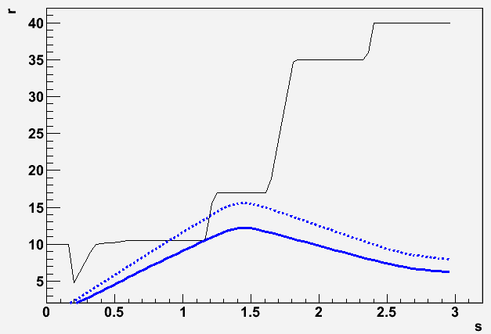
Strategy to reduce Coulomb BG
Larger QC1 physical aperture (r=10.5mm→13.5mm)
Vertical collimators!
QC1 aperture should not be narrowest over the ring
Collimator aperture should be narrower than QC1 aperture
Beam instability? (collimators should be very close(few mm) to the beam )
mm
mm
LER
HER
z-axis
z-axis
Physical aperture
Physical aperture
e-
e+
beta(55.5σ)
beta(85σ)
beta(43.5σ)
beta(66σ)
[m]
[m]
[m]
We widened QC1 aperture without major change in QCS design.
Coulomb lifetime improved (LER: 1360→2240sec, HER: 2100→3260sec)

Slide 39
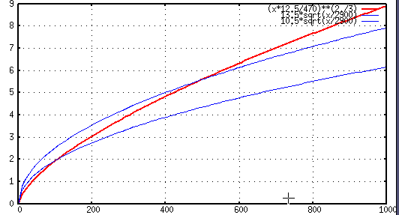
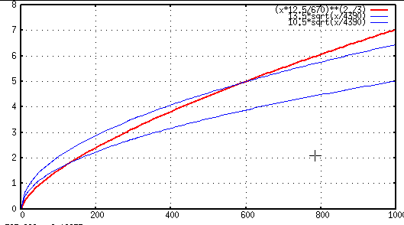
Candidate collimator locations
TMC condition
r=13.5mm
TMC condition
r=13.5mm
Collimator width d[mm]
(r=10.5mm)
(r=10.5mm)
LER
HER
beta_y [m]
beta_y [m]
lerfqlc_1604
herfqlc5605
V1 collimator @ LLB3R (downstream)
(s=-90→-82m, βy=30→146m)
βy=125m, 2.23mm<d<2.81mm
V1 collimator @ LTLB2 (downstream)
(s=-63→-61m, βy=81→187m)
βy=123m, 1.74mm<d<2.26mm
Collimator position should satisfy beta_y condition above,
need space(at least 1.5m), and the phase should be close to IP

Slide 40
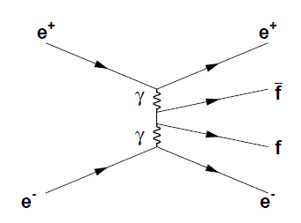
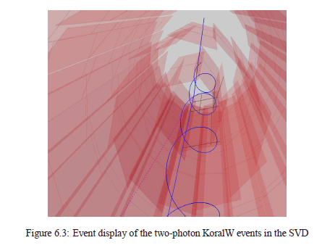
2-photon BG

Slide 41
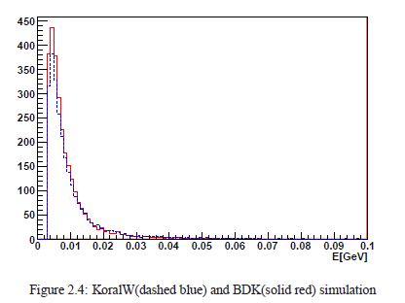
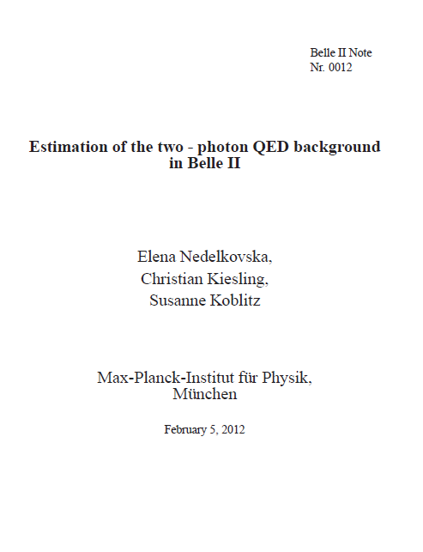
2-photon BG
C. Kiesling, S. Koblitz
E. Nedelkovska
Belle-II Note #12
Consistency among the various generator s
Documentation now available
KoralW
BDK
Discrepancy between SuperB numbers and ours disappeared now.
KEKB machine study in 2010 is consistent with our generator, and inconsistent with SuperB numbers

Slide 42
Beam-beam

Slide 43
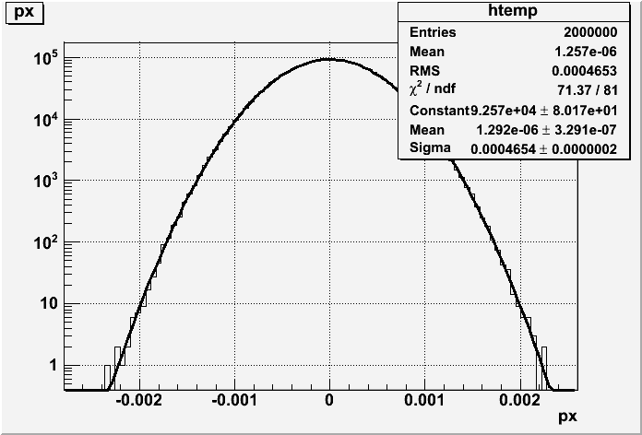
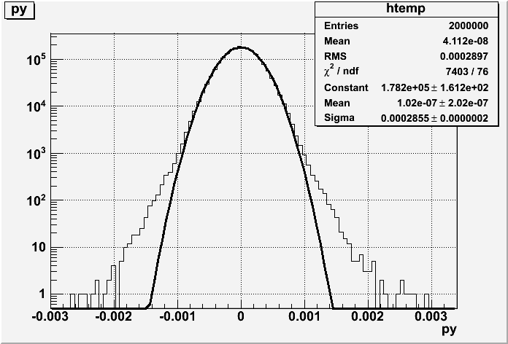
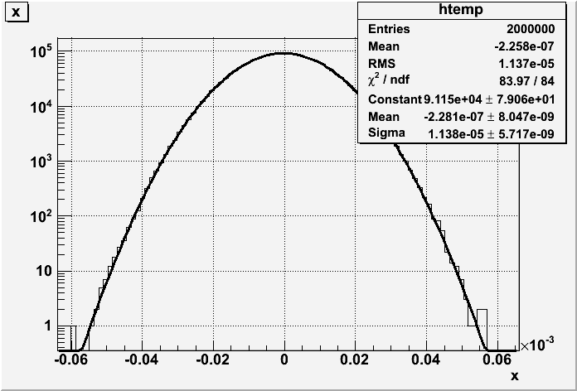
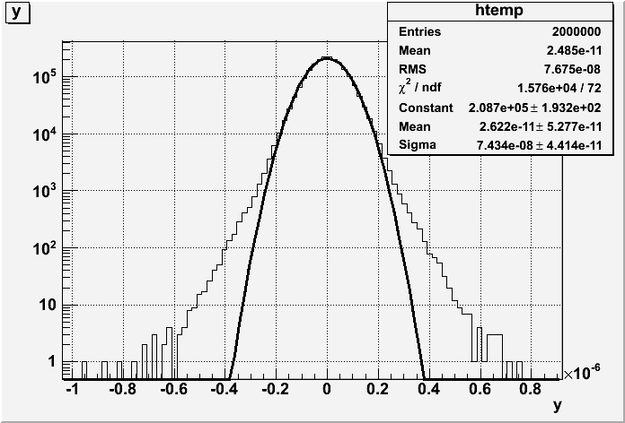
HER beam-beam
Fit:465urad
(>429urad)
Fit:286urad
(>200urad)
Mainly vertical
Fit:74.3nm
(>59nm)
Fit:11.4um
(~11um)

Slide 44
neutron damage /radiation dose
BKLM inner layers
Whole EKLM
ECL
Photo diodes
TOP readout electronics
Typical numbers:
neutron: 10¹¹ eqn/cm2/year
dose: 100Gy/year
CDC readout electronics boards
ARICH HAPD

Slide 45
TOP photocathode aging issue
For more details, See Marko Petric’s talk on Friday morning
Gammas(2-3MeV) in the shower generated by loss particle reach TOP quartz bars and generate electrons.
Such electrons run for few mm in the quartz and emit Cerenkov photons that reach TOP photocathode.
Gammas on quartz bar is FATAL for TOP!!
Factor >10 reduction is required (stop shower or reduce loss rate)

Slide 46
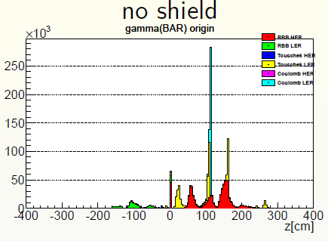
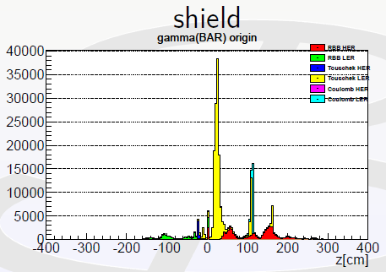
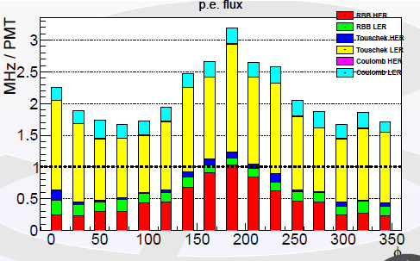
Quick simulation study for TOP photocathode aging
“Virtual” 3cm tungsten shield
Unlikely to put shield at z<1m in reality
3cm tungsten shield achieves reduction factor of 10 for the beam loss z>0.5m.
Simulation shows 3MHz/PMT with shield, Touschek loss near IP cannot be shielded.
In reality, shield can start only from z>1m, so we expect more unshielded components.

Slide 47
Tungsten shield inside/around cryostat
Tungsten shield inside cryostat
proposed by QCS group
SVD dock?
Narrowest space here
Cable path
for PXD/SVD
t15
t18
t15
t10
t28
t21.8
t15
t35
RBB e-
z=1m
z=2m

