Slide 1
Summary of
SuperKEKB/Belle II session
Yutaka Ushiroda (IPNS, KEK)
DESY-KEK Meeting
Mar. 20, 2012

Slide 2
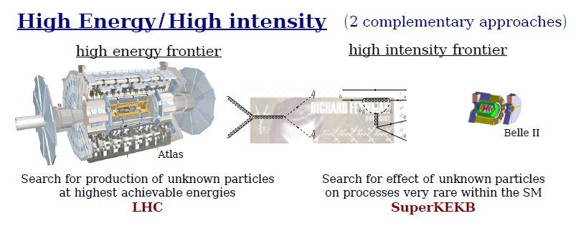
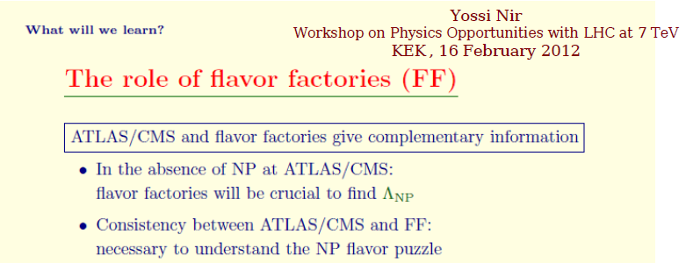
Role of Flavour Factories in coming 10 years

Slide 3
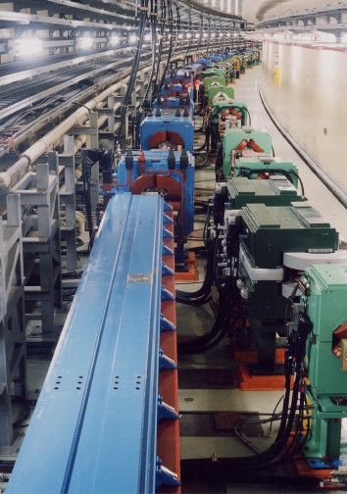
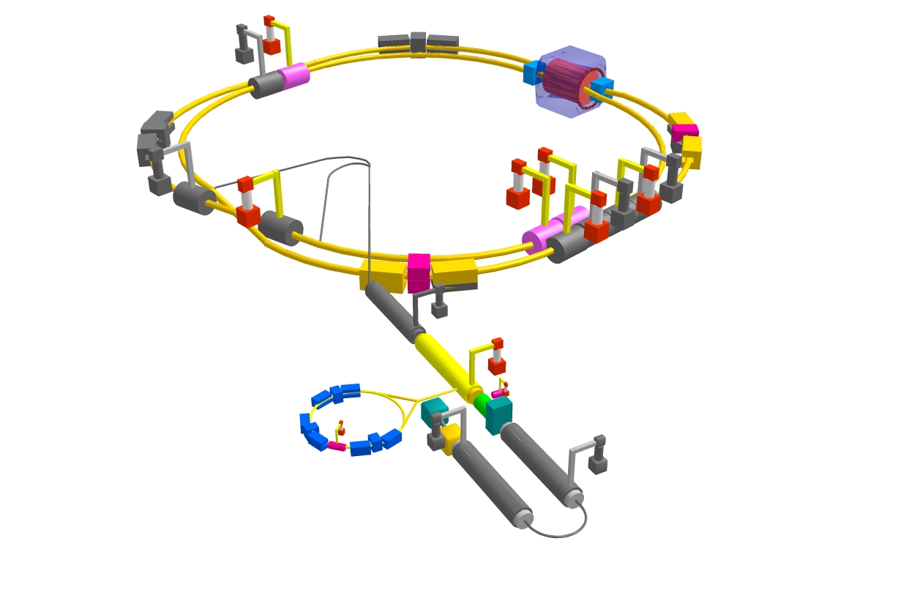
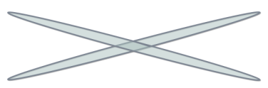
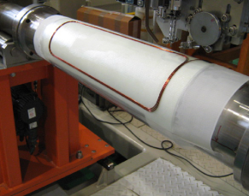
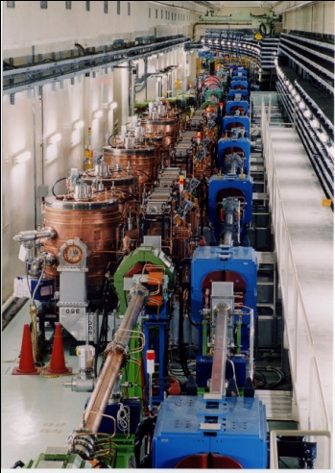


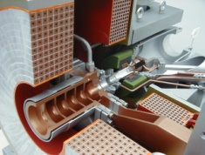
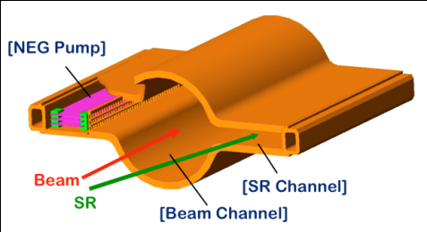
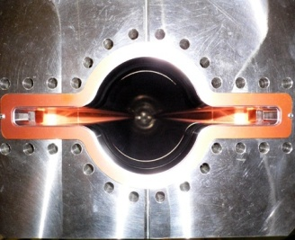

SuperKEKB and Belle II
Belle II
e⁺ 4GeV 3.6 A
Colliding bunches
New IR
e⁻ 7GeV 2.6 A
New superconducting /permanent final focusing quads near the IP
New beam pipe
& bellows
SuperKEKB
Replace short dipoles with longer ones (LER)
Add / modify RF systems for higher beam current
Low emittance positrons to inject
Positron source
Redesign the lattices of HER & LER to squeeze the emittance
Damping ring
New positron target / capture section
TiN-coated beam pipe with antechambers
Low emittance gun
Low emittance electrons to inject
Target: L = 8x10³⁵/cm²/s

Slide 4
Belle II Detector
K_{L} and muon detector:
Resistive Plate Counter (barrel outer layers)
Scintillator + WLSF + MPPC (end-caps, inner 2 barrel layers)
EM Calorimeter:
CsI(Tl), waveform sampling (barrel)
Pure CsI + waveform sampling (end-caps)
Particle Identification
Time-of-Propagation counter (barrel)
Prox. focusing Aerogel RICH (fwd)
electron (7GeV)
Beryllium beam pipe
2cm diameter
Vertex Detector
2 layers DEPFET + 4 layers DSSD
positron (4GeV)
Central Drift Chamber
He(50%):C2H6(50%), Small cells, long lever arm, fast electronics

Slide 5
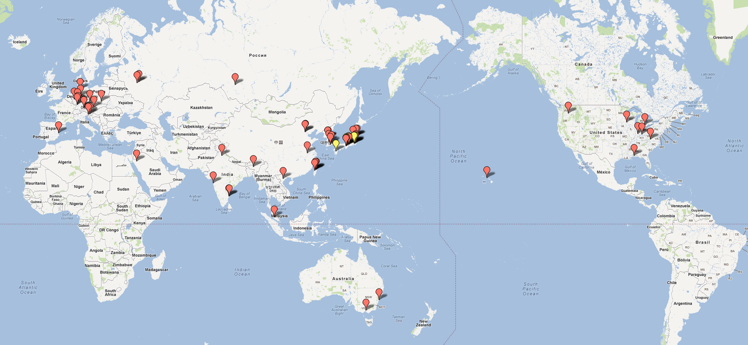
Belle II Collaboration
19 countries/regions, 66 institutes, ~400 collaborators
9 German institutes (2nd largest)

Slide 6
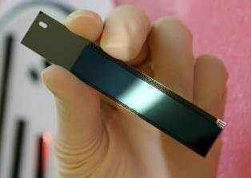
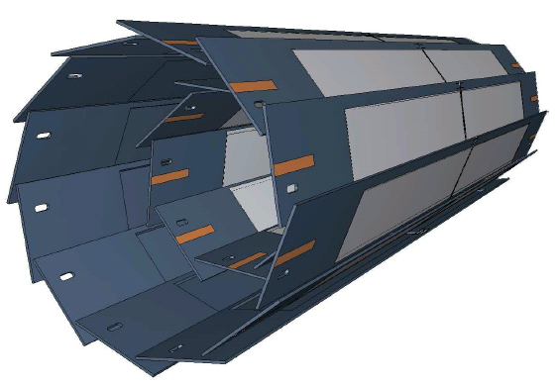
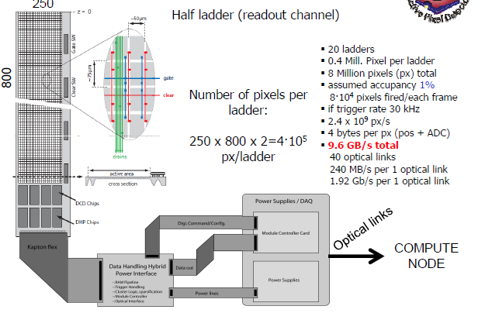
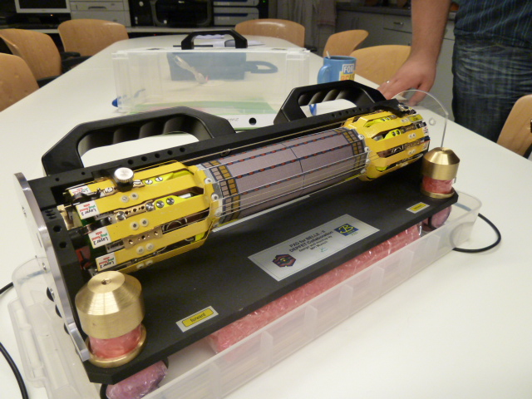
DEPFET for Belle II
Layer | radius (mm) | px size (μm²) | thickness (μm) | half ladder rows×cols | half ladder size (mm×mm) | #ladders
1 | 14 | 50x55 | 75 | 768×250 | 70×15 | 8
2 | 22 | 50x75 | 75 | 768×250 | 85×15 | 12
total of 8 Mpx
Mechanical mockup

Slide 7
The DEPFET Collaboration
Country | Funding Agency | Member (Abbreviation) | Representative
Czech Republic |  | Charles University Prague (PRA) | Zdenek Dolezal
China | CAS | Inst. for High Energy Physics (IHEP) | Zhen’An Liu
Germany | BMBF | University of Bonn (BON) | Norbert Wermes
 |  | University of Göttingen (GOE) | Ariane Frey
 |  | University of Heidelberg (HEI) | Peter Fischer
 |  | University of Karlsruhe (KAR) | Thomas Müller
 |  | University of Gießen (GIE) | Sören Lange
 |  | University of Munich (LMU) | Jochen Schieck
 |  | Technical University Munich (TUM) | Stephan Paul
 | DESY | DESY Hamburg (DES) | Carsten Niebuhr
 | MPI | MPI for Physics, München (MPI) | Hans-Günther Moser
Japan | JSPS | Struct. Biol. Research Center (KEK) | Soichi Wakatsuki
Poland |  | Inst. of Nucl. Phys,, Krakow (KRA) | Maria Rozanska
Spain | Ministerio de Ciencia e Innovación | CSIC-CNM Barcelona (CNM) | Enric Cabruja
 |  | University of Barcelona (UBA) | Angel Dieguez
 |  | CSIC-IFCA Santander (IFC) | Ivan Vila Alvarez
 |  | CSIC-IFIC Valencia (IFV) | Carlos Lacasta

Slide 8
Challenges in PXD integration
Beam Background Suppression
Mechanical Integration
  Dry volume, cooling pipe, cables
  Integration with Beam Pipe SVD, QCS
DAQ integration
Distributed Computing
Need help from DESY people

Slide 9
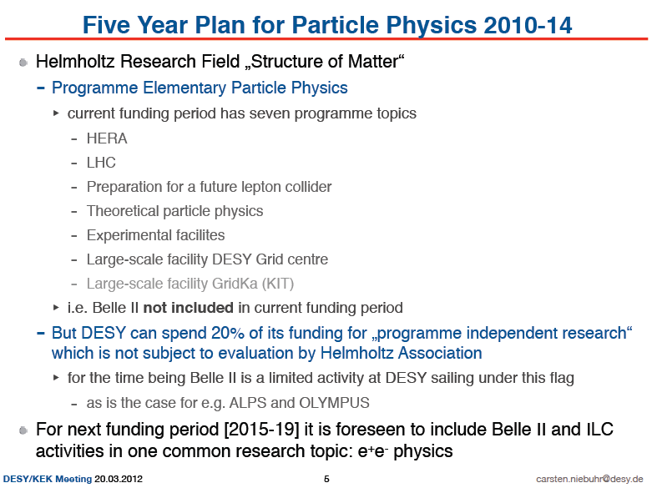
DESY joined Belle II in Nov. 2011

Slide 10
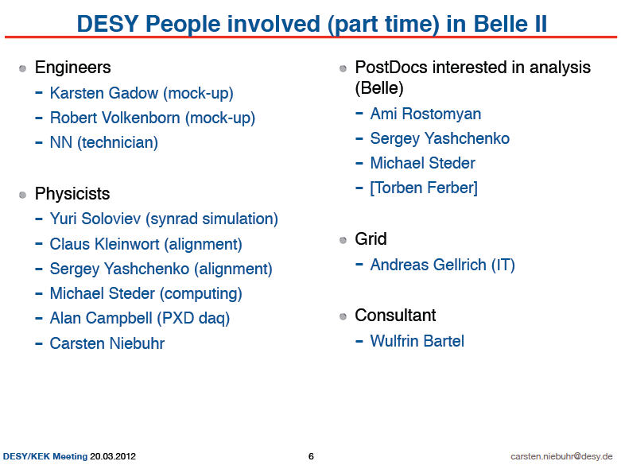

Slide 11
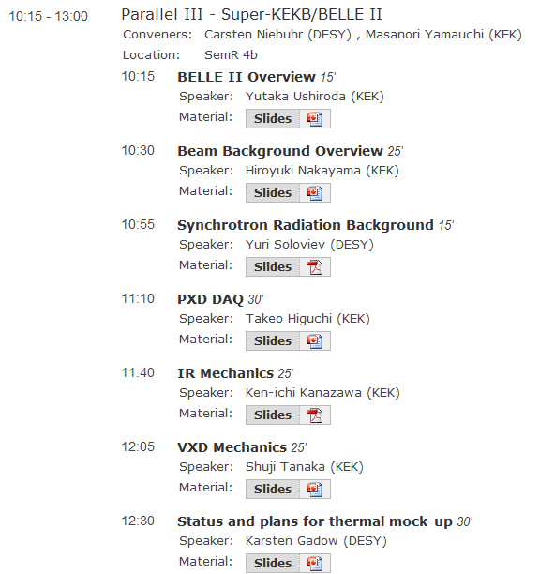
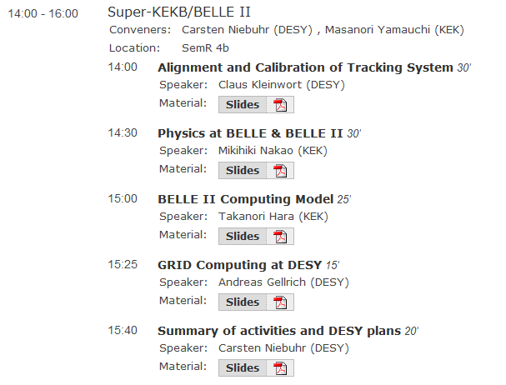
Agenda of parallel session

Slide 12
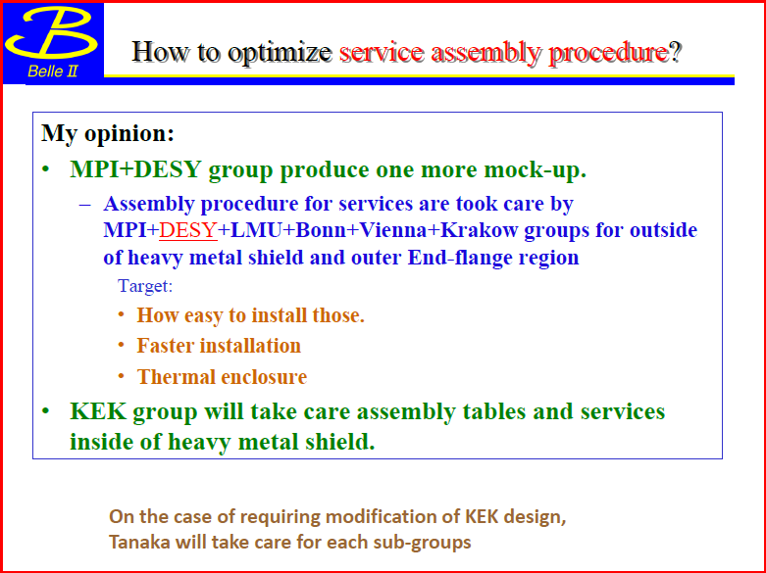
Mechanical Integration
Dedicated meeting at DESY on 12-13 Apr.

Slide 13
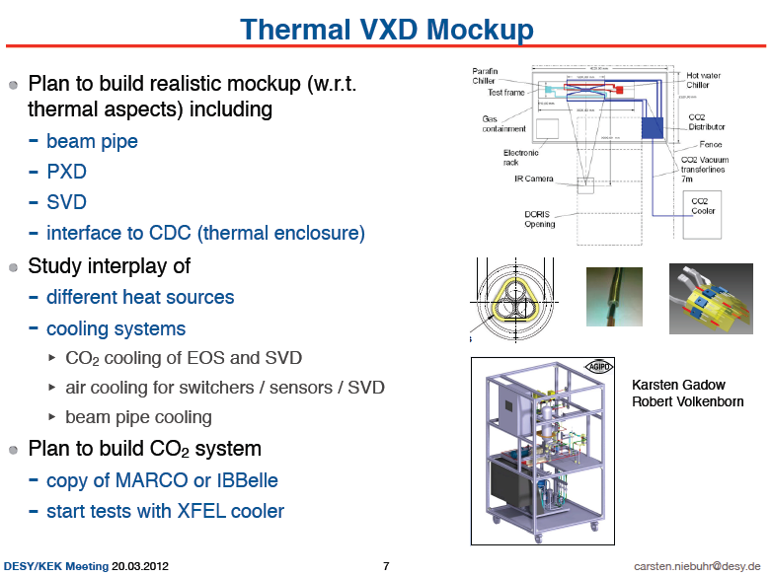
Thermal issues

Slide 14
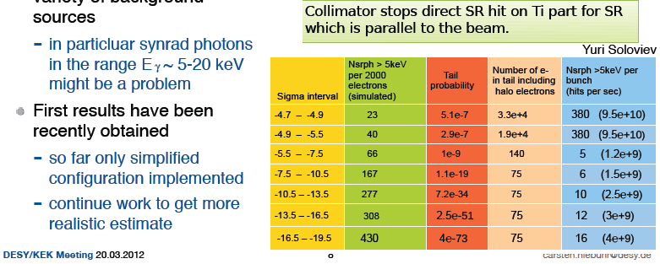
Background Simulation
Yuri Soloviev stayed at KEK for one month (short-term invitation program)
and learnt Belle II background simulation (especially synchrotron radiation) from scratch
Ti
Be
Ti
HER e- beam
SR must not hit Be part.
SR is desired not to hit Ti part.
LER e+ beam

Slide 15
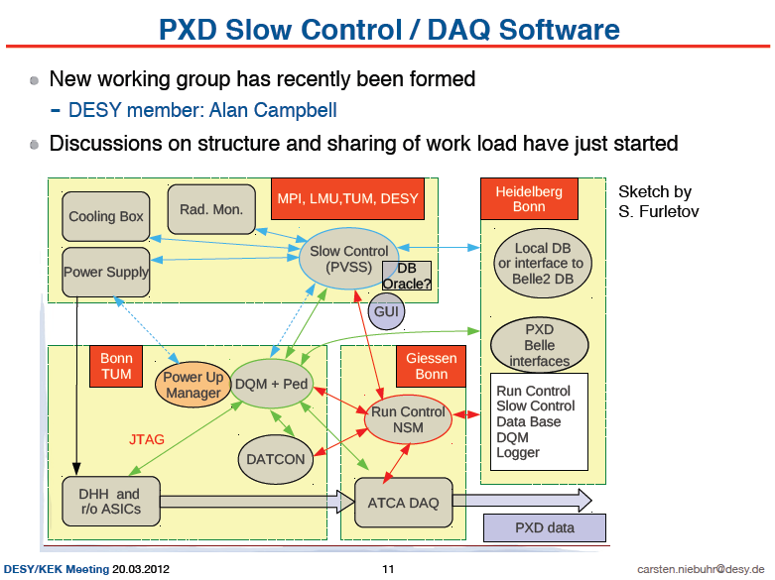
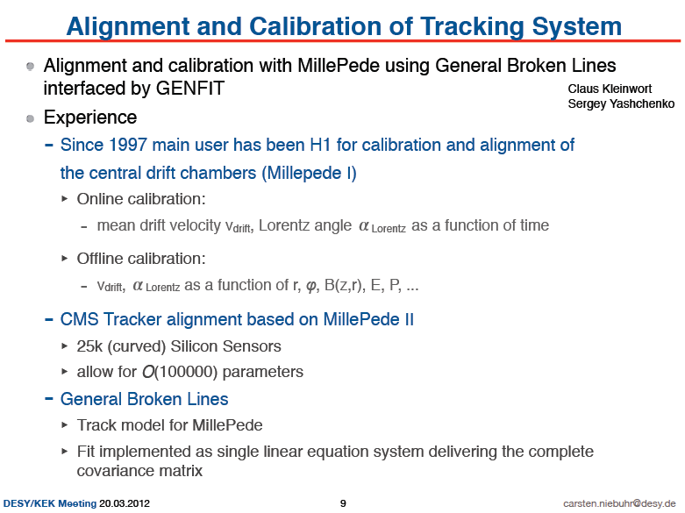
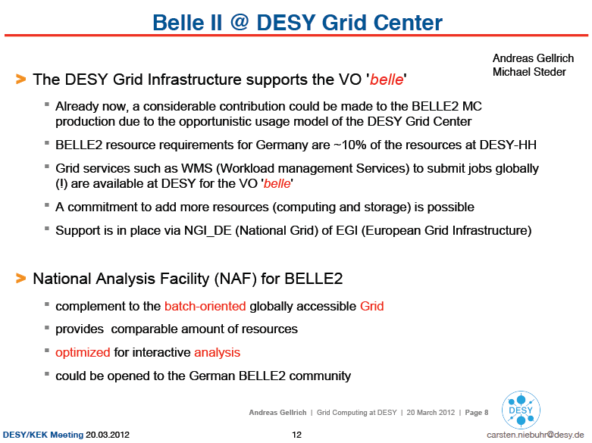
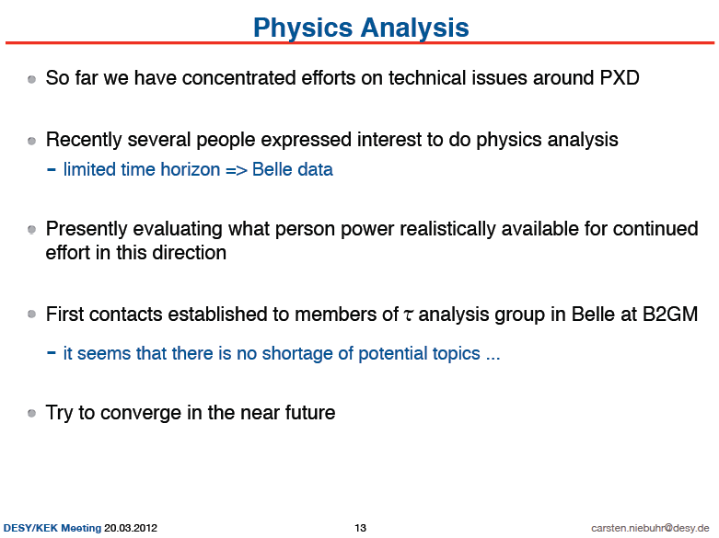

Slide 16
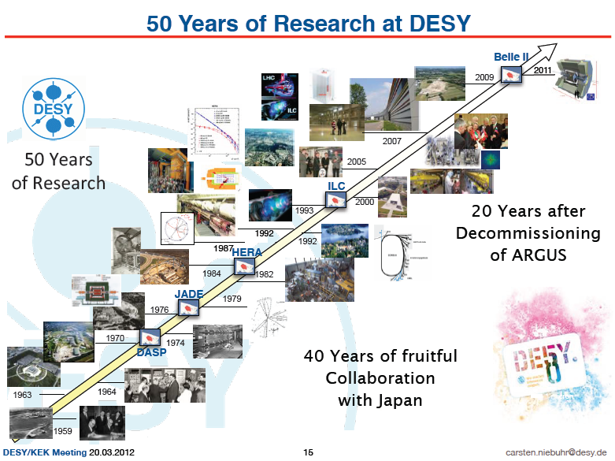

Slide 18
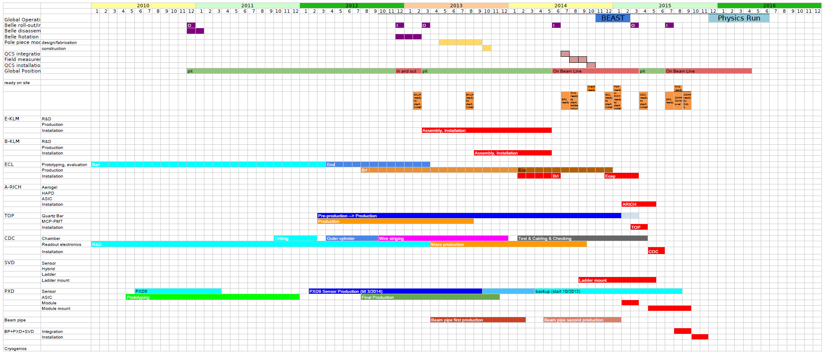
Belle II Construction Schedule
JFY 2014
Machine operation starts
JFY2012 (April-March)
Belle rotation
JFY2013
Installation of KLM
Physics run starts in end of CY 2015

Slide 19
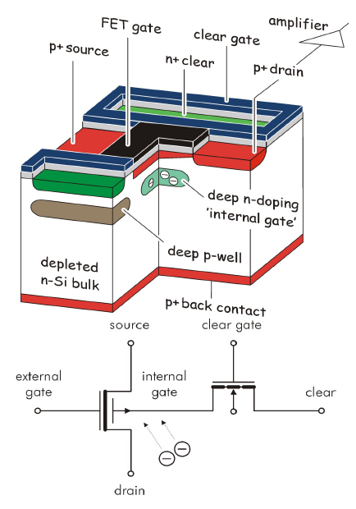
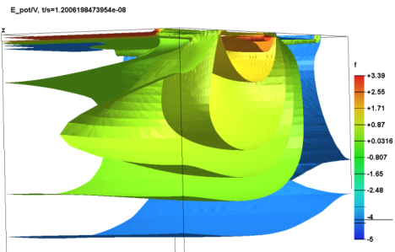
Principle of DEPFET
Each pixel is a p-channel FET on a completely depleted bulk
A deep n-implant creates a potential minimum for electrons under the gate (“internal gate”)
Signal electrons accumulate in the internal gate and modulate the transistor current (g_{q} ~ 400 pA/e⁻)
Accumulated charge can be removed by a clear contact (“reset”)
Rolling shutter mode (column parallel) for matrix operation
20 µs frame readout time
Low power (only few lines powered); 0.1W/cm²
Air-cooling sufficient

Slide 20
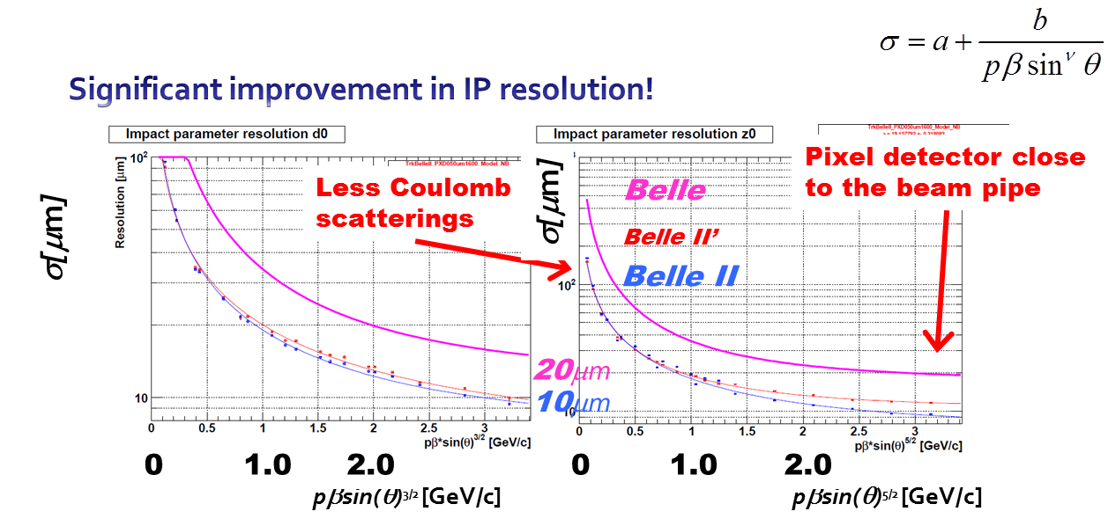
Real merit for B physics (esp. t-dep. CPV)

Slide 21
Weak Point of DEPFET Collaboration
have never built and installed a full DEPFET detector into a real HEP detector complex as a system
  Practical constraint in space, …
  Integration with others
  …

