Slide 1
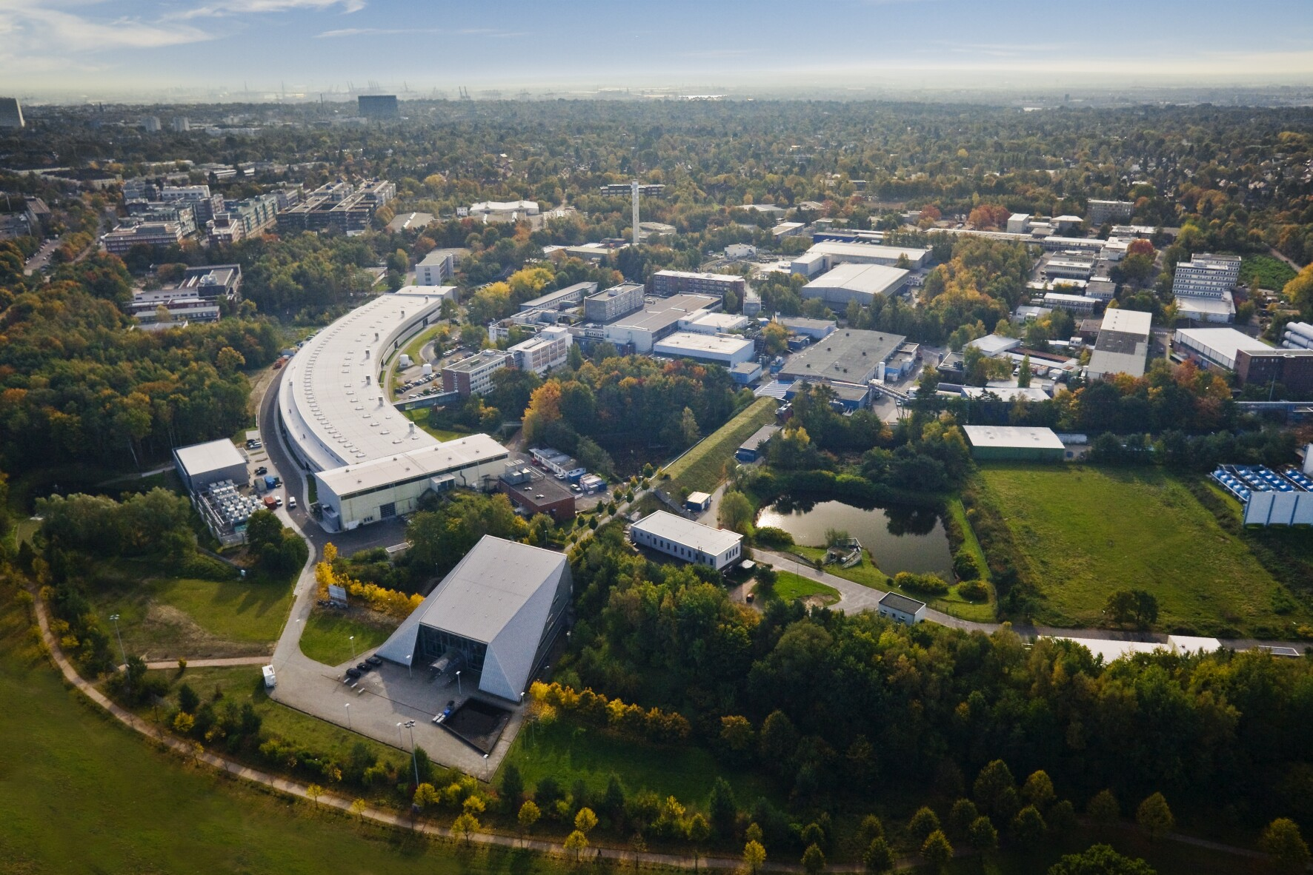
FLASH at DESY in Hamburg
XFEL
PETRA III
FLASH

Slide 2
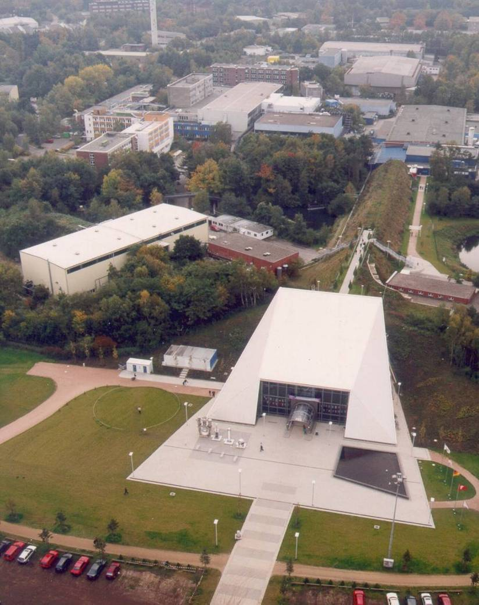
FLASH at DESY in Hamburg
Primarily a Photon User Facility
  since 2005
Single-pass high-gain SASE
Free-Electron Laser
  SASE = self-amplified spontaneous emission
Photon wavelength range from
vacuum ultraviolet to soft x-rays
Femtosecond range pulses with high brilliance
FLASH II, a second undulator beam line is in preparation
SCRF Linac started life as a test-bed for a linear collider (TESLA Test Facility)
  Beam time available for ILC experiments
  Currently unique facility in the world (integrated systems testing)
Notes:
2

Slide 3
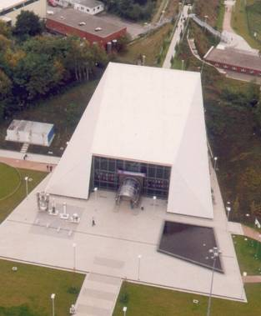
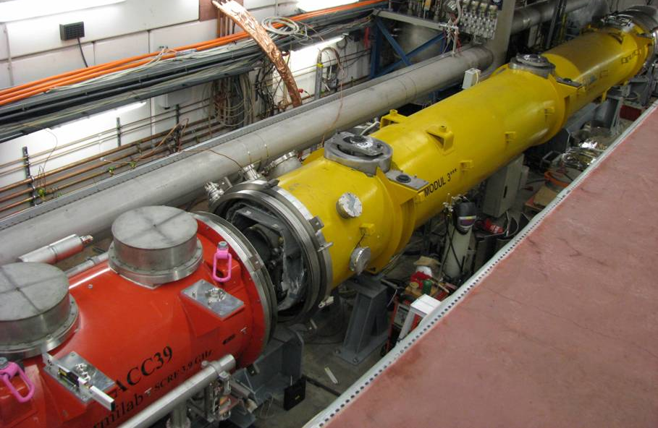
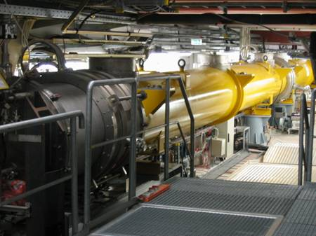
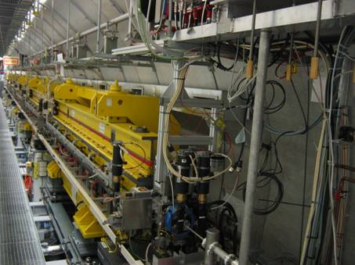
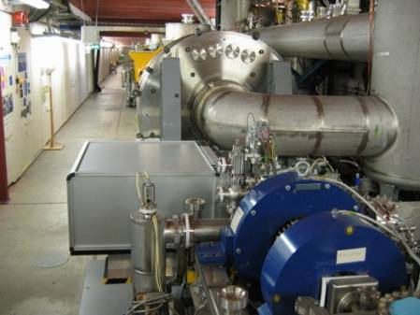
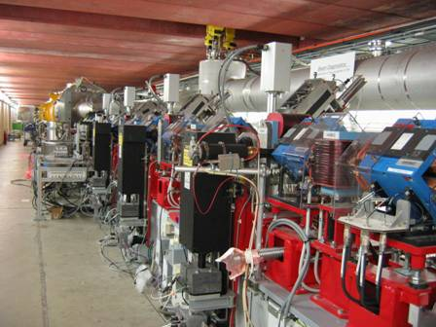
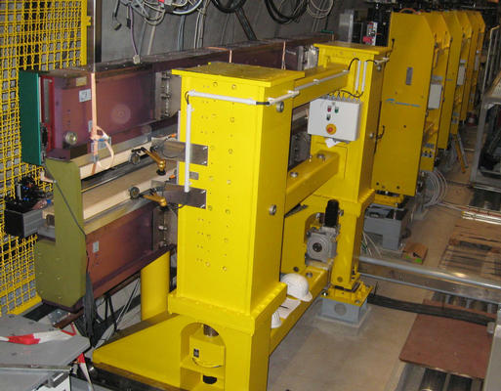
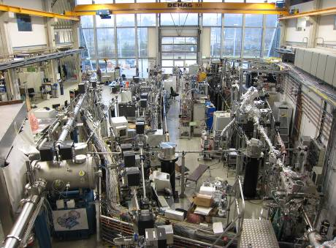
FLASH layout after the upgrade 2009/2010
TESLA type superconducting accelerating modules
Fixed gap SASE undulators
FEL Experimental Hall
3.9 GHz module
RF stations
Diagnostics
Accelerating Structures
sFLASH
Undulators
Bunch Compressor
Bunch Compressor
LOLA
RF Gun
FEL Experiments
5 MeV
150 MeV
500 MeV
1200 MeV
Bypass
315 m
sFLASH Undulators
Experimental Hall
Laser driven photo injector
Diagnostic Sections

Slide 4
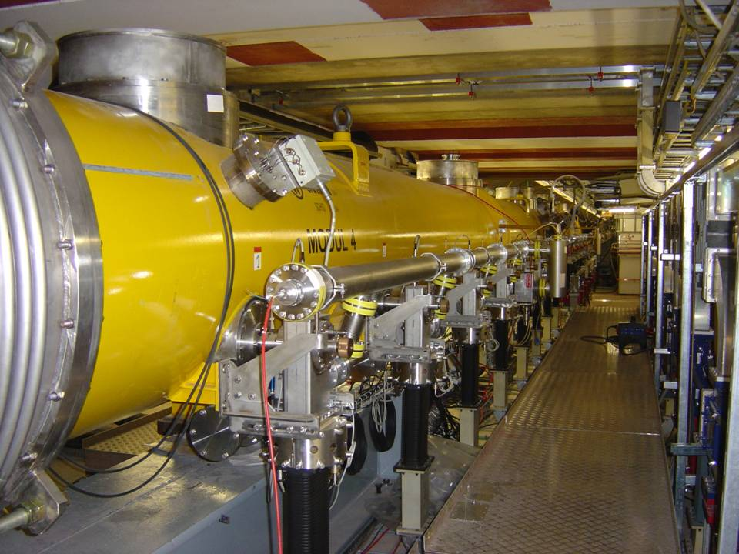
Tour tomorrow at 10:15

Slide 5
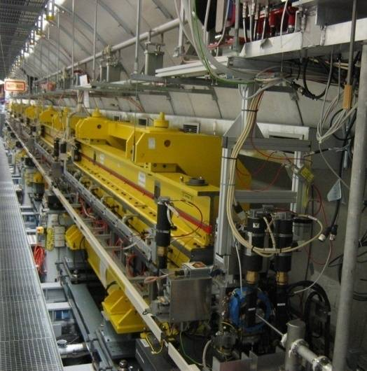
FLASH as a VUV laser
6 undulator modules, total length 27 m
  Fixed gap of 12 mm, permanent NdFeB magnets, peak field B = 0.48 T
  K = 1.23, period λ_{u} = 27.3 mm
  Gain length L_{gain} = 2.5 ± 0.3 m (@13 nm)
Requirements for electron bunches
Peak current > 2 kA
Emittance (slice, norm.)
< 1 mm mrad
Energy spread (slice, rel.)
< 10⁻³
Notes:
5

Slide 6
SASE Parameters for 4.4 nm
Preliminary data for 4.4 nm:
Energy 140 µJ (max.)
Peak power ~ 2 GW (estimate)
bandwidth 0.25 % rms
Peak Brilliance
B ~ 10³⁰ - 10³¹
photons/s/mrad²/mm²/0.1%bw
preliminary

Slide 7
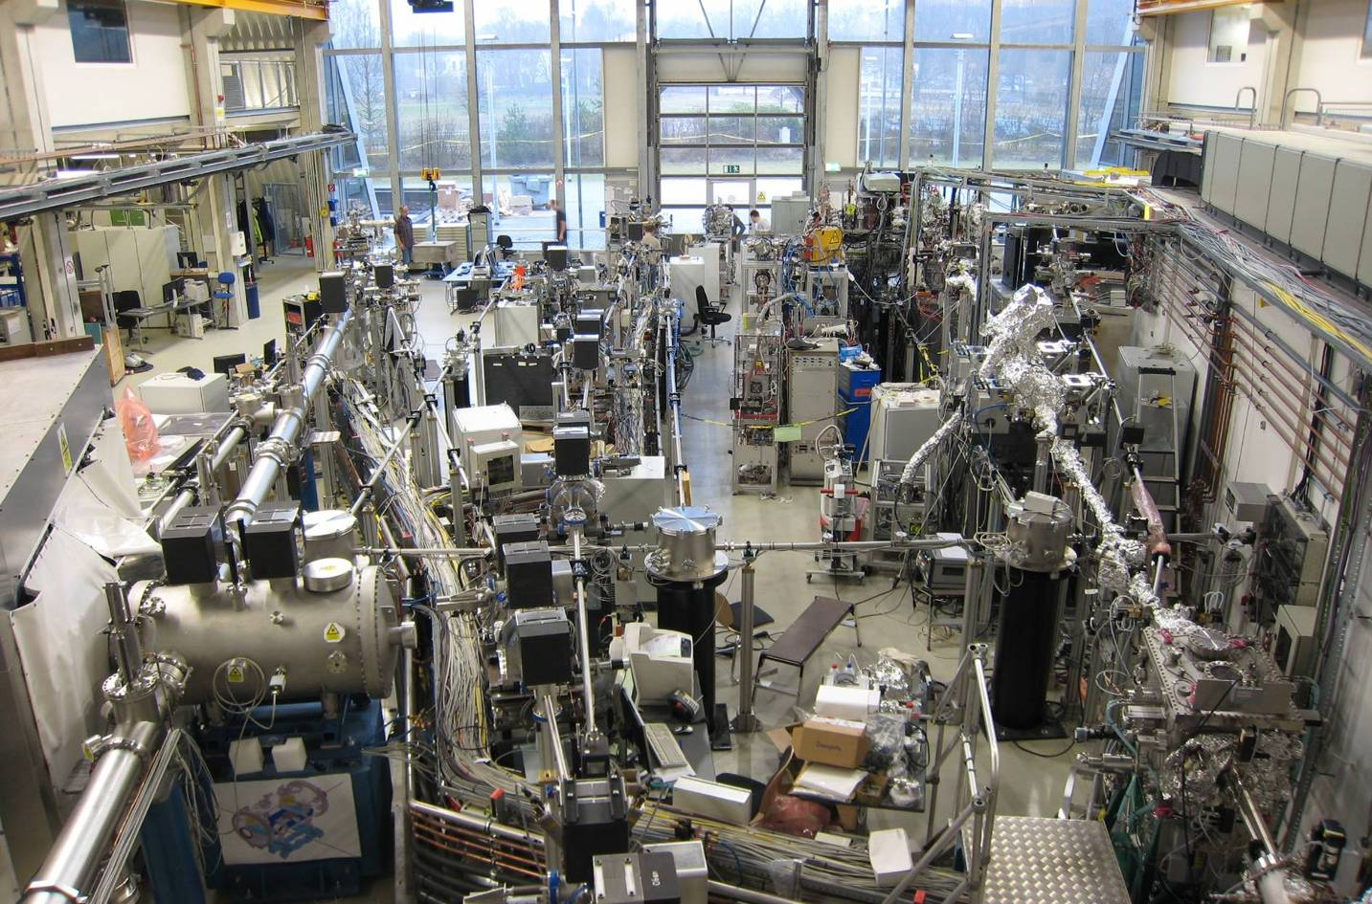
Experimental Hall
BL3
unfocused (5 -10 mm),
optional multilayer mirror
in experiment for few to
sub-μm focus
PG2
50 μm focus,
monochromatized
PG1
sub-10 μm focus,
monochromatized
2-stage Raman-
Spectrometer
BL1
100 μm focus
BL2
20 μm focus
Visible Laser
FIR -Beamline
Plane Grating
Monochromator

Slide 8


9mA Experiments at TTF2/FLASH
TTF2/FLASH: unique worldwide facility
ACC 4-7
 |  | XFEL | ILC | FLASH design | FLASH experiment
Bunch charge | nC | 1 | 3.2 | 1 | 3.0 (typical 1.0)
# bunches |  | 3250* | 2625 | 7200* | 2400
Pulse length | μs | 650 | 970 | 800 | 800
Current | mA | 5 | 9 | 9 | 9

Slide 9
Primary Objectives
Long-pulse high beam-loading (9mA)
demonstration
  800μs pulse with 2400 bunches (3MHz)
  3nC per bunch
  Beam energy 700 MeV ≤ E_{beam} ≤ 1 GeV
Original primary goals
  Demonstration of beam energy stability
    Over extended period
  Characterisation of energy stability limitations
    Operations close to gradient limits
  Quantification of control overhead
    Minimum required klystron overhead for LLRF control
  HOM absorber studies (cryo-load)
*Recent Goal* operation with “flat gradients”
Major challenge for FLASH !
  Pushes many current operational limits
Primarily a LLRF experiment

Slide 10
Context
Relevant to ILC, XFEL, FLASH
  ILC: International GDE stated milestone for systems test
    Primary driver: important and visible deliverable for international effort
  XFEL: Close collaboration with world-wide LLRF groups
    Focus (potentially accelerate) development and planning for XFEL
    “Operation at limits” experience provides important Input for future XFEL development
  FLASH: Addresses many operational issues
    Automated exception handling and recovery
    Better characterisation of machine
    Towards routine high-power long-pulse operation for users.
International collaboration (ILC-GDE driven)
  ANL, DESY, FNAL, KEK, SLAC, …
  >40 registered on mailing list
  Direct international participation in machine shifts and data analysis
Notes:
Comment concerning MAC.

Slide 11
Focus on ACC6 and ACC7
Operation with Gradient Spread
  From single RF source
  now baseline
Specifically: achieving constant gradients for each individual cavity during beam pulse
  to within few percent
  close to gradient limits
40.0
ACC6
ACC7
35.0
31.5 MV/m
30.0
25.0
20.0
15.0

Slide 12
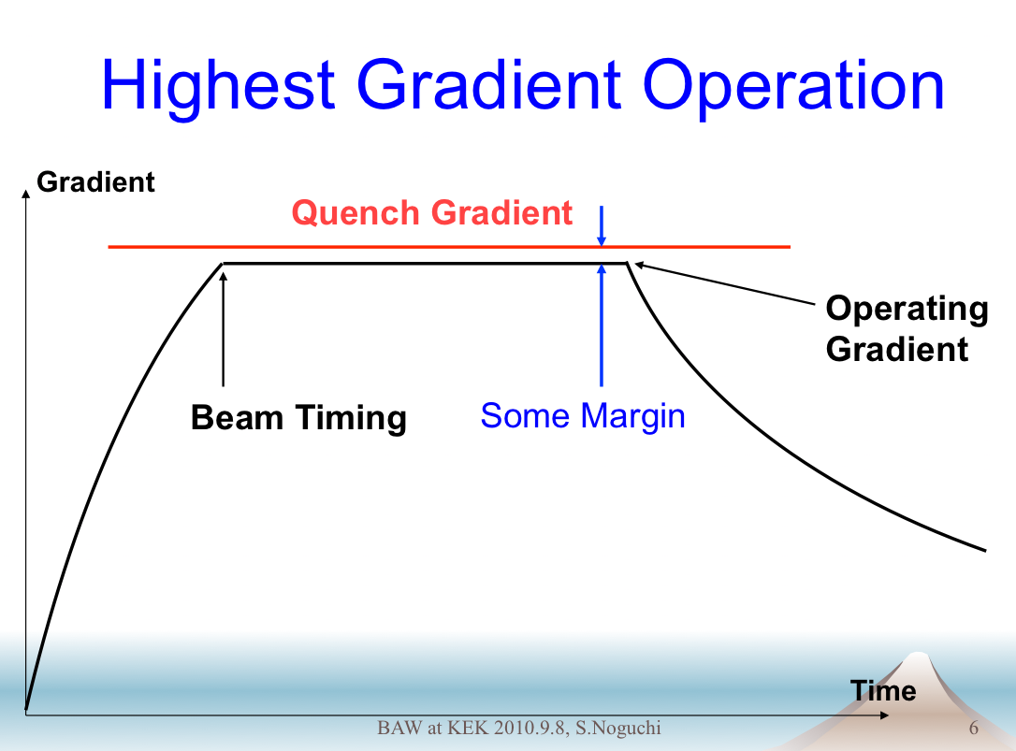
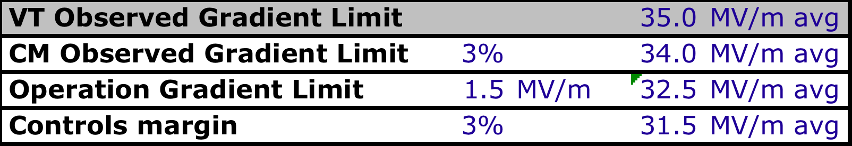
ILC: Maximising Energy
ILC baseline parameter:
31.5±20% MV/m accelerating gradient (25-38 MV/m)
Full individual cavity P_{for} and Q_{L} control foreseen
  but not cheap!
  FLASH only has Q_{L} adjustment
  Flat gradient solutions I_{B} dependent!
(Positive) slopes on individual cavity gradients ‘eat away’ gradient overhead
Goal: <3% change in V over flat top
  including during turn-on
±20%

Slide 13
ILC: Beam Dynamics
Random cavity misalignments (tilt) α_{cav}
Transverse kick to the beam
  time dependent due to voltage ‘slope’ V_{a}(t)
Resulting oscillations causes emittance growth
  different for different bunches along train
Cavity alignment pitch: 300 μr RMS
γε_{y} = 30 nm
1.5% RMS ‘voltage tilt’ → 1 nm γε_{y} growth
(for entire ILC linac)
Note: Δ(γε_{y} ) ∝ ΔV_{a}(t)²
Tolerance similar to quench limit overhead (few %)

Slide 14
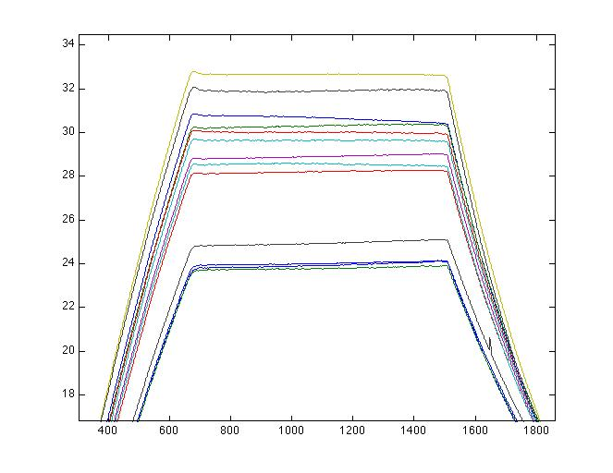
FLASH: Flat Gradients (Feb 2012)
2400 bunches @ 3MHz
Average charge q_{b} ~1.5nC (~4.5mA)
800μs flat top pulse
(could not increase q_{b} due to beam loss)
Detuned:
ACC6 C5 C6 (low gradient)
ACC7 C1 (piezo tuner broken)
Average cavity gradient: 28.2 MV/m
(23-33 MV/m)
Gradient (MV/m)
RMS ‘flatness’ ~0.02%

Slide 15
Flat Gradient Solution (Feb 2012)
Raised ACC6-7 vector sum to 380 MV
  close to quench limits of several cavities
Flat gradients iteratively achieved by automated adjustment of individual Q_{L}
  RMS ‘tilts’ ~0.2% achieved!
Other (critical) key tools
  LFD piezo compensation server
  LLRF quench-protection system

Slide 16
Limits achieved (380 MV)
limiting cavity
Gradient (MV/m)

Slide 17
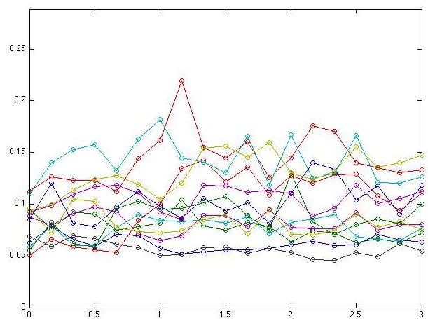
Gradient “Tilt” Stability
13 cavities plotted
Each data point is average over
RMS over flat-top divided by average voltage.
100 pulses averaged (20 seconds)
Scale is equivalent relative rms for 1% voltage change over flat-top (tilt)
[= 1% / (2*sqrt(3)) ~ 0.29%]
σ_{flat-top}/V_{avg} in %
hours

Slide 18
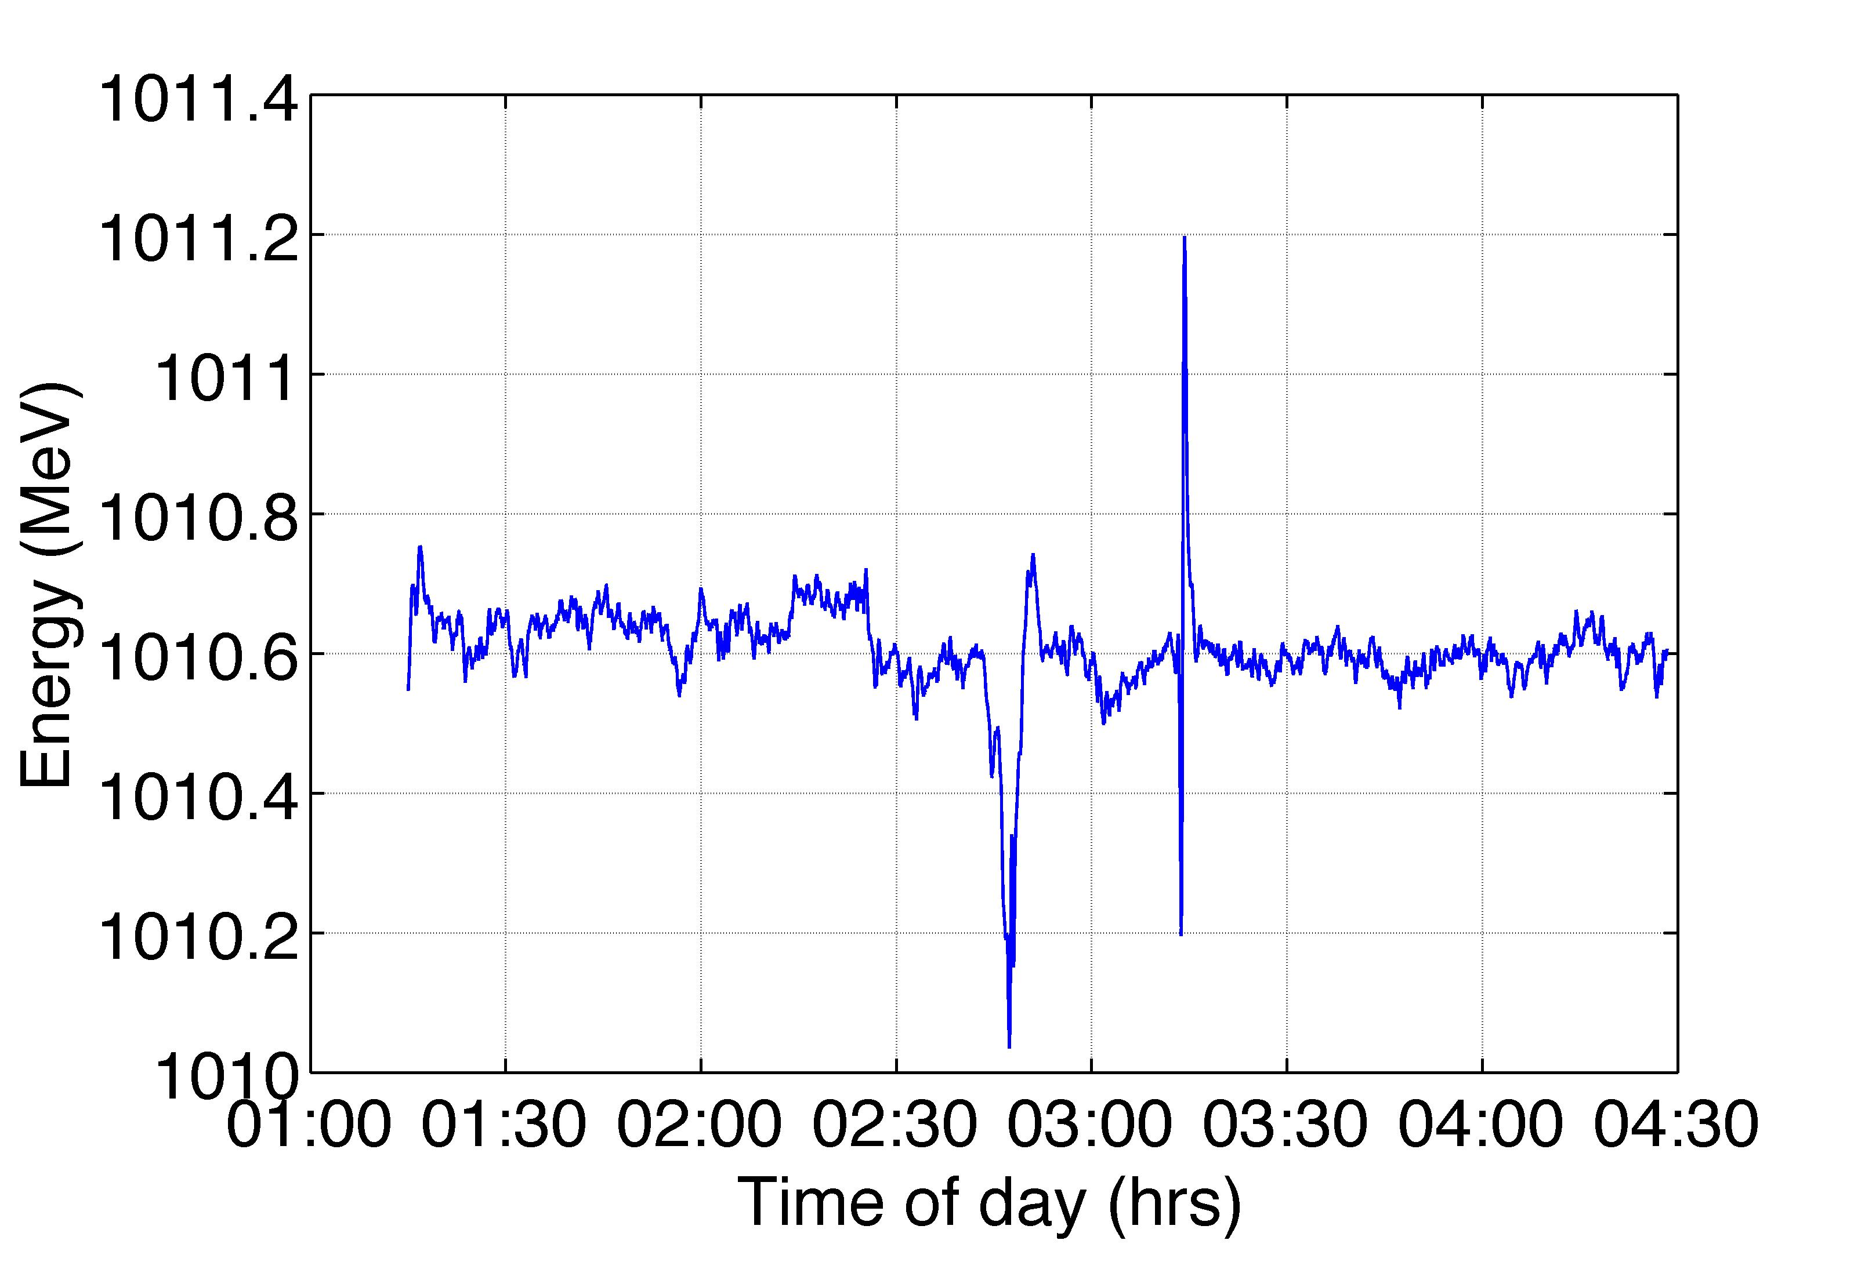
FLASH: Stability
15 consecutive studies shifts (120hrs), and with no downtime
Time to restore 400us bunch-trains after beam-off studies: ~10mins
Energy stability with beam loading over periods of hours: ~0.02%
Individual cavity “tilts” equally stable
Energy stability over 3hrs with 4.5mA
~0.02% pk-pk
9 Feb 2011

Slide 19
Recovery/Boot-strap Scenario
With no beam (loading) tilts appear on cavities
  Would reduce vector sum / RF to avoid quench
Progressive restoration of beam pulse allows Q_{L} tuning without quench
  initial ΔV too small to quench
  short pulse tuning enough to go to longer pulses
  After that small corrections needed

Slide 20
Other important observations
Quench recovery
  Major quench (~intentional) required time to allow automated piezo system to re-tune cavities (minutes)
  After cavity tuning, full 2400 bunches restored instantaneously
    no machine trips or instabilities
Beam-off crash test
  Intentionally killed laser (beam) to test LLRF response
  Quench protection system and beam-loading compensation system worked correctly to prevent quenching

Slide 21
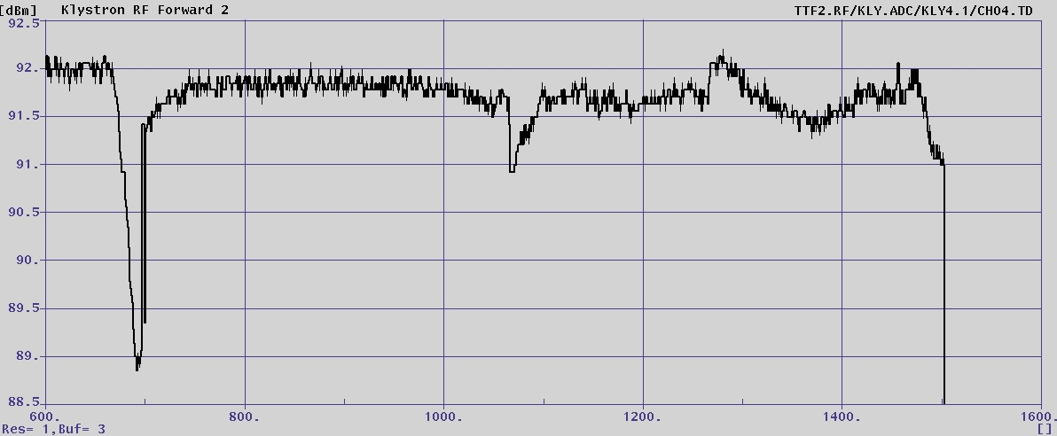
RF Power Overhead
S. Michizono KEK
ILC specific
HV of klystron was decreased from 108 kV to 86.5 kV.
4.5 mA beam was used.
Filling time was adjusted to have ~rectangular output.(500us ->660us)
Operation point is about -7% (in power) from saturation.
Filling Flat-top
Saturation (1.58MW)
7%
Operation(1.48MW)
operation point
RF output with “bump” set-table

Slide 22
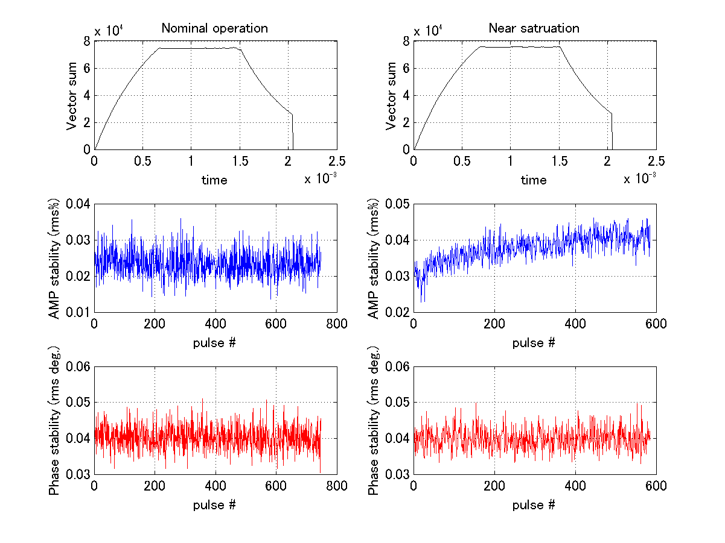
S. Michizono (KEK)
Stabilities at nominal and near saturation
Amplitude stability was x2 worse at near sat. because of the limitation of rf.
But 0.05%rms in amplitude can satisfy the requirements (~0.1% in amplitude)
Phase stability was almost same between nominal and near saturation.
Possible to operate at 7% below saturation
VS amplitude
VS phase

Slide 23
Future
Currently one more dedicated run in 09.12
  Primary goal: 6mA 800 us
  (Last possibility for 9mA ?)
  Final results possibility for GDE TDR
Q1 2013 shutdown for FLASH 2 installation
  FLASH 1 Undulator Bypass will be removed
Still expect possibilities for further ‘long bunch train, high beam-loading experiments’
  Possibly in collaboration with STF and NML

Slide 24
