Slide 1
Detector Technology Project (DTP)
1970-2000
DAQ
ASIC
Mechatronics
Cryogenics
Belle
12GeVPS
TRISTAN
ATLAS
Pixel technology
Cryogenic detector
New photon detector
2D gas detector
Liquid TPC
J-PARC
ILC
Detector Technology is a basic strength for every research activity.
Horizontal activities among the projects
KEKDTP for Innovative Particle Detector is one of the keys to the future of KEK.
IMSS
Material Science

Slide 2
Detector development for J-Parc(Neutrino) and LC programs

Slide 3

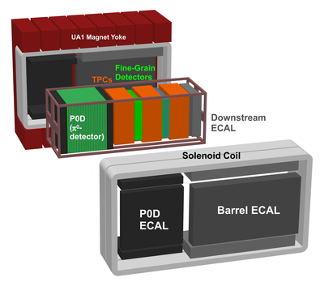
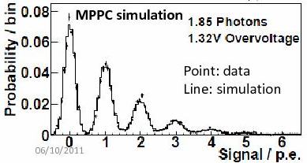
Detector R&Ds for T2K and beyond
For the T2K experiment, we have done a lot of R&D works.
  Photo-sensor (Multi Pixel Photon Counter, MPPCs) + scintillators
  All of detectors are worked very stably after the installations (2009-2010), and produced lots of physics outputs.
MPPC (PPD)
  T2K was the first experiment to use large number of MPPCs (~55000ch)
  Main features of the T2K MPPC
    Number of pixels ; 667
    Active area ; 1.3x1.3 mm²
    Pixel size ; 50x50 μm²
    Operation Voltage; 68-71V
    Typical Gain ; 10⁶
    Photon detection eff. (@525nm) ; 25-30%
    Dark rate (@ 0.5pe thresh @25deg) ; <1.35MHz
MPPCs are used for
  On-axis detector (INGRID) ~10000ch
  Pi0 detector (P0D) ~10000ch
  Fine Grain Det. (FGD) ~8500ch
  Electromagnetic calorimeter ~22000ch
  Side Muon Range Detector ~4000ch

Slide 4
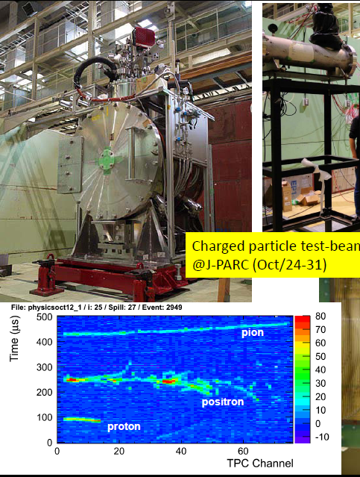
Detector R&Ds in T2K and beyond (2)
As a future detector R&D, the liquid argon TPC detector R&D has been performed for four years.
  0.4 ton detector prototype test was done so far
  Goal: 100kton detector.
LArTPC activity (J.Phys.Conf.Ser.308:012008,2011 )
  0.4 ton prototype is working
  0.3 ppb (O2 equivalent purity) was already achieved.
  Cockcroft-Walton HV system supply 33kV to cathode.
  Using well defined charged particles, we tested the detector performance (paper is ready)

Slide 5
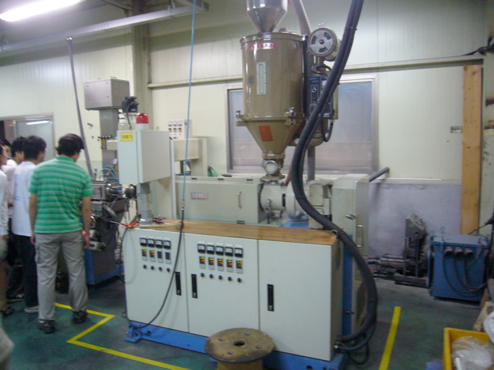
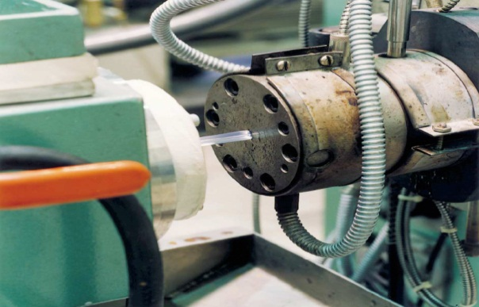
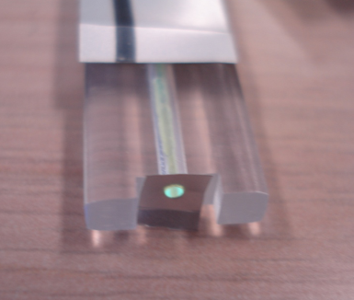
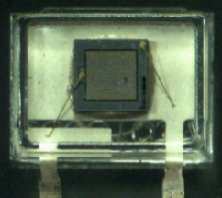
Collaboration on ILC Calorimeter R&D
PFA calorimeter: O(10M) of small sensors for a precise ILC physics.
Scintillator ECAL R&D : in CALICE for ILD
  Shinshu U. – Kobe U. – Tsukuba U. : MPPC
  Kyungpook Nat. U. : Extruded Scintillator
KNU
Mega-channel system with
ILC performance and low cost
a typical multi-jet event
Scintillator
Scintilator
Extruder
MPPC

Slide 6
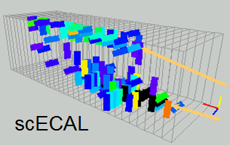
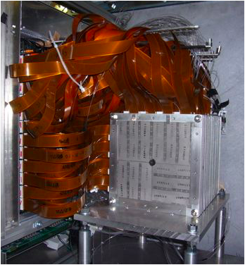
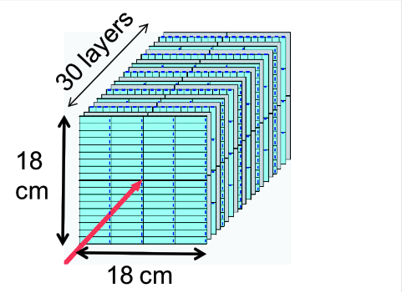
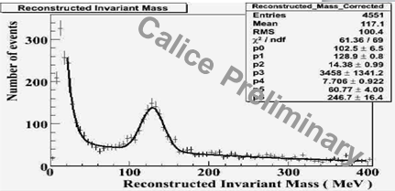
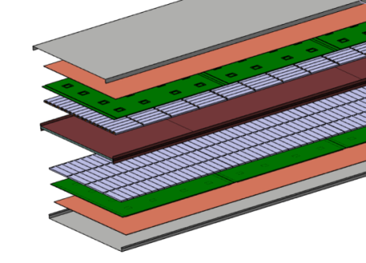
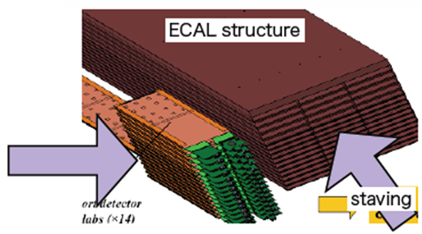
Calorimeter Beam Tests
A series of at DESY, KEK, FNAL
π⁰
Strip: 4.5x1x0.3cm³
~2k strips & MPPCs
Mγγ
absorber
sensor
readout
A new test in preparation
  integrated electronics
  hybrid of Silicon and Scintillator sensors

Slide 7
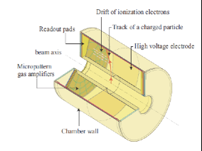
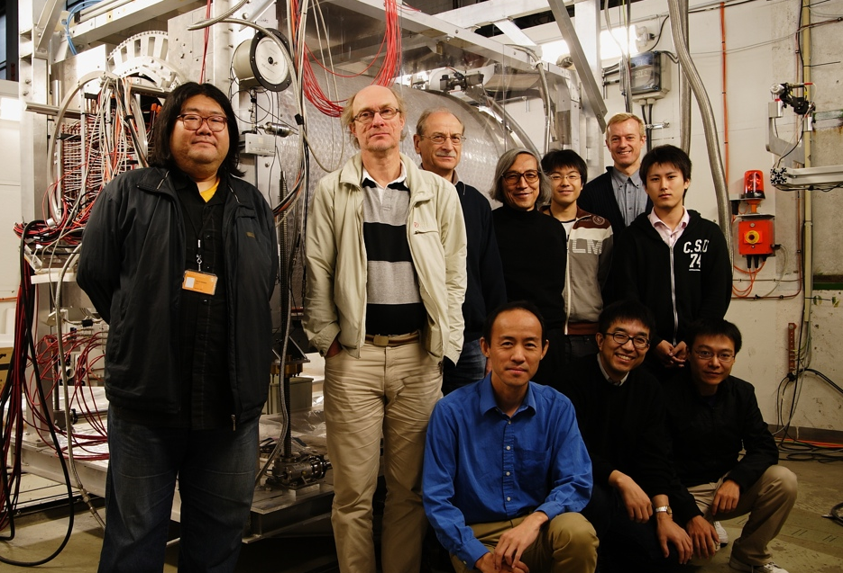
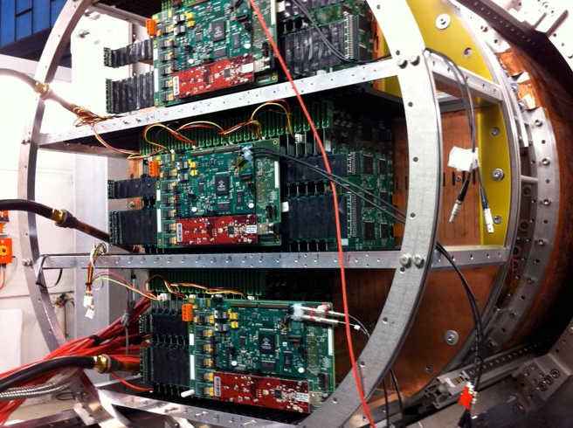



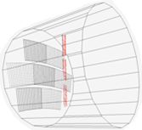

Collaboration on ILC TPC
LCTPC : Testing TPC performance in non-uniform B field, long drift, …
DESY beam tests (2009-2011)
PCMAG(1T, ~60cm drift)
80cm^{φ}
~ 10k readout
TPC Concept
Typical Event

Slide 8
FPCCD (Fine Pitch CCD) for ILC
R&D goal
FPCCD sensors
  Pixel size; 6um
  Chip size;1cmx6.5cm
  Speed >10Mpix/s
  F.W.C. > 10000 e(?)
  Power <10mW/ch
  Rad. Tolerance >1x10¹³e/cm² (=1x10¹²/cm²/y x 3y x safety factor 3)
Readout ASIC
  Speed > 10Mpix/s
  Power < 6mW/ch
  Noise < 30 electrons
Peripheral circuit
  Clock driver
  Data suppression
  Etc.
Engineering R&D
  Over-all design
  Low-mass ladder
  Cooling system (~-40℃)
  Support structure
  Engineering prototype
Software tools
  Track reconstruction
  Cluster shape analysis

Slide 9
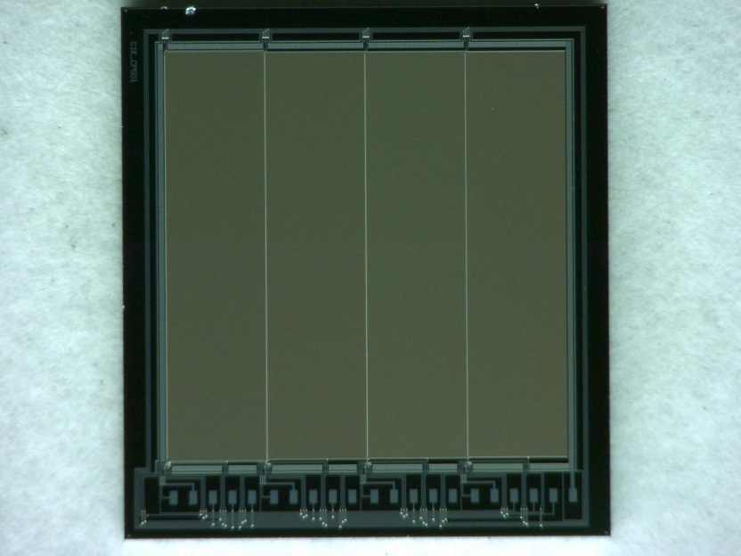
Sensor R&D
FPCCD prototype-3
  Pixel size：12, 9.6, 8, 6μm
  12, 9.6, and 8μm pixels work, but 6μm pixels do not work at all
12μm 9.6μm 8μm 6μm

Slide 10
Sensor R&D
FPCCD prototype-4
  Same parameters as prototype-3
  Improvement of potential profile based on device simulator
  x2 improvement of the depth of the potential well is expected
  6μm pixel works, but not properly
FPCCD prototype-5 (to be delivered FY2012)
  First large size (~1cmx6cm) prototype
  Horizontal shift register for 6μm pixel has a size of 6μmx12μm to improve full-well capacity and to decrease resistance of gate line
  Multiple wire for gate: Many bonding pads along the longer side of the chip

Slide 11
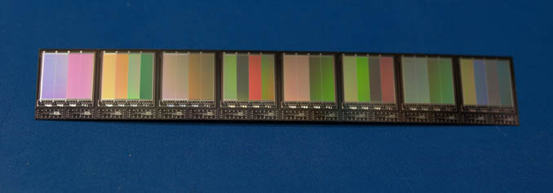
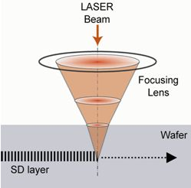
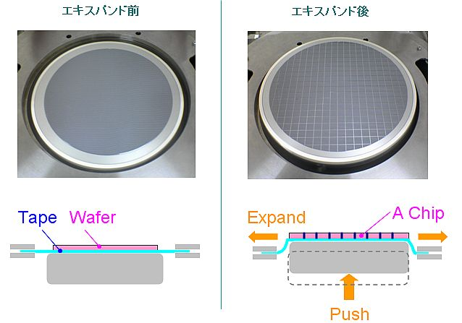
Wafer thinning
50μm thick prototype
  Thinned by mechanical grinding
  Dicing by “stealth dicing” technology
  No increase of dark current was observed
  Sag ~0.3 -- 0.7 mm over 60mm
60mmx9.7mmx50μm
Before expansion
After expansion

Slide 12
CO2 cooling system
CO2 collaboration in Japan
  ILC VTX, ILC TPC, Belle-II VTX, and KEK cryogenic group
  We constructed “blow system” and temperature was successfully controlled between -40 and +15 degrees

Slide 13
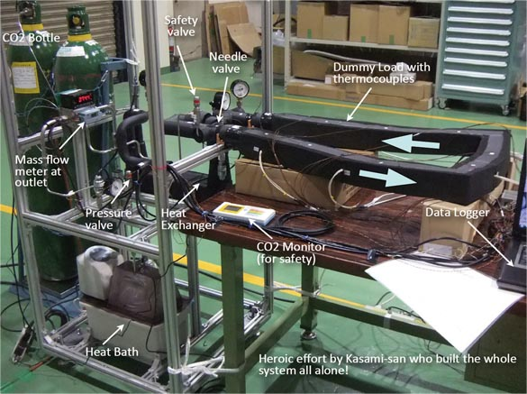
CO2 cooling system

Slide 14
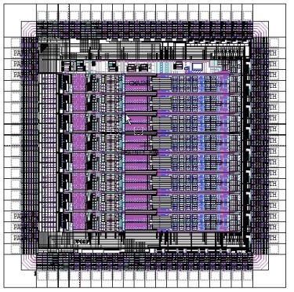
ASIC R&D
ASIC Prototype
  Amp, LPF, CDS, ADC, LVDS driver
  Charge-sharing successive approximation register array ADC → Low power consumption and medium speed
  Alternative operation of two 5MHz ADCs → 10MHz readout speed
  8-channel/chip
Evaluation of prototype ASICs
  Test system at Tohoku Univ.
    SiTCP, DAQ-middleware
  Expected performance is not achieved
  → Improved prototype in FY2009-2010

Slide 15
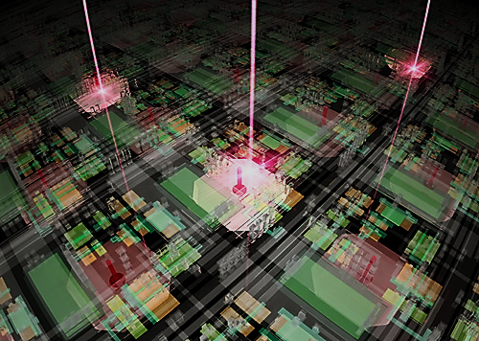
KEK
Detector Technology Project

Slide 16

KEK : international frontier research institute
employing accelerators to explore
universe, elementary particles, nuclei, matters and life
Acc. Lab.
Construction&
operation
R&D for future acc.
IPNS
Particle physics
Nuclear physics
Detector TP
IMSS
Material science
Life Science
Applied Research Lab
Radiation safety
Computing
Cryogenics
Mech. Enginnering

Slide 17
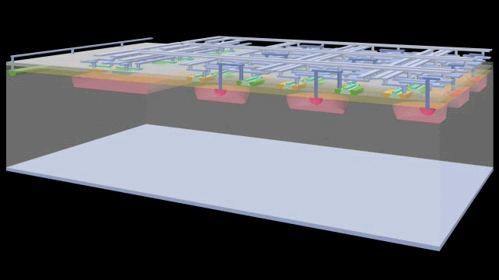
The most advanced radiation detector: SOI pixel
Monolithic detector using Bonded wafer (SOI : Silicon-on-Insulator) of
Hi-R and Low-R Si layers.
No mechanical bump bondings
-> High Density, thin material
-> Low parasitic Capacitance
Standard CMOS circuits can be built
No Latch Up, Small SEE Cross section.
Based on Industrial standard technology
17

Slide 18
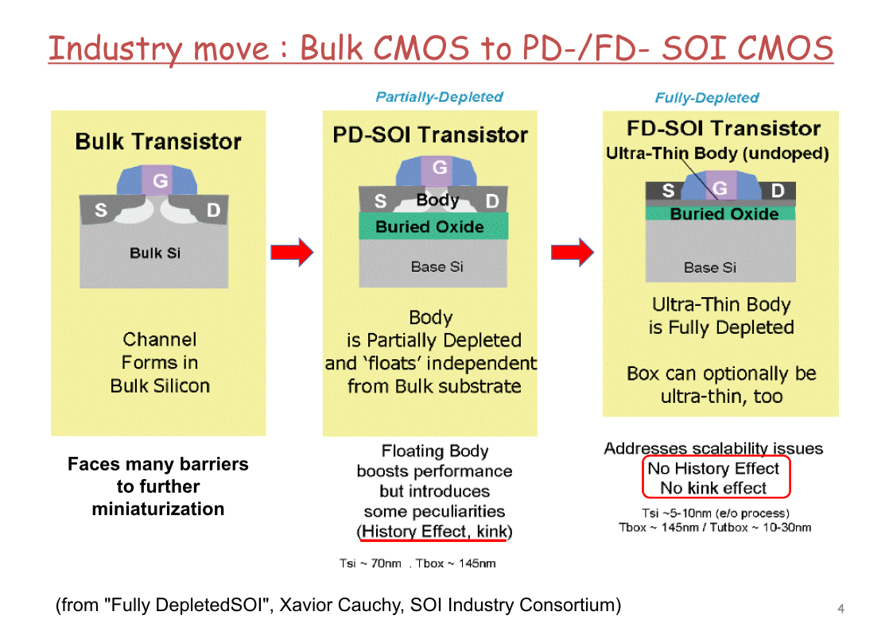

Slide 19
Steady growth
17x17 μm, 512x832 (~430k）pixels

Slide 20
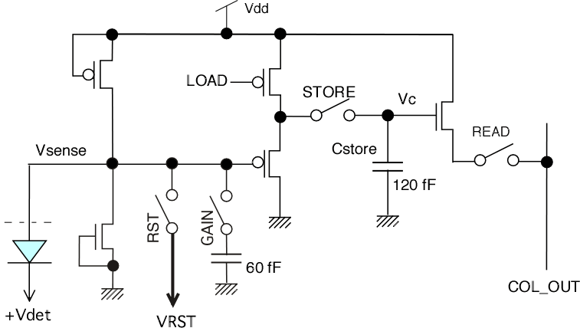
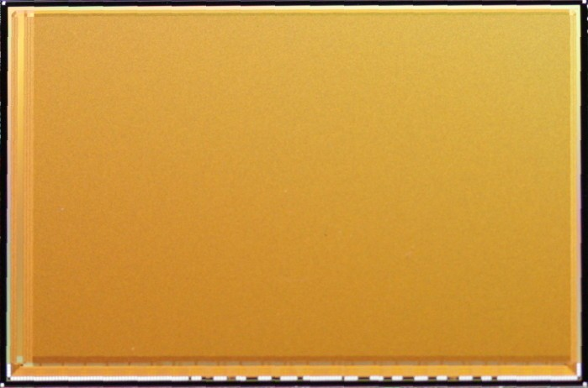
2012
INTPIX5
1.3 Mega Pixels!
Finer pitch also
in progress
17 x 17 um²
12 x 12 um²
8 x 8 um²
12.2 mm x 18.4 mm
896 x 1408 pixels

Slide 21
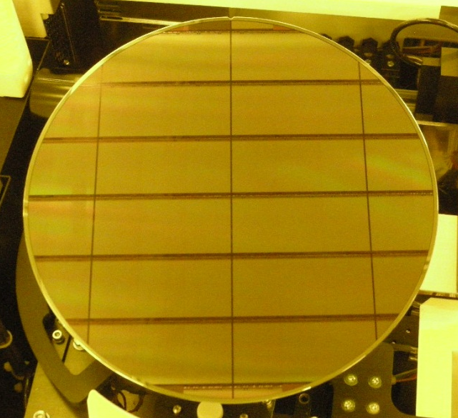
Toward further large aperture
Mask Layout
Exposed Layout
Pixel
~30 mm
~66 mm

Slide 22
High precision X-ray imaging

Slide 23
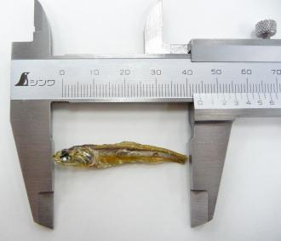
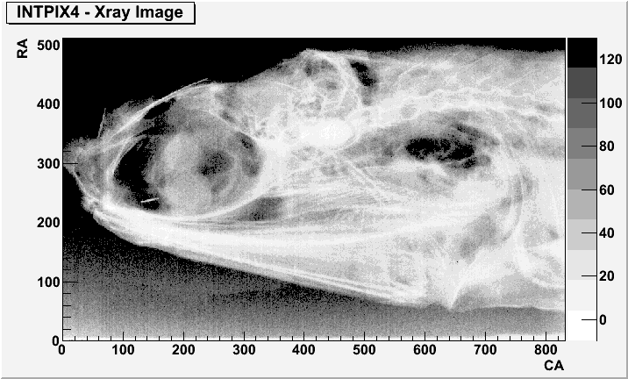

X ray
from Quantum beam
High precision
X-ray imaging
5mm
SOI pixel sensor

Slide 24
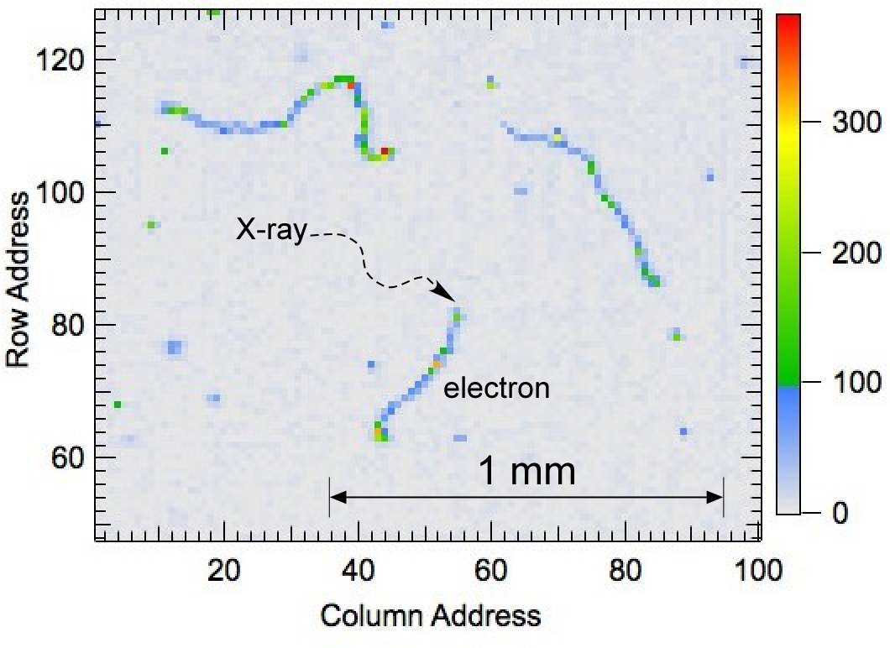
Bubble chamber?
No! Digital Emulsion!

Slide 25
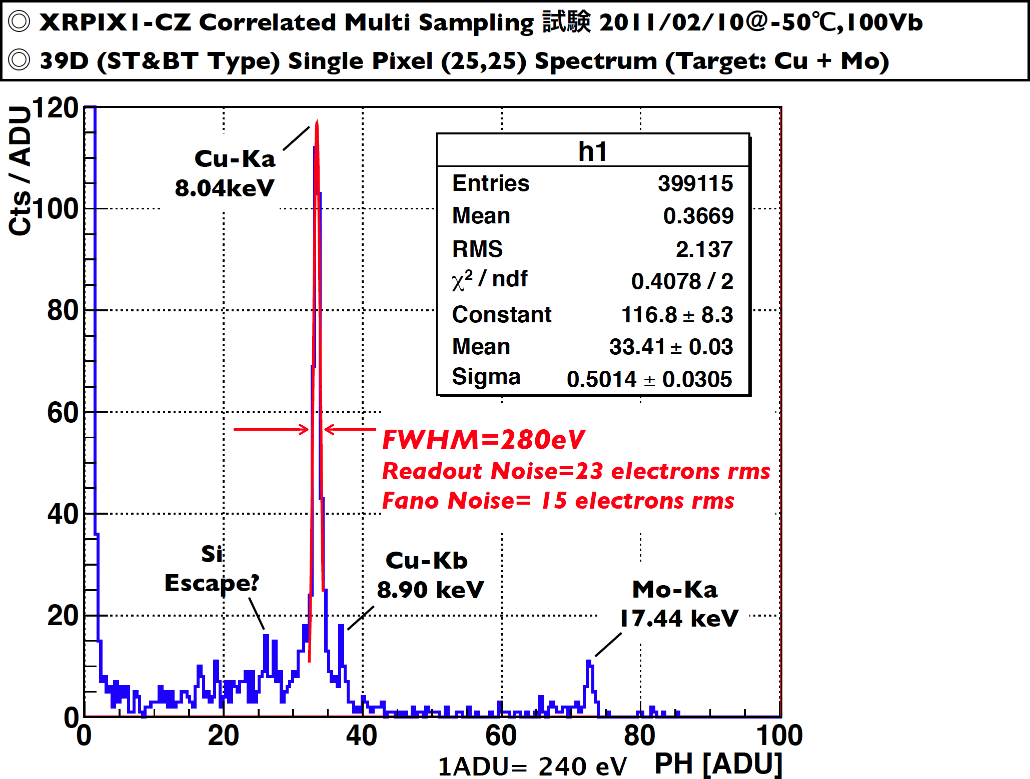
Excellent Energy Resolution for Astronomy
Cu Kα and Kβ is separated
Noise ~ 23e⁻
Kyoto Univ.

Slide 26

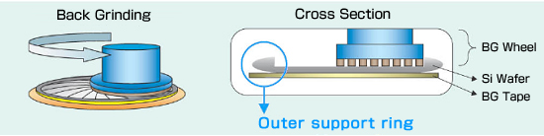
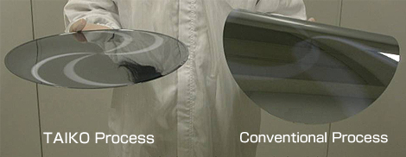
Wafer Thinning (TAIKO process)
Back side process still can be done after thinning.

Slide 27
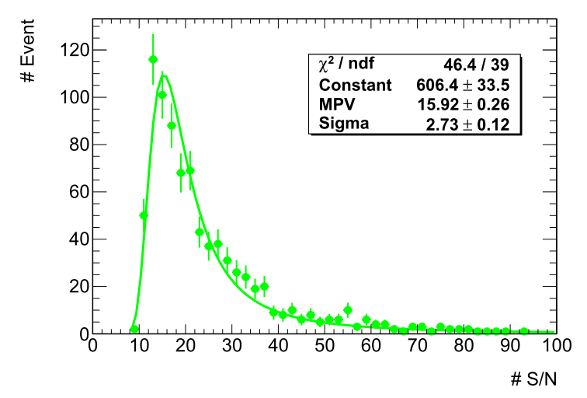
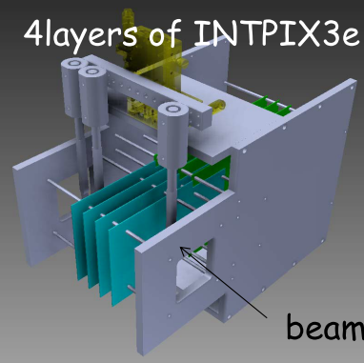
Beam test at CERN with the 50um thick sensor
Good S/N for MIP in the full size pixel sensor thinned to 50μm (CZ)

Slide 28
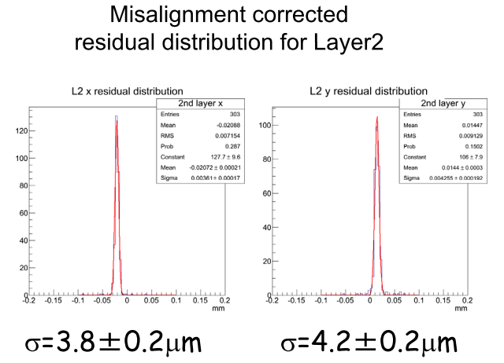
Preliminary
Should be better after proper clustering

Slide 29
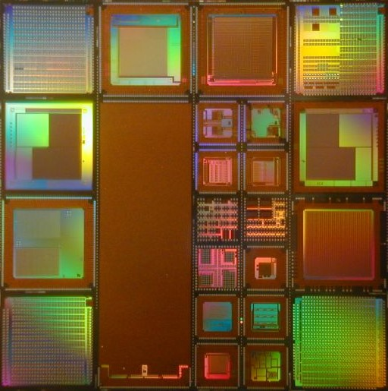
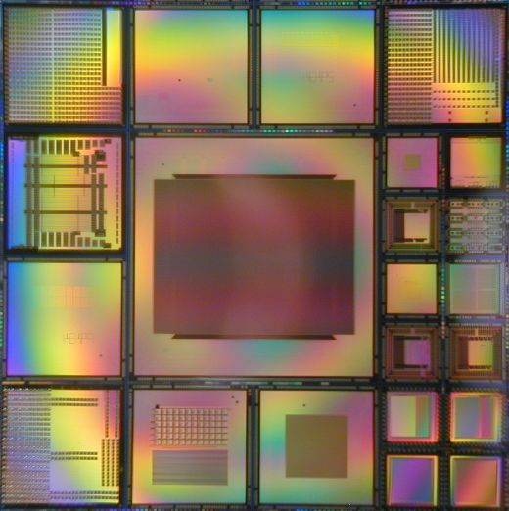
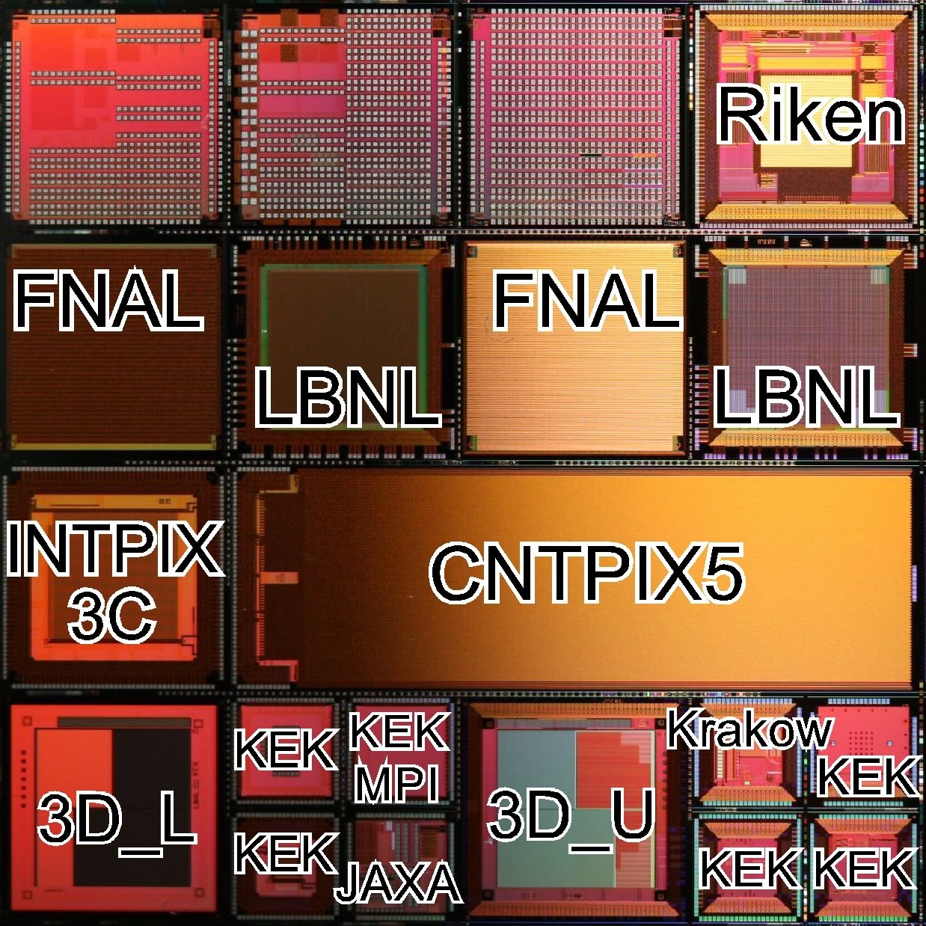
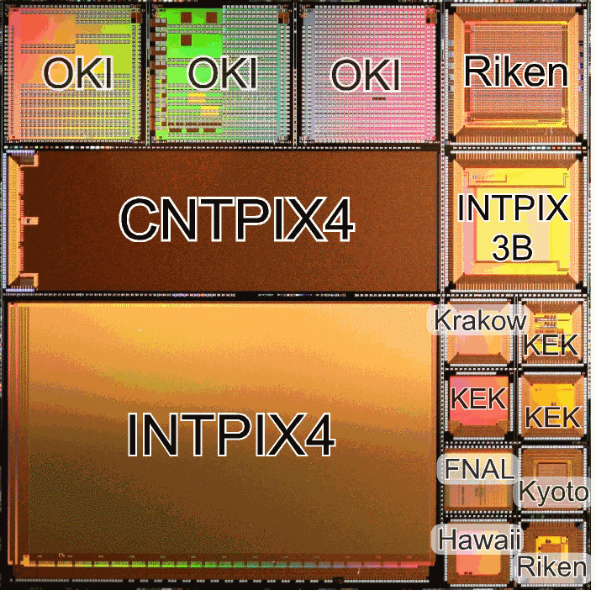
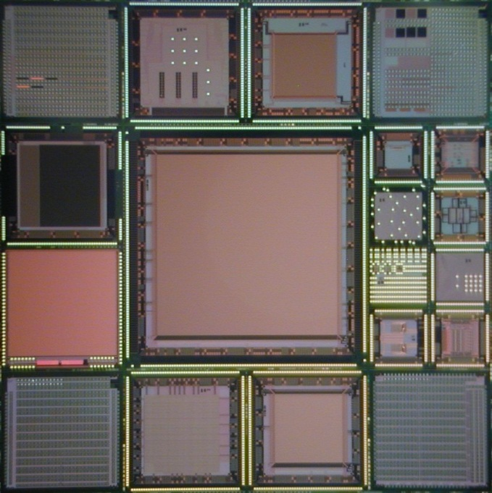
MPW (Multi Project Wafer) run hosted by KEK (twice a year)
Louvain-la-Neuve Univ.
U. of Hawaii
INP Krakow
IHEP China
U. Heidelberg
U. Tohoku
Kyoto Univ.
JAXA/ISAS
Tsukuba Univ.
AIST

Slide 30
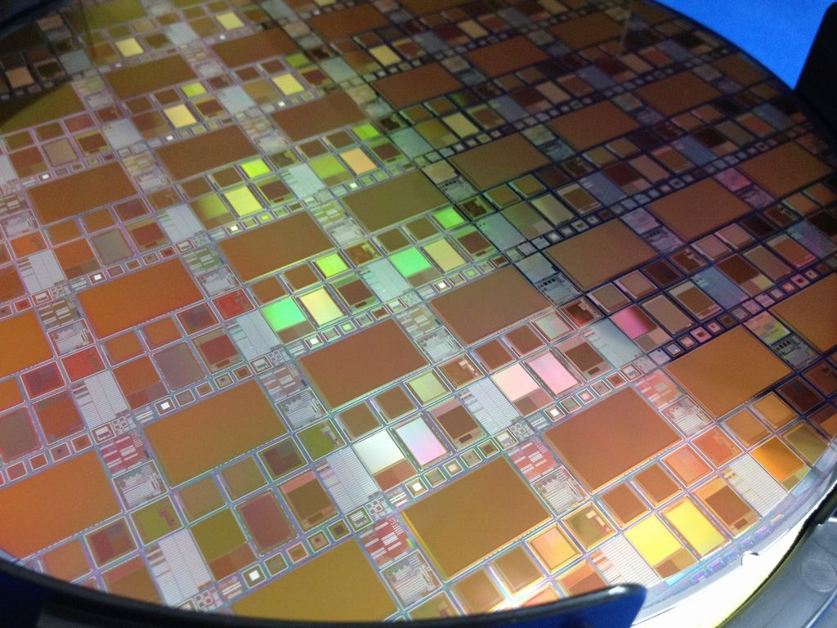
Next SOI MPW run Plan
1st MPW run : ~End of June
2nd MPW run : ~Middle of December
Please Join These MPW runs!

Slide 31
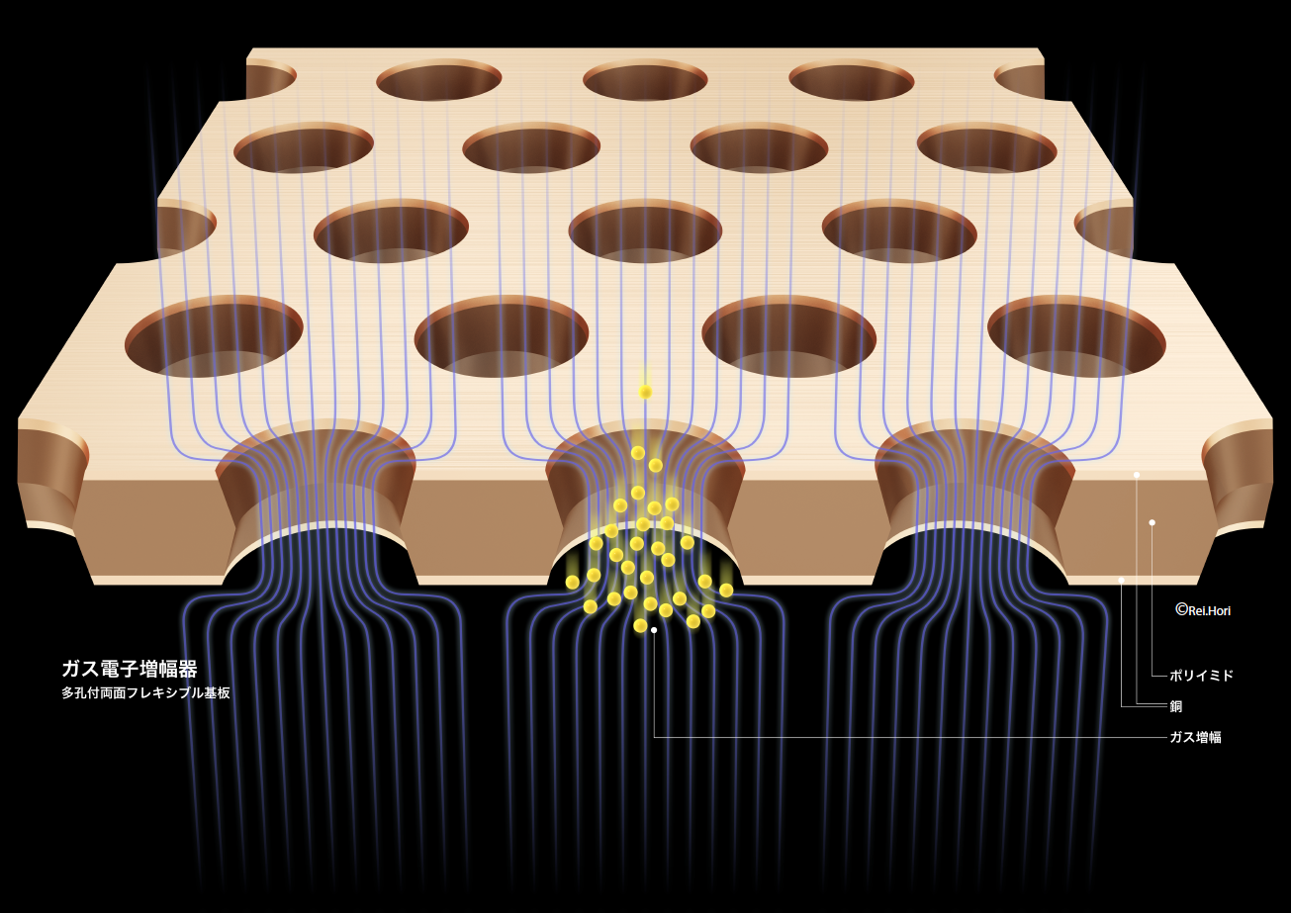
Wireless gas detector
MPGD and its applications
Large area imaging for neutron/Xray

Slide 32
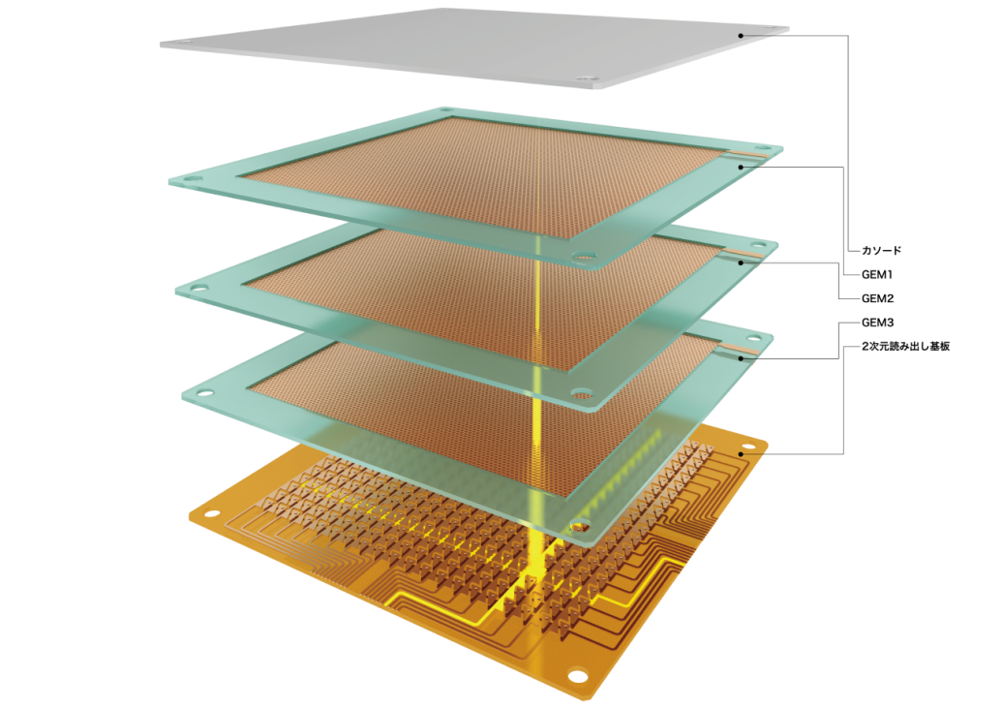
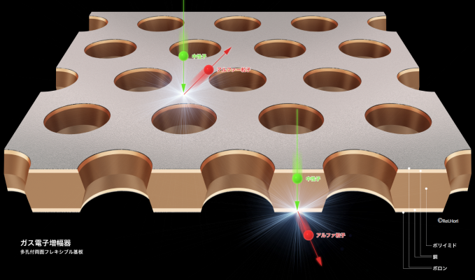
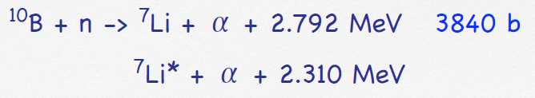
Neutron imaging with MPGD

Slide 33
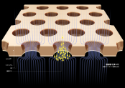
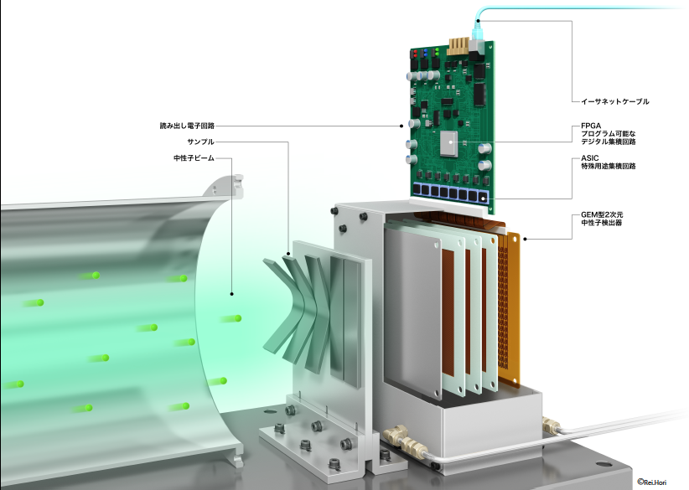
Neutron beam reveals a hidden
stress in the material.

Slide 34



Precise diagnositics with precision gamma camera
Gold plated MPGD
ガンマ線
診断用 放射線源
Point
a tiny
Indication

Slide 35



Development toward new structure/fabrication
New type MicroMegas
New type GEM with
resistive material
Cu
PI
Conductive
PI or other
Conducting
polymers

Slide 36


QPIX for advanced pixel electronics
Circuit part
400 pixels
200μm
5mm
200μm
Pad for charge collection
Pad for bump-bonding
5mm
Detection area : 16 mm² (64% of chip area)

Slide 37




QPIX test with neon beam (TIARA)

Slide 38



Slide 39



Super Conducting Detector (SCD) for CMB camera, neutrino decay observation..

Slide 40



STJ and MKIDs device fab. In KEKDTP clean room
KEKDTP
μ device
Clean Rm.

Slide 41


SiTCP and RTmiddleware
New Generation DAQ scheme
Distributed network DAQ with SiTCP and DAQ-middleware.
Being “standard” system in the J-Parc neutron beam lines.
working
preparing

Slide 42
KEKDTP others
Liquid Xenon/Argon TPC application → ν future huge exp.
  DM search, Neutrino detector, PET ……
Advanced Photon sensor → MPPC in T2K
Ultra fast pixel for SRF → Kishimoto’s report

Slide 43
KEKDTP activities
Project | Leader | Abstract
MPGD | S. Uno | Application of MPGD to neutron or X ray detection
SOI pixel | Y. Arai | Silicon On Insulator technology for the next generation pixel sensor
Photon sensor | K. Yoshimura | MPPC application
ASIC | M. Tanaka | Development of pixel readout chip with high functionality to match TimePix of CERN
Liquid TPC | T. Haruyama | Development of technology necessary for liquid noble gas TPC for DM detection , large ν detector or PET
SCD | M. Hazumi | Super conducting technology for ultra high sensitive radiation sensors
FPIX | S. Kishimoto | Array of APD pixels for high speed X ray measurement
CO2 cooling | K. Fujii | R&D for the new generation detector cooling system

