Slide 1
Materials Imaging and Dynamics (WP-83) status report
(towards the TDR)
PPR-1 2012
April 19, 2012
A. Madsen & J. Hallmann, XFEL.EU

Slide 2
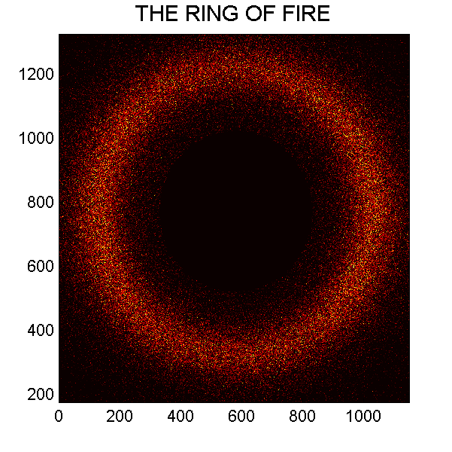
Progress since last PPR
Work on pre-TDR document
1st experiment as PIs at LCLS (Jan. 2012)
Recruitment campaigns
Staff: A. Madsen (WP leader, since July 2011)
J. Hallmann (Scientist, since Sept. 2011)
LL (Scientist, offer out)
MM (Instr. engineer, interviews in May)
NN (CIE engineer, interviews in May)

Slide 3
Pre-TDR document
List of all components with specifications (function, place, size, axes, supplies, conditions,…)
that are needed for the MID instrument
Indicate preferred technical solutions and design
Provide detailed footprint of the MID station
Allows to re-iterate on parts of the CDR (input from LCLS and other places)
Provide a basis for starting detailed discussions with the optics and diagnostics groups
Describe typical experimental strategies (interface to DAQ, detectors, and sample environment)
Initiate discussions to optimize the optical pump scheme (interface to laser group)
Describe the typical operation modes needed (interface to Machine and DAQ)
Allows a first reliable estimation of the investment budget required for MID
Good starting point for tendering procedures and discussions with external companies
Only limited need for engineering assistance for this pre-TDR but….
Deadline: Aug. 2012
After this date engineering support is desperately needed to progress toward the TDR!

Slide 4
Outline
Selected points from the pre-TDR, namely
Footprint of the MID station
The focusing scheme
X-ray split-delay line
Operation modes
Risks

Slide 5







SASE-2 Overview
Common to all SASE-2 beamlines
(MID, HED & NNN)
Distribution
390 – 395 m
0 m
149
245 277 m
938 m
XTD1_R9-11
XS2
XTD6, photon tunnel
Source
point
e- leave
Offset
(290-300 m)
C-mono
(310 m)
Absorber +
lens unit (213 m)
Imager
(241 m)
Shutter
(264 m)

Slide 6





MID Specific Tunnel Optics
Angle (2θ) 0.1 – 0.4 deg.
100 mm separation after 14 – 57 m
∼ 6 m long section
Distribution
390 – 395 m
Lens
(high E)
Si(111)
mono
Lens
(936 m)
Imager
277 m
938 m
XTD6 tunnel
726 m
Slit
(500 m)
BPM
(501 m)
Intermediate focus
option! beamsize:
50 - 100 μm
∼ 885 m

Slide 7
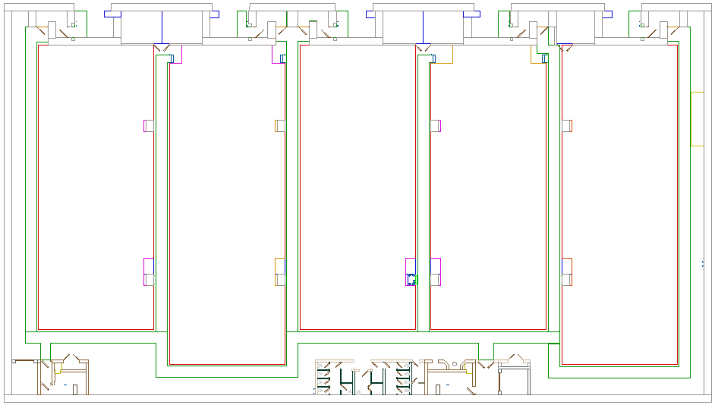




SASE-2 floor
942 m
~984 m
MID Optics Hutch
Wall
begins:
952.2 m
Si
mono
Slit
BPM
Split-
delay
line
Shutter
Wall
ends:
959.2 m
Shutter
(940.7 m)

Slide 8




SASE-2 floor
MID Exp.
Hutch
942 m
~984 m
PP-laser
959 m
MID Local Optics
MID Sample Env.
959.4
960.8
961.3
962.7
962.9
963
sample:
~964

Slide 9
SASE-2 floor
SASE-2 floor
Crane
Area
~4 x 7 m²
NNN
ctrl/
elec.
HED
ctrl/elec.
MID Exp.
Hutch
NNN
experiments
HED optics
Laser prep.
HED
experiments
PP
Laser
100TW-class
Laser
lock
Open questions:
Position and shape of laser hutches
Helmholtz laser (Helmholtz Beamline UC)?
NNN experiments?
Floor plan must be finalized soon;
Next: call for tender hutches

Slide 10
Compound Refractive Be Lenses for MID
Requirements:
Option for parallel beam
Option for large demagnification
Option for ~10 micron spot size
All the above from 5 to 25 keV
Everything with close to 100% efficiency
(no beam clipping)
Concave shape focusses X-rays
(n<1 but n~0.9999)
213 m
726 m
936 m
~965 m

Slide 11
CRL1 Chamber (213 m from the source)
CRL1 rod 1
CRL1 rod 2
IF1 quality Beryllium lenses
0.5 mm thick, f = 213m
Parallel beam option
13 lenses needed
Mounted in 2 x 4 slots this
gives 25 possible combinations
(incl. rod 1 and/or rod 2 OUT)
CRL1 rod 1
name R (μm) N 2R₀ (μm) E(keV) D_{eff} (μm)
CRL1_11 5800 1 3406 5.0 3245
CRL1_12 4000 1 2820 6.0 2743
CRL1_13 2800 1 2366 7.2 2325
CRL1_14 2000 1 2000 8.5 1980
CRL1 rod 2
name R (μm) N 2R₀ (μm) E(keV) D_{eff} (μm)
CRL1_21 2300 1 2145 8.0 2120
CRL1_22 2800 3 2366 12.5 2338
CRL1_23 2000 3 2000 14.8 1982
CRL1_24 500 2 1000 24.1 996

Slide 12
CRL1 Chamber (213 m from the source)
Combinations of the two rods
(Energy and effective diameter)
 | CRL1_21 | CRL1_22 | CRL1_23 | CRL1_24
CRL1_11 | 9.4 keV 2113 μm | 13.5 keV 2341 μm | 15.6 keV 1983 μm | 24.7 keV 996 μm
CRL1_12 | 10.0 keV 2117 μm | 13.9 keV 2343 μm | 16.0 keV 1984 μm | 24.9 keV 996 μm
CRL1_13 | 10.8 keV 2121 μm | 14.4 keV 2344 μm | 16.5 keV 1984 μm | 25.2 keV 996 μm
CRL1_14 | 11.7 keV 1982 μm | 15.1 keV 1983 μm | 17.1 keV 1985 μm | 25.6 keV 996 μm

Slide 13
CRL1 Chamber (213 m from the source)
Comparison of beam size at 213 m (3 x FWHM, worst-case
estimate from WP-73 CDR) and the effective lens diameter D_{eff}

Slide 14
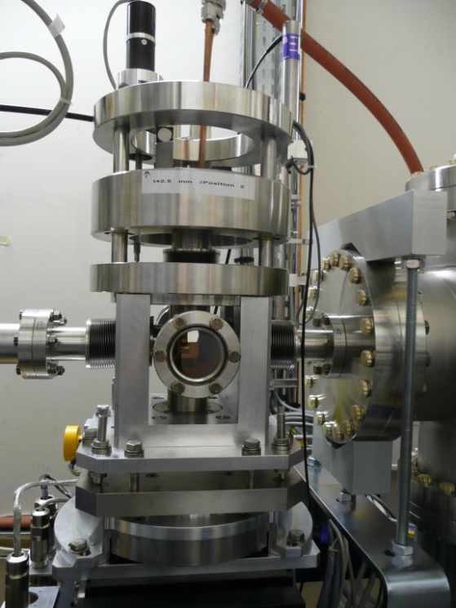
CRL2 Chamber (936 m from the source)
Design of CRL 2 chamber similar to the CRL1 chamber
27 lenses required to cover 5-15 keV (focus parallel beam, refocus)
Sub-100 μm focusing for E > 15 keV not included in CRL 2
Mechanics: e.g. ESRF design
(one rod, water cooling
UHV compatible ~ 30 k€)
40 lenses (Be IF1 quality, large radii) cost approximately 180 k€
Total estimated prize for CRL optics + mechanics
(40 lenses, 2 UHV chambers, supports): 300 k€
Upgrade to higher energies (additional chamber + lenses)
200 k€ (optional)
Next: wave front simulations

Slide 15
X-Ray Split-Delay Line
Delay of simple pyramid split-delay line
PLD (up-down) = 2h/tan2θ x (1-cos2θ) / cos2θ; h∈[h_{min}; H] with H=L/2*tan2θ
Si(111)
h
L
Extra path length by lower CC mono (d: channel width)
d(1-cos2θ)/sinθ
Beam separation:
d*sin2θ / sinθ
Si mirror
CC mono
max angle 0.4 deg
Split-delay line 8 m upstream of the sample i.e. max beam separation 56 mm

Slide 16
X-Ray Split-Delay Line
E= 7 keV, Si (111), L =2000 mm
CC lower mono with d = 20 mm
offsets the lag time 0 point to
h = 20 mm
max lag > 1 ns
Resolution: 2 ps/mm or 2 fs/μm

Slide 17
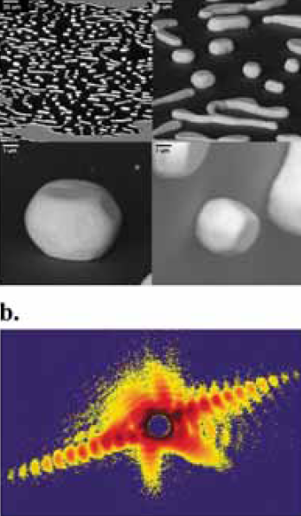
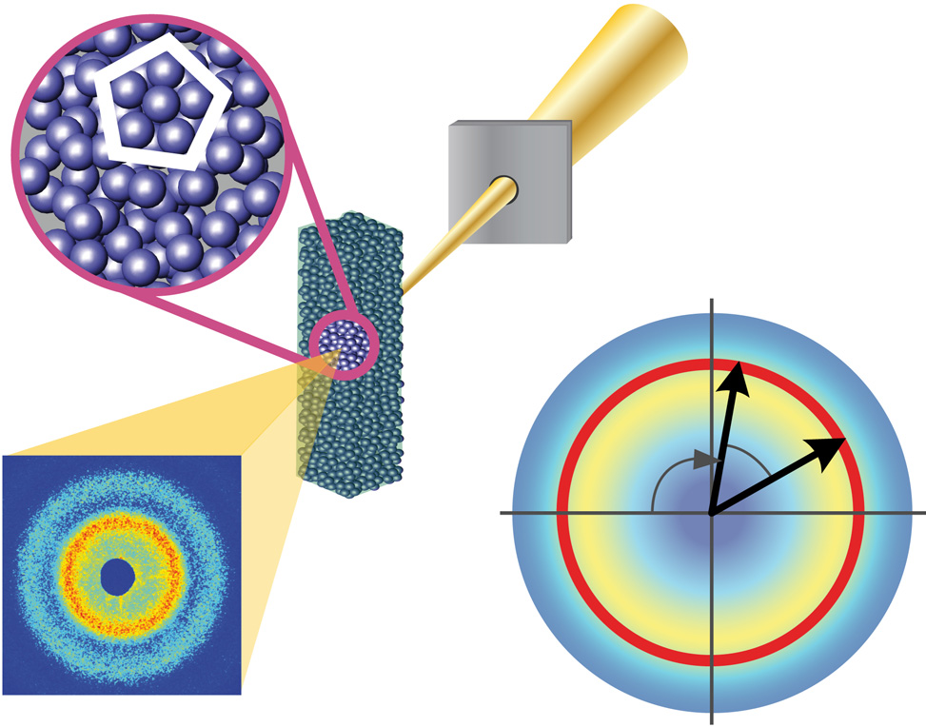
Operation Modes
1 bunch/train (10 Hz) mode for alignment and special experiments
Full burst mode (4.5 MHz, 10 Hz) for high rep. rate experiments
Special XPCS modes
every n^{th} pulse
logarithmic pulse pattern
two pulses spaced by t, 220 ns > t > 1 ns
Bunch charge: 1 pC – 1 nC
Photon energy: 5 – 25 keV, possibly > 25 keV
Bandwidth: 1e-3, 1e-4, 1e-5,…
Seeding: YES
Beam spot on sample: 1 μm, 10 μm, 100 μm or more

Slide 18
Risks
Major Risks:
Fail to get enough engineering support in time
Consequence: TDR will be late (or incomplete..), production readiness late, MID delayed
Solution: reinforce recruitment efforts, redirect internal resources,…
Not enough funds available to realize the MID station as planned
Consequence: Science case weakened, loss of interest in the community,…
Solution: Budget reserve, strict control of expenses, prioritizations,..

