Slide 1
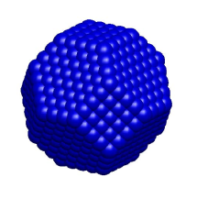
WP-85 SQS Scientific Instrument XFEL Project Progress Report (1-2012)
Atoms
“Small Quantum
Systems”
Molecules
Clusters
presented by
Tommaso Mazza
(for WP-85)
Notes:
How to edit the title slide
Upper area: Title of your talk, max. 2 rows of the defined size (55 pt)
Lower area (subtitle): Conference/meeting/workshop, location, date, your name and affiliation, max. 4 rows of the defined size (32 pt)
Change the partner logos or add others in the last row.

Slide 2
Comparison of forecasted and achieved progress: Jul. 11 -> Dec. 11
OUTLINE
Status of SQS
Towards the Technical Design Report
Experimental campaigns at FELs
Installation of the HHG experiment
Recruitment process
Forecast
TDR
Experiments
WP-85, T. Mazza / M. Meyer XFEL Project Progress Report (1_2012) - 19th of April 2012
Notes:
Before you start editing the slides of your talk change to the Master Slide view: Menu button “View”, Master, Slide Master:
Edit the following 2 items in the 1st slide: 1) 1st row in the violet header: Delete the existent text and write the title of your talk into this text field 2) The 2 rows in the footer area: Delete the text and write the information regarding your talk (same as on the Title Slide) into this text field.
If you want to use more partner logos position them left beside the DESY logo in the footer area Close Master View

Slide 3
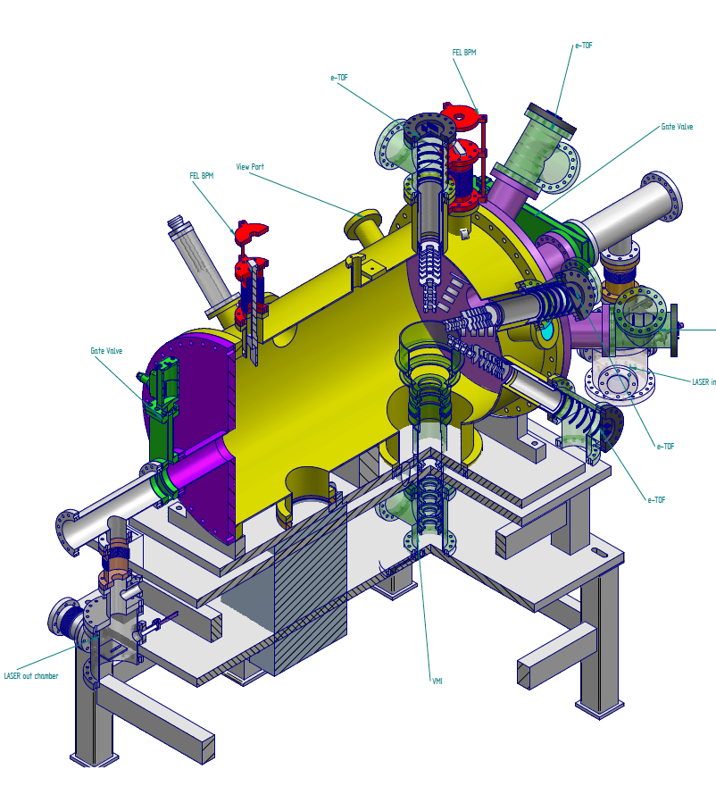
Comparison of forecasted and achieved progress: Jul. 11 -> Dec. 11
Towards the TDR
Preparation of TDR
Detailed design study started March 2012
UHV chambers AQS and NQS
arrival of H. Zhang (SQS Instrument engineer)
AQS - chamber
“Atomic-like Quantum Systems”
Vacuum < 10⁻¹⁰ mbar
Analyzers:
5 e-TOFs
Velocity Map Imaging (e/ions)
Magnetic bottle electron spectrometer
High resolution XUV spectrometer
WP-85, M. Meyer
WP-85, T. Mazza / M. Meyer XFEL Project Progress Report (1_2012) - 19th of April 2012
Notes:
Before you start editing the slides of your talk change to the Master Slide view: Menu button “View”, Master, Slide Master:
Edit the following 2 items in the 1st slide: 1) 1st row in the violet header: Delete the existent text and write the title of your talk into this text field 2) The 2 rows in the footer area: Delete the text and write the information regarding your talk (same as on the Title Slide) into this text field.
If you want to use more partner logos position them left beside the DESY logo in the footer area Close Master View

Slide 4
Comparison of forecasted and achieved progress: Jul. 11 -> Dec. 11
Towards the TDR
Preparation of TDR
In-kind contribution & User consortia
Swedish in-kind proposals U. Uppsala
XUV (grating) fluorescence spectrometer J.Norgren/J-E.Rubenson
Magnetic bottle-type electron spectrometer R. Feifel
User consortia & add-on equipment
Controlled molecules (COMO) J. Küpper / CFEL
((XUV (crystal) fluorescence spectrometer M. Simon / France))
WP-85, M. Meyer
WP-85, T. Mazza / M. Meyer XFEL Project Progress Report (1_2012) - 19th of April 2012
Notes:
Before you start editing the slides of your talk change to the Master Slide view: Menu button “View”, Master, Slide Master:
Edit the following 2 items in the 1st slide: 1) 1st row in the violet header: Delete the existent text and write the title of your talk into this text field 2) The 2 rows in the footer area: Delete the text and write the information regarding your talk (same as on the Title Slide) into this text field.
If you want to use more partner logos position them left beside the DESY logo in the footer area Close Master View

Slide 5
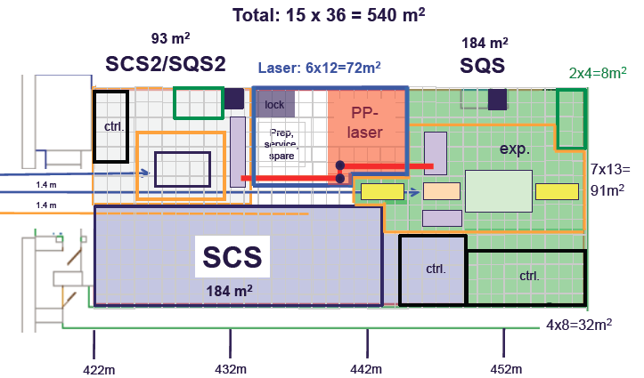
Comparison of forecasted and achieved progress: Jul. 11 -> Dec. 11
Towards the TDR
Revised floor plan
Definition of space requirements behind SASE3
WP-85, M. Meyer
WP-85, T. Mazza / M. Meyer XFEL Project Progress Report (1_2012) - 19th of April 2012
Notes:
Before you start editing the slides of your talk change to the Master Slide view: Menu button “View”, Master, Slide Master:
Edit the following 2 items in the 1st slide: 1) 1st row in the violet header: Delete the existent text and write the title of your talk into this text field 2) The 2 rows in the footer area: Delete the text and write the information regarding your talk (same as on the Title Slide) into this text field.
If you want to use more partner logos position them left beside the DESY logo in the footer area Close Master View

Slide 6
Comparison of forecasted and achieved progress: Jul. 11 -> Dec. 11
Towards the TDR
Ongoing exchange with other WPs (now focused on TDR)
Detailed definition of DAQ & Control (WP-76) requirements Ch. Youngman / N. Coppola
Soft X-ray detector requirements (WP-75)
Working group (DSSC) M. Kuster / M. Turcato
Sample environment (WP-79)
Cluster source, liquid jet J. Schulz
Optical Layout for SQS (WP-73)
KB-optics, monochromator H. Sinn
Optical Laser (WP-78)
Definition of “common” & “SQS” items M. Lederer
WP-85, M. Meyer
WP-85, T. Mazza / M. Meyer XFEL Project Progress Report (1_2012) - 19th of April 2012
Notes:
Before you start editing the slides of your talk change to the Master Slide view: Menu button “View”, Master, Slide Master:
Edit the following 2 items in the 1st slide: 1) 1st row in the violet header: Delete the existent text and write the title of your talk into this text field 2) The 2 rows in the footer area: Delete the text and write the information regarding your talk (same as on the Title Slide) into this text field.
If you want to use more partner logos position them left beside the DESY logo in the footer area Close Master View

Slide 7
Comparison of forecasted and achieved progress: Jul. 11 -> Dec. 11
Towards the TDR
Exchange with User community
Presentation & Discussions of CDR
FLASH II Workshop October 12 – 14
Joint Instrumentation seminar November 11
European XFEL school – Moscow November 14/15
European XFEL Users Meeting January 25/26
SQS Workshop @ Users Meeting January 26
Seminar Dublin City University April 19
WP-85, M. Meyer
WP-85, T. Mazza / M. Meyer XFEL Project Progress Report (1_2012) - 19th of April 2012
Notes:
Before you start editing the slides of your talk change to the Master Slide view: Menu button “View”, Master, Slide Master:
Edit the following 2 items in the 1st slide: 1) 1st row in the violet header: Delete the existent text and write the title of your talk into this text field 2) The 2 rows in the footer area: Delete the text and write the information regarding your talk (same as on the Title Slide) into this text field.
If you want to use more partner logos position them left beside the DESY logo in the footer area Close Master View

Slide 8
SQS Science
Experimental campaigns at XUV sources
LCLS – THz streaking for X-ray timing diagnostics
(PI: A. Cavalieri, CFEL)
5 shifts March 15 – 19, 2012
FERMI – LDM commissioning
(LDM consortium)
8 shifts March 22 – 25, 2012
BESSY II – Two-color (opt. Laser + SR) experiments
(Within SFB925 – A3)
2 weeks March 12 – 25, 2012
WP-85, M. Meyer
WP-85, T. Mazza / M. Meyer XFEL Project Progress Report (1_2012) - 19th of April 2012
Notes:
Before you start editing the slides of your talk change to the Master Slide view: Menu button “View”, Master, Slide Master:
Edit the following 2 items in the 1st slide: 1) 1st row in the violet header: Delete the existent text and write the title of your talk into this text field 2) The 2 rows in the footer area: Delete the text and write the information regarding your talk (same as on the Title Slide) into this text field.
If you want to use more partner logos position them left beside the DESY logo in the footer area Close Master View

Slide 9
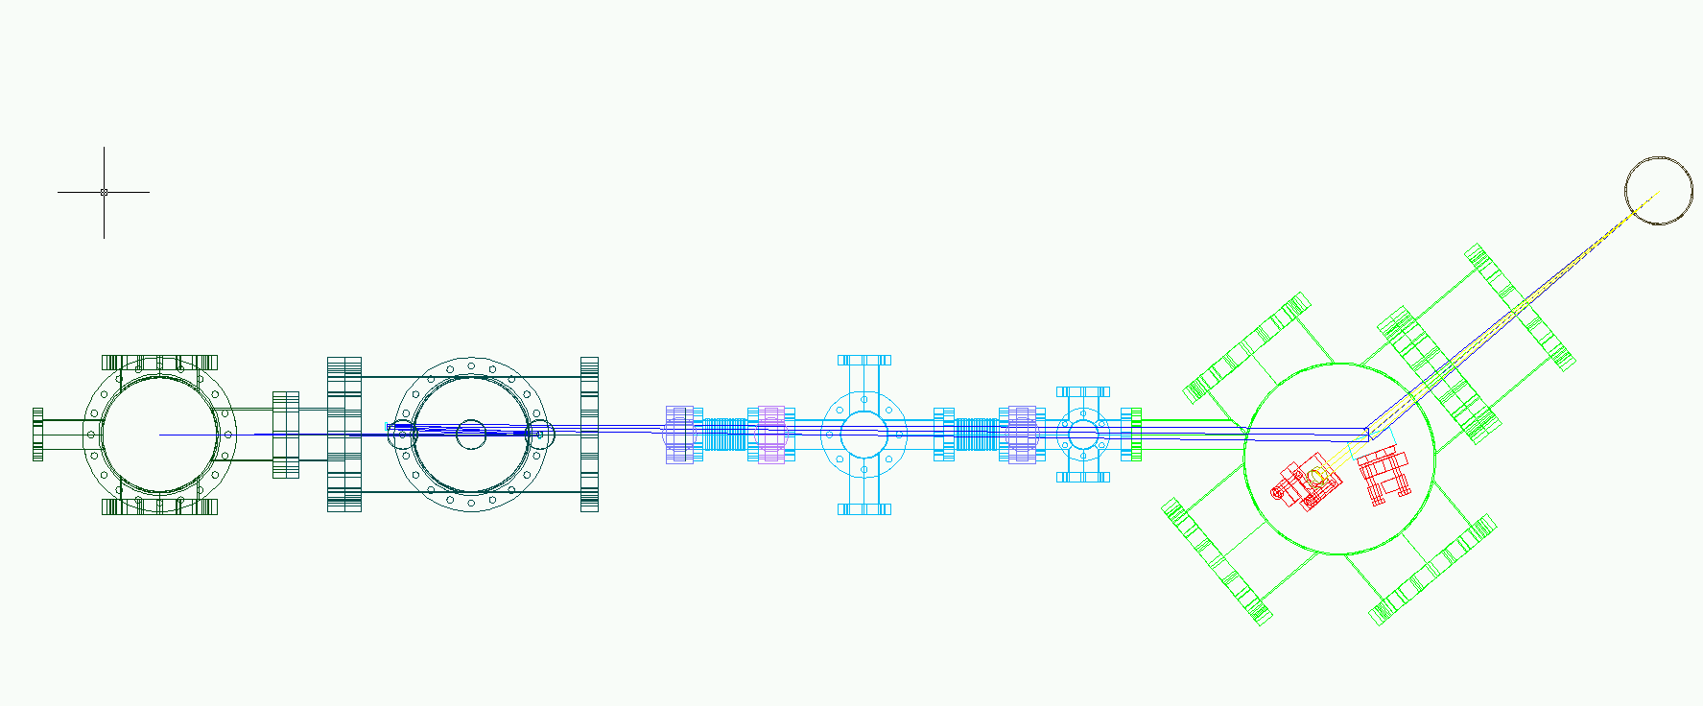
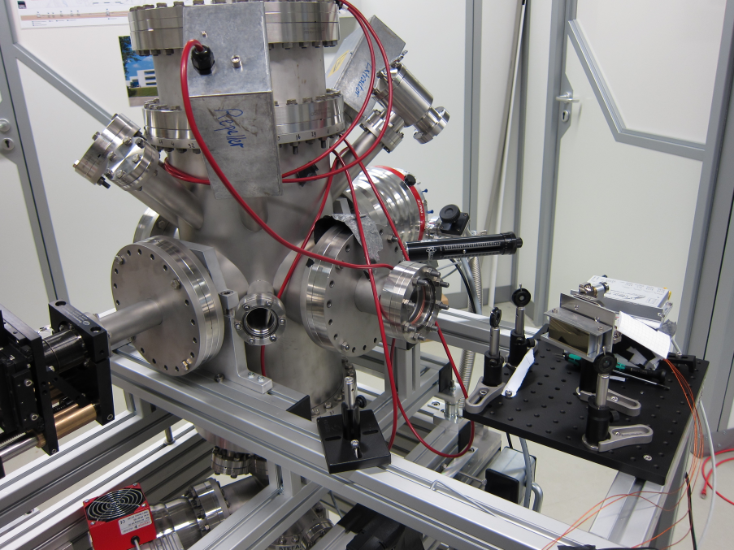
SQS Science
HHG Installation
Beamline design completed
Focusing optics tested
Vacuum parts being delivered
Setup for coincidence measurements (VMI + eTOF) installed, detectors tested
Focusing mirror
diagnostics
monochromator
HHG cell
VMI
Focusing mirror
eTOF
HHG beampath
WP-85, M. Meyer
WP-85, T. Mazza / M. Meyer XFEL Project Progress Report (1_2012) - 19th of April 2012
Notes:
Before you start editing the slides of your talk change to the Master Slide view: Menu button “View”, Master, Slide Master:
Edit the following 2 items in the 1st slide: 1) 1st row in the violet header: Delete the existent text and write the title of your talk into this text field 2) The 2 rows in the footer area: Delete the text and write the information regarding your talk (same as on the Title Slide) into this text field.
If you want to use more partner logos position them left beside the DESY logo in the footer area Close Master View

Slide 10
Delays / deviation from the planning
Design studies for TDR
Late and not yet finished
late recruitment of mechanical engineer
Pump-probe experiments with HHG sources
Delayed
no replacement of 2nd postdoc yet
WP-85, M. Meyer
WP-85, T. Mazza / M. Meyer XFEL Project Progress Report (1_2012) - 19th of April 2012

Slide 11
Status of SQS WP
Personal resources
Leading scientist: Michael Meyer 05-2010
Post-doc: Tommaso Mazza 04-2011
Post-doc: NN Q2-2011
28 candidates (2nd round)
interviews planned May 11, 2012
Mechanical engineer Haiou Zhang 03-2012
PhD Student: Sadegh Bakhdiarzadeh 11-2011
SFB 925, project A1 (PIs. M. Martins / M. Meyer)
PhD Student: Amir Jones Rafipoor 03-2012
SFB 925, project A3 (PIs: M. Drescher / M. Meyer)
WP-85, M. Meyer
WP-85, T. Mazza / M. Meyer XFEL Project Progress Report (1_2012) - 19th of April 2012
Notes:
Before you start editing the slides of your talk change to the Master Slide view: Menu button “View”, Master, Slide Master:
Edit the following 2 items in the 1st slide: 1) 1st row in the violet header: Delete the existent text and write the title of your talk into this text field 2) The 2 rows in the footer area: Delete the text and write the information regarding your talk (same as on the Title Slide) into this text field.
If you want to use more partner logos position them left beside the DESY logo in the footer area Close Master View

Slide 12
WP schedule
Technical Design Report – SQS October 2012
Detailed design
Definition of analyzer specifications
Definition of focusing optics
Definition of optical laser transport
Exchange with Diagnostic group – WP-74 (J. Grünert)
Information & participation of UC
Series of ½ or 1 day meetings (including ART)
AQS – NQS
Optical laser
VMI, REMI, Coincidence modes
Non-linear processes
Imaging
Sample preparation
etc
Organization of inkind and add-on equipment
WP-85, M. Meyer
WP-85, T. Mazza / M. Meyer XFEL Project Progress Report (1_2012) - 19th of April 2012

Slide 13
WP schedule
Experiments with kHz laser system at PETRA III
Installation of HHG set-up
Experiments with combined VMI-eTOF setup
First fs pump-probe experiments
Experimental Campaigns at XUV sources (next 6 months)
5 shifts at DORIS (BW3 beamline) (May, 2012)
Test -> Characterization of VMI spectrometer
6 shifts at FLASH (June, 2012)
Non-linear photoionization dynamics in atoms
12 shifts at FERMI (July, 2012)
Last commissioning of the LDM endstation before open-to-users beamtime
WP-85, M. Meyer
WP-85, T. Mazza / M. Meyer XFEL Project Progress Report (1_2012) - 19th of April 2012

Slide 14
WP schedule
Technical Design Report – SQS October 2012
Start of sending out orders beginning 2013
Reception, test and assembly 2013
Installation in experimental hall end 2014
Ready for beam end 2015
WP-85, M. Meyer
WP-85, T. Mazza / M. Meyer XFEL Project Progress Report (1_2012) - 19th of April 2012

