Slide 1
WP-72
Simulations of photon fields
XFEL Project Progress Report
(1-2012)
Presented by
Gianluca Geloni
Notes:
How to edit the title slide
Upper area: Title of your talk, max. 2 rows of the defined size (55 pt)
Lower area (subtitle): Conference/meeting/workshop, location, date,
your name and affiliation,
max. 4 rows of the defined size (32 pt)
Change the partner logos or add others in the last row.

Slide 2
Comparison of forecasted and achieved progress:
Jan. 12 → Mar. 12
WP-72, together with V. Kocharyan and E. Saldin Took part as observers to commissioning HXRSS at LCLS, January 2012
Notes:
Before you start editing the slides of your talk change to the Master Slide view:
Menu button “View”, Master, Slide Master:
Edit the following 2 items in the 1st slide:
1) 1st row in the violet header:
Delete the existent text and write the title of your talk into this text field
2) The 2 rows in the footer area: Delete the text and write the information
regarding your talk (same as on the Title Slide) into this text field.
If you want to use more partner logos position them left
beside the DESY logo in the footer area
Close Master View

Slide 3
Working principle (I)
3
Weak chicane
Self-seeded
X-ray pulse
Mono
electrons
SASE undulator
Output undulator
First part: usual SASE → linear regime pulse
Weak chicane (R₅₆ ~ several μm for short pulse mode of operation) for:
  Creating a small offset (a few mm) to insert the monochromator
  Washing out the electron beam microbunching
  Acting as a tunable delay line
The photon pulse from SASE goes through the monochromator
Photon and electron pulses are recombined
Notes:
3
Before you start editing the slides of your talk change to the Master Slide view:
Menu button “View”, Master, Slide Master:
Edit the following 2 items in the 1st slide:
1) 1st row in the violet header:
Delete the existent text and write the title of your talk into this text field
2) The 2 rows in the footer area: Delete the text and write the information
regarding your talk (same as on the Title Slide) into this text field.
If you want to use more partner logos position them left
beside the DESY logo in the footer area
Close Master View

Slide 4
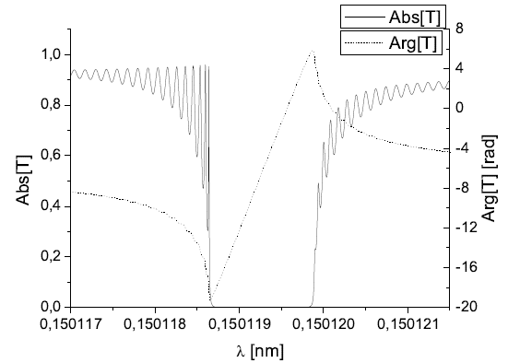
Working principle (II)
4
The monochromator hardware is constituted by a single
crystal in Bragg geometry.
The forward diffracted beam
is considered.
Alignment can be performed
With the help of a suitable detector. This
Fixes the central frequency of the filter
transmittance
Notes:
4
Before you start editing the slides of your talk change to the Master Slide view:
Menu button “View”, Master, Slide Master:
Edit the following 2 items in the 1st slide:
1) 1st row in the violet header:
Delete the existent text and write the title of your talk into this text field
2) The 2 rows in the footer area: Delete the text and write the information
regarding your talk (same as on the Title Slide) into this text field.
If you want to use more partner logos position them left
beside the DESY logo in the footer area
Close Master View

Slide 5
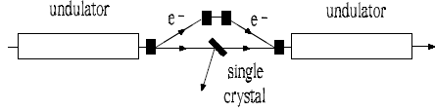
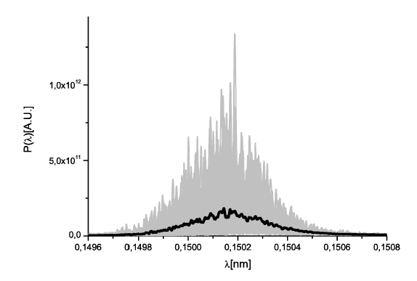
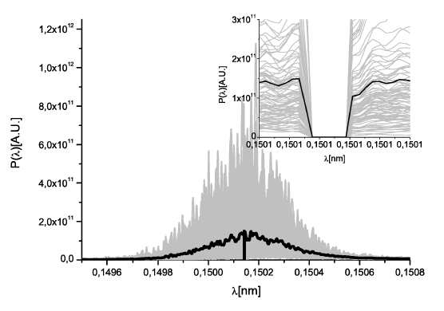
Working principle
5
The single-crystal monochromator principle: frequency domain
Notes:
5
Before you start editing the slides of your talk change to the Master Slide view:
Menu button “View”, Master, Slide Master:
Edit the following 2 items in the 1st slide:
1) 1st row in the violet header:
Delete the existent text and write the title of your talk into this text field
2) The 2 rows in the footer area: Delete the text and write the information
regarding your talk (same as on the Title Slide) into this text field.
If you want to use more partner logos position them left
beside the DESY logo in the footer area
Close Master View

Slide 6
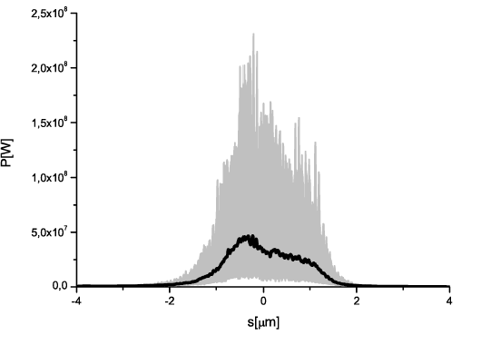
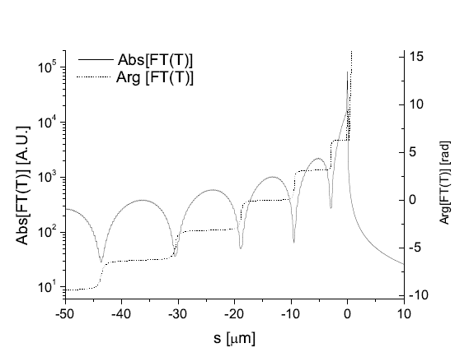
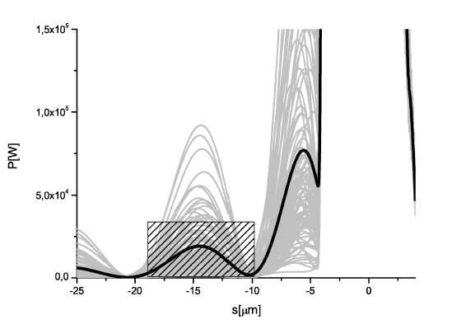
Working principle
6
The single-crystal monochromator principle: time domain
Notes:
6
Before you start editing the slides of your talk change to the Master Slide view:
Menu button “View”, Master, Slide Master:
Edit the following 2 items in the 1st slide:
1) 1st row in the violet header:
Delete the existent text and write the title of your talk into this text field
2) The 2 rows in the footer area: Delete the text and write the information
regarding your talk (same as on the Title Slide) into this text field.
If you want to use more partner logos position them left
beside the DESY logo in the footer area
Close Master View

Slide 7
Comparison of forecasted and achieved progress:
Jan. 12 → Mar. 12
Single crystal Hard X-ray Self-seeding works
Nearly BW limited ~5e-5 pulses for 10fs long radiation pulses obtained
A self-seeding WG is being coordinated @ E.XFEL, with the aim of producing a preliminary proposal for SAC
Notes:
Before you start editing the slides of your talk change to the Master Slide view:
Menu button “View”, Master, Slide Master:
Edit the following 2 items in the 1st slide:
1) 1st row in the violet header:
Delete the existent text and write the title of your talk into this text field
2) The 2 rows in the footer area: Delete the text and write the information
regarding your talk (same as on the Title Slide) into this text field.
If you want to use more partner logos position them left
beside the DESY logo in the footer area
Close Master View

Slide 8
Comparison of forecasted and achieved progress:
Jan. 12 → Mar. 12
Investigation of self-seeding schemes for the European XFEL (with V. Kocharyan, E Saldin)
Notes:
Before you start editing the slides of your talk change to the Master Slide view:
Menu button “View”, Master, Slide Master:
Edit the following 2 items in the 1st slide:
1) 1st row in the violet header:
Delete the existent text and write the title of your talk into this text field
2) The 2 rows in the footer area: Delete the text and write the information
regarding your talk (same as on the Title Slide) into this text field.
If you want to use more partner logos position them left
beside the DESY logo in the footer area
Close Master View

Slide 9
Extension of self-seeding to hard X-rays > 12 keV as a way to increase user access at
XFELs
With V. Kocharyan and E.Saldin, DESY 11-224
9
Notes:
9
Before you start editing the slides of your talk change to the Master Slide view:
Menu button “View”, Master, Slide Master:
Edit the following 2 items in the 1st slide:
1) 1st row in the violet header:
Delete the existent text and write the title of your talk into this text field
2) The 2 rows in the footer area: Delete the text and write the information
regarding your talk (same as on the Title Slide) into this text field.
If you want to use more partner logos position them left
beside the DESY logo in the footer area
Close Master View

Slide 10
Extension to harder X-rays (I)
10
0.15 nm.
5
6
6
5
6
5 cells
4 cells
15 cells
0.075 nm.
100 GW
Self-seeded
pulse
Uniform
0.15 nm.
Uniform
0.075 nm
Tapered
0.075 nm
0.15 nm.
0.15 nm.
Extension to harder X-rays
Notes:
10
Before you start editing the slides of your talk change to the Master Slide view:
Menu button “View”, Master, Slide Master:
Edit the following 2 items in the 1st slide:
1) 1st row in the violet header:
Delete the existent text and write the title of your talk into this text field
2) The 2 rows in the footer area: Delete the text and write the information
regarding your talk (same as on the Title Slide) into this text field.
If you want to use more partner logos position them left
beside the DESY logo in the footer area
Close Master View

Slide 11
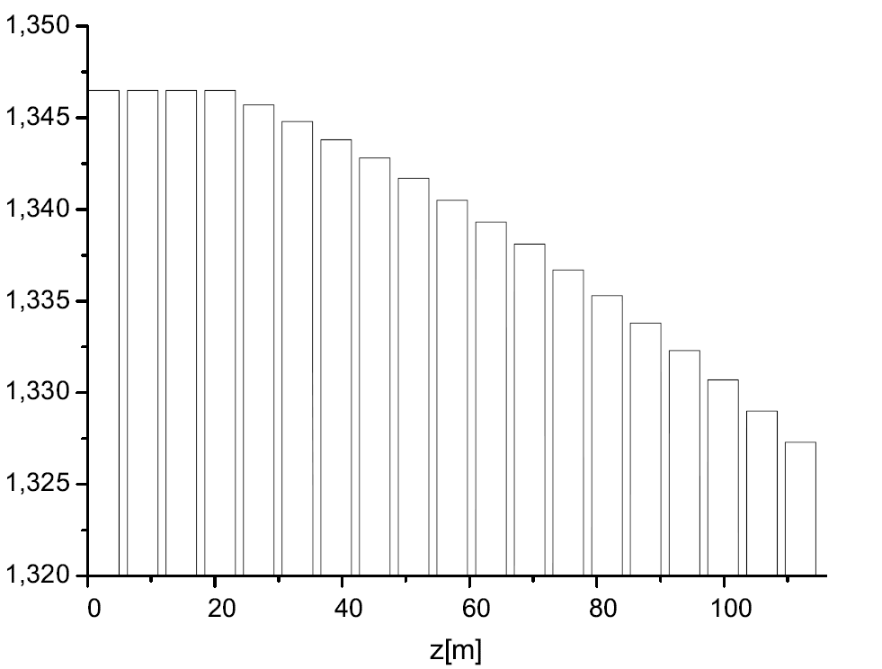
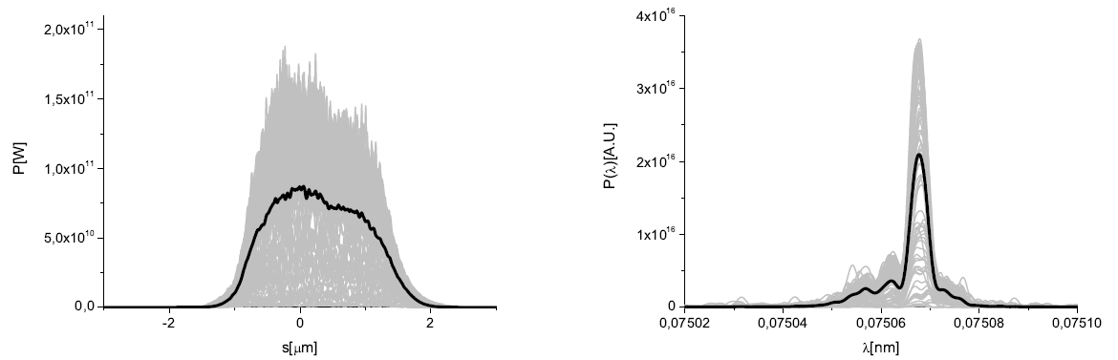
Extension to harder X-rays (II)
11
Combination with tapering allows to reach 100 GW power level
Notes:
11
Before you start editing the slides of your talk change to the Master Slide view:
Menu button “View”, Master, Slide Master:
Edit the following 2 items in the 1st slide:
1) 1st row in the violet header:
Delete the existent text and write the title of your talk into this text field
2) The 2 rows in the footer area: Delete the text and write the information
regarding your talk (same as on the Title Slide) into this text field.
If you want to use more partner logos position them left
beside the DESY logo in the footer area
Close Master View

Slide 12
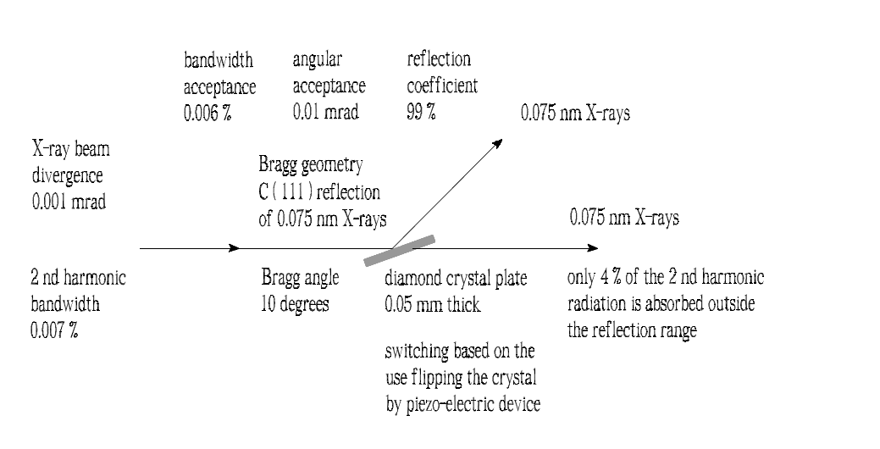
Extension to harder X-rays (III)
12
Monochromaticity at these wavelengths allows for novel X-ray distribution system – Option 1:
Notes:
12
Before you start editing the slides of your talk change to the Master Slide view:
Menu button “View”, Master, Slide Master:
Edit the following 2 items in the 1st slide:
1) 1st row in the violet header:
Delete the existent text and write the title of your talk into this text field
2) The 2 rows in the footer area: Delete the text and write the information
regarding your talk (same as on the Title Slide) into this text field.
If you want to use more partner logos position them left
beside the DESY logo in the footer area
Close Master View

Slide 13
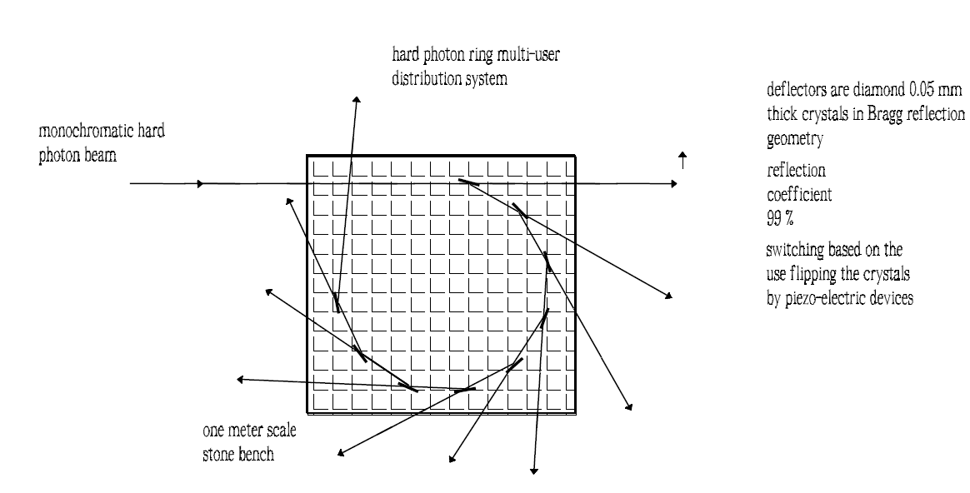
Extension to harder X-rays (IV)
13
Monochromaticity at these wavelengths allows for novel X-ray distribution system – Option 2:
Notes:
13
Before you start editing the slides of your talk change to the Master Slide view:
Menu button “View”, Master, Slide Master:
Edit the following 2 items in the 1st slide:
1) 1st row in the violet header:
Delete the existent text and write the title of your talk into this text field
2) The 2 rows in the footer area: Delete the text and write the information
regarding your talk (same as on the Title Slide) into this text field.
If you want to use more partner logos position them left
beside the DESY logo in the footer area
Close Master View

Slide 14
Soft X-ray self-seeding
14
Compact grating monochromator: Feasibility for the E.XFEL
With V. Kocharyan and E. Saldin: DESY 12-034, February 2012
Notes:
14
Before you start editing the slides of your talk change to the Master Slide view:
Menu button “View”, Master, Slide Master:
Edit the following 2 items in the 1st slide:
1) 1st row in the violet header:
Delete the existent text and write the title of your talk into this text field
2) The 2 rows in the footer area: Delete the text and write the information
regarding your talk (same as on the Title Slide) into this text field.
If you want to use more partner logos position them left
beside the DESY logo in the footer area
Close Master View

Slide 15
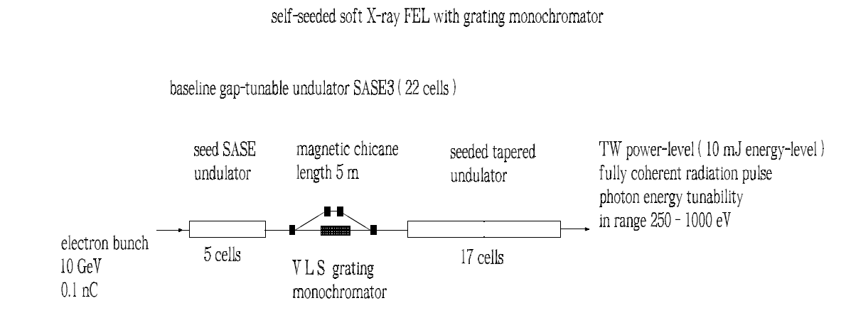
Soft X-ray Self-seeding
15
Back to the original DESY idea by Feldhaus et al. (Optics. Comm. 140, 341 (1997) : 15 years ago)…
…but with a great, very compact monochromator design by SLAC, allowing for short chicane!
Notes:
15
Before you start editing the slides of your talk change to the Master Slide view:
Menu button “View”, Master, Slide Master:
Edit the following 2 items in the 1st slide:
1) 1st row in the violet header:
Delete the existent text and write the title of your talk into this text field
2) The 2 rows in the footer area: Delete the text and write the information
regarding your talk (same as on the Title Slide) into this text field.
If you want to use more partner logos position them left
beside the DESY logo in the footer area
Close Master View

Slide 16
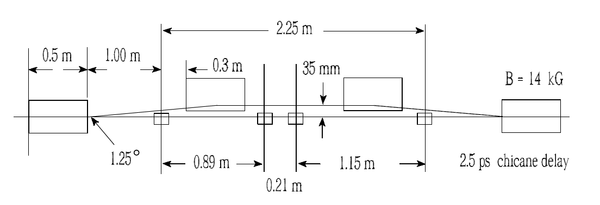
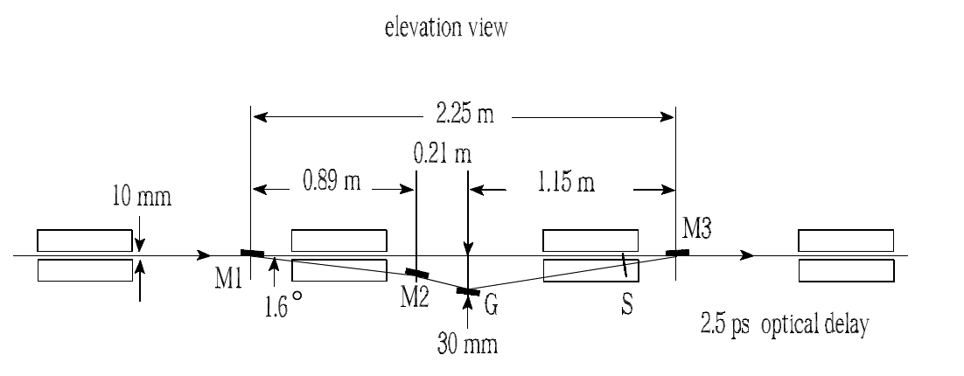
SLAC grating monochromator adapted to E.XFEL
16
Great design by SLAC
See e.g. Y. Feng, P. Heimann, J. Wu, J. Krzywinski, M. Rowen, and J. Hastings. “Compact Grating Monochromator Design
for LCLS-I Soft X-ray Self-Seeding”, Oct. 1, Seeded FELs in the Soft X-Ray Regime Workshop, Berkeley:
https://sites.google.com/a/lbl.gov/realizing-the-potential-of-seeded-fels-in-the-soft-x-ray-regime-workshop/talks
Notes:
16
Before you start editing the slides of your talk change to the Master Slide view:
Menu button “View”, Master, Slide Master:
Edit the following 2 items in the 1st slide:
1) 1st row in the violet header:
Delete the existent text and write the title of your talk into this text field
2) The 2 rows in the footer area: Delete the text and write the information
regarding your talk (same as on the Title Slide) into this text field.
If you want to use more partner logos position them left
beside the DESY logo in the footer area
Close Master View

Slide 17
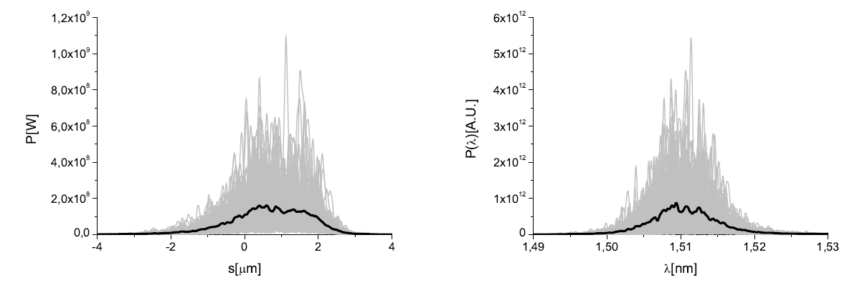
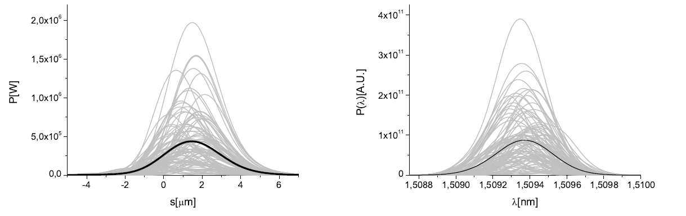
Soft X-ray Self-seeding: monochromator
17
Notes:
17
Before you start editing the slides of your talk change to the Master Slide view:
Menu button “View”, Master, Slide Master:
Edit the following 2 items in the 1st slide:
1) 1st row in the violet header:
Delete the existent text and write the title of your talk into this text field
2) The 2 rows in the footer area: Delete the text and write the information
regarding your talk (same as on the Title Slide) into this text field.
If you want to use more partner logos position them left
beside the DESY logo in the footer area
Close Master View

Slide 18
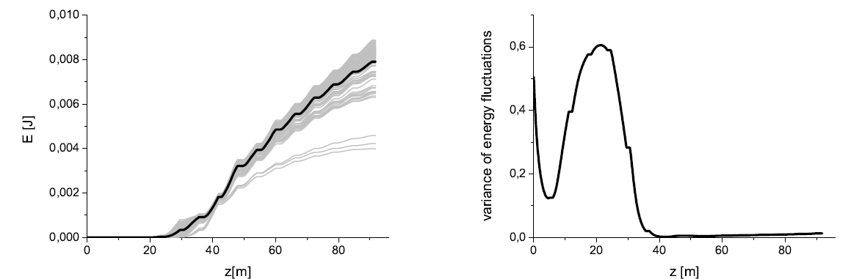
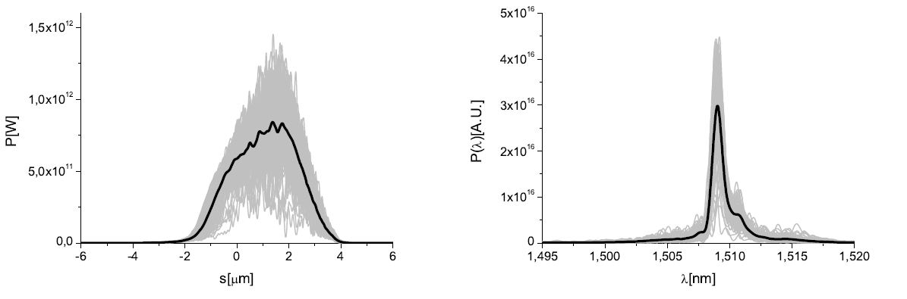
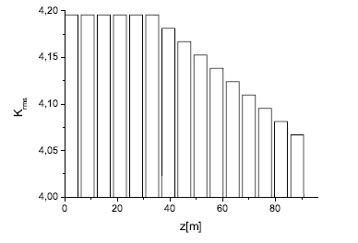
Soft X-ray Self-seeding
18
Notes:
18
Before you start editing the slides of your talk change to the Master Slide view:
Menu button “View”, Master, Slide Master:
Edit the following 2 items in the 1st slide:
1) 1st row in the violet header:
Delete the existent text and write the title of your talk into this text field
2) The 2 rows in the footer area: Delete the text and write the information
regarding your talk (same as on the Title Slide) into this text field.
If you want to use more partner logos position them left
beside the DESY logo in the footer area
Close Master View

Slide 19
Soft X-ray self-seeding
19
Pulse-front tilt caused by the use of grating monochromator and self-seeding of soft X-ray FELs
With V. Kocharyan, E. Saldin: DESY 12-05, March 2012
Notes:
19
Before you start editing the slides of your talk change to the Master Slide view:
Menu button “View”, Master, Slide Master:
Edit the following 2 items in the 1st slide:
1) 1st row in the violet header:
Delete the existent text and write the title of your talk into this text field
2) The 2 rows in the footer area: Delete the text and write the information
regarding your talk (same as on the Title Slide) into this text field.
If you want to use more partner logos position them left
beside the DESY logo in the footer area
Close Master View

Slide 20
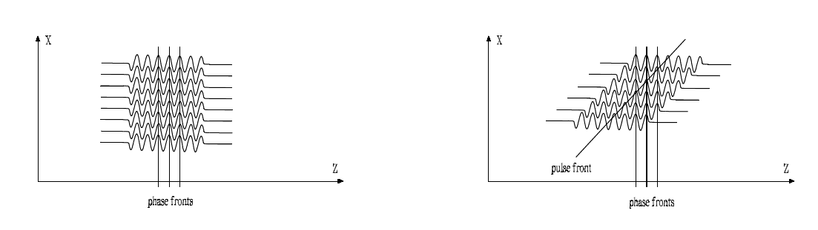
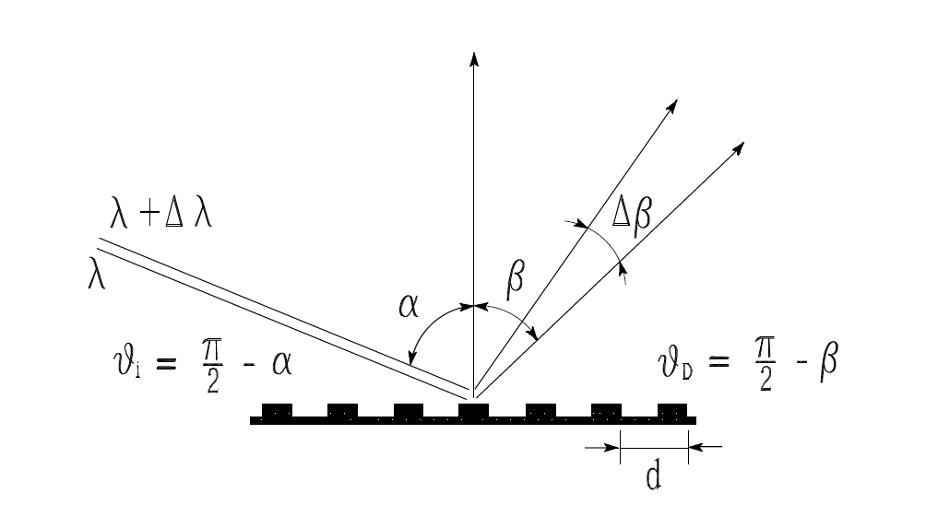
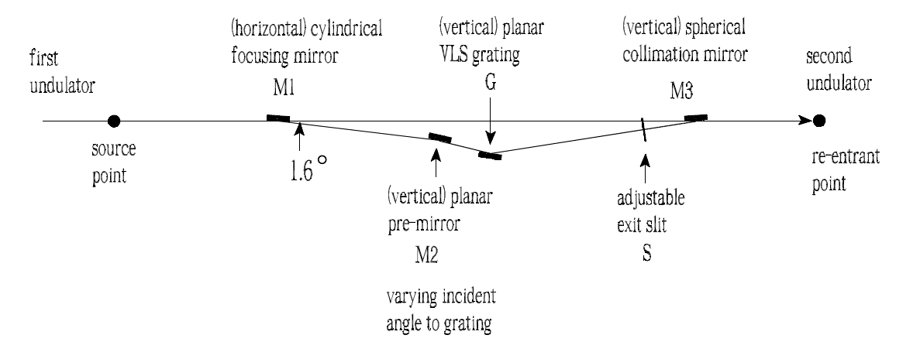
Soft X-ray self-seeding
20
Important effect for self-seeding!
Notes:
20
Before you start editing the slides of your talk change to the Master Slide view:
Menu button “View”, Master, Slide Master:
Edit the following 2 items in the 1st slide:
1) 1st row in the violet header:
Delete the existent text and write the title of your talk into this text field
2) The 2 rows in the footer area: Delete the text and write the information
regarding your talk (same as on the Title Slide) into this text field.
If you want to use more partner logos position them left
beside the DESY logo in the footer area
Close Master View

Slide 21
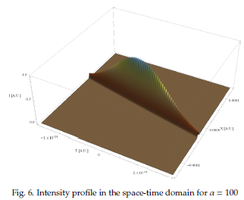
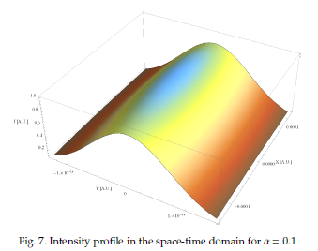
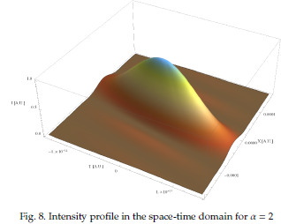
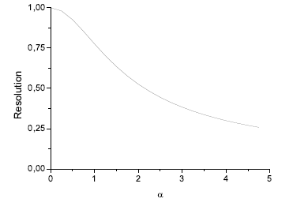
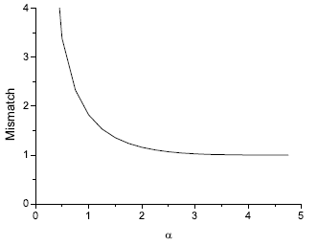
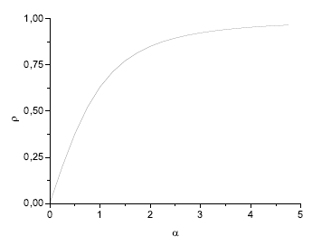
Soft X-ray self-seeding
21
Notes:
21
Before you start editing the slides of your talk change to the Master Slide view:
Menu button “View”, Master, Slide Master:
Edit the following 2 items in the 1st slide:
1) 1st row in the violet header:
Delete the existent text and write the title of your talk into this text field
2) The 2 rows in the footer area: Delete the text and write the information
regarding your talk (same as on the Title Slide) into this text field.
If you want to use more partner logos position them left
beside the DESY logo in the footer area
Close Master View

Slide 22
Theoretical studies
22
On quantum effects in spontaneous emission by a relativistic electron beam in an undulator
With V. Kocharyan, E. Saldin: DESY 12-022, February 2012
Notes:
22
Before you start editing the slides of your talk change to the Master Slide view:
Menu button “View”, Master, Slide Master:
Edit the following 2 items in the 1st slide:
1) 1st row in the violet header:
Delete the existent text and write the title of your talk into this text field
2) The 2 rows in the footer area: Delete the text and write the information
regarding your talk (same as on the Title Slide) into this text field.
If you want to use more partner logos position them left
beside the DESY logo in the footer area
Close Master View

Slide 23

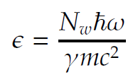
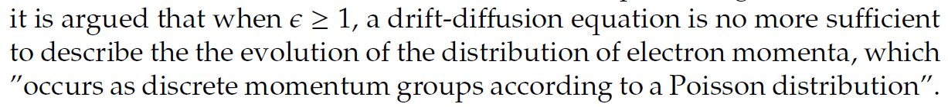
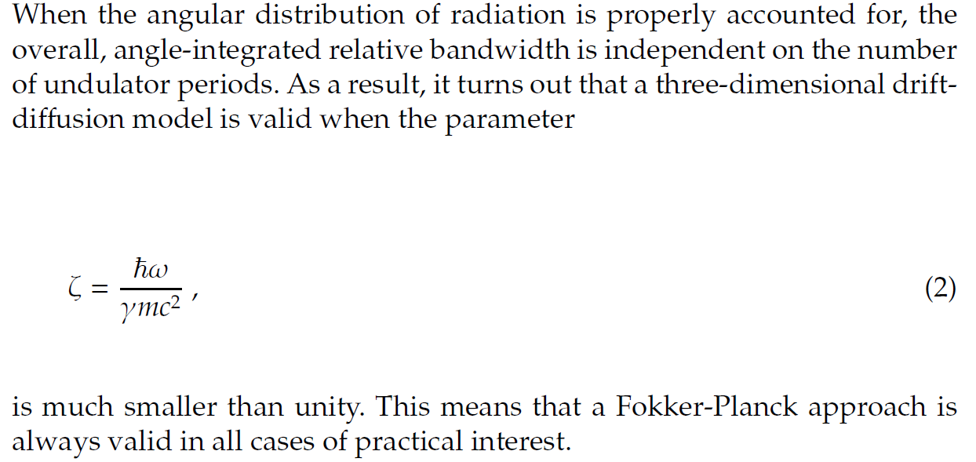
Study on quantum effects on SR

Slide 24
Comparison of forecasted and achieved progress:
Jan. 12 → Mar. 12
Cooperation with O. Chubar (support, R&D and extension of capabilities, PBBA problems)
First Implementation of parallelization (it-hpc @desy, 512 cores)
Integration of different SR code parts began: common input/output framework, GUI, support of high-performance computing in the GUI
Student hired within HZB cooperation (Malte Titze)
Notes:
Before you start editing the slides of your talk change to the Master Slide view:
Menu button “View”, Master, Slide Master:
Edit the following 2 items in the 1st slide:
1) 1st row in the violet header:
Delete the existent text and write the title of your talk into this text field
2) The 2 rows in the footer area: Delete the text and write the information
regarding your talk (same as on the Title Slide) into this text field.
If you want to use more partner logos position them left
beside the DESY logo in the footer area
Close Master View

Slide 25
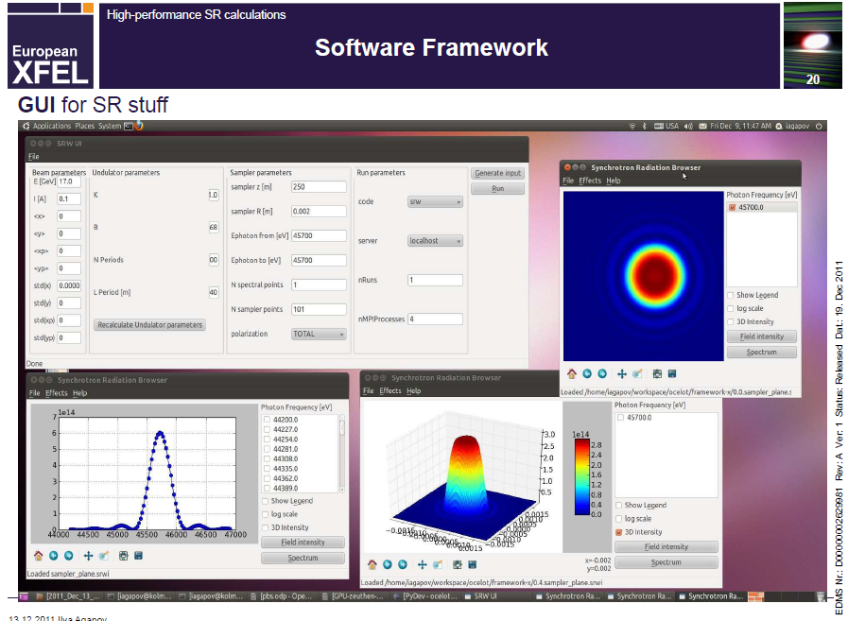
Comparison of forecasted and achieved progress:
Jan. 12 → Mar. 12
I. Agapov
Notes:
Before you start editing the slides of your talk change to the Master Slide view:
Menu button “View”, Master, Slide Master:
Edit the following 2 items in the 1st slide:
1) 1st row in the violet header:
Delete the existent text and write the title of your talk into this text field
2) The 2 rows in the footer area: Delete the text and write the information
regarding your talk (same as on the Title Slide) into this text field.
If you want to use more partner logos position them left
beside the DESY logo in the footer area
Close Master View

Slide 26
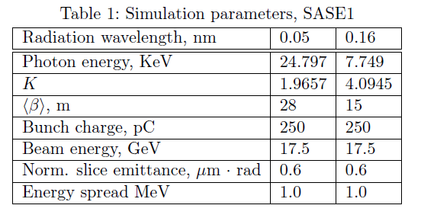
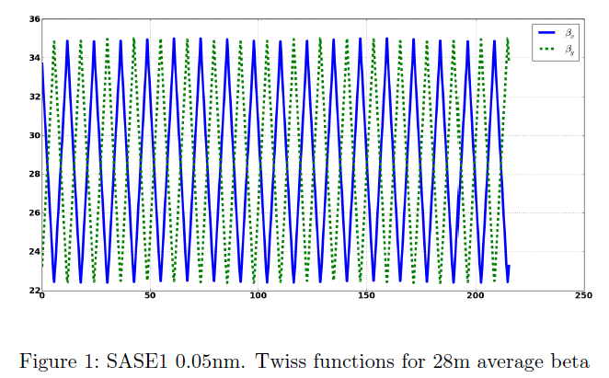
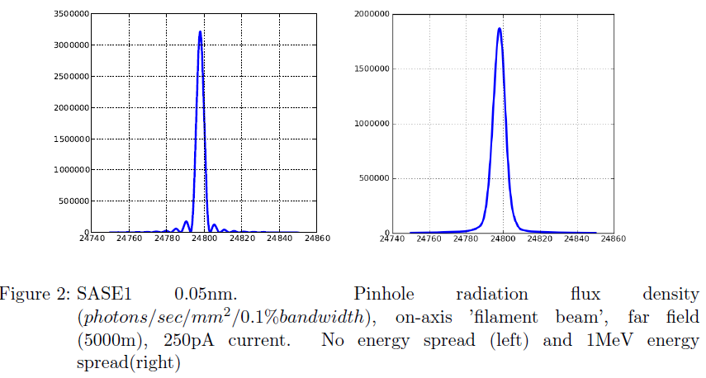
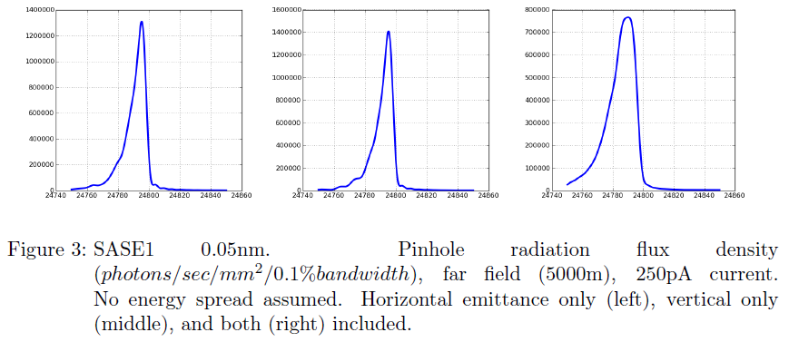
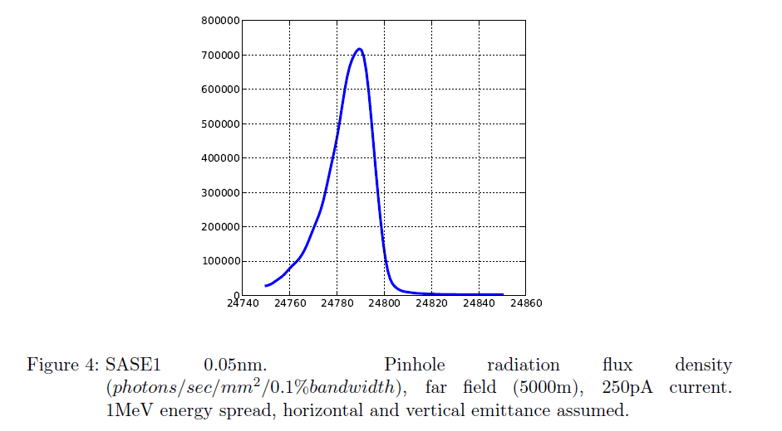
Comparison of forecasted and achieved progress:
Jan. 12 → Mar. 12
Cooperation with WP-74 on PBBA continues
I. Agapov
Notes:
Before you start editing the slides of your talk change to the Master Slide view:
Menu button “View”, Master, Slide Master:
Edit the following 2 items in the 1st slide:
1) 1st row in the violet header:
Delete the existent text and write the title of your talk into this text field
2) The 2 rows in the footer area: Delete the text and write the information
regarding your talk (same as on the Title Slide) into this text field.
If you want to use more partner logos position them left
beside the DESY logo in the footer area
Close Master View

Slide 27
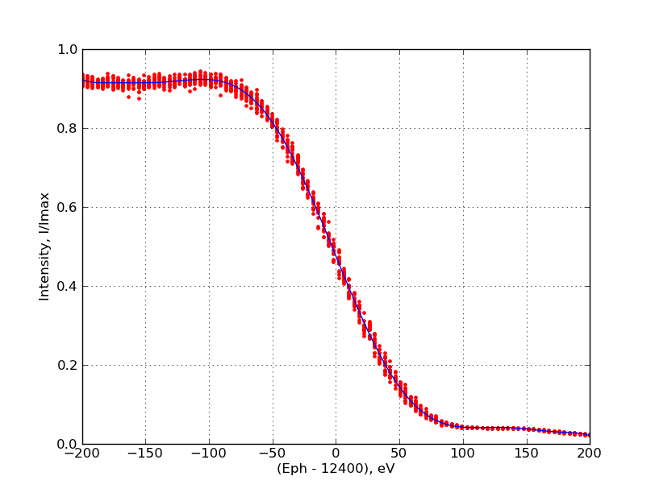
Comparison of forecasted and achieved progress:
Jan. 12 → Mar. 12
Tuning of K-parameter
Sergey Tomin and Nikolay Smolyakov
Notes:
Before you start editing the slides of your talk change to the Master Slide view:
Menu button “View”, Master, Slide Master:
Edit the following 2 items in the 1st slide:
1) 1st row in the violet header:
Delete the existent text and write the title of your talk into this text field
2) The 2 rows in the footer area: Delete the text and write the information
regarding your talk (same as on the Title Slide) into this text field.
If you want to use more partner logos position them left
beside the DESY logo in the footer area
Close Master View

Slide 28
Activities and milestones scheduled for the next half year
Continue investigation of schemes beyond baseline for the European XFEL
Continue cooperation with O. Chubar (support, R&D and extension of capabilities, PBBA problems)
Continue cooperation with Dr. N. Smolyakov and S. Tomin (integration into E. XFEL package, PBBA, alternative routines for SR calculations)
Continue implementation of parallelization: algorithm analysis and hardware/software evaluation for optimal performance
Continue cooperation with WP-74 on PBBA
Continue Support to A. Mancuso and M. Meyer
Continue HZB cooperation
Continue integration of different SR code parts: common input/output framework, GUI, support of high-performance computing in the GUI

