Slide 1
WP-71 XFEL Project Progress Report (1-2012)
J. Pflüger
Notes:
How to edit the title slide
Upper area: Title of your talk, max. 2 rows of the defined size (55 pt)
Lower area (subtitle): Conference/meeting/workshop, location, date, your name and affiliation, max. 4 rows of the defined size (32 pt)
Change the partner logos or add others in the last row.

Slide 2
Comparison of forecasted and achieved progress: Jan. 12 → Mar. 12
Progress with magnetic measurement techniques – needs more work
Two more benches XFEL#2 and XFEL#3 fully commissioned. All benches XFEL#1 - XFEL#3 are fully operational. –finished!
First U40 segment successfully tuned to specs on XFEL#1 – finished!
First U68 segment successfully tuned to specs on XFEL#2. U68 design complies with specifications – finished!
RfQ for 85 Undulator segments finished and approved by MB end of March 2012 - slightly delayed
Work on global control systems started: First proof of synchronous, collective move of two undulator segments – in schedule
First undulator segment transported with the tunnel transport vehicle and placed into the Mockup tunnel.
Notes:
Before you start editing the slides of your talk change to the Master Slide view: Menu button “View”, Master, Slide Master:
Edit the following 2 items in the 1st slide: 1) 1st row in the violet header: Delete the existent text and write the title of your talk into this text field 2) The 2 rows in the footer area: Delete the text and write the information regarding your talk (same as on the Title Slide) into this text field.
If you want to use more partner logos position them left beside the DESY logo in the footer area Close Master View

Slide 3
Comparison of forecasted and achieved progress: Jan. 12 → Mar. 12
MBOM for the undulator segments estabilshed in EDMS
Establish archive of released PDF drawings in EDMS.
All XQA Quadrupoles for the Undulator systems delivered from BINP to Stockholm University. Fiducialization measurements started
Review on Phase Shifter held in Nov 2011 but delays continue

Slide 4
Planned Activities I
Contracts for undulator segments to be awarded by end of April 2012 - done by 12.4.2012
Start of serial production for 85 Undulator Segments
Establish project management structure for serial production at EXFEL
Prepare lab in Building 36 for serial production expected to start in late summer
Hiring 1 mechatronics engineer for control system, 2 scientists for the magnetic lab - by end of April
2 technicians to be hired

Slide 5
Planned Activities II
Build full scale undulator cell in mockup tunnel
PRR for the intersection in May/June
Further planning of Tunnel infrastructure
All quadrupoles fiducialized at Stockholm University by July 2012

Slide 6
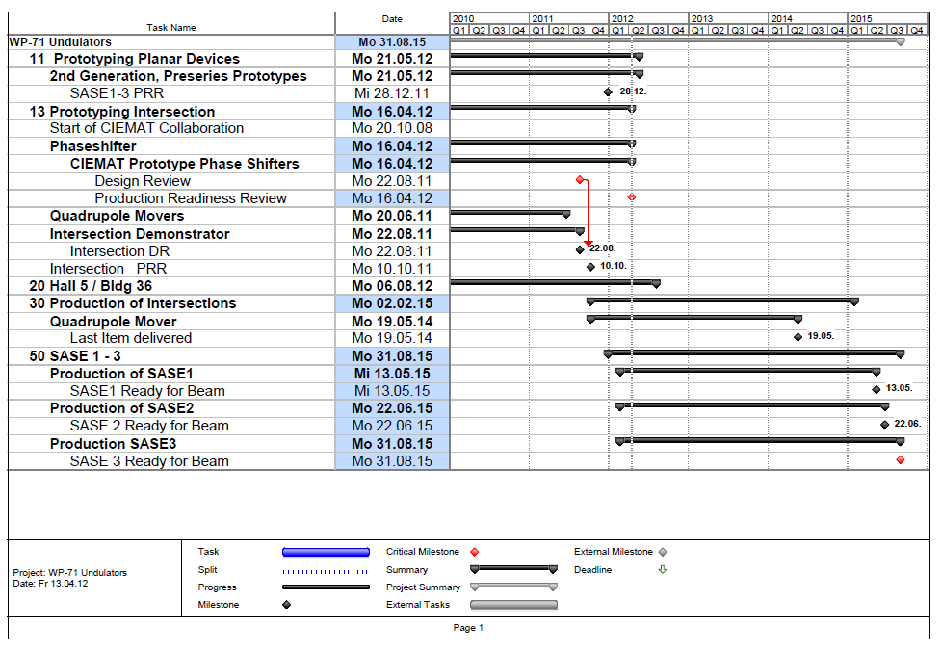
Reporting Milestones

Slide 7
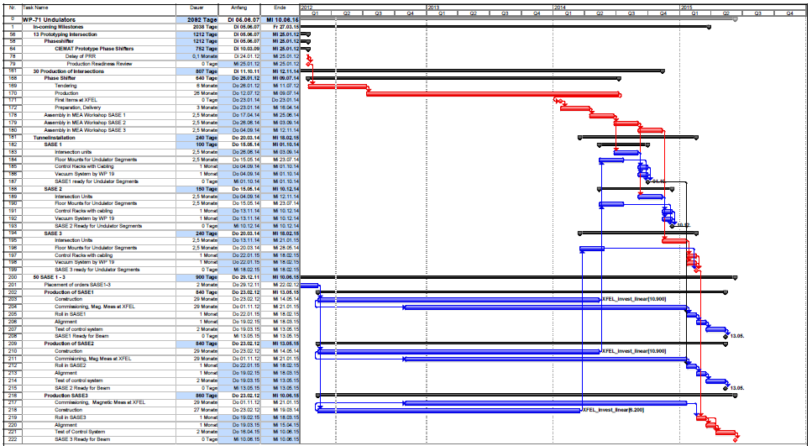
Delay through Phase Shifters: Status 3 Nov 11
Review @CIEMAT Nov 2011
23.01.12
Assembly in MEA Workshop
15.04.15
15.04.15
20.07.15
Tunnel Installation
13.05.15
13.05.15
13.06.15

Slide 8
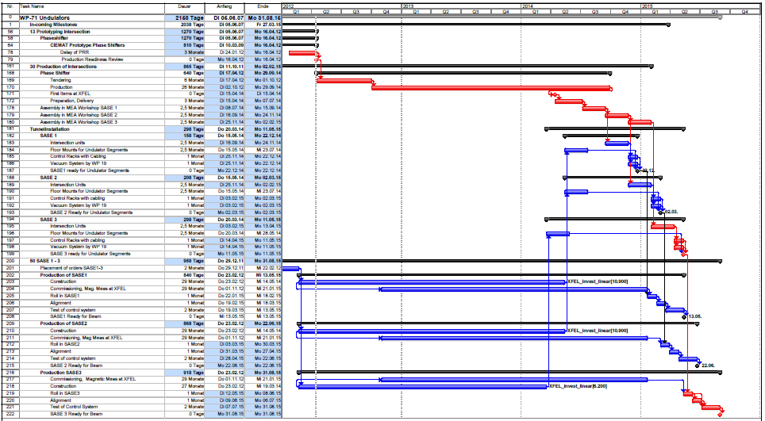
Delay through Phase Shifters: Status 3 April 12
Best positive assumption
16.04.12
13.05.15
22.06.15
31.08.15

Slide 9
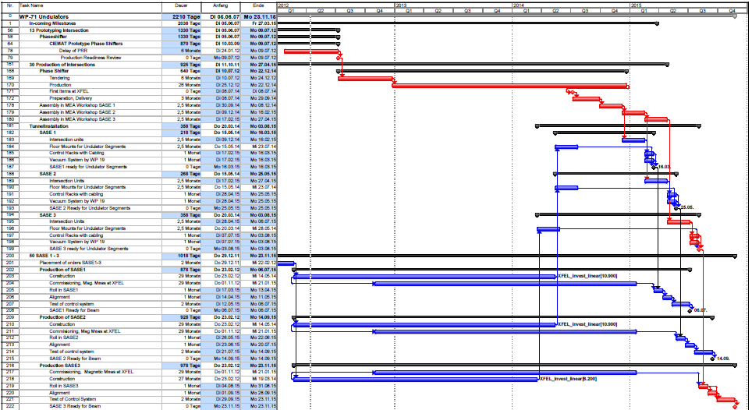
Delay through Phase Shifters: Forecast June 11
What will happen
7.07.12
6.7.15
14.9.15
23.11.15

Slide 10
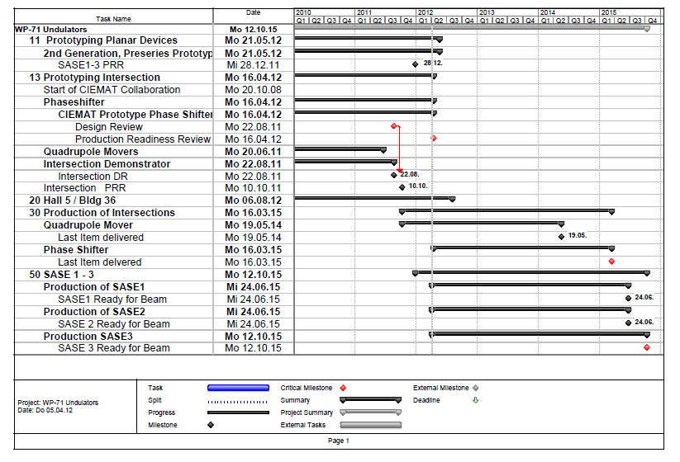
Reporting Milestones

Slide 11
Open Issues
Phase Shifter situation is not solved and gets more severe.

Slide 12
The End

