Slide 1
WP-74
XFEL Project Progress Report
(1-2012)
presented by
Jan Grünert
Achievements since last PPR (Nov 2011)
Next plans
Concerns
Notes:
How to edit the title slide
Upper area: Title of your talk, max. 2 rows of the defined size (55 pt)
Lower area (subtitle): Conference/meeting/workshop, location, date,
your name and affiliation,
max. 4 rows of the defined size (32 pt)
Change the partner logos or add others in the last row.

Slide 2
Main achievements
Nov.11 -> Mar. 12
CDR Reviews on
1) Framework CDR 2) Photoelectron Spectrometer 3) Imaging Stations
first „XGMD for intensity measurements“ constructed;
tested and used to characterize the Japanese XFEL SACLA
ordering of 6 XGMDs (vacuum chambers + HV) started;
HAMP chamber design started
prototype chambers for K-monochromator and MCP-based detector designed, constructed and delivered
participation in SXR@LCLS beamtime on timing diagnostics
3-site meeting participation at SACLA; talk and poster contributions to the DPG Spring Meetings 2012 at Stuttgart and Berlin
dedicated workshop on Photon Diagnostics within XFEL User Meeting 2012
successful submission of several beamtime applications (DESY, ESRF, ...) and conference contributions (SRI, SPIE, DPG) for 2012
WP74 Labs at HERA-South:
2 lab rooms prepared, large clean room tent delivered and installed
Notes:
Before you start editing the slides of your talk change to the Master Slide view:
Menu button “View”, Master, Slide Master:
Edit the following 2 items in the 1st slide:
1) 1st row in the violet header:
Delete the existent text and write the title of your talk into this text field
2) The 2 rows in the footer area: Delete the text and write the information
regarding your talk (same as on the Title Slide) into this text field.
If you want to use more partner logos position them left
beside the DESY logo in the footer area
Close Master View

Slide 3
Comparison of forecasted and achieved progress:
Jan. 12 -> Jun. 12
Experimental Campaigns at PETRA3 and HZB
for testing of prototypes of:
  K-Mono, Imagers, PES, Diamond PSD
Experimental Campaigns at FERMI and FLASH for
  damage studies, testing of scintillators, timing properties
Possibly participation of temporal diagnostics tests at SACLA
MCP-Detector (with JINR)
  Conceptual Design
  Production of one hard x-ray prototype
2nd round of wavefront sensing with successive screens at LCLS (with SPB- and CXI-team)
Hiring of engineer for WP74
Scheduled beamtimes
in April, June, July
Participation in beamtimes
at SLS & FERMI in May
Not scheduled
Done
90% done (photodiodes to be added)
Beamtime last week
29 applications, interviews earlier this week

Slide 4
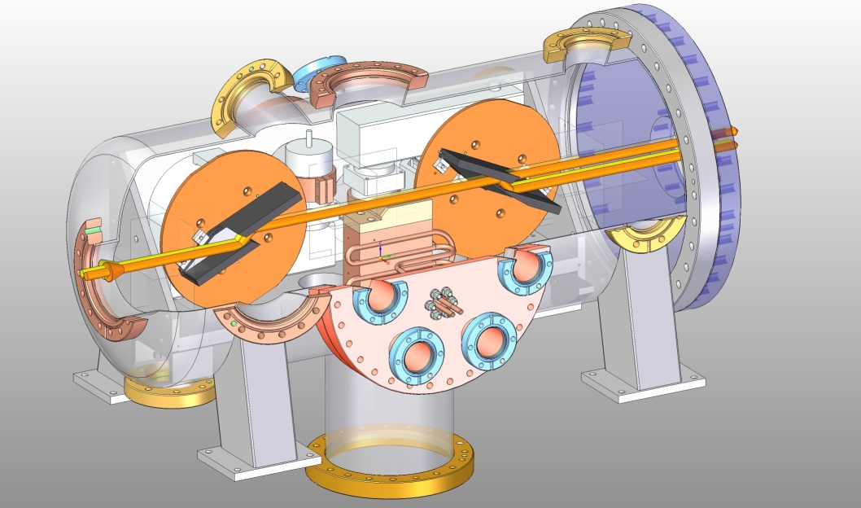
Prototypes
SASE1&2
MCP Prototype
SASE1&2
K-mono Prototype

Slide 5
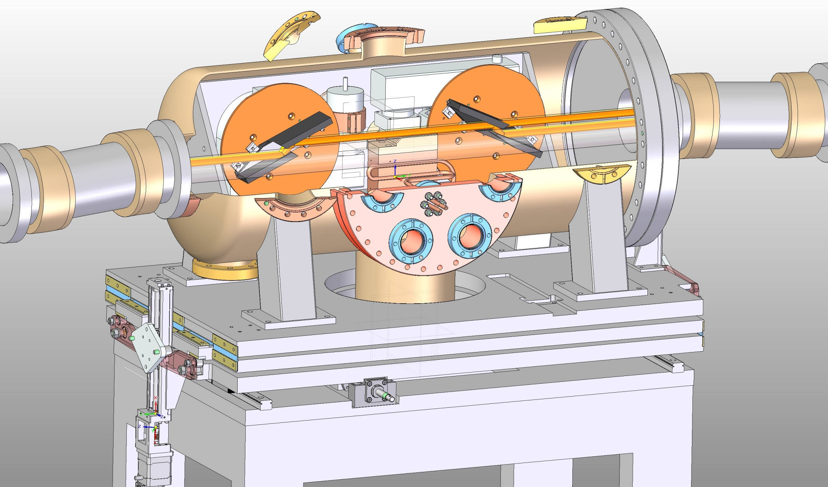
Motion – design
Wolfgang Freund,
WP74

Slide 6
Comparison of forecasted and achieved progress:
Jan. 11 -> Jun. 12
XBPM : revised design: use HAMP chamber w/ split electrodes
PES
  DORIS BW3 beamtime April 2012
  CDR reviewed & updated, soon ready for approval
K-monochromator
  SR test of our first channel-cut crystal at HZB (03/2012)
  DORIS BW1 beamtime in 06/2012, P01 beamtime in 07/2012
Imagers:
  Beamtimes see K-mono
  CDR reviewed & updated, soon ready for approval
Backscatter monitor: prototype construction

Slide 7
Reasons for schedule deviations
Nov. 11 -> Mar. 12
milestone completion:
CDR creation, redaction and approval very time consuming
Backscattering PSD originally not forseen at all, first CDR date was artificially set, but now has a realistic date in view of available manpower
Diamond prototype production very slow („handcrafted“, manpower)

Slide 8
Forecasted progress for
Apr. 12 -> Sep. 12
beamtimes at DORIS BW3 and BW1, at PETRA P01, at SLS, and at FERMI
Finish approval procedure for CDRs on PES, Imaging Stations, MCP-based detector, Framework
XGMD: Test new high voltage isolation concept, high voltage capacitor and pulse resolved signals from the electron Faraday cup at FLASH; Further test of the XGMD for characterization of the LCLS XCS beamline (April); Construction of 5 XGMDs ("first chamber"); Start of calibrations at the PTB; Start construction of the HAMP chamber prototype; Start first campaign for the cross section measurement (August till October)
MCP-based detector: prototype test for MCP efficiency and damage
SR prototype test for BSM and diamond PSD
Organizational: hiring of a new mechanical engineer for WP74
Active participation in the conferences SRI, SPIE, MEDSI

Slide 9
WP schedule and critical path
Critical path: XBPM
  RFI 28.5.2014
  (last piece)
Outgoing milestones:

Slide 10
Open Issues / Risks
No major risks
delays to XGMD/XBPM development
  defines WP74 critical path, more design changes ?
So far no formalized collaboration on wavefront sensing + SSS
  decision to be pursued
Commissioning plan (photon beam systems)
  will be defined in “Workgroup on Commissioning”
  determines some requirements to the commissioning diagnostics devices
  needs follow-up only within workgroup
Budget mismatch plan/actual:
  the “big” DESY/HASYLAB invoices are still missing
  large JINR payment due end 2011 is 4 months delayed
  (pending milestone: CDR approval)
Thank you for your attention

