Slide 1
Photon Beam Transport
WP73
Harald Sinn
PPR1-2012, April 19, 2012

Slide 2
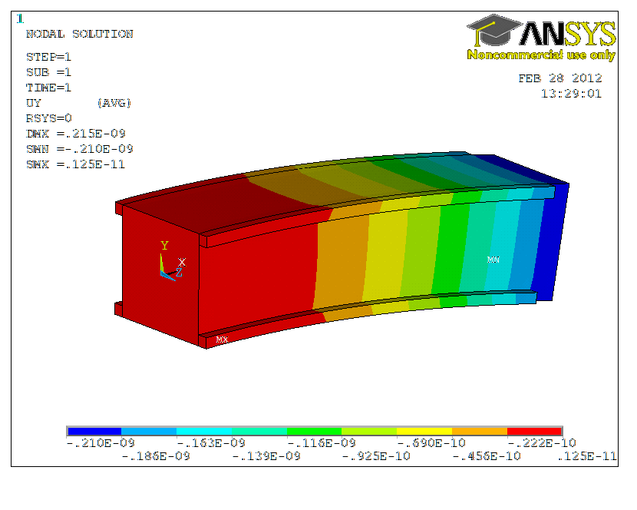
Achievements since last PPR (Nov. 2011)
Contract on mirror prototype was signed on February 28th :
2 nm PV figure error, 80 cm long mirror, weakly bendable, adaptive design and water cooled.
(FEA ongoing, CDR expected mid June)
From F. Yang, E.XFEL

Slide 3
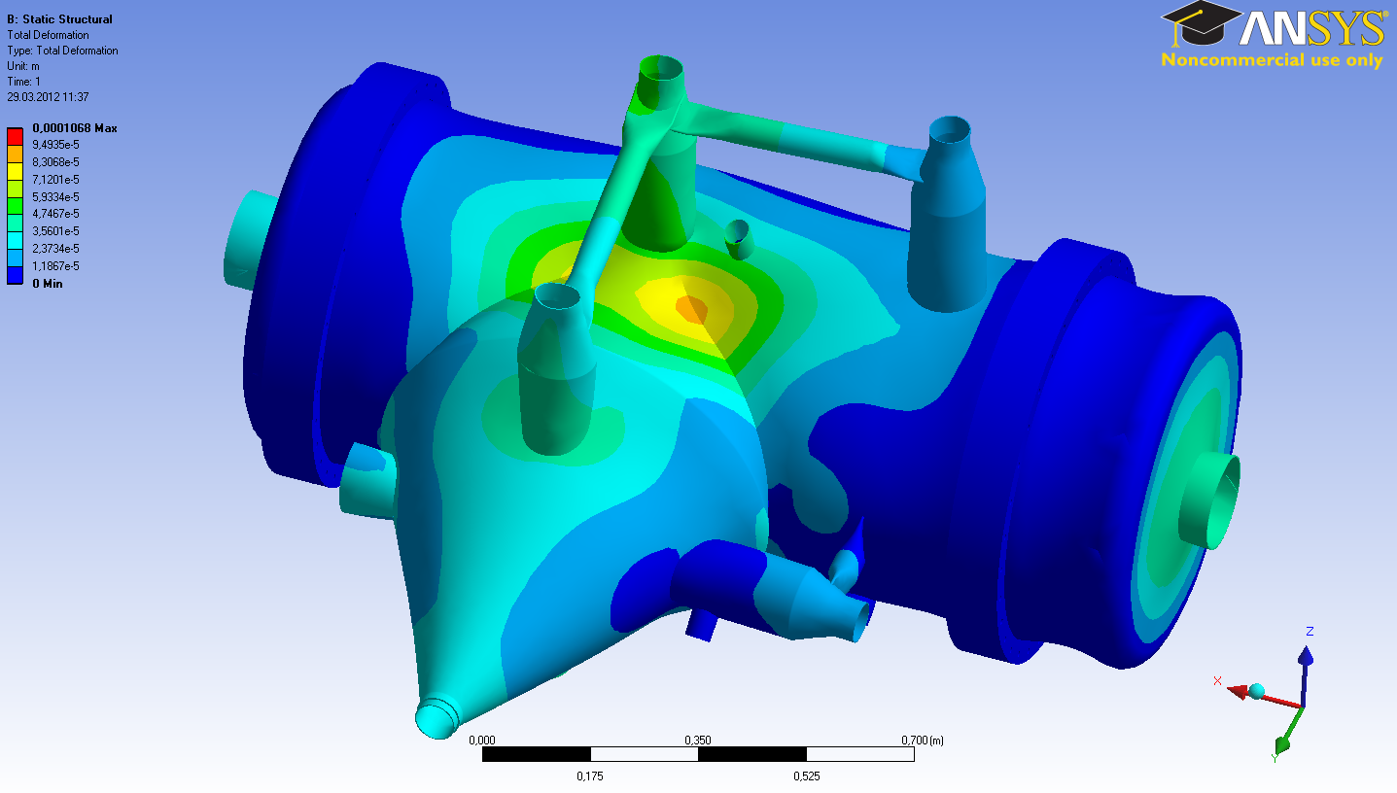
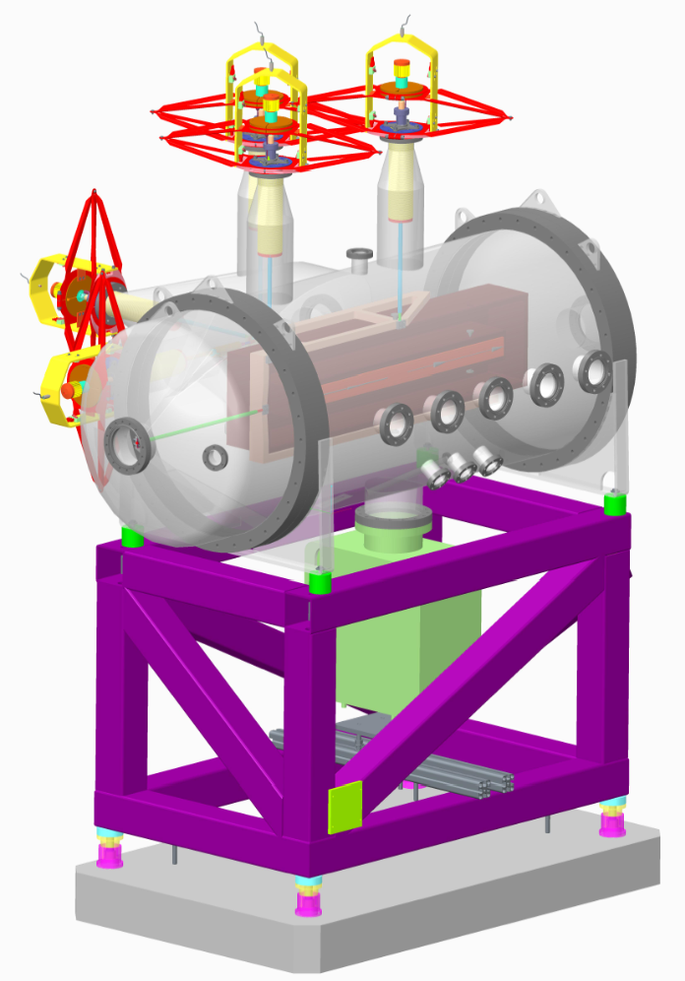
Mirror chamber development
DR in January, FEA reveals problem with sensitivity to air pressure variations, tender expected in June.
1 bar = 6 microns
± 40 hPa = ± 240 nm = ± 480 nrad
SASE2: 660 m × 480 nrad × 2 = ±0.6 mm hor. beam motion depending on weather
T. Noll, HZB, A. Trapp E.XFEL

Slide 4
SASE3 monochromator (CDR update)
Side view
VLS G1, G2, (M4)
horizontal focus
experiment hall
M1
M2
M5
M6
M3a,b,c
vertical exit slits
Top view
open
SQS
SCS
281
283.9
300
301
339
341
374
400
417

Slide 5
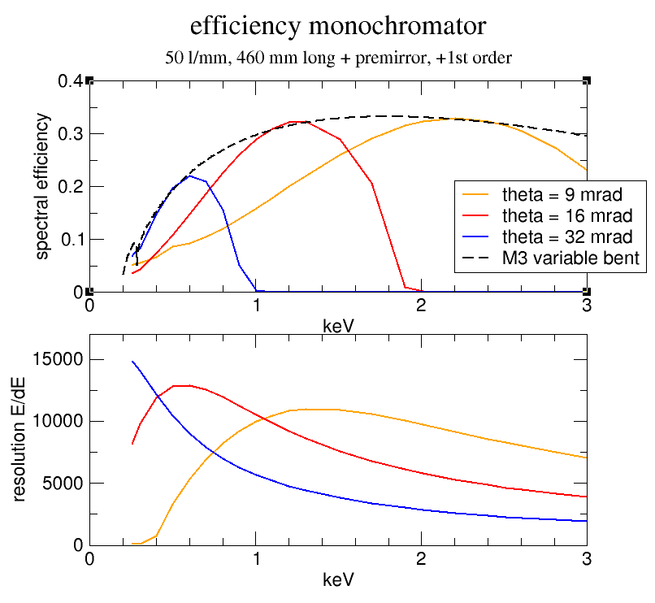
SASE3 mono and resolution
800 eV +/- 160 meV
Ray tracing by R. Follath, HZB
ΔE = 60 meV
800 eV/60 meV = 13.000
Next step: wavefront calculations + technical design concept

Slide 6
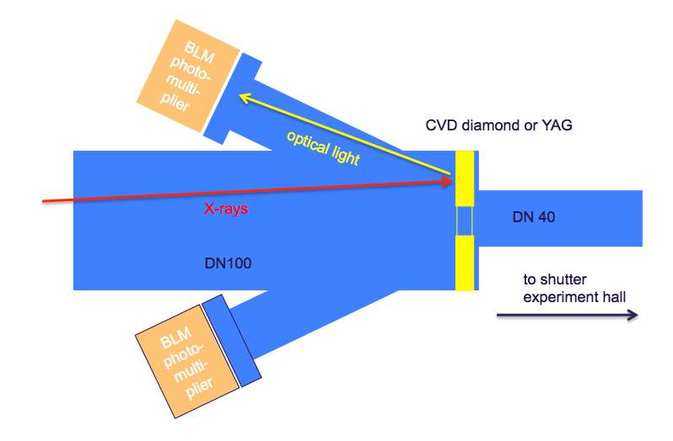
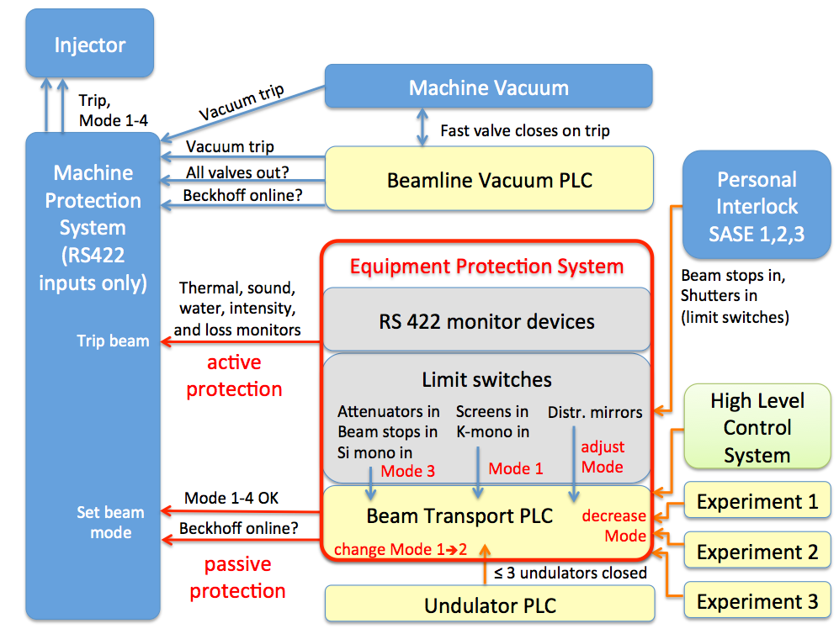
Equipment protection system
Concept
Devices
Under discussion with MPS group, WPs 74,17&76,
Presented in XFEL meeting on Feb. 8, 2012

Slide 7
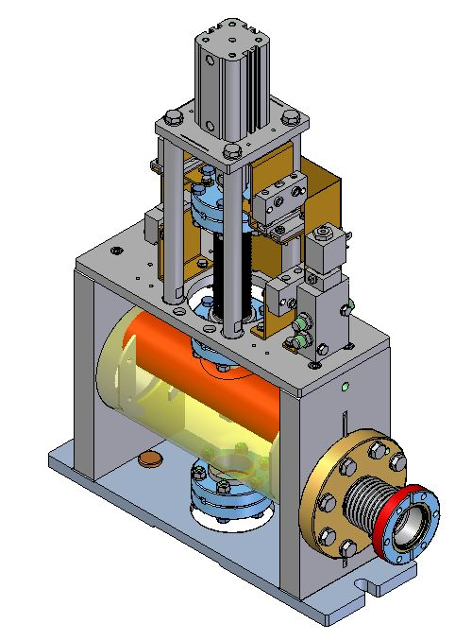
Other achievements since Nov. 2011
3D CAD placeholder model updated including E-racks
Started E-crate allocation plan
Signed contract on Hard X-ray Monochromator
First vibration studies in tunnels
Interferometer test setup reached 100 nrad stability
Prototype pump station build up
Prototype SR-Aperture received
Shutter requirements determined (WP35), collaboration with DESY started on design
Damage studies on gratings
CDR for gas attenuator
DESY FSBT design,
F. Yang E.XFEL

Slide 8
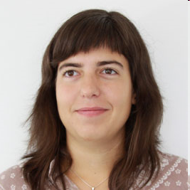
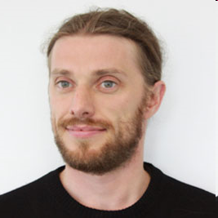
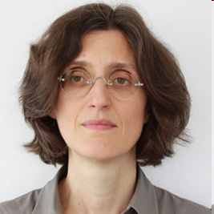
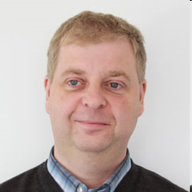
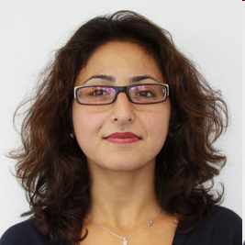
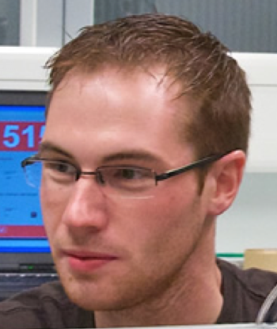
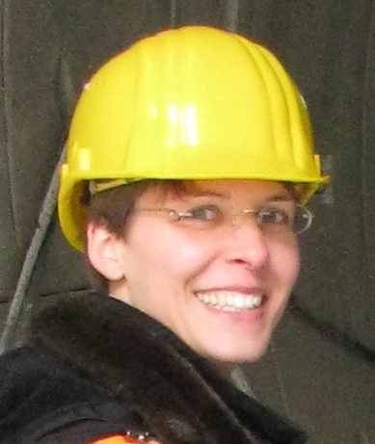
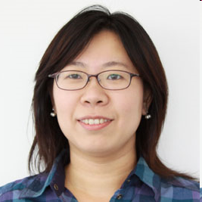
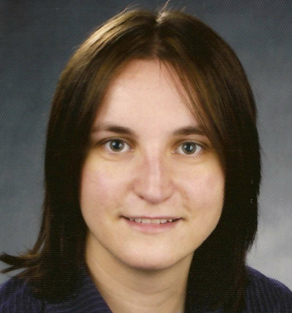
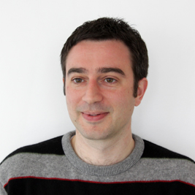
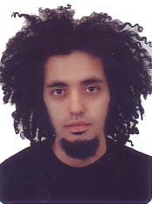

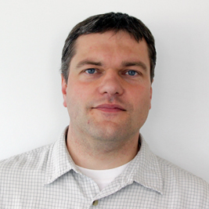
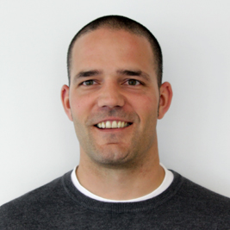

WP73 team
x-ray optics
students
Idoia Freijo
Jerome Gaudin
Liubov Samoylova
Shafagh Dastjani
Jens Linnemann
Harald Sinn
design
Antje Trapp
Fan Yang
Nicole Kohlstrunk
Daniele La Civita (ALS)
Xiaohao Dong (Soleil)
vacuum
New !
WP-73
Martin Dommach
Alexander Bartmann
Raul Villanueva
Timo Korsch starts 1.5.2012

Slide 9
Next plans
Get out mirror chamber design
Make progress on mirror prototype
Progress on hard + soft X-ray mono
Design of 3.5 km beam transport, IKC Poland (?)
Design of beam stops, apertures
Vacuum test setup in Hera Süd
Build-up and test of gas attenuator
Damage experiment on metal–coated mirrors
Technical Design Review in September 2012

Slide 10
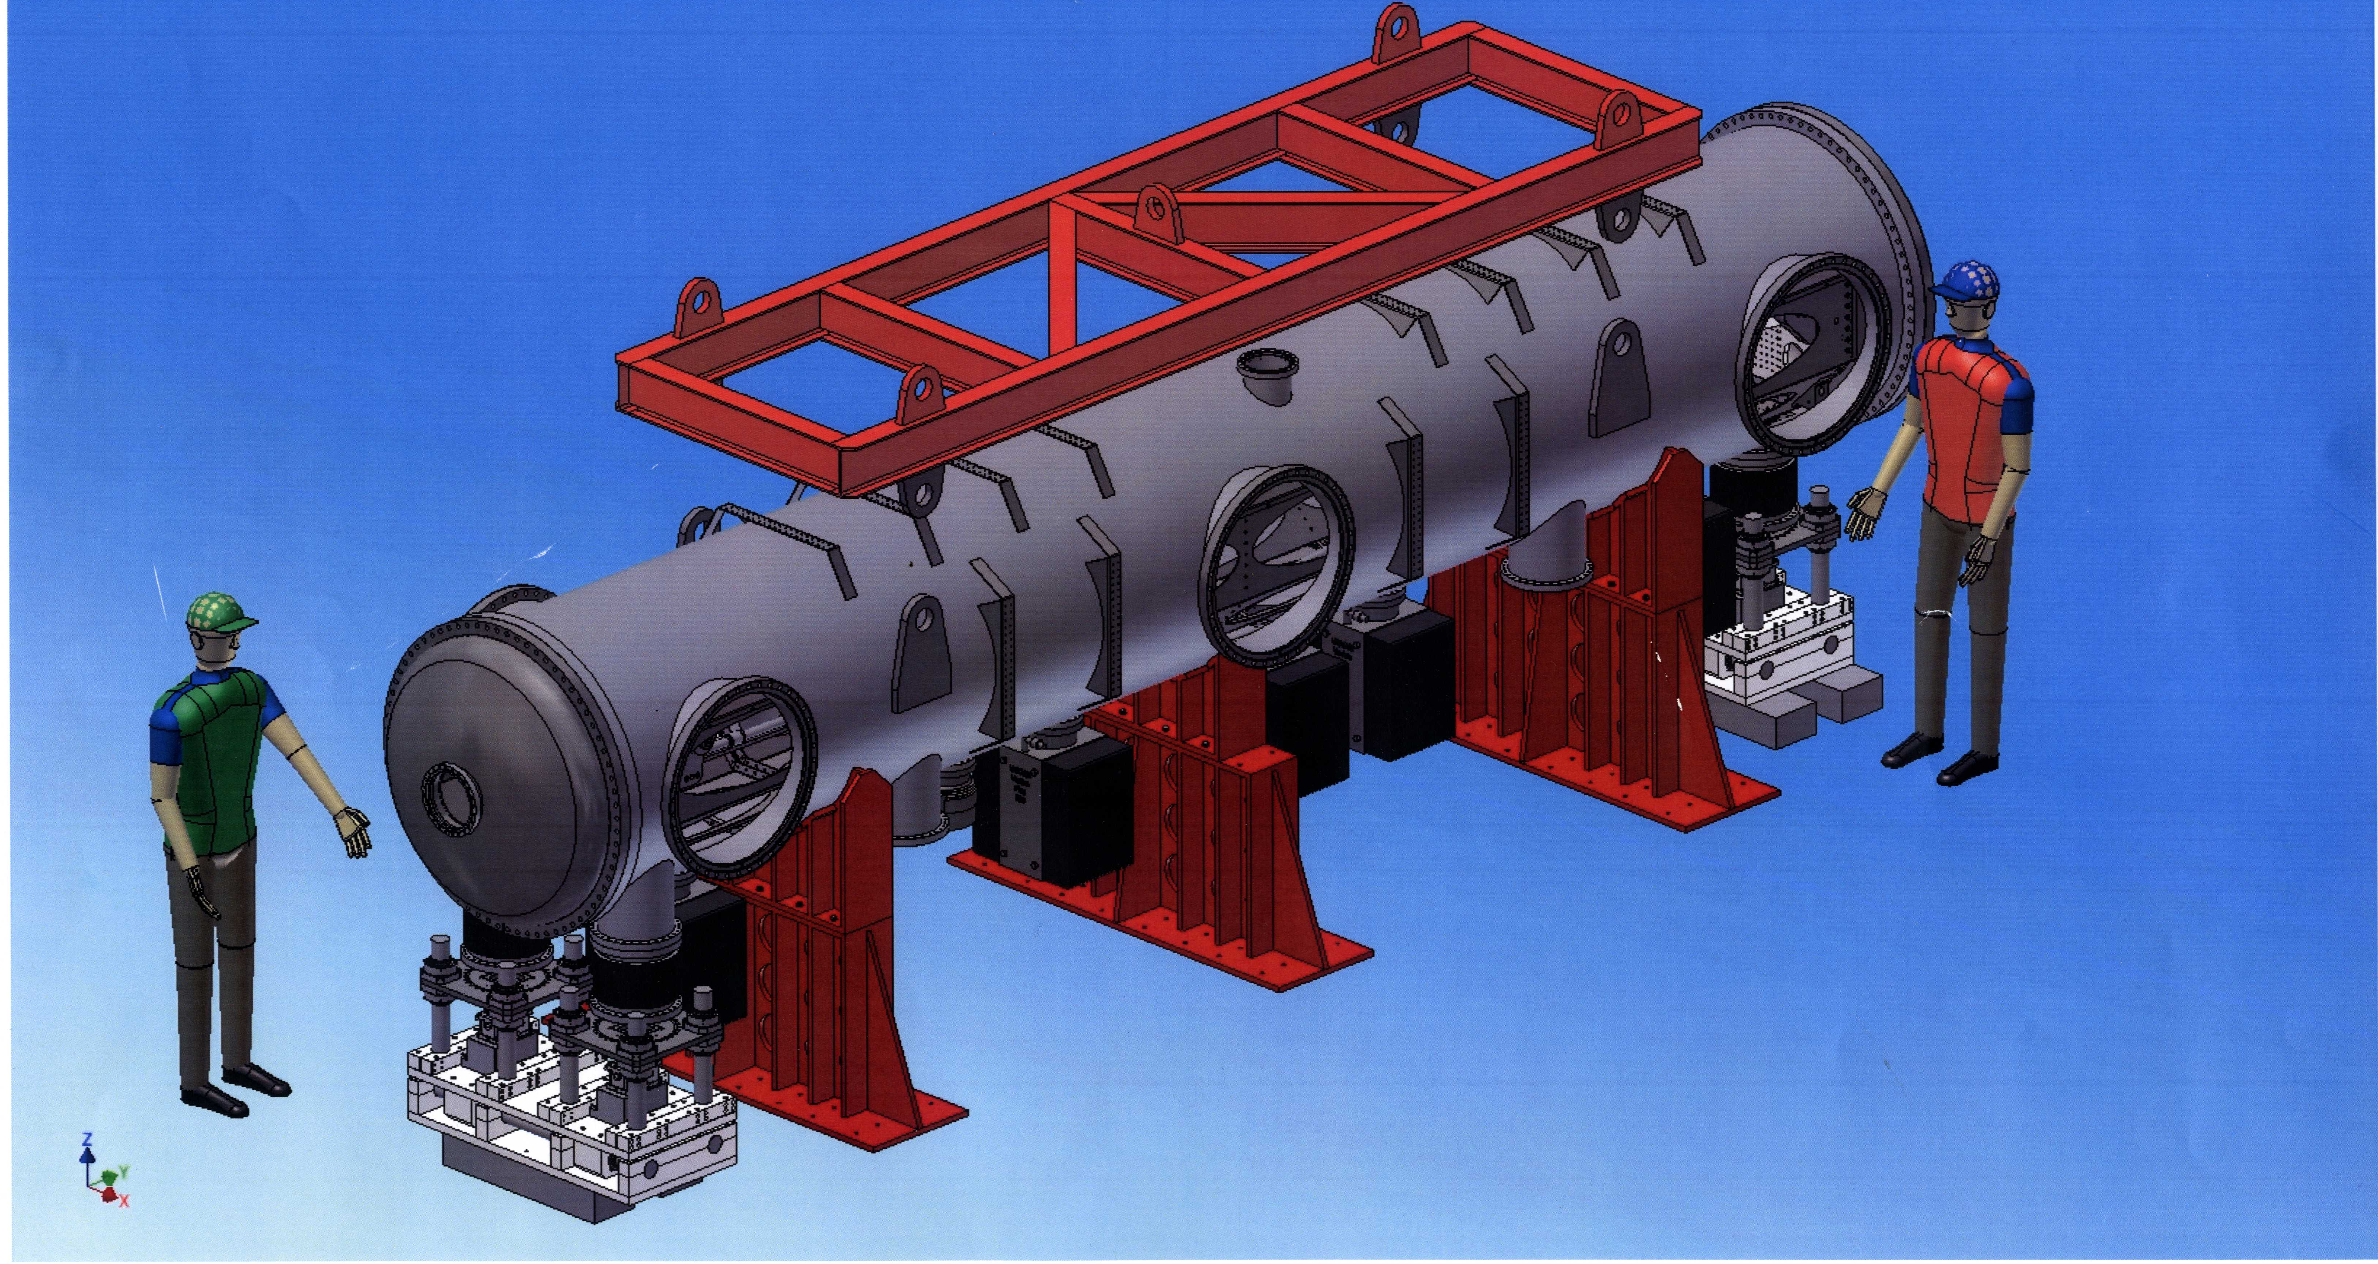
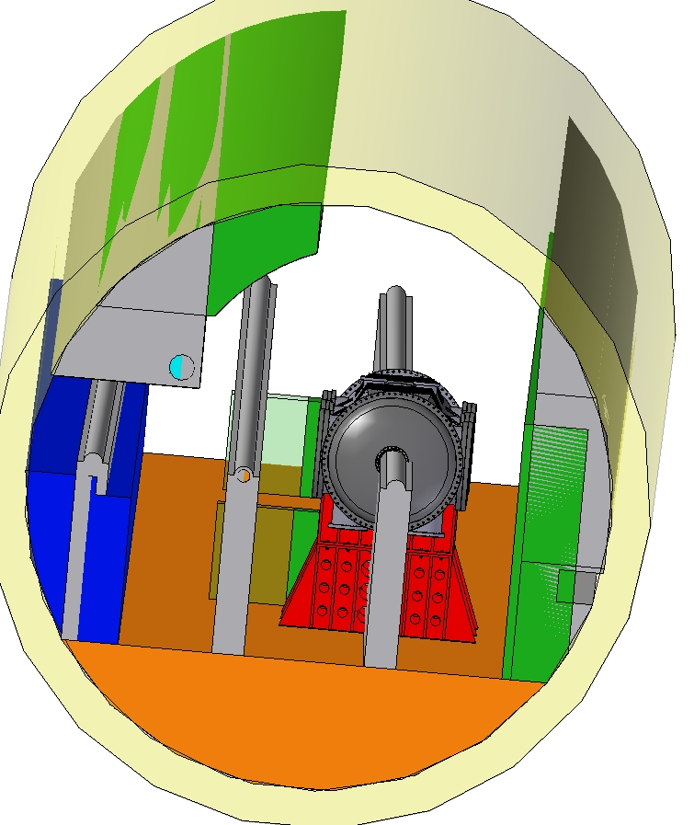
Concerns: Where to put Spilt & Delay line?
IKC from Uni Münster: Split & Delay Line
Not clear, which experiment will use it and in which tunnel & beam transport it should go
(requires collision checks, infrastructure, controls)
SASE 2, XTD6

