Slide 1
WP-79 Sample Environment XFEL Project Progress Report (1-2012)
presented by
Joachim Schulz
Notes:
How to edit the title slide
Upper area: Title of your talk, max. 2 rows of the defined size (55 pt)
Lower area (subtitle): Conference/meeting/workshop, location, date, your name and affiliation, max. 4 rows of the defined size (32 pt)
Change the partner logos or add others in the last row.

Slide 2
Start-up of the sample environment group
Biology
Aerodynamic lens (Uppsala IKC)
Bio-labs (together with UseXBI UC)
Fixed targets
Hexapod
Ultra-fast sample change
Gases
COMO UC
Ultrasonic beam
Liquids
Droplets in vacuum
Droplets
Advanced preparation
Sandwiches
Cryo samples
In gas cell
Cluster beam
Gas cell
Nano-droplets
Jets and sheets
In air
In vacuum

Slide 3
Planning progress
Evaluation of requirements
Sample environment survey
What kinds of sample technologies are foreseen at the beamlines
Common use labs survey
Defining common use labs in the XHQ
Defining potential users and tasks
Bio labs
Evaluating space requirements
Defining bio safety standards (on-going)

Slide 4
Planning progress
In-kind contribution from Uppsala University (J. Hajdu)
Contract
Schedule and budget fixed in Fall 2011
Contract signed December 2011
Sample injector
Milestone 1: Conceptual design finished
Milestone 2: Initial R&D finished
Optical probes
Milestone 1: Conceptual design finished
Milestone 2: Initial R&D finished

Slide 5
Planning progress
User consortia and further in-kind contributions
UseXBI: Bio-facility with EMBL and co-applicants
Setup a bio facility in XHQ
Deliver samples to SPB, SQS and potentially others
COMO: controlled molecules by J. Küpper (CFEL)
Electrically selected, aligned, and oriented molecules
Sample delivery method for SQS
Polish in-kind contributions
Defining possible in-kind contributions to sample delivery (on-going)

Slide 6
Plans for 2012
Development projects
Preliminary labs in HERA-S
Space allocation for WP79
Set-up of lab equipment
Liquid jet testing station and development
Scientist starting from June 1st
Getting started in collaboration with M. Faubel (Göttingen)
Setup for jets in air, helium, and vacuum
Confined jet for bio samples
Fast (10Hz) and very fast (MHz) solid sample changer
Possibly as in-kind contribution (on-going discussion)

Slide 7
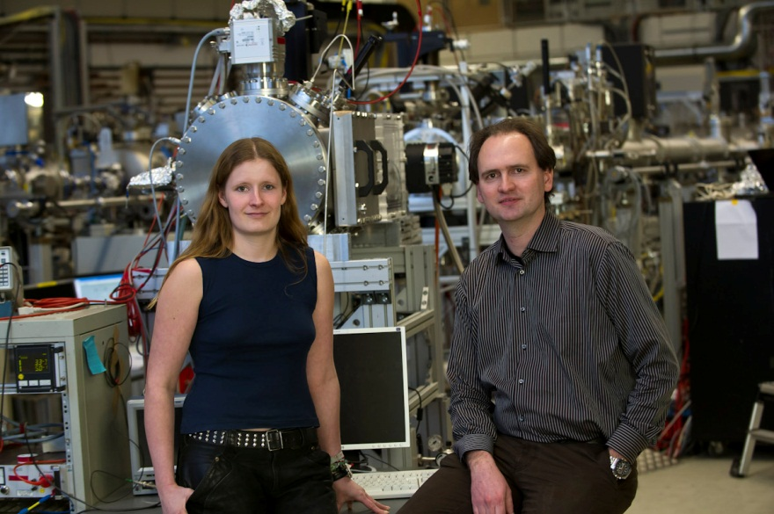
Personal development
Sample Environment staff
Guest researcher (bio-samples) Charlotte Uetrecht
Scientist for liquid jets and aerosols Starts June 2012
Instrumentation Engineer Late 2012
Scientist for solid state and surface science Late 2012
Scientist for gas phase methods Early 2013
Lab technician Summer 2013

