Slide 1
WP81 FXE Instrument
XFEL Project Progress Report
(1-2012)
Andreas Galler for Christian Bressler
Notes:
How to edit the title slide
Upper area: Title of your talk, max. 2 rows of the defined size (55 pt)
Lower area (subtitle): Conference/meeting/workshop, location, date, your name and affiliation, max. 4 rows of the defined size (32 pt)
Change the partner logos or add others in the last row.

Slide 2
XAS/XES/XRD at the FXE instrument
Dynamics of Solids and Liquids
Combine versatile structural tools into one single setup - x-ray absorption (XANES, EXAFS) - x-ray emission (XES, RXES, …) - x-ray scattering (XRD, diffuse scattering) → Obtain new information during the dynamics
Maintain both ambient and vacuum options - ambient conditions for liquids, solids, … - vacuum chamber for surfaces, cryogenic samples, …
Exploit the highest possible time resolution (≤25 fs) …include as much flux as possible (≥ 120 pulses)

Slide 3
Towards the TDR
Preparation of TDR and Instrument Realization
In-kind contribution
Danish in-kind proposal DTU
production carried out by JJ X-ray
The IKC basically covers nearly the entire scientific instrument.
But MHz compatible 1D/2D detectors, required CRLs, and timing tools remain one of the development tasks of the FXE group.

Slide 4
Towards the TDR
Technical Realization:
The design will be performed in a collaborative effort between FXE and JJ X-Ray and DTU
The production will be performed by JJ X-Ray in Denmark.
List of the acceptance tests foreseen:
Factory acceptance test (FAT) prior to delivery
Installation and mechanical site acceptance tests (SAT) at XFEL.
Commissioning with beam

Slide 5
The Envisioned FXE Instrument
Maintain both Vacuum and Ambient conditions

Slide 6
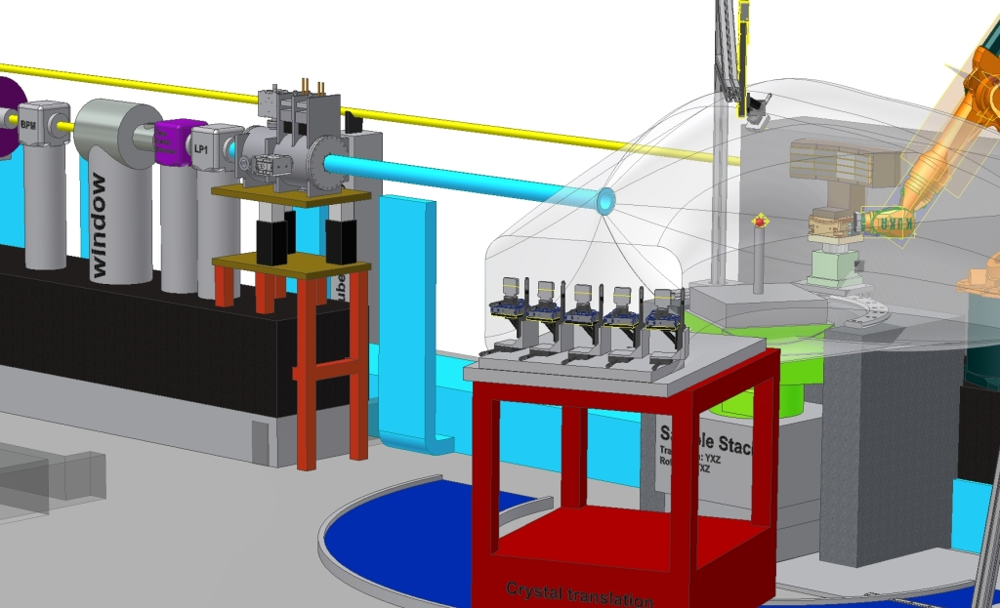
FXE Sample Area

Slide 7
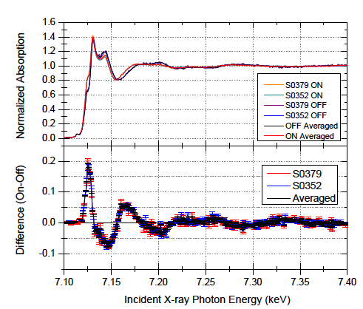
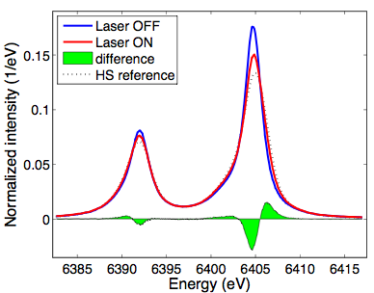
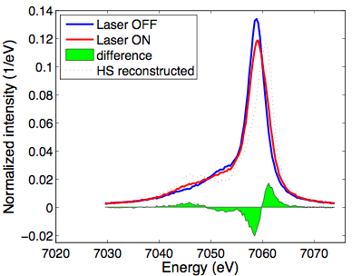
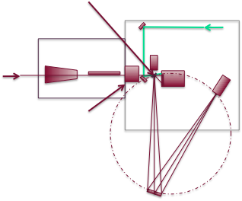
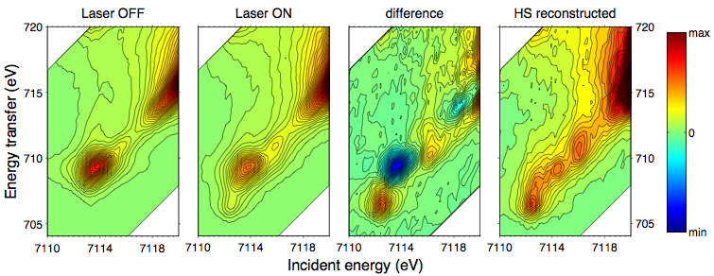
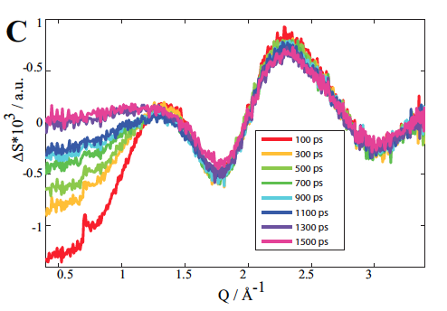
Exploiting complementary techniques (ESRF, APS)
1s2p XES
1s3p XES
XANES
EXAFS
Sample
APD
Laser
KB optics
Pilatus
1s2p RXES
APD
He-filled
sample chamber
Si/Ge analyzer crystal
UDECS collaboration at work!
X-ray Diffuse Scattering (XDS)
Sector 7ID @ APS, Argonne (3.36 MHz)
To be submitted 2012

Slide 8
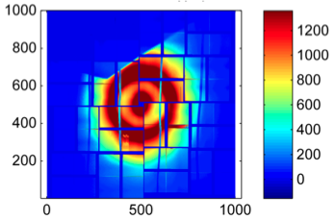
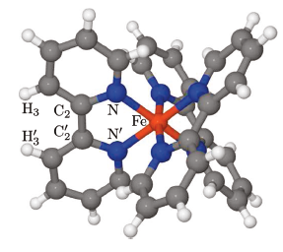
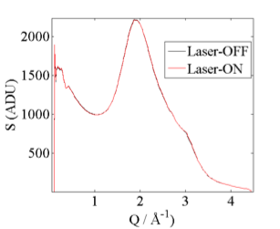
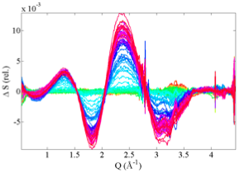
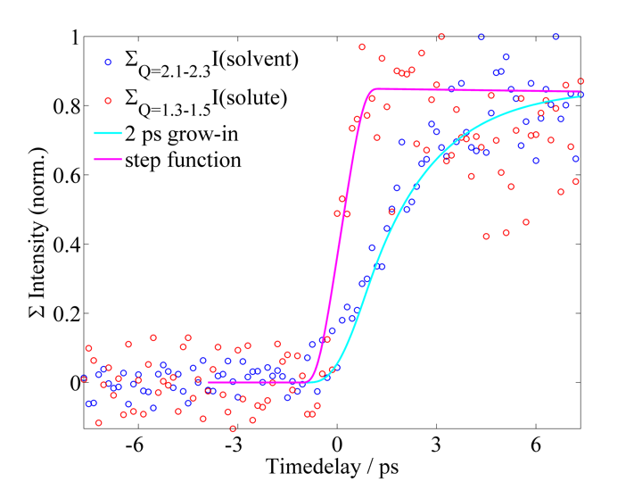
XDS preliminary Analysis
Fe(bpy)3/H2O
Raw data
Azimuthally integrated data
Measure solute structural changes via fs XDS!

Slide 9
Activities and Milestones of the IKC
The major milestones and time schedule:
Technical Design Report: Sept. 2012
Final Design Review of each component: Sept. 2013
Production and Factory Acceptance Tests (FAT’s): 2013 - 2015
Delivery of all components completed: Mar. 2015
Site Acceptance Tests of mechanical performance: Jun. 2015
Commissioning with beam: Dec. 2015

Slide 10
X-ray Beam Transport (5-20 keV)

Slide 11
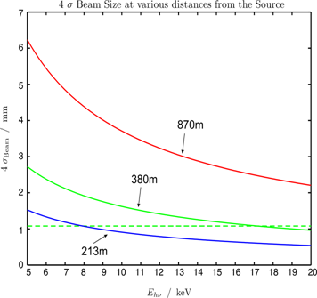
Beam Size Considerations
Beam on DM (380 m): - horizontally bend OM (250 m) (intermediate focus near 600 m)
- collimate beam at 213 m (CRL collection) - combination of both

Slide 12
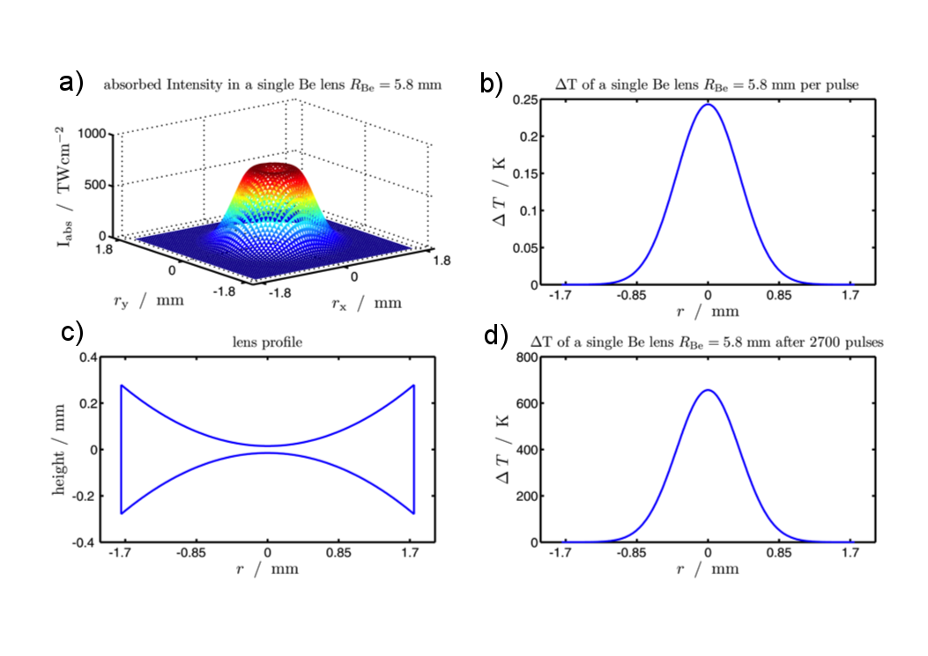
Heat Load on Be lens (213 m), 5 keV/0.25 nC

Slide 13
Revised Floor Plan
Optical laser (~16.5x6 m²)
lock
MMM
ctrl
MMM
experiments
Sync
PP-laser
Prep, service, spare
SPB racks
SPB
optics
KB1
Jet
Jet
KB2
FXE optics
FXE
experiments
racks
SPB experiments
FXE racks
FXE
ctrl
Staging
area
SPB
ctrl
(preliminary)

Slide 14
Time Line
April 2011: CDR out
September 2012: TDR
2013+: JJ X-ray will deliver first components
2014+: Installation in exp. Hall
Late 2015: ready for beam

Slide 15
Other Issues
Participation in LCLS beamtime March 2012
PETRA III beamtime June 2012
Participation in SACLA Beamtime June 2012
PostDoc Julien Nillon hired for the CRISP Project devoloping a MHz NOPA April 2012
Openings: 2 PhD students 2012
(1 SFB925; 1 IMPRS)

