Slide 1

Challenges of the Intensity Frontier
Steve Holmes, Fermilab
New Particle Physics Facilities Seminar Series
University of Hamburg/DESY
July 4, 2012

Slide 2
Outline
Why the Intensity Frontier?
What is the Intensity Frontier?
Accelerators at the Intensity Frontier
Project X: A Next Generation Intensity Frontier Facility (at Fermilab)
Longer Term Prospects

Slide 3

Questions for Particle Physics (http://www.interactions.org/quantumuniverse/)
Particle Physics attempts to answer a number of very big questions:
What is the nature of the universe and what is it made of?
What are matter, energy, space, and time?
How did we get here and where are we going?

Slide 4
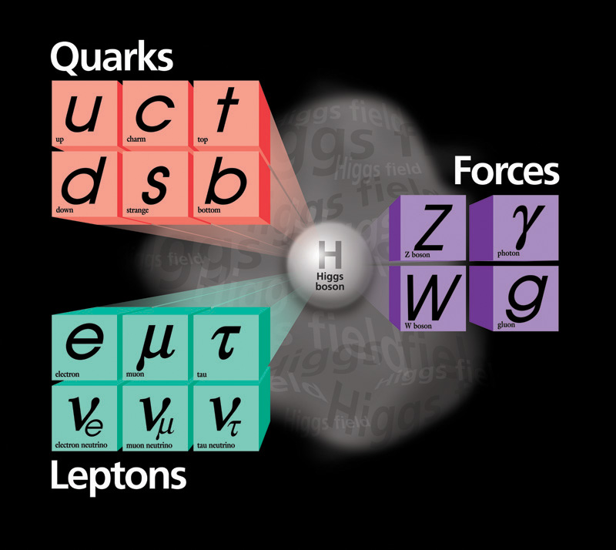

What do we know?
The Standard Model explains a lot…
… but many questions remain

Slide 5

How do we get to the answers?
A natural organizing principle is to
attack these questions from three
directions:
Energy Frontier
Intensity Frontier
Cosmic Frontier
The Energy and Intensity Frontiers
offer complementary approaches,
and share a strong reliance on
accelerators.

Slide 6
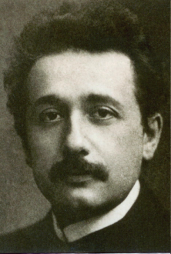
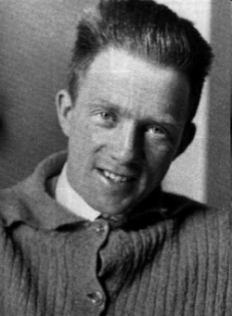
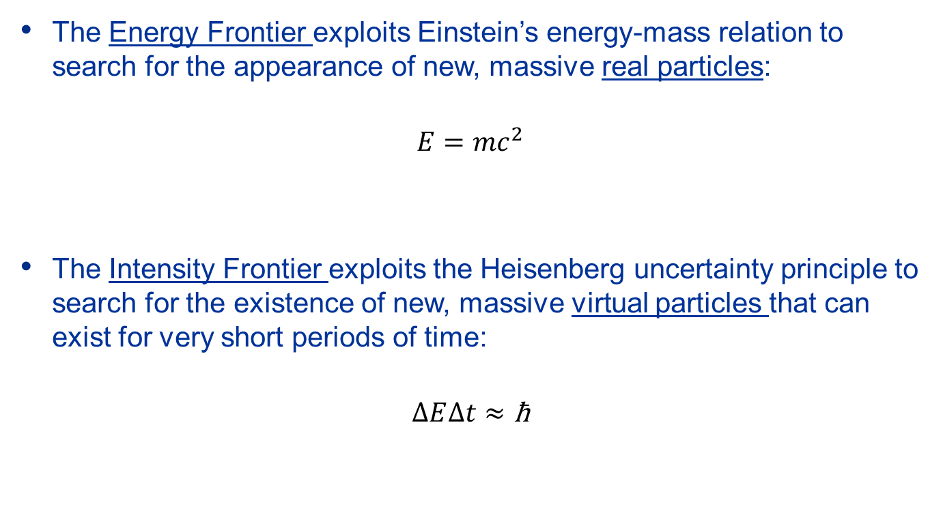
Frontiers
The Energy Frontier exploits Einstein’s energy-mass relation to search for the appearance of new, massive real particles:
$$E=mc^{2}$$
The Intensity Frontier exploits the Heisenberg uncertainty principle to search for the existence of new, massive virtual particles that can exist for very short periods of time:
$$∆E∆t≈\text{ħ}$$

Slide 7
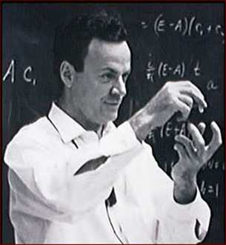
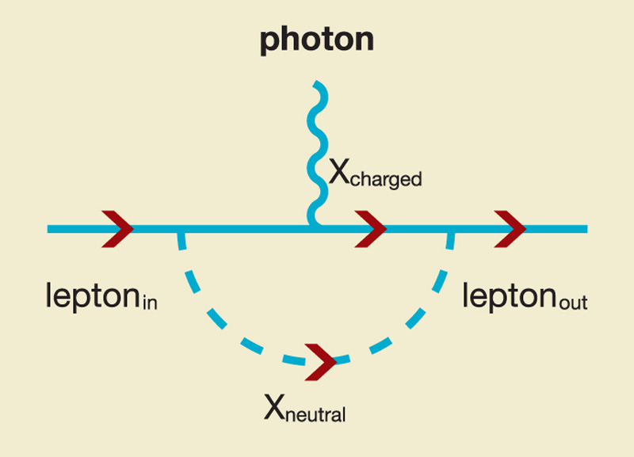
What is the Intensity Frontier? Loops
Example: The lowest order loop diagram for the electromagnetic interaction of a charged particle(s)
X_{charged} and X_{neutral} can be any known/unknown particles, of any mass
This diagram could represent a contribution to any of the following:
g-2, electric dipole moment, lepton flavor violation

Slide 8
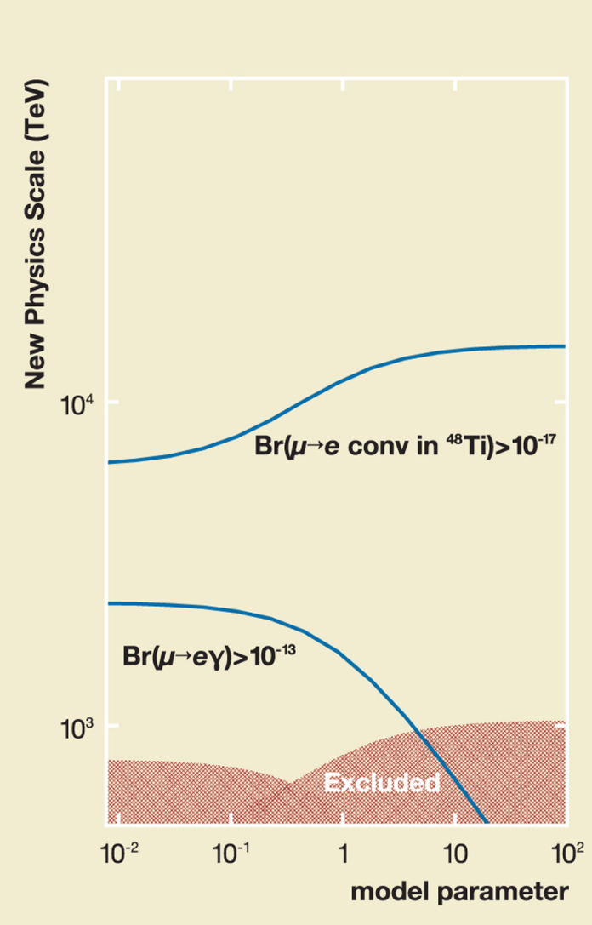
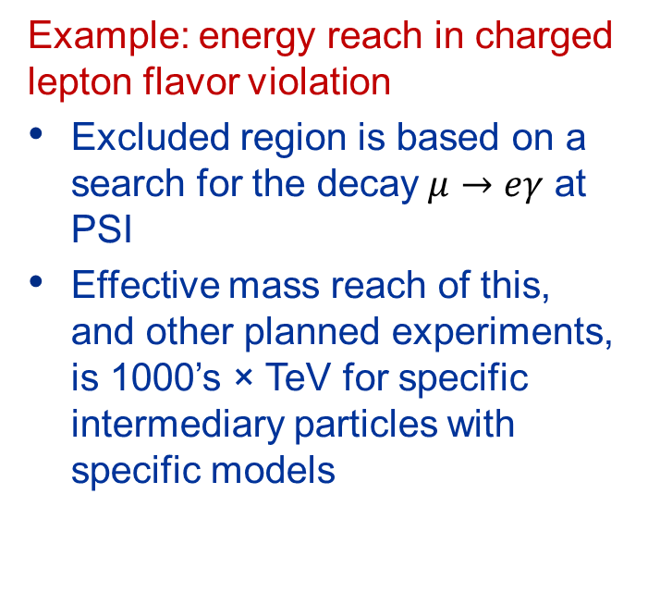
What is the Intensity Frontier? Effective Energy Reach
Example: energy reach in charged lepton flavor violation
Excluded region is based on a search for the decay$μ→eγ$ at PSI
Effective mass reach of this, and other planned experiments, is 1000’s × TeV for specific intermediary particles with specific models

Slide 9
What is the Intensity Frontier? Another Example: Rare Kaon Decays
Standard Model rate of 3 parts per 100 billion!
BSM particles within loops can increase the rate by x10 with respect to SM.

Slide 10
What is the Intensity Frontier? Neutrinos
Neutrino oscillations provide the only known example of physics beyond the Standard Model:
Neutrinos have mass
Neutrinos violate (neutral)
lepton flavor conservation
Are neutrinos their own anti-
particles?
Could neutrino CP violation
be a contributor to the
matter-antimatter asymmetry
of the Universe?

Slide 11
What is the Intensity Frontier? Requirements
A comprehensive Intensity Frontier program would encompass:
Neutrino physics – long and short baselines
Extremely low interaction cross-sections
Rare kaon and muon decays/conversions
Branching ratios below <<1×10⁻¹⁰
Electric and magnetic dipole moments
Neutron-antineutron oscillations
Beyond particle physics:
nuclear energy applications
Most of these particles are produced as secondary or tertiary beams
The Intensity Frontier uses very high intensity beams to probe the fundamental questions confronting particle physics.
The relevant metric is beam power

Slide 12
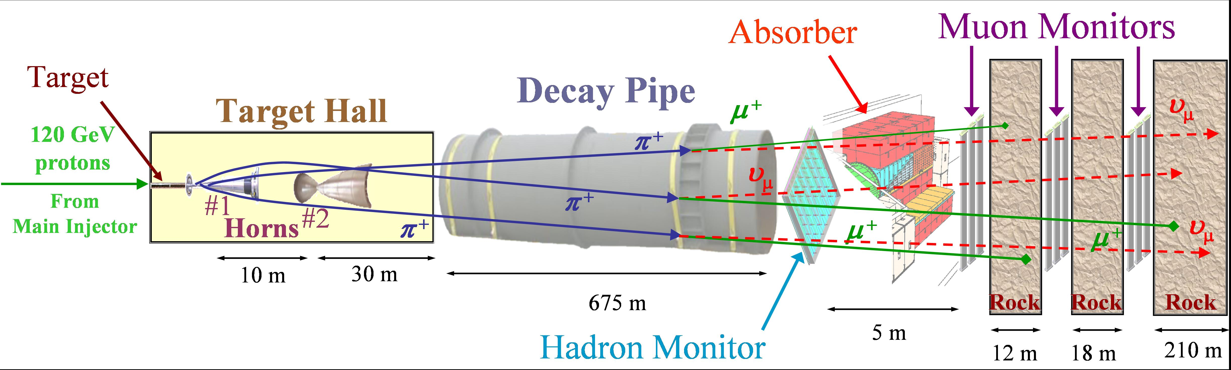
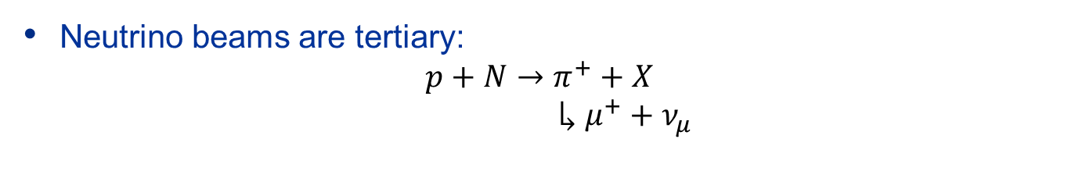
What is the Intensity Frontier Neutrinos
Neutrino beams are tertiary:
$$p+N→π^{+}+X$$
$$↳μ^{+}+ν_{μ}$$

Slide 13
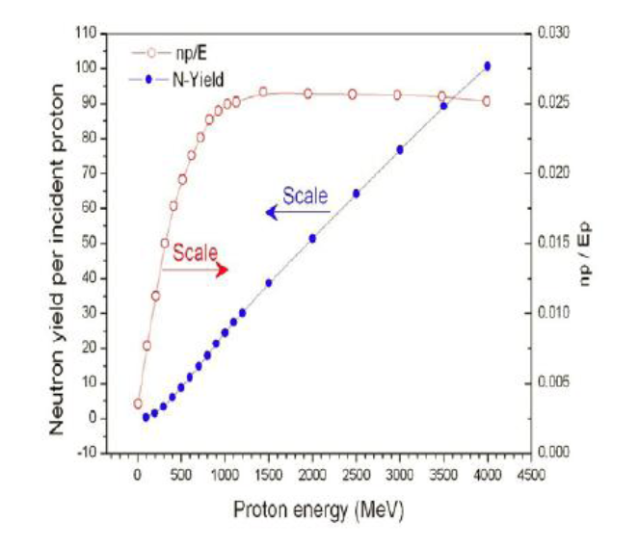
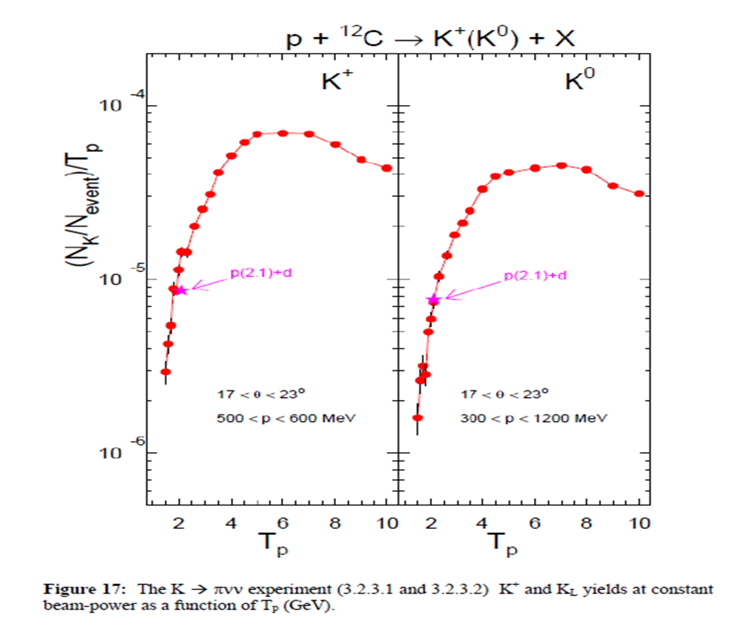
What is the Intensity Frontier? Beam Requirements
Beam power (Energy × particles/time)
The number of secondary particles produced is roughly proportional to beam power (once above the production threshold).

Slide 14
What is the Intensity Frontier? Beam Requirements
Flexible duty factors
Rare decay experiments are inherently high rate. In such an environment accidental coincidences from beam sources can lead to mis-identifications. The accidental rate is proportional to I²×δt where δt is the resolving time.
We want low I_{peak}/I_{av} ⇒ high duty factor
Neutrino experiments are inherently (very) low rate. In such an environment accidental coincidence from non-beam sources can lead to mis-identifications. The accidental rate is proportional to Δt, where Δt is the live time fraction of the beam.
We want high I_{peak}/I_{av} ⇒ low duty factor
In some case, like experiments base on muon capture, we need a time structure related to the muon lifetime (2 μsec)
Ideally, we would be able to deliver multiple time structures to different experiments simultaneously

Slide 15
What is the Intensity Frontier? Beam Requirements
The ideal Intensity Frontier facility for Particle Physics would have:
Beam Power
> 1 MW
Beam Energy
> 3 GeV (K production threshold)
Duty Factor
1×10⁻⁵ – 1
Bunch Patterns
Flexible
Upgrade potential
Factor of 2-3 in beam power

Slide 16
Accelerators at the Intensity Frontier Options
The menu:
*Flexible beam structures can be provided in a manner that I will describe later
**Note: Beam Power = N_{p}×E/cycle time (synchrotron)
I_{av}×E (linac)
 | >1 MW** | >3 GeV | Duty Factor | Bunch Structure | Upgradable
Cyclotron | Y | N | H | Fixed | Not easily
Synchrotron | Y | Y | H/L | Fixed | Perhaps
Linac (pulsed) | Y | Y | L | Fixed | Y
Linac (CW) | Y | Y | H | Flexible* | Y

Slide 17
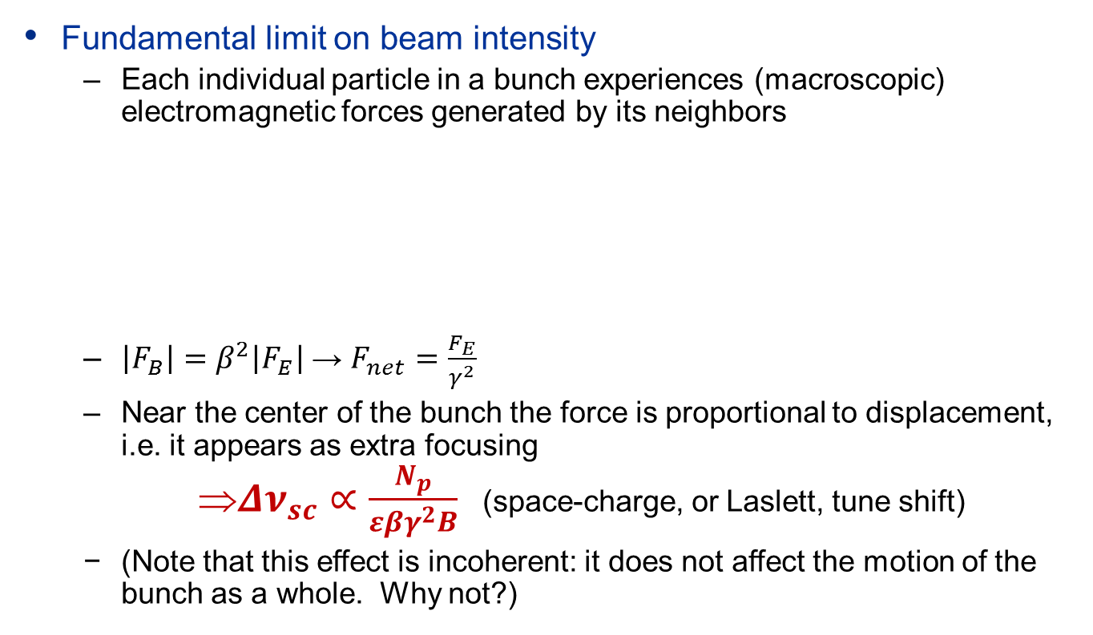
Accelerators at the Intensity Frontier Circular Accelerators (synchrotrons)
Fundamental limit on beam intensity
Each individual particle in a bunch experiences (macroscopic) electromagnetic forces generated by its neighbors
$\left|F_{B}\right|=β^{2}\left|F_{E}\right|$ → $F_{net}=\frac{F_{E}}{γ^{2}}$
Near the center of the bunch the force is proportional to displacement, i.e. it appears as extra focusing
$Δν_{sc}∝\frac{N_{p}}{εβγ^{2}B}$ (space-charge, or Laslett, tune shift)
(Note that this effect is incoherent: it does not affect the motion of the bunch as a whole. Why not?)
F_{E}
F_{B}

Slide 18
Accelerators at the Intensity Frontier Circular Accelerators (synchrotrons)
Space-charge
Experience show that we need to keep Δν_{sc}<0.2 to minimize beam losses
Note that the space-charge tune shift is:
Strongest at the injection energy of the accelerator;
Proportional to the total number of particles in the accelerator, i.e. the circumference
This leads to a strategy of initiating acceleration with a linac, followed by a cascade of accelerators
Overall performance is generally dictated by the injection energy into the first accelerator.
Recent example: J-PARC
Currently undergoing an upgrade of the linac energy from 181 to 400 MeV to support higher power operations.

Slide 19
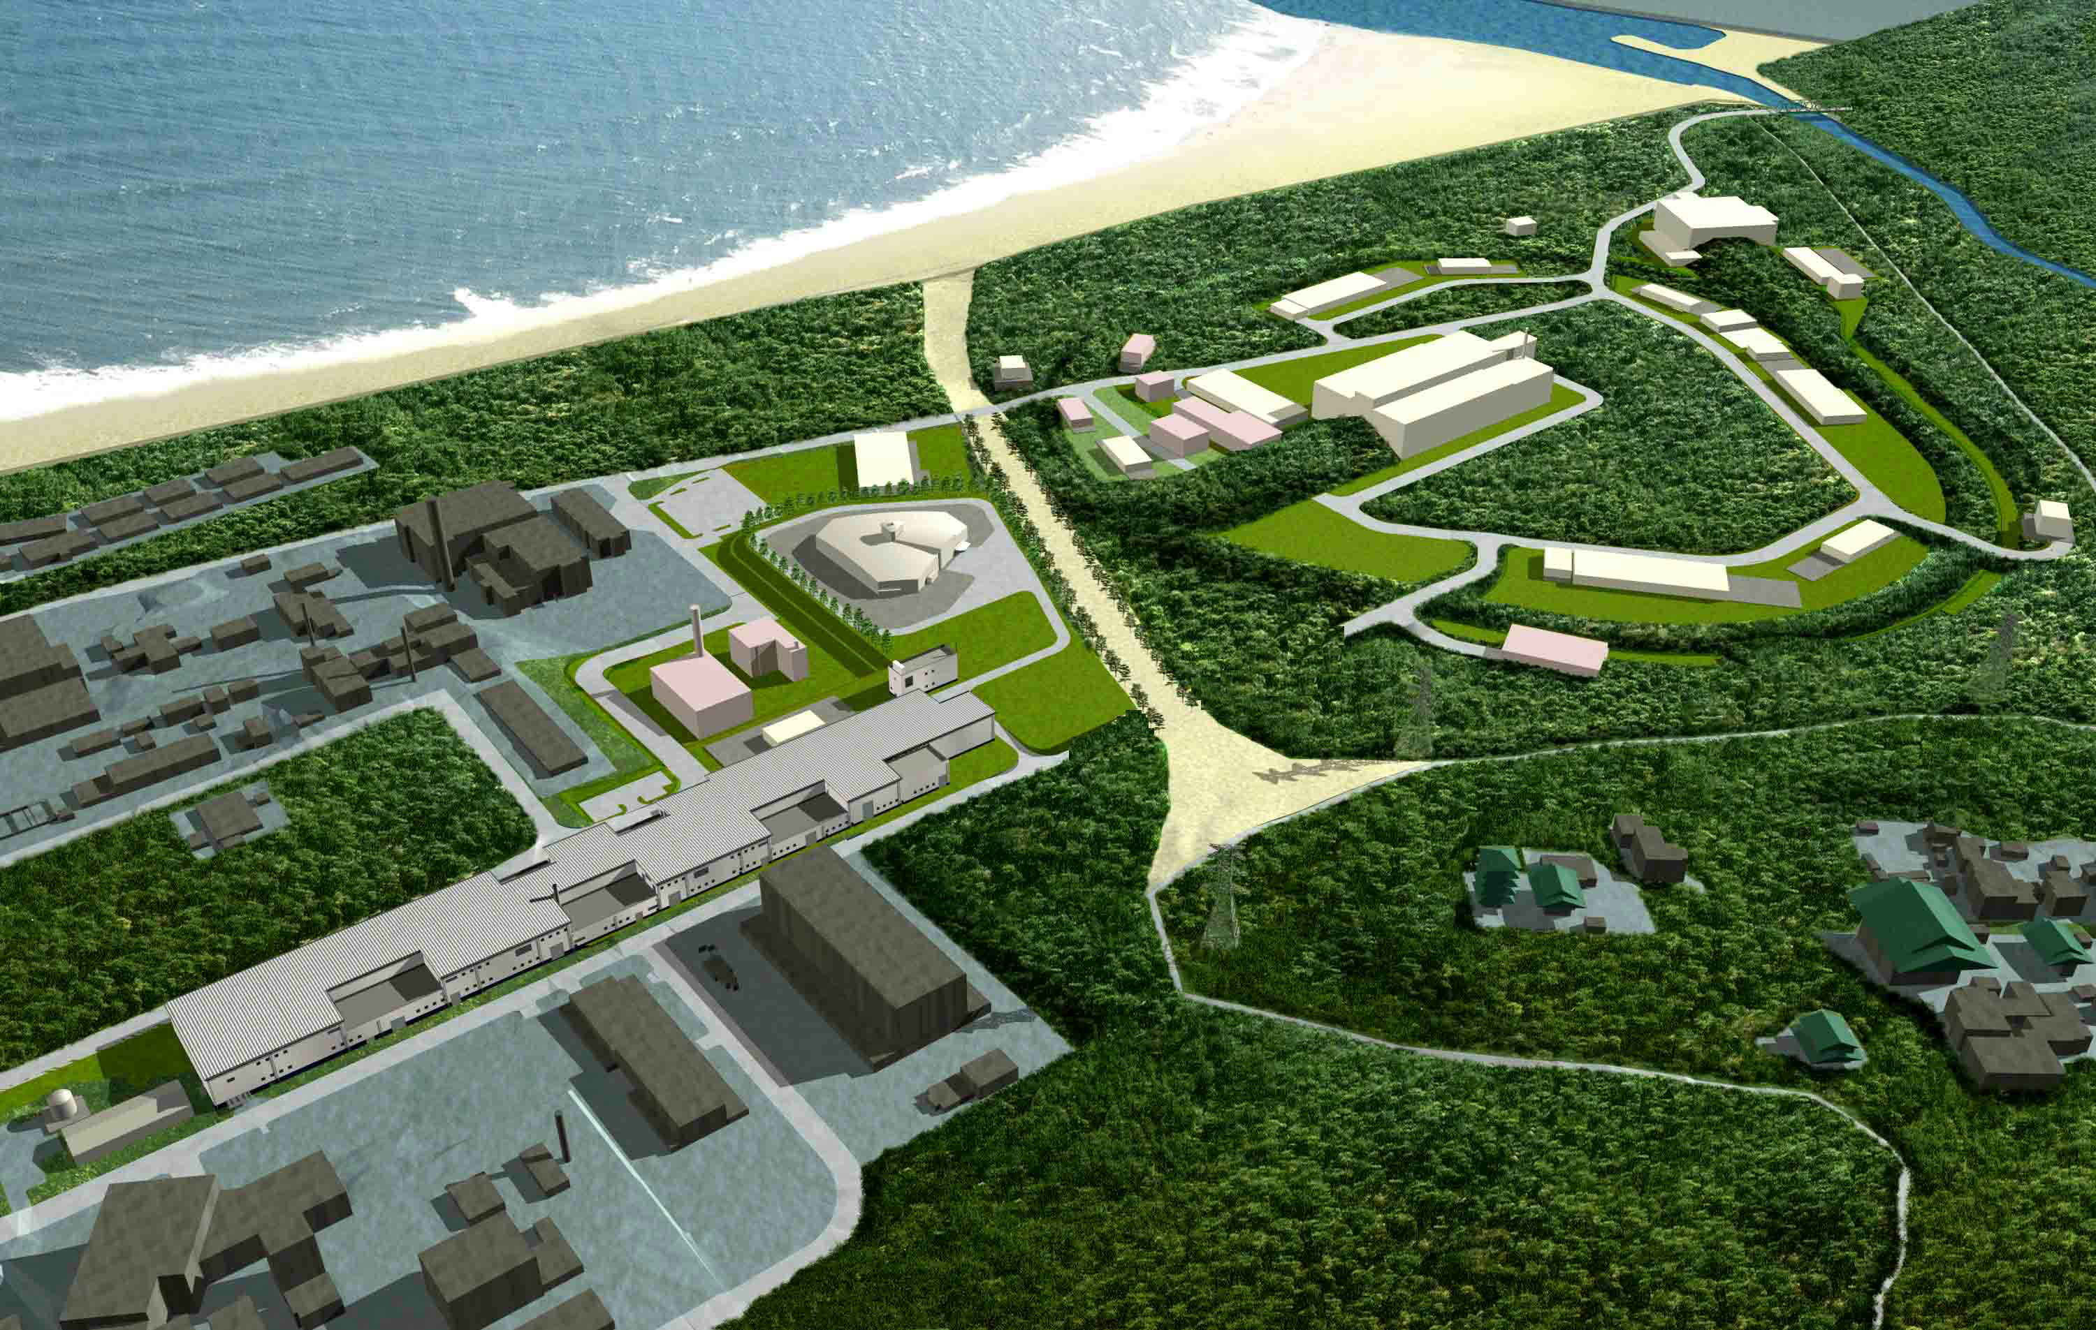
Accelerators at the Intensity Frontier J-PARC
Materials and Life Science
Experimental Facility
Hadron Beam Facility
５００ｍ
Neutrino to Kamiokande(T2K)
3 GeV Synchrotron
(25 Hz, 1MW)
50 GeV Synchrotron
(0.75 MW)
Linac
(330m)
J-PARC = Japan Proton Accelerator Research Complex

Slide 20
Accelerators at the Intensity Frontier Circular Accelerators (synchrotrons)
Duty fraction (Cycle time)
Synchrotron operate on repeatable cycles
The fraction of the time devoted to delivery of beam can be quite low. This limits the average beam power.
This can be ameliorated by using a second ring to accumulate beam at the injection energy while the synchrotron is completing its acceleration/flattop/ramp-down cycle
Example: Conversion of the 8 GeV Recycler Ring (Fermilab) from an antiproton storage ring to a proton accumulator for the Main Injector
Flattop
Energy
Accelerate
Ramp down
Inject
Physics
time

Slide 21
Accelerators at the Intensity Frontier Circular Accelerators (synchrotrons)
Duty factor (during flattop)
For neutrino experiments a low duty factor is good.
Generally will extract the beam in a single turn (fast spill)
Fermilab Main Injector: Duty Factor = 9 μsec/1.33 sec = 7×10⁻⁶
For rare decays/conversions a large duty factor is desirable
Can be increased by using a second ring to accept a single turn beam transfer from the synchrotron, and then resonantly extracting while the synchrotron is completing its acceleration/flattop/ramp-down cycle (slow spill)

Slide 22
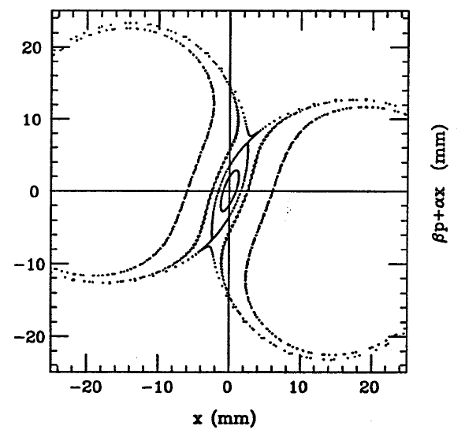
Accelerators at the Intensity Frontier Circular Accelerators (synchrotrons)
Bunch structure/resonant extraction
High duty factor extraction from a ring is based on resonant extraction
The extracted bunch structure is
the same as the bunch
structure in the ring
The beam can be shared by
multiple experiments, but each
experiment receives the same
bunch structure
At high power the fundamental
limitation is beam power loss
on the septum (~1-2%)
Can generally manage a
few kW of beam loss in the
extraction region
Septum

Slide 23
Accelerators at the Intensity Frontier Circular Accelerators (synchrotrons)
Beam loss through various mechanisms represents and additional limitation at high power
Rule of thumb: Can tolerate ~1 W/m
Generally controlled via collimation systems that transport particles on the verge of being lost into dumps.
Upgradability: The primary routes to higher beam power are via higher beam intensities and/or shorter cycle times
Higher beam intensity generally requires raising the injection energy of the first circular accelerator in the complex and rf upgrades (Watts)
Shorter cycle times require upgrades to the rf (Volts) and magnet power supply systems

Slide 24
Accelerators at the Intensity Frontier Linacs
Linacs are not as efficient as synchrotrons in their utilization of rf
Cost considerations have limited linacs to the 1-10 GeV range
Linacs avoid the space charge and cycle time issues of synchrotrons
Space-charge exists, but in a more benign form since the linac is single pass
Beam-breakup (akin to head-tail instability in a circular machine) can be an issue
Cycle time is not an issue: beam is accelerated and delivered simultaneously
Primary beam loss mechanisms are halo formation at low energy, resulting in beam loss later in the linac
Same rule of thumb as circular machines: can tolerate ~1 W/m
Linacs historically have delivered low duty factors
Heat generated in a normal conducting linac at duty factors >1 % are unmanageable (and unaffordable)
Upgradability: The primary routes to higher beam power are via higher beam current and/or higher beam energy
Higher beam current requires more rf power (Watts, not Volts)
Higher energy requires extending the linac

Slide 25
Accelerators at the Intensity Frontier Linacs
The advent of superconducting rf technology has allowed an increase in duty factor, and is thus becoming the new standard for high power, multi-GeV, proton accelerators.
Recent example: Spallation Neutron Source (SNS, Oak Ridge, TN)
Based on superconducting linac (1 msec x 60 Hz x 40 mA)
1 MW beam power at 1 GeV
6% linac duty factor in linac
4×10⁻⁵ duty factor at target, generated through utilization of an accumulator ring

Slide 26
Accelerators at the Intensity Frontier Spallation Neutron Source (SNS)

Slide 27
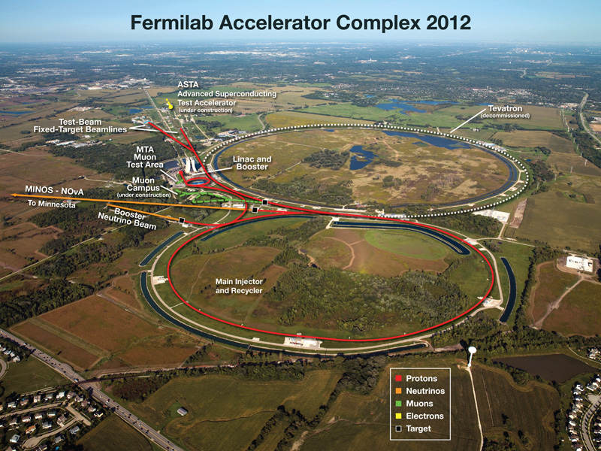
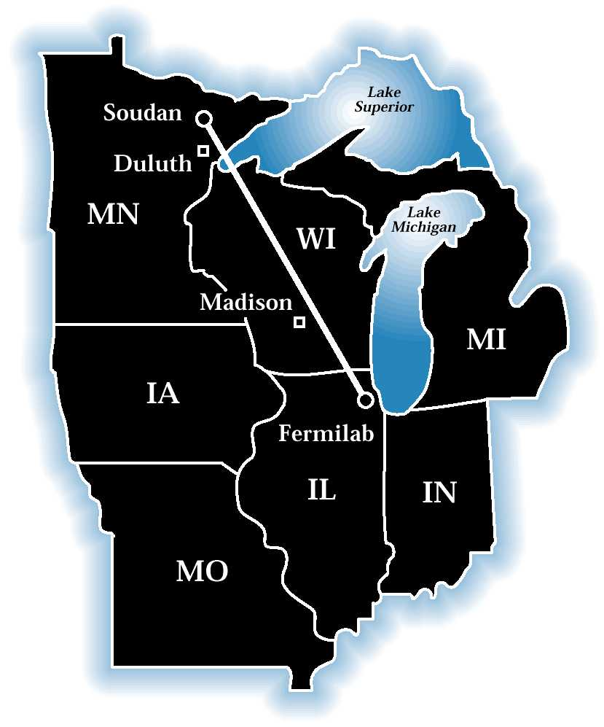
Accelerators at the Intensity Frontier Fermilab
Neutrinos at the Main Injector (NuMI)
>300 kW @ 120 GeV
MINOS detector located at 735 km
Upgrading to 700 kW @ 120 GeV
NOvA detector under construction at 810 km
>300 kW @ 120 GeV
MINOS detector at 735 km
Upgrading to 700 kW @ 120 GeV
NOvA detector under construction at 810 km

Slide 28

Accelerators at the Intensity Frontier
The ideal Intensity Frontier facility for particle physics would have the following features:
>1 MW beam power @ E>30 GeV
Duty factor <1×10⁻⁴
>1 MW beam power @ E>3 GeV
High duty factor
Multiple bunch structures to multiple experiments
Availability of these two capabilities simultaneously
We have developed a design concept meets these goals in an innovative and flexible manner

Slide 29
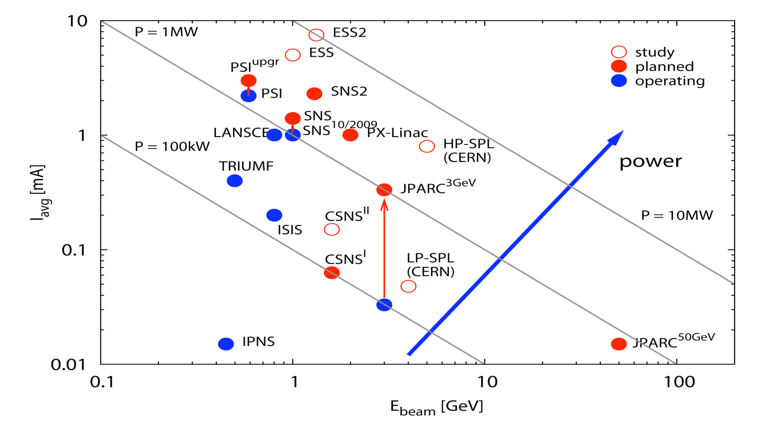
Accelerators at the Intensity Frontier The Landscape
Project-X
M Seidel, PSI

Slide 30
Accelerators at the Intensity Frontier The Landscape
x Duty Factor
*
Project-X CW-Linac
PSI
*
TRIUMF
power
*
Stopped/Slow kaon yield/Watt
* Beam power x Duty Factor

Slide 31

Project X Mission Elements
A neutrino beam for long baseline neutrino oscillation experiments
2 MW proton source at 60-120 GeV
Low energy, MW-class proton beams
for kaon, muon, neutrino, and nuclei
based precision experiments
Operations simultaneous with the
long baseline neutrino program
A path toward a muon source for
possible future Neutrino Factory
and/or a Muon Collider
~4 MW at ~5-15 GeV; low duty factor
Possible missions beyond Particle Physics
Nuclear energy applications

Slide 32
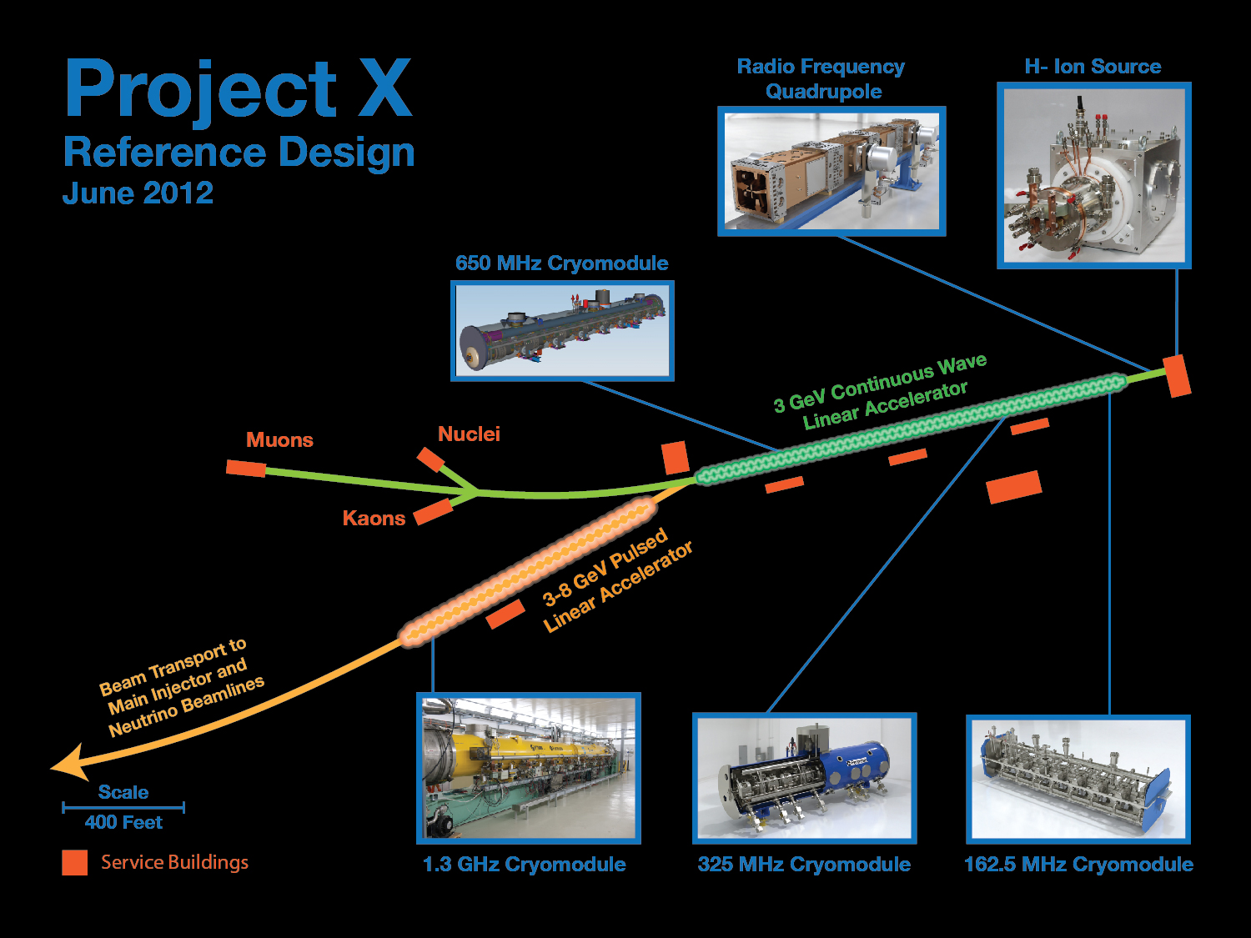
3 MW @ 3 GeV
200 kW @ 8 GeV
2 MW @ 120 GeV
as;lkjfda;lskdjf;salkjfd
Argonne National Laboratory • Brookhaven National Laboratory • Fermi National Accelerator Laboratory • Lawrence Berkeley National Laboratory
Pacific Northwest National Laboratory • Oak Ridge National Laboratory / SNS • SLAC National Accelerator Laboratory
Thomas Jefferson National Accelerator Facility • Cornell University • Michigan State University • ILC/Americas Regional Team
Bhaba Atomic Research Center • Raja Ramanna Center of Advanced Technology • Variable Energy Cyclotron Center • Inter University Accelerator Center

Slide 33
Project X Reference Design Scope
3 GeV CW superconducting H- linac with 1 mA average beam current.
Flexible provision for variable beam structures to multiple users
CW at time scales >1 μsec, 20% DF at <1 μsec
Supports rare processes programs at 3 GeV
Provision for 1 GeV extraction for nuclear energy program
3-8 GeV pulsed linac capable of delivering 300 kW at 8 GeV
Supports the neutrino program
Establishes a path toward a muon based facility
Upgrades to the Recycler and Main Injector to provide ≥ 2 MW to the neutrino production target at 60-120 GeV.
Utilization of a CW linac creates a facility that is unique in the world, with performance that cannot be matched in a synchrotron-based facility.
Notes:
ADS Development with Nuclear Energy Applications

Slide 34
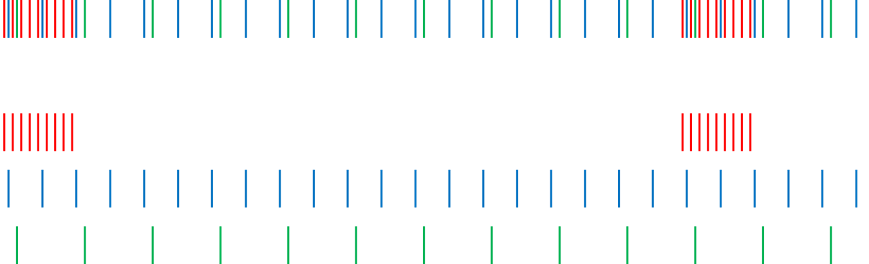
Project X Operating Scenarios CW Linac
1 μsec period at 3 GeV
Muon pulses (17e7) 80 MHz, 100 nsec 700 kW
Kaon pulses (17e7) 20 MHz 1540 kW
Nuclear pulses (17e7) 10 MHz 770 kW
Ion source and RFQ operate at 4.4 mA
77% of bunches are chopped @ 2.1 MeV ⇒ maintain 1 mA over 1 μsec
Separation scheme
1 μsec
Transverse rf splitter

Slide 35
Project X Performance Goals
Linac
Particle Type H⁻
Beam Kinetic Energy 3.0 GeV
Average Beam Current 1 mA
Linac pulse rate CW
Beam Power 3000 kW
Beam Power to 3 GeV program 2870 kW
Pulsed Linac
Particle Type H⁻
Beam Kinetic Energy 8.0 GeV
Pulse rate 10 Hz
Pulse Width 4.3 msec
Cycles to MI 6
Particles per cycle to MI 2.6×10¹³
Beam Power 340 kW
Beam Power to 8 GeV program 170 kW
Main Injector/Recycler
Beam Kinetic Energy (maximum) 120 GeV
Cycle time 1.4 sec
Particles per cycle 1.6×10¹⁴
Beam Power at 120 GeV 2200 kW
simultaneous

Slide 36
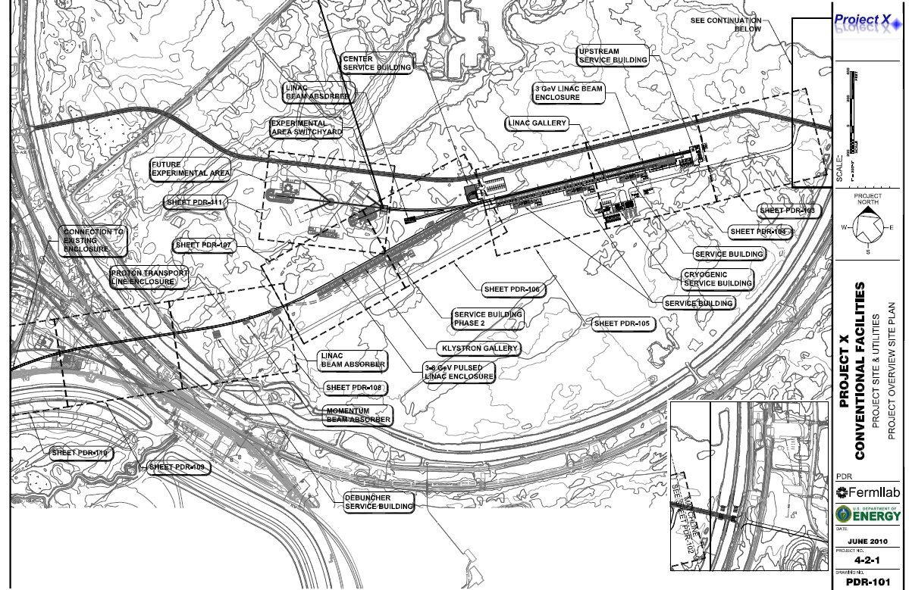
Project X Siting
3 GeV Experimental Area
CW Linac
8 GeV Linac
Transfer Line

Slide 37
Project X R&D Program
Primary elements of the R&D program:
Primary technical risk element is the front end
CW ion source/RFQ
Wideband chopping with high (1×10⁻⁴) extinction rate
(Low-β) acceleration through superconducting resonators with minimal halo formation
MEBT beam absorber (>8 kW)
Development of an H- injection system
Superconducting rf development
Cavities, cryomodules, rf sources – CW to long-pulse
High Power targetry
Upgrade paths: Multi-MW low energy neutrinos and Muon Collider
All of these elements are required at Stage 1, with the exception of 1.3 GHz pulsed RF
First and third elements addressed in an integrated system test: PXIE
Goal is to complete R&D phase by the end of 2016

Slide 38
Project X Injector Experiment (PXIE)
PXIE is the centerpiece of the Project X R&D program
Integrated systems test for Project X front end components
Validate the concept for the Project X front end, thereby minimizing the primary technical risk element within the Reference Design.
Operate at full Project X design parameters
Systems test goals
1 mA average current with 80% chopping of beam delivered from RFQ
Efficient acceleration with minimal emittance dilution through ~30 MeV
Achieve in 2016
PXIE should utilize components constructed to PX specifications wherever possbile
Opportunity to re-utilize selected pieces of PXIE in PX/Stage 1
Collaboration between Fermilab, ANL, LBNL, SLAC, India

Slide 39
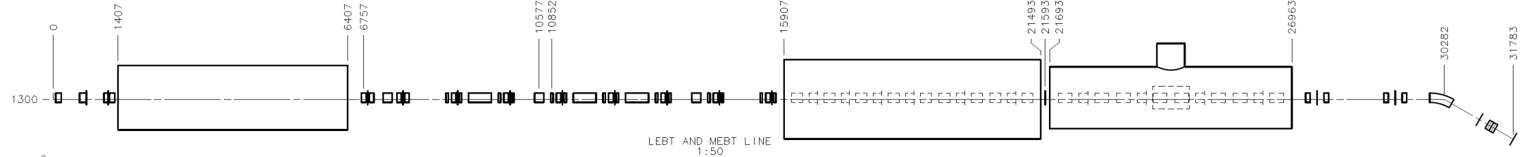
PXIE Program
RFQ
MEBT
HWR
SSR1
LEBT
LBNL, FNAL FNAL, SLAC ANL FNAL
Dump
32 m, 30 MeV
PXIE will address the address/measure the following:
Ion source lifetime
LEBT pre-chopping
Vacuum management in the LEBT/RFQ region
Validation of chopper performance
Kicker extinction
Effectiveness of MEBT beam absorber
MEBT vacuum management
Operation of HWR in close proximity to 10 kW absorber
Operation of SSR with beam
Emittance preservation and beam halo formation through the front end

Slide 40
Project X Linac SRF Technology Map
β=0.11
β=0.22
β=0.4
β=0.61
β=0.9
β=1.0
CW
Pulsed
162.5 MHz
2.1-10 MeV
325 MHz
10-160 MeV
650 MHz
0.16-3 GeV
1.3 GHz
3-8 GeV
Section | Freq | Energy (MeV) | Cav/mag/CM | Type
HWR (β_{G}=0.1) | 162.5 | 2.1-10 | 9/6/1 | HWR, solenoid
SSR1 (β_{G}=0.22) | 325 | 10-42 | 16/18/ 2 | SSR, solenoid
SSR2 (β_{G}=0.47) | 325 | 42-160 | 36/20/4 | SSR, solenoid
LB 650 (β_{G}=0.61) | 650 | 160-460 | 42 /14/7 | 5-cell elliptical, doublet
HB 650 (β_{G}=0.9) | 650 | 460-3000 | 152/19/19 | 5-cell elliptical, doublet
ILC 1.3 (β_{G}=1.0) | 1300 | 3000-8000 | 224 /28 /28 | 9-cell elliptical, quad
Notes:
I would suggest that you point out that Indian DAE labratories are already working on SSR1, 650 and ILC cavities.

Slide 41
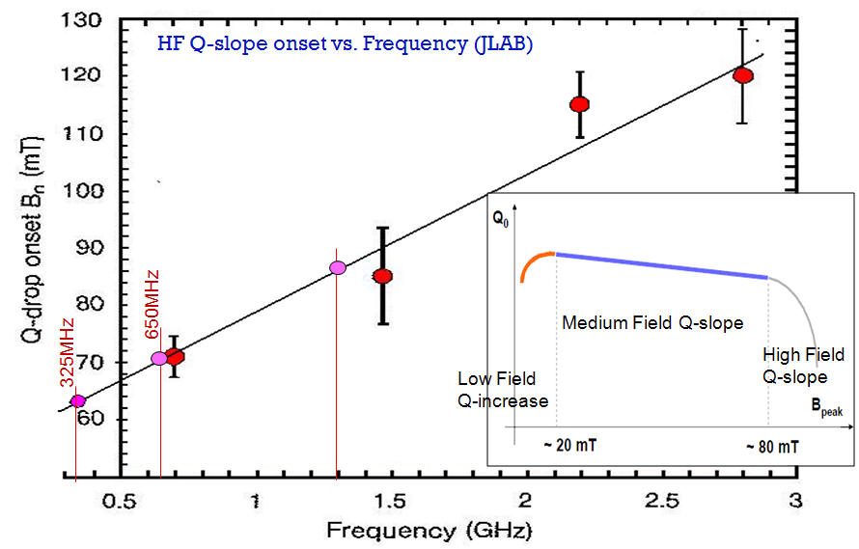
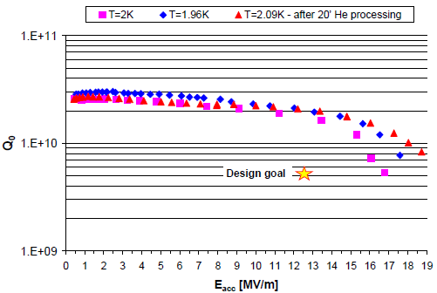
Choice of Cavity Parameters
Example: SNS, 805 MHz, β=0.81
70 mT
CW Linac assumptions:
162.5 MHz B_{pk} < 60mT
325 MHz B_{pk} < 70mT
650 MHz B_{pk} < 70mT
1300 MHz B_{pk} < 80mT
⇒ E_{acc} = 15.6 MV/m; Q_{o} ~1.7∙10¹⁰ @ 2 K

Slide 42
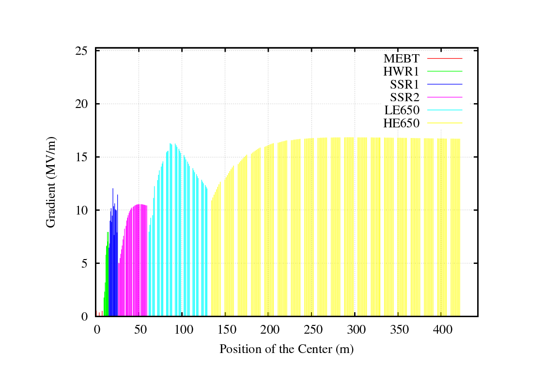
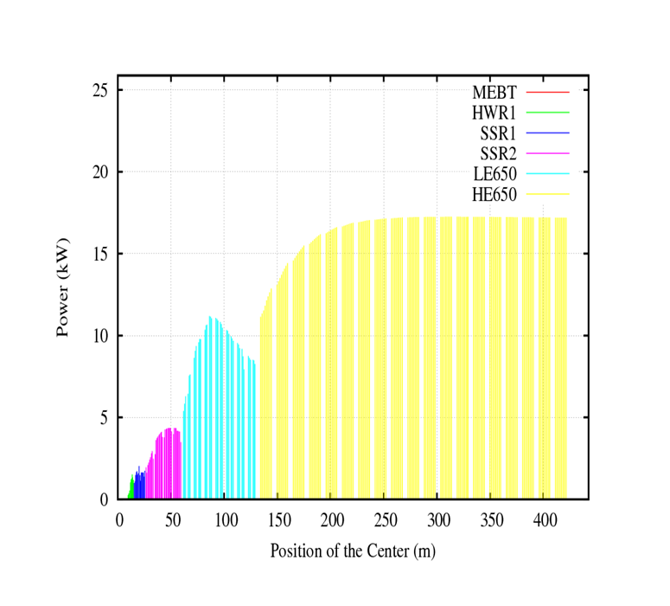
Project X SRF Acceleration Parameters
Energy Gain
Beam Power

Slide 43
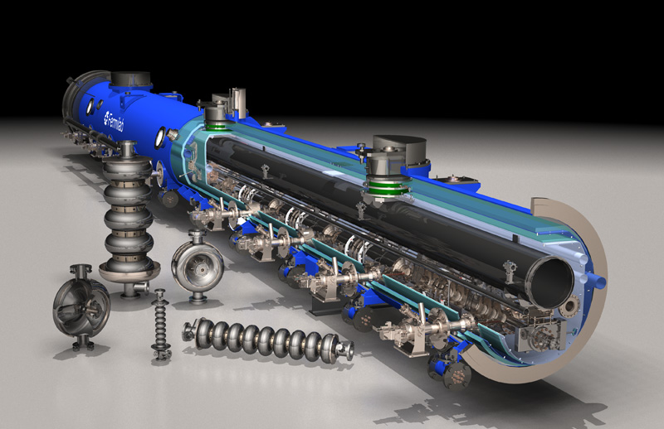
Project X SRF Development

Slide 44
Project X SRF Development Cavity/ CM Status
1300 MHz
90 nine-cell cavities ordered
60 received (32 from U.S. industry:16 from AES, 16 from Niowave-Roark)
~ 40 processed and tested, ~20 dressed
2 CM built: one from a DESY kit and a second U.S. procured
CM1 testing at NML is complete; CM2 was delivered to NML April 26 for testing
CM2 should meet ILC spec of >31.5 MV/m
650 MHz
JLab built two single-cell β =0.61 cavities
Six β = 0.9 single-cell cavities ordered from U.S. industry recently arrived
Order for six β = 0.61 (2 JLab, 2 FNAL design) single-cell cavities in industry
325 MHz
2 SSR1 β =0.22 cavities (Roark, Zanon) both VTS tested
1 of these dressed and tested at STF
2 SSR1 being fabricated in India (IUAC, spring 2012)
10 SSR1 ordered from Industry (Niowave-Roark)
6 delivered; 1 VTS tested, second soon to follow
Design work advanced on 325 MHz CM, but proceeding with lower priority on 650 MHz CM (not required in PXIE)

Slide 45
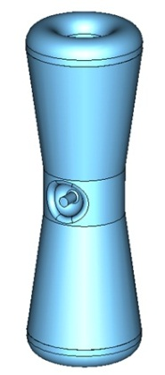
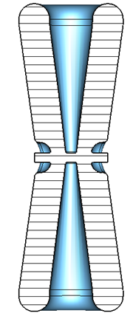
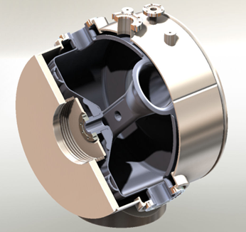
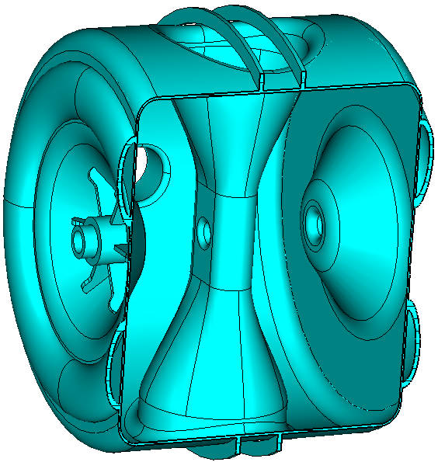
162.5 and 325 MHz Cavities
HWR (β_{G} = 0.11 ) Half Wave Resonator
EM and mechanical design underway at ANL
Similar to cavities & CM already manufactured by ANL
SSR1 (β_{G} = 0.22 ) Single Spoke Resonator
Initiated under HINS program → more advanced
8 prototype cavities to date
3 tested as bare cavities at 2K
Second unit met PX spec
One dressed and tested at 4.8K
SSR2(β_{G} = 0.47 ) Single Spoke Resonator
EM design complete
Mechanical design in progress

Slide 46
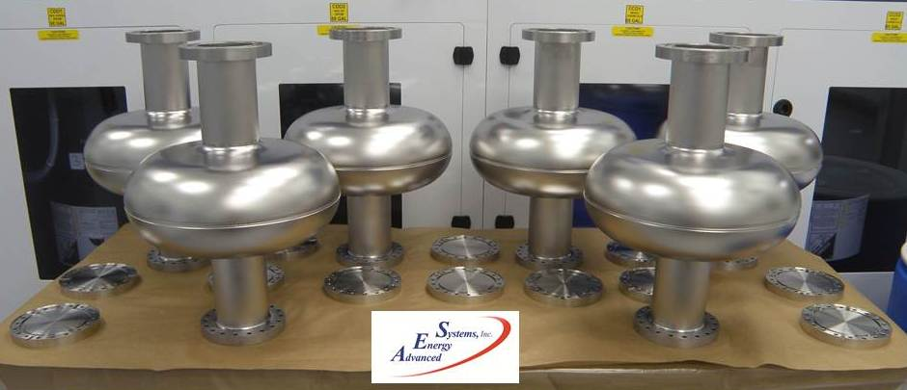
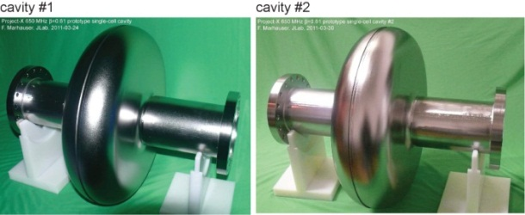
650 MHz Cavities
For purposes of cryogenic system design, the dynamic heat load limited to 250 W at 2K per cryomodule
<35W per cavity (β_{G} = 0.61) and <25W per cavity (β_{G} = 0.9)
Q0 = 1.7E10
Multiple single cells received from JLab and industry
β=0.9, AES β=0.6/JLab
Five-cell design complete for β_{G} = 0.9 cavities
Four 5-cell β_{G} = 0.9 cavities on order from AES; two expected in FY12

Slide 47
650 MHz Single Cell Performance (JLab, β=0.6)

Slide 48
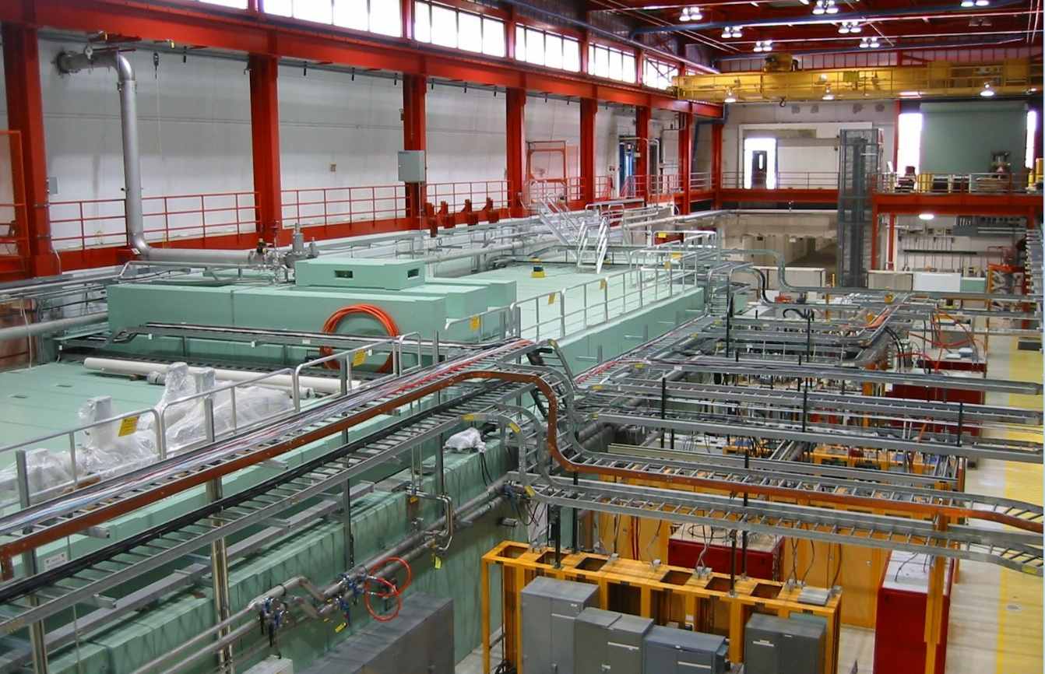
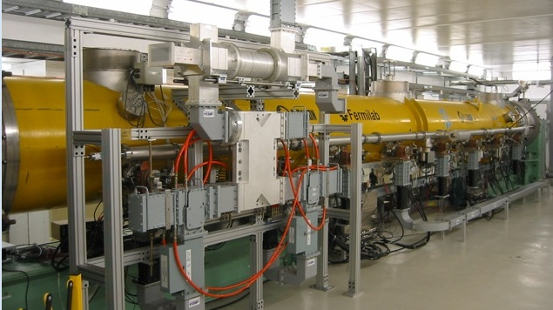
NML: RF Unit Test Facility
1st Cryomodule Tests now complete

Slide 49
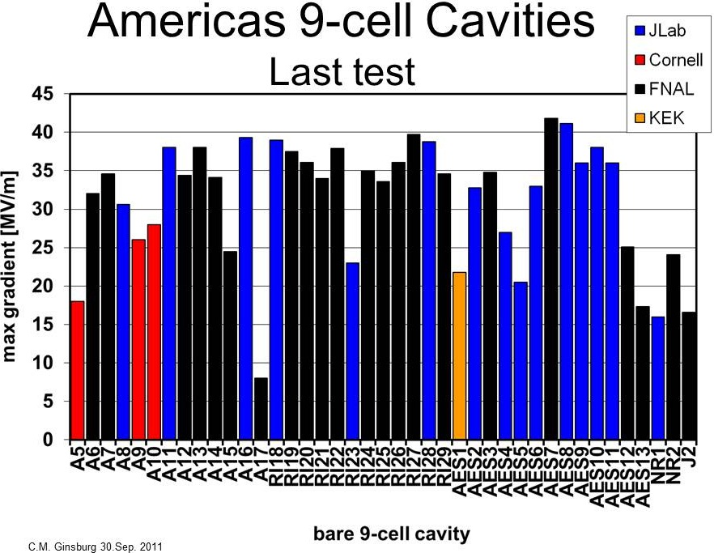
ILC
PX
Pits in EB weld HAZ
New vendor

Slide 50
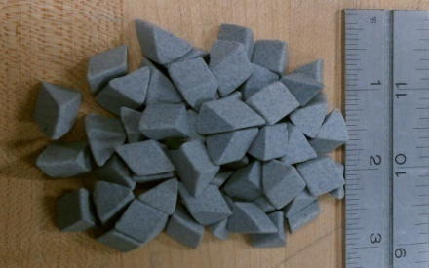
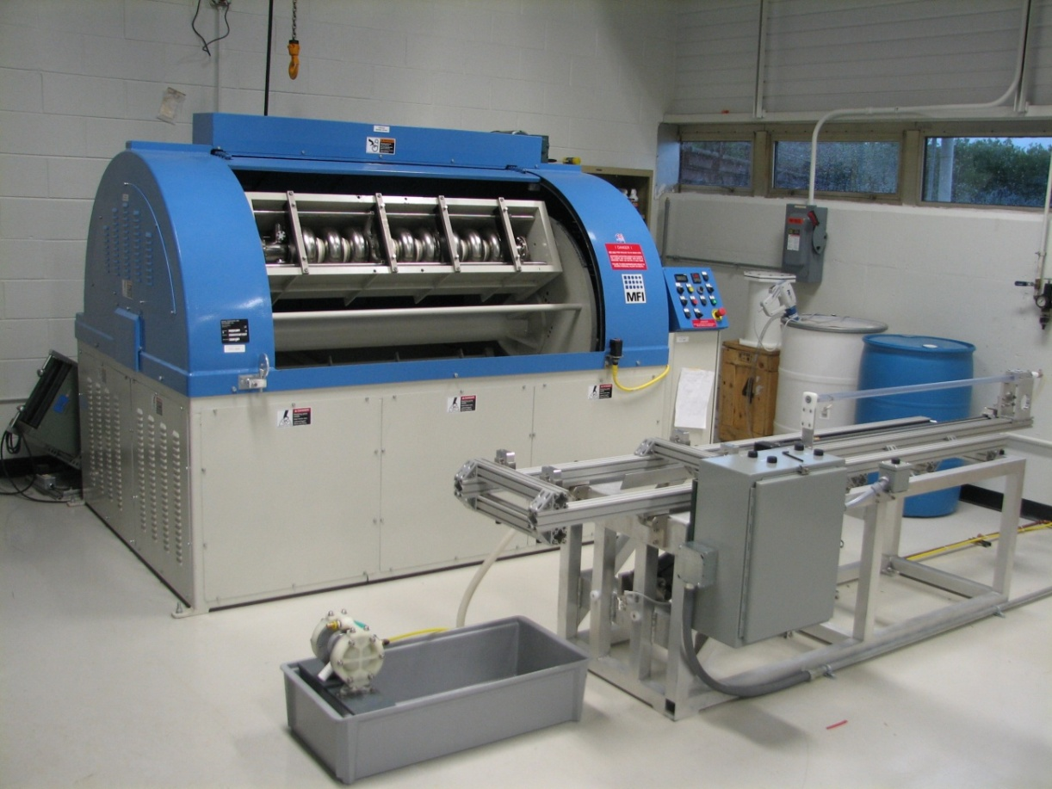
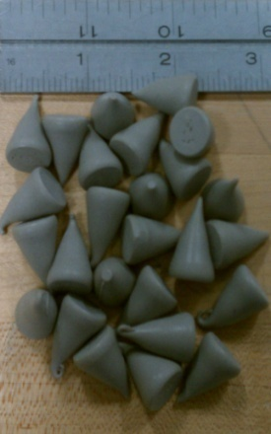
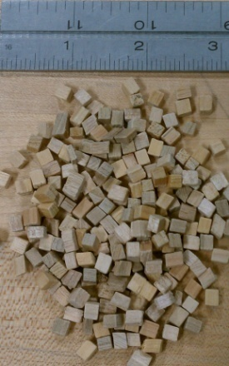
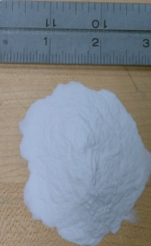
Centrifugal Barrel Polishing IB4 Tumbling Machine
C. Cooper Recipe Media
Multi-step process for elliptical cavities using multiple sets of media
Potential for up to 4 cavity-cycles per week

Slide 51
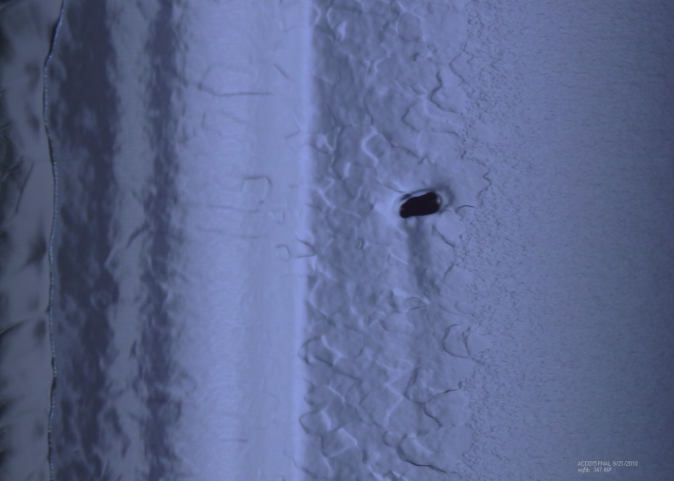

Centrifugal Barrel Polishing 9-Cell Results
Previously limited here
ACC015 Before CBP
Demonstrated cavity gradients > 35 MV/M
Drastic reductions in acid use.
Demonstrated as a cavity repair method.
After CBP and 40 μm EP

Slide 52
SRF Plan Cavities & Cryomodules

Slide 53
SRF Plan Infrastructure

Slide 54
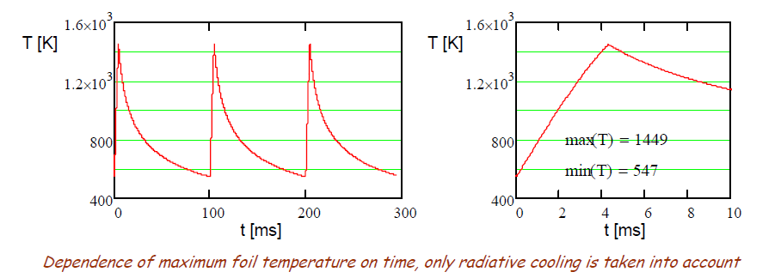
Project X R&D H- Injection
Need to accumulate 26 mA-ms protons in the MI/Recycler (RD)
For a stationary foil, a single 26-ms pulse would destroy the foil.
6 pulses at 10 Hz provide sufficient radiative cooling between pulses
~400 turns
Also looking at moving/rotating foils and laser assisted stripping
1 mA-msec protons required to load the Booster in Stage 1
600 turns

Slide 55
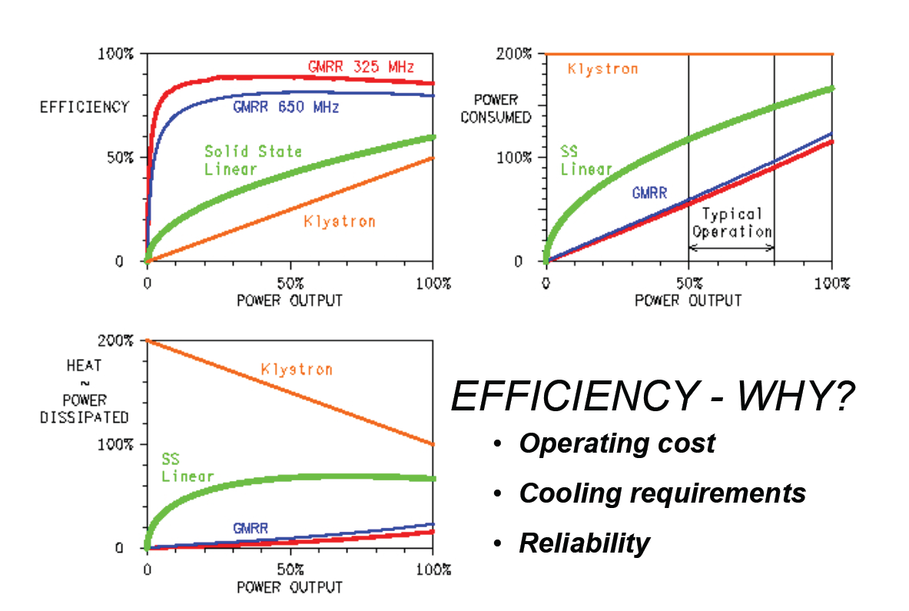
Project X R&D RF Sources
162.5 and 325 MHz sources will be solid state
~5-20 kW/unit
Evaluating multiple technologies for 650 MHz
IOT
Solid State
1300 MHz (Stage 3) based on klystrons

Slide 56
Project X Status and Strategy
Project X strategy is strongly tied to the overall USDOE Intensity Frontier Strategy
LBNE: Stage 1 proposal to DOE
Project X and LBNE stages interleaved
Project X is being well supported financially for the R&D phase
Significant effort is going into defining the physics research opportunities at all stages
Recent workshops on opportunities with spallation sources and on short baseline neutrinos
Project X Physics Study: June 14-22
Snowmass 2013 in planning stages (DPF)
A significant contribution from India is a strong possibility
DOE-DAE Joint Collaboration Meeting mid-June (sponsored by US State Department)

Slide 57
Collaboration Activities
Two MOUs covering the RD&D Phase
National IIFC
ANL ORNL/SNS BARC/Mumbai
BNL PNNL IUAC/Delhi
Cornell TJNAF RRCAT/Indore
Fermilab SLAC VECC/Kolkata
LBNL ILC/ART
MSU
Informal collaboration/contacts with CERN/SPL, ESS
China/ADS, UK, Korea/KoRIA
Weekly Friday meeting: https://indico.fnal.gov/categoryDisplay.py?categId=168
Collaborator participation via webex
Meeting notes posted
Semi-annual Collaboration meetings

Slide 58
Staged Physics Program
Project X Campaign
Program: | NOνA + Proton Improvement Plan | Stage-1: 1 GeV CW Linac driving Booster & Muon, n/edm programs | Stage-2: Upgrade to 3 GeV CW Linac | Stage-3: Project X RDR | Stage-4: Beyond RDR: 8 GeV power upgrade to 4MW
MI neutrinos | 470-700 kW** | 515-1200 kW** | 1200 kW | 2450 kW | 2450-4000 kW
8 GeV Neutrinos | 15 kW + 0-50 kW** | 0-42 kW* + 0-90 kW** | 0-84 kW* | 0-172 kW* | 3000 kW
8 GeV Muon program e.g, (g-2), Mu2e-1 | 20 kW | 0-20 kW* | 0-20 kW* | 0-172 kW* | 1000 kW
1-3 GeV Muon program, e.g. Mu2e-2 | ----- | 80 kW | 1000 kW | 1000 kW | 1000 kW
Kaon Program | 0-30 kW** (<30% df from MI) | 0-75 kW** (<45% df from MI) | 1100 kW | 1870 kW | 1870 kW
Nuclear edm ISOL program | none | 0-900 kW | 0-900 kW | 0-1000 kW | 0-1000 kW
Ultra-cold neutron program | none | 0-900 kW | 0-900 kW | 0-1000 kW | 0-1000 kW
Nuclear technology applications | none | 0-900 kW | 0-900 kW | 0-1000 kW | 0-1000 kW
# Programs: | 4 | 8 | 8 | 8 | 8
Total max power: | 735 kW | 2222 kW | 4284 kW | 6492 kW | 11870kW
* Operating point in range depends on MI energy for neutrinos.
** Operating point in range is depends on MI injector slow-spill duty factor (df) for kaon program.

Slide 59
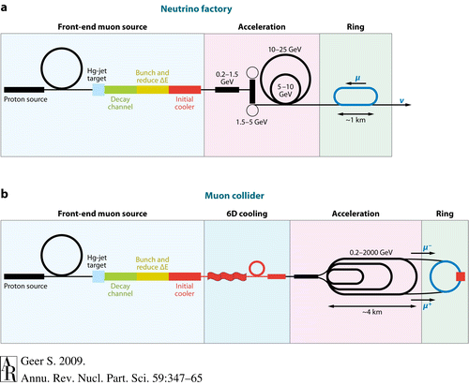
The Longer Term Muon-based Facilities
A high intensity proton facility (like Project X) could serve as a gateway to a novel muon-based facility:
Neutrino Factory (Intensity Frontier)
Muon Collider (Energy Frontier)

Slide 60
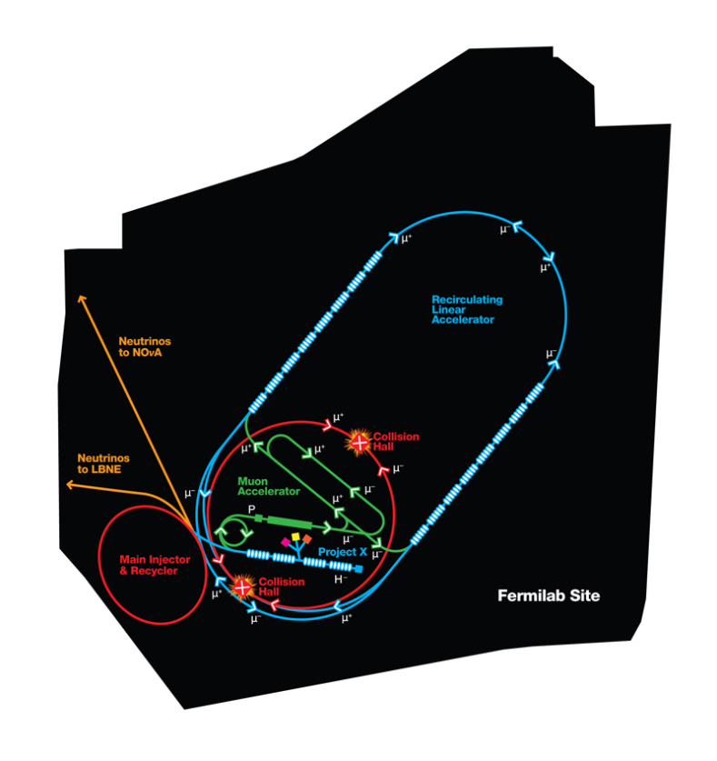
The Longer Term Fermilab
Project X shares many features with the proton driver required for a Neutrino Factory or Muon Collider
NF and MC require ~4 MW @
10± 5 GeV
Primary issues are related to
beam “format”
NF wants proton beam on
target consolidated in a few
bunches; Muon Collider requires
single bunch
Project X linac is not capable of
delivering this format
It is inevitable that a new ring(s) will be required to produce the correct beam format for targeting.

Slide 61
Summary
The Intensity Frontier presents many opportunities for addressing the most fundamental questions confronting particle physics, in experiments not accessible via the Energy Frontier
There are many research opportunities outside of particle physics (nuclear physics and energy applications)
Most important performance metric for Intensity Frontier facilities is beam power
The next generation of facilities will target beam powers well in excess of 1 MW
Linacs have inherent advantages over synchrotrons for the next generation of Intensity Frontier facilities
Superconducting rf is the enabling technology of these next generation facilities
Project X is Fermilab’s plan for a facility that would provide world leadership on the Intensity Frontier over many decades
Utilization of a srf-based CW linac, coupled with an innovative scheme for delivering independent beam formats to multiple users, is unique among facilities either operating or under development
>10 MW of facility wide beam power is ultimately achievable
Step towards a return to the Energy Frontier
The Project R&D program underway with very significant investment in srf
Emphasis on the CW linac components, including front end development program (PXIE)

Slide 62
Backups

Slide 63
A permanent EDM violates both time-reversal symmetry and parity
+
T
+
P
-
-
-
+
EDM
Spin
EDM
Spin
EDM
Spin

Slide 64
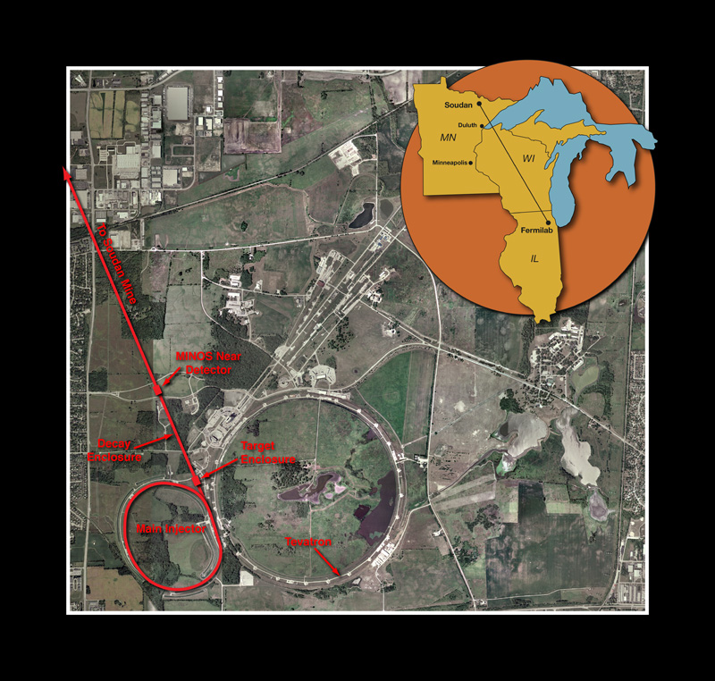
Accelerators at the Intensity Frontier Fermilab
Neutrinos at the Main Injector (NuMI)
>300 kW @ 120 GeV
MINOS detector located at 735 km
Upgrading to 700 kW @ 120 GeV
NOvA detector under construction at 810 km
Simultaneous delivery of ~20 kW at 8 GeV

Slide 65
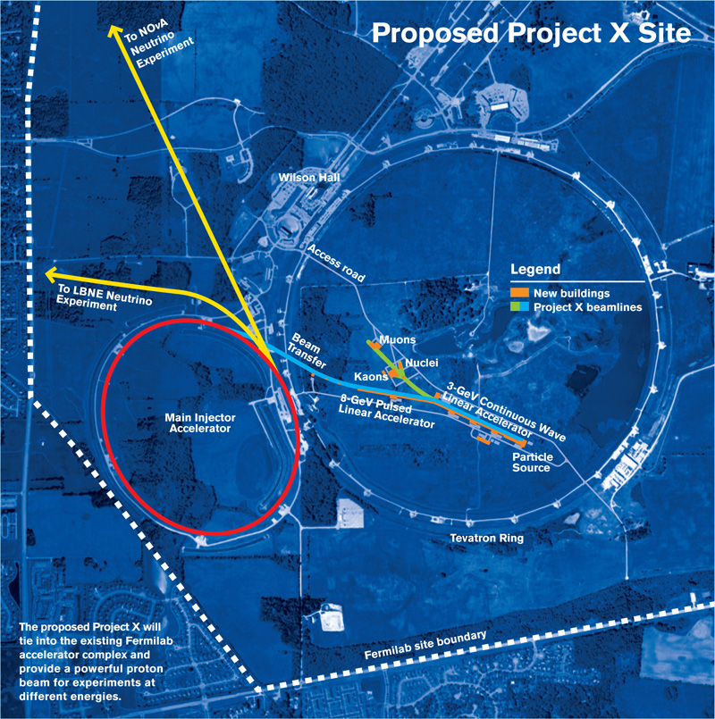

Slide 66
