Slide 1
News from Fittino Fits
Xavier Prudent (IKTP, Dresden University)
Prejudice meets Reality, 23rd August 2012
Philip Bechtle (Bonn), Torsten Bringmann (Hamburg), Klaus Desch (Bonn), Herbi Dreiner (Bonn), Matthias Hamer (Göttingen), Carsten Hensel(Göttingen), Michael Krämer (Aachen), Nelly Nguyen (Hamburg), Werner Porod (Würzburg), Xavier Prudent (Dresden), Björn Sarrazin (DESY), Mathias Uhlenbrock (Bonn), Peter Wienemann (Bonn),

Slide 3
Searching for SUSY at the TeV scale … and ?
2011: long LHC run, center-of-mass energy 7 TeV, luminosity ~5/fb.
Direct step into Terascale
No significant excess seen
https://atlas.web.cern.ch/Atlas/GROUPS/PHYSICS/PAPERS/SUSY-2011-19/
CMSSM/NUHM1 parameter space still allowed ?
Tension between LHC and pre-LHC ?
Impact of light SUSY Higgs of 126 GeV ?
Impact of direct & indirect search for dark matter ?
Interpretation in (non-)minimal models?
Xavier Prudent – IKTP (TU Dresden)

Slide 4
The Inversion Problem
?
Model→code→parameters
Observables
Model→code→parameters
?
Observables (±)
Non analytic / linear relations between observables and parameters
Xavier Prudent – IKTP (TU Dresden)

Slide 5
Grid-sampling of parameter space ?
→ Sampling in n hyper-cubes (e.g. n=1000)
→ Calculate the predicted observables at each point
1 parameter ➔ n = 1000 points
2 parameters ➔ n x n = 10⁶ points
4 parameters ➔ n⁴= 10¹² points
Non-mininal models > 6 parameters
Smarter methods:
- Markov chain
- Simulated annealing
For 4 parameters, minimum can be found with ~millions points
Xavier Prudent – IKTP (TU Dresden)

Slide 6
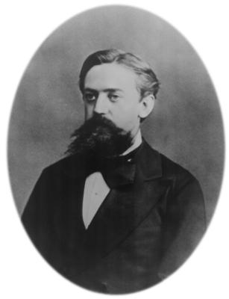
Markov Chains
1 Pick a starting point
2 Build a proposal distribution (Gaussian)
Andrei Markov
1856-1922
3 Pick a second point according to the proposal distribution
4 Compare the 2 points with
If L₁/L₂ > 1 : point 2 accepted (lower χ²)
If L₁/L₂ < 1 : point 2 accepted with a probability of L
χ²
χ²[2]
2
χ²[1]
1
χ²[2]
2
Parameter
Xavier Prudent – IKTP (TU Dresden)

Slide 7
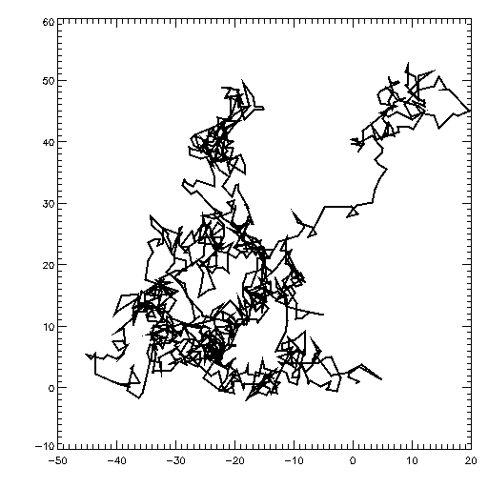
Markov Chains (2)
This algorithm (Metropolis-Hasting) gives out a suite of numbers, each depending ONLY on the precedent
Markov chain
Brownian movement
Higher density around minima
Possibility to accept points in a worse χ2 region
Allows scan of the surface
χ2
2
1
Secondary minimum
Absolute minimum
Xavier Prudent – IKTP (TU Dresden)

Slide 8
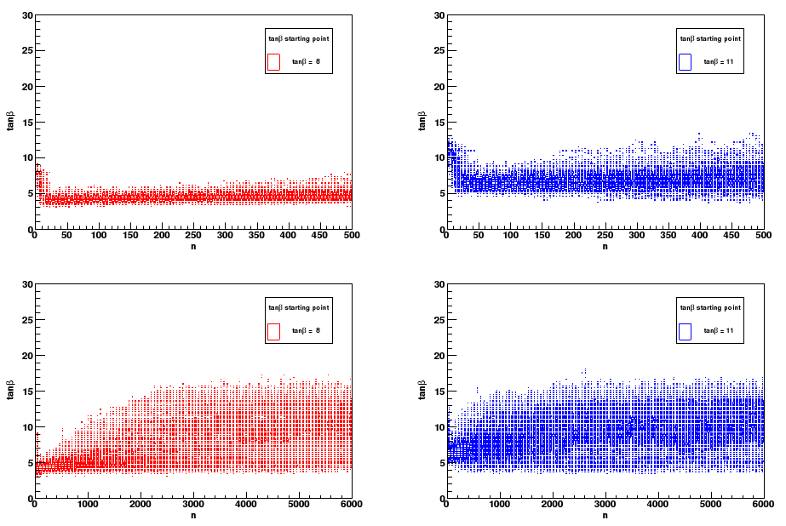
Markov Chains (3)
Where should the Markov chain start … ?
Start value = 8
Start value = 11
# steps
# steps
# steps
# steps
For unbiased results: - long enough chain, but how long … ?
- adapted proposal distributions

Slide 9
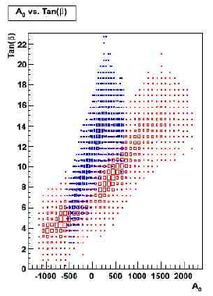
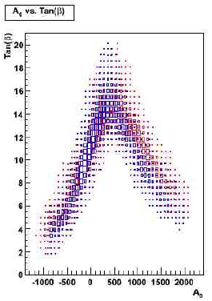
Short fixed chain length
Optimised Markov chain at work…
Start value 1
Start value 2
Non optimised
Optimised

Slide 10
F I T T I N O
C++ program for SUSY model testing and SUSY parameter analysis
Currently supported SUSY models: CMSSM, GMSB, AMSB, MSSM24, NMSSM
Measurements from low/high energy experiments, LEP/SLC, Tevatron, cosmology, LHC and LC, (g-2)_{μ}, B, K...
Parameter analysis using full correlation information: Auto-adaptive Markov Chain Monte Carlo (MCMC)
Proof of principle with SPS1a’: http://arxiv.org/abs/0907.2589v1
10
Xavier Prudent – IKTP (TU Dresden)

Slide 11
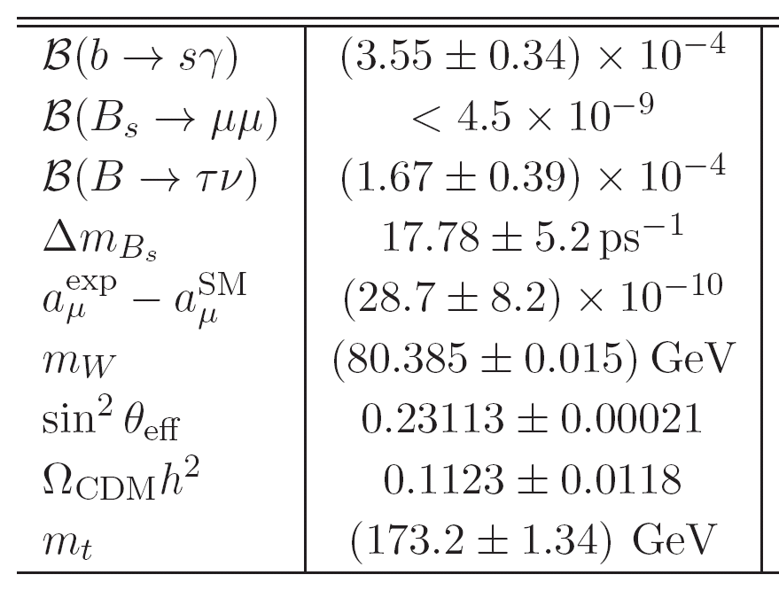
Including “low energy” observables
SuperISO, FeynHiggs
micrOMEGAS, DarkSUSY
(In)direct dark matter detection bounds
Astrofit
Higgsbound ± 3.0 GeV
or direct cut for LHC result
mass(h⁰)
LEP bound in e+e-→χ₁⁺χ₁⁻
SPheno, SoftSUSY
SM parameters fixed (PDG value)
Require lightest neutralino to be LSP
Xavier Prudent – IKTP (TU Dresden)

Slide 12
Scan of the SUSY parameter space with Markov chain
Each point, calculate χ2:
For measurements:
For bounds:
Require lightest neutralino to be LSP
Xavier Prudent – IKTP (TU Dresden)

Slide 13
Estimation of the contour
Gaussian hypothesis on parameter likelihood:
1σ contour → 68%
Δχ2 < 1 (1D)
Δχ2 < 2.33 (2D)
χ2
Δχ2
Minimum χ2
Xavier Prudent – IKTP (TU Dresden)

Slide 14
Fluctuations due to a lack of points
P-value in principle calculable with the Gaussian hypothesis…
Xavier Prudent – IKTP (TU Dresden)

Slide 15
Future and Current
Fittino Upgrades
Xavier Prudent – IKTP (TU Dresden)

Slide 16
Latest Physics Results & Statistical Method
LHC SUSY search:
extension to non-minimal models
SUSY2012 results
Addition of cross sections @LHC
Higgs signal:
HiggsSignal→ constraint from measurements of μ, m(h⁰) from 17 analysis
Correlation between analysis included
Dark matter Direct detection:
Last XENON result
General:
Careful consideration of (theoretical) uncertainties
Correct statistical derivation of p-values and contours (no Gaussian approximation)
Xavier Prudent – IKTP (TU Dresden)

Slide 17
Code Performance
Faster and more efficient scan:
Intelligent Markov chain with auto-adaptive width through an estimation of the variance of the chi2 profile
Flexible post-processing of fit:
Fast incorporation of new experimental results
Plots & Figures
Xavier Prudent – IKTP (TU Dresden)

Slide 18
What About the Others ?

Slide 19
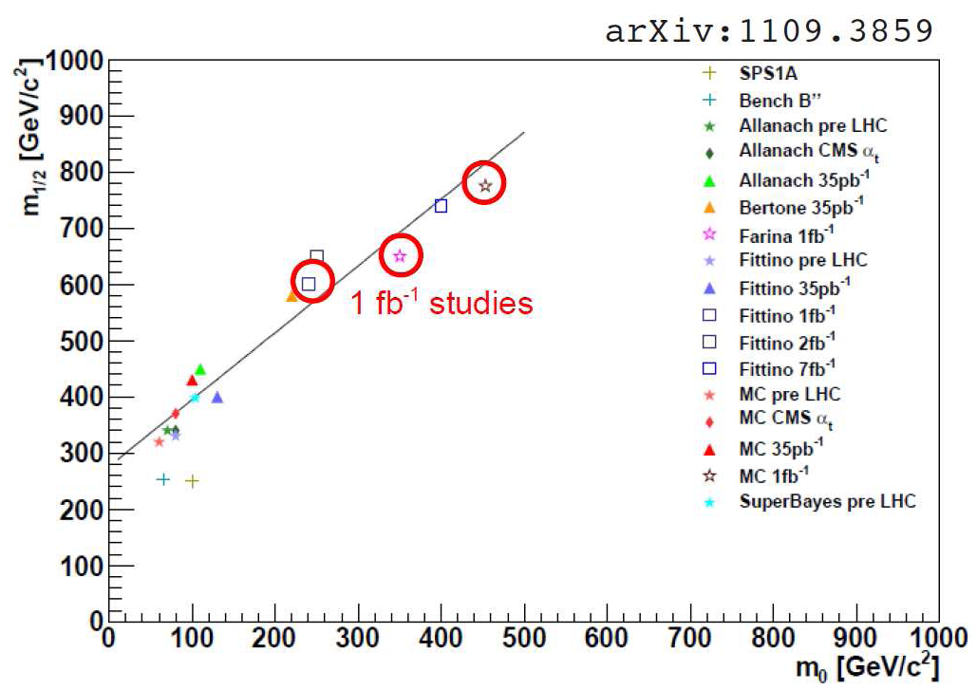
Different methods ➔ different results ! (+different observable, calculators,…)
Xavier Prudent – IKTP (TU Dresden)

Slide 20
2σ Bayes.
2σ freq.
2σ Bayes.
2σ Bayes.
Don‘t underestimate the differences between statistical methods !
Attention to Bayesian priors !!
Xavier Prudent – IKTP (TU Dresden)

Slide 21
Let‘s (at least) agree on the experimental constraints
https://wiki.terascale.de/index.php/SUSY/BSM_Parameter_Fitting
- Most up-to-date/used experimental constraints
- Precise location in the original paper
- Hypothesis, context (measurement, fit, …)
To add one -> drop me a mail
Xavier Prudent – IKTP (TU Dresden)

