Slide 1
10Gb Ethernet and beyond on FPGA Workshop UDP/IP Implementation and Data streaming
Rob Halsall
European XFEL/DESY
25 May 2012

Slide 2
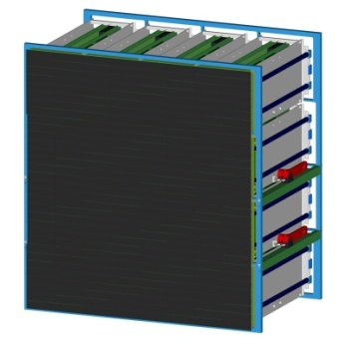
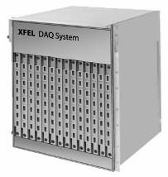
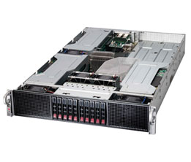
XFEL
10G
10G
10G
Detector
Train Builder
10g Switch
10g server
1M Pixel, 2B/Pixel,4.5Mhz, 512 Samples, @10Hz
10Gbyte per Second per Megapixel rate
16 x 10G Links off detector per Megapixel
10G Ethernet using UDP protocol
Scalable to multiple Megapixels – 160 x 10G Links
Switch & Farm

Slide 3
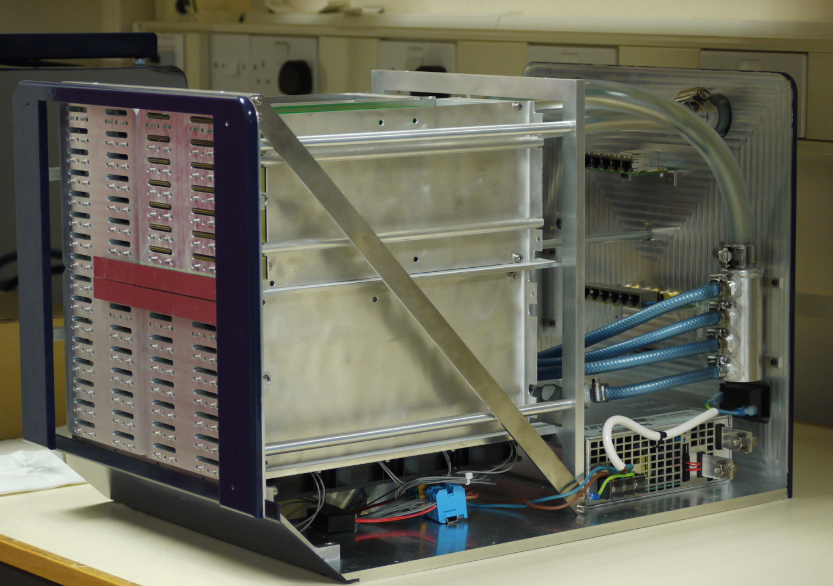
XFEL LPD Quadrant Prototype
LPD Quadrant
256K Pixels
512 ASICs
Embedded Readout
4 x FEMs
4 x 10G Links

Slide 4
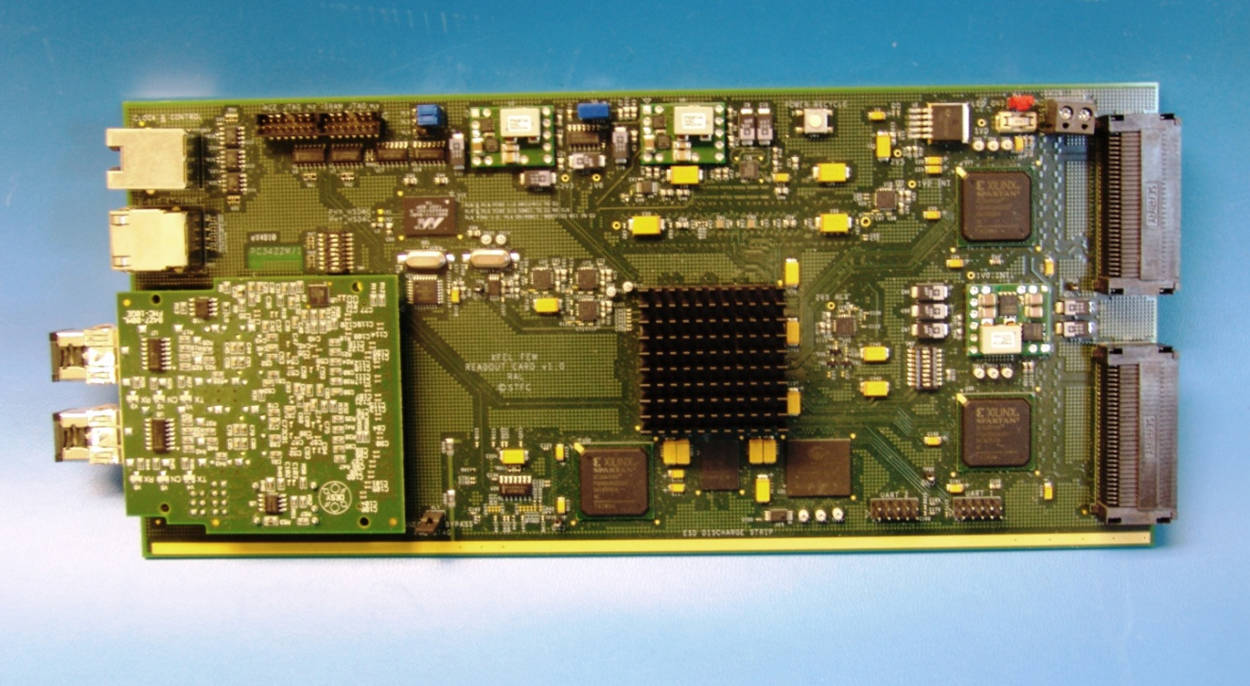
XFEL LPD FEM
Front End Module
128 ASIC
480 Way LVDS
2 x SP3 I/O FPGA
V5 FXT 100 FPGA
SODIMM DRAM
Dual 10G FMC (DESY)
1GE LAN
RJ45 LVDS Timing
16 per M Pixel
Embedded in Detector Head

Slide 5
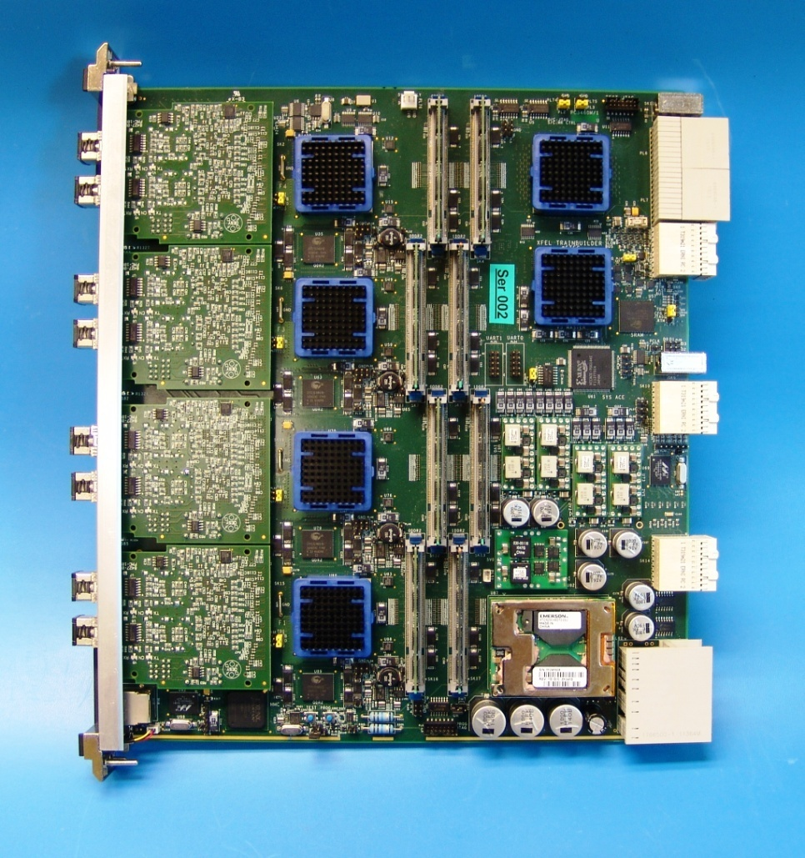
XFEL Train Builder
Train Builder Prototype
4 x V5FXT100 FPGAs
4 x DESY dual 10G FMC
Mindspeed X-point
80x80 @ 6.5G
8 x 4GB SODIMM DDR2 Modules
1 Pair per 0.5 Mpixel
ATCA form factor
Builds Images for Farm
8 x 10 Gbit/s
Scale up to 160x160
Notes:
Optical fibres

Slide 6
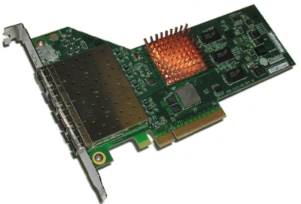
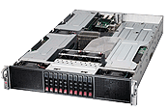
PC Side
10G Switch
Arista
10G NICs
Mellanox/Chelsio
Linux Servers
Supermicro

Slide 7
XFEL
FEMs
Train Builder
Train Builder
SWITCH
PC
PC
Detector
N x 512
N x 512
FEMs
SWITCH
PC
PC
0.25 M Pixel Train Builder
Train builder receives image trains spread across 4 inputs synchronously
4 Outputs send complete image trains
Scale to 160 x 10G Links
Requires external 4 x 160 x 160 Xpoint Module

Slide 8
FEM FPGA Firmware
Virtex 5 FPGA
Clock & Controls
C&C Timing & Veto
ASIC Fast Commands
R
ASIC Pipeline Emulation
SP3 Top I/O
(80%)
ASIC Slow Ctrl
SP3 I/O
FPGAs
PC
UART
RS232
R
GbE
Processor Embedded
Software
ASIC Data Rx
128 ASICs
10Gb Link
LPD
Super
Module
MatLab
R
Python
R
Virtex5 Main FPGA
DDR2
ASIC Simulated Data
SP3 Confign
FPGA
DATA
CTRLS

Slide 9
Core TB Firmware
DDR2 SDRAM
TB FPGA
DUAL
10G PHY
FMC
XPOINT
XAUI
Core
0
UDP
Core
Power PC
Memory Controller
Subsystem
Aurora
Core
0
‘XCTRL’
4 TX PAIRS
4 TX PAIRS
SFP+
PHY
4 RX PAIRS
4 RX PAIRS
XTAL
PLL
XTAL
PLL
XAUI
Core
1
UDP
Core
Power PC
Memory Controller
Subsystem
Aurora
Core
1
4 TX PAIRS
4 TX PAIRS
SFP+
PHY
4 RX PAIRS
4 RX PAIRS
DDR2 SDRAM

Slide 10
FEM/TB Firmware
Detector
RAM
FPGA
FEM
TB
RAM
RAM
FPGA 1
FPGA 5
ASIC
RX
PPC
UDP
XAUI
PHY
SFP
SFP
PHY
XAUI
UDP
PPC
AUR
AUR
PPC
UDP
XAUI
PHY
SFP
SFP
PHY
XAUI
UDP
PPC
AUR
AUR
PPC
UDP
XAUI
PHY
SFP
RAM
RAM
FPGA 2
RAM
RAM
FPGA 6
SFP
PHY
XAUI
UDP
PPC
AUR
AUR
PPC
UDP
XAUI
PHY
SFP
SFP
PHY
XAUI
UDP
PPC
AUR
AUR
PPC
UDP
XAUI
PHY
SFP
RAM
XP
RAM
FPGA 3
RAM
RAM
FPGA 7
SFP
PHY
XAUI
UDP
PPC
AUR
AUR
PPC
UDP
XAUI
PHY
SFP
SFP
PHY
XAUI
UDP
PPC
AUR
AUR
PPC
PE
XAUI
PHY
SFP
RAM
RAM
FPGA 4
RAM
RAM
FPGA 8
RAM
FPGA
SFP
PHY
XAUI
UDP
PPC
AUR
AUR
PPC
PE
XAUI
PHY
SFP
ASIC
RX
PPC
UDP
XAUI
PHY
SFP
SFP
PHY
XAUI
UDP
PPC
AUR
AUR
PPC
PE
XAUI
PHY
SFP
RAM
FPGA
RAM
GIGE

Slide 11
10G IP Library
LL-10G-AURORA
Local_Link
LL_FIFO, LL_MUX, LL_DEMUX
LL_GEN, LL_CHK
RDMA
RS232_RDMA
RDMA_SER_SPLIT
RDMA_PAR_BUS_SPLIT
RDMA_REG
Aurora
LL_10G_AURORA
Video
LL_VID_GEN
X10G
LL_10G_UDP
156.25MHz
156.25MHz
LL 64
XAUI
RDMA
32

Slide 12
10G UDP IP
156.25MHz
LL-10G-UDP
156.25MHz
Used in
FEM & TB FEM
Features
LL FRAME <-> UDP PKT STREAM
FPGA <-> FPGA - FPGA <-> PC
RDMA Programmable
Rx IP, PORTS, MAC
Tx MAC, IP PORT LUT
IFG…
No Handshake/flow control
No resend
LL 64
XAUI
RDMA
32

Slide 13
Local Link transport via UDP
LL Header | 8
Detector Data | 2M+
LL Trailer | 8
UDP Header | 42B
Detector Data | 8K
Frame Number | 4B
SOF/EOF Packet No | 4B
Index
UDP Header | 42B
Detector Data | 8K
Frame Number | 4B
SOF/EOF Packet No | 4B
LL 10G
Tx Channel splits Local Link frame into 8K Byte UDP packets
Adds a LL frame number & a packet number
SOF & EOF Flags in top bits of packet number
Rx channel re-assembles packet stream into a Local Link frame

Slide 14
FEM -> TB - UDP Train
Local Link Frame
LL Header | 8
Detector Data | 2M+
LL Trailer | 8
Index
First UDP Packet
N x Data UDP Packet
Last UDP Packet
UDP Header | 42
Detector Data | 8K
Frame Number | 4
Packet No 0 | 4
UDP Header | 42
Detector Data | 8K
Frame Number | 4
Packet No 1,2,3… | 4
UDP Header | 42
Detector Data | 8K
Frame Number | 4
Packet No 1,2,3… | 4
UDP Header | 42
Detector Data | ≤8K
Frame Number | 4
Packet No N | 4
SOF
EOF
Local Link Frame
LL Header | 8
Detector Data | 2M+
LL Trailer | 8
FNUM

Slide 15
TB -> PC - UDP Packet Format
Detector Header
Detector Data | 8M
Trailer | 8B
Packet trailer
Frame/Packet Count +sof/eof
Overwrite next packet over trailer of previous packet
No copies to remove trailer
Re-assembles Local Link Frame in memory
Some copying may be required to fix out of order and missing packets but at a low rate
Detector Data | 8M
Trailer | 8B
Detector Data | 8M
Trailer | 8B
Detector Data | 8M
Trailer | 8B
Detector Data | 8M
Trailer | 8B
Detector Data | 8M
Trailer | 8B

Slide 16
UDP TB -> PC - Trailer Format
31 |  |  |  |  |  |  | 24 |  |  |  |  |  |  |  | 16 |  |  |  |  |  |  |  | 08 |  |  |  |  |  |  |  | 00
Frame Count
SOF | EOF | Reserved |  |  |  |  |  | Packet Count
Frame Count 2^32 frames => 10 years
@10Hz
Packet Count 2^24 => 128 Gbyte Max Frame Size
8192 Bytes/pkt
SOF/EOF flags + 6 bits reserved
e.g. SOP/EOP/RESEND/,…
Same Format as Header Mode…

Slide 17
10G UDP Block Tx Path
8k pipe
ll fifo
hdr
trl
xtr
ll pkt
splitter
ll pkt
hdr/trl
insert
ll pkt
chks
len
chks
Packet
Engine
len
ll frm
ll pld
ll pkt
64
64
64
64
64
64
xgmii-tx
Index
extract
MAC
IP
PORT
LUT
64D+8C
mac
ll hdr/trl
index
ip
port
Simplified view of Transmit packet processing
Local Link Frame contains train data
Local link frame header contains index to MAC, IP, PORT in LUT
Entire local link frame packet stream sent to the address indexed in the LUT – ‘farm mode’
Power PC or firmware can set this for each train
The addresses could simply loop or be sourced from broadcasts

Slide 18
10G UDP Block Rx Path
LL FIFO
PKT
COMBINE
UDP
EXTRACT
ENET frame
Sync
align
xgmii-Rx
64
64
64
64
64D+8C
Simplified view of Receive packet processing
Re-assembles Packet stream into Local Link Data Frame using trailer info
Extracts MAC, IP, PORT info
Provides MAC, IP & PORT Filter
Currently Receives from a single address

Slide 19
Slice Test Design
1
PowerPC
LL64
LL-10G
UDP
+FM
LL-MUX
LL64
Tx
LL-VID
LL64
LL-MON-IP
XAUI
SEQ
trig_0
LL-GEN
LL64
done_0
RDMA
8
PowerPC
LL64
LL-10G
UDP
+FM
trig_n
done_n
LL-MUX
LL64
Tx
LL-VID
LL64
LL-MON-IP
XAUI
LL-GEN
LL64

Slide 20
Slice Test
ML510
FEM
TB
Server
10G
10G Switch
Server
Firmware
10G UDP with Farm Mode exists VHDL
Software
UDP Local Link Frame Receive exists python -> c/c++ boost
UDP 10G Setup exists Matlab -> python

Slide 21
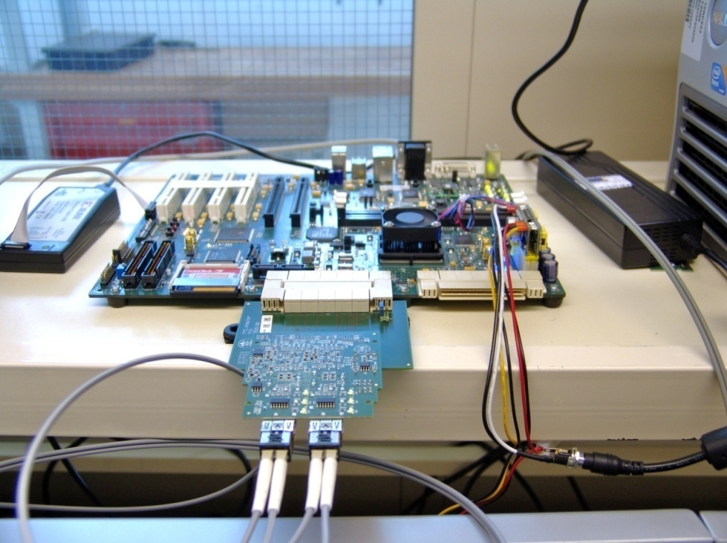
Test Bench
FEM + DESY 10G FMC
ML510 ‘TB’ + DESY 10G FMC

Slide 22
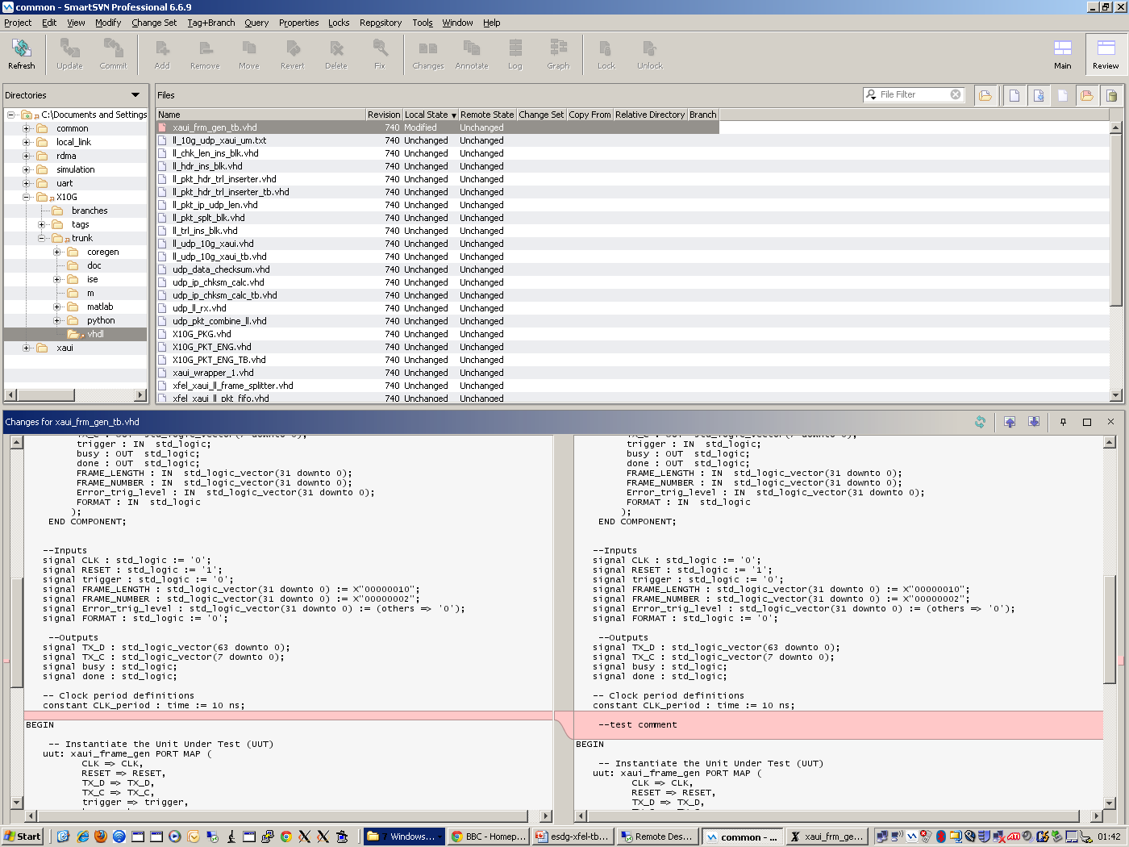
Tools
Subversion
Structure
Libraries
Documentation
Tool compatibility
ISE, EDK, ISIM, PlanAhead…
Linux
Design & DAQ

Slide 23
Summary/Plans/Future
10G Ethernet successful so far...
Complete Testing of 10G UDP IP ‘Farm Mode’
Complete Testing/Development of Train Builder at RAL
Train Builder Slice Tests at DESY in July
Consider Simple Re-send capability
Porting to Xilinx K7/V7 10G direct/DDR3 SDRAM
Longer term 40G Ethernet & iWarp/RDMA & ROCE interest
Ordered Xilinx & HTG K7/V7 Dev Boards
Have Mellanox 40G Ethernet NICs

Slide 24
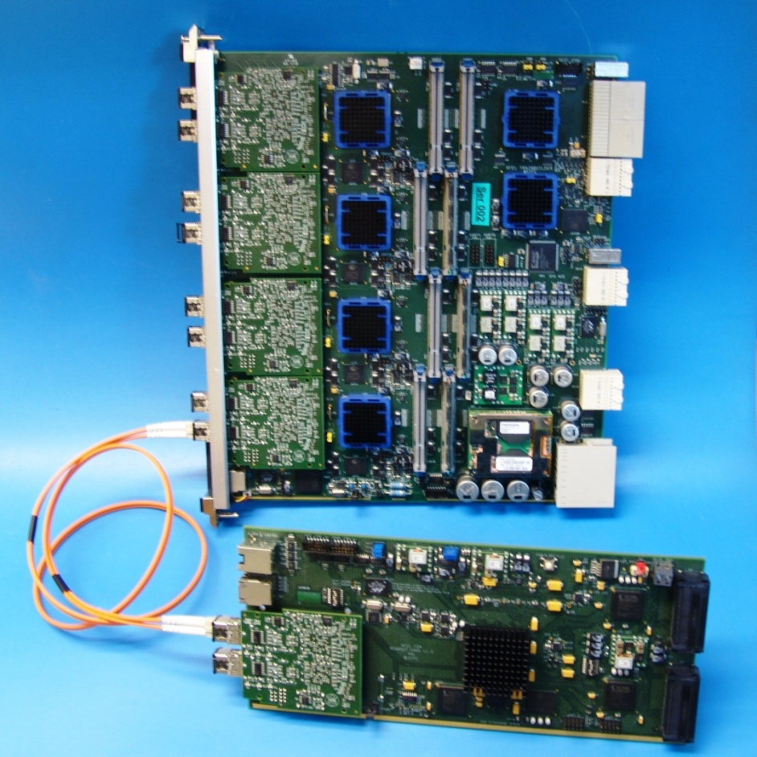
Questions

