Slide 1
10Gb Ethernet and beyond on FPGA Workshop Future Networked DAQ
Rob Halsall
European XFEL/DESY
25 May 2012

Slide 2
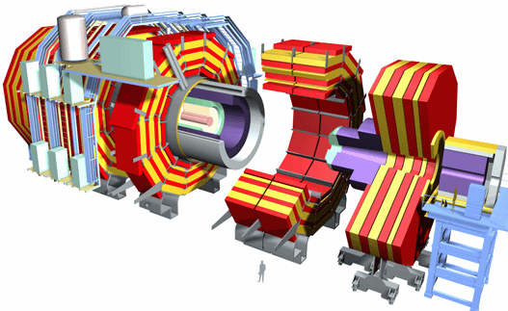
CMS
Early 2000s Technology
10.5 Million Channel
80K APV25 Readout Chips on Detector
40K ADC Readout System Off Detector
400 ADC Readout Boards
2 TByte/s ADC Conversion Rate
Hardware (FPGA) data processing
75 GByte/s to Processor Farm
10K
100K
50K
500
PC Farm

Slide 3
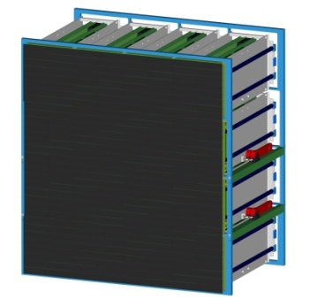
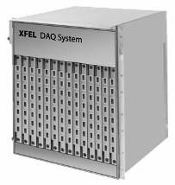
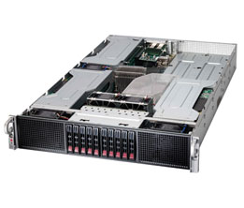
XFEL
10G
10G
10G
Detector
Train Builder
10g Switch
10g server
10Gbyte per Second per Megapixel rate
10Megapixel => 100GByte/s...

Slide 4
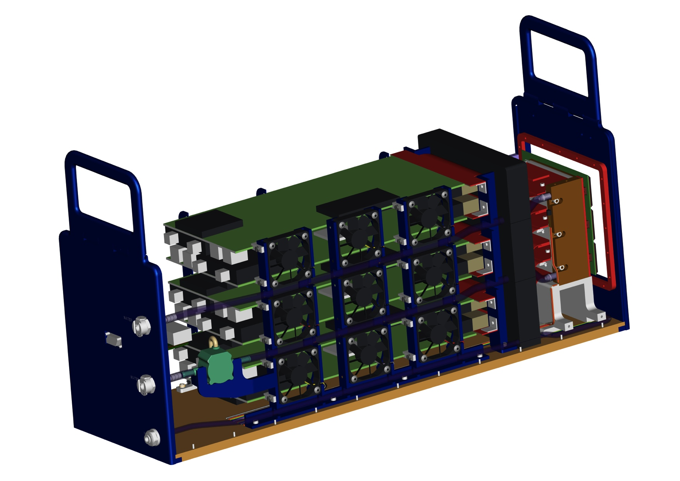
DIAMOND
EXCALIBUR – Medipix 3 3MPixel 1kHz 6GB/s

Slide 5
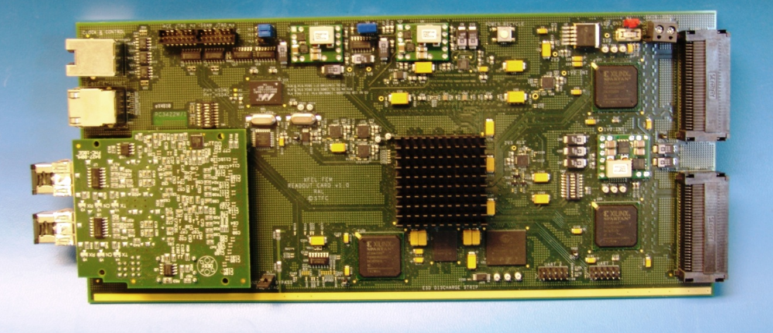
XFEL FEM
480 Way Detector Head Connector LVDS
Xilinx Virtex 5 FPGA + SODIMM
Dual 10G Output Ethernet
Latest Technology => Dual 40G or 100G...

Slide 6
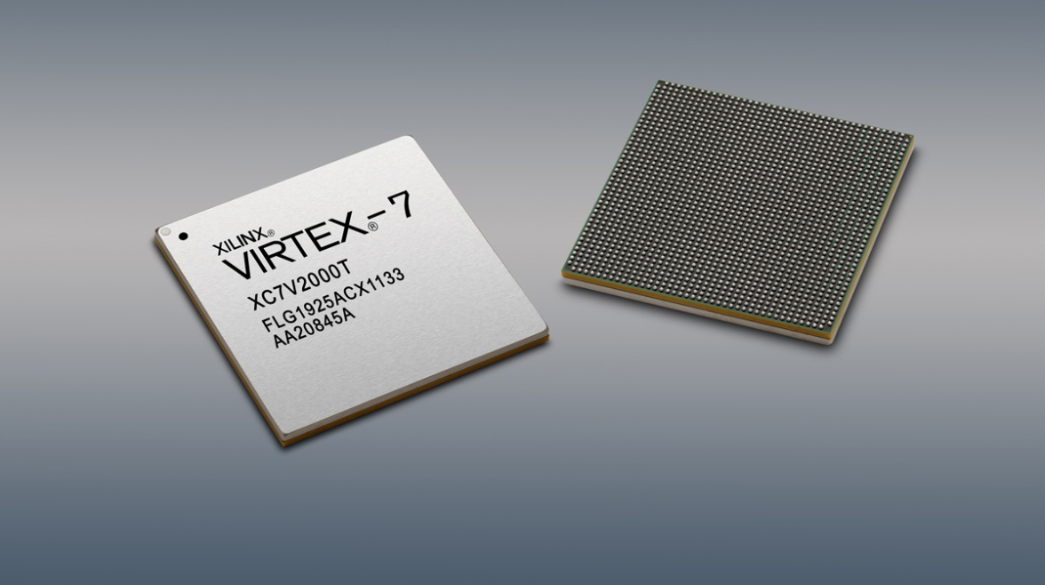
FPGA
Features | Virtex-7
Logic Cells | 2,000,000
BlockRAM | 68Mb
DSP Slices | 3,600
DSP Performance | 5,335GMACS
Transceiver Count | 96
Transceiver Speed | 28.05Gb/s
Total Transceiver Bandwidth | 2,784Gb/s
Memory Interface (DDR3) | 1,866Mb/s
PCI Express® Interface | Gen3x8
I/O Pins | 1,200
28nm today
Up to 80 x 10G Transceiver per device

Slide 7
Crosspoint
10G Crosspoints
144x144 @ 10G
E.g.
Vitesse
Mindspeed

Slide 8
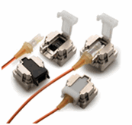
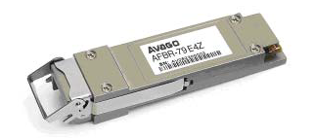
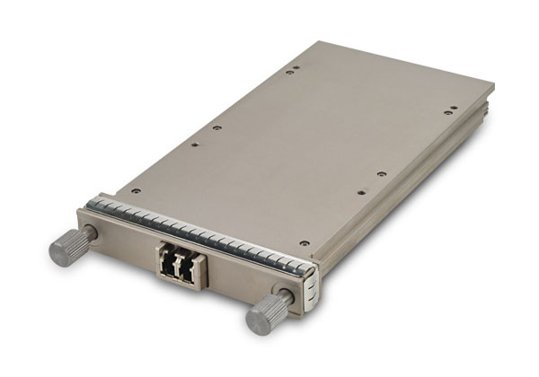
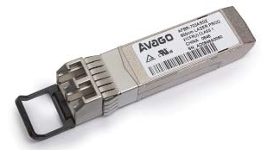
Opto
Optical Transceivers
SFP+ 10G
QSFP 40G
Mini-pod 120G
CFP 100G

Slide 9
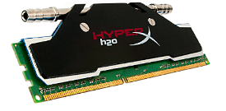
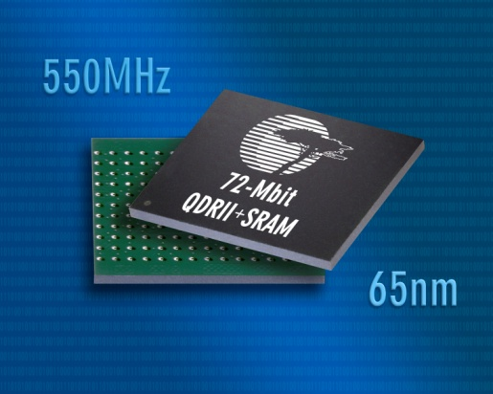
Memory
DDR3 Module
1866, 2133, 2400 MHz+
19.2 GByte/s
FPGAs @ 1850MHz
14.8 Gbyte/s per bank
QDR II Component
1.1 Ghz
4GByte/s throughput

Slide 10
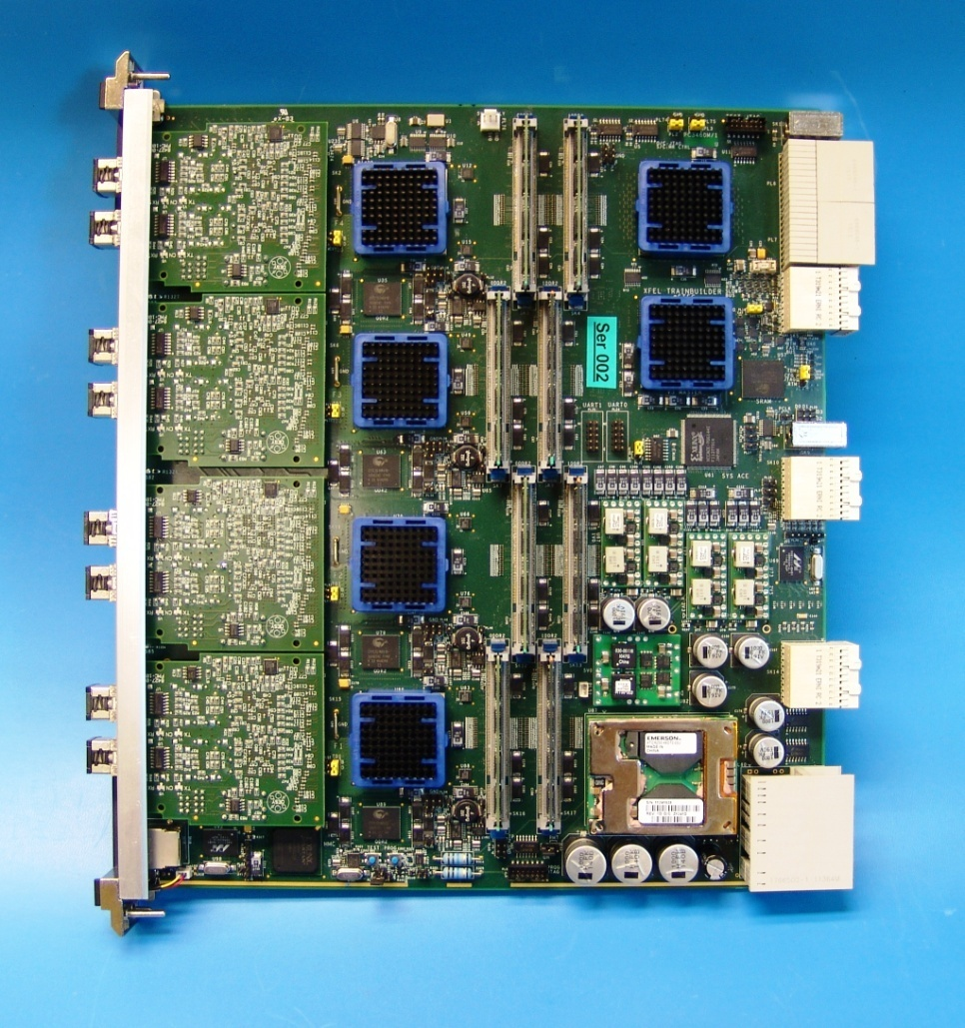
Form Factors
AdvancedTCA & MicroTCA
High Speed Serial Backplanes
FPGA/Memory/Xpoint/Opto...
FMC - SFP/QSFP Optical I/O
RTM - SFP/QSFP Optical I/O
250W
XFEL Train Builder pictured
80G throughput

Slide 11
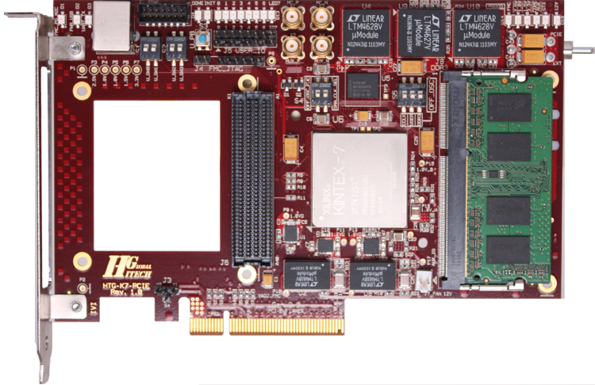
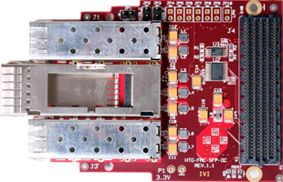
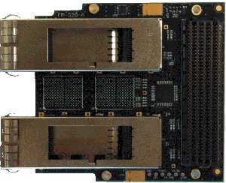
Development boards
K7
Dual QSFP+ FMC
2 x 40G
Hitech Global & faster technology

Slide 12
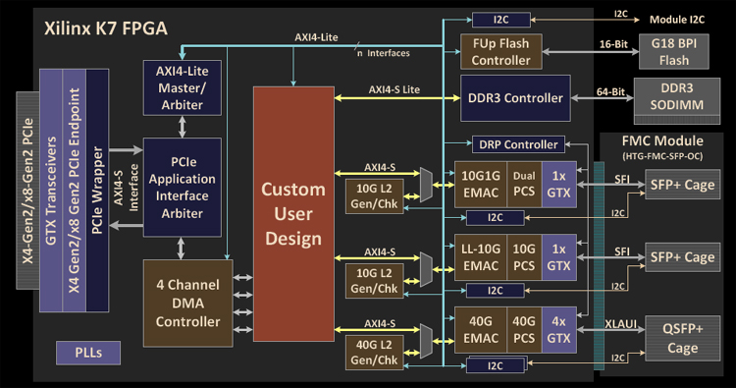
Reference Design - IP
HTG

Slide 13
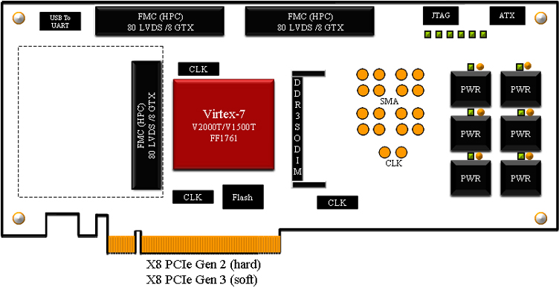
Development Board
V7
3 FMC
6 x 40G
HTG

Slide 14
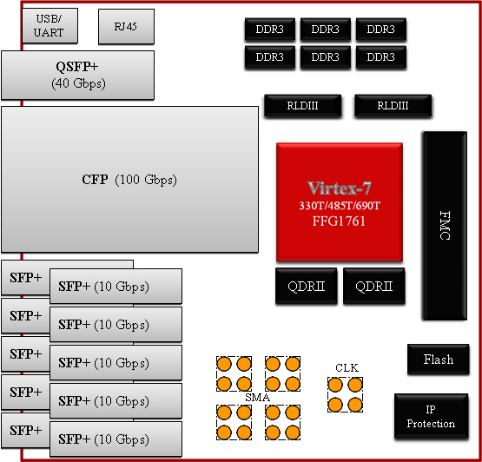
Development Boards
V7
10/40/100G
FMC
HTG

Slide 15
IP
40G/100G
XLAUI & CAUI
TCP/IP & RDMA
Buy v DIY
Commercialisation
Collaboration
AXI4 & AXI4 Stream
Memory – MIG
Vendor IP
Open Source
Velocitytech

Slide 16
Development Tools
Vivado
‘Planahead’
New Synthesis & fitters
System C
System Verilog
Xcell 79 – System C 1G UDP implementation

Slide 17
Protocols
Ethernet
UDP – Financial Markets NICs & Switches
TCP/IP
iWarp RDMA
ROCE – RDMA Over Converged Ethernet
RAL CFI funding
Others
PCIe 3 -> PCIe 4
Infiniband
Interlaken...

Slide 18
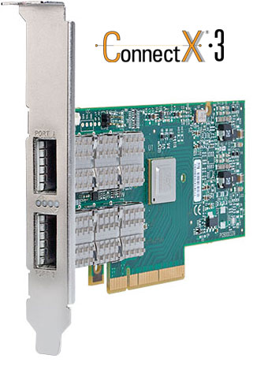
Network
Ethernet
10/40G Today
100G Soon
400G Test
1000G R&D

Slide 19
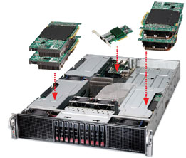
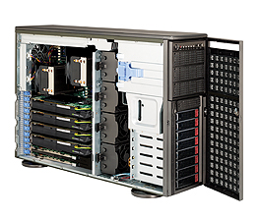
PC
2U Chasis
Dual E5 Xeon/I7
2011 socket
Quad RAM channels
CPU direct PCIe 3
32 Core
256 GB RAM
Quad GPU
Dual 40G NIC
1KW+
£££

Slide 20
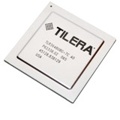
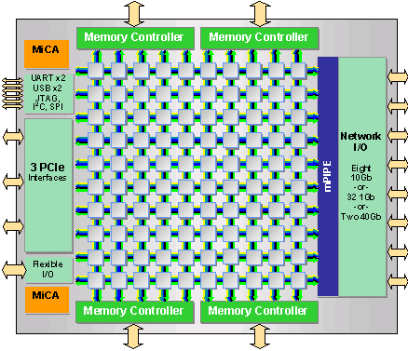
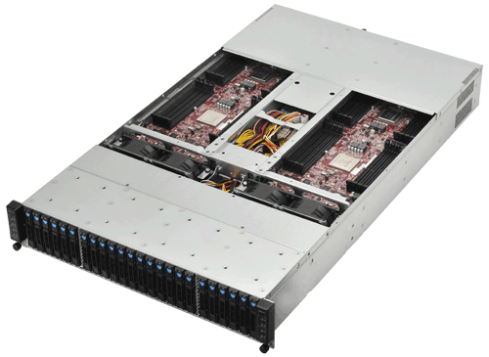
Alternative Processing
100 Core
Lower clock speed
Lower Power
Embedded & PC Layer
500 cores/server
10K Cores/rack@8kw
 | TILE-Gx100 | TILE-Gx64 | TILE-Gx36 | TILE-Gx16
Number of Cores | 100 | 64 | 36 | 16
Core Frequency | 1.2, 1.5GHz | 1.2 1.5GHz | 1.0, 1.2, 1.5GHz | 1.0, 1, 1.2GHz
Network Interface | 2x 50G Interlaken 8 XAUI, 32 SGMII | 2x 50G Interlaken 6 XAUI, 24 SGMII | — 4 XAUI, 16 SGMII | — 2 XAUI, 12 SGMII
PCIe | Three 8-lane | Three 8-lane | One 8-lane,Two 4-lane | Three 4-lane
DDR3 Controllers | 4 | 4 | 2 | 2
DDR3 Frequency | 1866 MT/s | 1600 MT/s | 1600 MT/s | 1333 MT/s

Slide 21
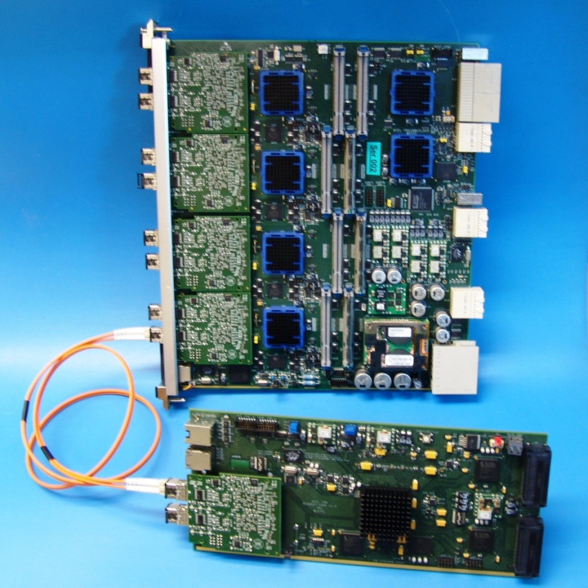
Near Future TB/FEM
TB
V7/K7
≥8 x QSFP+
>8 x DDR3 SODIMM
XP 144 x 144 @10G
XP -> V7/K7
QDR Bandwidth?
Bigger Packages
No FMC
FEM
V7/K7
≥ 2 x QSFP+
≥ 1 x DDR3 SODIMM
≥ 2 x QDR

Slide 22
Summary
Plenty of technology for Extreme Data Rates!
Roadmap reality check!
Not necessarily cheap or low power
Relatively easy to create/move Extreme Rates
Not so easy to process or store...
A future detector with 100KHz frame rate would generate 200GByte/s per megapixel

Slide 23
Questions

