Slide 1
High speed data recording - software
Djelloul Boukhelef (XFEL)
25.05.2012
10Gb Ethernet and beyond on FPGA Workshop
The Cluster of Research Infrastructures for Synergies in Physics is co-funded by the partners and the European Commission under the 7th Framework Programme Grant Agreement 283745
Notes:
How to edit the title slide
Upper area: Title of your talk, max. 2 rows of the defined size (55 pt)
Lower area (subtitle): Conference/meeting/workshop, location, date, your name and affiliation, max. 4 rows of the defined size (32 pt)
Change the partner logos or add others in the last row.

Slide 2
Outline
Introduction
Slice test
Test measurements
Software
UDP Feeder (TB emulator)
PCL application
Some preliminary test results
Summary

Slide 3
Purpose of slice test
Timeline: 2010-2012 – evaluation, development and testing of hardware and software components
Hardware level
Link bandwidth: Do we see the full wire speed (10Gbps)
UDP behavior: Packets loss
Network performance: Concurrent read and write operations
Software level:
Develop the software: Feeder (emulation) and PC layer
Effect of concurrent processing on read/write activities
Device/DeviceServer model, configurability: is s/w framework good?
Outlook:
Complete software suite: processing, formatting
Test 10GB/s disk write
Notes:
Proof of concept
Capability to handle 10GB/s data rate: read data from train builder, process/format, and send it to the computing and storage devices.
Identify issues/bottlenecks, solve them: Error situations (UDP packet loss), speed-up data transfer, data format (HDF5, Wrona)…
Dimensioning and tuning
Measure processing capabilities on the PC layer including data compression and rejection
Assess scalability of the processing and storage system
Ability to run multiple concurrent experiments, investigate usage of shared resources and data access protection
Test different data storage hardware configurations, find the proper balance between capacity and access speed
Identify data access patterns and improve access performance accordingly
…

Slide 4
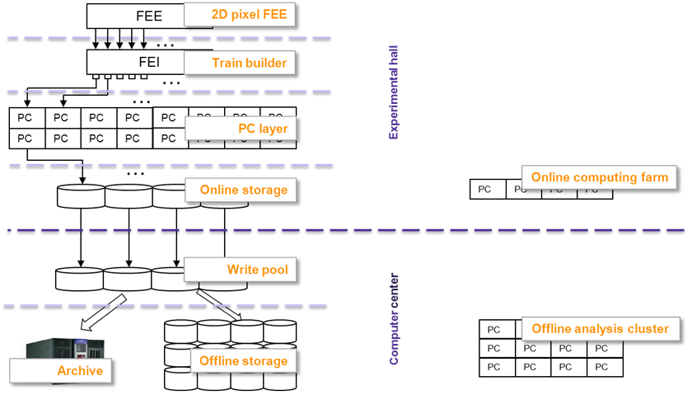
System architecture

Slide 5
Software status

Slide 6
Purpose
Proof of concept
Ability to handle 10GB/s data rate: read data from train builder, process/format, and send to the computing and storage layers
Use the EXFEL homogenous software framework
Development
Write the necessary software components: read., processing, formatting, write …
Identify issues/bottlenecks: e.g. error situations (UDP packet loss), speed-up data transfer…
Test and tuning
Measure the processing capabilities of the PC Layer
Test different software and hardware configurations, find the proper balance between scalability, performance, and reliability

Slide 7
Software architecture - overview
Two applications are under development
Train builder emulator
PCL node application
Data-driven model (push)
Start PC nodes
Wait for data
Start UDP feeder
Wait for timer signal
Start timing system
Communication model
1-to-1, N-to-N
Train builder emulator
Timing system
UDP feeder 1
UDP feeder 2
UDP feeder m
UDP
Node 1
Node 2
Node n
PC Layer

Slide 8
UDP feeder
Train generator
Circular train buffer
Trains are generated at the beginning (offline)
Train dispatcher
PCL nodes directory (configurable)
At every timer signal, select next train and next channel
Divide the train into packets and send them using UDP
Internal structure
Train buffer (Circular)
1
Train generator (file, random)
Next train
Timer
Nodes directory
Next channel
3
Train data
2
4
Serialization through UDP

Slide 9
Train serialization
Train structure (configurable)
Header, images & descriptors, detector data, trailer
Implementation
Plain vanilla UDP
The train is divided into chunks of 8k (configurable)
Packet structure
Adhere to Rob’s proposal
Header
Body
Trailer
Images data
Images desc.
Data 8129 bytes
000
001
002
003
.
.
.
SoF=1
EoF=1
# Frame 4b
SoF, EoF
1b
# Packet 3b

Slide 10
PC Layer node
Train builder
Processing pipeline
Multithreaded application
Design aims
Performance
Configurability
Reliability
UDP
Train reader
token
Read
T1
T2
Train queue
Reconstruct
Processing
Process
T1
T2
Available buffer slots
Write
T1
T2
Train buffer
Pre-allocated memory
Reject
Free
Train writer
TCP
Train formatter (HDF5)
Storage layer

Slide 11
Network-wide timer service
TCP
Listener Thread
Timer Threads
Register
Unregister
Member (name, channel)
Time events queue
Notifyer Thread
TCP
Groups
(name, rate, timeout,…)

Slide 12
Data structures and algorithms
Concurrent queue
Lightweight inter-thread communication
Wraps std::queue
Use “condition variable” to reduce access contention
Multi-threading: Thread class
Virtual runLoop()
Define pre-processing: in()
Processing: process()
Post-processing: out()
Examples: producer, consumer, pipeline, multicaster, …

Slide 13
Inter-thread Communication fabric
Pluggable modules
Run-time flexibility
Initial application settings
On-the-fly reconfiguration: Enable/disable, insert/remove/replace modules
Idea:
Pipe-like naming convention
Create typed-queues
Build a networked queue
Plugins is the glue: source/sink/error queues
Practical/theoretical framework

Slide 14
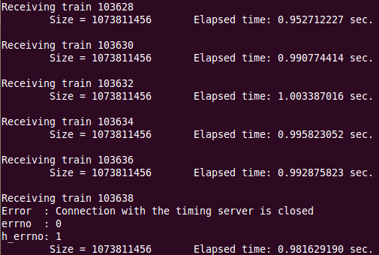
Implementation and test
1
5
Device/Device server model
Homogenous software framework
Highly configurable components
Our applications are already Devices (DeviceServers will be integrated soon)
Implementation
One feeder can feed one PCL node
Up to 8 feeders run in parallel: 8 (full size) trains per second
Some results (very preliminary)
MTU=1500: 1 train sent/received in 0.98 sec
MTU=9000: 1 train sent/received in 0.86 sec
Running time: few minutes
No processing, no TCP out-streaming
2
6
3
7
4
8

Slide 15
Unidirectional tests
UDP:
Send buffer size=128K → 8.39 Gbps
Packet loss: 80% (128K) ~ 0.01% (1M)
With CPU affinity: 20% (128K) ~ 0.01% (1M)
Send buffer size=256K~1M → 9.61 Gbps
Packet loss: 67% (128K) ~ 0.03% (1M)
With CPU affinity: 0.3% (128K) ~ 0% (1M)
Send buffer size=4M → 13Gbps send / 8.4Gbps receive
Packet loss: 35%
Why: driver’s send queue overflow (tx-queue-len should be increased)
Default Linux kernel behavior: Does not return ENOBUFS error “The output queue for a network interface was full. This generally indicates that the interface has stopped sending, but may be caused by transient congestion. (Normally, this does not occur in Linux. Packets are just silently dropped when a device queue overflows.)”. From man

Slide 16
Performance tuning
Buffers sizes
As big as possible on the receiver side
Time profile
Fine grained (frame level): Considering the maximum NIC throughput (frame/sec)
Coarse-grained (train level):
CPU affinity
Bind the UDP reader thread to the right CPU core
Tuning the kernel parameters (IRQ, TX queue length)
TX queue length: as long as possible on the sender
IRQ binding: Reduce context switching (20-30% of CPU improvement - fasterdata.es.net): To be investigated.
Interrupt grouping ? To be investigated.

Slide 17
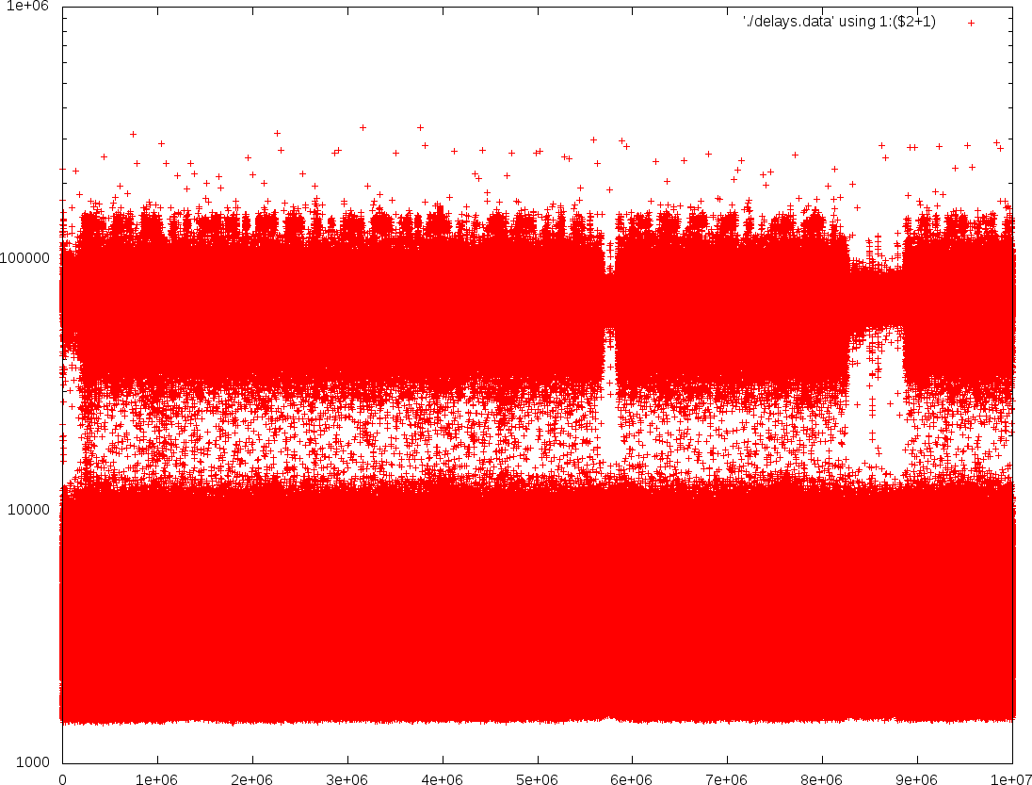
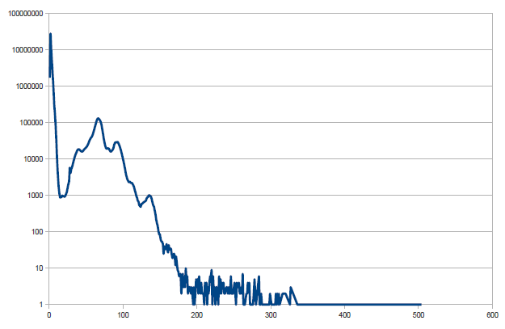
Experimental study
Results
Running time: 10mn ~few hours
UDP stream (# packets): 10⁶ ~3.5x10⁸
Packet loss rate: 10⁻⁷~10⁻⁸
Very slow (rare)
Slow (5%)
Delays (ns)
Frequency (#packets)
Fast (>95%)
Packets
Time (us)
Time delay between packets

Slide 18
Considering the time profile
Sending profile: send a bunch of packets then have break.
maximum throughput vs. minimum (no) packet loss
Frame rate (fps):
Packet size = 8192*8 = 65536 bits
Preamble = 64 bits
Inter-frame gap (IFG) = 96 bits
Frame rate = 10Gbps/65696 = 152216 fps = 138580 fps (jumbo frame)
Frame size = 65696 bits

Slide 19
Some results (very preliminary)
Lost packets = [1285301 1285302 1285303 ] # packet received: 100000000 # packet lost : 3 Delay (us) Max: 5152.525 Min: 1.478 Avg: 7.495 Total time (sec): 749.545
Lost packets = [0 1 2 …130 131 2364451905 ] # packet received: 3500000000 # packet lost : 133 Delay(us) Max: 10814.772 Min: 1.479 Avg: 7.510 Total time (sec): 26284.9
Bunch = 27 Gap = 50 us
Bunch = 27 Gap = 52 us
Set CPU affinity of the reader thread the same as eth5 IRQ
Packet loss: 3.8 10⁻⁸ 2.85 10⁻¹⁰ (exclude first packets)

Slide 20
Summary
Preparation of the slice tests (1st part)
Network, PC layer hardware are configured
Software for data readout under test
Hardware:
Full link bandwidth: 9.93Gbps
Plain vanilla UDP: very low packet loss rate (ongoing!)
Concurrent read and write on dual NIC
Software
UDP Feeder and PCL (readout) software with some processing (Adler checksum) and TCP out streaming
Device implementation (DeviceServer, full configuration will be done)
Outlook
Test the impact of concurrent processing on read and write

Slide 21
Thank you!

