Slide 1
10 GbE developments at DESY
I. Sheviakov FEA
- 10 GbE XPM Test Design
- Two Channels 10 GbE FMC
High Speed Data Acquisition Mezzanine Card with 4 x 10GbE Cannels

Slide 2
10 GbE XPM Design
Design goal :
Development of a 10G Ethernet card with low risk and low budget in relatively short time as design prototype for 2-D detectors and the train builder.
Focus the board development on the demands of 10 G-Ethernet and routing of high frequency digital signals.
Realization:
Development of an adapter card to an FPGA-evaluation board with 2 independent 10G- Ethernet channels.
Evaluation Board from XILINX (ML510) , based on a Virtex5 FPGA and support of XPM¹ adapter cards with 8 RocketIOs at the XPM-connector.
VSC8486 from VITESSE as physical interface to 10G SFP+ Transceivers (direct support of SFP+, single supply voltage of 1.2V, low power of 0.75 W, several loopback modes).
The SFP+ Transceivers operate at 850nm with multi-mode-fiber.
¹XPM: XILINX Personality Module

Slide 3
Block Diagram
Custom 10G-Ethernet XPM-Module
ML510 Evaluation Board
Optical fiber
850 nm
multimode
PHY
DDR2 Memory
Power
Clock
PC Peripherals
SFP+
Tx
Vitesse VSC8486
Virtex 5
10G Ethernet (2x)
Rx
XAUI (2x)
Tx
XPM-Connector
SFP+
Vitesse VSC8486
Rx
Test I/O
8 Rocket I/Os
+ control signals
+ power
Control & Configuration

Slide 4
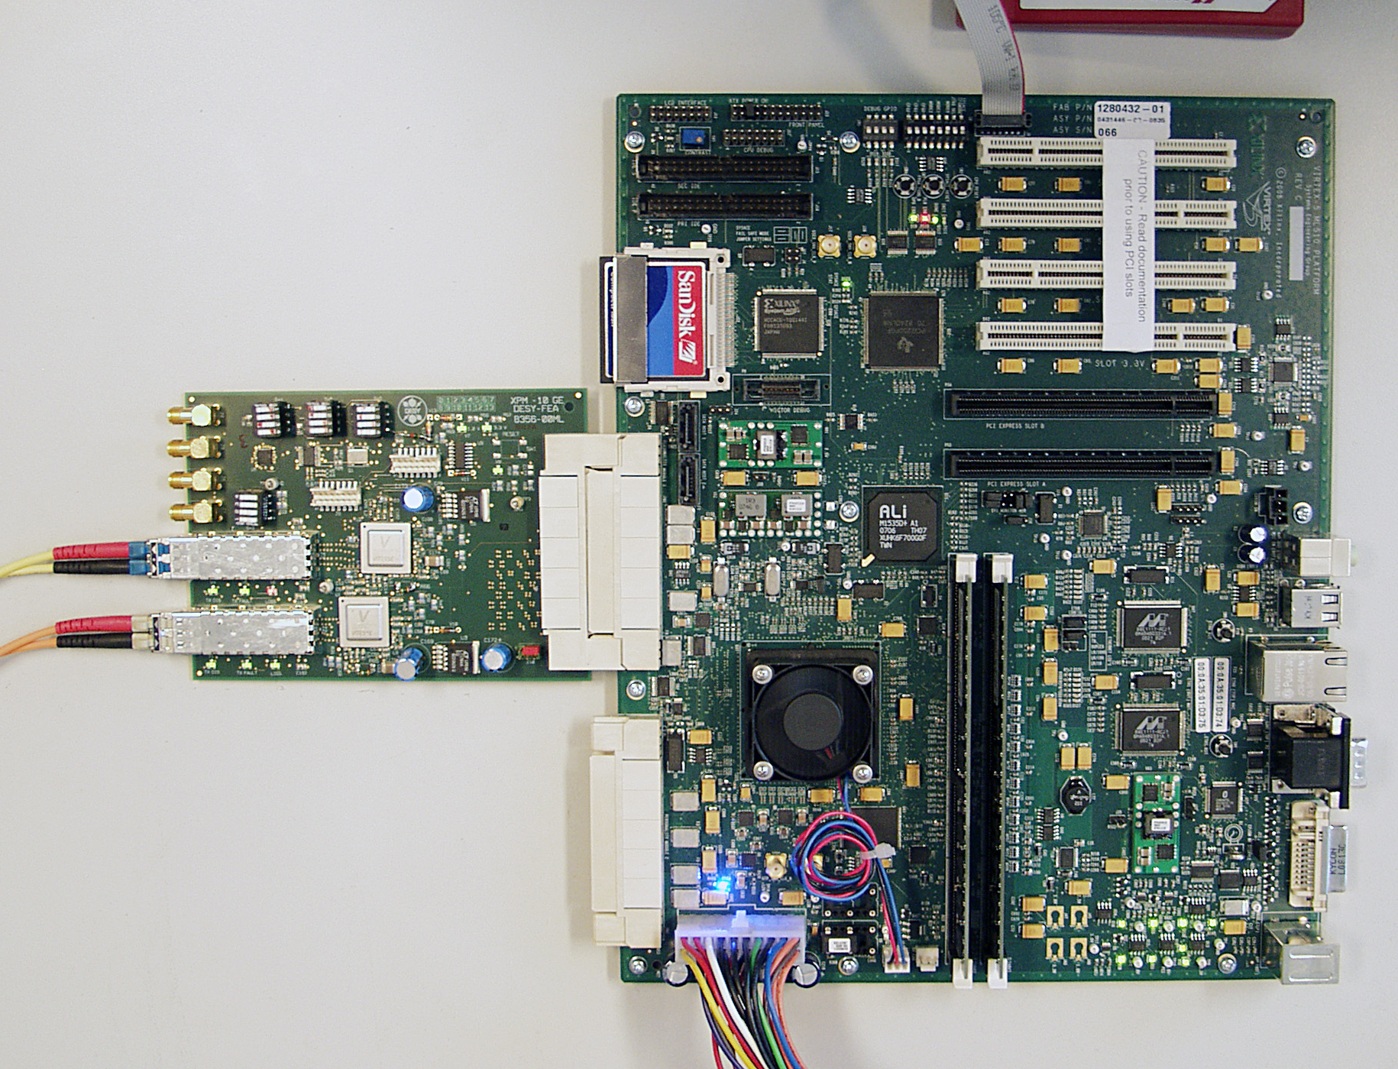
XPM with ML510
ML510 Evaluation Board
10Gb-Ethernet XPM-Module

Slide 5
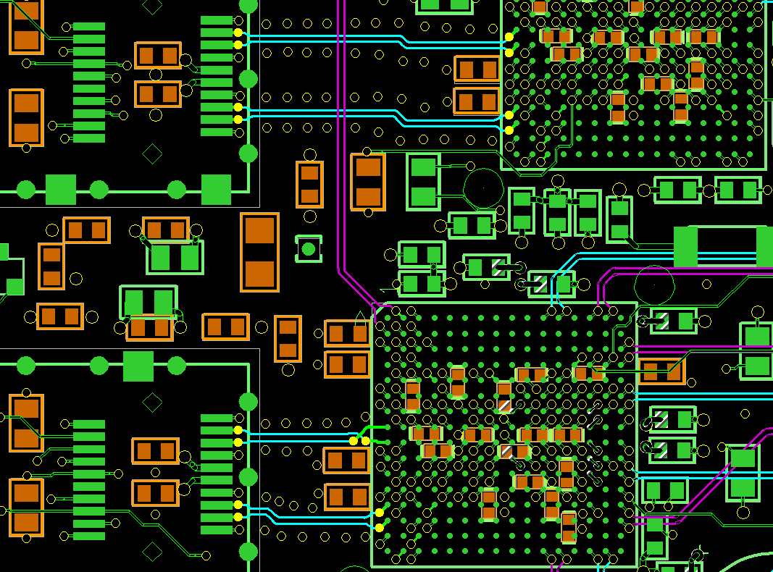
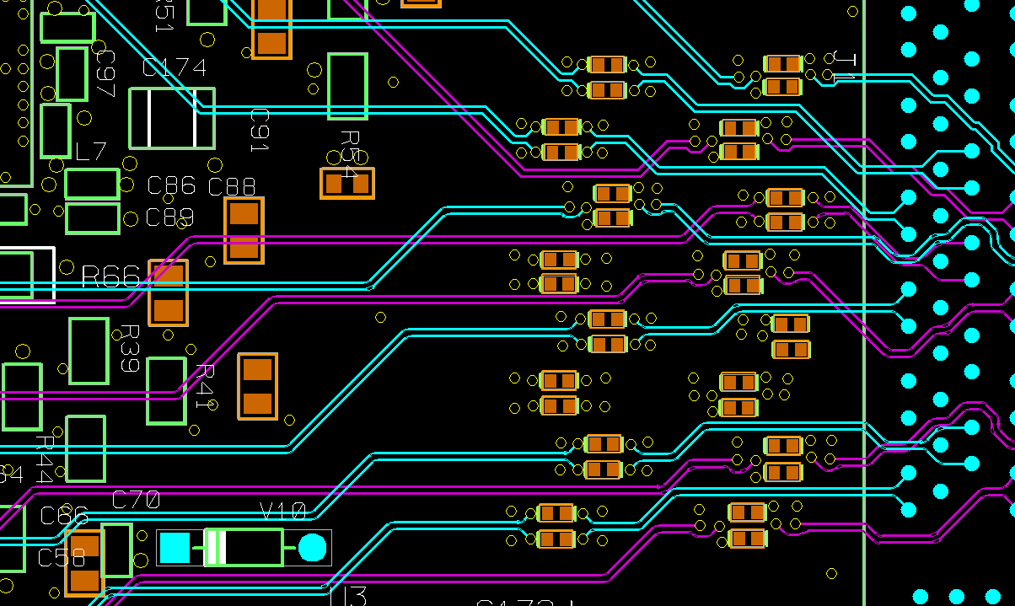
Critical PCB Areas
Tx
SFP+
Vitesse VSC8486
Rx
3.125 Gbit/s
( XAUI )
Optical
Fiber
10G Ethernet (2x)
XAUI
Tx
SFP+
Vitesse VSC8486
Rx
XPM-
Connector
SFP+
PHY
10 Gbit/s
( XFI )

Slide 6
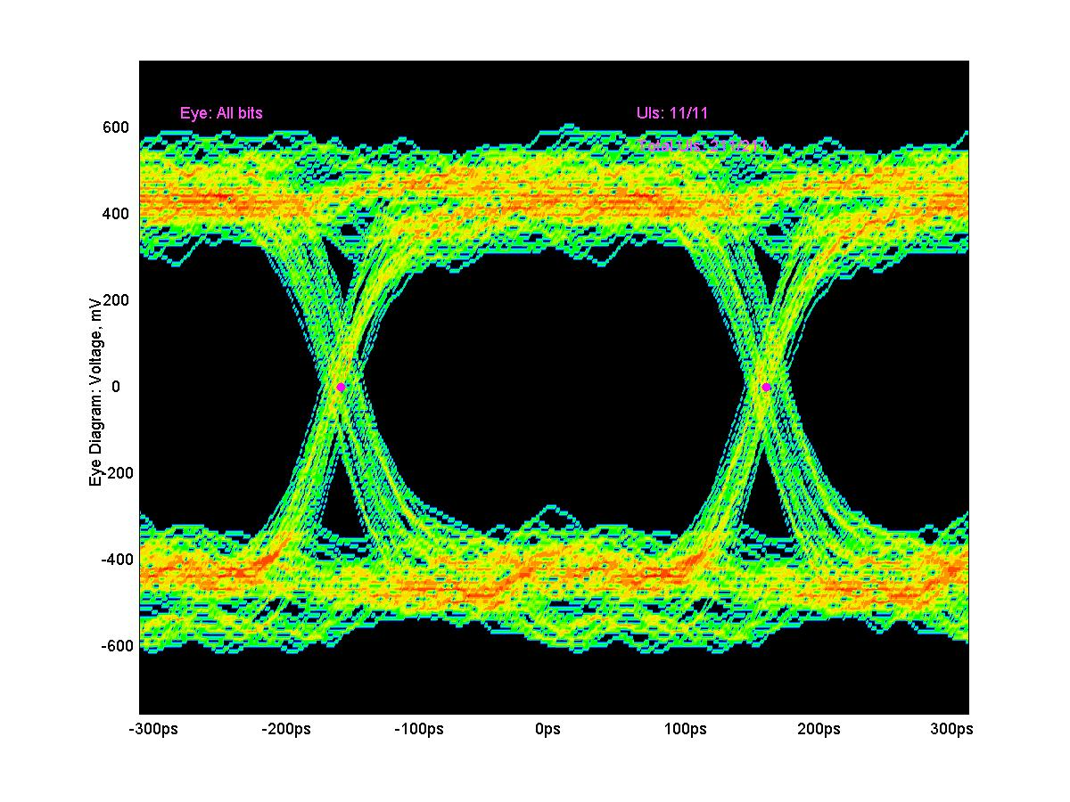
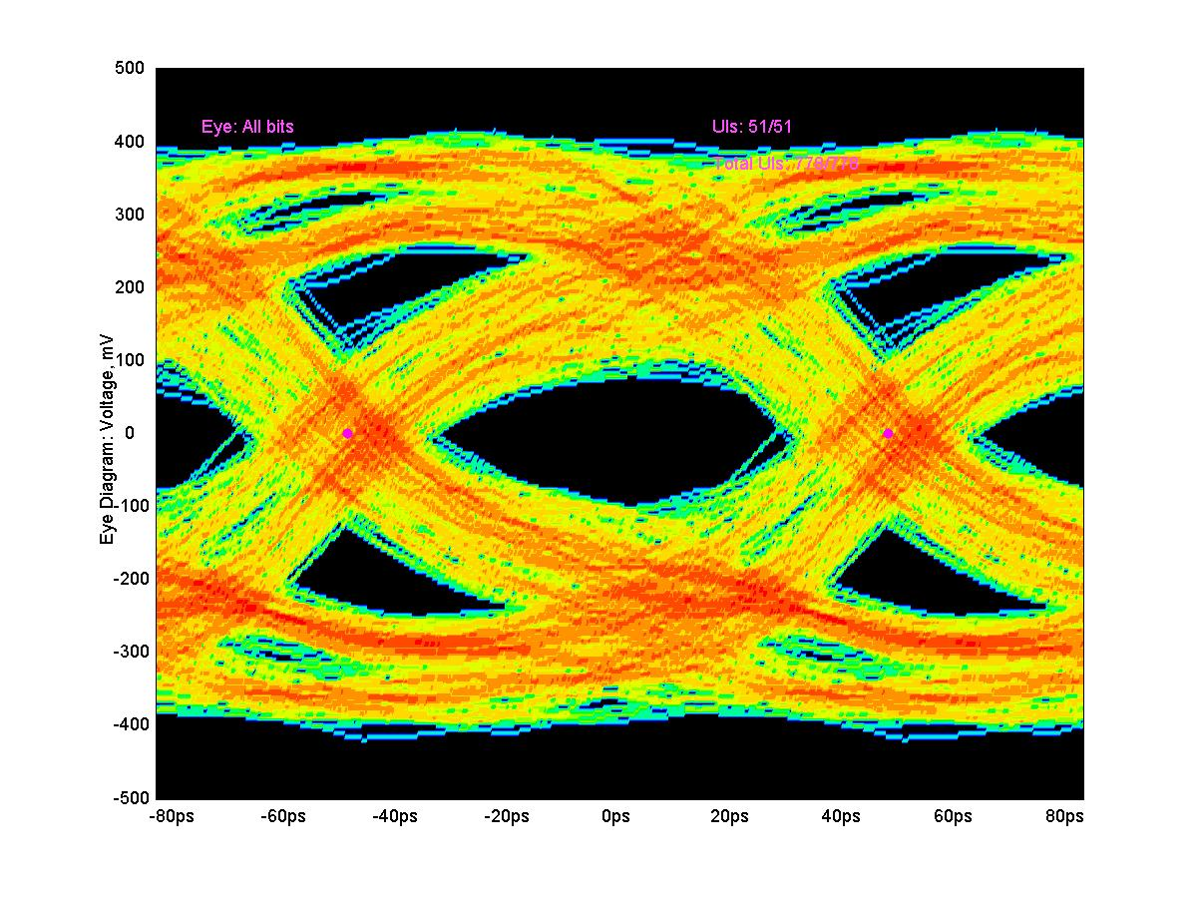
Eye Diagrams XAU and 10 Gb
3.125 Gbit/s ( XAUI )
10 Gbit/s ( DSA 71604 16 GHz limitation )

Slide 7
DATA Transfer Measurement Setup
10-GE XPM
DDR2 RAM
VSC8486
SFP+
Data Pat. Gener.
Tx, Rx Eng. 10G MAC
XAUI
VSC8486
SFP+
ML510 (Virtex–5)
Error Handling
MDIO
Standalone loopback test through optical fiber
Tx, Rx, Engine Data/Event Manager + 10G-MAC Frame + IPv4 + UDP
Optic Fiber
XAUI
10GE XPM
PC
10G Ethernet Full Duplex Tests with LINUX-PC

Slide 8
Bit Error Measurements
Setup Measurement | Stand alone via optical loop | Via UDP with LINUX-PC with 10G Ethernet card
Data Throughput | 99% frame sizes > 8 KB | ~70% (7.1 Gbit/s) without frame loss
Bit Error Rate | < 10⁻¹⁵ At 99% of 10GBit/s | < 10⁻¹⁵ for (7.1 Gbit/s) success. patterns
Temp. stability 20° - 70° C | No dependence found, Bit error < 10⁻¹⁵ for all transmission conditions
Layout impact of different routing | Bit error < 10⁻¹⁵ for both channels and all transmission conditions

Slide 9
10 GbE XPM - PC Data Throughput measurement
Limited by
not optimal
PC Chip-Set

Slide 10
2 x 10GbE FMC-Module
FMC - FPGA Mezzanine Card is a native issue from the XPM-10G prototype fulfilled in the common for mezzanine designs standard.

Slide 11
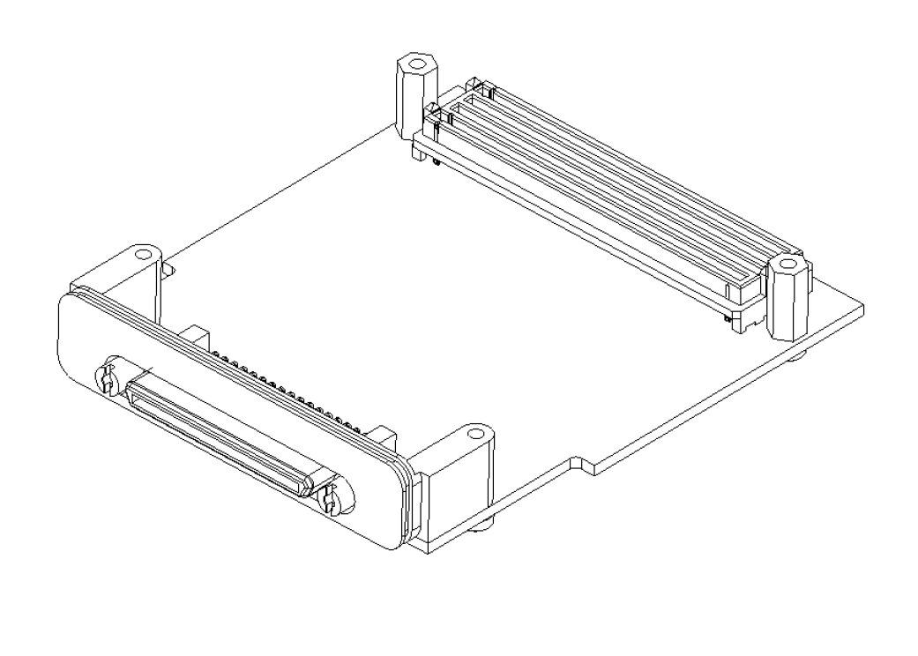
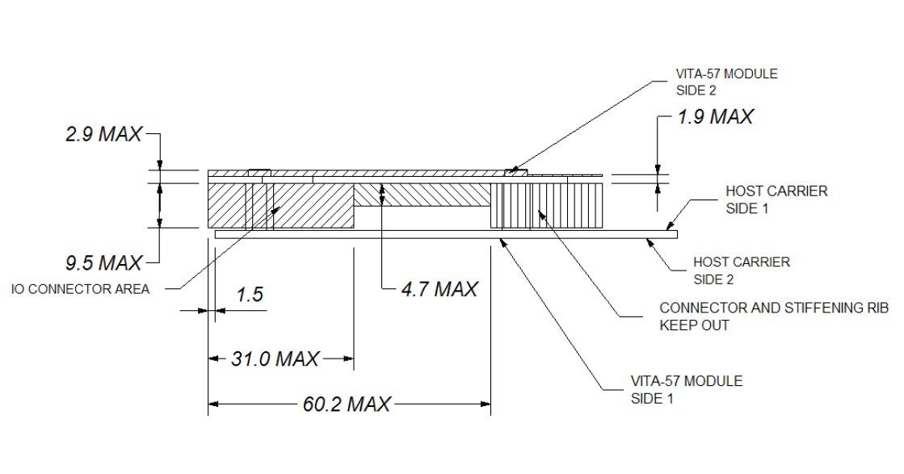
2 x 10GbE FMC Mechanical Design
10.0
40.0
20.0
SFP Cage
VSC8486

Slide 12
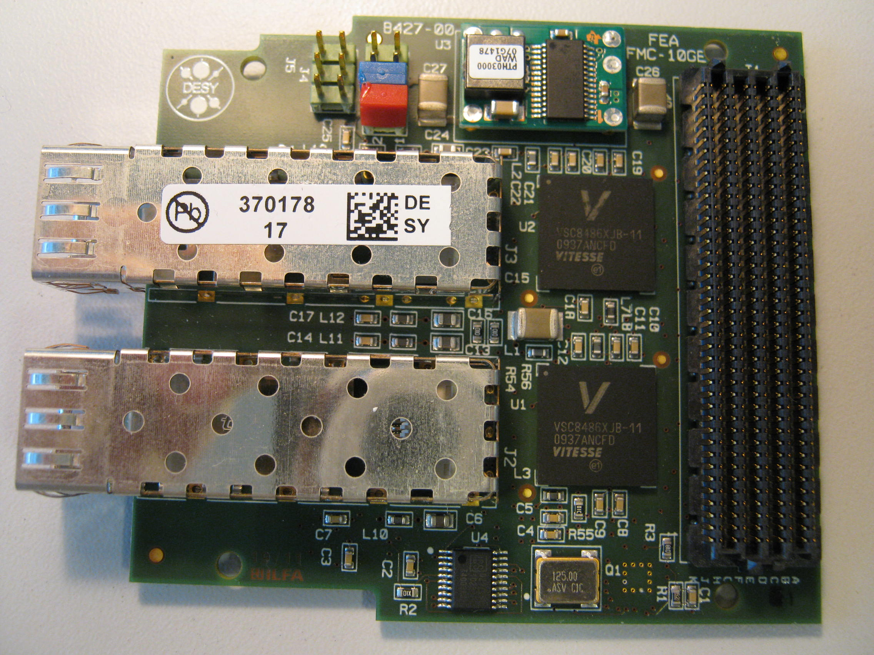
2 x 10GbE FMC Board

Slide 13
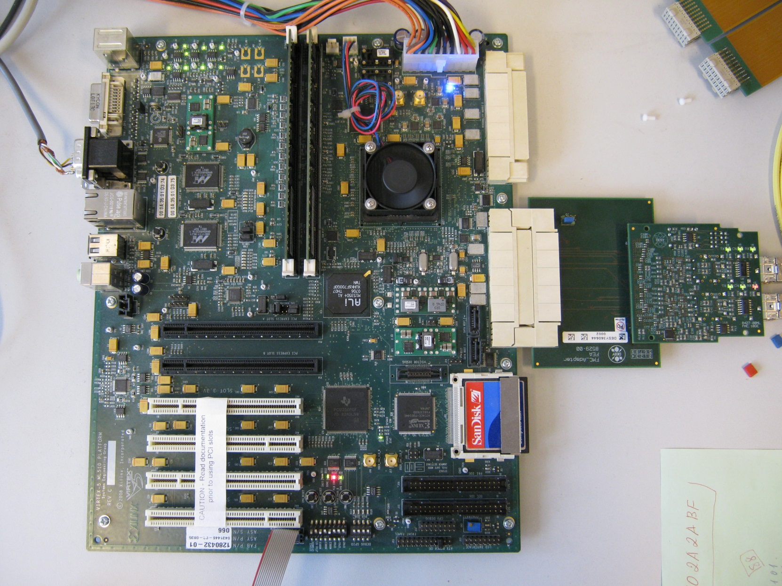
2 x 10GbE FMC Test System Setup

Slide 14
2 x 10GbE FMC Tests, Issues and Applications
Hardware tests:
A similar to XPM the 10E-15 bit errors level is achieved also for the FMC Test Setup.
Firmware ( VHDL ) issue
Implemented an IP core for standard 10GbE communication .
First Applications
This FMC is intended to be used in the Train Builder and LPD .

Slide 15
High Speed Data Acquisition Mezzanine Card with 4x10GE Cannels
Design goal
A FPGA-based Mezzanine board for high data throughput applications . It is intended for the digital readout of Megapixel X-ray cameras at Light Sources, but it can also be applied to other environments, where multiple digital signals have to be preprocessed, buffered and transmitted to computing hardware.

Slide 16
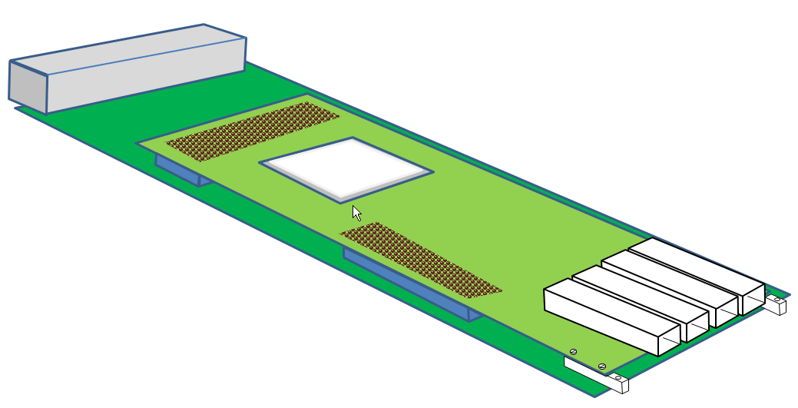
High Speed Data Acquisition Mezzanine Card with 4x10GE Cannels
Mechanic Concept
Carrier Card
- Front end Connector
- Power, DC/DC conv.
- Voltage regulators
- Slow Control,
Front Connector
Mezzanine Card
- FPGA
- 10GE
- DDR2 memory
- FPGA configuration
FPGA
4xSFP(+) 10GE
SEAM 500, 400 Connectors
(Carrier and Mezzanine interconnections)

Slide 17
High Speed Data Acquisition Mezzanine Card with 4x10GE Cannels
Key Features:
FPGA: XC5VFX70T-1FFG1136
Configuration
Onboard configuration circuitry (JTAG)
2 x 32MB Platform Flash XL
System ACE CF with Compact FLASH (CF)
Dynamic Reconfiguration: From/To external FRMC-40
Communications and Networking
4 x SFP(+) 10GE, 1GE transceiver connectors
RS232 port
Memory
2 x DDR2 SO-DIMM
Clocking
200 MHz Oscillator (Differential) IO Control
25 -100 MHz Oscillator (Differential) System CLK
33 MHz Socketed Oscillator (Single-Ended) FPGA Configuration
GTX, PHY Reference Clocks 156 MHz, 125MHz (Differential)
Input / Output Ports
SEAM – 500 pin connector with 146 LVDS or 130 LVDS + 16 ADC Channels
SEAM – 400 pin connector with 80 IO: GPIO(I2C, UART, ..), System Monitor ,
JTAG, MPU BUS, POWER CHECK & supply 3.3V, 1.8V, 1.0V

Slide 18
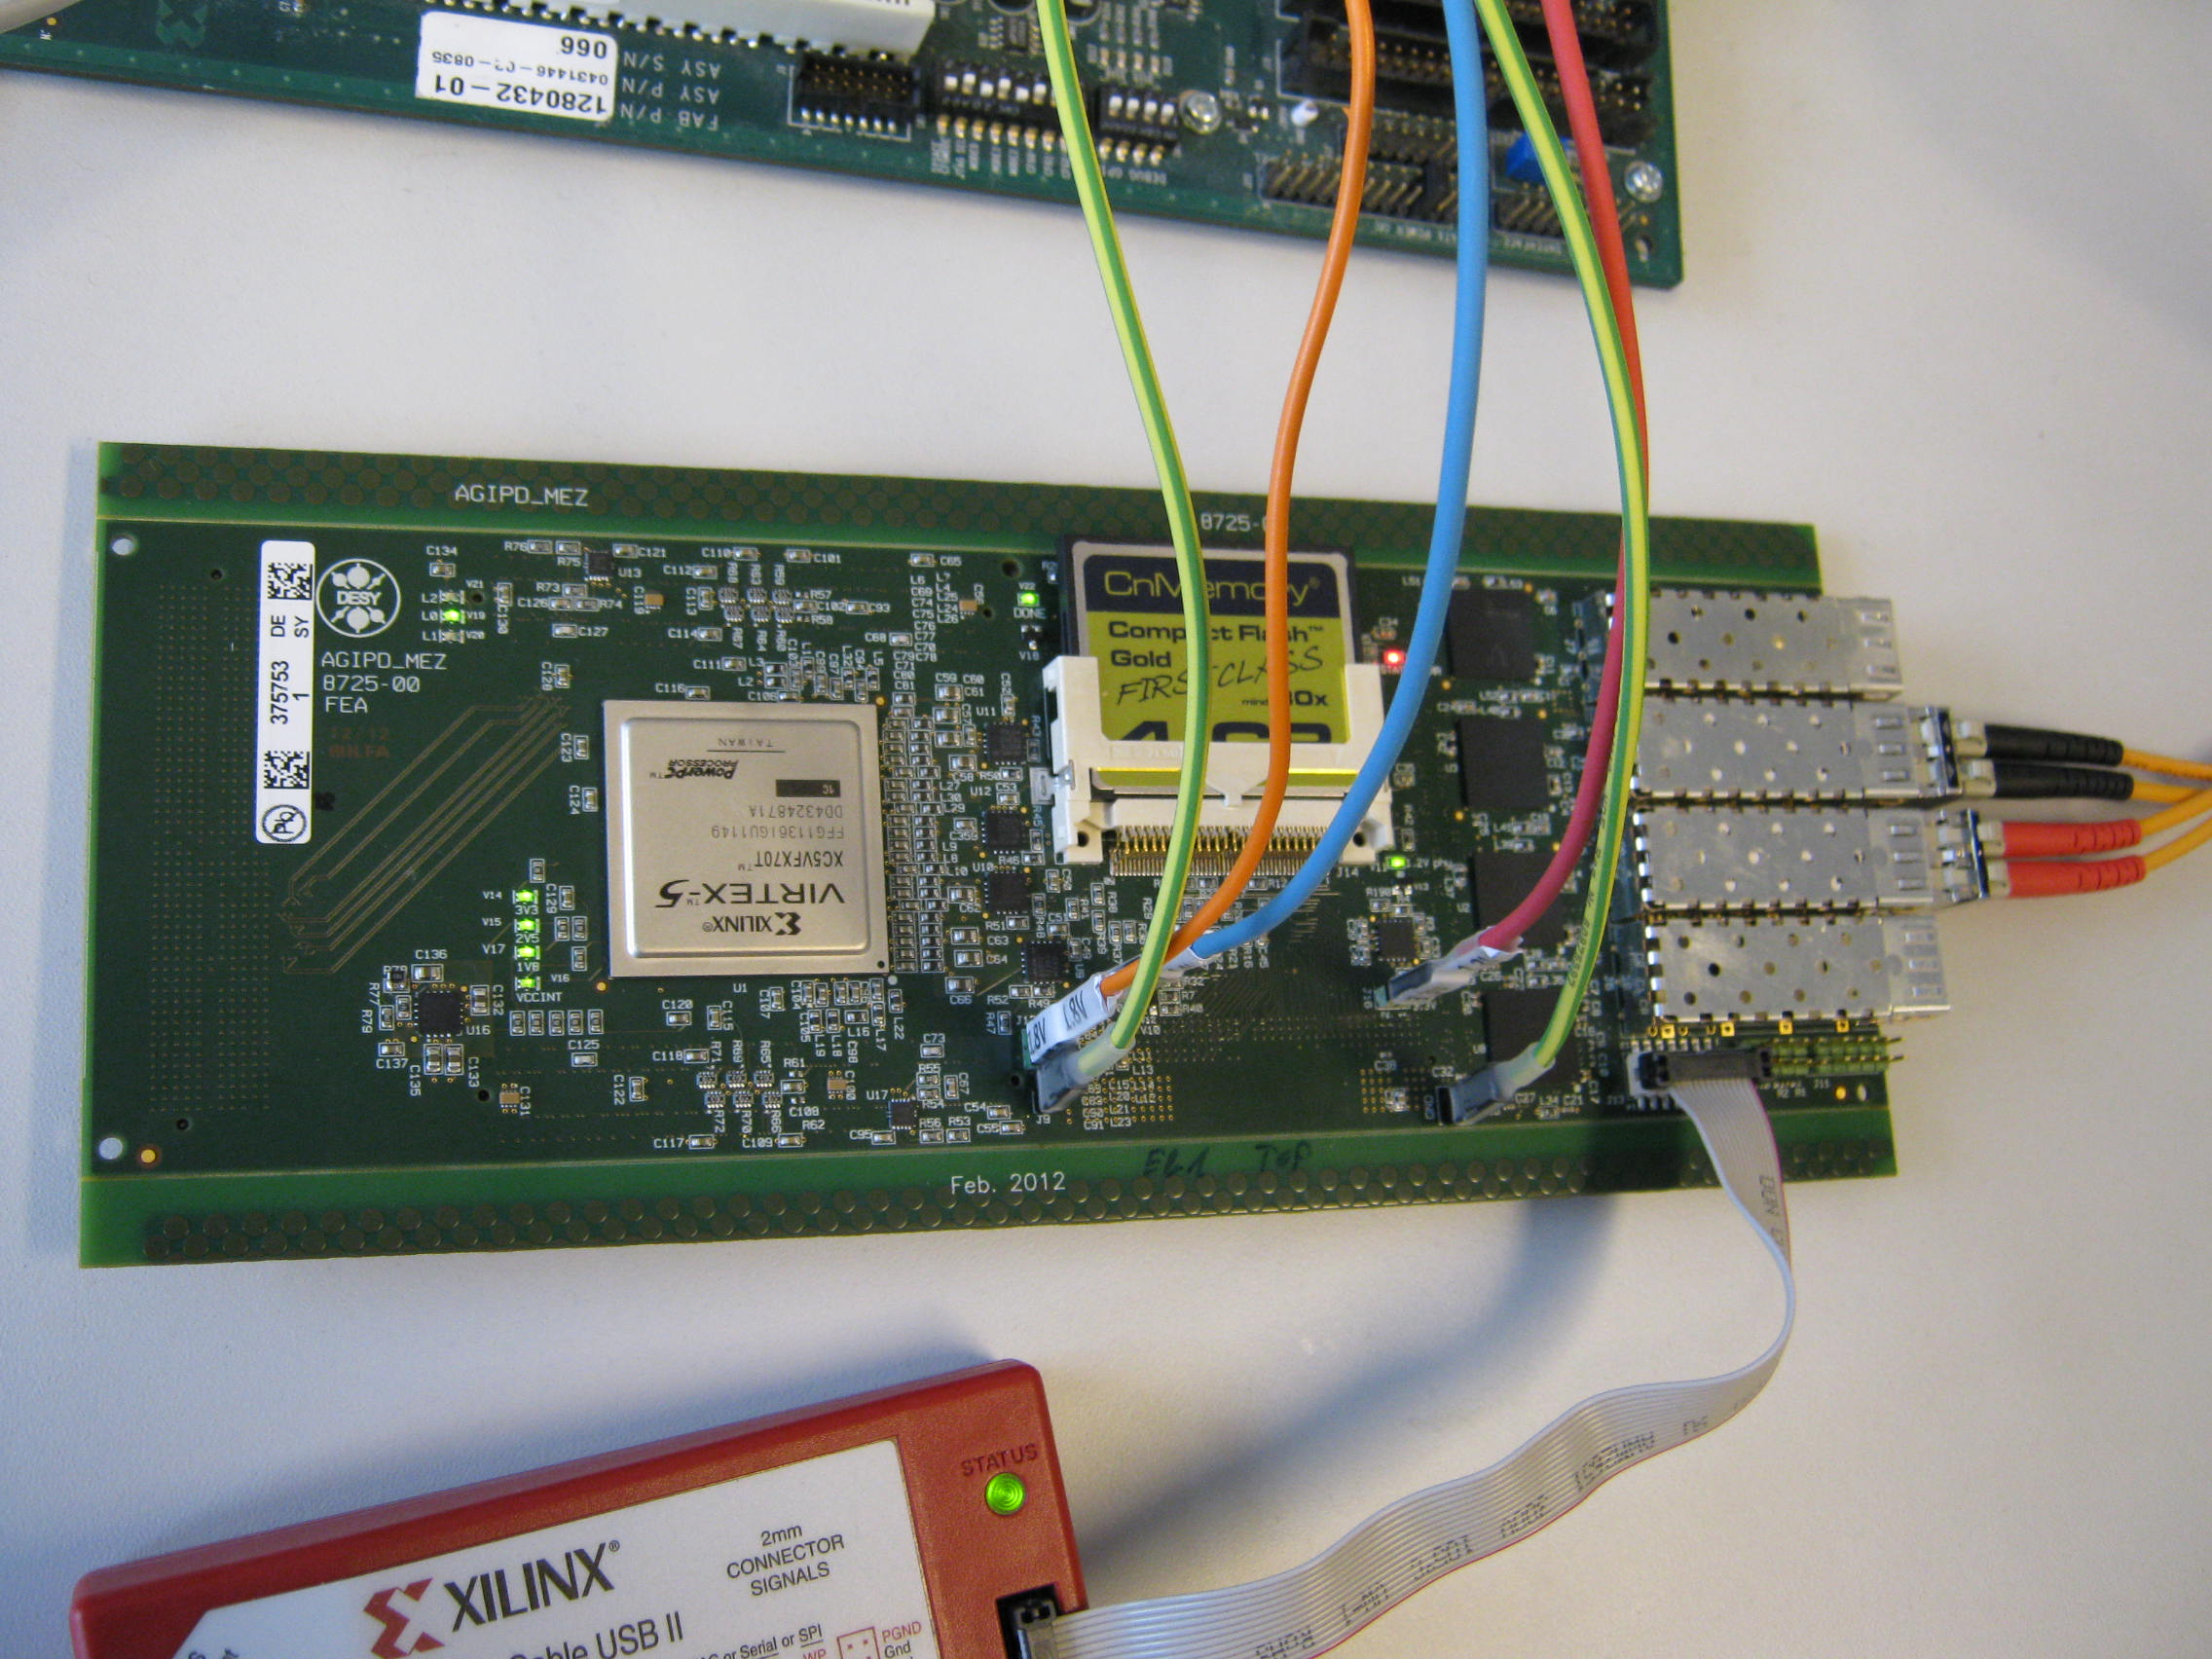
High Speed Data Acquisition Mezzanine Card with 4x10GE Cannels
The Board ( top view )

Slide 19
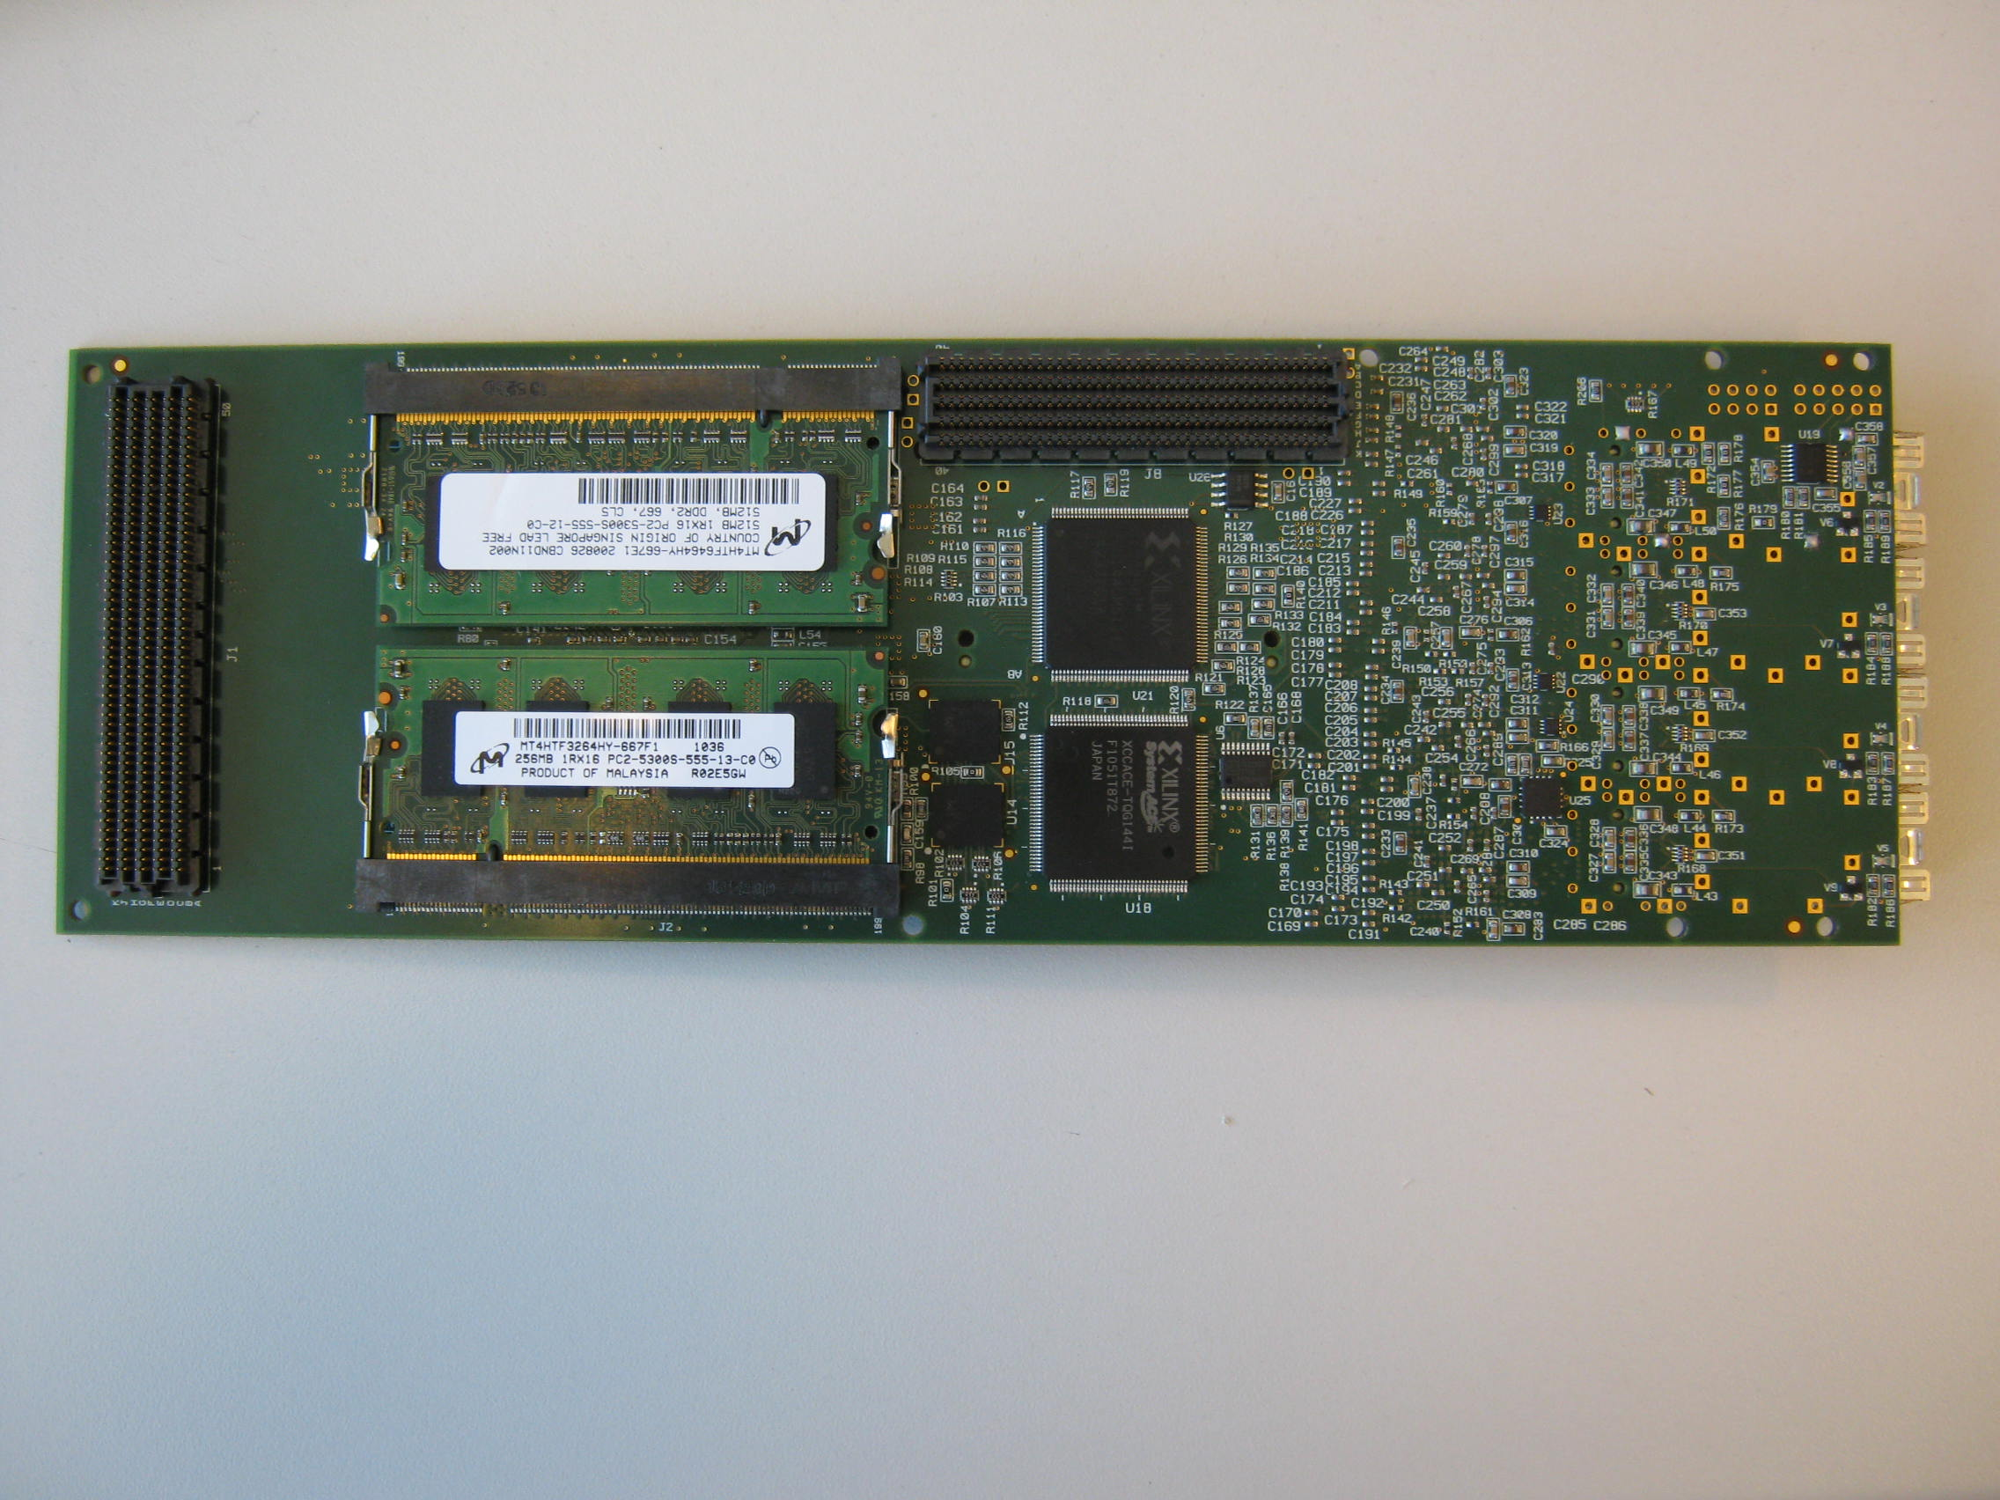
High Speed Data Acquisition Mezzanine Card with 4x10GE Cannels
Bottom view
80 mm
246 mm

Slide 20
High Speed Data Acquisition Mezzanine Card with 4x10GE Cannels
SEAM 500 pins
146 LVDS IO (or 292 single)
up to ~800 Mbit/ s / line
2xDDR2 SO-DIMM
2 x 64bit
~80 Gbit/ s
32MB
Platform
Flash 1
32MB
Platform
Flash 0
JTAG
S-Boot
FPGA
XC5VFX70T
1FFG1136
4 x GTX (3.2Gbit/s)
10GE PHY
SFP(+)
4 x GTX (3.2Gbit/s)
10GE PHY
SFP(+)
4 x GTX (3.2Gbit/s)
10GE PHY
SFP(+)
Connectors to Carrier
4 x GTX (3.2Gbit/s)
10GE PHY
X
SFP(+)
GTX (1.25Gbit/s)
330MB/s
16 Mb/s
C BUS
JTAG
System ACE
XCCACE
CPLD
XC2C256
66 MB/s
JTAG
16 Mb/s
MPBUS
JTAG
JTAG
SEAM 400 pins
80 IO GPIO(I2C, UART, ..),
Connector
JTAG

Slide 21
High Speed Data Acquisition Mezzanine Card with 4x10GE Cannels
Some design issues
-It is able to handle peak data rates of more than 100 GBit/s with 146 LVDS input pairsworking in parallel at speeds up to 800 Mbit/s each.
-Two SO-DIMMS slots can be equipped with 8 GBytes of DDR2 Memory providing a bandwidth at least 80 Gbit/s
-The maximum sustained data throughput of the module is limitedto 40 GBit/s by four 10G Ethernet links to external processing devices.
- The board configuration is managed by a CPLD and allows to boot up ofthe FPGA from multiple local (Platform Flash RAM, 4 GByte CompactFlash Card) and external sources like JTAG or a microcontroller interface, Ethernet
Multiple boards can be connected in “clusters” and booted in common by one of the board specified as a master.
A flexible clocking interface as well as several General Purpose Ios (I2C,SPI,etc.) simplify the integration of the board into various applications.
-The FPGA-internal PowerPC processor can be optionally used for additional control and monitoring tasks.

Slide 22
High Speed Data Acquisition Mezzanine Card with 4x10GE Cannels
Tests
Basic functionalities and data transfer parameters has been tested and gives the similar with 10GbE -XPM results .

Slide 23
High Speed Data Acquisition Mezzanine Card with 4x10GE Cannels
Conclusions
Starting with XPM 10GbE prototype based on Evaluation Board from XILINX (ML510) we investigated the critical 10GbE development features with minimum design efforts.
The new designs based on XPM 10GbE experience was successively finished and already intended to be used in several XFEL detectors (AGIPD, LAMBDA, PERCIVAL, LPD)

Slide 24
Spare Slides
Spare Slides

Slide 25
Results 3

