Slide 1
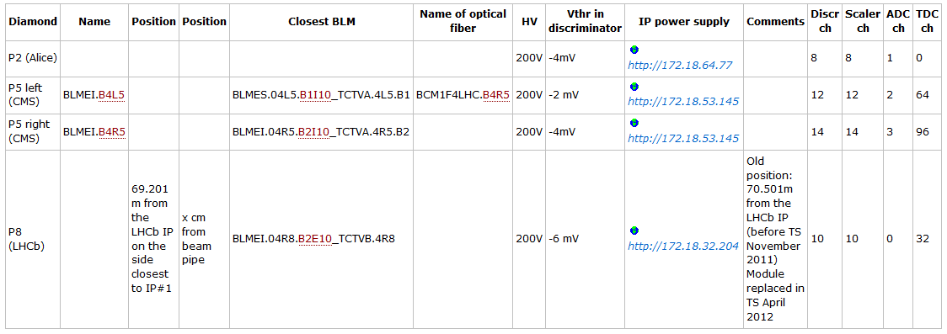
BCM1F4LHC status
Last week the 2 new diamonds in P5 delivered the 1st signals to the DAQ.
Summary table

Slide 2
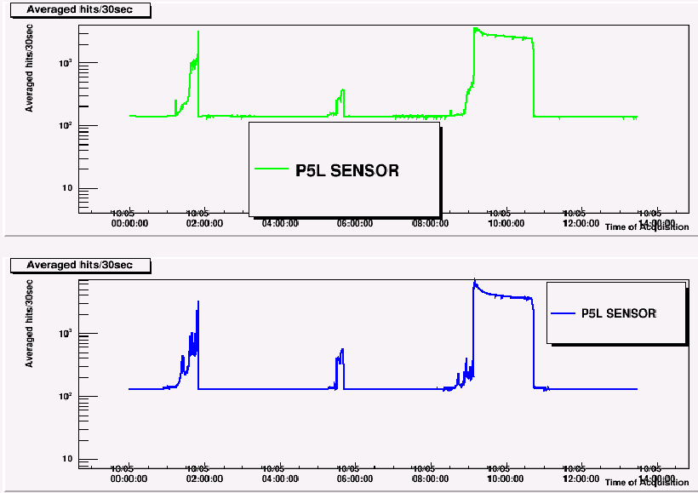
BCM1F4LHC: First signals in P5
Signals mounted on a rate of
130Hz due to the test pulse
P5 Right

Slide 3
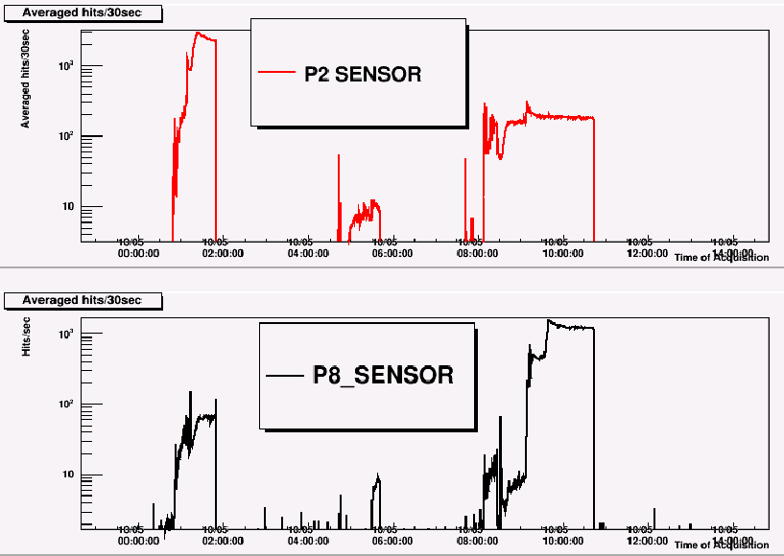
BCM1F4LHC: signals in P2 & P8

Slide 4
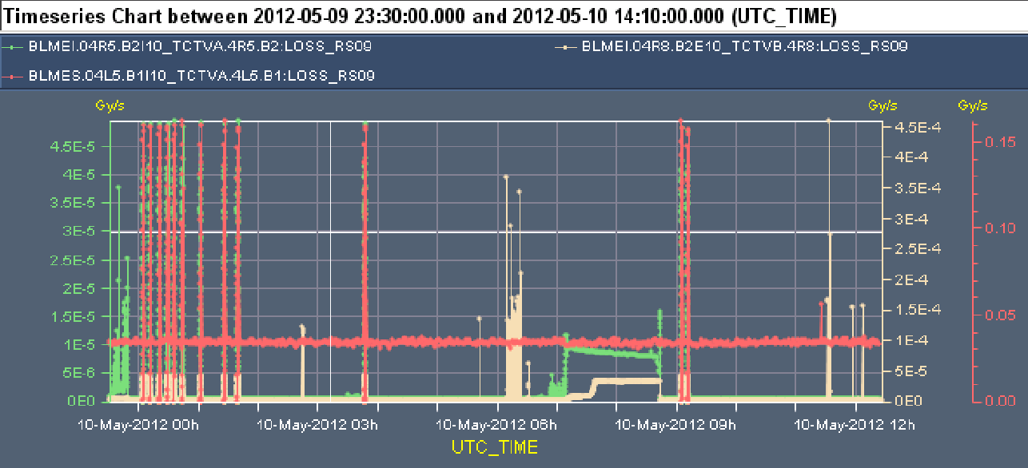
Correlation with losses in BLMs close to sensors
Yellow: BLM close to sensor in P8
Green: BLM close to sensor in P5 Right
Red: BLM close to sensor in P5 Left (???)

Slide 5
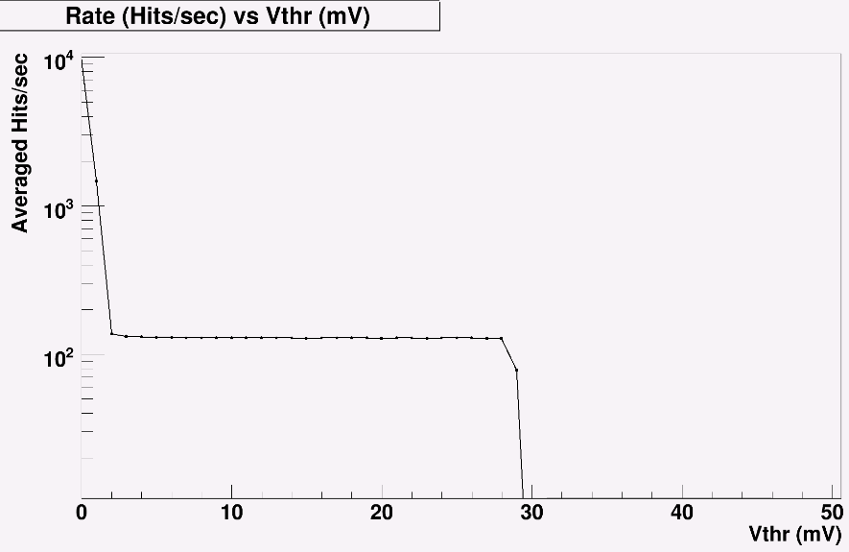
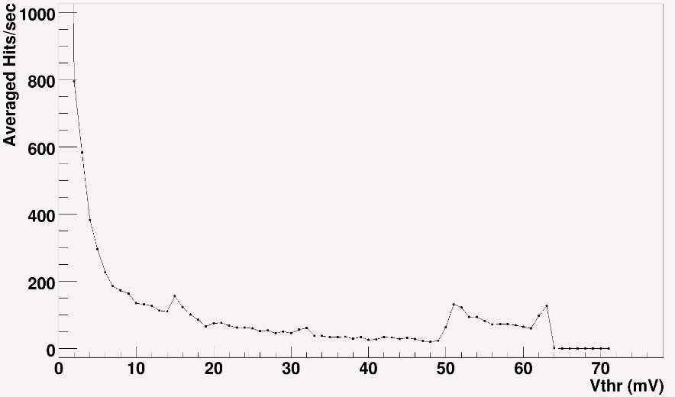
Vthr scans
P5 Left test pulse vthr scan
HV=125V
P5 Left vthr scan 50ns_1380b_1331_0_1320_144bpi12inj
HV=125V

Slide 6
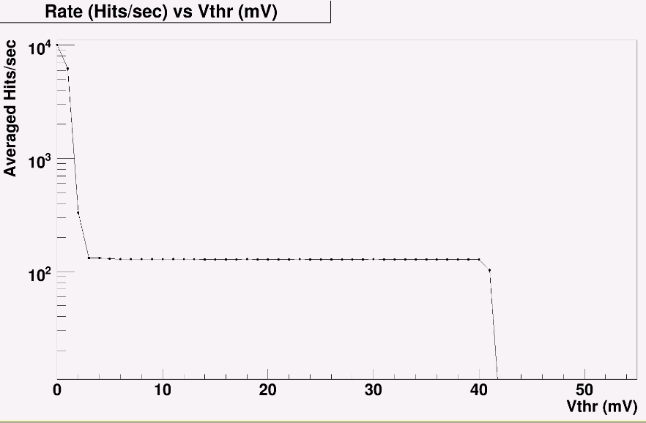
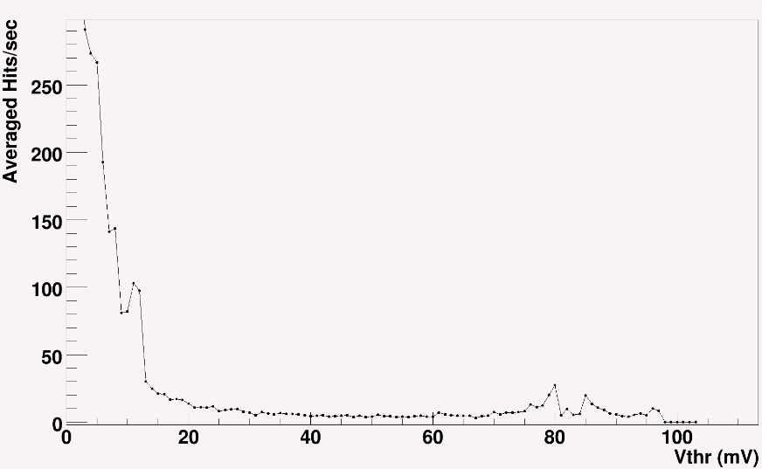
Vthr scans
P5 Right test pulse vthr scan
HV=125V
P5 Right vthr scan 50ns_1380b_1331_0_1320_144bpi12inj
HV=125V

Slide 7
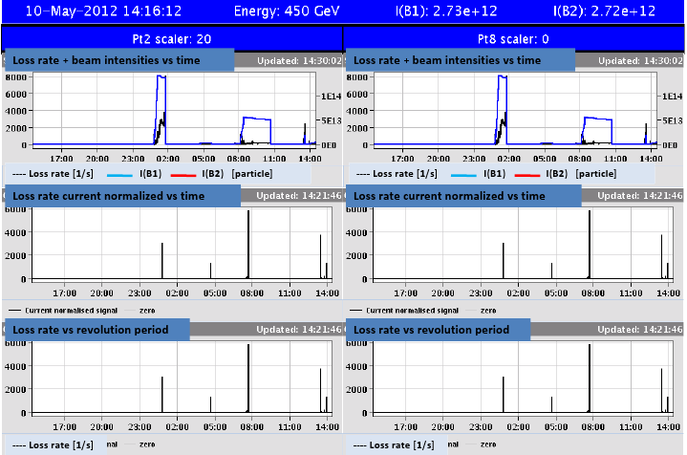
Format of web display to be decided
Suggestion of Bernd Dehning:

Slide 8
Our proposal?
Loss rate vs revolution period
Loss rate vs revolution period
Loss rate current normalized vs time
Loss rate current normalized vs time
Baseline of 8 diamonds

Slide 9
Other stuff
BRM will display in CMS control room the 2 new diamonds (once the dip data of closest BLMs is found....)
Marina Giunta is implementing the Slow control for the CMS BCM1F.
VME GUI (Serivas) installed in BRM lab pc. Will try to install it in the CMS BCM1F DAQ pc.
My tasks for next trip to CERN.
  Configuration of network card for RHU card
  Help Hans with the installation of his new hardware.

