Slide 1


Module Weight for Statics
Markus Hüning
16th May 2012
Technical Coordination Meeting
Notes:
How to edit the title slide
Upper area: Title of your talk, max. 2 rows of the defined size (55 pt)
Lower area (subtitle): Conference/meeting/workshop, location, date, your name and affiliation, max. 4 rows of the defined size (32 pt)
Change the partner logos or add others in the last row.

Slide 2
Objective
For the correct design of the module suspension it is necessary to know the weight and center of mass of the module
For the calculation of the statics a certain additional off-center weight (15kN 650mm from center of module) was assumed
In the PRR for the ceiling frames it was decided to perform an external audit
For this and because we needed to assess the additional weight by cables and pipes we added up the external masses at the module

Slide 3
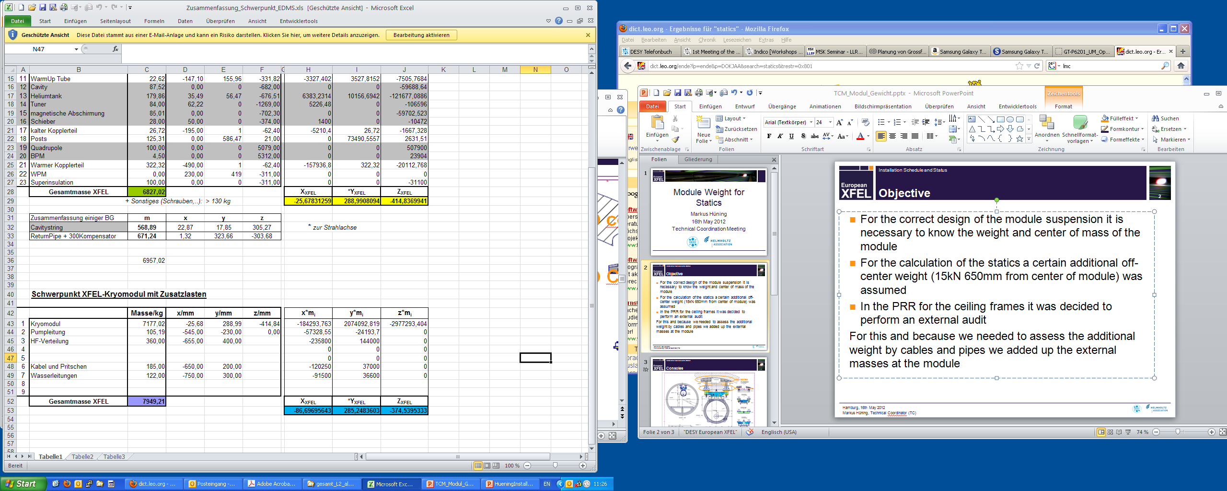
Complete List

Slide 4
Individual Entries
Item | Weight 650mm | Weight 750mm
Waveguides | 360 kg
Water pipe and filling |  | 122 kg
WG cables | 32 kg
Coupler Cables | 20 kg
LLRF Cables (+HOM) | 40 kg
Cable trays, patch panels, connectors | 90 kg
 | 540 kg | 122 kg

Slide 5
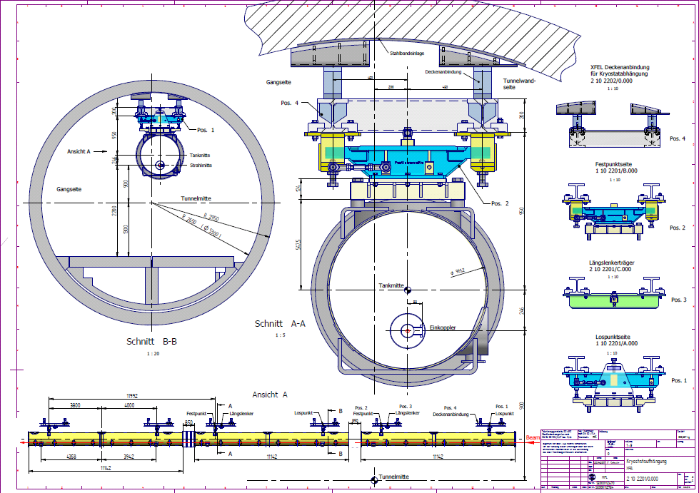
Consoles
X
X:87mm
Y: 285 mm

